Slide 1
Cryo Commissioning Concept
Holger Kollmus für COM/CRY

Slide 2
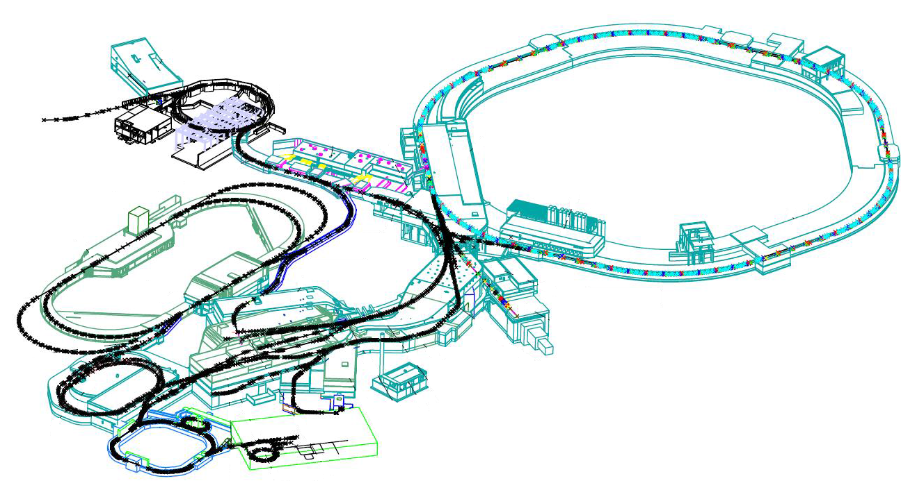
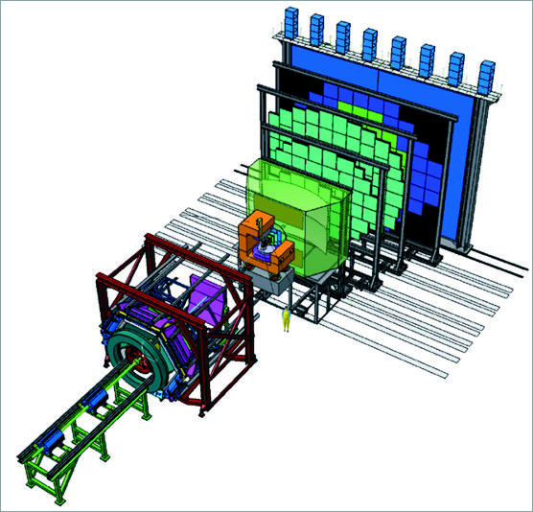
SIS100 with SuperFRS and CBM
SIS18
SIS 100
CBM
SuperFRS
CBM
SIS100, SuperFRS and CBM are using SV magnets supplied by one central plant

Slide 3
Cryogenic Supply for FAIR
SIS 100
(SIS 300)
CBM
SuperFRS
Panda
APPA
R3B

Slide 4
Cryogenic Control Architecture
  The Cryo Control Systems are based on:
    Siemens SIMATIC S7 PLC‘s
    Win CC SCADA running on Windows
    WinCC OA SCADA System running on CentOS LINUX server
      UNICOS framework from CERN, which provides automatic code generation for PLC and SCADA database
  Both SCADA HMI will be accessable from FCC as well as locally in the field and from office machines or home
  Long term archiving will be available within the Controls Archive
  Short term archiving will be available within the WinCC/WinCC OA SCADA

Slide 5
Topology of FAIR Cryo-Systems
    Siemens SIMATIC S7 PLC‘s
Win CC SCADA running on Windows Provided by supplier
    WinCC OA SCADA System and UNICOS
    Provided by GSI (AAC/IND)
german in-kind
german in-kind
polish in-kind

Slide 6
Central Cryo Plant Configuration
for FAIR
Approximately 19 kW @ 4 K equivalent
Dedicated Cool down and Warm up Unit (CWU) for SuperFRS cool down to 80 K
Design ongoing, CDR-1 successfully approved in Mai/2020

Slide 7
Commissioning of CRYO2
Mechanical completion ➔ Hardware installed, electrical cabinets in place, cables routed
Communication test of SCADA and PLC ➔ All sensors and actors are visible and accessible
Sensor and actor tests ➔ All connections are correct, for every click in the SCADA the right actor reacts and values shown for the sensors are reasonable
Commissioning with all steppers and control loops already implemented
Adjusting of steppers and control loops according to commissioning experience
Executing SAT ➔ CRYO2 against DB3 equipped with heaters
Adjusting of steppers and control loops according to SAT experience

Slide 8
Commissioning of Distribution System and Local Cryogenics
Mechanical completion ➔ Hardware installed, electrical cabinets in place, cables routed
Communication test of SCADA and PLC ➔ All sensors and actors are visible and accessible
Sensor and actor tests ➔ All connections are correct, for ever click in the SCADA the right actor reacts and values shown for the sensors are reasonable
Commissioning with main steppers (cool-down and warm-up sequence) and main control loops (phase separator) already implemented
Commissioning in mainly manual operation mode
Understanding of machine behavior
Adjusting of steppers and control loops according to commissioning experience, including more and more automation
Establish communication and automation between CRYO2 and rest of the cryo campus

Slide 9
Conclusion
A campus wide controls HW standard in terms of PLC and electrical cabinet design is defined
The cryogenic controls is realized by two different SW solutions running on different platforms:
  WinCC supplier system for CRYO2, DB3 and CWU, running on Windows
  WinCC OA and UNICOS in-house system for distribution and local cryogenics, running on Windows and Linux, but will be used based on Linux server
The supplier of CRYO2 has a long term experience in cryo pant operation and automation
Machine operation (DS, SIS100, Super-FRS) is unique, experience has to be gained during commissioning
An active communication has to be established between both control systems
A later migration of CRYO2 controls to WinCC OA is possible

Slide 10
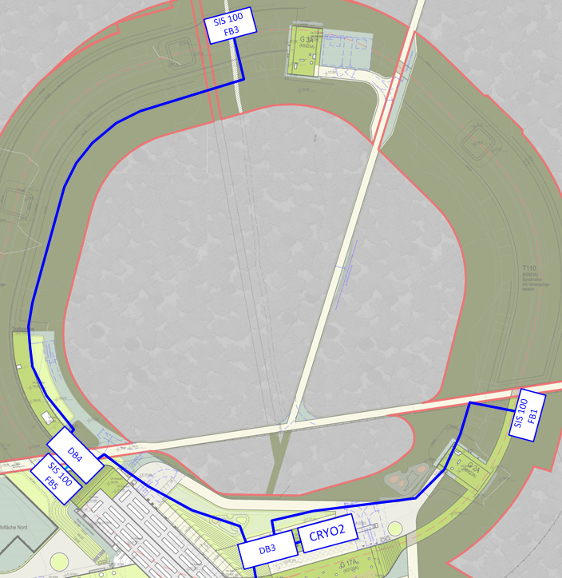
Das kryogene Verteilsystem für SIS100
3 Feedboxen (polnisches In-Kind) versorgen je 2 Sektoren mit kryogenem Helium
Bau und Installation der Verteilbox DB4 und der Transferleitungen durch Industriepartner

Slide 11
Das kryogene Verteilsystem für FAIR
Zentrale Helium Kälteanlage CRYO2:
ca. 14 kW Kühlleistung bei 4,4 K (-269 °C)
ca. 50 kW Kühlleistung bei 50 K (-223 °C)
Hauptnutzer:
  SIS100 Beschleunigerring im Norden
  Super-FRS Fragmentseparator im Süden
Heliumverteilung durch ca. 2 km vakuumisolierte Transferleitungen + Verteilboxen (DB2, DB3 und DB4)

