Slide 1
Beam Instrumentation Activities and Commissioning Concept
M. Schwickert, 17.09.2020
on behalf of the Beam Diagnostics Department

Slide 2
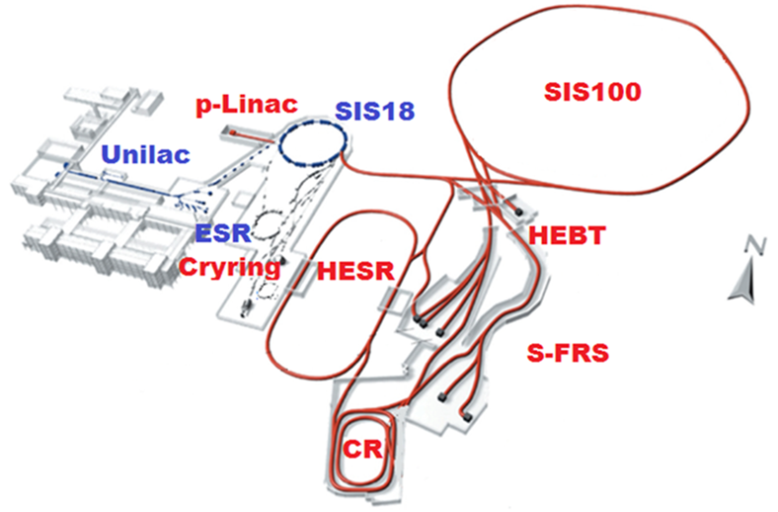
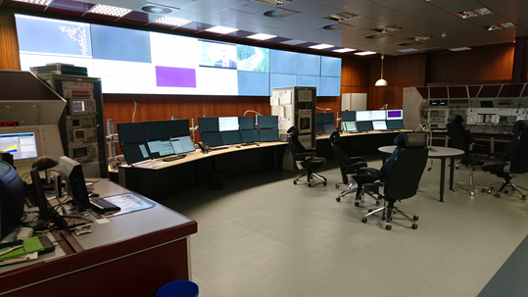
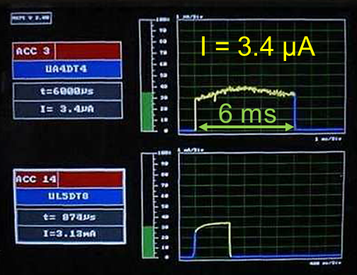
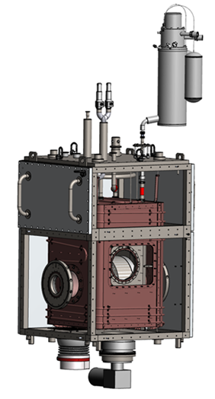
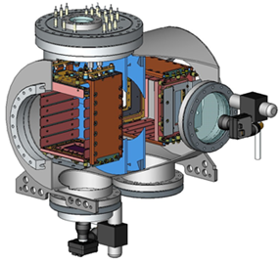
Outline
How we work
Schematic of beam diagnostic software integration
What we do
Activities at existing GSI accelerators
What we plan
Tasks during installation and commissioning
Where we struggle / possible pitfalls
Interfaces and requirements to be met by the control system

Slide 3
Schematic of BEA Software-Stack
HKR Diagnostics GUIs
JavaFX (→ Qt?)
BEA DAQ Team: full vertical SW stack
Software for subsystems (FESA classes, SILECS)
Diskless OS via PXE for Front-End Controllers (FEC)
DAQ software (FESA classes on FEC)
Support for FESA Explorer (FEX)
Expert-GUI for detector tests with full access (JavaFX)
+ Diagnostic GUIs with reduced param set (JavaFX, HKR consoles)
BEA DAQ Team does NOT develop overarching/synoptic GUIs for accelerator operations (1 GUI for 1 instrument)
For commissioning, troubleshooting: JODA-Tools (Java-Oriented Device Access) and Expert-GUIs
Remark: ACO devolopers work on horizontal layers
Middleware / ZeroMQ
Front-End Controller (IPC, VME, MTCA.4, SCU, Libera)
FESA class
Data Acquisition Boards
CentOS-based Diskless OS
WR-Timing
Boot- Server
Stepping-Motor Drive
Infrastructure Subsystems (Pneum. drives, high-voltage, detector gas)
Pneumatic Drive
FESA class
Detector
Ion beam

Slide 4
Overview of (controls related) BI activities
Ongoing DAQ-Upgrades at existing machines
Unilac
MAPS
UNIMON
pLinac BPM teststand
SIS18
BPM-Topos
Closed-Orbit Feedback
Teststand for SIS100
Fast Current Transformer
Scintillating screens (CUPID)
HEBT
Profile-Grids (POLAND)
Beam-loss monitors
Scintillating screens (CUPID)
Faraday-Cups
ESR
DC Current Transf., Fast Current Transf.
BPM (teststand for FAIR)
Scintillating screens
DAQ-Systems and Diagnostic GUIs: available
Diagnostic System | Machine | Status
DCCT | Rings | operational
ACCT | TK/SIS18/YR | operational
Unimon | Unilac | operational
JODA Tools | All | operational
Uni-Energy | Unilac | operational
Pneum Drive Control | YR | operational
LASSIE | SIS18, HEST | operational
Genesys | All | operational
MicroSpillTDC | SIS18, HEST | Expert
Cupid | All | operational
BIF | Unilac | operational
Faraday-Cups | YR | operational
FCT | ESR, SIS18 | operational
BPM | YR, ESR | operational
TOPOS | SIS18/HEST | operational
TOPOX | SIS18/HEST | operational
Phaseprobe | YR | operational
BPM Oscill. LXI | YR | operational
Scaler System | YR | operational
Cryring IPM | YR | operational
Schottky-Switch | ESR | operational
HV supply | SIS18/HEST/YR | operational
BPM AMP Control | SIS18 | Expert
BPM AMP Control | ESR | Expert
DAQ-Systems
in work (green) foreseen (black)
Diagnostic System | Machine
MAPS | Unilac
Unimon Upgrade | Unilac
Resonant Transformer RT | HEBT
Poland | All
Bunch Structure Monitor | Unilac
CCC | YR/HEBT/CR
Magnet-IPM | SIS100
Quad. PickUp | SIS100
Schottky | SIS100/CR
LASSIE Expert | SIS18
FCT | HEST/HEBT
BPM | HEST/HEBT
Please note: this is done with 3-4 software developers of BEA DAQ team!!

Slide 5
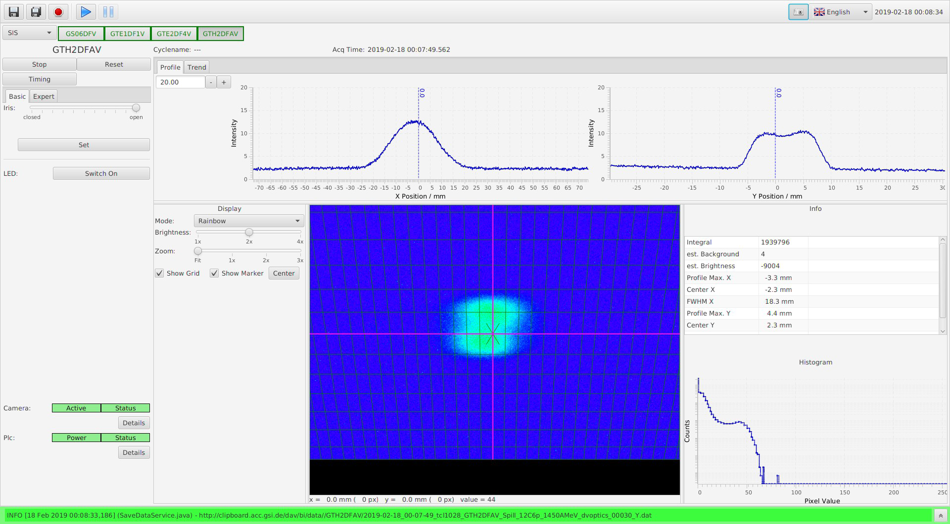
Diagnostic GUI Example: CUPID

Slide 6
Beam Diagnostic Device Commissioning
Preconditions: HW and SW prototype development and series delivery of mechanics and DAQ electronics finished
Pre-assembly
Single diagnostic component DAQ test @ teststands (Heck hall → ACC network, TES hall,…)
Mechanic, vacuum and electronic/detector tests
DAQ test using Diagnostic Expert GUIs → full FESA ecosystem required at teststand (see next slides)
Alignment, transfer measurement (if necessary)
→ transfer to „Baugruppenverantwortlicher“
Preconditions: building, technical infrastructure, cabling etc. ready, tested and accepted
Installation in tunnel and equipment rooms
Rack installation of DAQ equipment
Installation of Baugruppe in tunnel and cabling
Analog signal and network tests
Single diagnostic component DAQ test using Diagnostic Expert GUIs → full FESA ecosystem required for machine section
Machine section diagnostic tests (DAQ + beam diagnostics infrastructure)
Full machine diagnostic test (DAQ + infrastructure)

Slide 7
Interfaces and Controls Requirements
Controls Ecosystem for Beam Instrumentation:
White-Rabbit Timing (availability of running patterns for tests!)
Working FESA environment
New FESA releases
FESA reference class for each update required
Full check of each new FESA version before roll-out
Eclipse Plugin (for FESA developers)
Functional LSA releases
Java FX for GUIs
Future currently uncertain, decision on replacement, Qt?
CentOS8-Upgrade (significant change longterm planning )
SILECS (responsible? status unclear, needs active coordination, requires compatibility with actual FESA version, to become standard tool!)
Hardware:
Stand-alone WR timing receiver (required as TIF replacement, PC+FTRN is no adequate replacement)
PLC integration (for scintill. screens, pressurized air, remote power cycle…)
→ MISSING EXPERTISE: PLC expert left BEA department in Sept 2019, re-staffing set „on-hold“ !!!!
For planning of diagnostic software developments a clear roadmap / consolidated time schedule and communication (ACO, OPE, BEA) with respect to software upgrades and conceptual design changes on all levels is required !!
Bad example: required change in multiplexing due to storage ring mode!

Slide 8
Difficulties for FESA – Development @ BEA
Present diagnostic FESA classes do NOT feature (missing specs, manpower):
Archiving
Logging (decision on logstash, greylog, others…?)
Post-Mortem
Management of proposed accelerator and beam modes (beam presence flag…)
Role-based Access (still foreseen?)
Problem: huge work effort for all existing FESA classes required, if all (soft-specified) requirements should be implemented
We need a comprehensive strategy (ACO, OPE, BEA), common roadmap and time plan!
Soft-Oscilloscope System (skipped? replaced by Digitization project?)
Sequencer (presently not foreseen as commissioning tool, example code and (written!) information required)

Slide 9
Summary and Open Issues
BEA develops SW for standard diagnostic, no overarching tools, as full vertical SW stack
FESA class for different form factors + Expert-GUI for detector tests
Commissioning: single diagnostic component DAQ test (pre-assy + tunnel)
Operating: Diagnostic GUIs, ie. Expert-GUI with reduced param set
Open
Comprehensive roadmap for FESA updates etc. Synchronize SW development time plans to gain efficiency!
Strategy for archiving, logging, post-mortem, beam modes…
Stand-alone WR timing device Important, especially during commissioning and troubleshooting
Diskless OS for FECs developed and maintained by BEA ACO infrastructure is used at the moment, OS development by BEA DAQ team (1 single person)
Very urgent: re-staffing of PLC expert, support from ACO e.g. for FAIR technical planning

Slide 10
Questions ?
Special thanks to the BI DAQ team!
Thank you for your attention.

