Slide 1
Activities at FRS and Requests to Controls
Christoph Scheidenberger
GSI Darmstadt, JLU Gießen
Workshop on
“Controls Developments for FAIR Commissioning and
the Operation of the existing Accelerator Complex“
Sept. 16-18, 2020 – GSI-FAIR + ZOOM

Slide 2
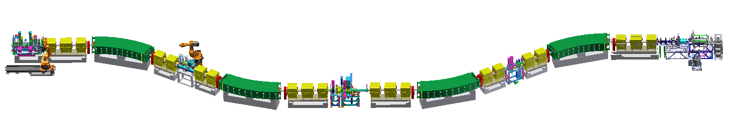
FRS – the central instrument for NUSTAR at SIS-18
The fragment separator FRS…
  … has a dual capability:
    high-resolution spectrometer
    production, separation, ID of exotic nuclei and delivery to various destinations (S2/S4, S6→ESR/CRYRING, S8→Cave-C/Cave-M)
  … is the Super-FRS test bench for
    the Super-FRS project group (Super-FRS “machine”)
    the whole NUSTAR Collaboration (detectors)
    in particular the Super-FRS Experiment Collaboration (committed to the development and support of Super-FRS construction)

Slide 3
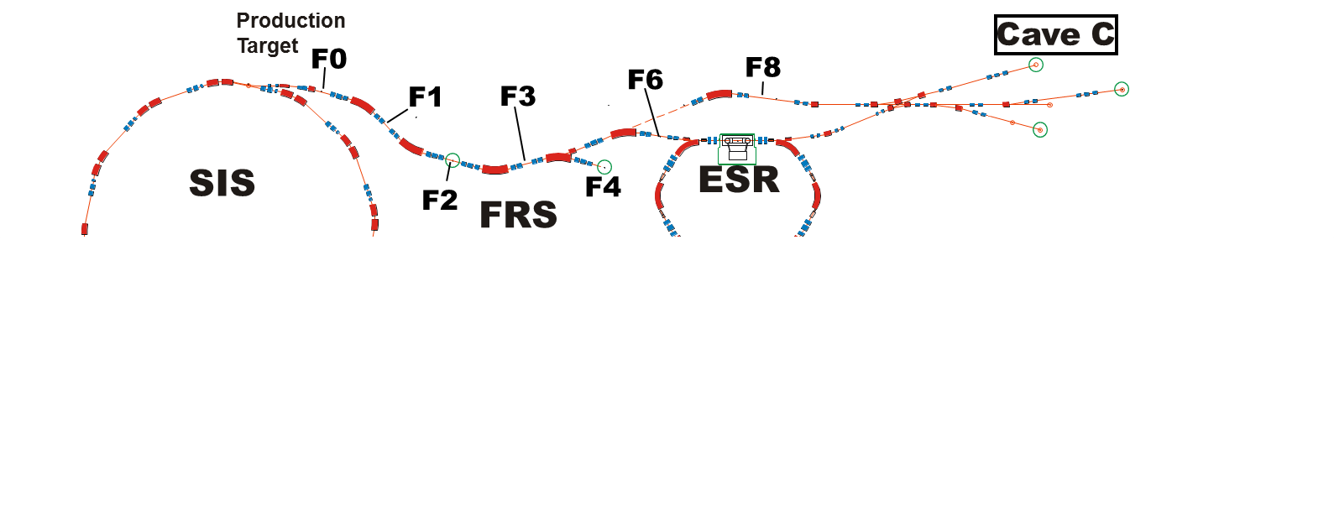
FRS – the central instrument for NUSTAR at SIS-18
The fragment separator FRS is embedded in the SIS-ESR complex
  for reliability reasons: FRS builds on industry standards from the begin, e.g. for power supplies, drives, robots, vacuum equipment etc.
  for compatibility reasons: we use same controls software like all GSI (e.g. SD up to 2016)
NUSTAR experiments with exotic nuclei take place…
  at FRS itself (focal planes F2 and F4)
  in ESR/CRYRING
  in Cave-C
  …and soon also in Cave-M

Slide 4
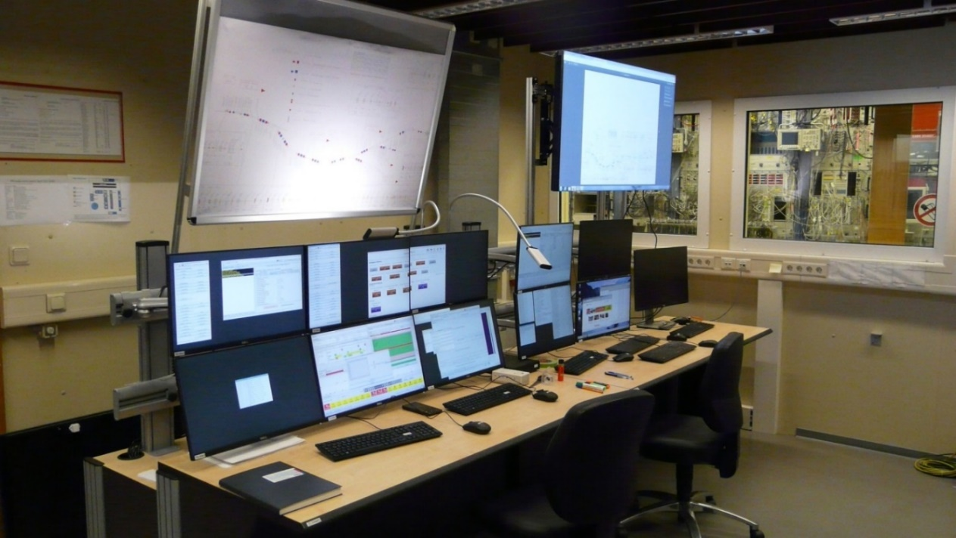
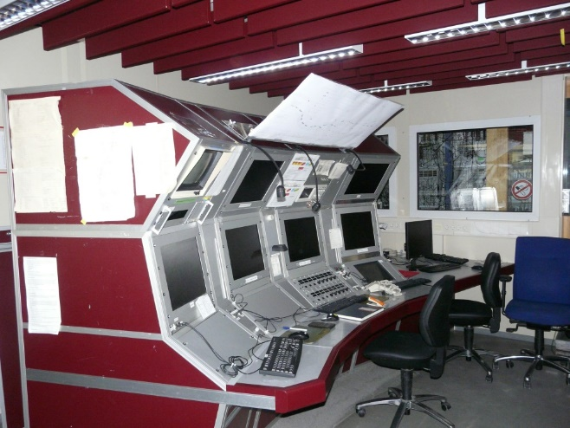
New control system
New LSA-based control system have been developed, debugged and tested
Some important functions, e.g. ramping of magnets, are not provided by the control system group -> Super-FRS project group has made the necessary developments (S. Pietri, J.-P. Hucka, F. Schirru, H. Rösch)
New consoles in the FRS Messhuette
LSA-MIRKO and gicosyback for interaction with new control system (B. Franczak, H. Geissel, H. Weick)
Beam 1-3 of April 2019 -> first experience with new control system
1990 - 2017
Messhuette
Notes:
LHC Software Architecture]
STD equipment (production/separation/ID) at all focal planes (S1-S8) is available and ready for experiments; electronics, DAQ and online-analysis are ready
Set-up / integration of experiment detectors is completed

Slide 5
FRS beamtimes in 2019 and 2020
Enigneering run 2019
  Commissioning of the FRS and its three branches
    Check signals from all standard detectors of the separator-spectrometer
    Ion-optics tests, Bρ calibration, test of new LSA-based control system
  Tests and training
    Get used to new programs
    How to control the FRS
  Preparations for beamtime 2020
    Beam to special detectors and detector systems
    Proof of principle stopping measurements
Experiments 2020
  11 G-PAC approved experiments performed at main branch, storage-ring and target-hall branch
  Overall 169 shifts during 103 days

Slide 6
FAIR control system for FRS 2020
Courtesy: S. Pietri
Presentation
tier
MIRKO
scheidenb@asl7XX.gsi.de
Gicosy/
gicosyback
Developer: ACO, (S)FRS, LOBI, B.Franczak
FMGSKAL
MagStat
Paramodi
DriveStat
Device Control
Lassie spill
DGX
Device Control
towards hardware: set values
Machine model
Application
tier
LSA
towards presentation: read values
FSLD
Resource
tier (FESA)
Magnets
Drives
Seetram
CG

Slide 7
Acknowledgements
Design: F. Ameil, S. Pietri, C. Scheidenberger, H. Weick
Machine model: Jan-Paul Hucka, S. Pietri, D. Ondreka, H. Liebermann, B. Schlei
Drivestat F. Schirru
Magstat: F. Schirru
MGSCAL : F. Schirru, J.P. Hucka
FSLD: J.P. Hucka (application to move DC drives from LSA)
MIRKO: B. Franczak, H. Geissel, E. Haettner
Perl script save: H. Weick
Perl script alignment: H. Weick
Shell script to save per section: S. Pietri
Thanks for support: R. Mueller, J. Fitzek, R. Baer, S. Heymel and ACO
→ It is desirable that the new programs will
be kept operational by R.Baer and his team!

Slide 8
Experience and follow-up (I): some observations
We have identified some items for possible improvements,
for instance DEVICE-CONTROL
  user interface is somewhat confusing w.r.t. the device nomenclatures (e.g. „GTS2DG5_P“ – what does it mean, which device is it?). It will help to have more user specific names (e.g. CG02 – everybody at FRS will immediately know what it is!)
  the displayed status is not always in agreement with the real status of a device (e.g. in/out ?)
…needs discussions in a separate meeting among experts

Slide 9
Experience and follow-up (II): future developments
Critical and urgent: stepper motors
  FRS has ~60 channels, e.g. target, slits, degraders, detectors, etc.
  install and commission new FAIR system at FRS in 2021 (manufacturing process underway)
  integrate stepper motor control in LSA, save and recall settings (like magnet settings in SRMAG), combine with simulations and machine model
Failsafe operation
  stepwise approach towards control-error prevention in order to avoid „dangerous“ modes of separator status and in order to protect the separator equipment

Slide 10
Experience and follow-up (III)
Operation of the FRS with the new control system
  Functionality similar to those of the old control system, but use is not as fast as with the old system
  The FRS specific program developments Machine Model, FMGSkal, MagStat, DriveStat and the file exchange possibility via asl7XX@acc.gsi.de are essential for the operation of the FRS
  Removal of MIRKO as an integral part of the control system, and lack of reasonable save and import functions in parammodi, is still an obstacle…
  Remote control and surveillance possibilities are very extensive
    spring 2020: Remote experiment participation from all over the world was proven to be very useful
    Remote control of electronics, DAQ and online analysis possible and widely routinely used
    Remote access to launcher → also drives, detectors, magnets (of not only) the FRS can be controlled from outside GSI
  may be increased or strengthened in future?!, needs careful regulation (hazards, failures, liability, …?)
…
Notes:
Not as fast has mainly to do with many more steps to perform an action

Slide 11
New porject BARB: connection FRS – Cave-M
GSI with PI Durante was awarded an Advanced ERC grant BARB to develop the basics of hadron therapy with positron emitters, including first demonstration with mice
The ultimate goal of the BARB project is to perform animal irradiation with a positron-emitter (e.g. ¹¹C, ¹⁵O) in Cave-M within 5 years from now
This project will need:
  Pattern for SIS-Cave M via FRS (TS) with possibility to adjust the Bρ of the accelerator zones (will be needed in 2021 beam time block)
  More than four patterns simultaneously to enable energy variation alternatively a feedback to magnets for passive energy variation with matter (a bit longer time scale)
Production
Target
Cave C
F0
F8
F6
¹²C
F1
F3
SIS
SIS
ESR
Cave M
F2
F4
FRS
^{11,10}C
INJECTION
FROM UNILAC

Slide 12
Our wish list for controls - summary
Essential! Maintain present functionalities, also the FRS specific programs
  Machine model, FMGSkal, MagStat, DriveStat
  File exchange possibility via asl7XX@acc.gsi.de is essentially needed to be maintained!
  → othwersie no FRS experiments without these programs!
Essential! Changes related to upgrade of the stepper motor system
Critical for BARB project! Pattern for SIS-Cave M via TS with possibility to set Brho of different accelerator zones
Improve some issues with Device Control (see above)
Development and implementation of failsafe operation
Reduce number of steps for certain actions
SWOT analysis of remote control possibilities for FRS
…

Slide 13
….many thanks for your attention!

