Slide 1
Requirements to Controls for Linacs/Injectors
Peter Gerhard, PSU dept., GSI
on behalf of the Injector Controls Upgrade Project
Controls Workshop 16.-17.09.2020

Slide 2
Content
Project „Injector Controls Upgrade“
General Remarks: Linacs vs. Synchrotrons
From Main Control Room to FCC
New Timing System
Operating & FAIR requirements
Ion Sources
Prospective retrofits
Upgrades
Conclusion

Slide 3
Injector Controls Upgrade Project
Roadmap and scope of the project for UNILAC
Phase 0: Sustain operation of UNILAC until 2024 -> ACO-INN
Phase 1: Retrofit of UNILAC until 2024
Retrofit with LSA based FAIR control system, reference/baseline existing machine
Replace „analogue“ systems, prepare for move to FCC
Enable strategic developments for Phase 2 (e.g. early availability of WR timing)
Phase 2: Upgrades from 2024, some may be earlier
Replacement of UNILAC timing system (Pulszentrale) by WR based timing system
Replacement of obsolete hardware, e.g. VME frames with SE/Gµ and Device Access front ends by SCU / FESA (>1000 devices, ~ 35 equipment models)
Digitisation of slow and fast rf signals for further integration and exploitation within control system
Integration of machine upgrades: Pulsed gas stripper, PRIDE, new ECRIS@HLI, Alvarez 2.0, …
Additional scope of the project:
pLinac, HITRAP, cw linac

Slide 4
General Remarks: From synchrotrons to linacs
Development @ACO focussed on synchrotrons and storage rings
Personal experience: Developers have to learn & change their minds for linacs
At a first glance, Linacs may seem to be relatively simple machines
But: Linacs are far from being simple from a control system‘s point of view, their challenges are located at different topics
This imposes new challenges especially to
timing, data supply and readout in terms of speed and data volume
basic control system procedures, concepts and philosophies in terms of adequancy, applicability, flexibility, and adaptability

Slide 5
General Remarks: Linacs vs. synchrotrons
Linacs
Synchrotrons
Can be far from being linear
Driven by physics parameters
Flat and straight models Nearly fixed, short cycles
Simple set values
Dominated by rf
Special installations like strippers (UNILAC 6 strippers), choppers
Operation and beam diagnostics differ
Are fast (cycle to cycle)
Need less precise timing, but rf phase!
Are linear! (with periodic boundary cond.)
Driven by high level physics parameters
Highly hierarchical, sophisticated models
Varying cycles with long sequences
Ramped set values
Dominated by magnets
Special installations like electron coolers
Operation and beam diagnostics differ
Are slow (cycle to cycle)
Need precise timing (BuTiS)

Slide 6
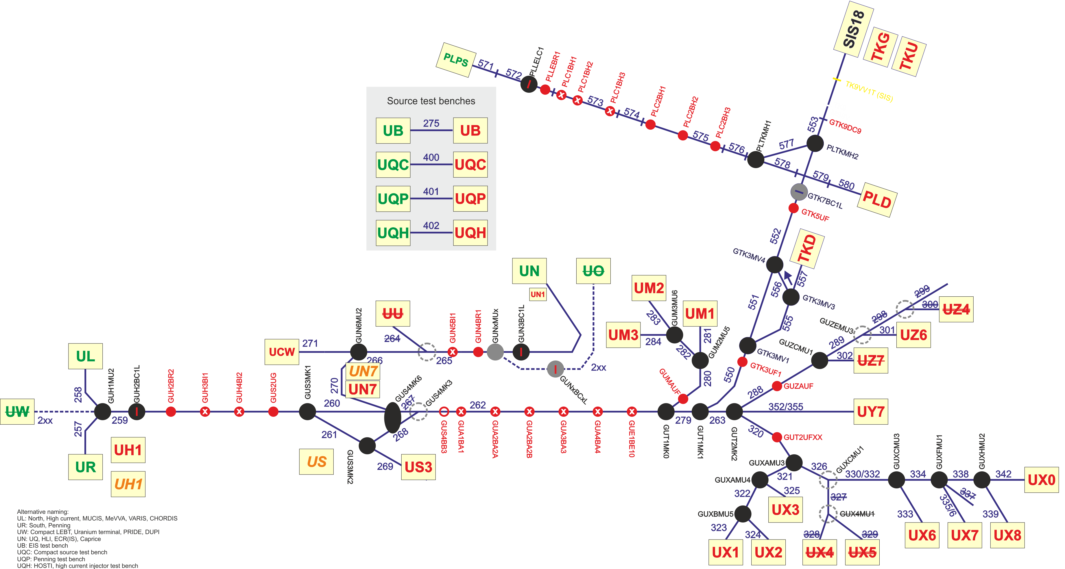
UNILAC / plinac overview

Slide 7
From Main Control Room to FCC
Contains >100 systems / functions for UNILAC operation
Ca. 25-30 systems / functions need development
Software development:
Migration of existing operating programs (~5) or their functionality (~3) to new control system
New or extension of existing applications for replacement of „analogue“ functions and systems (SEM safety, faraday cup panel, beam request, CDCU, …)
Hardware development:
Potiboard
Interface to UNILAC experiments (beam request, target wheel synchronisation, beam pulse signalisation, …?)
Large part covered by BEA (MAPS, rf probes, BPM, video, UNIMON),
Interfacing to control system

Slide 8
New Timing System
Existing Pulszentrale has to be replaced in the medium to long term
Pulszentrale recognised as ingenious timing system, not easy to replace
Nonlinear structure of UNILAC, TK and pLinac leads to >50 Timing Groups
Simple, nearly static event structure per cycle/pulse
High repetition rate + high number of Timing Groups still leads to Event rates orders of magnitudes higher
Highly parallel operation of different Beam Production Chains and other Beam Processes within Injectors -> Injector operation a complex Pattern of its own
Pattern has to run smoothly while trimming, changes of timing parameters (pulse length) and Patterns have to be adopted without stop of Pattern
Timing has to incorporate some operating mode changes in „real“ time (SEM safety, TK mode)

Slide 9
Operating & FAIR requirements
Pattern & chain execution, synchronization with SIS18:
Pulszentrale plans cycles in real time, dominated by source availabilities, highly efficient for UNILAC
FAIR requirement: Timely delivery of beam pulses to SIS18
Today asynchronous handshake between SIS18 and UNILAC, leads to waiting times and timeouts -> Not acceptable for FAIR operation
Additionally, number of timing restrictions (A4 10Hz operation) and need for more flexibility (source operation) is growing, more conditions to be considered for, hard to implement in Pulszentrale
Decouple Pattern planning from execution, planning in software
Transition from one pattern to next must be smooth and instantaneous

Slide 10
Operating & FAIR requirements
Data supply and readback:
Data supply may not interfere with the execution of chains or patterns
During large-scale data supply of single beam production chains (initialisation, energy change), this chain may be skipped or run in a safe/beam off mode
During trimming of single devices, chains have to continue normal execution
Trimming of single devices in real time (feedback <100ms), results in up to 50 trim values per second -> archiving, data aggregation
Concurrent trimming of different devices for different chains
Generally, lossless readback of device data at 50Hz -> archiving, data aggregation

Slide 11
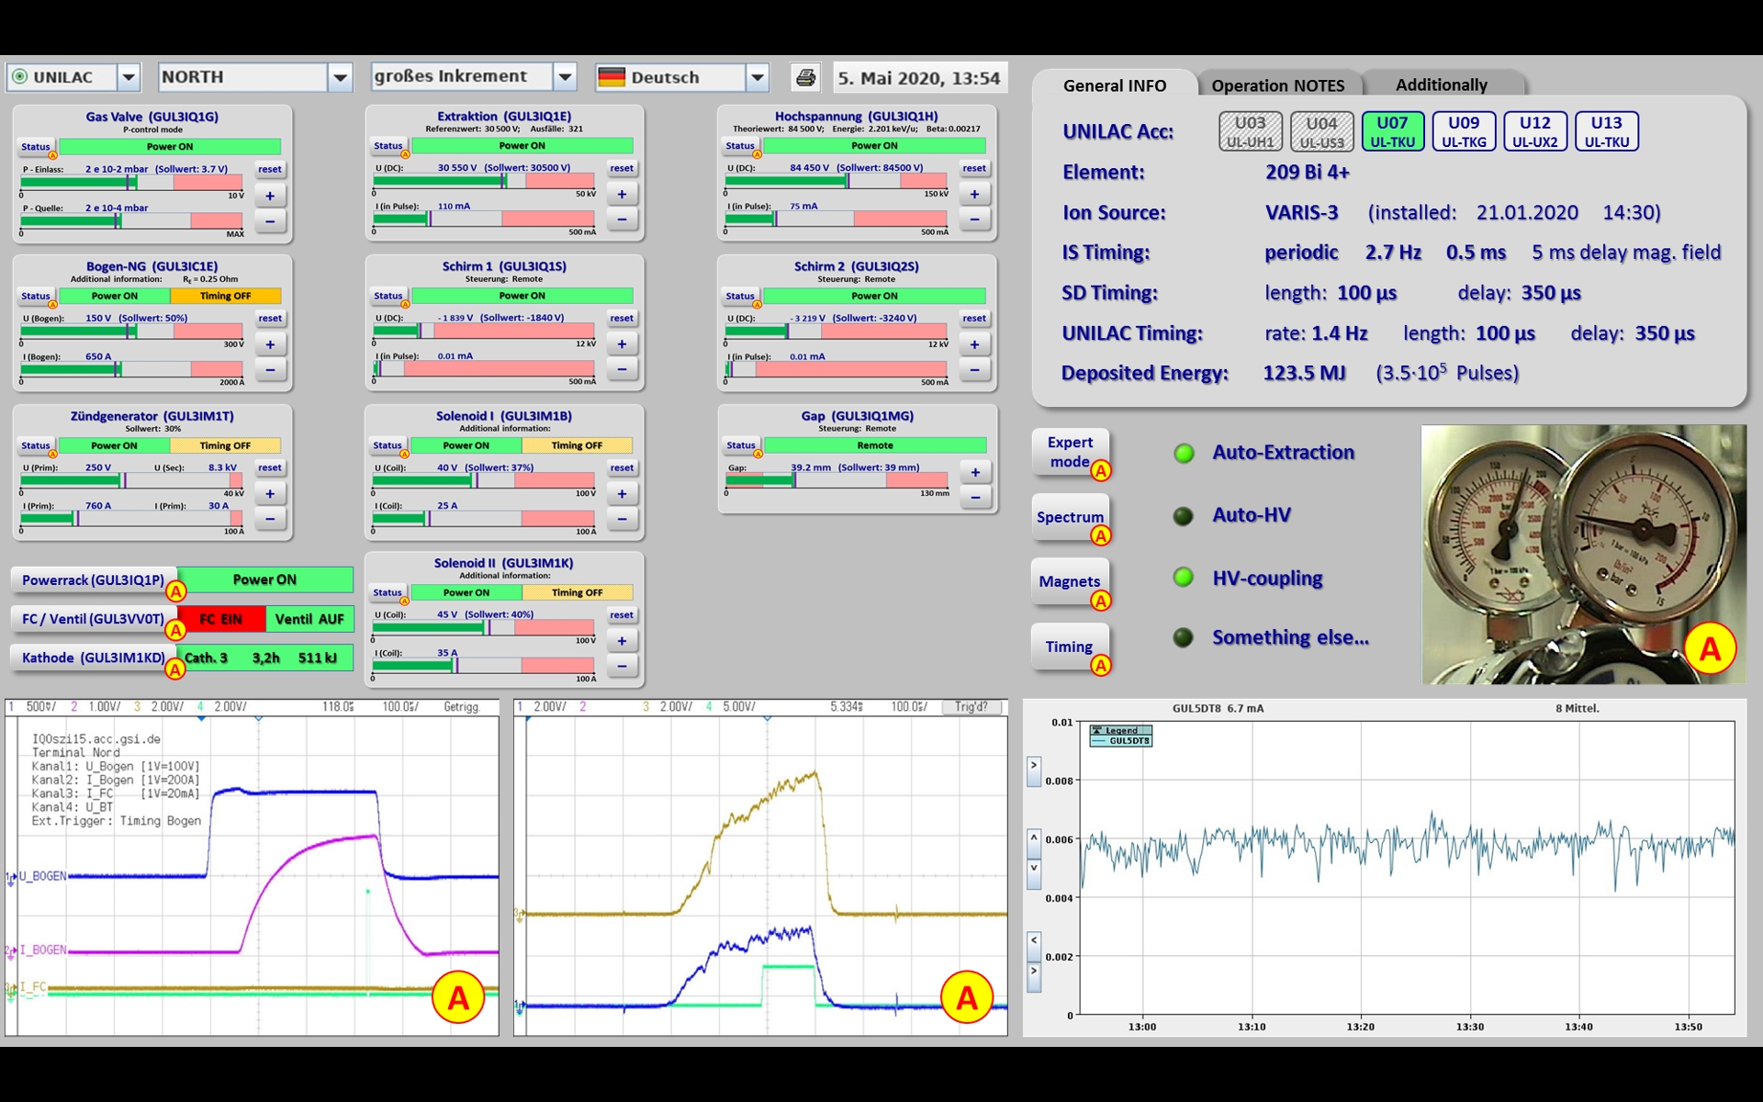
Ion Sources (A. Adonin)
New Ion Source program is under development:
improved user interface, enhanced functionality and advanced operating features
working team of Christian Hillbricht
Goal: to have a β-version until next user-beamtime (Feb. 2021)
New branches have to be implemented:
PRIDE (Terminal West and Compact-LEBT)
2-nd ECR ion source
P-Linac source
Modernization of interface electronics to high voltage platform
IMPORTANT: Response time of the Control System must be below 1 second

Slide 12
Phase 2: Prospective retrofits
Replacement of future obsolete Systems
Real time systems: Pulszentrale, Chopper controls, Interlock aggregation and alarm, Beam loss and SEM safety
Slow systems: Vacuum controls (partly done), TVS, Interlock control
Front ends: Replace VME frames with SE/Gµ and Device Access software by SCU / FESA (>1000 devices, ~ 35 equipment models)
Rf systems: BPM
BIF?

Slide 13
Phase 2: Upgrades
Digitisation of all remaining systems, bring data into control system -> archiving, monitoring, data aggregation with high data rates
Maintenance and further development of operating applications
Implementing of modern operating concepts
Generic interface to external/experiment signals
Pulsed gas stripper:
Change from global static device to pulsed multiplexed operation
Safety requirements due to hydrogen
Additional sources: PRIDE, ECRIS, pLinac source
pLinac: Commissioning and connection to TK
cw linac

Slide 14
Conclusion
Injectors retrofit is essential, as well as integration of new machines -> not if, but when and how -> priorities, approach
Linacs impose different challenges to control system
Speed is an obvious requirement, but many less visible things have to be worked on as well
This talk … … can only highlight some major topics, … can not at all be comprehensive, … is intended to give a notion of what (and how much) will be required!
There will be solutions if we are open minded, creative and target-oriented
Thank you!

