Slide 1
Controls Achievments and Requirements
Deceleration and Storage of heavy, highly charged ions
CRYRING@ESR
and HITRAP
Z. Andelkovic, N. Bauer, A. Bräuning-Demian, R. Bär, H. Danared, C. Dimopoulou, O. Dolinskyy, W. Enders, M. Engström, S. Fedotova, B. Franzke, M. Frey, W. Geithner, O. Gorda, F. Herfurth, L. Heyl, P. Hülsmann, A. Källberg, Th. Köhler, N. Kotovskiy, C. Krantz, M. Lestinsky, S. Litvinov, J. Mohr, I. Pschorn, A. Reiter, G. Riefert, J. Roßbach, A. Simonsson, T. Sieber, J. Sjöholm, M. Steck, Th. Stöhlker, G. Vorobjev, N. Winckler, ...
The SPARC Collaboration
GSI/FAIR, Stockholm University, KVI Groningen, HI Jena, Krakow University
Workshop on “Controls Developments for FAIR Commissioning and the Operation of the existing Accelerator Complex“ Sep/2020
Notes:
25 min ...

Slide 2
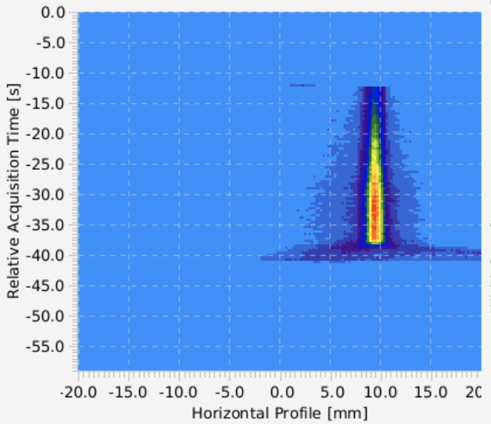
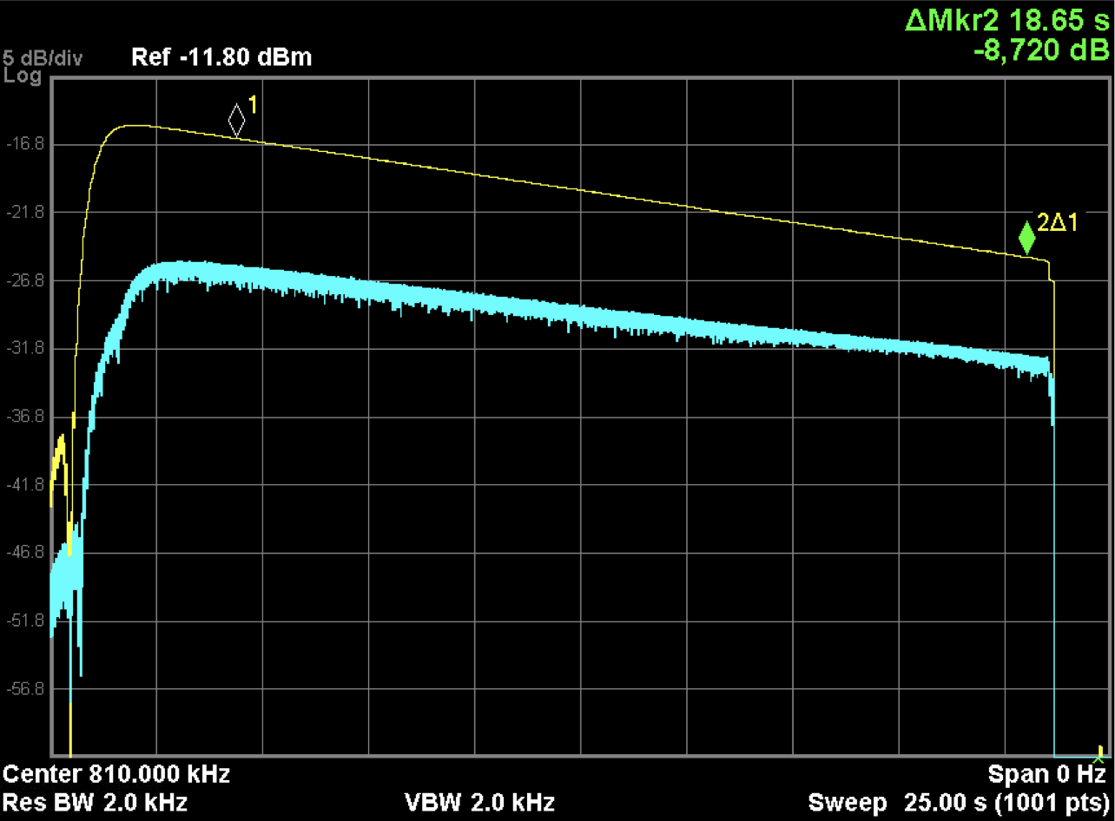
… arrived at ESR
CRYRING
Captured, Stored and Cooled Pb⁷⁸⁺ and Pb⁸²⁺ (bare)
6 x 10⁶ particles extracted from ESR at 10 MeV/nucleon
3 x 10⁵ particles available for experiments in CRYRING@ESR after cooling
Ion beam deceleration to 4 MeV/nucleon has been successfully tested
Lifetimes measured for different energies and ions
Pb⁸²⁺ lives between 10 and 20 seconds @10MeV/u
This is also an achievement of the Control System
Storage
Time
Life time ca. 18s
Cooling
Horizontal beam profile over time
Lifetime, i.e. time for a signal drop of 8 dB
Sep-17, 2020
Frank Herfurth

Slide 3
Kick-Off Workshop in Nov. 2012
+ Machine Expert + Operator
Sep-17, 2020
Frank Herfurth

Slide 4
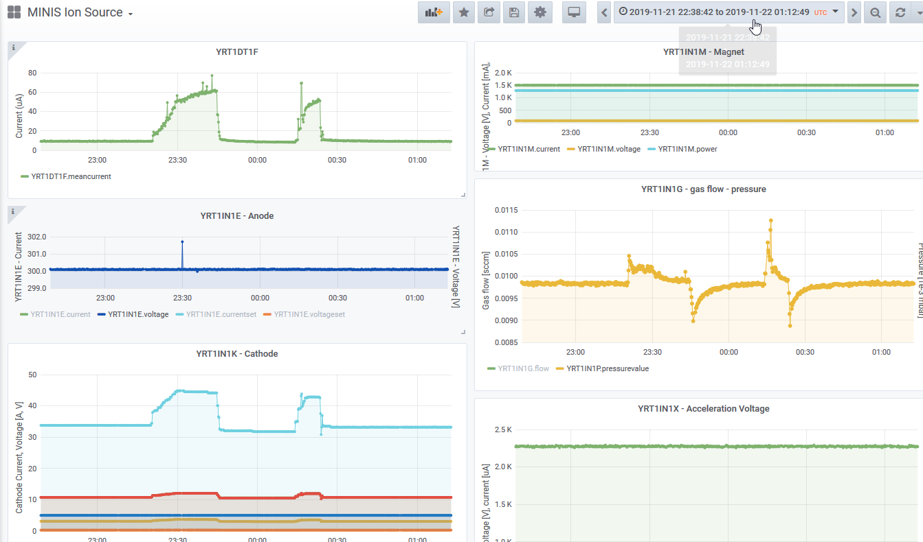
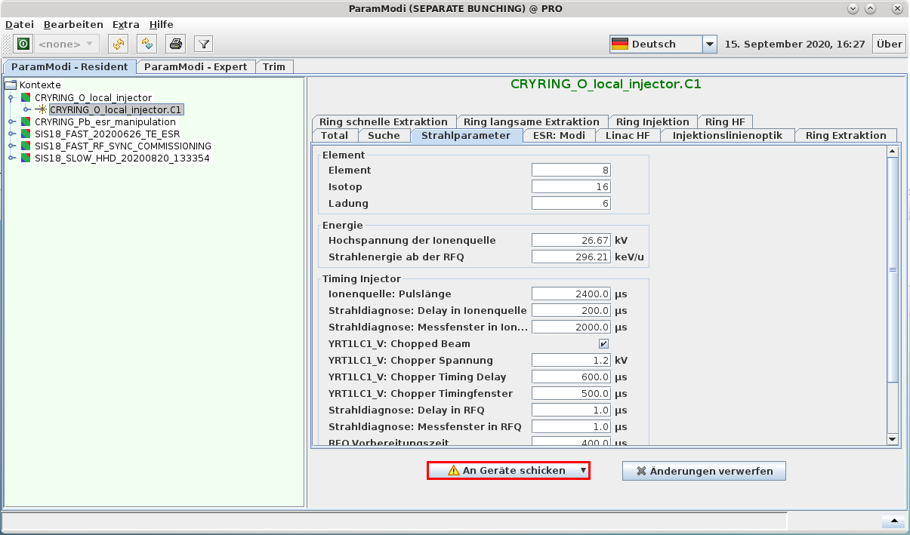
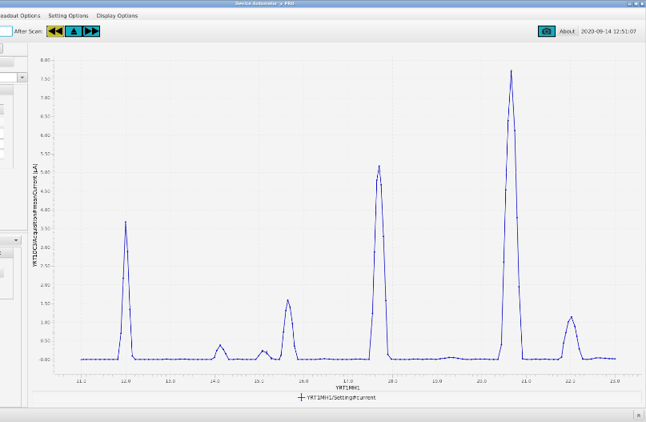
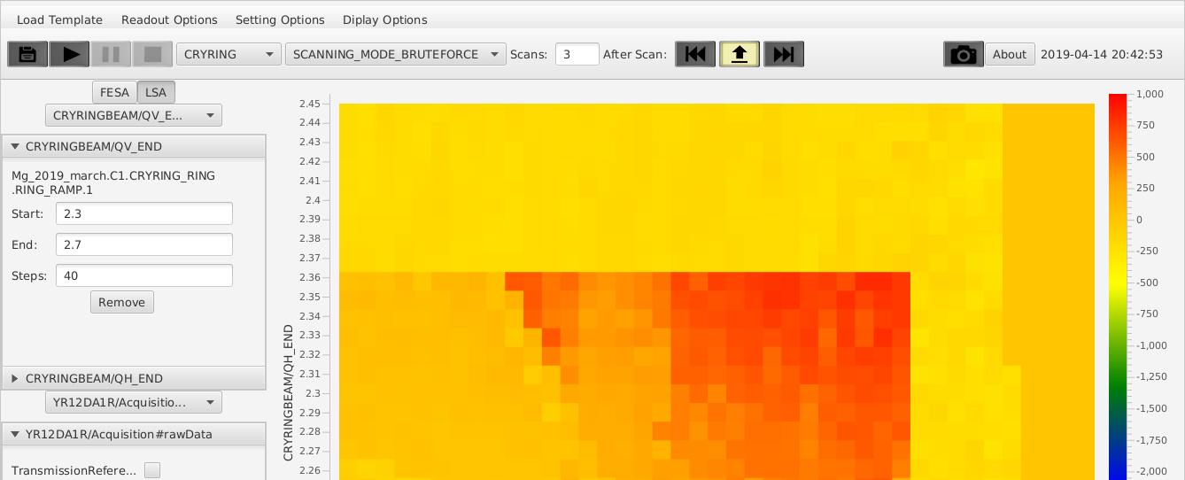
Control System – my view
Setup
Optimize
Supervise and Analyze
Beam Instrumentation
computer assisted
manually
Sep-17, 2020
Frank Herfurth

Slide 5
Setup
physics based
reproducible (although storage and retrieval manual)
access to physics model and mods of pattern etc. requires Java/Controls expert
Setup
Beam Instrumentation
Sep-17, 2020
Frank Herfurth

Slide 6
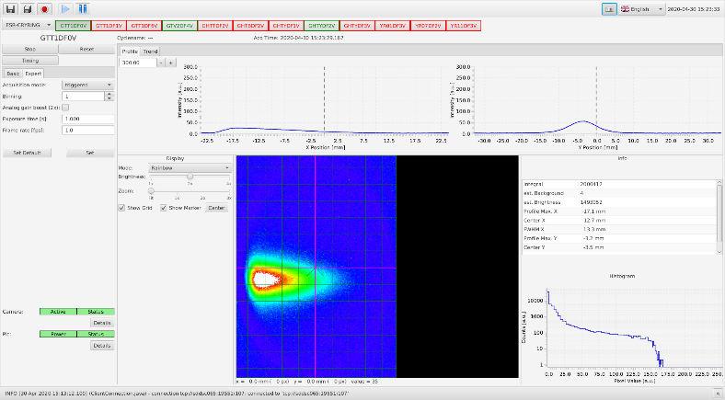
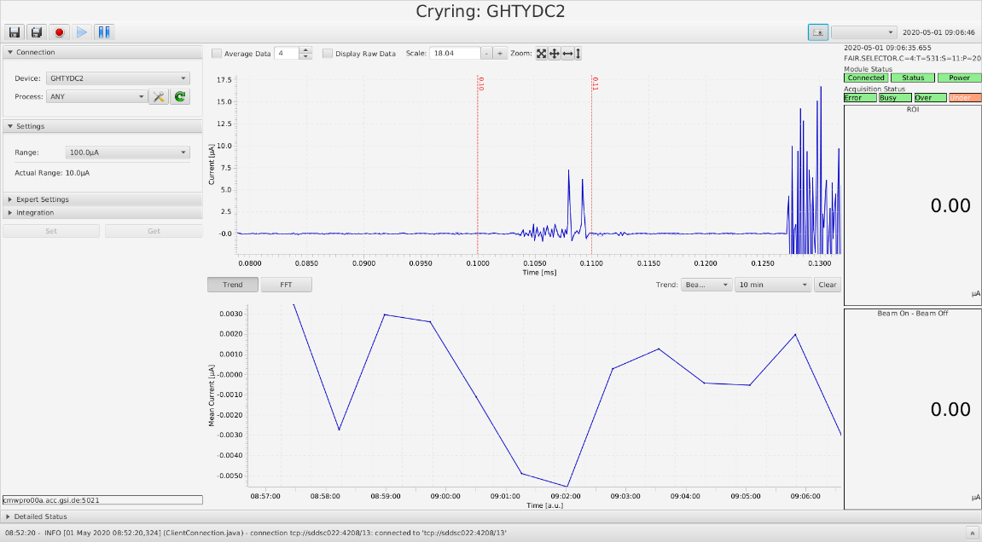
Optimize - manually
works using ParaModi
speed/response time
comfort/efficiency
increments
back button
“trim” allows for very flexible changes
Beam Instrumentation
Optimize
manually
Sep-17, 2020
Frank Herfurth

Slide 7
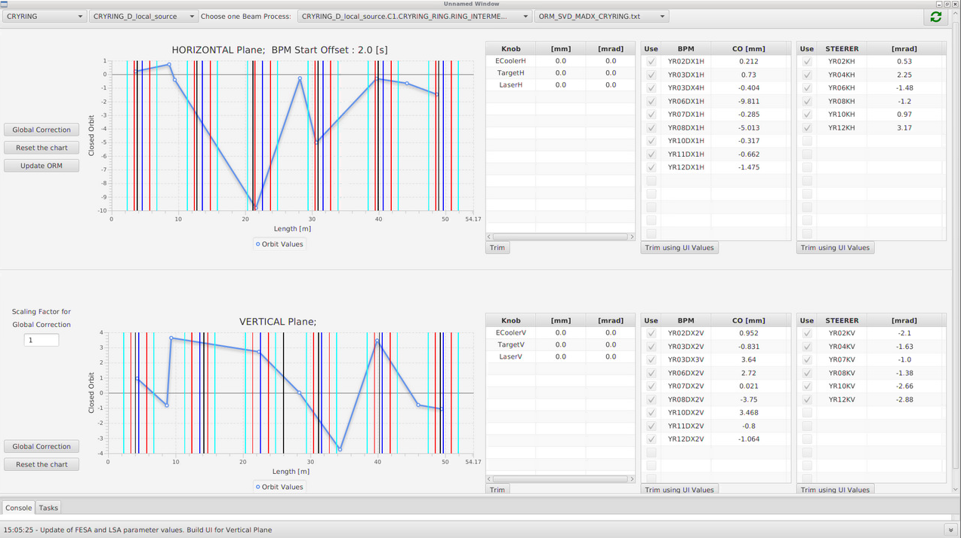
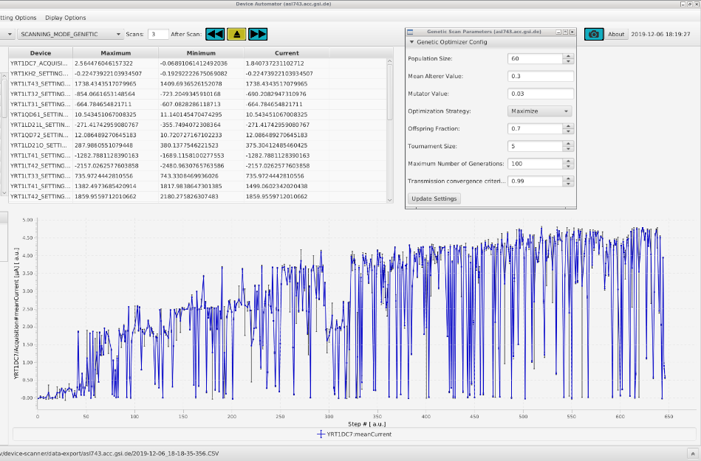
Optimize – computer assisted
W. Geithner, S. Appel, S. Reimann
within Control System
Device Automator (with somewhat experimental features like Genetic Algorithm)
Orbit Correction (COCO)
only basic integration with beam measurements
So far developments at GSI/FAIR machine centered and not well aligned
mass scan after ion source
Beam Instrumentation
COCO app
Optimize
tune scan
computer assisted
Sep-17, 2020
Frank Herfurth

Slide 8
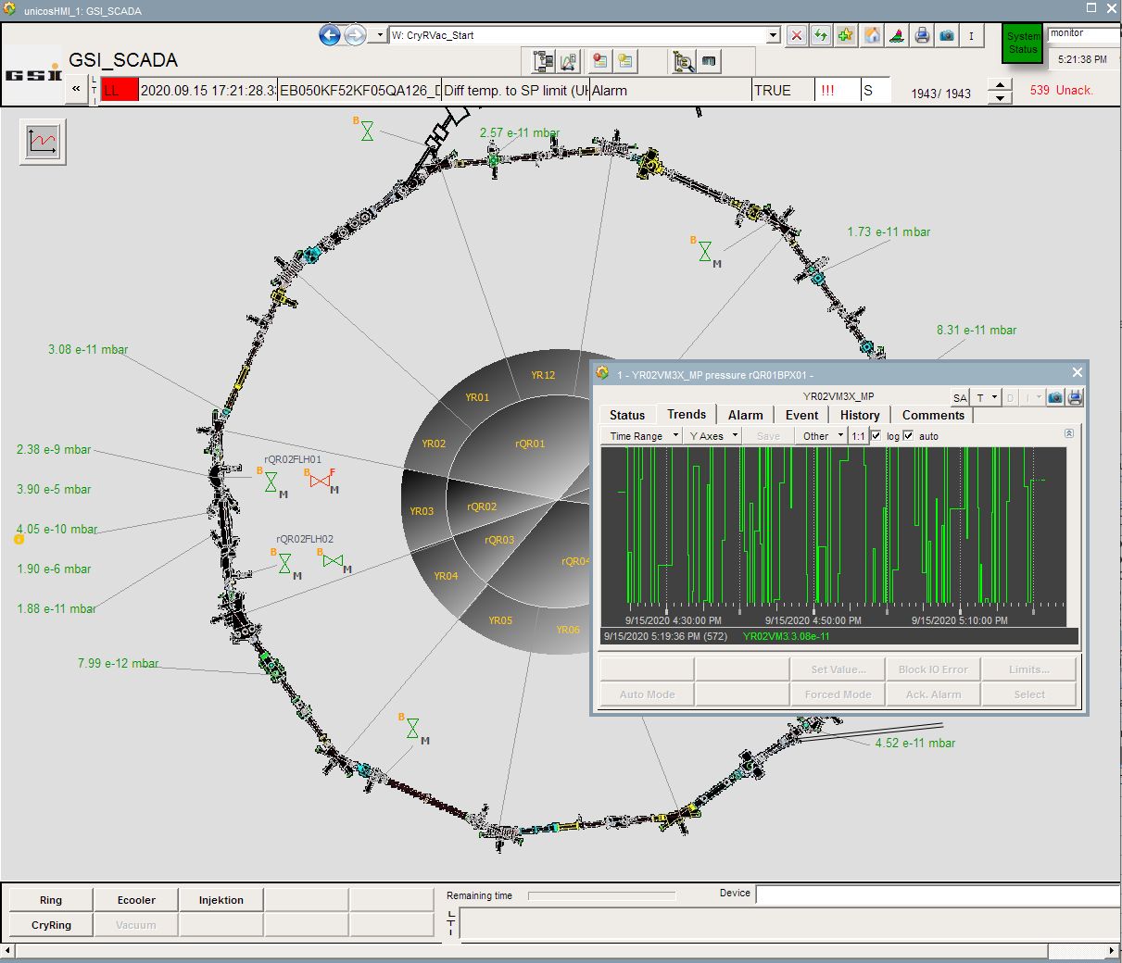
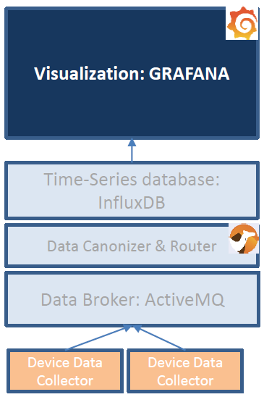
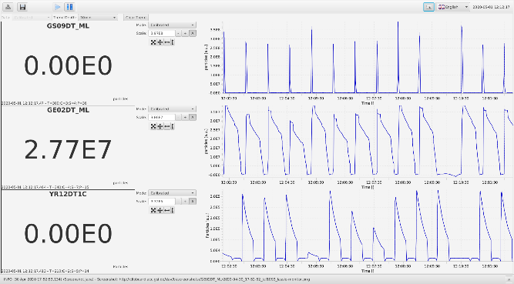
Supervise and Analyze
local stack (“GRAFANA”)
LASSIE monitor
Archiving
Digitization, i.e. Soll-Ist comparison
complicated access to vacuum controls – No computer interface!
Supervise and Analyze
Beam Instrumentation
Requirements for improved Monitoring and Optimization
„Real Time“, i.e. < 1 second, access to archived data via a user friendly API (not Java)
fast write access to archiving for „external“ data, as for instance vacuum, cryogenics, “exotic” devices = multi-meters
access to control system parameters (read & write) from other environments (LabView, Python)
Sep-17, 2020
Frank Herfurth

Slide 9
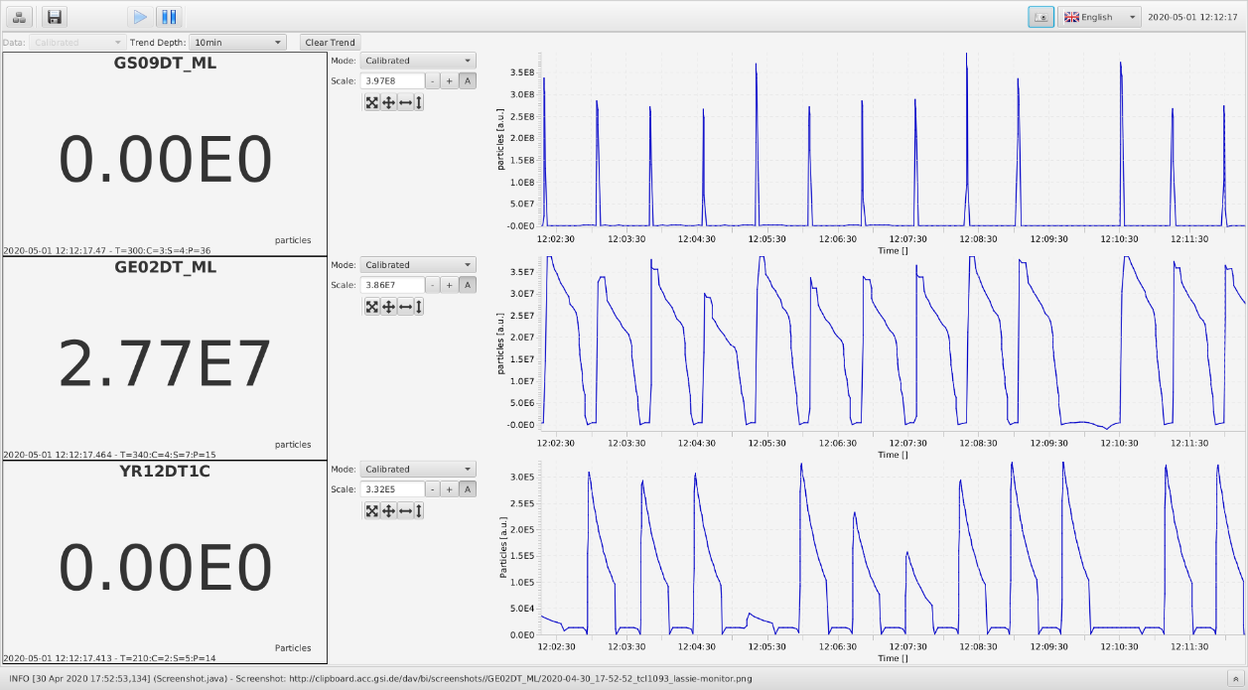
Beam Instrumentation + Controls
all units central to machine operation work
somewhat decoupled, but improving (ion source app, COCOapp)
no permanent storage of data
large flexibility (side by side of apps, VNC, old, new … )
Beam Instrumentation
Sep-17, 2020
Frank Herfurth

Slide 10
Summary CRYRING@ESR Controls
Basic functionality (and some more) is there!
Changes will happen! - add-ons of hardware and low level software, whenever there is experiments to be prepared (step motors, interlocks, valves, etc.)
Efficiency of setup, optimization and beam time quality requires additional efforts
Interfaces need discussion (Experiments, Logging, Optimization, Industrial Controls), Read&Write!
Thank you all for the achieved system performance and the constructive and pleasant work atmosphere!
Setup
Optimize
Supervise and Analyze
Beam Instrumentation
Sep-17, 2020
Frank Herfurth

