Slide 1
Activities at the ESR and Requests to Controls
M. Steck, Accelerator Operations, Storage Rings,
GSI Helmholtzzentrum, Darmstadt

Slide 2
History of ESR Operation with the New Control System
After the termination of the old control system in 2016 the operation of the ESR is still in a recommissioning phase with the new LSA system,
about half of the recommissioning is done.
Between autumn 2018 and spring 2019 the synchrotron mode was used at the ESR for studies of beam storage, cooling and optics measurements.
At the end of 2019 first tests of the storage ring mode were successful.
During the 2020 beamtime the storage ring mode was successfully employed in recommissioning and user operation.
Further recommissioning is needed to achieve the level of operation performed with the old control system.
During and after recommissioning new features will be introduced which were not available in the old control system.

Slide 3
Requirements of ESR Operation
A storage ring is similar to a synchrotron: similar components, similar structure.
The modes of operation show significant differences compared to a synchrotron
extensive use of cooling integration of experimental set-up, control of experimental devices
cycle times from milliseconds to days (depending on the lifetime of the ion)
Storage ring operation requires large flexibility, depending on the experiment
variable ion optics (cooling, internal target, spectrometry)
ideal orbit depends on the experiment (due to large acceptance)
not all installed components are needed for the different operation modes e.g. operation without rf is common to many experiments
orbit manipulations by magnetic components
acceleration/deceleration by cooling systems or detuning of electrons (DR)
Operation in vivo, i.e. manipulation during the cycle with beam stored
Interfaces to experiments (cooling, target, lasers, detectors, data acquisition)

Slide 4
The Heavy Ion Storage Ring ESR
Fast injection (stable ions / RIBs)
Stochastic cooling ( ≥ 400 MeV/u)
Electron cooling ( 3 - 430 MeV/u)
Laser cooling (C³⁺ 120 MeV/u)
Internal gas jet target
Deceleration (down to 3 MeV/u)
Fast extraction (HITRAP/CRYRING)
Slow (resonant) extraction
Ultraslow extraction (charge change)
Beam accumulation
Multi charge state operation
Schottky mass spectrometry of RIBs
Isochronous mode (TOF detector}

Slide 5
Status of ESR
Control of most power converters is migrated to SCUs. Typically SCUs show some dropouts at the beginning of a beamtime, but finally work reliably.
The storage ring mode has been established successfully (after one year of development)
some specific aspects were implemented: waiting points, manipulations, repetitions.
The storage ring mode will be the basis for further developments and user operation.
To fully benefit from the new control system significant additional effort is required,
development of control system, training of operators.
Presently the control system user interface is very complex, powerful, but intransparent.
A big deficiency is the lack of component value read back (power convertors, vacuum).
ESR operation is heavily relying on existing analog signals in the MCR.
Latency problem: waiting time 30 - 200 seconds after input of a new parameter.
New diagnostics components and GUIs are in development, only expert versions, but by now all diagnostics software is stand alone, links to control system are missing.
Interfacing to experiments is still based on old timing system events,
modernized interfaces to cooling system components, internal target, detectors drives, experiment data acquisition are missing.

Slide 6
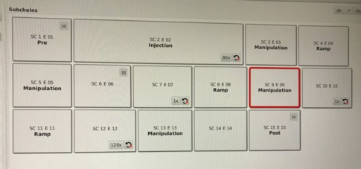
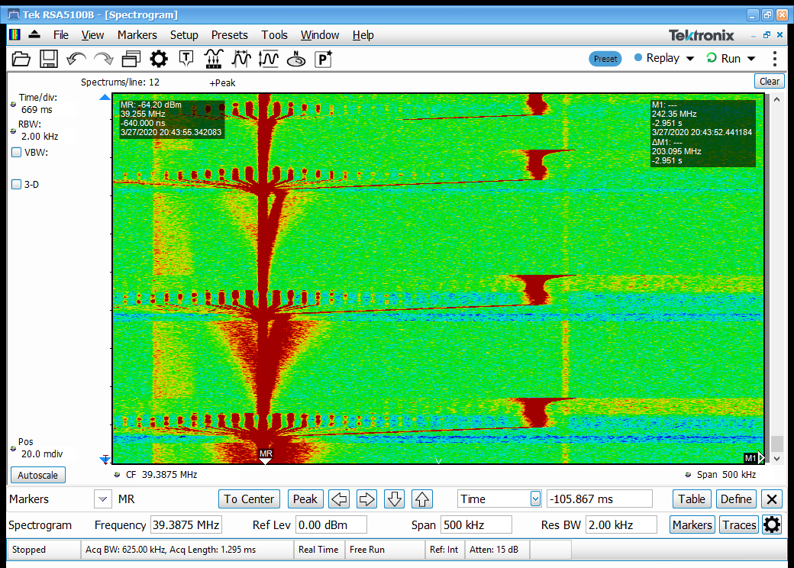
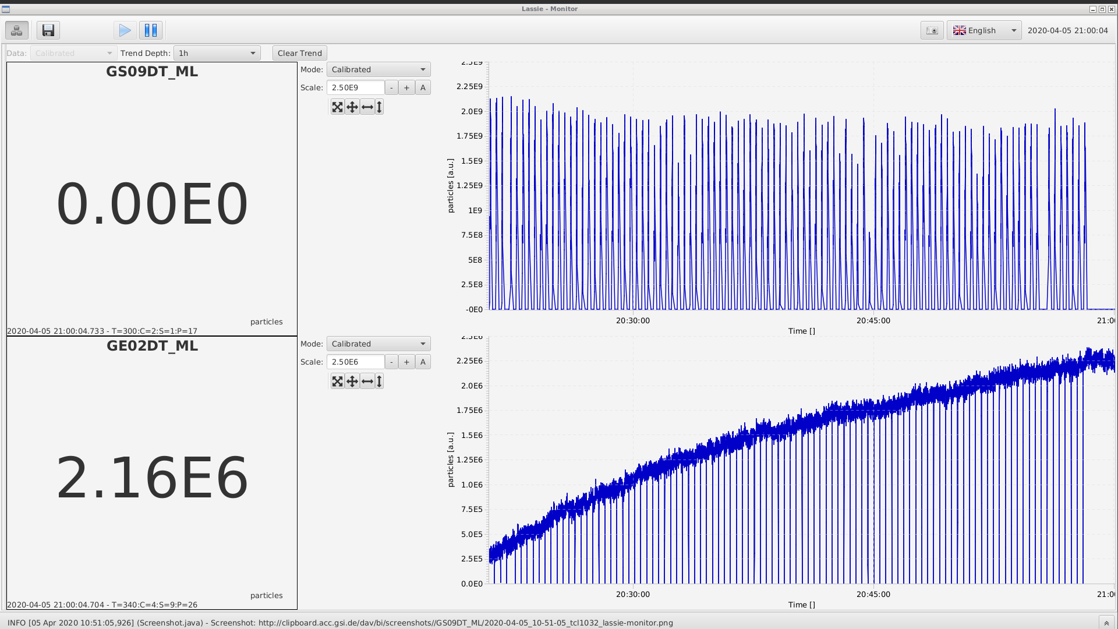
Some Achievements of ESR Operation
stable beam storage with (proven) storage time up to half a day, but with an extended pattern (very time consuming generation)
accumulation at 400 MeV/u by combination of stochastic cooling on injection orbit, deceleration with rf, electron cooling on inner orbit
pattern with 15 subchains for Tl205 experiment
stack orbit (electron cooling)
injection orbit (stochastic cooling)
Δp/p ≈ 1.6%
stored intensity in ESR

Slide 7
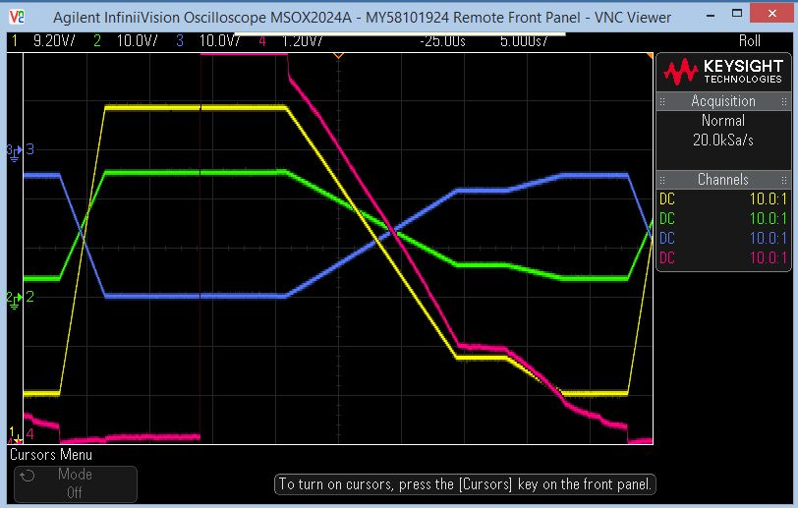
Some Achievements of ESR Operation
deceleration of Pb⁸²⁺ from 400 to 10 MeV/u
ion current
for low intensity (N ≤ 10⁶) losses are negligible
losses at higher intensity are not attributed to improper control of the ESR
dipole field
fast extraction of decelerated beam from ESR and transport to CRYRING with synchronization of kickers but: without rf synchronization (B2B)
slow charge changing extraction demonstrated but: trimming the beamline with stored beam in the ESR will be useful

Slide 8
Requests from ESR
availability of actual value read back is indispensable (not necessarily new digitization)
improvement of latency problem (check the results of task force in 2021)
improvement of reliability of DEVICE CONTROL
migration of all components to new control system (device access units) and operation with one timing system
rf synchronization between rings (B2B), for transfer to CRYRING and accumulation in the ESR
remove limitation in allocatable patterns and simplify pattern generation
flexibility in programming of timing events (for experiments)
simplified system for saving and recall of settings
removal of inconsistencies in parameter manipulations and trims (illogical and unpredictable response, unclear sequence of manipulations, interplay of pattern status and sending of new data, outage of AEG ? )
integration of beam diagnostics into controls and use in machine optimization (tuning machine parameters, optimization of transmission)

Slide 9
Summary and Outlook
The new control system has made significant progress during the last 2 years when it was introduced into ESR operation.
It has a lot of features for advanced machine operation.
Presently the ESR operation for users is not as efficient as it was with the old system: user operation ↔ controls development
More efforts are needed to achieve the previous level of operation both by the control system developers and the machine operators.

