Slide 1
Requirements to controls for CR commissioning
Oleksii Gorda
17 September 2020
Workshop on Controls developments for FAIR commissioning

Slide 2
Recap: overview and tasks of CR
Antiprotons
ε_{x,y} = 240 mm mrad
δp/p = ± 3%
No beam acceleration or deceleration. Operation at the fixed magnetic rigidity.
Flexibility in switching between the different operation modes.
Polarity change of equipment required when switching between antiproton and RIB modes.
from $\overline{p}$-separator
from Super-FRS
RIBs
ε_{x,y} = 200 mm mrad
δp/p = ± 1.5%
TCR1
to HESR
Beam
 | Operation mode | Kin. Energy | N_{max} | Cycle Time
1 | $\overline{p}$ pre-cooling | 3 GeV | 10⁸ | 10 s *
2 | RIB pre-cooling | 740 MeV/u | 10⁸ | 1.5 s
3 | RIB isochronous mass-measurements | 400-790 MeV/u | 1-10⁸ | few turns
4 | Delivery of primary stable beams from SIS-18 to HESR ** | On demand, (with pre-cooling if necessary)
extraction to HESR *
extraction to HESR *
Circumference 221.45 m
Max. magnetic rigidity 13 Tm
in-ring
extraction to HESR **
* within the Modularized Start Version (MSV) of the FAIR project
** option under consideration

Slide 3
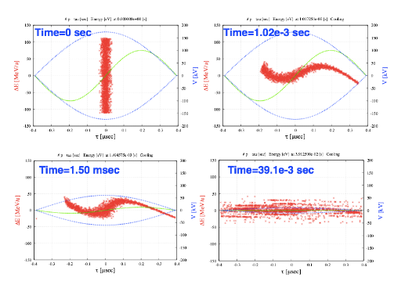
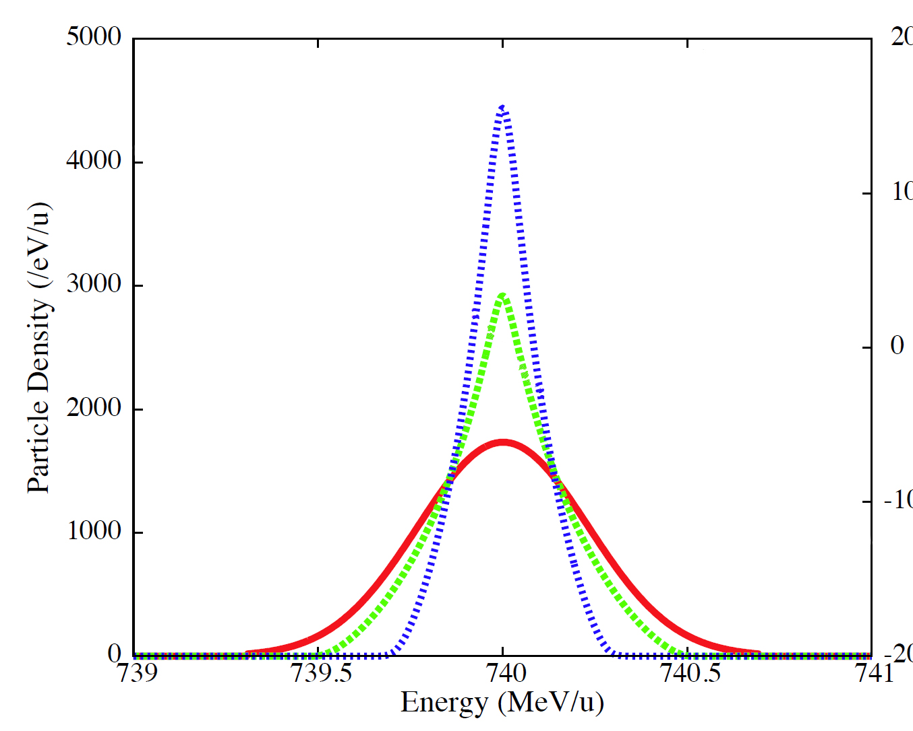
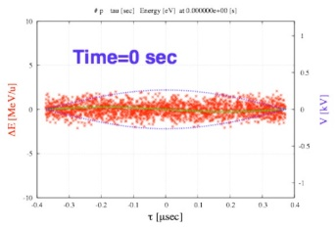
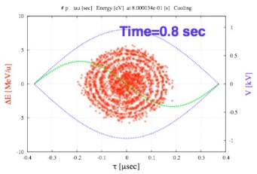
CR cooling cycle
Injection
single-turn
Bunch rotation & de-bunching
Max. RF voltage of 100 kV for p-bar bunch rotation.
Stochastic cooling
Re-bunching
Extraction
Re-excite RF voltage for re-bunching
Simultaneous 3D cooling
to HESR
injected bunch length σ_{b} ~ 50 ns.
Injection
Schematic RF pattern for antiprotons *
* not true to scale

Slide 4
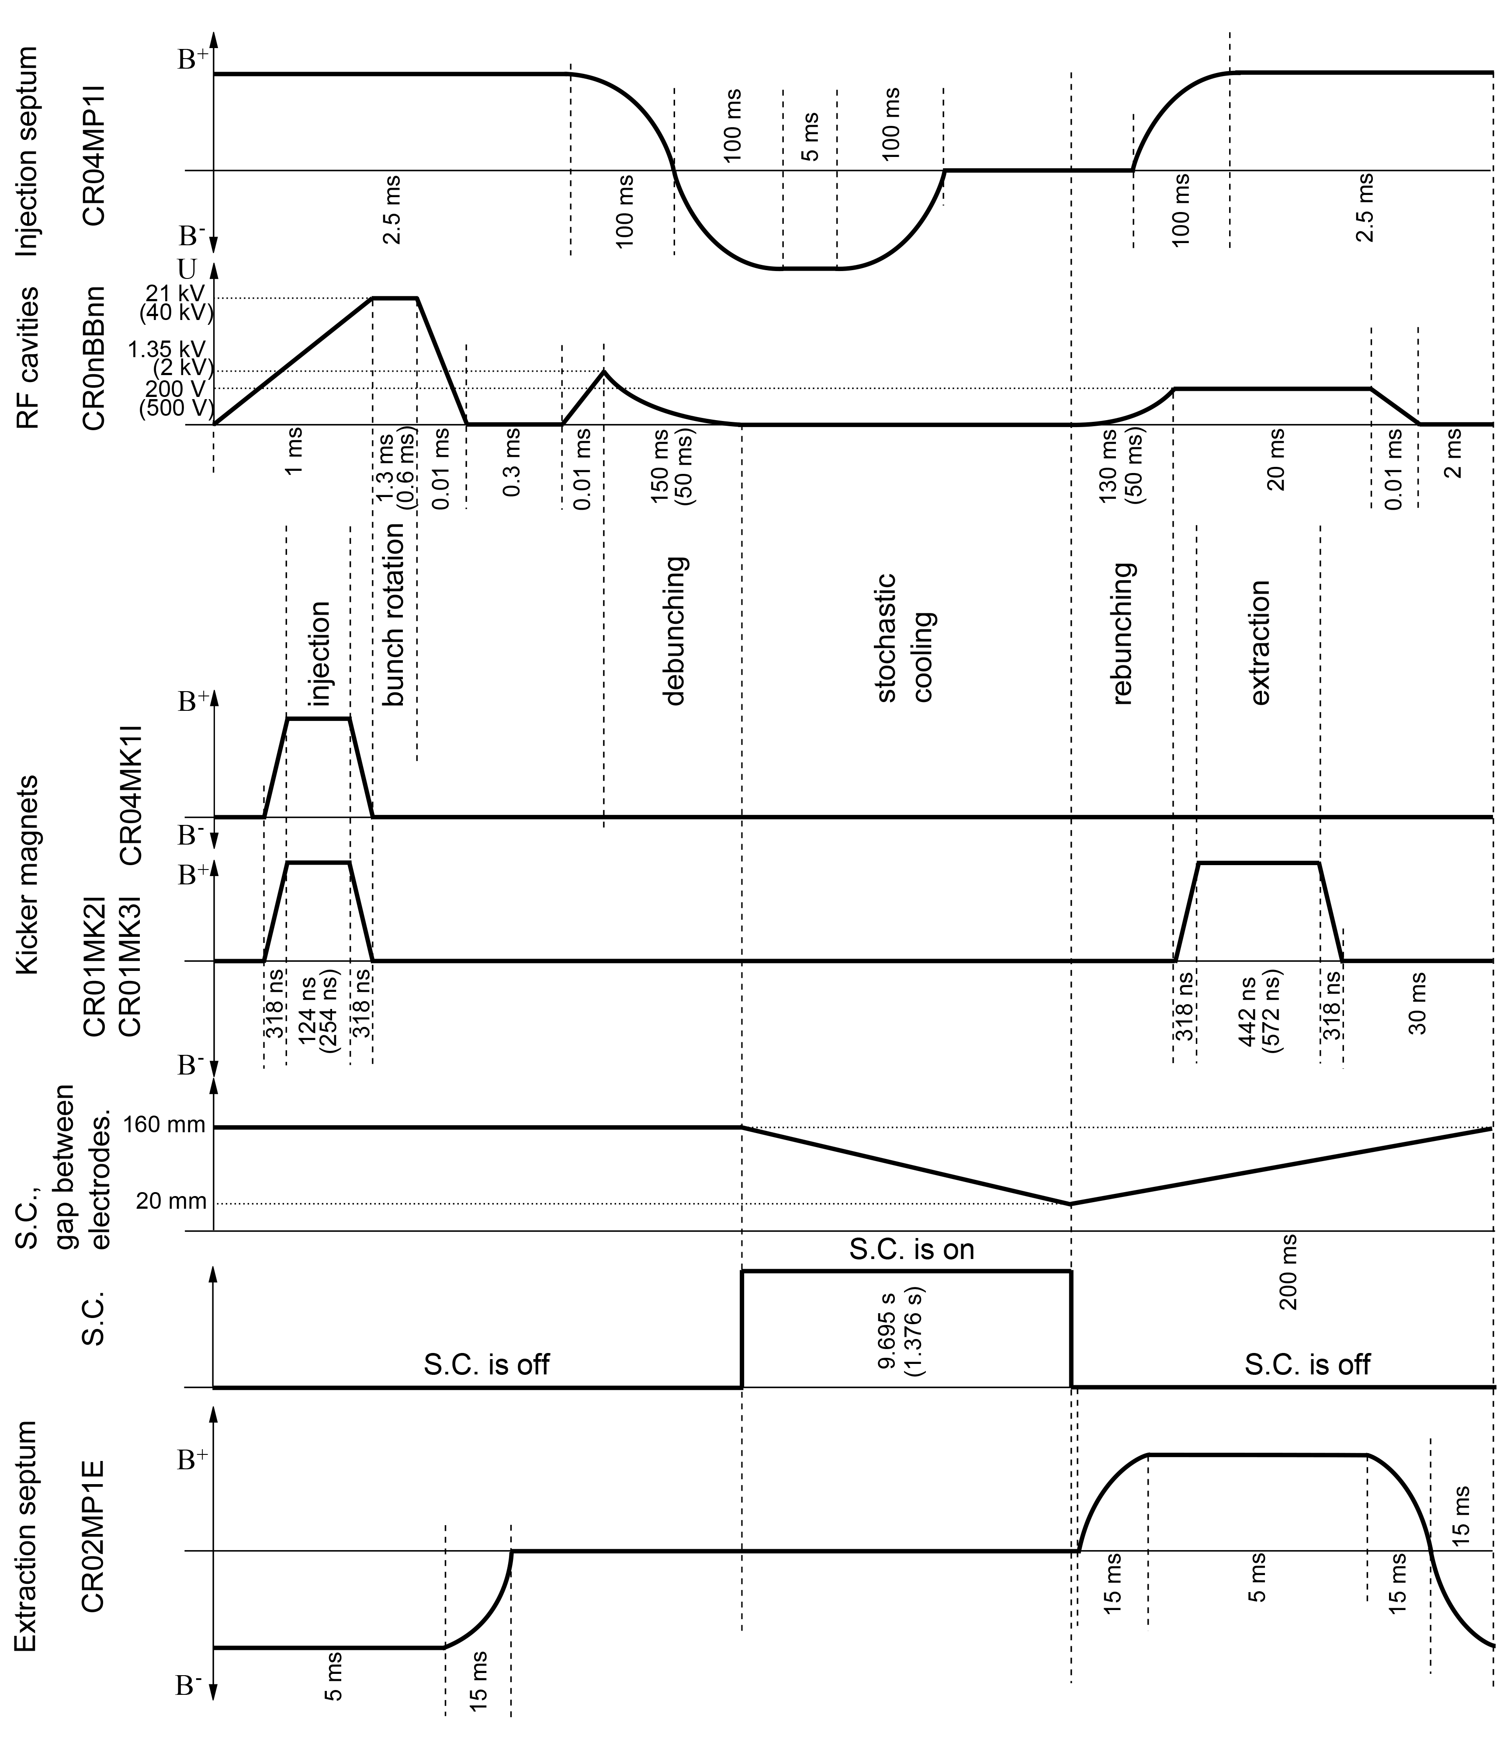
Planned operation cycle
Appropriate timing signals/sequences for the septum magnets, kicker magnets, RF cavities and stochastic cooling system.
Real-time timing triggers for the machine modes, RF clock, stochastic cooling and other events: manual adjustment/optimization of the timing sequence depending on the operation mode.
Individual equipment timing triggers during the commissioning with/without beam.
Synchronization of hardware operation including Super-FRS, pbar-separator, RF turn on, equipment state changes, data acquisition for power supplies and beam diagnostics.
Polarity change of the main magnets, kickers and septa for commissioning and operation with different beams.
* not true to scale
** values in () correspond to RIB mode

Slide 5
Commissioning without beam
Testing/dry running of individual TCR1 and CR equipment – testing of components and data acquisition systems according to specifications (magnets/power converters, RF system, injection/extraction, beam diagnostics, stochastic cooling components, experimental devices).
Manual and/or automated testing with using of programmable sequencer tasks (connection/communication, powering, interlocks, etc.).
Tools for data analysis and visualization – manual or automated (for standard testing procedures)?
Possibility of parallel equipment testing: lock test circuits during testing to prevent simultaneous access.
Dry running of the complete CR system within programmed sequencer tasks taking into account the required timing dependencies.

Slide 6
Example: power converters
1
DPC
Thermostab
Control rack
DC magnets/ correctors
48
QPC+TCR1 DPC
48
ACU+DCCT
26
SPC
26
ACU
CR Magnet System
12
OPC
6
SCU+IO
53
CPC
27
SCU+IO
INJECTION
SEPTUM
3
SCU+IO+Sync
Injection/ Extraction
magnets
EXTRACTION
SEPTUM
2
SCU+IO+Sync

Slide 7
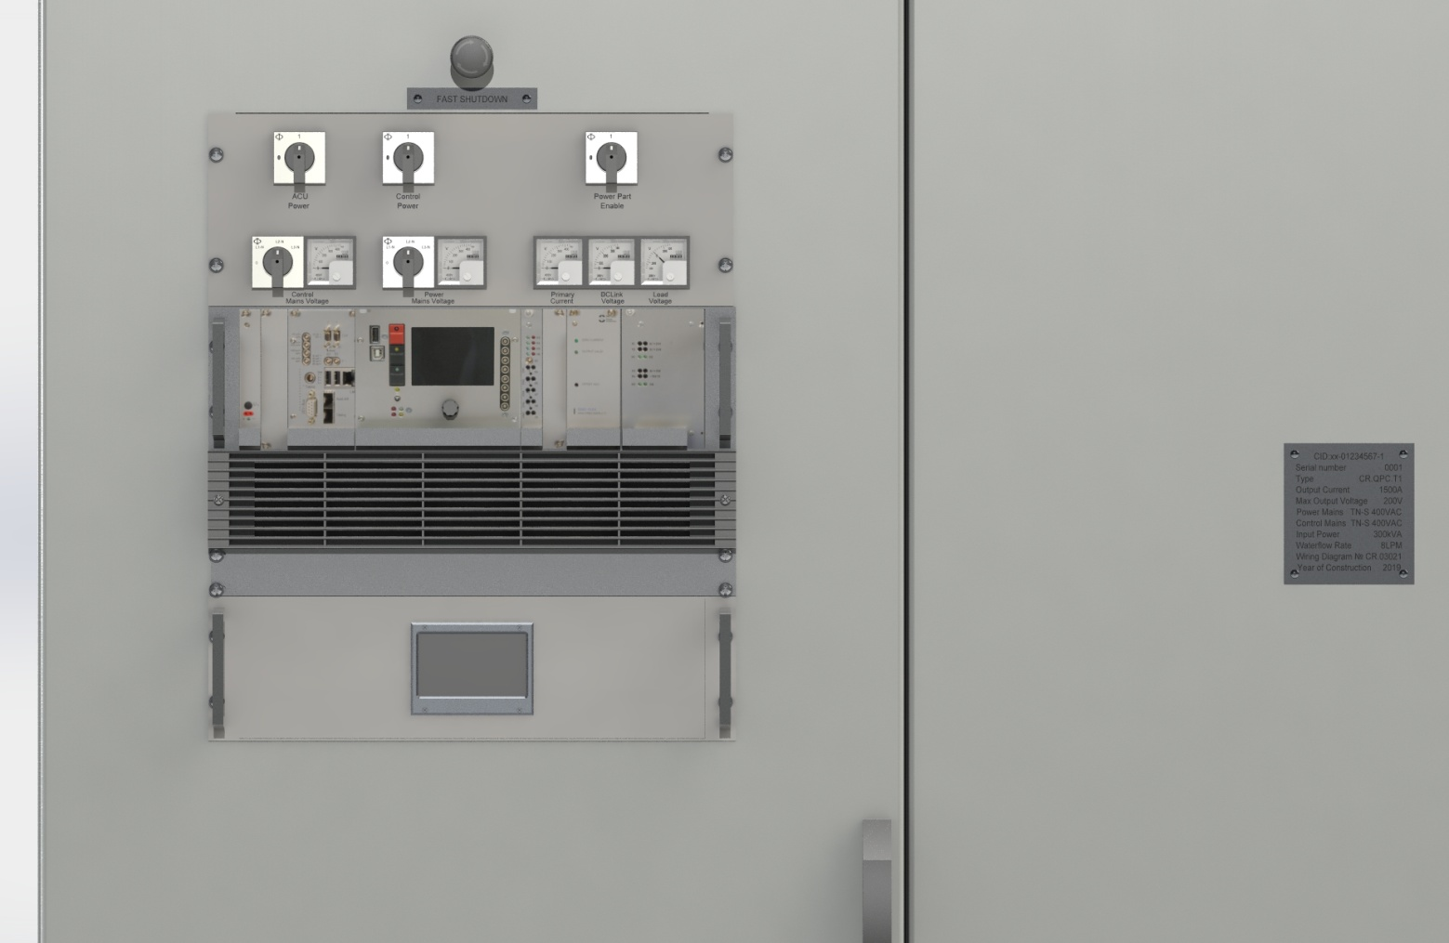
Example: quadrupole PC control
Interlock source | Interlock | ICM target connector
ICM board
Main contactor | DIN1 - Main contactor | X4
Fast shutdown + Door switch | DIN2 – Fast OFF | X5
Control Part Mains Monitor | DIN3 – Control Part Mains Voltage | X6
Power Part Mains Monitor | DIN4 – Power Part Mains Voltage | X7
Control part power CBs status | DIN5 – Protective Power Switch | X8
Heatsink TSW | DIN6 – Heatsink overheat | X9
PAS Interlock / reserve | DIN7 – PAS interlock | X10
WCable connection TSW | DIN8 – Load cable TSW | X11
Termoswitch @130 Transformer | DIN9 – Step-down transformer warning | X12
TermoSwitch @120 Transformer | DIN10 – Step-down transformer Overheat | X13
Output overvoltage | AIN1 – Load voltage | X2
Primary overcurrent | AIN2 – Primary current | X31
DC Link voltage level | AIN3 – DCLink voltage | X3
Earth current monitor | AIN4 – Earth current | X32
Out Oscillations | AIN5 | X15
Waterflow monitor 1 | WF1 – PC waterflow monitor | X30
Waterflow monitor 2 | WF2 – WCable waterflow monitor | X30
40 DIN Extention board
Thermo SW Magnet 1 – EXT1 | DIN11 – Load protection TSW | EBoard
CWater SW Magnet 1 – EXT1 | DIN12 – Load protection Water | EBoard
Thermo SW Magnet 2 – EXT2 | DIN13 – Load protection TSW | EBoard
CWater SW Magnet 2 – EXT2 | DIN14 – Load protection Water | EBoard
Thermo SW Magnet 3 – EXT3 | DIN15 – Load protection TSW | EBoard
CWater SW Magnet 3 – EXT3 | DIN16 – Load protection Water | EBoard
Thermo SW Magnet 4 – EXT4 | DIN17 – Load protection TSW | EBoard
CWater SW Magnet 4 – EXT4 | DIN18 – Load protection Water | EBoard
List of QPC type PC control and status
channels:
Control: PC soft start
Control: PC on/off
Control: Output current setpoint
Status: Load current
Status: Load voltage
Status: Primary current
Status: Dclink voltage
Status: Earth current
Status: up to 20 DIN
Specific features:
testing of the polarity change within the specified time of 60 sec.
quadrupole ramping test within the planned antiproton cooling cycle according to the requirements (0.024 T/s ramping rate).

Slide 8
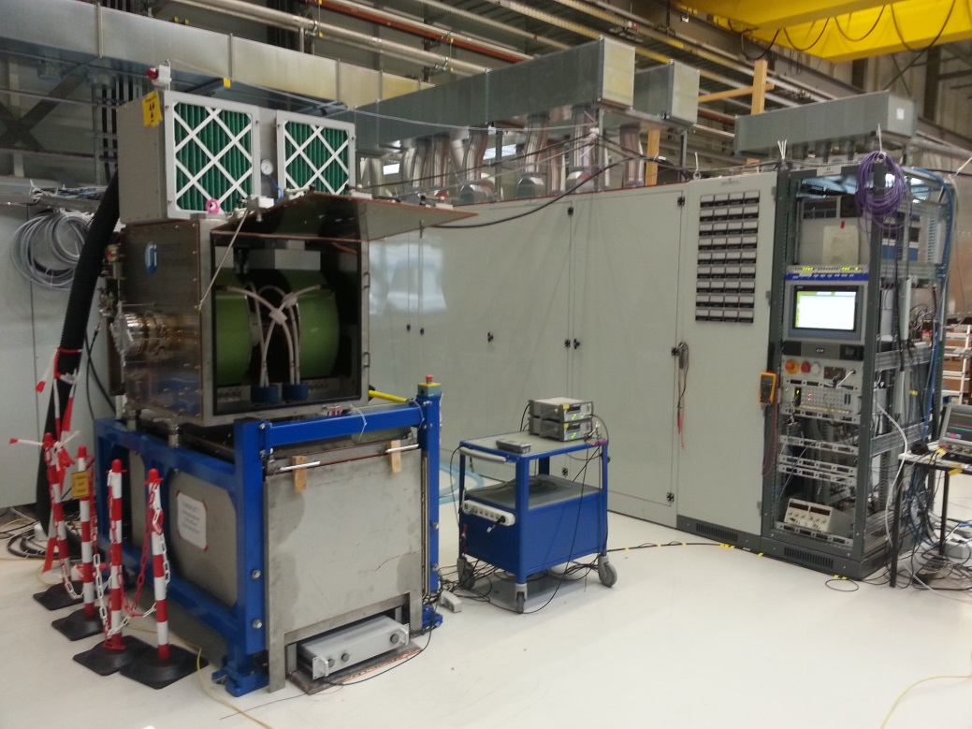
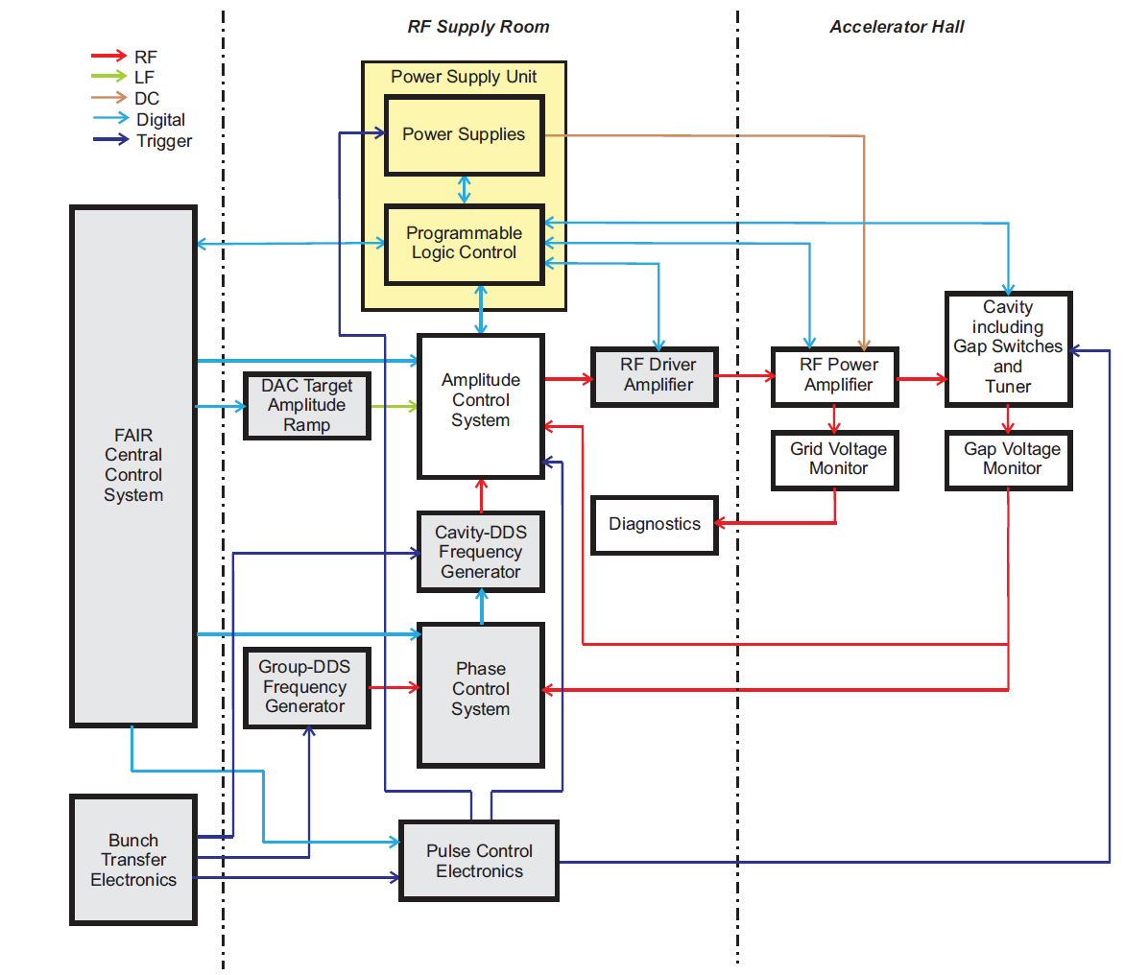
RF de-bunchers
Schematic RF pattern for antiprotons *
* not true to scale
Testing of interfaces for pulse, amplitude and phase control in operational environment.
Flexibility in manual setting and testing of the RF pattern implementation and timing sequences for the RF processes during commissioning and operation with beam.
Different operation modes (antiprotons, RIBs, stable ions) require specific settings and timing: system optimization and dry running of pre-defined RF cycles according to the planned operation modes (create sequencer tasks?).
Saving settings and archiving measured parameters.

Slide 9
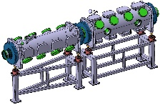
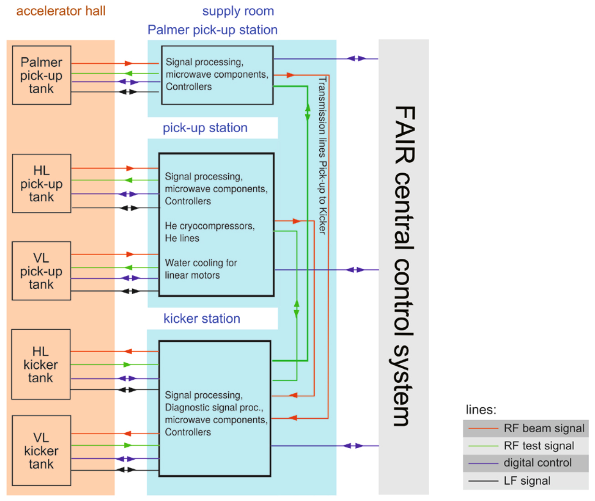
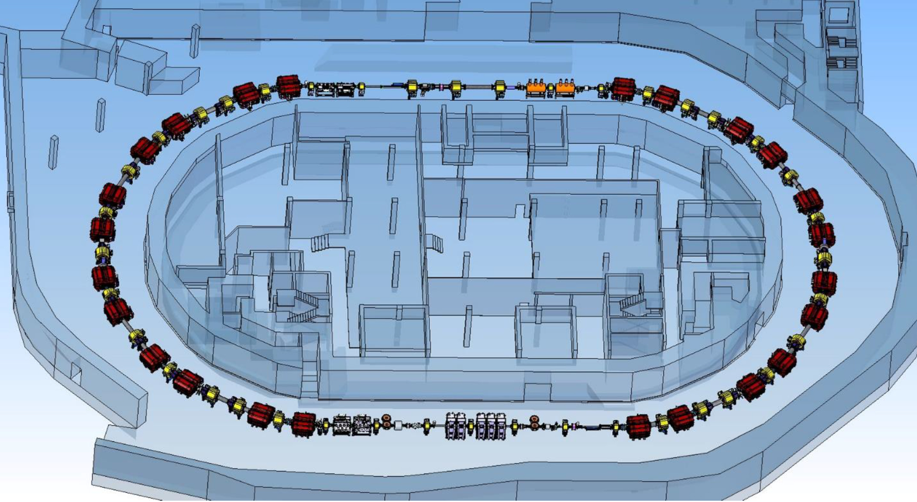
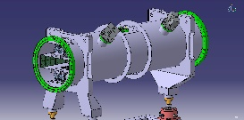
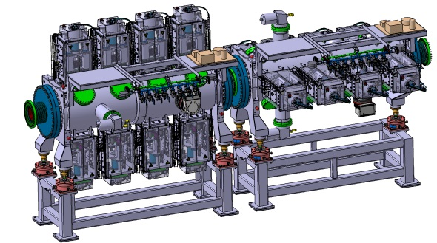
Stochastic cooling system
Kickers
Palmer Pick-Up
Local controls developed by technical expert group. Development of operational planned in collaboration with FZJ colleagues to be integrated into FAIR control system.
Implementation of different cooling methods depending on operation modes (antiprotons, RIBs, stable ions) require different sequences/cooling time/hardware need flexibility in setting up of the operation cycles/timing signals.
Interfaces for testing and tuning of movable linear motors of the cryo pick-ups within planned working cycles following shrinking beam during cooling.
Testing of controls for the cryocompressors, interlocks etc.
Slot-line double Pick-Up

Slide 10
Commissioning with beam
First stage - commissioning and tuning of the machine with proton beam (later with stable ions) from SIS18: commissioning with antiprotons and RIBs – later stage.
Multiple settings have to be prepared, pre-programmed and saved according to the commissioning stages/available beams.
Provide possibility for manual and/or automated control of individual equipment.
Dedicated timing sequences/dependencies and hardware synchronization between SIS18, pbar-separator, Super-FRS and beamlines according to the commissioning stages/operation modes.

Slide 11
Commissioning with beam – injection
Scintillation screen
Proton beam
TCR1
Injection septum magnet
BPM
Injection kicker
BPM
CR
Scintillation screen
Beam stopper
Control and optimization of key equipment section-by-section.
Collect and save equipment settings and measured data from the beam diagnostics devices.
Diagnostics in TCR1 channel: 6 BPMs and 3 scintillation screens to measure the transverse beam position and shape.
Diagnostics in CR injection region: 2 BPMs and 2 scintillation screens.
Beam stopper will be used for relative measurement of the beam current and for protection of the ring equipment.
Beam loss monitors might be used for beam loss detection at specific locations.

Slide 12
First turn stored beam
First turn – data from scintillation screens, BPMs and scrapers to monitor the beam position/profile.
Beam stoppers for terminating the beam and measurements of relative beam current.
Application of beam loss monitors for control of beam losses and estimation of beam position in combination with scrapers.
For commissioning with antiprotons additional collimation in the pbar-separator might be necessary, e.g. need to adjust and control the device settings and timing sequence.
Beam current measurements and evaluation of injection efficiency.
Stored beam – standard measurements of the main parameters:
orbit measurements, tuning and corrections,
tune and chromaticity measurements and corrections etc.
Longitudinal bunch profile measurements during the RF processes.
Measurements of transverse beam profile and momentum distribution during the stochastic cooling.
Data collection and saving for further analysis and visualization.
Proton beam

Slide 13
Outlook
Establish a more intense and regular communication with Controls department regarding interfaces to the control system and specific requirements for CR involving technical experts.
Preparation of detailed test procedures for equipment testing by technical expert groups.
Major part of the CR components including magnets, power converters, injection/extraction, beam diagnostics and vacuum will be produced and delivered by BINP (Novosibirsk). BINP colleagues would like to be involved into development of the control system interfaces for CR in order to prepare for testing and commissioning of equipment (writing FESA classes etc.) taking into account requirements of the FAIR control system.

Slide 14
Thank you!

