Slide 1
System Principles, Responsibilities, Installation and Commissioning of
IND Control Systems for FAIR

Slide 2
Introduction / Content
  Part 1: UNICOS and IND Control System Principles
  Part 2: Beamline Vacuum Control System
Part 3: Bake Out Control System
Part 4: Cryo Control System incl. Insulation Vacuum

Slide 3
P1: UNICOS and IND Control System Principles
  IND Control Systems are based on:
    Siemens SIMATIC S7 PLC‘s
    WinCC OA SCADA System running on CentOS LINUX server
    UNICOS framework from CERN, which provides automatic code generation for PLC and SCADA database
  Communication between SCADA server and PLC‘s via ACC network
  Communication between PLC‘s via completly isolated Ind. Ethernet
  SCADA HMI will be accessable from FCC as well as locally and from office machines
  Operation of vacuum gate valves and visualisation of the main pressure value of each section will be integrated into the GUI‘s of ACC control system
  Long term archiving will be available within the Controls Archive
  Short term archiving will be available within the WinCC OA SCADA

Slide 4
P1: System Architecture

Slide 5
P1: Timeline
Timeline

Slide 6
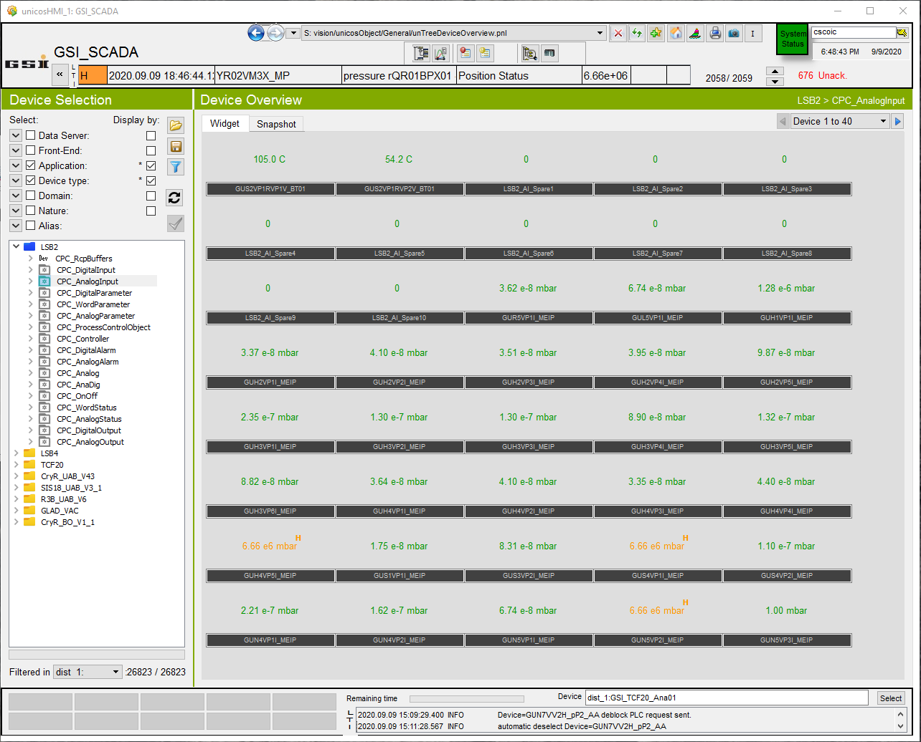
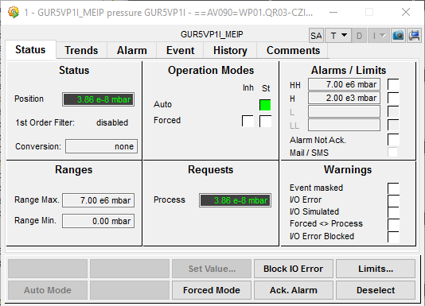
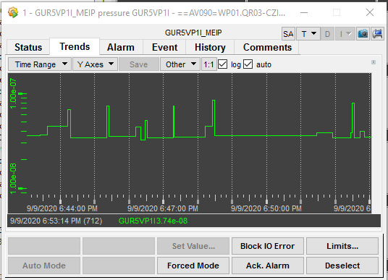
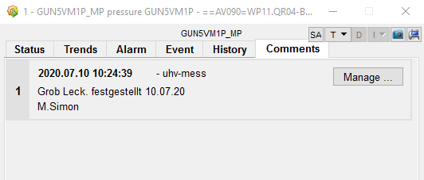
P1: Basic Look and Feel of UNICOS SCADA

Slide 7
P2: Beamline Vacuum Control System
  SW Development, electrical Cabinet Design and Manufacturing is Slovenian Inkind task, but based on the principles developped for Cryring and UNILAC vacuum systems
  FAT/SAT for cabinets PLC/Controller at factory, but under supervision of GSI
  GSI (VAC) has to provide Slovenian partners the complete information belonging the system structures, this includes the dedicated list of valves, gauges, pumps and related controllers and channels incl. all naming conventions, the actual deadline is Q2/2021
  Responsibility for installation of PLC cabinets and cable connections to the PLC cabinets, signal tests and commissioning of PLC has to be clarified and will probably be shifted from Cosylab -> GSI/IND
  Responsibility for installation/commissioning at the machine and towards the controller cabinets has GSI/VAC
  Installation and Test Support through temporarily hired skilled workers will be required
  Signal tests can be executed based on the commissioning SW version, which should be already fully functional for all known components
  Commissioning/parametrization of the controllers and the connected gauges or pumps will be already fully supported through the SW
  IND is presently not able to provide during/after commissioning 24h or on-call service

Slide 8
P2: Responsibilities and PSP-codes
 |  | Cabinet types
 | Task/Project description | Controller | PLC | Schütz-steuer-ungen | BO PLC | BO SSR Heater Cab. w. TB set | PLC com-ponents | Vacuum Controller devices | SW based on UNICOS and GSI specfile Generator | Instrumentation-list and UHV-Design | related SLO PSP codes | related VAC PSP codes | related IND/ACO PSP codes | Electro design based on GSI Macros and Generator
 | Beamline Vacuum FAIR (wo HESR) | GSI (VAC) | SLO (CSL/INEA) | GSI (VAC) | --- | --- | GSI (IND) | GSI (VAC) | SLO (CSL) | GSI (VAC) | 2.14.10.6.1-4 |  | 2.14.10.6.6 | SLO (CSL/INEA)
 | Beamline Vacuum HESR | GSI (IND) | GSI (IND) | GSI (VAC) | --- | --- | GSI (IND) | FZJ | GSI (IND) | FZJ | --- | --- | 2.14.10.6.6/2.14.10.6.9 | GSI (EPK)
 | Bake Out FAIR (wo HESR) | --- | --- | --- | GSI (VAC)? | GSI (VAC)? | FAIR (IND) | --- | SLO (CSL) | GSI (VAC) | 2.14.10.6.1-4 |  | 2.14.10.6.7/2.14.10.7 | FAIR (EPK)
 | mobile Bake Out HESR | --- | --- | --- | FZJ | FZJ | FZJ via FC GSI | --- | FZJ | FZJ | --- | --- | --- | FZJ
 | Insulation Vacuum SIS100, SFRS and DS | --- | FAIR (IND) | GSI (VAC) | --- | --- | FAIR (IND) | GSI (VAC) | FAIR (IND) | GSI (VAC) | --- |  | 2.14.10.6.10 | FAIR (EPK)
 | mobile pumping stations (wo HESR) | GSI (VAC) | --- | --- | --- | --- | GSI (IND) | GSI (VAC) | SLO (CSL) | GSI (VAC) | 2.14.10.6.1-4 |  | 2.14.10.6.6 | SLO (CSL/INEA)
 | mobile pumping stations HESR | FZJ | --- | --- | --- | --- | FZJ via FC GSI | FZJ | GSI (IND) | FZJ | --- | --- | 2.14.10.6.6 | FZJ
 |  | Legend:
 |  | --- | not relevant
 |  | GSI (VAC) | Vacuum group of GSI
 |  | FZJ | Forschungszentrum Jülich
 |  | FZJ via FC GSI | Forschungszentrum Jülich via GSI contract for Siemens components
 |  | SLO (CSL) | Slovenien Inkind (Cosylab)
 |  | SLO (CSL/INEA) | Slovenien Inkind (Cosylab and INEA)
 |  | GSI (IND) | IND group of GSI
 |  | FAIR (IND) | IND group of GSI, but FAIR money from CB8
 |  | GSI (EPK) | EPK group of GSI
 |  | FAIR (EPK) | EPK group of GSI, but FAIR money from CB8
 |  |  | Need for clarification Finances
 |  |  | Need for clarification Technical solution and responsibilities

Slide 9
P2: Timeline
Timeline

Slide 10
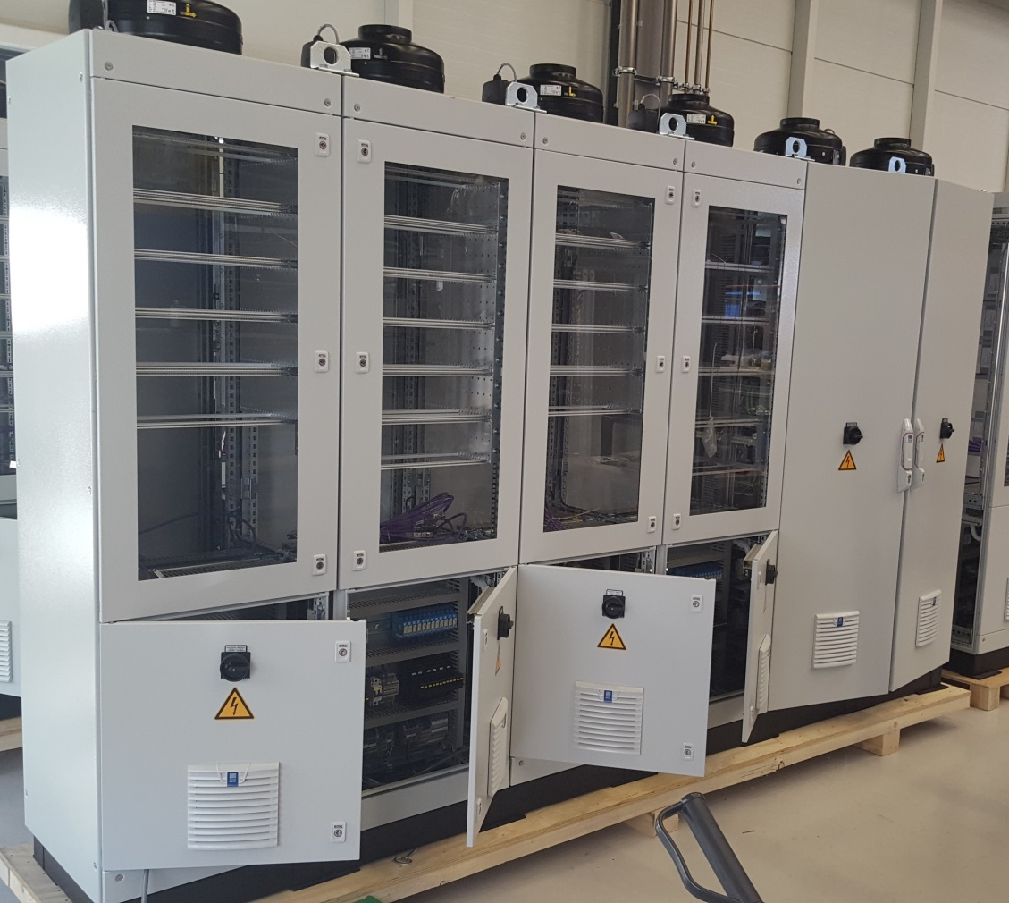
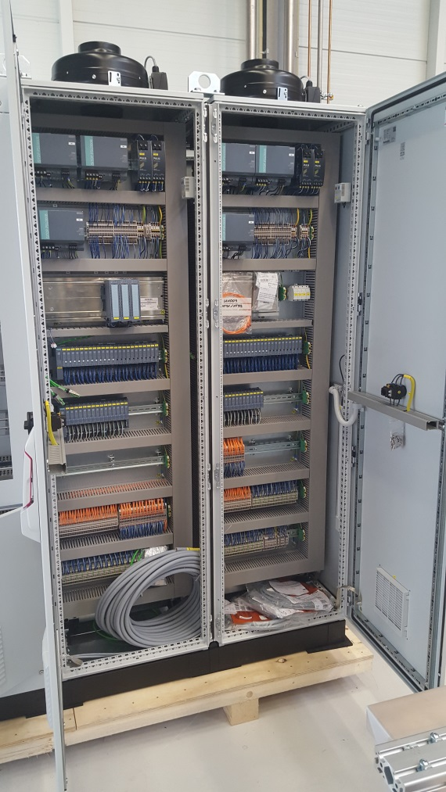
Controller Cabinets for Vacuum Control System (example from UNILAC)
P2: Cabinet Design
Controls Cabinets
(for PLC components) (UH001/UH002)
Controller Cabinets (UH011-UH22)

Slide 11
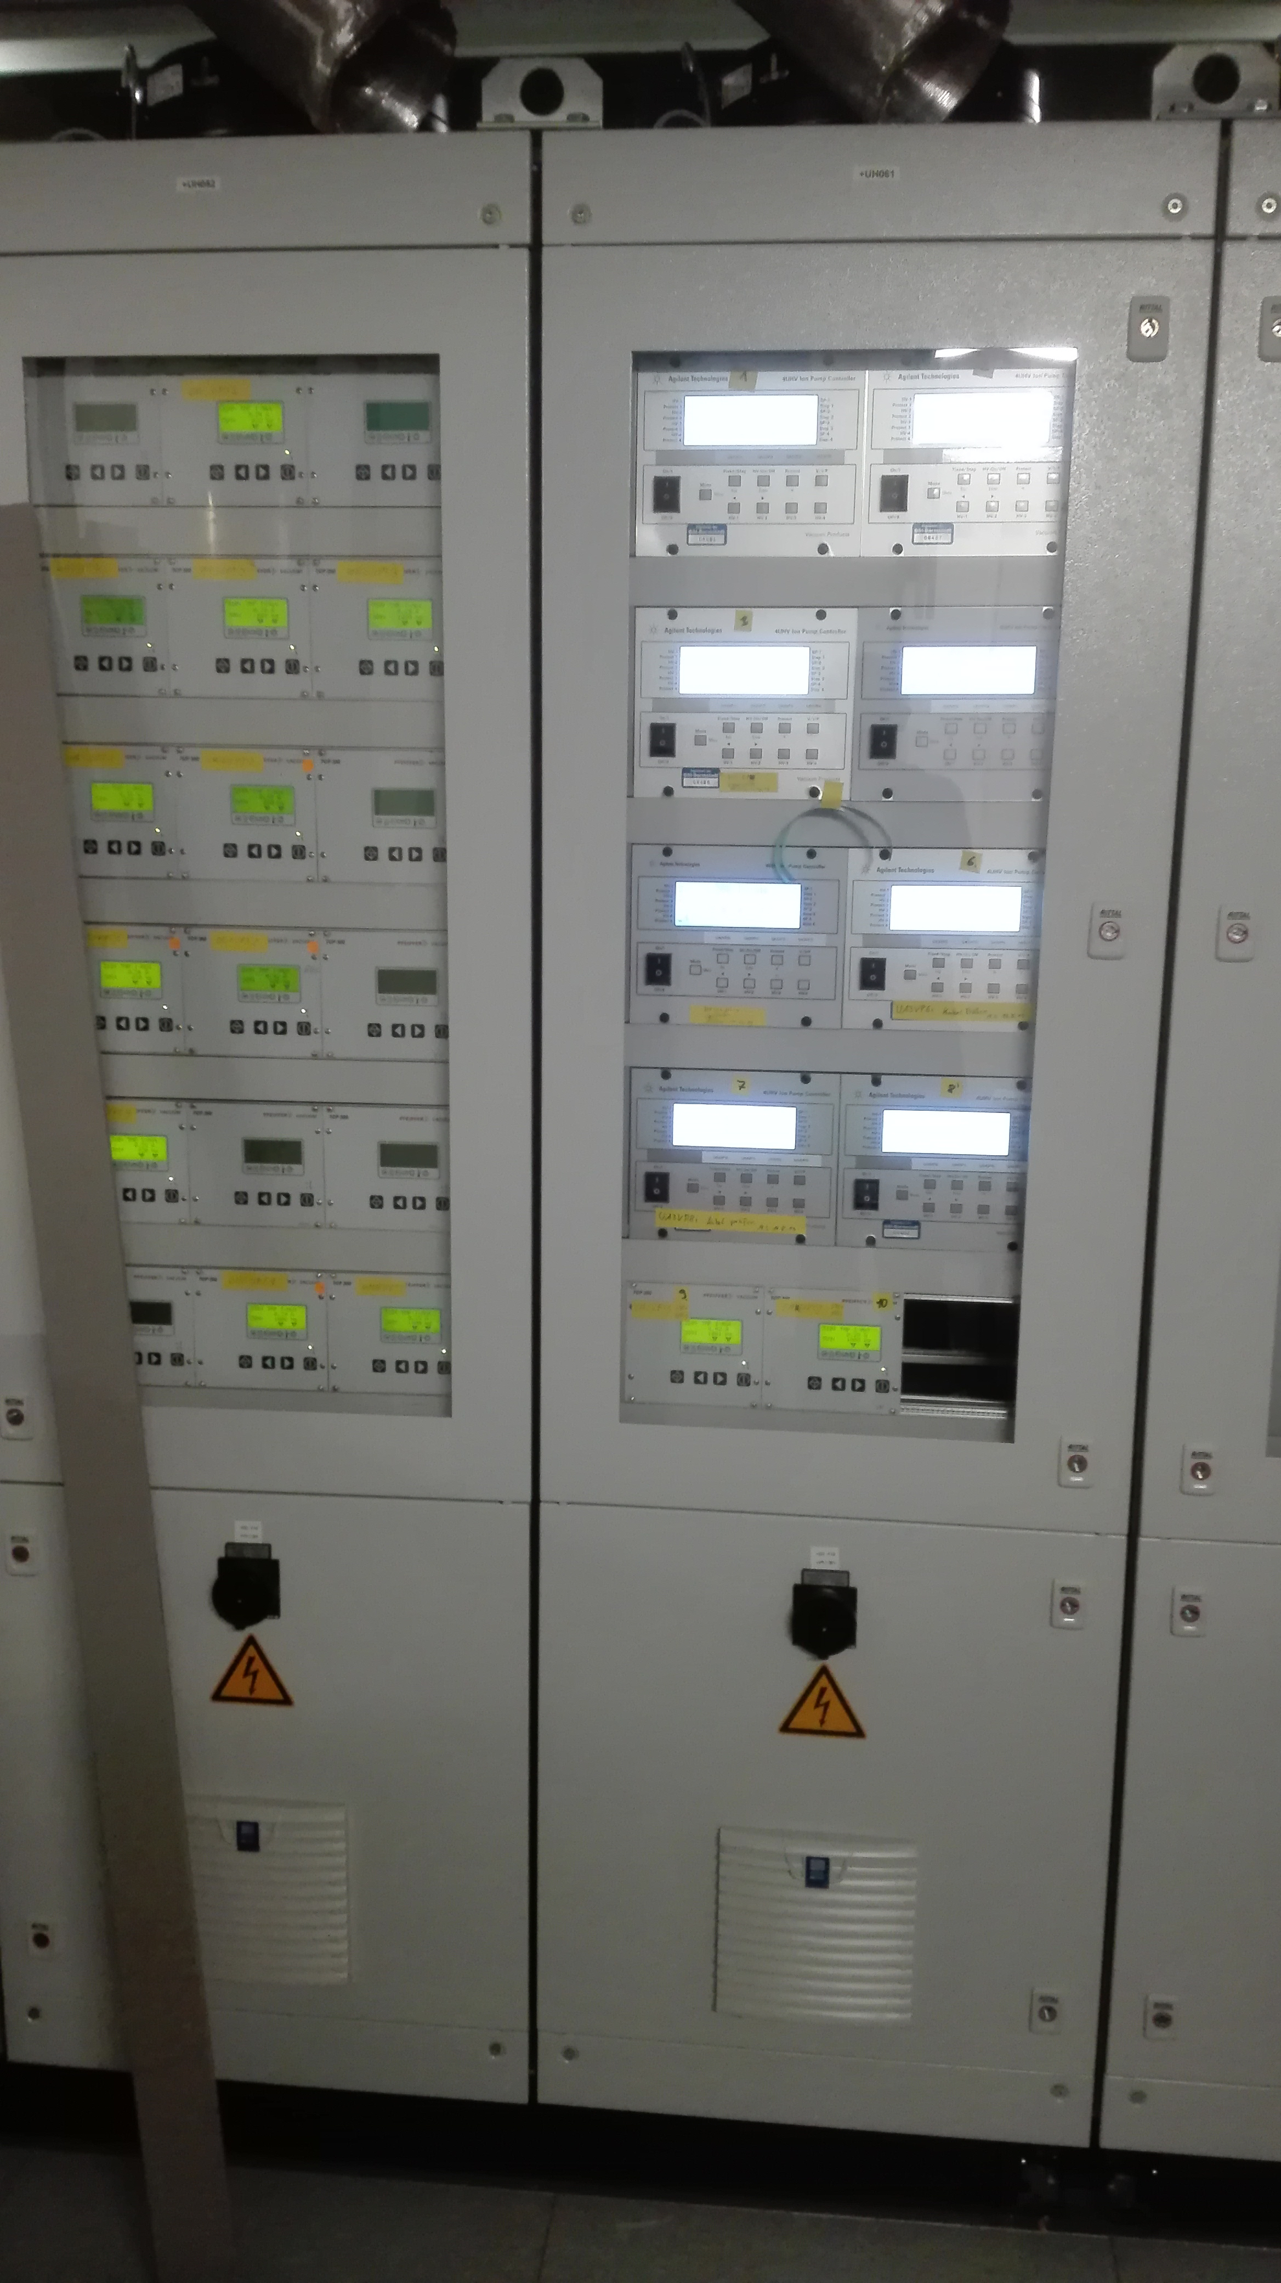
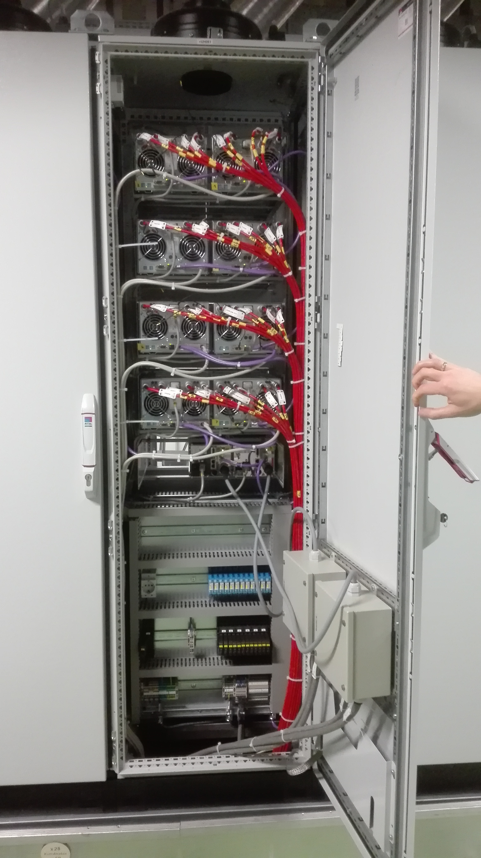
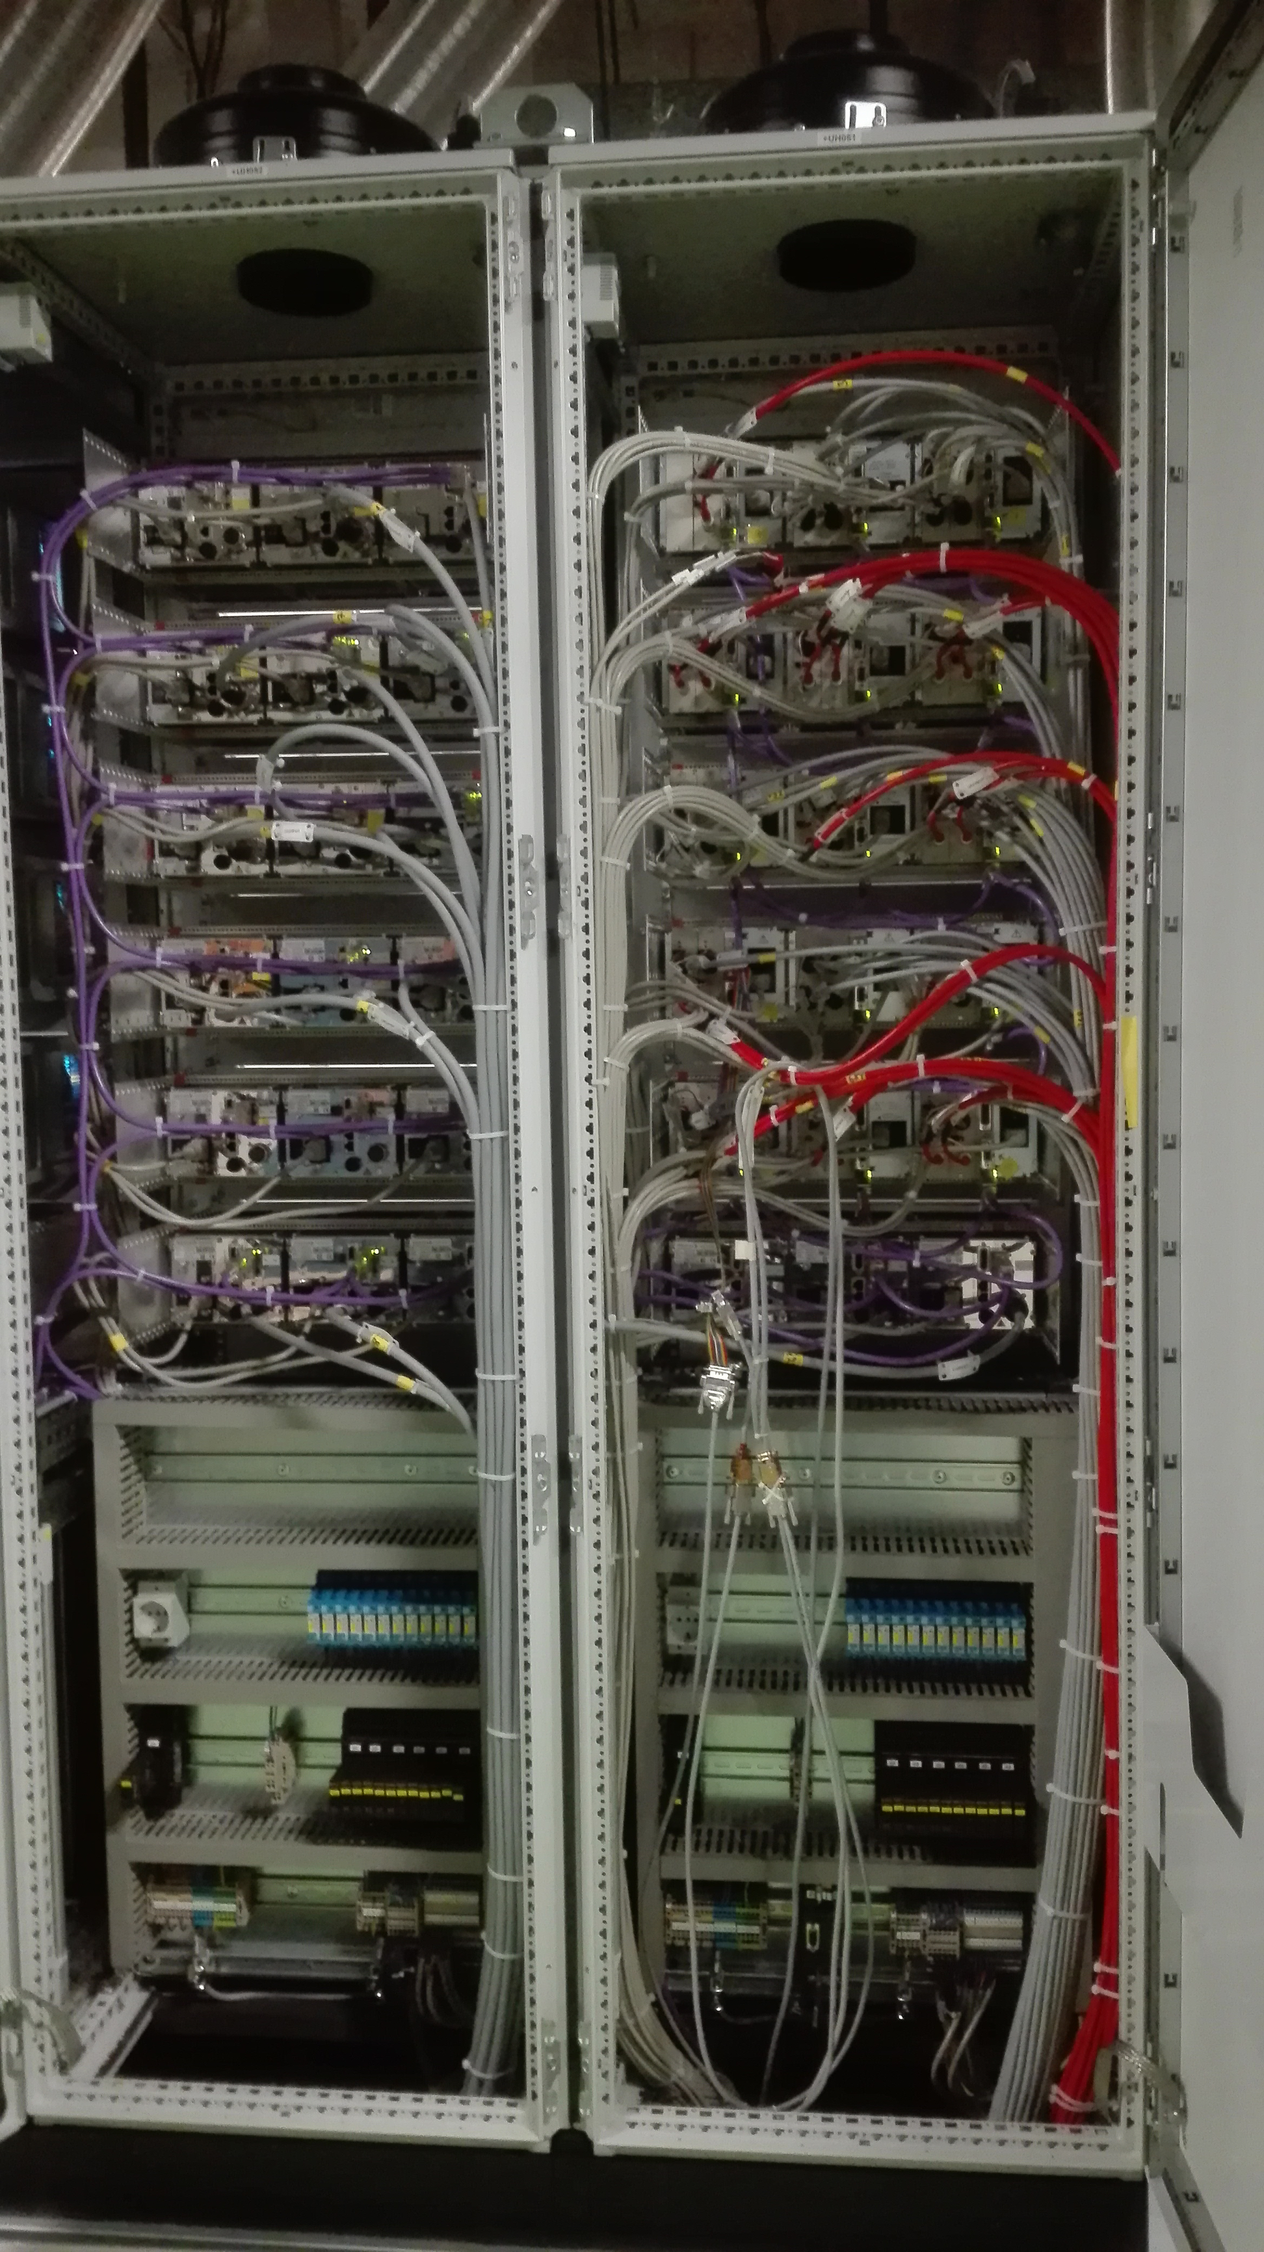
Controller Cabinets for Vacuum Control System (example from UNILAC)
P2: Cabinet Design
Controller Cabinets (UH011-UH22)

Slide 12
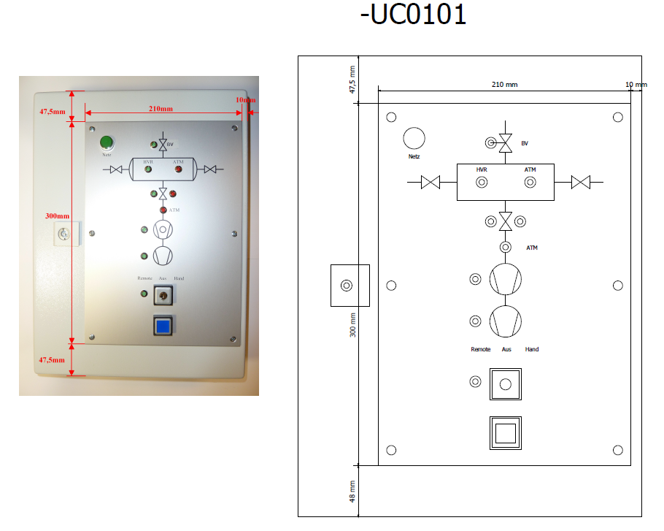
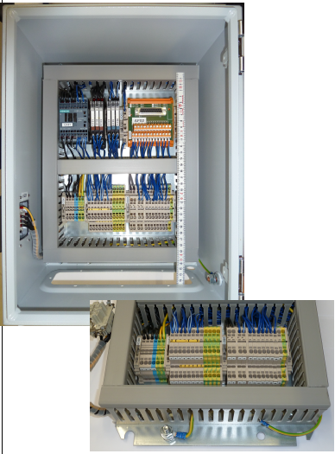
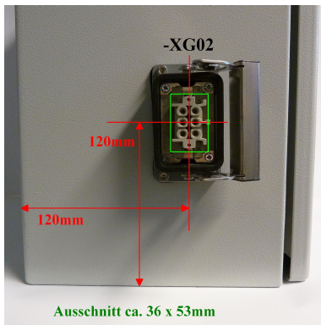
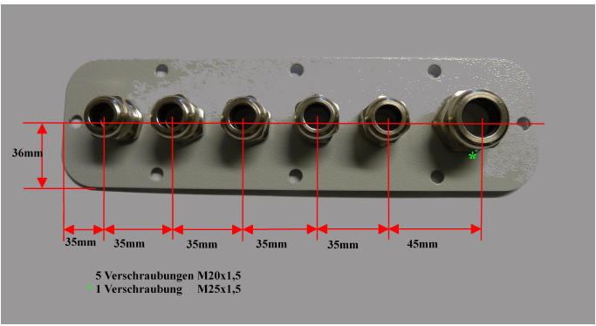
Stationary Pumping Stations SFRS (example from UNILAC)
P2: stationary pumping stations

Slide 13
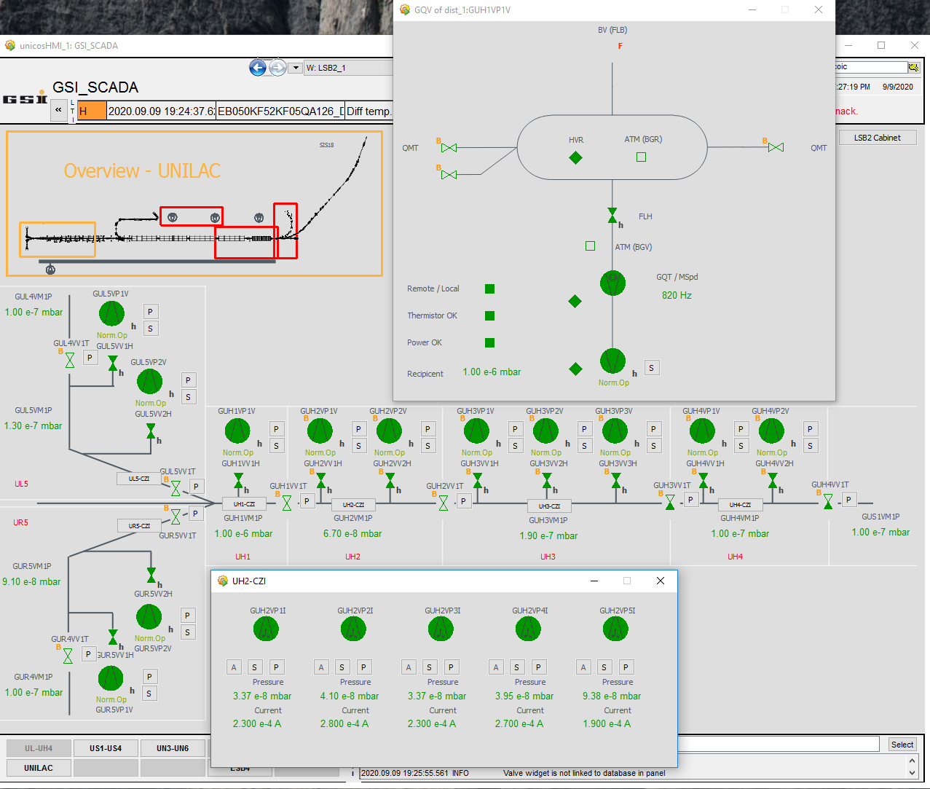
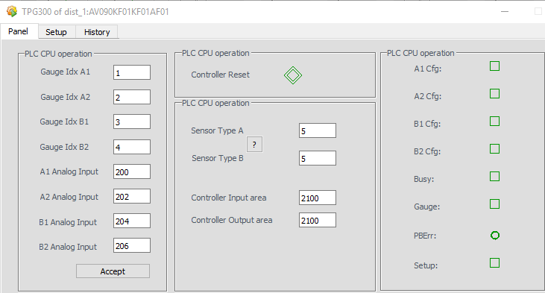
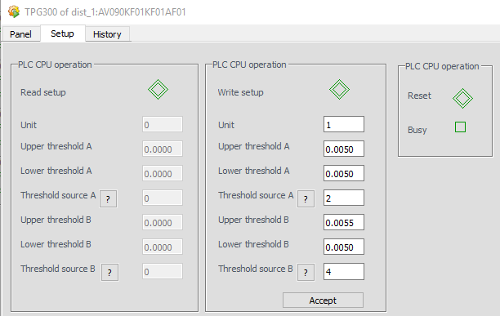
P2: Look and Feel of Vacuum Systems

Slide 14
P3: Bake Out Control System
  SW Development is Slovenian Inkind task, but based on the principles developped for Cryring, for HESR it will be provided through FZJ
  Electrical Cabinet Design and Manufacturing is GSI Inkind (for HESR FZJ) task, will be based on the principles developped for Cryring and HESR (ongoing as mobile solution)
  FAT/SAT for cabinets PLC/Controller at factory, but under supervision of GSI/FZJ
  GSI (VAC) has to provide Slovenian partners the complete information belonging the system structures, this includes the dedicated amount of heating channels, the actual deadline is Q2/2021
  Responsibility for installation of SIS100/HEBT PLC cabinets and cable connections to the PLC cabinets, signal tests and commissioning of PLC has GSI/IND, for HESR no PLC cabinet installation required
  Responsibility for installation/commisioning at the machine has GSI/VAC
  Installation and Test Support through temporarily hired skilled workers will be required
  Signal tests can be executed based on the commissioning SW version, which should be already fully functional
  Commissioning/parametrization of the PID controllers will be already fully supported through the SW via autotuning and recipes
  IND is presently not able to provide during/after commissioning 24h or on-call service
  FCC solution for acoustic alarm is required

Slide 15
P3: Timeline
Timeline

Slide 16
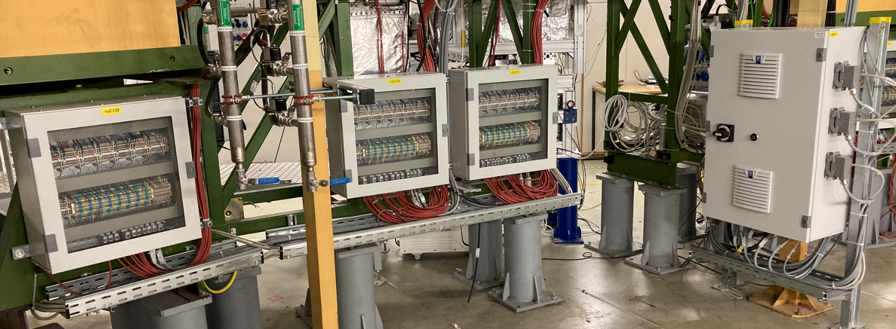
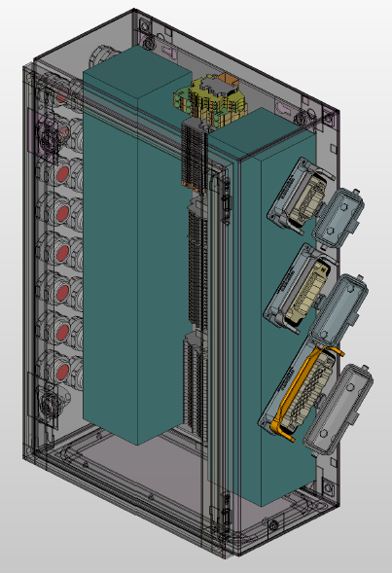
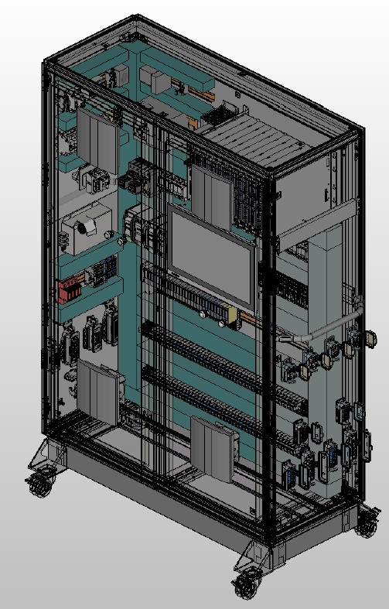
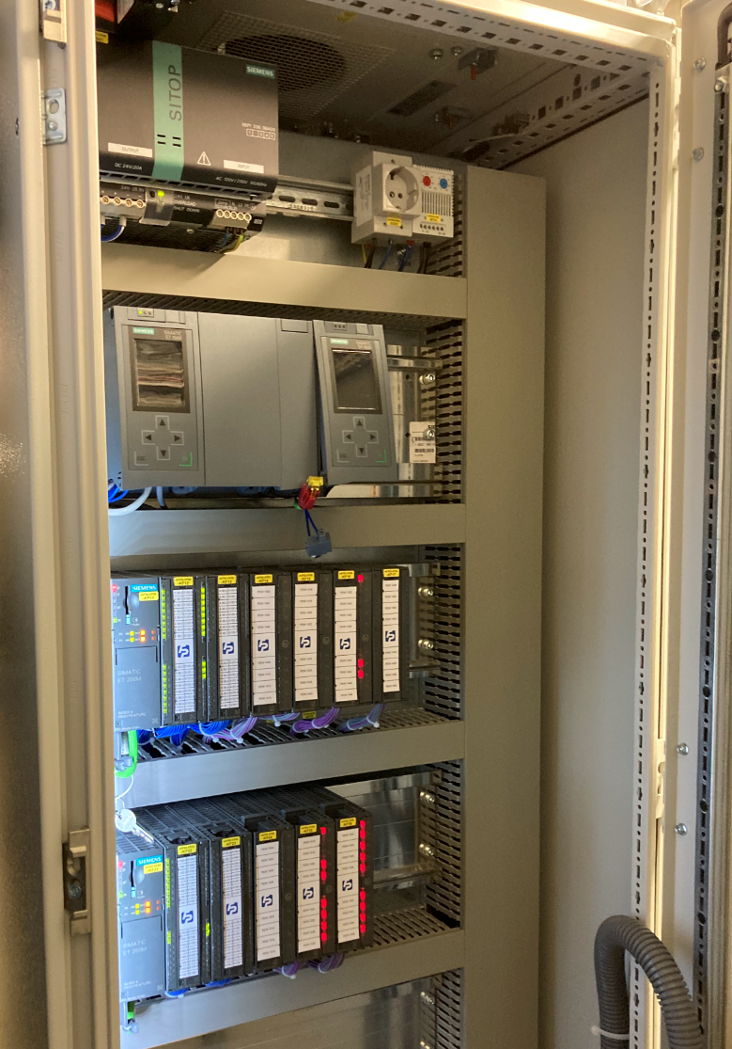
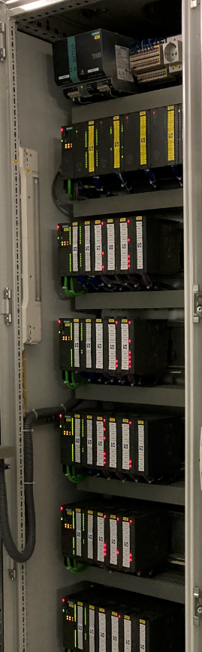
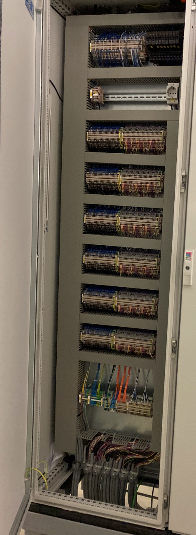
P3: Cabinet Design

Slide 17
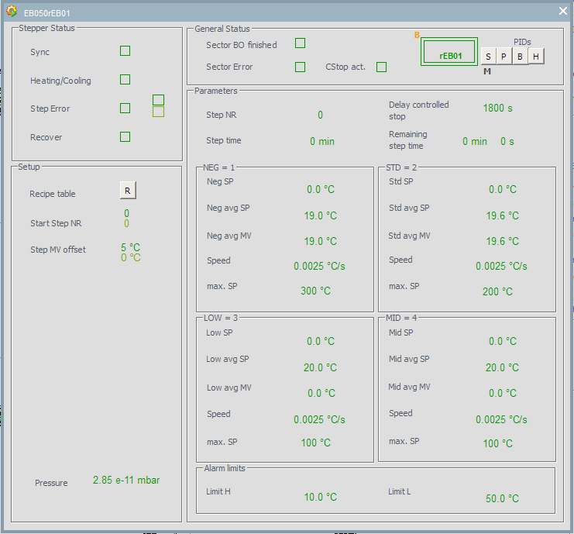
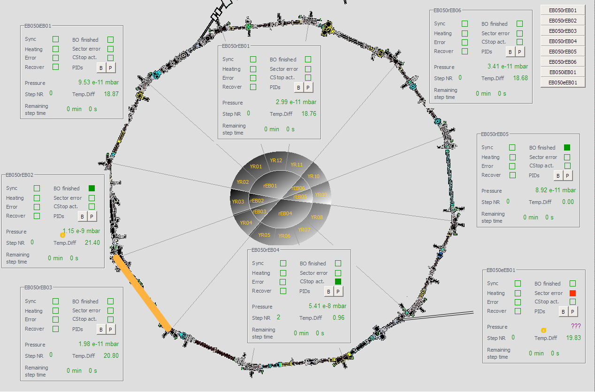
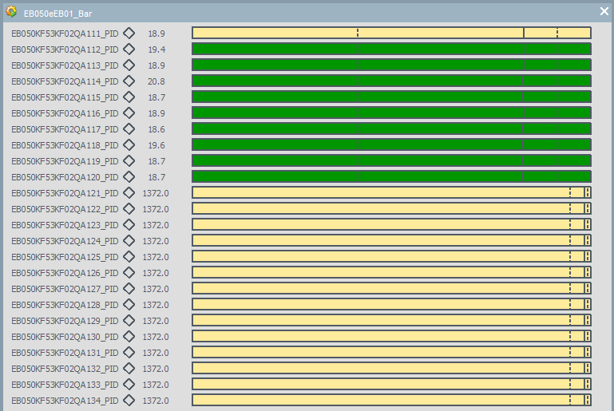
P3: Look and Feel of Bake Out Systems

Slide 18
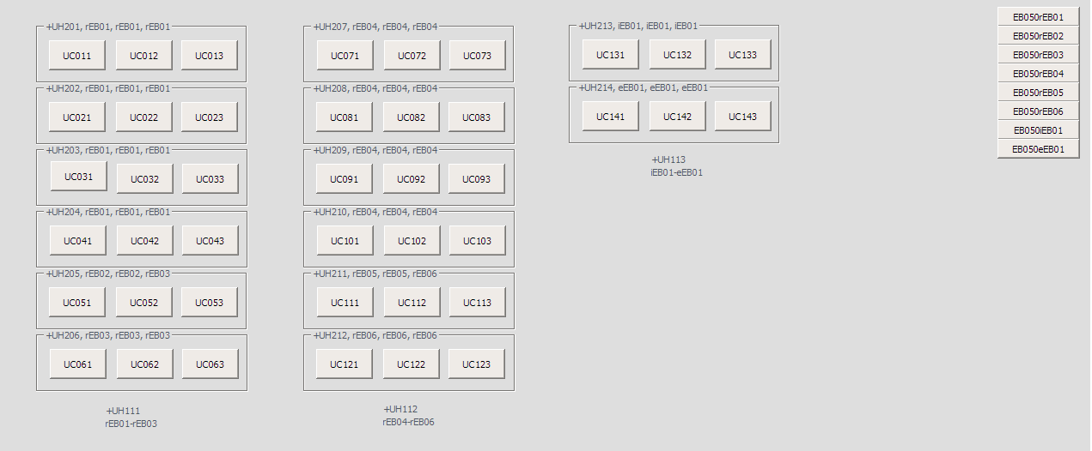
P3: Look and Feel of Bake Out Systems

Slide 19
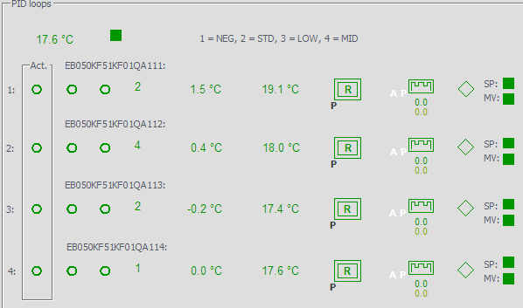
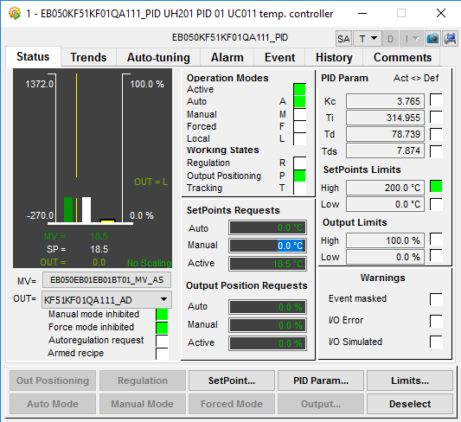
P3: Look and Feel of Bake Out Systems

Slide 20
P4: Cryo Control System incl. Insulation Vacuum
  SW development for Distribution System, CBM Feedbox and SIS100/SFRS local cryogenics is IND task
  Electrical Cabinet Design and Manufacturing is GSI Inkind task, will be based on the principles developped for SFRS CERN magnet testing
  FAT/SAT for cabinets PLC/Controller at factory, but under supervision of GSI
  GSI (CRY/SCM) has to provide IND the complete information belonging the system structures, this includes the complete P&ID, the instrumentation lists and the functional analysis, the actual deadline for SIS100/DS is Q1/2021 and for SFRS unknown because of delay in Polish Inkind
  GSI (VAC) has to provide IND the complete information belonging the insulation vacuum pumpstations, this includes the dedicated list of valves, gauges, pumps and related controllers and channels incl. all naming conventions
  Responsibility for installation of cabinets and cable connections to the PLC cabinets, signal tests and commissioning has GSI/IND
  Responsibility for installation/commissioning at the machine has GSI/CRY or GSI/SCM or GSI/VAC

Slide 21
P4: Cryo Control System incl. Insulation Vacuum
  Installation and Test Support through temporarily hired skilled workers will be required
  Signal tests can be executed based on the commissioning SW version, which includes the functionality for complete temperature read-out and manual mode operation of all valves and heaters and insulation vacuum pumping stations
  Automatic mode SW will be prepared, which means logical structure with the intended operating modes and the necessary stepper chains as functional framework
  Commissioning/parametrization of the PID controllers will be already fully supported through the SW via autotuning and recipes
  IND is presently not able to provide during/after commissioning 24h or on-call service

Slide 22
P4: Timeline
Timeline

Slide 23
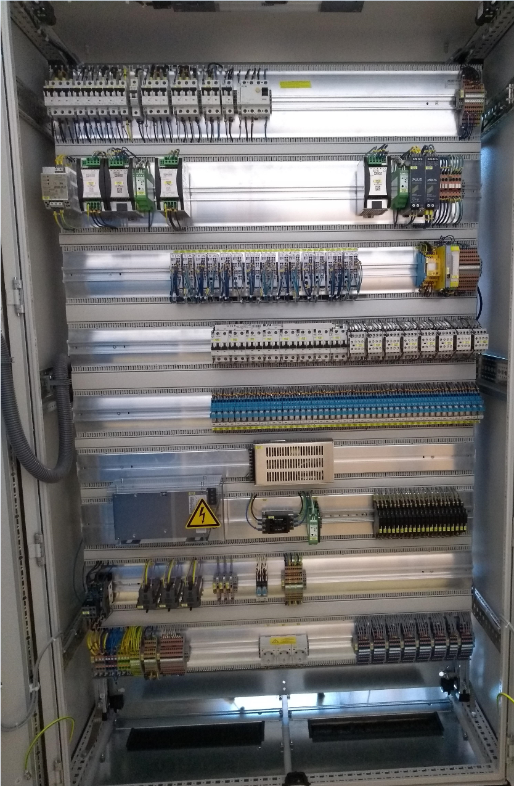
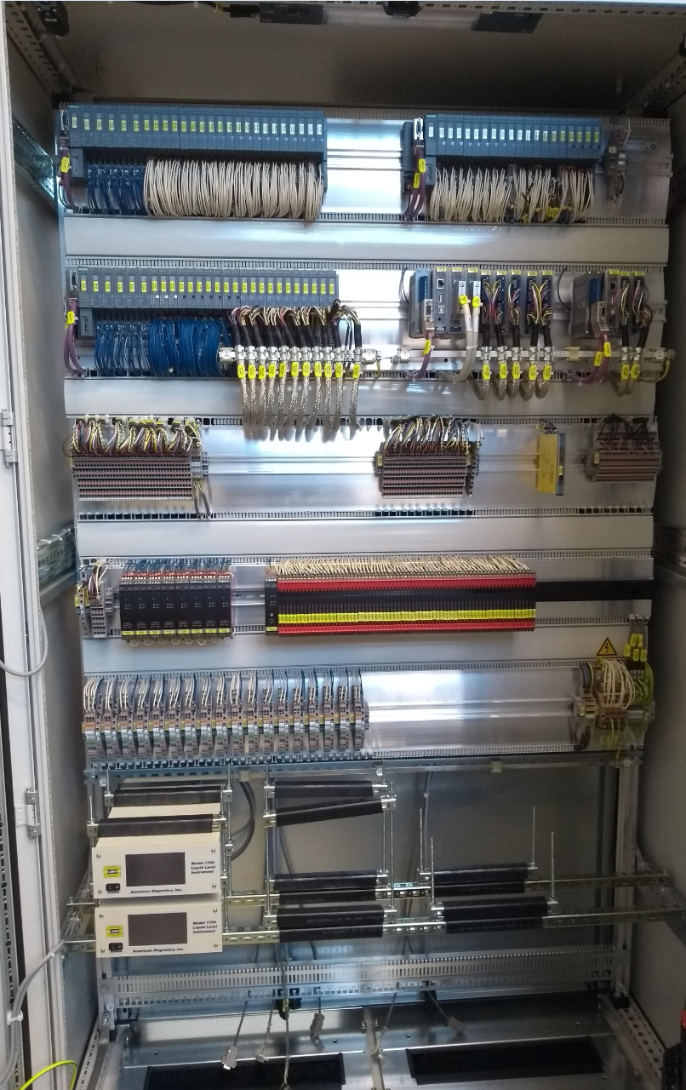
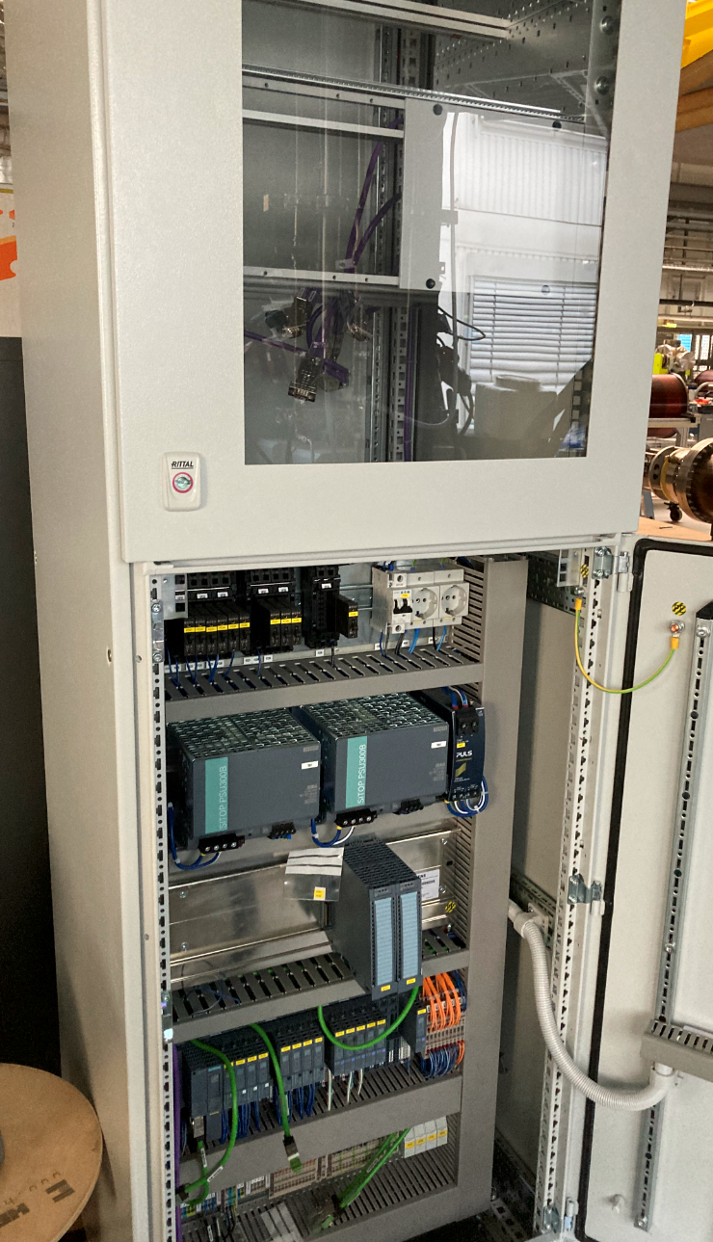
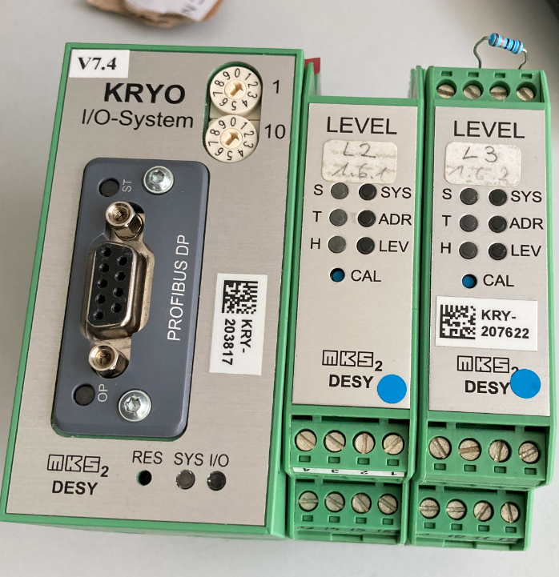
P4: Cabinet Design

Slide 24
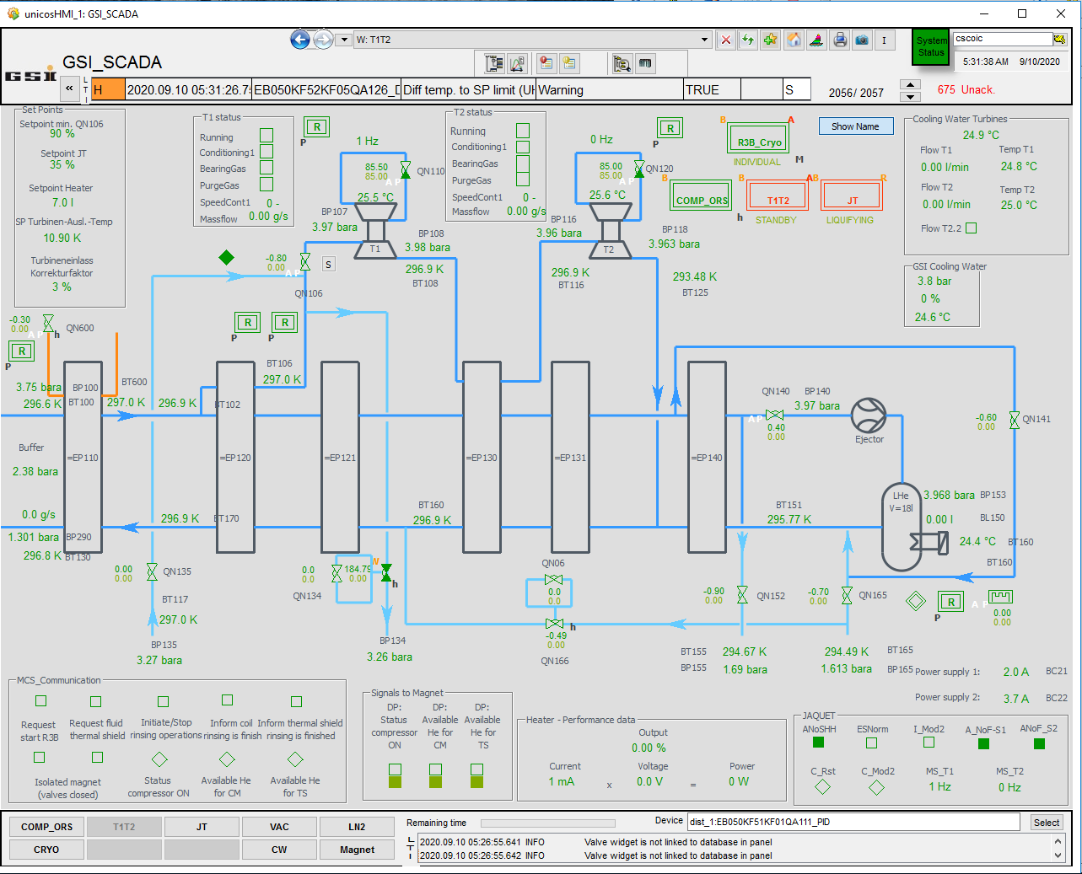
P4: Look and Feel of Cryo Systems

Slide 25
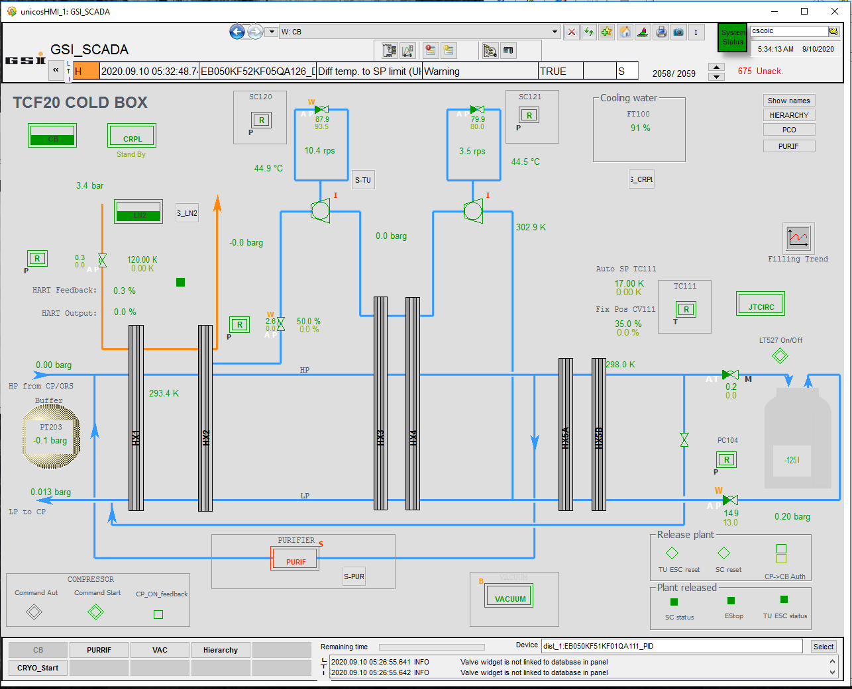
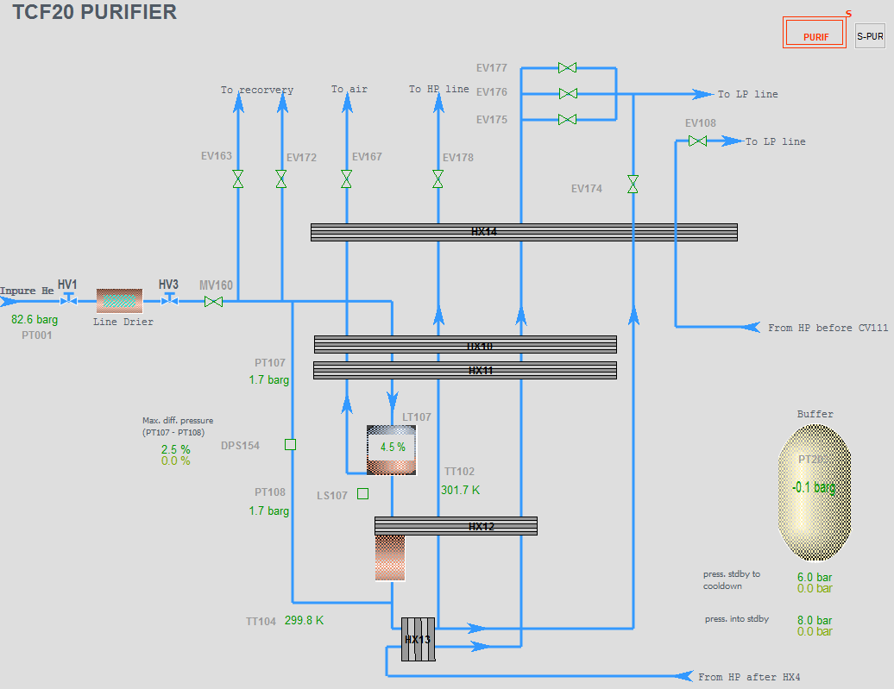
P4: Look and Feel of Cryo Systems

Slide 26
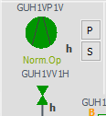
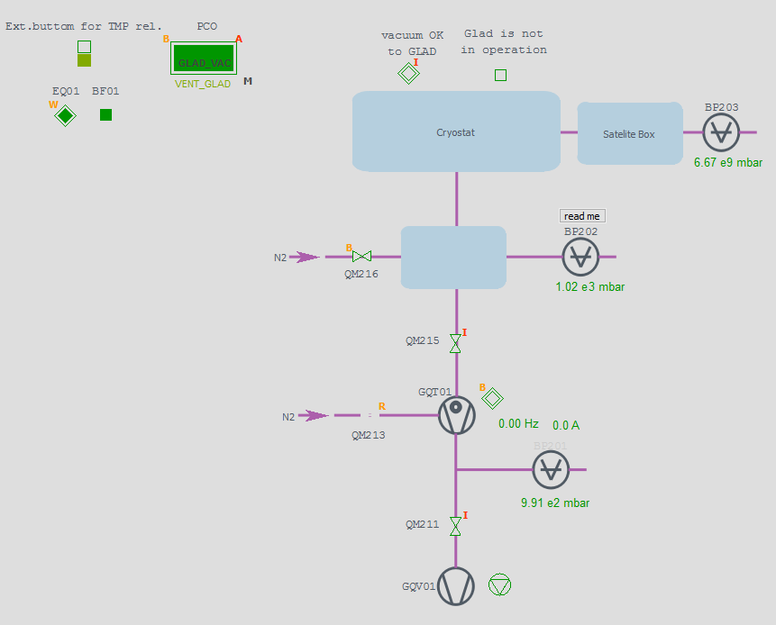
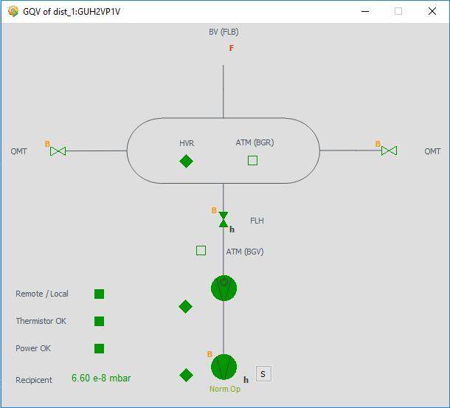
P4: Look and Feel of Insulation Vacuum

Slide 27
Thank you

