Slide 1
Experience from LHC Hardware-Commissioning (HWC)
K. Fuchsberger

Slide 2
Introductory Remarks
Thanks to M. Zerlauth, R. Schmidt, M. Solfaroli Camillocci and M. Pojer for providing material and ideas!
Copyright CERN for all pictures and Schematics/Graphics in this presentation.
Several screenshots were done by myself (K. Fuchsberger), as I was for a long period part of the team, developing and improving several concepts and tools mentioned in this presentation (e.g. AccTesting, eDSL)

Slide 3
Content
Introduction: The LHC Circuits
Key Approaches/Tools for HWC
Summary

Slide 4
Introduction
... The LHC Circuits

Slide 5
The LHC
27 km Ring
2 Beams

Slide 6
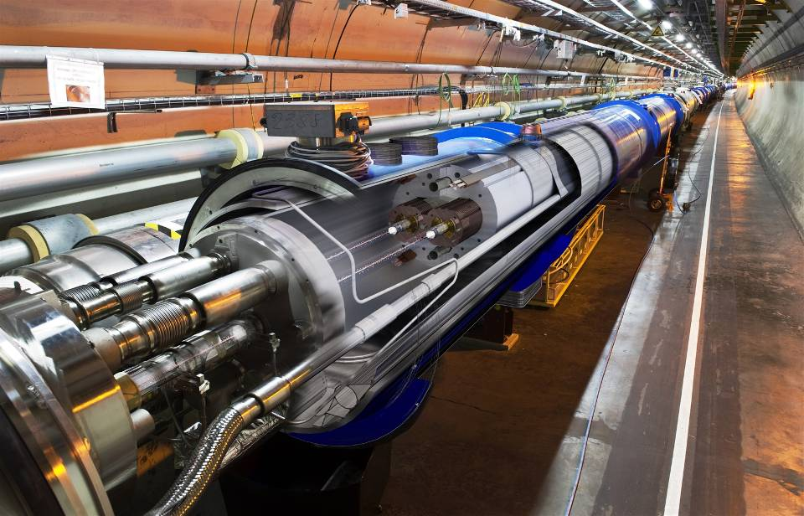
LHC magnets inventory
More than 10.000 superconducting magnets of 50 different types, e.g.:
  1232 main dipoles
  (powered in series)
  752 orbit corrector magnets
  (powered individually)
  392 Main Quadrupole magnets
  (powered in series)
  Triplets at Interaction points, correctors, ...
→In total 1618 Electrical Circuits
→ 9 Circuit types, depending on:
  Stored Energy, Risks
  Protection Elements (for magnets, busbars and current leads)
Examples:
  Individual orbit corrector: 60 A, 9 kJ
  154 mains (series): 12 kA, 1.2 GJ
Notes:
6

Slide 7
Exemplary Circuit: Main dipoles in arc cryostat
Time for the energy ramp is about 20-30 min (Energy from the grid)
Time for regular discharge is about the same (Energy back to the grid)
DFB
Magnet 2
Magnet 4
Magnet 152
Magnet 154
DFB
Magnet 1
Magnet 3
Magnet 5
Magnet 153
Energy Extraction: switch closed
Energy Extraction: switch closed
Courtesy: R. Schmidt
Power Converter

Slide 8
Main dipoles: quench of a magnet
Quench in one magnet: Resistance and voltage drop across quenched zone
Quench is detected: Voltage across magnet exceeds 100 mV for >10 ms
DFB
Magnet 2
Magnet 4
Magnet 152
Magnet 154
DFB
Magnet 1
Magnet 3
Magnet 5
Magnet 153
Energy Extraction: switch closed
Energy Extraction: switch closed
Quench
Detector
Power Converter

Slide 9
Main dipoles: magnet protection
Quench heaters warm up the entire magnet coil: energy stored in magnet dissipated inside the magnet (time constant of 200 ms)
Diode in parallel becomes conducting: current of other magnets through diode
Resistance is switched into the circuit: energy of 153 magnets is dissipated into the resistance (time constant of 100 s for main dipole magnets)
DFB
Magnet 2
Magnet 4
Magnet 152
Magnet 154
DFB
Magnet 1
Magnet 3
Magnet 5
Magnet 153
Energy Extraction: switch open
Energy Extraction: switch open
Quench
Detector
Quench
Heater PS
Power Converter

Slide 10
Conditions for powering
Cryogenics: correct conditions
1.9K, 4.5K, other conditions
Safety systems ready (Emergency Stop Switches, UPS)
Power converter ready
Magnet protection system ready
Power converters
Operator / Controls: must give permission to start powering
Powering Interlock Controller (PIC)
Energy extraction
Beam Interlocks
Quench in a magnet inside the electrical circuit
Warming up of the magnet due to quench in an adjacent magnet
Warming up of the magnet due to failure in the cryogenic system
Emergency Switch or UPS fault
Power converter failure

Slide 11
Summary: LHC HWC Challenges
1618 Superconducting Magnet Systems (!!!):
→ „Integration Testing“ (in the real environment)
Magnet + Power Converter + QPS + EE + ...
~ 7000 individual Tests in total
Magnets performance
Protection functionalities
To be reproducibly repeated each year after Christmas Shutdown and/or whenever a sector is warmed up.

Slide 12
Key Approaches/Tools for LHC HWC
... It‘s been a long road ...

Slide 13
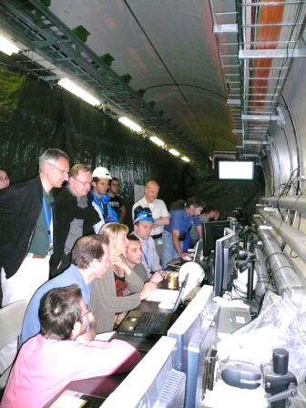
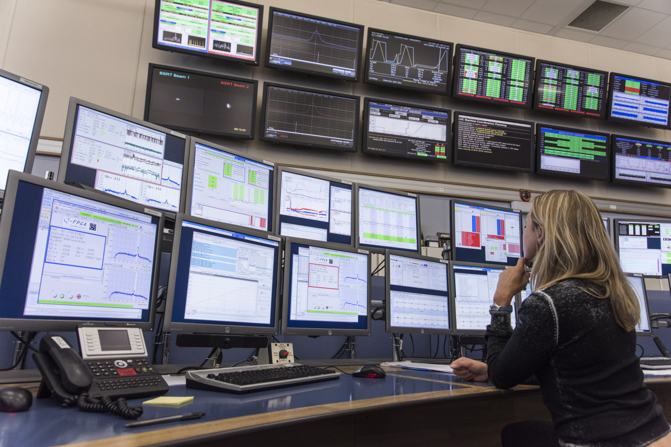
... getting from there to here ...
24th April 2007
Start of LHC S/C circuits commissioning
Initial plan: HWC in the tunnel (close to the electronics).
Soon decided, that this is not necessary (System built to be remotely controlled ;-), and not super-comfortable ...

Slide 14
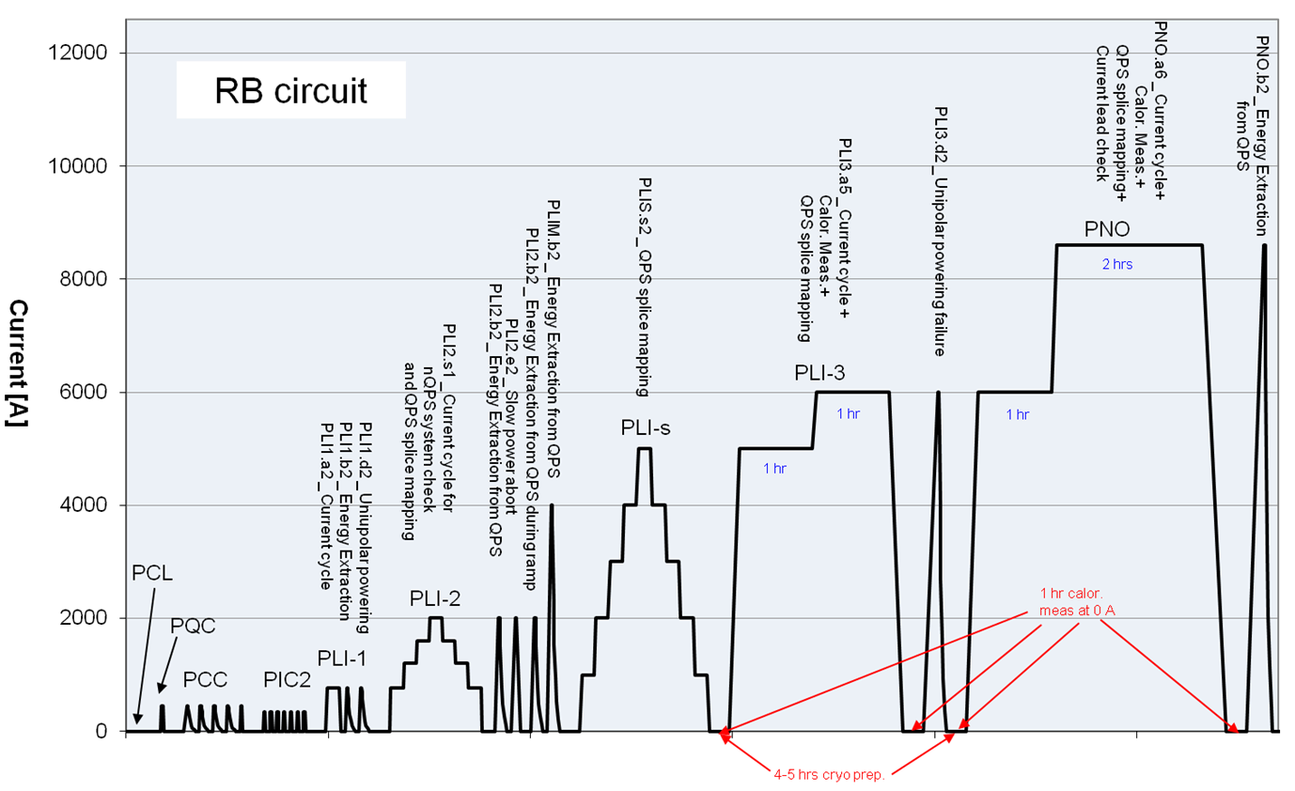
0) How to test? → Test Procedures
Textual step by step Guide for particular circuit type + Guide to Analysis
Contains Parameter for the tests (might change from campaign to campaign), potentially per circuit
Maintained and updated before every campaign. Still today the ‚only source of truth‘
Nominal current
Low Current
Intermediate Current
Splice
Measurements
Power Converter
Setup
Interlock
tests
→ Reference / Only source of truth
Example Procedure: 600A Circuit (Courtesy: CERN)

Slide 15
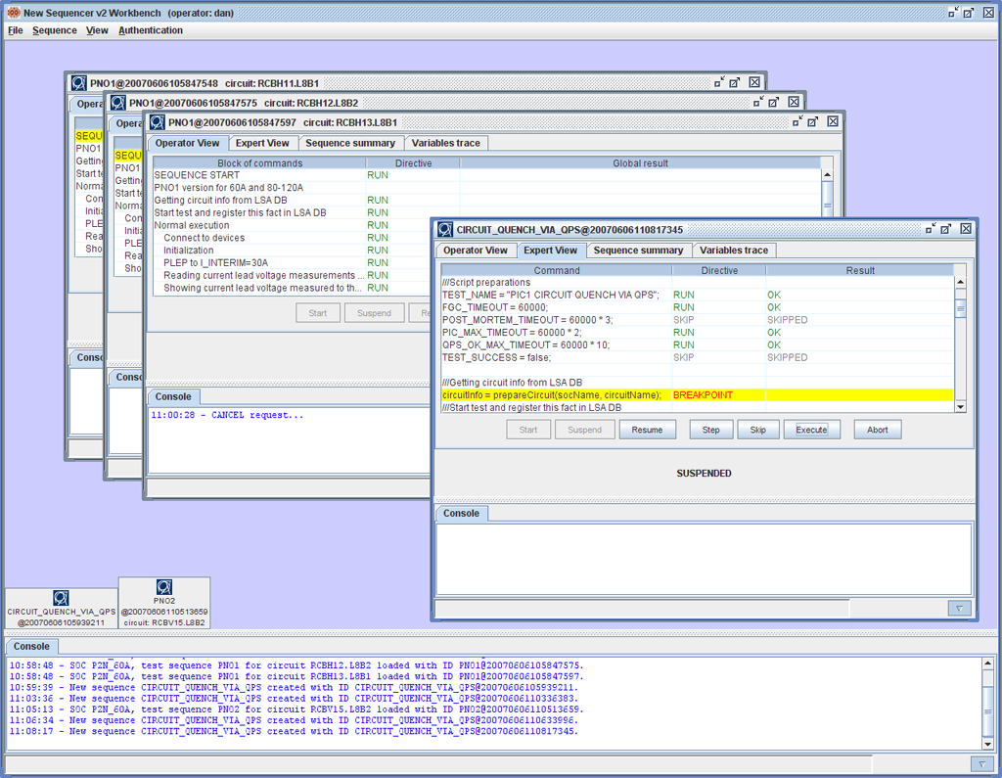
1) Efficient Execution → HWC Sequencer
Kind of ‚scripting‘ of repetitive tasks → „Sequences“.
Possibility to step through the Tests
Different modes:
  Strict (fails the full test on any problem)
  „Expert“ mode (e.g. Failed tasks can be retried)
→ Very similar Concept already almost ready at GSI.
→ See presentation of S. Krepp

Slide 16
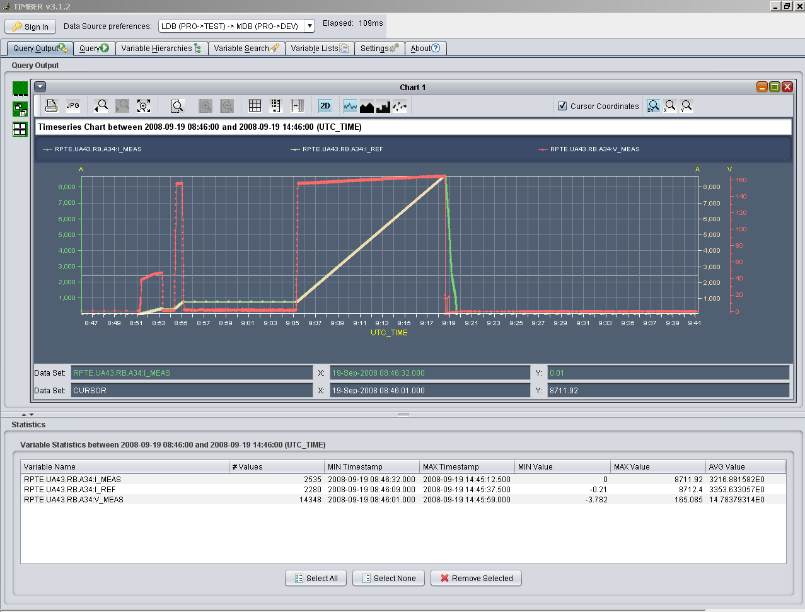
2) Knowing what happened → Signal Data
(Powering) Post Mortem System:
  Event driven (e.g. Triggered by power aborts)
Logging Database (CALS):
  Logged continuously
  Lower resolution; (potental) data reduction.

Slide 17
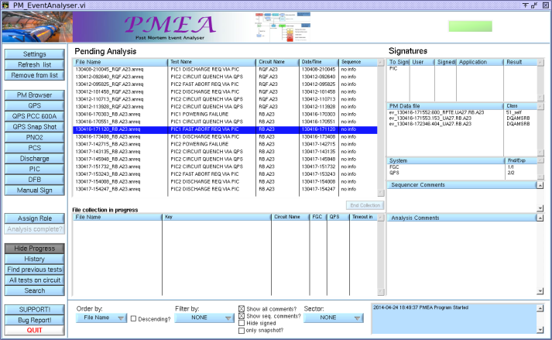
3) Test Analysis
Some ideas in the beginning that sequencer could also do (some) verification → Proofed to be difficult (e.g. Long time until data arrives, Complexity of Analysis)
→ Analysis was kept separate from Execution
Analysis in the beginning done manually (PMEA – LabView tools)
More and more automation over time:
  Semi-Automation (e.g. Pulling data together and visualizing appropriate for the specific Test)
  Some fully automated Test modules in LabView

Slide 18
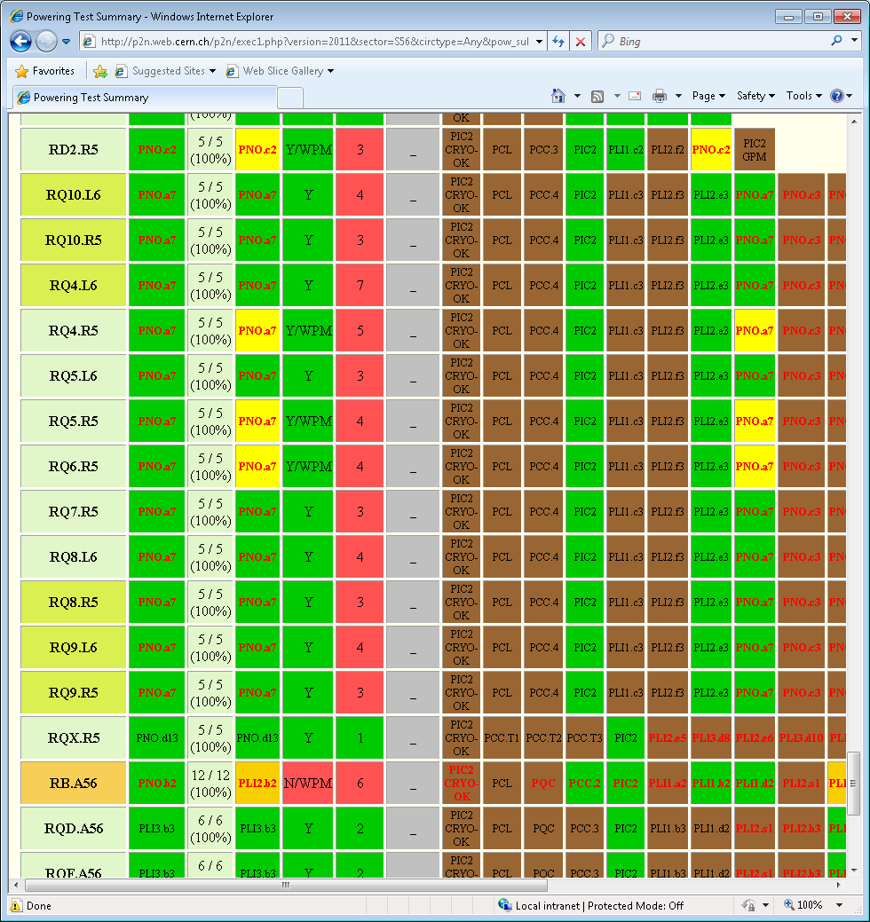
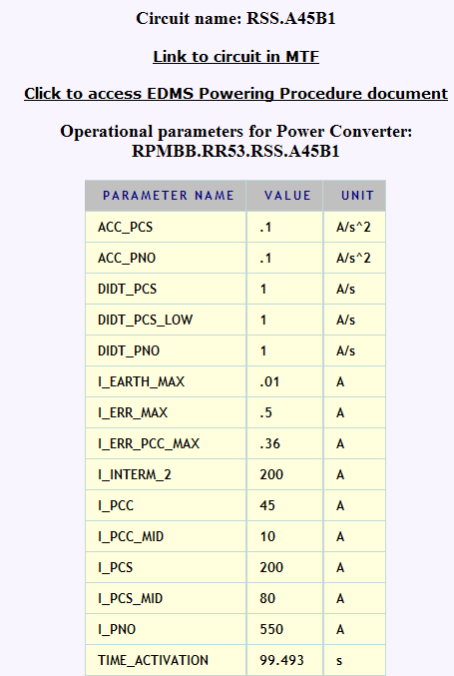
4) Keeping the overview
In the beginning: Excel Spreadsheets by Rüdiger
Later: “Alvaro’s pages”:
Dedicated website. (php, directly accessing LSA DB – where test results were stored)

Slide 19
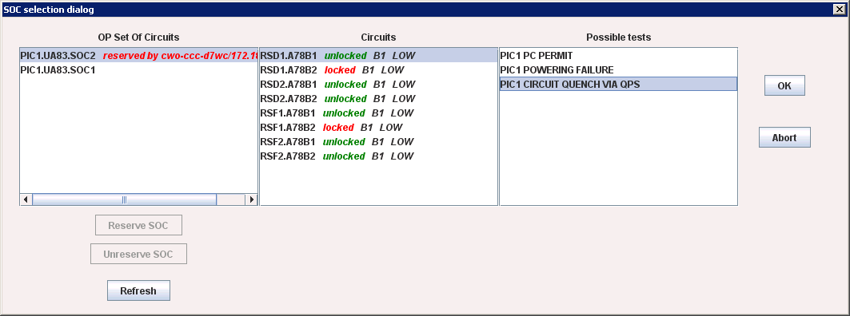
5) Avoiding Testing Crosstalk
Parallel Test execution: To avoid that several Operators would access the same hardware:
  Reservation of „Set of Circuits“
  Sequencer „locks“ (db) a circuit during execution.
Still much interference between the tests:
  Some Tests (e.g. of close circuits, or same QPS controller) must not be executed at the same time (fail otherwise)
  Some tests on different circuits MUST be executed at the same time .
  ...
→ A lot of Knowledge required in the head of the operators!

Slide 20
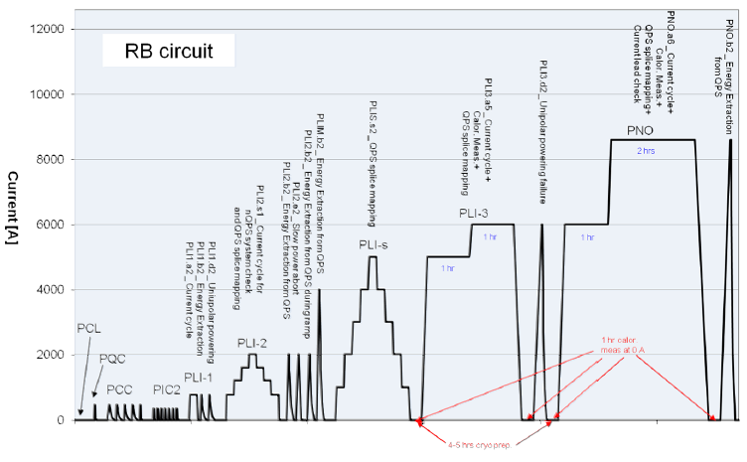
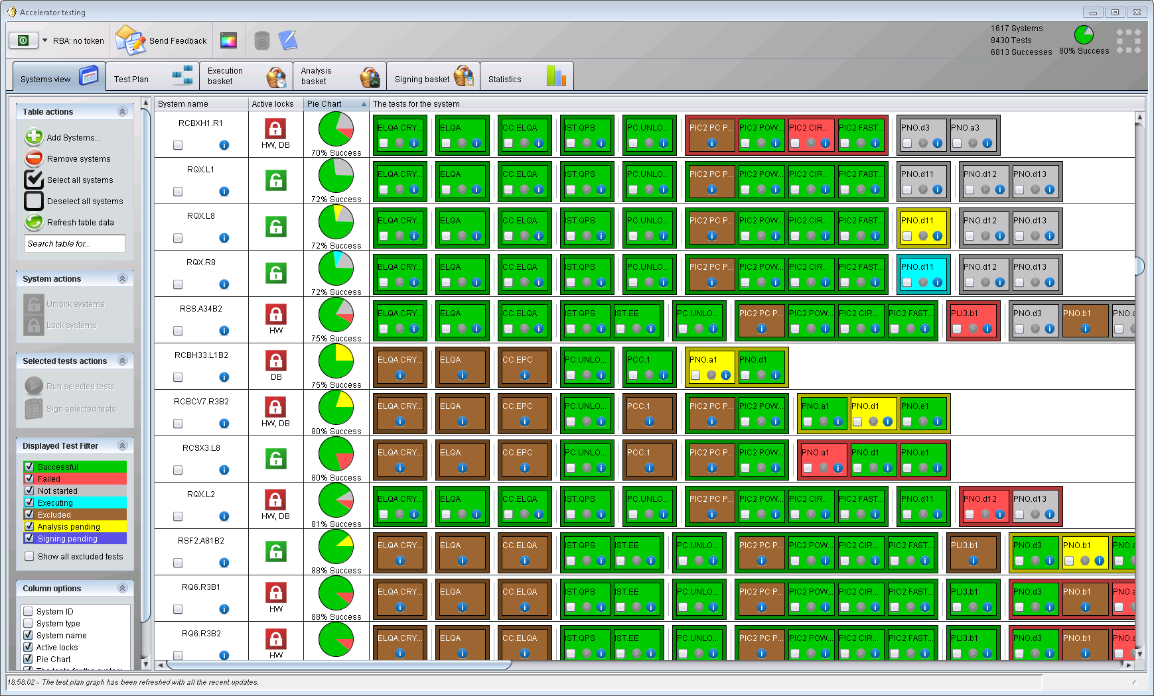
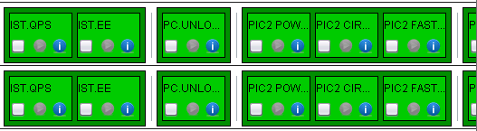
6) Orchestration → AccTesting
Tests
Test-Phases.

Slide 21
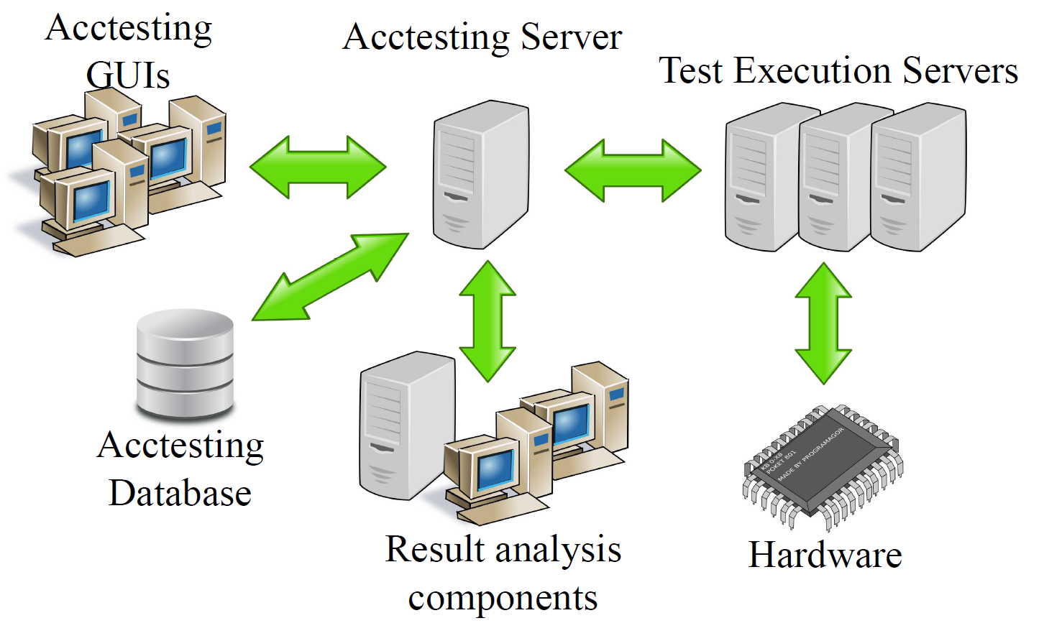
AccTesting Concepts
Central Server with many Uis
Open Architecture, which supports ‚plugins‘ for execution and Analysis.
→Integrates all the existing tools.
Takes care of all the tricky things:
  Correct Order of execution
  Locking of Circuits
  Tracking of results
  Avoiding Crosstalks (through „Constraints“)
  Signatures
e.g.: HWC Sequencer
e.g.: LabView
e.g.: Magnet Circuits, BIC/PIC …

Slide 22
AccTesting - Workflow I
1. User “expresses his/her wish” to execute one (or many) tests.

Slide 23
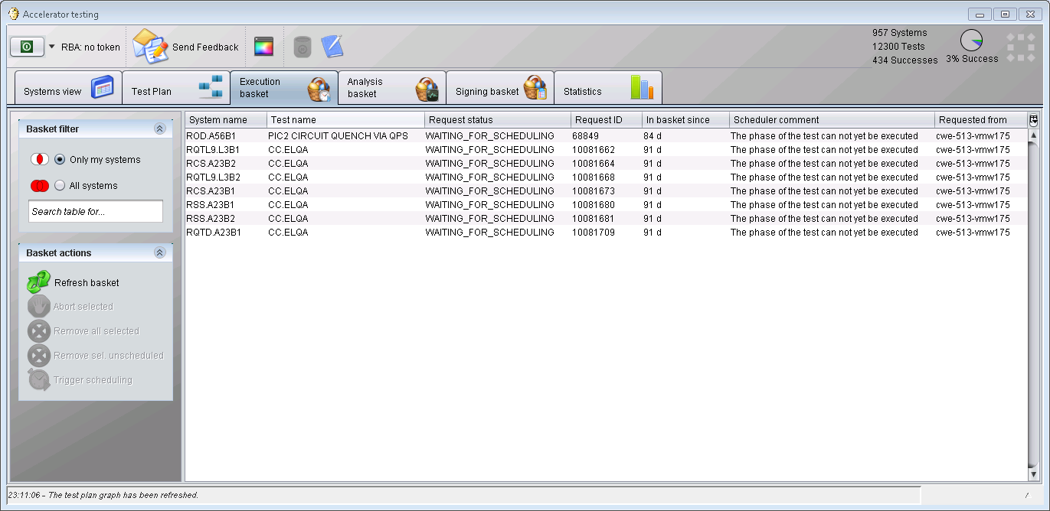
AccTesting - Workflow II
2. The Tests go to the Execution Basket (Server!)

Slide 24
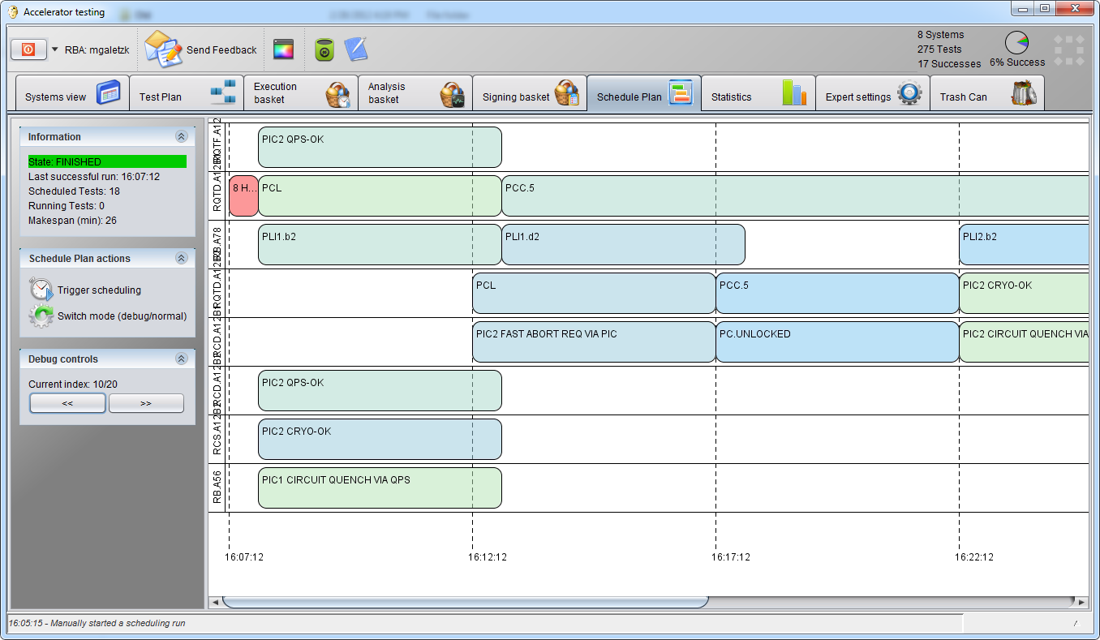
AccTesting - Workflow III
Central Scheduling can respect all the conditions (Phases, Locks, Constraints …), even if requests come from different GUIs.
No Test started, if preconditions are not fulfilled.
When conditions are fulfilled later, the tests are started automatically (No delays).
No Need for reservation of Systems
3. The Scheduler (on the Server) will decide when to start which test(s).
→ Big boost in Testing throughput!

Slide 25
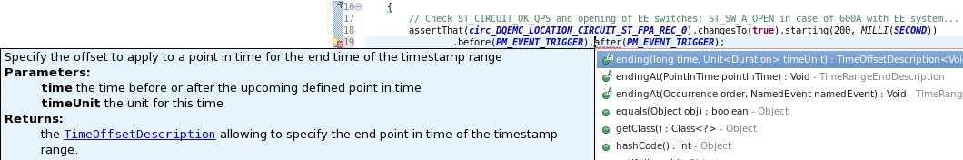
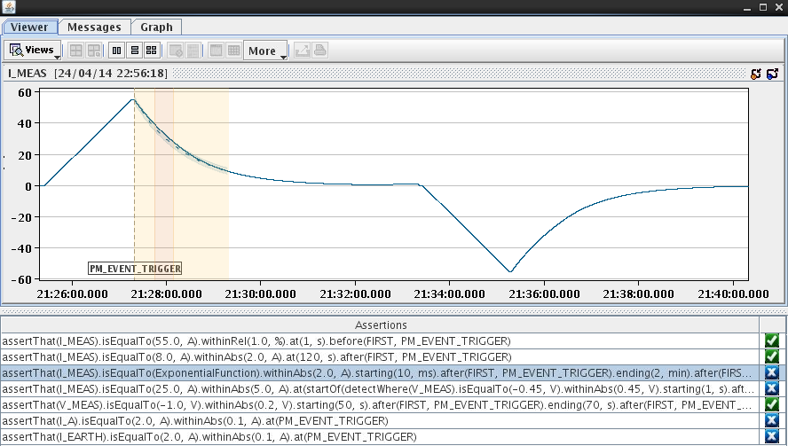
7) Analysis Automation → Analysis DSL
Small domain specific language, integrated in java.
  Code completion, grammer, javadoc → out of the box
  Supports fixed set of conditions
  Can be run on extra servers (scalable)
GUI plugin directly for AccTesting → direct presentation of assertion Results.
Brought large gain in time, in particular for tests of the (numeroes) small circuits.
Takes away ‚monkey analysis‘ from the experts and saves their energy for the „tricky cases“

Slide 26
Summary
... and lessons learnt

Slide 27
Summary and Lessons learnt
Good (not neccesary long) procedures are the basics. If kept up to date, together with the results of the test, serve as essential documentation.
Automation pays off! (Tests are frequently repeated)
  Execution: Sequencer (see also Stefan‘s talk)
  Analysis
Dumping data is easy, finding it again might be tricky ...
  Archiving System → see Vitaliy‘s presentation
Orchestration avoids mistakes and saves time!
Not everything has to be perfect from the beginning (it anyway wont;-). Better:
  Start from „the simplest thing that might possibly work“
  Try + use it → learn
  Iterate („goto 1“)
Thank you!

