Slide 1
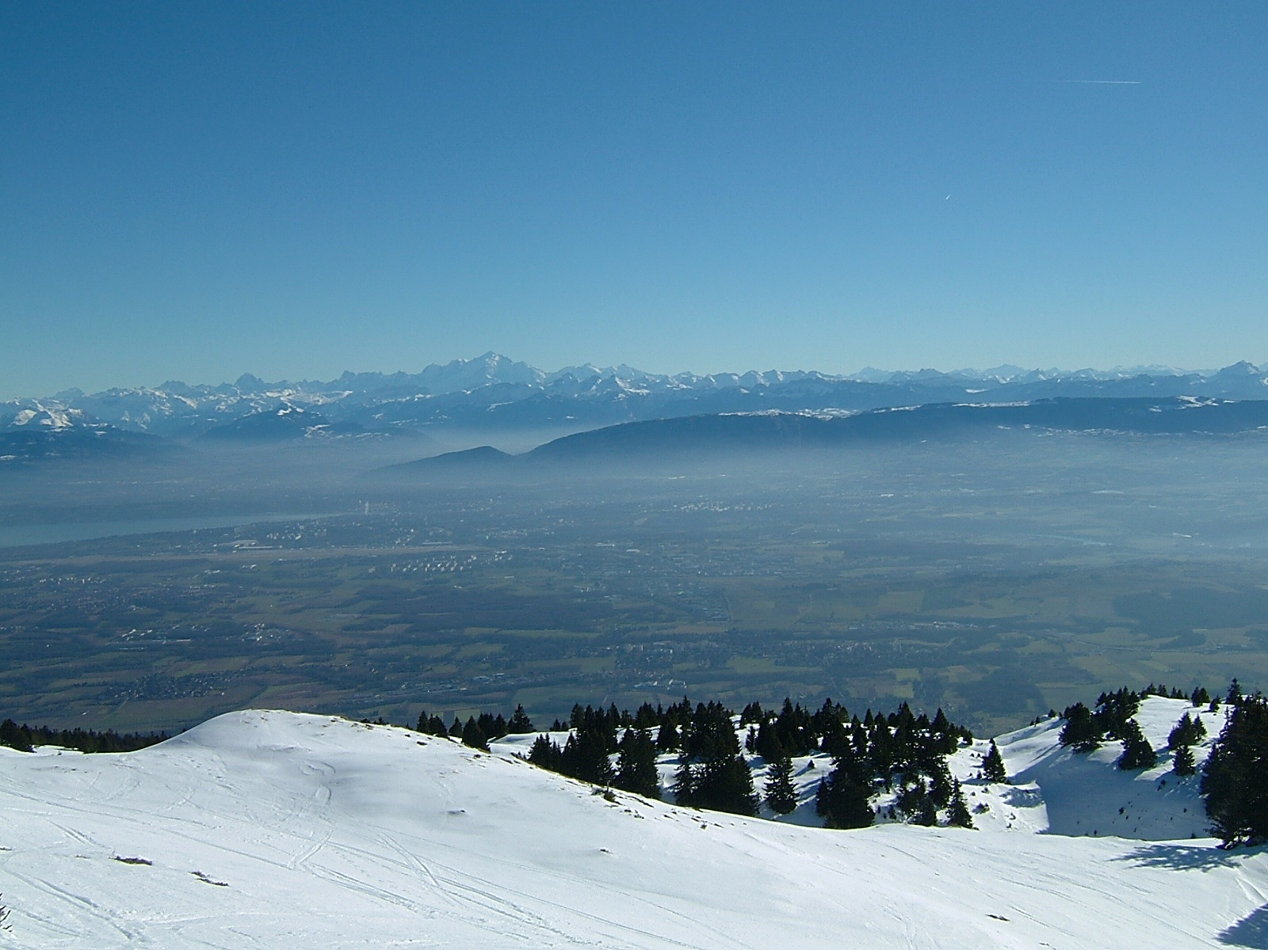
Experience from LHC control system commissioning
Workshop on Controls Developments for FAIR Commissioning
16-17 September 2020
Jörg Wenninger
CERN Beams Department
Operation Group / LHC

Slide 2
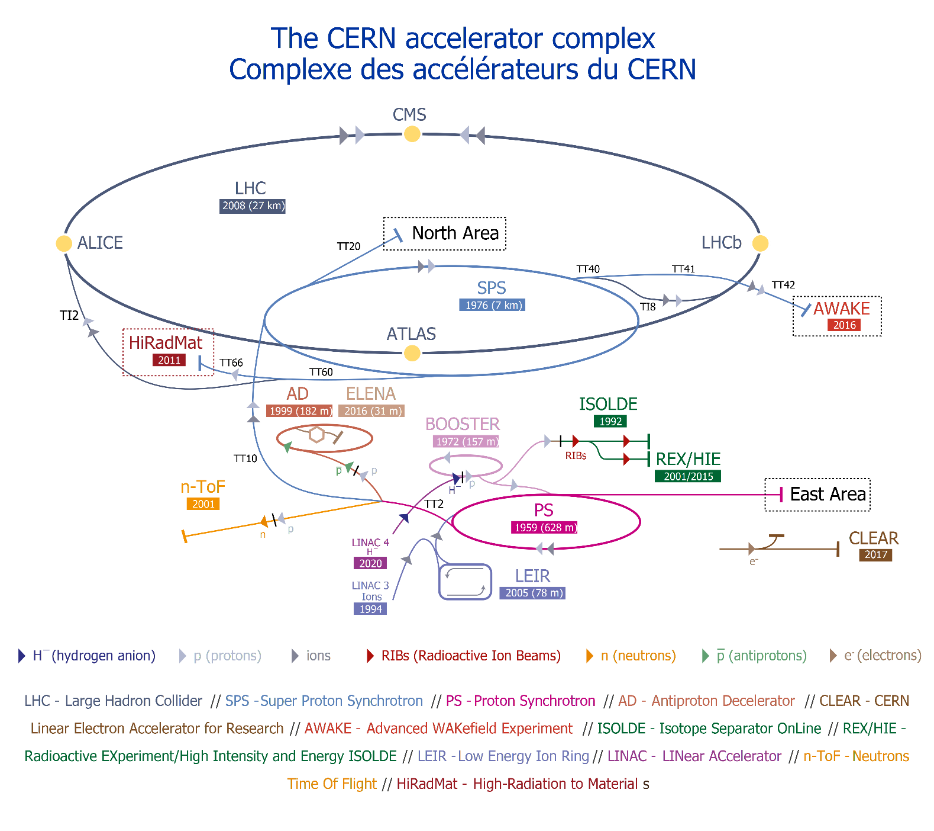
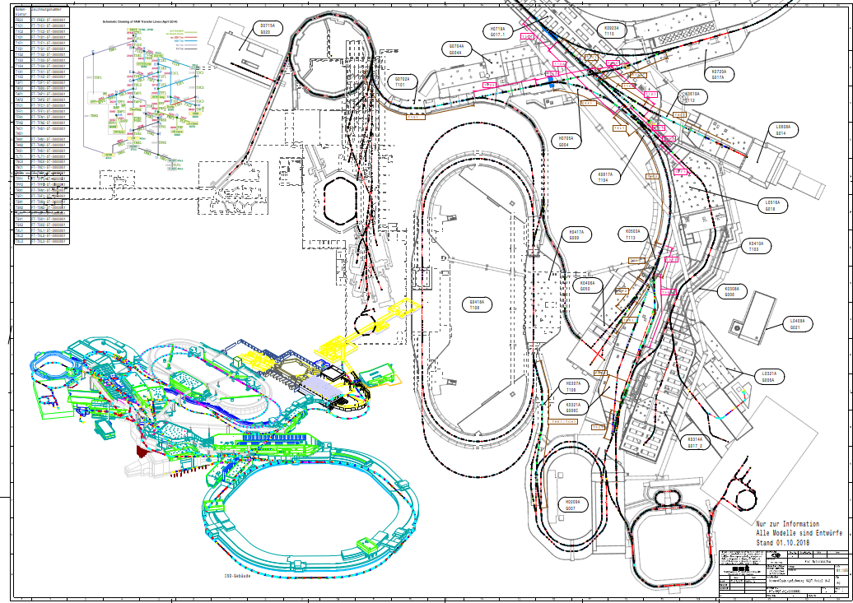
CERN and FAIR accelerators
CERN and FAIR accelerator chains are of qualitatively similar complexity.
Many different clients who want beam at the same time !

Slide 3
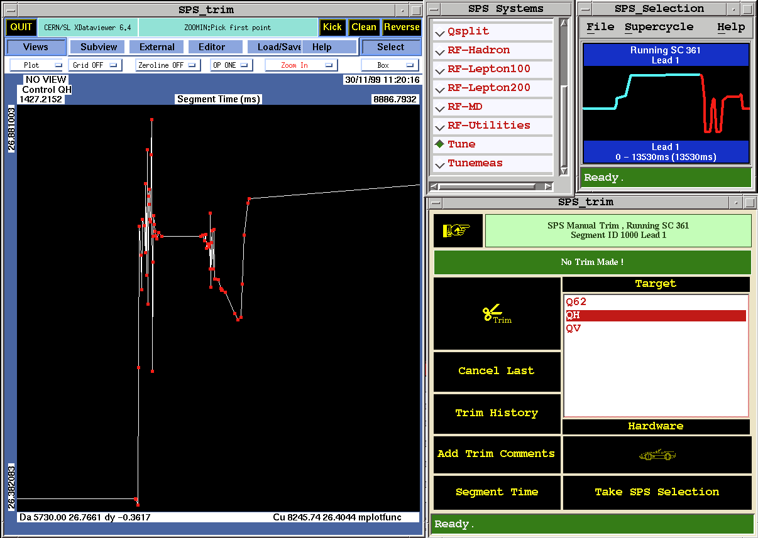
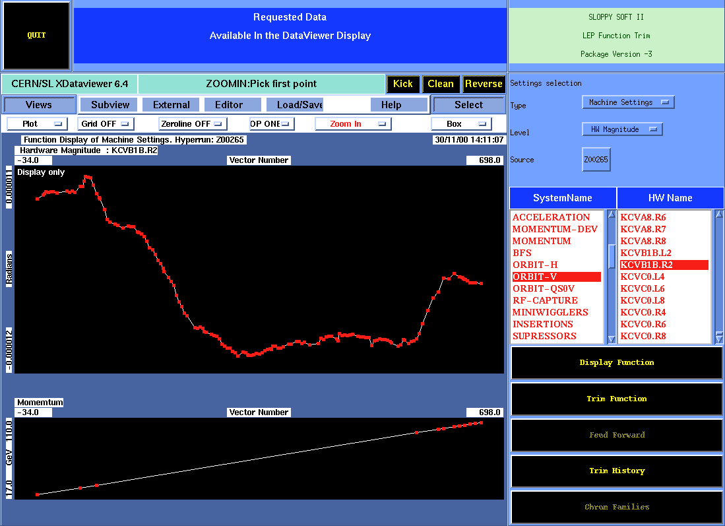
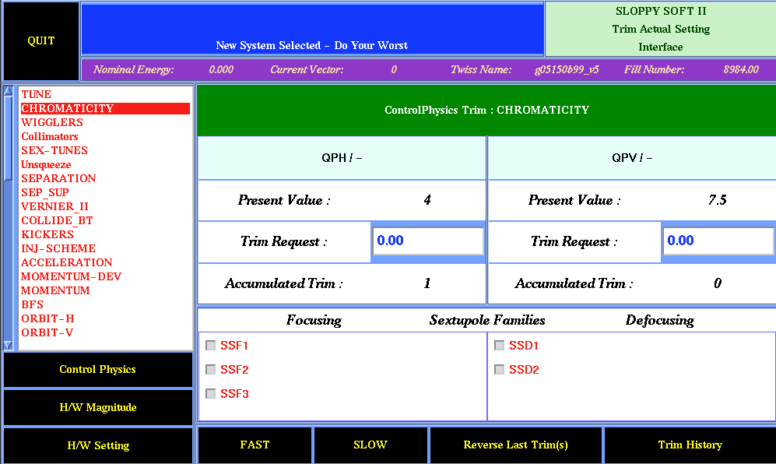
At the beginning…
In the 1990’s a database driven high level control system was designed at CERN to operate the SPS and the LEP collider – “sloppysoft”.
This system was designed and written with dominant contribution from the operation group.
The physicists in the operation group designed the system to control the beam with high level physics parameters (tunes, angles, gradients, etc), they did not want to tweak currents directly.
Many concepts of this system were re-cycled in the LHC control system a few years later.
LEP orbit corrector kick ramp function (in rad)
SPS horizontal tune trim function

Slide 4
From the 1990‘s to LHC
In the second half of the 1990‘s the LHC, full of superconducting magnets, appeared on the horizon to replace LEP.
There was a need to build a new control system for LHC and for SPS (LHC injector), a machine that had to become much more flexible to serve both LHC and its own users.
The SPS-2001 software project was born at the time, led by the controls group.
Nice concepts, but lacking results.
By 2001 not even an embryo of a control system had been deployed...

Slide 5
Lhc Software Architecture - LSA
In parallel to the SPS-2001 project, work was initiated on the upcoming LHC, the efforts were merged in 2002-2003 into a single project: the Lhc Software Architecture – LSA.
Maybe an unfortunate name, since LHC was not the only target machine.
After the merger, a mixed team from operation and control (and with important GSI contributions) used the preparatory work of SPS-2001 to develop LSA.
JAVA was adopted as language for high level servers and UIs.
Configuration and settings stored in an Oracle DB.
Due to the delay of the LHC (2005 becoming 2008) the first deployment milestones of LSA were LEIR (Low Energy Ion Ring) in 2004 and the SPS in 2005-2006.
Despite the differences between collider and pulsed ring operation, those two milestones were essential to confront the code with reality – an immense gain for the future LHC.
This period was not easy, with bugs and performance issues, but the mixture of operation and control teams within the project created mutual understanding for the problems and helped reduce conflicts.

Slide 6
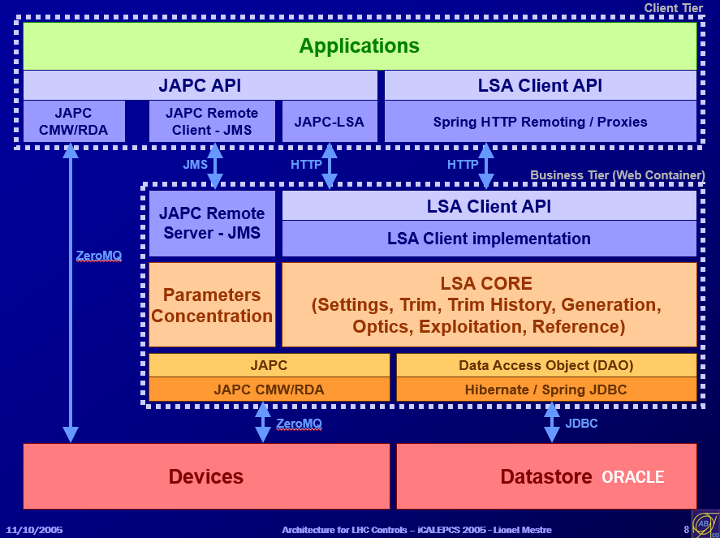
Low level software
In parallel changes to the high level software, many changes also occurred on the front end level.
A standard Common Middleware (CMW) slowly emerged as the communication standard.
Although mostly invisible to the control room teams.
The FESA framework progressively conquered many CERN front end computers, providing a standard way of accessing FEC data over CMW.
Good for the user and developers, but also essential for data logging !
Industrial controls world (PLCs…) is still a bit separate and not so well integrated.
This did not go witout many headaches !

Slide 7
From dry tests...
The LHC the schedule delays and the long phase of circuit commissioning provided ample time for dry (no beam) testing of LHC equipment.
Dry runs of equipment or comple systems up to full vertical slice tests for injection, RF, interlocks etc.
Driven by operation in collaboration with equipment experts, with CO backing when needed.
Out of the early and often very manual dry tests (lot‘s-of-clicking) emerged the movement towards task automation in the form of applications or sequences.
The work was backed by procedures for many (but not all) systems.
Very rigorous and well maintained procedures exist mainly for the magnet powering → see presentation by K. Fuchsberger.

Slide 8
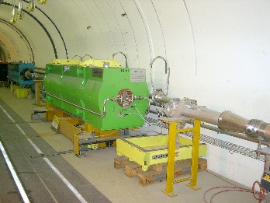
... to wet tests
In addition to the LEIR and SPS beam milestones, the dry tests were backed by beams tests approaching slowly LHC.
Three main event types were scheduled:
Beam extraction from SPS to a dump – 2003+
~10’s m downstream of the extraction point.
Beam to the downstream end of the ~3km long SPS-LHC transfer lines – 2004+.
Towards intermediate dumps.
Sector tests of the LHC (beam through parts of the LHC operated as a transfer line, dump on collimators) – 2008.
Including extraction into the LHC dump blocks using the LHC beam dumping system.
With this preparation, beam was circulating with reasonable lifetime in the LHC after ~1 shift on day 1 (2008).
This test sequence is still used after long shutdowns for re-commissioning.
TL test beam 2
Sector test beam 1
Sector test beam 2
TL test beam 1
SPS extraction
Mobile transfer line dump
=

Slide 9
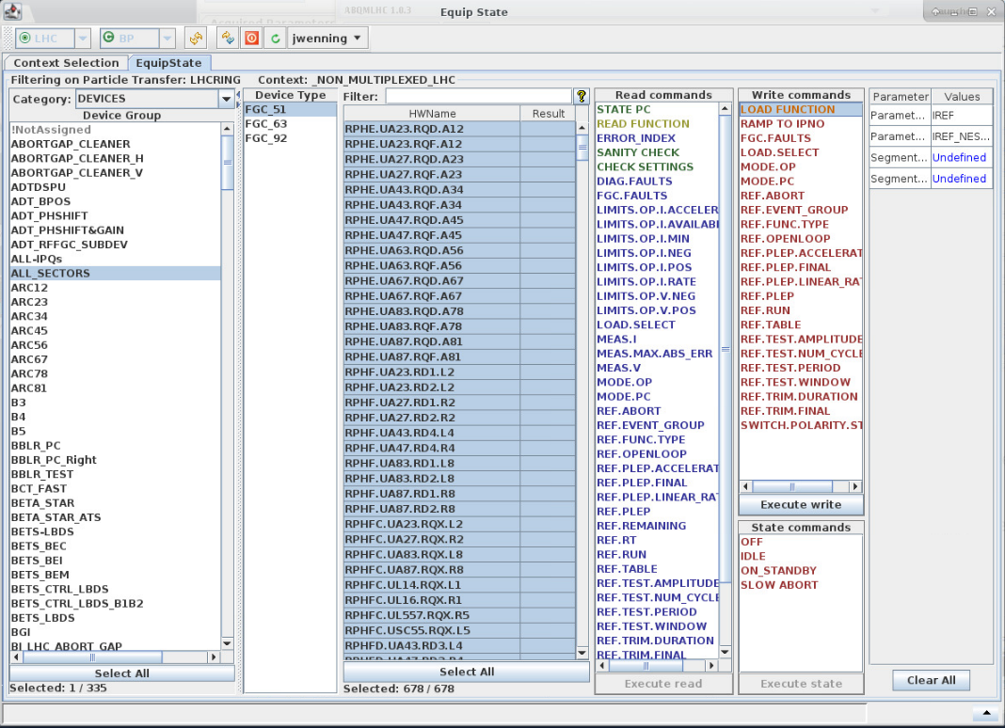
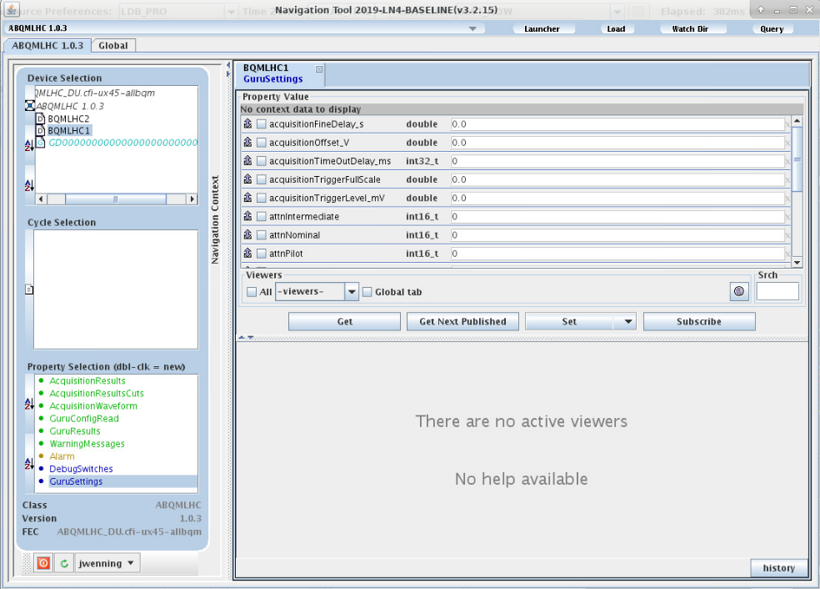
Modest start
The key goal for initial operation was to have essential software ready:
Be able to control all key equipment.
Be able to measure and correct key parameters: orbit/trajectory, tune, chromaticity, ...
Automate if possible, do-it-by-hand-with-recipe as backup.
Leave some of the exotic and sexy stuff for later.
In the first year(s), both at SPS and LHC, the FESA navigator and the equipstate UI of LSA were key tools to control certain devices.
Better than no control at all, still provides some sort of standard access tools.
Side benefit: good understanding of the inner life of some controls components – useful later in case of problems.
But such manual actions also led one of the largest quenches at injection in the LHC (5 magnets).
Due to a mishap in a list selection.

Slide 10
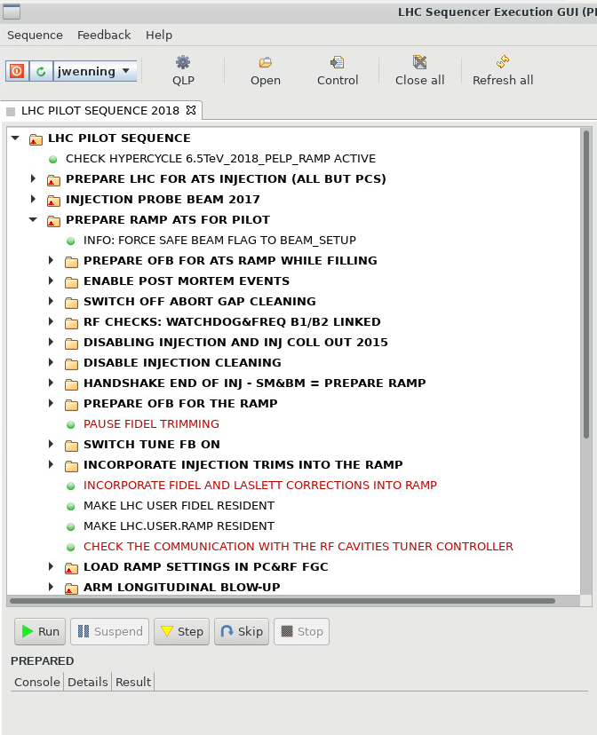
Towards automation
3rd generation sequencer
Already at an early stage of the commissioning a first LHC sequencer was developed to automate tasks.
Clicking on a task rather than on the FESA navigator.
Continuous evolution from manual actions to sequencer tasks.
Many easily configurable tasks.
In a second phase complex tasks – requiring dedicated JAVA code – were also developed.
Tasks & sequences to 95% in OP hands.
Currently the standard LHC machine cycle is run over ~90% through the sequencer.
The LHC sequencer is gradually appearing in the other machines to manage transitions (to and from access, etc).
But role of the sequencer is less important for pulsed machines.

Slide 11
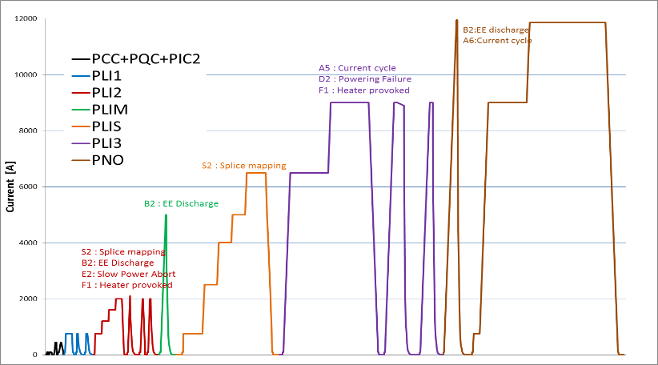
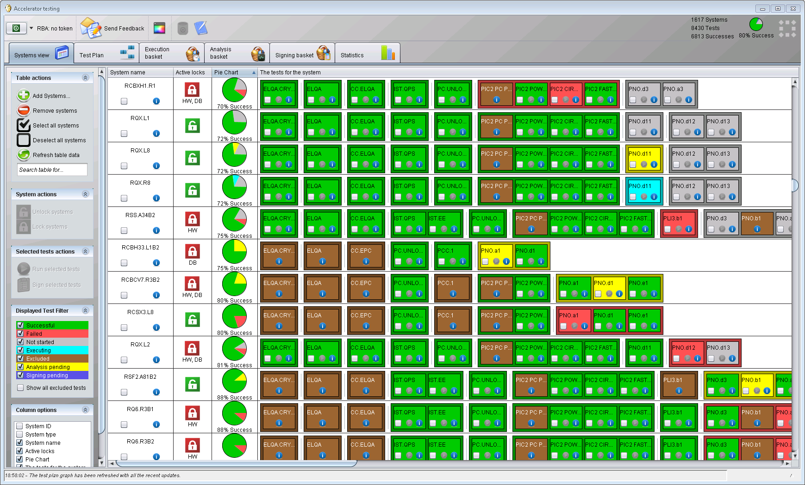
Circuit commissioning automation
The powering tests of the LHC super-conducting magnet system evolved over time towards a highly automated and configurable commissioning tool that is used for any circuit commissioning – even during a run after repairs.
Predefined and approved test sequences,
Automated execution of the tests that are ready,
Test sequence blocked until tests are signed,
Tracking of results – no step is missed !
More details in K. Fuchsberger‘s talk
encoding in a test sequence
1 block = 1 test

Slide 12
Data logging
The LHC logging project (CALS) grew out of the LEP experience, extended to include injector data.
Based on an ORACLE DB which captured more and more data over time.
The growing data logging needs of the entire complex, over 3 TB per day, called for a replacement of this initial logging system.
Dominated by LHC data.
Data saving by applications is still widespread because CALS is not adapted to logging complete cycle data of the pulsed machines or massive turn-by-turn-bunch-by-bunch data (of which more and more appeared over time)
This may change with the new logging system.
The deployment of a new logging system (NXCALS), based on Hadoop open source framework, is in progress.
Distributed storage and parallel processing,
Data analysis within the cluster as opposed to local analysis on extracted data (when possible / meaningful),
The transition is not straightforward …
All CALS data to be migrated to NXCALS – a challenge !
Data volumes in CALS

Slide 13
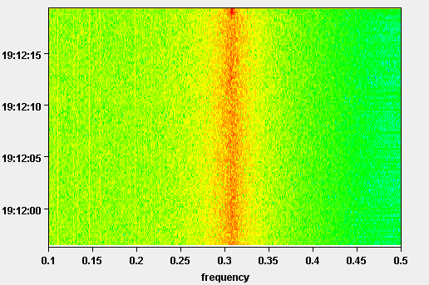
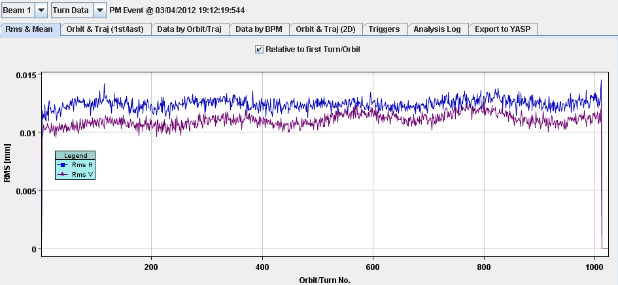
Post-mortem
For a slow cycling machine like LHC and for its superconducting circuits standard data logging is not sufficient to capture transients events that occur at the moment of a fault / beam dump →Post-mortem (PM) system.
The PM system is made of:
an event triggered acquisition and event builder,
PM event data storage,
associated PM data analysis code.
The PM system was essential to understand beam dumps and circuit failures.
For FAIR it applies to the SC circuits.

Slide 14
Code development lessons
During commissioning we did not have the complete tool box for nominal operation.
Not enough resources to write all code for day 1,
Not enough experience on how to best operate (eg LHC).
A lot of code was developed at CERN by temporary staff, with varying quality, generally related to guidance and supervisions (wrt coding).
Technical students (1y), PHD students (3y), fellows (2-3y), project associates ...
An impressive code based was created, but as those persons leave and time passes, a Himalaya of code to maintain has grown slowly but steadily.
To improve the situation and provide better integration of temporary / leaving staff, LHC operation has adopted the strategy of coding in teams (initiated by K. Fuchsberger).
All important SW projects are now developed with a team of at least 3 persons.
Main development in ‘sprints’ – 1-2 week sessions where a team develops together one project.
Important benefit: sharing knowledge and technical skills.
But we did not manage to get all other machines on board…

Slide 15
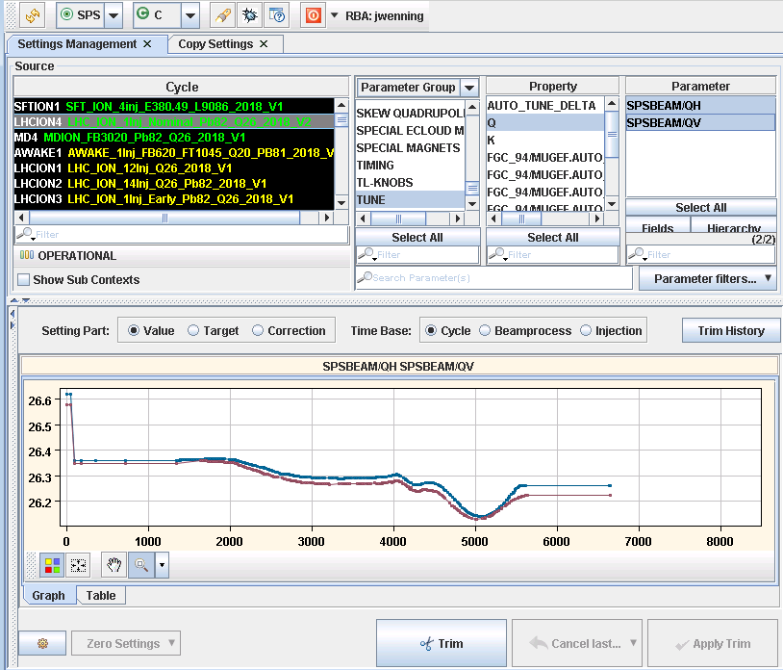
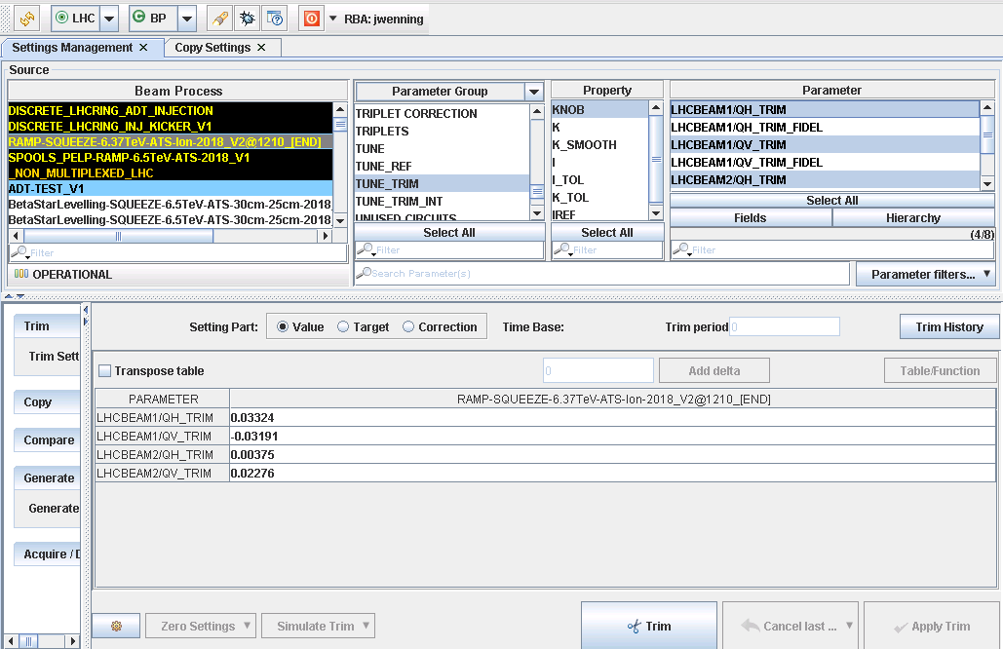
Coming next
Python is evolving into the dominant language in many groups (in particular among accelerator physicists), the control system is therefore opening up slowly to it.
Initially mainly for data analysis (online in the CR and offline).
Progressively more controls functionality is provided.
It provides means for rapid development of applications for machine tests etc by the test teams (without need of a dedicated operation UI).
Integration / interaction with JAVA world still an issue.
Most of the ~500 UIs in use in the CERN control room are based on JAVA Swing for the graphical components. Swing is ‘on the way out’, we should move away from Swing, but the roadmap is not defined.
Our controls group is proposing / evaluating PyQt and WEB, but both options involve massively rewriting the UIs…

Slide 16
Summary
The control system LSA was born ~20 years ago, reaching full maturity around 2015.
Deployment on existing machines as testbeds and early dry-test programs proved essential and led to a rather well working control system on LHC beam day 1.
The evolution at the lower levels of CMW and FESA contributed to the success.
The mixed operation-controls development team helped reduce tensions and conflicts with OP in the provider and consumer role.
Development in teams is proving to be highly beneficial (@ LHC), but it is not easy to convince some persons…
Not everything was perfect on the first days on LHC commissioning (both HW and beam), a lot of operations were possible but were very ‘manual’. Automation followed in a second phase.
At the beginning, be modest and concentrate on the key points !

Slide 17
Thank you for listening !

