Slide 1
Requirements to Controls for FAIR-HEBT Commissioning
Workshop on
“Controls Developments for FAIR Commissioning and the Operation of the existing Accelerator Complex”
F. Hagenbuck

Slide 2
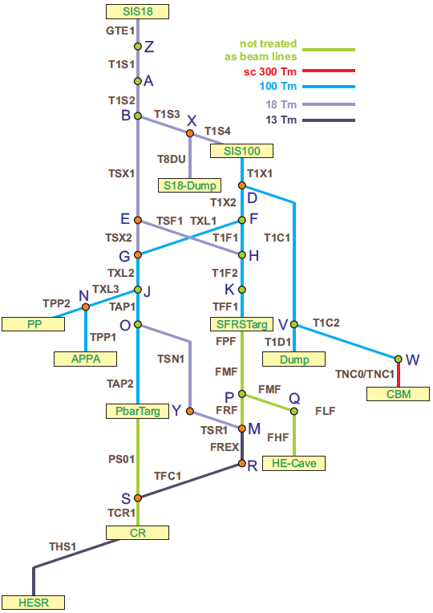
HEBT – Short Overview
CBM
Overview
29 sections (13 connections/beam lines)
total length (HEBT) ca. 1.5 km
all beam lines normalconducting
nominal magnetic rigidity 100Tm, 18Tm, 13Tm
parallel operation

Slide 3
Requirements (to Controls) – HEBT technical subsystems
Beam Instr., Vacuum and Power Converters ➔ presentations of techn. subsystems
Special Installations
Foil Stripper (located in T1S1)
Timing critical; unit has to be able to change position between two cycles of SIS18 (within 400 ms)
write: fast stepper motor controller (tbd)
read: set of limit switches / position indicators (potentiometer/photo sensor, tbd)
relevant for interlock, e.g. that the primary beam does not hit the frame of the foils (position has to be confirmed by the control system, before beam clearance, otherwise beam might hit the frame of the foils)
details pending, workpackage will be defined via AüG
Collimators
timing uncritical; unit is set into position once (for each type of beam) and then stays in position; timing uncritical
write: MBOX controller for standard AXIS line stepper motors (Oriental)
read: 14 position indicators, one for each axis
relevant for interlock, e.g. that the primary beam does not hit the collimator block (only charge transferred ions or beam halo shall hit the blocks)
Diffusors
controlled via the PAS
unit fulfills a redundant safety function, in addition to the monitored dipole magnets power supplies along the HEBT
unit is set into position once, in dependence of the targeted NE area of the beam, and then stays in position in normal operation
write: solenoid valve (of pneumatic actuator), in case of system alert (e.g. unauthorized access to a currently restricted NE area)
read: 10x2 limit switches

Slide 4
Requirements (to Controls) – HEBT Commissioning
Extraction
HEBT
Injection
Experiment
interface extr/inj: beam parameters at (point of ) transfer (trajectory, emittance, …) (definition of responsibilities)
trajectory control: measurement of beam position and optimisation of trajectory
optimisation tools: check ion-optics model, emittance measurements, automatic steering, etc.
transmission monitoring: beam line transmission (injection/extraction efficiency)
system status: efficient status (warnings, errors) display across system boundaries
archiving: store data, identify & tag reference data, etc.
special installations: setup collimators/stripper
interface experiment: beam parameters at target (data exchange with experiment)

Slide 5

Thank you for your attention!

