Slide 1
Required Tools for Commissioning of SIS100 and SIS18
D. Ondreka, on behalf of SP SIS100/SIS18
Controls Workshop
GSI, 17.09.2020

Slide 2
Outline
Introduction
  Overview of commissioning
  Scope and prerequisites
Machine control
  Local cryogenics
  Quench detection
Beam based control
Priorities

Slide 3
Introduction:
Overview commissioning
Phases
  Installation (not part of commissioning)
  Hardware commissioning
  Beam commissioning
  Operation
Phases will overlap
  First HWC activities during installation phase, dep. on availability of media
  Overlap between HWC and BC to be minimized, but reality may interfere
  Overlap between BC and OP very likely due to staged commissioning approach
    BC for individual operation modes due to cycle dependent tuning of local cryo system
    Low intensities first, higher intensities later after commissioning of machine protection systems
    Commissioned operation modes available for experiments
    Requires real parallel operation of SIS18 and SIS100
Inst. (TGA, ACC)
HWC
BC
Operation
media fully available

Slide 4
Introduction:
Scope
Requirements for SIS100 commissioning regarding higher level functionality
  Mostly software, some hardware
  Control of local cryo
  Control of machine
  Beam commissioning tools
HW commissioning (mostly) not covered
  Commissioning of individual devices
    Responsibility of technical groups
    Have to define controls requirements for HW commissioning of their equipment
  Remember: device commissioning interleaved with machine commissioning
    No commissioning of SC magnet PCs without commissioning of cryo system
    Synchronized ramps (i.e. data supply, timing) required for many systems
      PCs of SC main magnet strings
      RF system for commissioning synchronized operation

Slide 5
Introduction:
Controls Prerequisites
All devices integrated into CS
  SCUs for active devices
  BI devices
Applications for general operation available
  Scheduling of chains and patterns
  Execution of patterns
  Data supply
  Basic device control
  Handling of interlock system
Expert applications available
  Visualization of data from all BI devices
  Visualization of data from generic digitizers
Many of these systems already in use for operation of GSI accelerators, but often need further development for FAIR

Slide 6
Introduction:
Beam Commissioning Phases
Integration tests without beam
  Operation of SIS100 as if beam was there
  All systems required for day 1 BC must be ready
  Test of all systems under operational conditions
BC of single low intensity mode
  Commissioning of all essential functions (injection, acceleration, extraction)
  Test of all BI devices with beam
  Beam-based verification of magnet function (polarities, multipole content)
  Some beam-based tools essential (e.g. trajectory/orbit control, B2B control)
BC of high intensity operation
  Verification of machine protection systems
  Mitigation of intensity dependent effects
  Further beam-based tools required (control of tune/chroma, RF gymnastics)

Slide 7
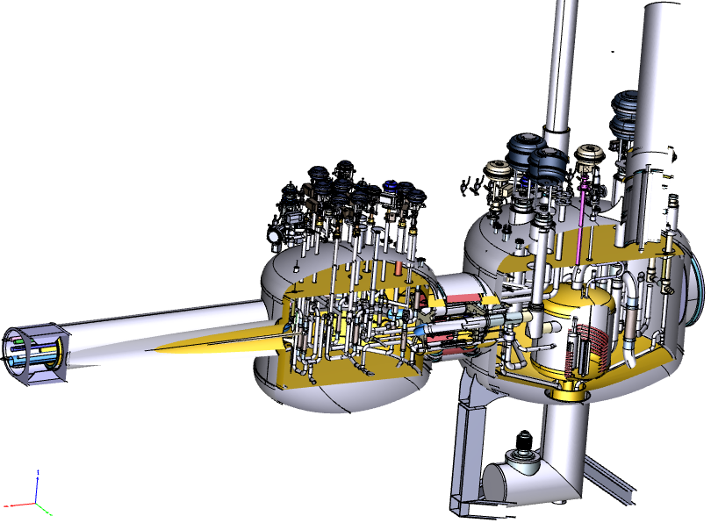
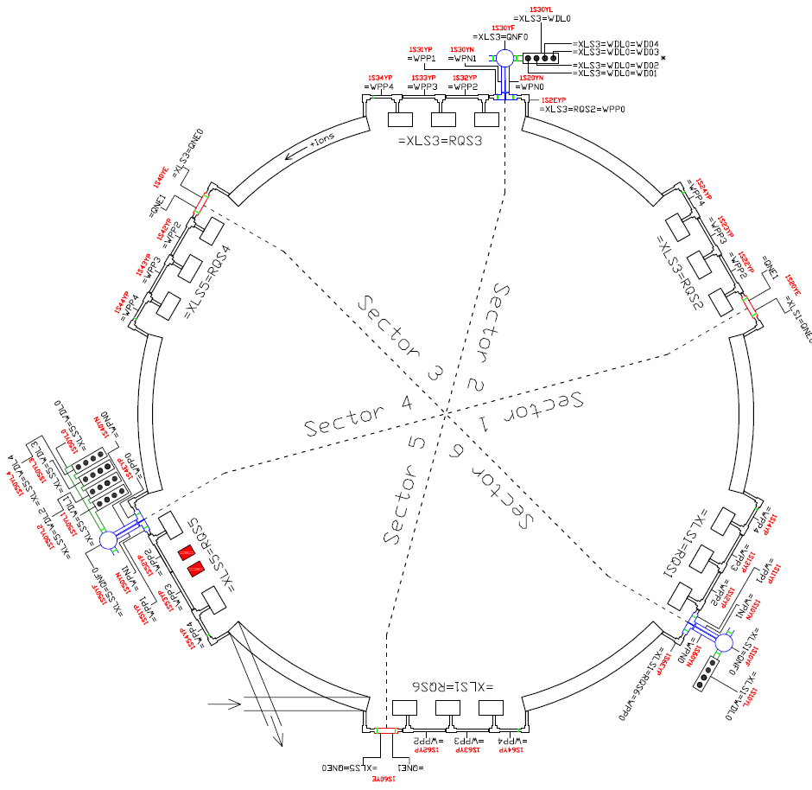
Local Cryo:
Commissioning Steps
Complex distributed system
  Magnets and BPL
    ~1500 Temperature sensors
    630 Heaters
  Feed boxes, end boxes, current lead boxes
    315 sensors for temperature, pressure, vacuum, mass flow, level, position
    150 valves, 108 heaters, 3 pumps
Cold commissioning
  Operation without powering magnets
  Checking of sensors and settings for static load
Powering of magnets
Development of operation modes
  Goal: stable operation for beam commissioning
  Fixed timing and fields to fix dynamic heat load
  Learning curve for more complex modes
Images courtesy of
T. Eisel (CRY)

Slide 8
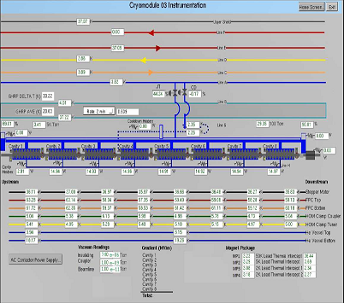
Local Cryo:
Software for Commissioning
Prerequisites
  Control of cryo plant and distribution system
  Integration of all local cryo sensors and actuators into control system
  Manual read-out of sensor values
  Manual setting of actuator values
Requirements for cryo commissioning
  Structured visualization of sensor and actuator states
  Aggregation into functional sub-groups and visualization of their state
  Definition of higher level parameters for controlling larger sets of actuators
  Possibility for saving and restoring settings
Requirements for operation
  Automation of control
  Mode dependent set values from LSA
LHC: display of two arc cells in CRYO-SCADA
LHC Project Report 1169, 2008
LCLS-II: cryo module control
ICALEPCS‘19, WEPHA002

Slide 9
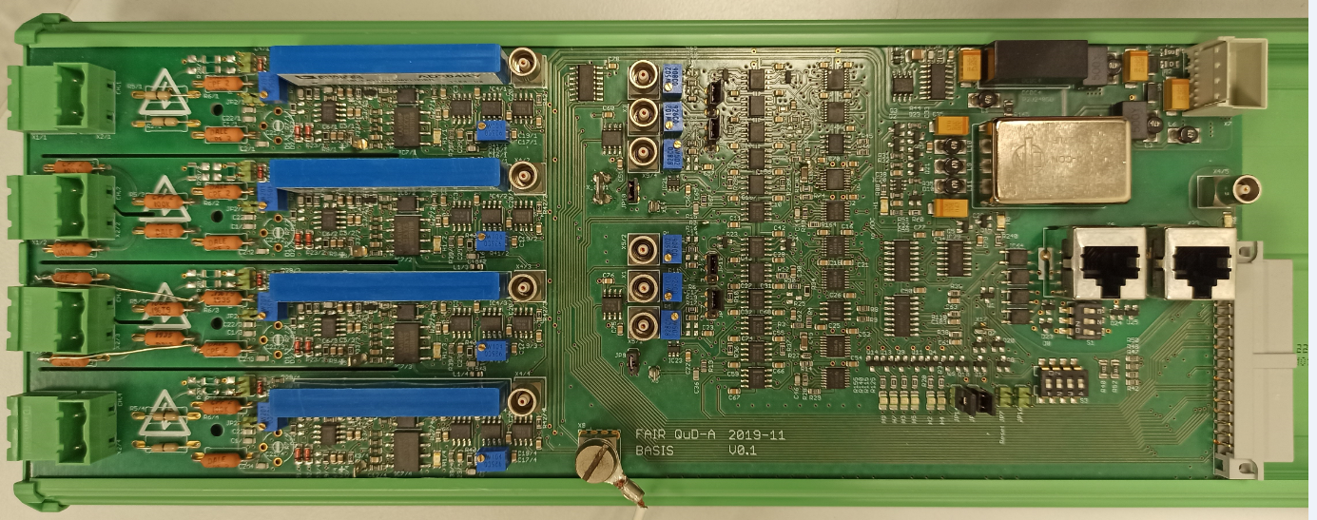
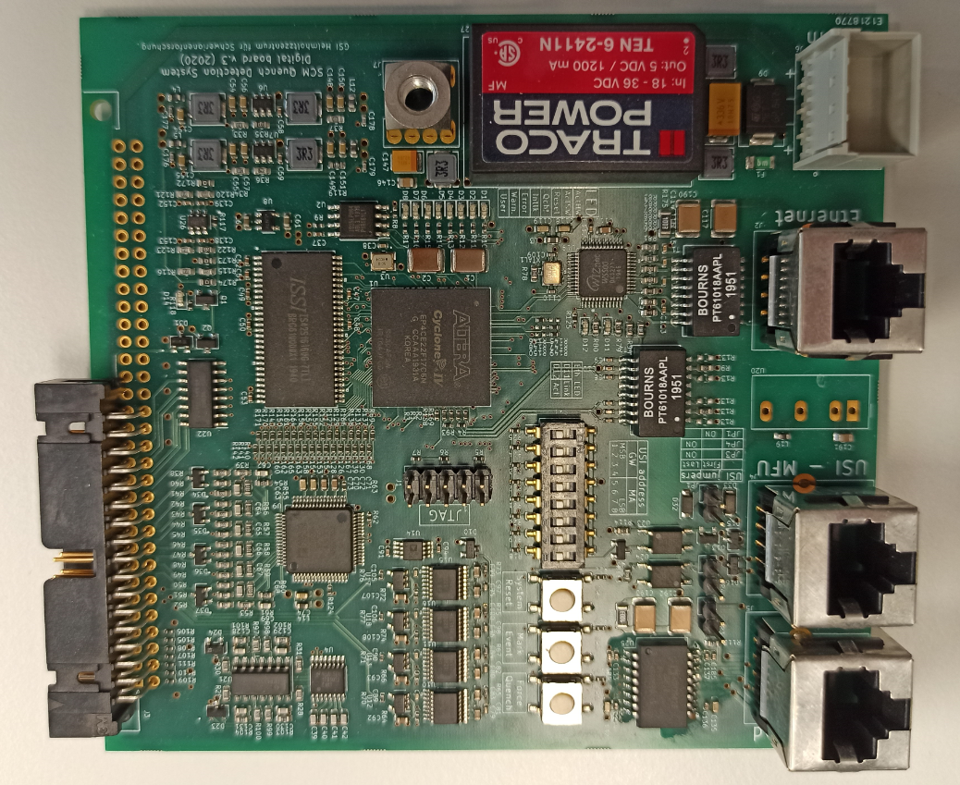
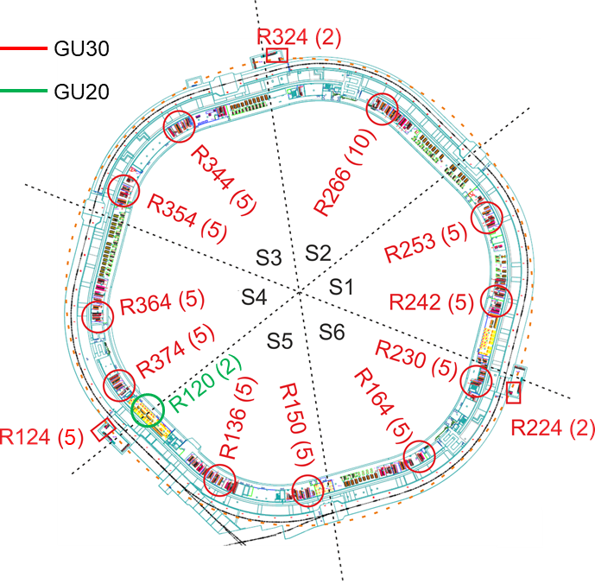
Machine Control:
Quench detection
QuD: Analog detection and digital read-out boards
Needed for safe operation of SC magnets
  Detection of quench by voltage measurements
  10 kHz sampling for post-mortem
  Logging at 10 Hz foreseen
Distributed around SIS100
  About 1200 voltage detectors
  QuD cabinets in 15 rooms in supply tunnel
  Priority sequence from trigger matrix
Post-mortem system essential
High-level software required
  Quickly find root cause of quenches
  Inspection of priority sequence
  Analysis of current and quench data
Images courtesy of
P. Szwangruber (SCM)

Slide 10
Machine Control:
Patterns and Chains for Parallel Operation
Concepts for modeling beam patterns
  Pattern
  Block of cycle executions across the
  facility to deliver a certain beam pattern
  Chain
  Sequence of cycles spanning machines to deliver beam to a single experiment
Use of patterns during commissioning
  Independent patterns for disjoint parts
    SIS100 dry runs independent of GSI operation
  Combined periodic patterns
    SIS100 beam commissioning in parallel to operation of SIS18 for experiments
  User interface for fast adaptation of patterns or creation of new patterns required
Requirements for parallel operation
  Nested chains SIS100 BC parallel to SIS18
Pattern
SIS18
SIS100
ESR
Chains
SIS18
SIS100
ESR
SIS18
SIS100
ESR
SIS18
SIS100
ESR

Slide 11
Machine Control:
SIS18 Booster Mode
Stacking scheme for RIB
Cycle time needs to be minimized
  Ramps up and down at 10 T/s (max)
  No ramping down to idle level after extraction
  Minimization of length of injection plateau
    No waiting for UNILAC allowed
    No gaps between cycles
  Minimization of length of extraction plateau
    No extra times for orbit bump at MS, creation during rounding times instead
    Max. 10 ms flattop to sync with SIS100
Expected cycle times
  Design value 2.7 Hz or 370 ms
  Precise value depends on AEG dipole
  Final value expected in range 360 to 380 ms
SIS18 booster ramps

Slide 12
Machine Control:
SIS18 Booster Mode Requirements
UNILAC timing system / PZ
  Reservation of TK for whole super-cycle
  Deterministic and known time interval between beam request and beam delivery
  UNILAC controlled by new WR timing system
FAIR timing system
  Synchronization with 50 Hz
  Completely deterministic timing
FG frontends
  Elimination of preparation time (except first BP)
  Can be done by sending FG_PREP in previous BP
LSA
  Integration of UNILAC coupling to avoid waiting
  Multiple sequences for SIS18 in chain to SIS100
SIS18 model
  Cycle time must be multiple of 20 ms
Timeline
  Need tested system for beam commissioning (2025)
  Want booster mode ready for machine experiments starting from 2023
  Intermediate steps using existing UNILAC PZ starting from 2021

Slide 13
Machine Control:
Bunch-To-Bucket (B2B) Transfer System
B2B transfer
  Transfer of bunched beam from one machine to another
  Essential for operation of SIS100
  Not a standard transfer scheme in GSI
  Requires precise synchronization of the RF systems of SIS18 and SIS100
B2B transfer system for FAIR
  Concept has been developed based on BuTiS (RRF) and timing system (ACO)
  Avoids comparison of analog signals
  Needed on day one of BC
Control software for B2B transfer
  Monitoring and adjustment of beam params
  Example of beam based application
Image from J. Bai, PhD Thesis, 2017

Slide 14
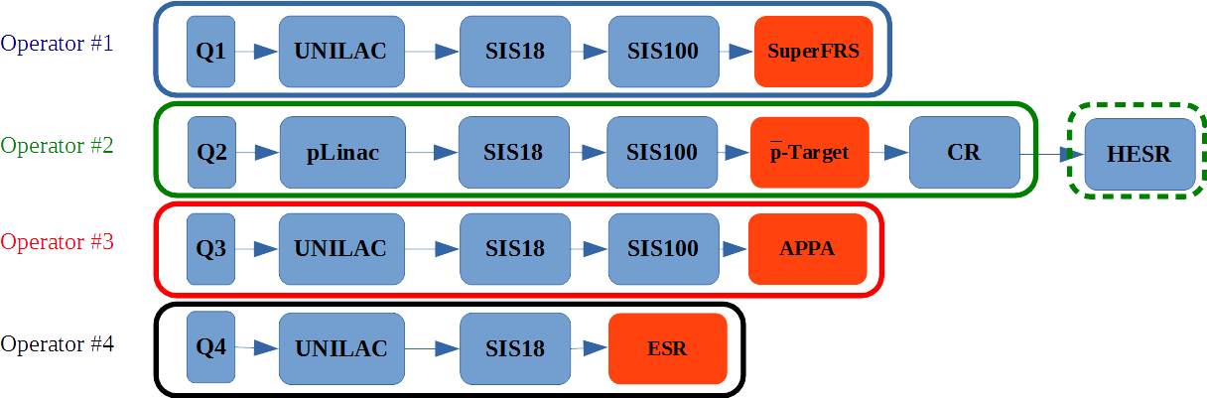
Beam Based Control:
Motivation
Efficiency of beam commissioning strongly depends on available tools
  SIS100 more complex than SIS18 and tighter constraints by beam dynamics
  Manual tuning based on observing BI data displays very time consuming
Requirements from parallel operation
  Limited number of operators
  Efficient operation requires support for
    Reduction of set-up time per accelerator
    Reproducibility of beam parameters
    Monitoring and maintaining of beam quality
Manual orbit tuning in SIS18 and SIS100
 | SIS18 | SIS100
#Cells | 12 | 84
#BPMs | 2 x 12 | 2 x 83
#Steerers | 2 x 12 | 2 x 83
#COC Knobs | 48 | 332
How long will it take to get the first turn in SIS100 without beam based threading?
Parallel operation concepts: 1 OP per chain

Slide 15
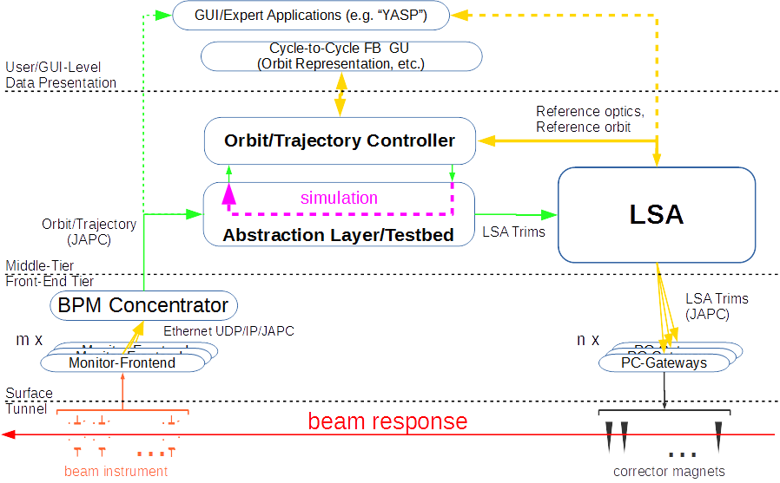
Beam based control:
Concept
Beam based control
  Combine beam signals, accelerator physics, and control theory to control beam efficiently
  Employ computers for repetitive tasks and quantitative reproducibility
  Automation possible but not mandatory
Cycle-to-cycle feedback
  Measure in a number of cycles, calculate and send correction for the next cycle
  Works very well for reproducible part of beam parameters
  Seamless integration of signal sources and beam influencing devices is essential
  Fast trims crucial if many feedbacks are running
Beam based systems for SIS100
  Many are useful for SIS18 (or others) as well
  Testing with existing machines essential to have proven system for SIS100 BC
Architecture of SIS18 cycle-to-cycle orbit feedback
Image courtesy of R. Steinhagen

Slide 16
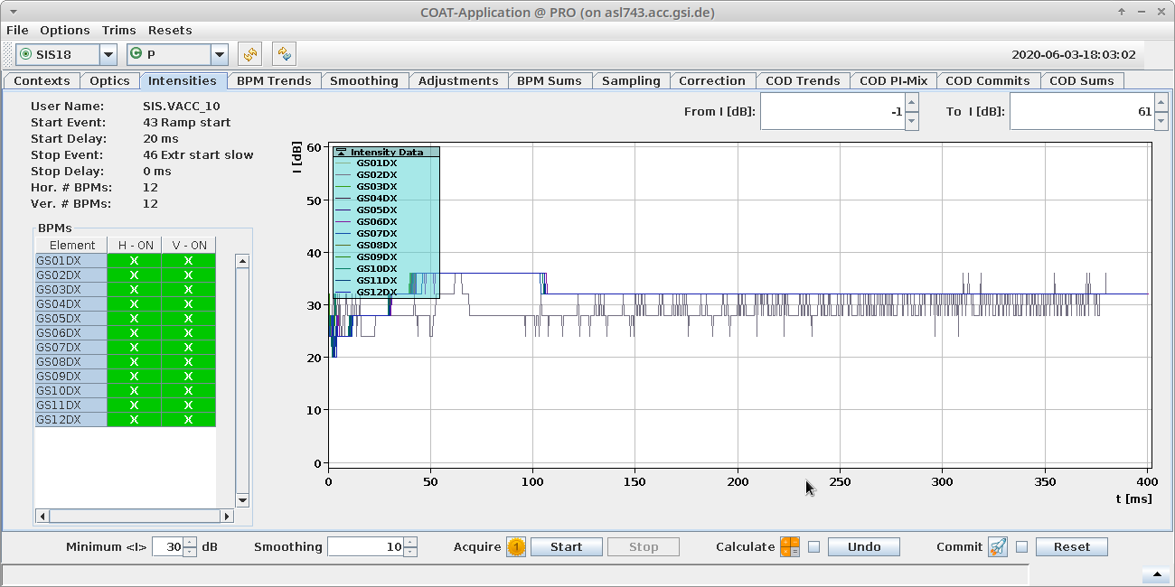
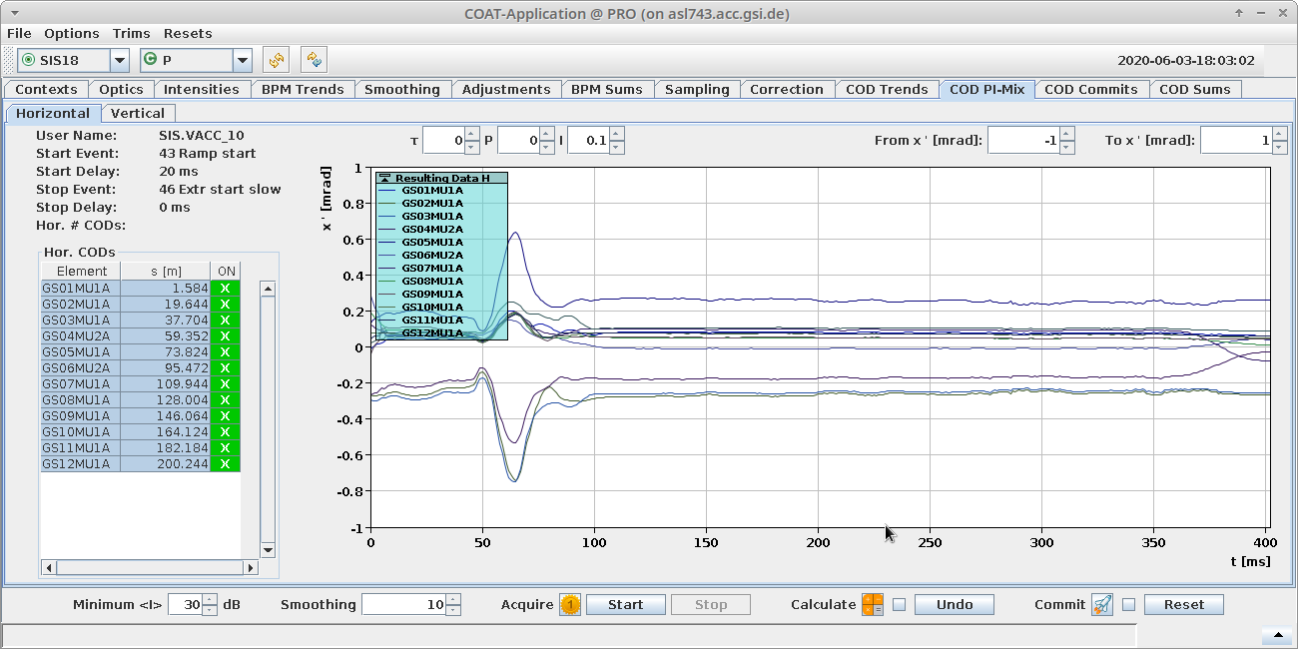
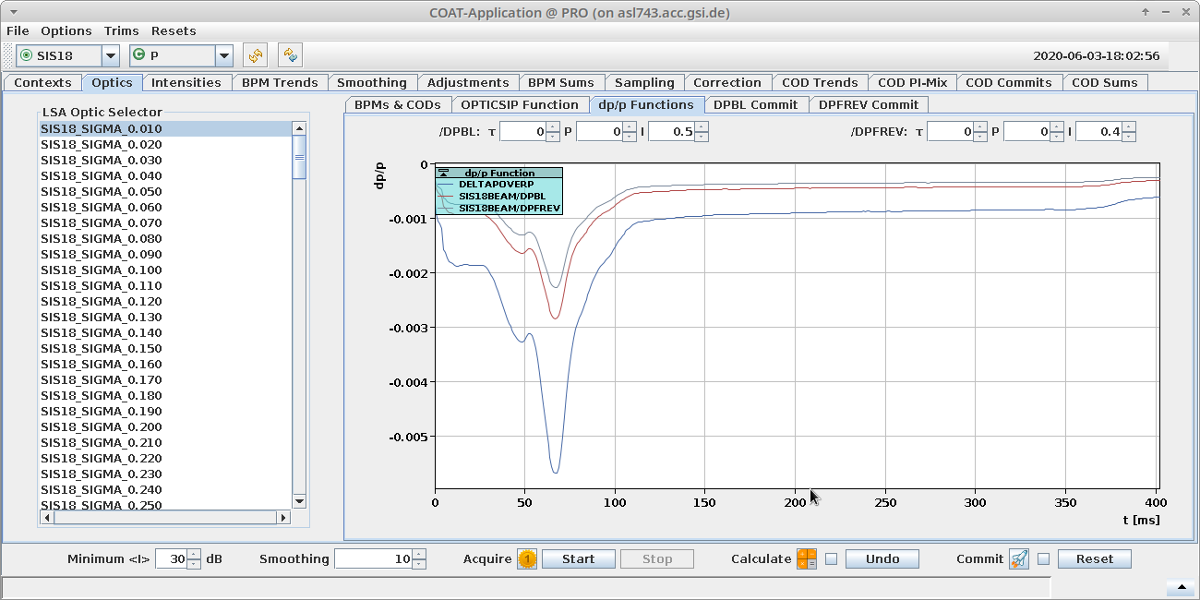
Beam Based Control:
Closed Orbit Feedback (Cycle-to-Cycle)
BPM intensity display
COAT: Closed Orbit And Trajectories (B. Schlei)
Signal source
  BPM signals, digitized by BI group
  Interface presently machine dependent, unification for FAIR
Correction algorithm (service layer)
  Data validation and filtering
  Optics retrieval and SVD computation
  Response matrix based correction
Visualization (UI layer)
  Context selection
  Display of
    signals (raw and filtered)
    calculated corrections
    response matrix properties
  Setting of parameters for PI controllers
  Deselection of faulty BPMs and steerers
Control of dispersion corrections
Control of dispersion corrections

Slide 17
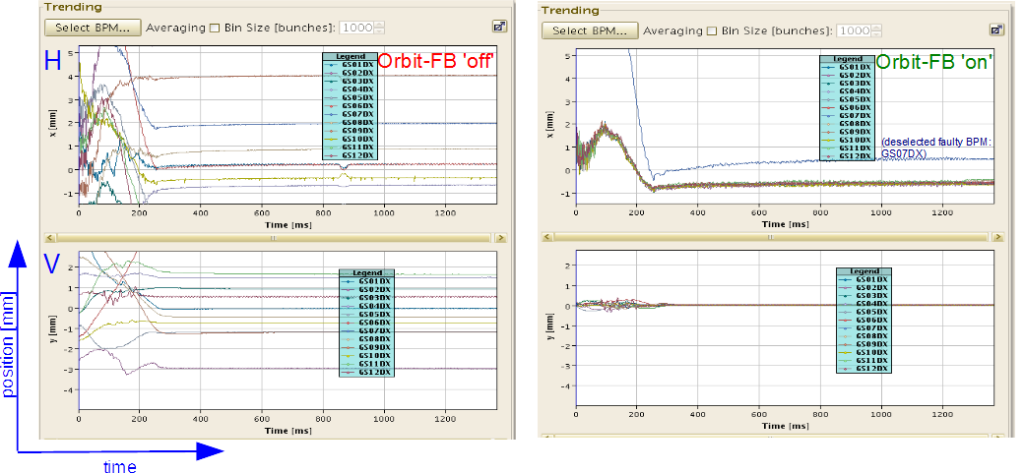
Beam Based Control:
Closed Orbit Feedback (Cycle-to-Cycle)
Stand-alone (fat client) version prepared for use in operation starting from 2021
New features will allow even to suppress the common horizontal motion on ramp
Follow-up during usage by operations crew to improve reliability and robustness

Slide 18
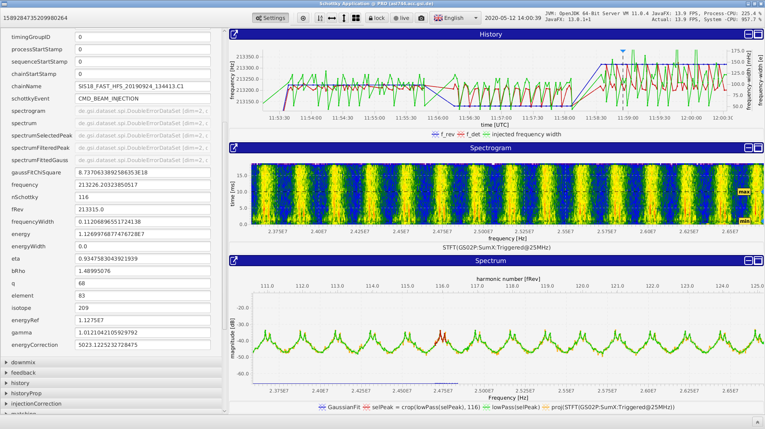
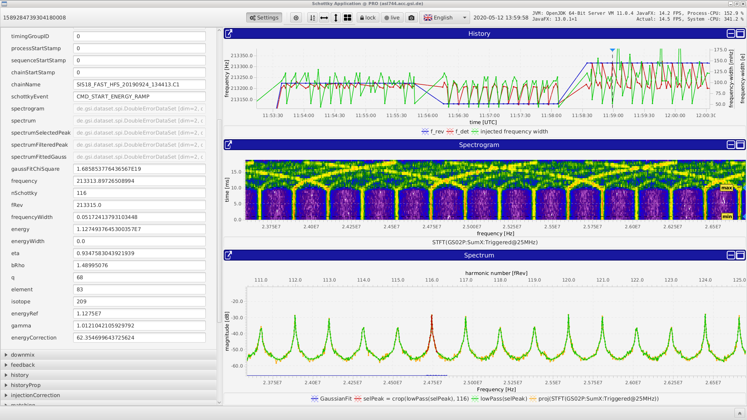
Beam Based Control:
Longitudinal monitoring and matching
Schottky Application (A. Krimm)
Coasting beam in SIS18 after injection
Signal source
  Stripline Schottky signal
  Time domain digitization on generic digitizer
Signal analysis (service layer)
  Spectrum calculation by FFT
  Increased S/N ratio by using many lines
  Peak detection algorithms
  Fit of frequency and width
Visualization (UI layer)
  Spectrogram (vs. time and time slice)
  Display of beam parameters
  History of freq./energy for monitoring
  Correction by trim if necessary
Prototype version prepared for use in operation starting from 2021
Bunched beam in SIS18 just before ramping

Slide 19
Beam Based Control:
Future Architecture
Middle tier service layer
  Data retrieval from devices (BI devices, digitizers, SCUs, services)
  Data aggregation and processing
  Publication of processed data for other services or UIs
Middle tier service framework
  Separation of functional code from generic service tasks (aggregation, communication)
  Minimization of user code
  Keeps system maintainable
  Communication supports CMW protocol
  C++ based due to availability of libraries
    Signal processing
    Data handling
    Mathematics
Micro-services concept
  Small, well-defined functionality
  Keep services small and maintainable
  Depending on required processing power even one service instance per BPC
  Load balancing on server cluster
  Major domo pattern for starting and distributing services
Data visualization and interaction
  Visualization framework (ChartFX)
  Libraries for efficient data handling
R. Steinhagen / A. Krimm

Slide 20
Beam Based Control:
Priorities
Prio 1 systems
  Trajectory control/steering
  (transfer lines and ring for threading)
  Closed orbit control (ring)
  Injection matching (longitudinal)
  Bunch-to-bucket control
Prio 2 systems
  Transmission monitoring
  Transfer line optics control
  Control of spill shape/structure (slow extr.)
  Control of RF gymnastics
Prio 3 systems
  Control of tune and chromaticity
  Optics measurement and correction (ring)
  Optics control and matching (transfer lines)
  Set-up and control of slow extraction
  Set-up and verification of collimator settings
  Validation of machine protection systems
  Final focus control at beam target
  Beam quality monitoring (emittances, etc.)
Priorities as defined by SPL SIS100

Slide 21
Summary:
SIS100 Priority 1 Items
Software
Hardware/Infrastructure
Control of local cryo
  Aggregated visualization
  Monitoring including warnings
  High-level abstraction for simplified control
Quench detection
  High-level visualization
  Quench analysis
Timing and patterns
(Framework, model and GUIs)
  SIS18 booster mode
  Nested patterns
Beam based tools
  Trajectory and orbit control
  Control of B2B transfer
  Injection matching
Core systems
  Timing system for nested patterns
  B2B transfer system
  Post-mortem system
Generic services
  Digitization
    BI signals (BEA)
    Generic digitizers (ACO)
  High BW data visualization (SYS)
  Middle-tier service framework (SYS)
Computing infrastructure
  Server cluster for middle-tier services
    Generic services
    Development env. (CI/CD)
Note: Focus on essential aspects with long lead times, which are missing or not finished yet

Slide 22
Thanks for your attention!
I’d like to thank all colleagues who contributed material for this talk, consciously or unconsciously.
There are certainly many more than I mentioned, and I’d like to acknowledge their work.

Slide 23
Timeline
Want tested systems for commissioning
  Avoid commissioning of control tools at the same time as system to be controlled
  Make sure to be ready well before start of commissioning
Test with existing machines
  Physics of those machines understood
  Focusing on optimization of tools for robustness possible
Beware of lead times
  Generic frameworks, while very useful in the long run, take big effort to implement
  Think about tools for commissioning now
  Procedures help expressing needs and dependencies, but take time to write up
  Take the right decisions now

