Slide 1
GSI operation and general
FAIR commissioning perspective
S. Reimann, P. Schütt, C. Heßler, O. Geithner

Slide 2
Outline
Operations Point of View
  requirements for an efficient operation of the existing facilities
FAIR Commissioning
  requirements for FAIR HW-commissioning
Preferred Timeline
  preferred combined timeline for software developments

Slide 3
Operations Perspective
Present Situation
  General statement: minimum toolset for standard beam production for experiment program is existing and working
  efficiency and handling could be better (sometimes much better), but is constantly improved (see: Task Force Performance & ACC-ACO-Steering Meeting)
What is missing and would boost efficient operation most
  Digitization: Actual Data of all Devices (esp. ramped) and Soll-Ist live-monitoring,
  Semi- or fully automatic orbit tuning for transfer lines (e.g. Geradelegen in Benno)
  Integrated user applications for beam instrumentation (e.g. Schottky @ SIS-Injection)
  Transmission monitoring system
  Sequencer for efficient re-commissioning after shutdown
  Archiving-System for failure analysis
  Alarm-System for dedicated monitoring in special situations (configurable)

Slide 4
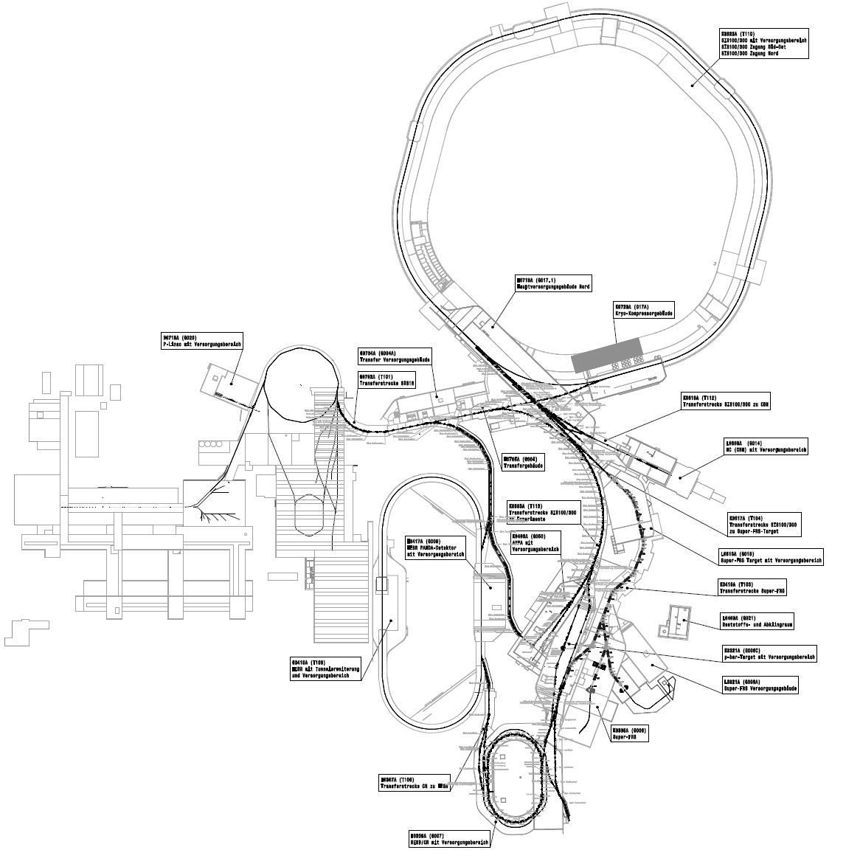
FAIR Commissioning - intermediate perspective - draft schedule
preliminary schedule according to project plans
FAIR Control Center finished
Machine-Commissioning activities will start in 2023 and will peak in 2024 → 2 years from now basic tools must be available
Transfer SIS18 towards APPA and APPA experiment area is most likely to be commissioned with beam first
Move to FCC-MCR in 2024

Slide 5
FAIR Commissioning - Requirements
Minimum tool-set needed for intermediated perspective (until 2024)
  Sequencer Application for automizing repetitive commissioning tasks
  Generic Applications to access (r/(w)) all device parameters & readback values and a live history (Parameters, Ramps, Instrumentation, Infrastructure (vacuum, cooling water, LHe, ...))
  Archiving System (with powerful UI) (incl. postmortem analysis) for detailed offline failure analysis, device debugging, parameter drifts
  Full Digitization of existing machines → Move to new MCR in FCC-building in 2024
  For Dry-Runs and full integration test: Implement FAIR machines that are about to be commissioned into existing controls infrastructure (Device data, models, modes, lattices, optics , FESA-classes, ...)
  Beam-Loss Monitoring system (for pilot beam commissioning of transfer lines)
  Alarm-System for monitoring critical systems
organizational
  Defined Processes and responsible persons for Database updates (LSA, Accelerator DB & Component Database, Optics, Lattices ...?) – which information has its root where? → Official process description
  1 Database solution for Tracking the Commissioning status (PLM?, CDB?,...)

Slide 6
Combined Timeline Sketch

