Slide 1
“Towards Quantum Magnetism with Ultracold Atoms”
Wolfgang Ketterle
Massachusetts Institute of Technology MIT-Harvard Center for Ultracold Atoms
11. Nov. 2010
EMMI Workshop GSI, Darmstadt

Slide 2
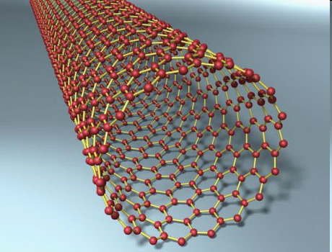
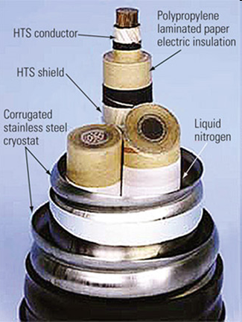
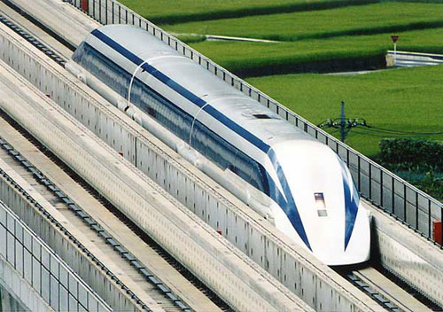
New Materials – driving force for modern technology
high temperature superconductors
carbon nanotubes
colossal magneto-resistance materials …
However:
Physical modeling of these new materials is currently impeded by our limited understanding of strongly interacting many-electron systems

Slide 3
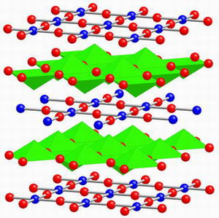
Crystal structure of high-temperature superconductors

Slide 4
Superconductors and other modern materials still have many unresolved mysteries
What is the simplest system to study superfluidity and magnetism?
A dilute gas

Slide 5
ULTRA-dilute gases
Ultralow density: 10¹³ cm⁻³
a million thinner than air
Almost nothing
0.01 femtomole
But:
Those atomic gases can be strongly interacting
They can show strong correlations
Like liquids
Like solids
Like superconductors Like a ferromagnet
When cooled to nanokelvin temperatures

Slide 6
Why quantum simulators?
New materials harnessing strong correlations in many-electron systems: Nanotubes, quantum magnets, superconductors, …
?
Approximations,
Impurities,
no exact solutions
Quantum simulators: Controlled, “simple” systems testing models and verifying concepts
Condensed matter models: Simple models which capture the relevant mechanism

Slide 7
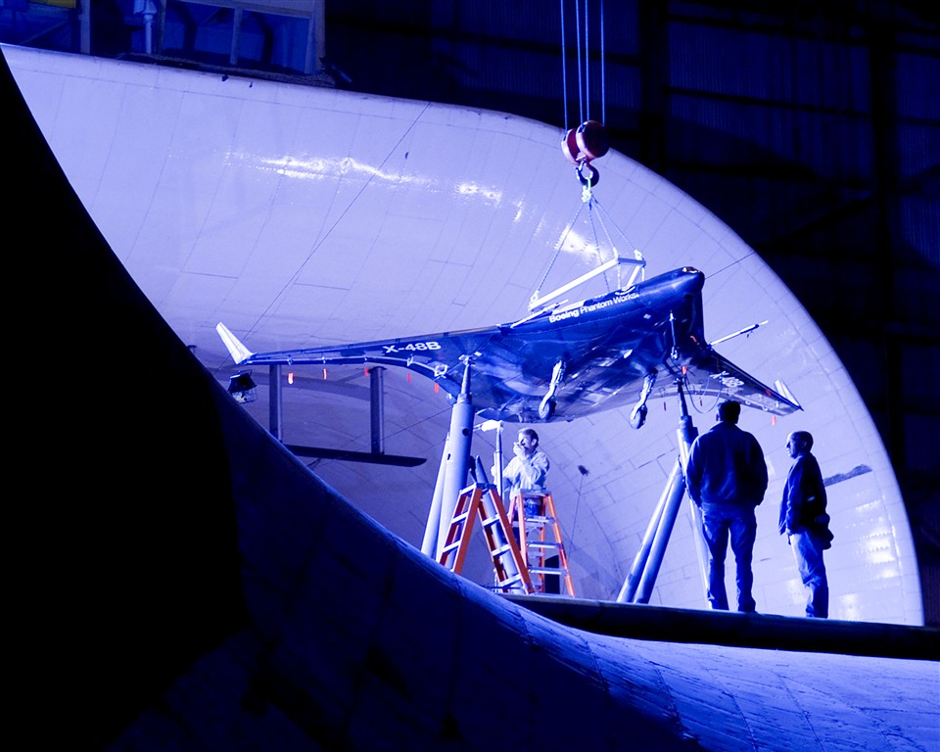
Analogy
New airplanes
?
Testing and understanding models: Wind tunnel
Approximations
Engineering design

Slide 8
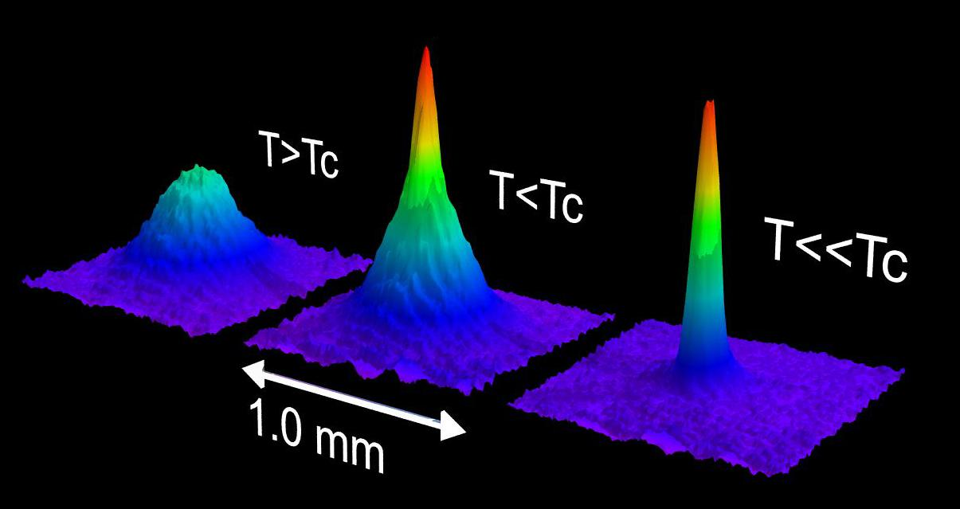
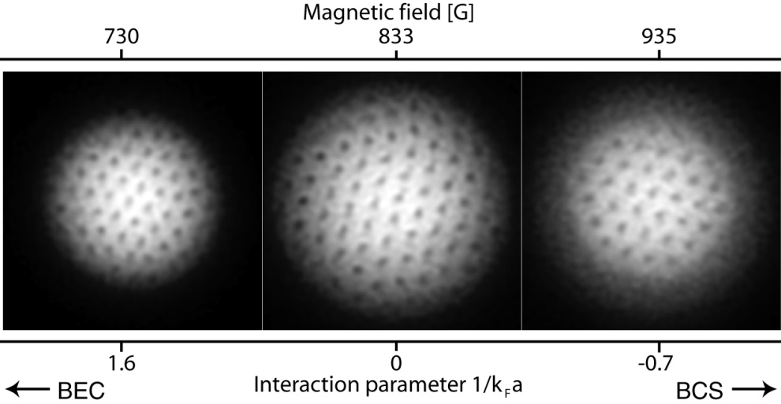
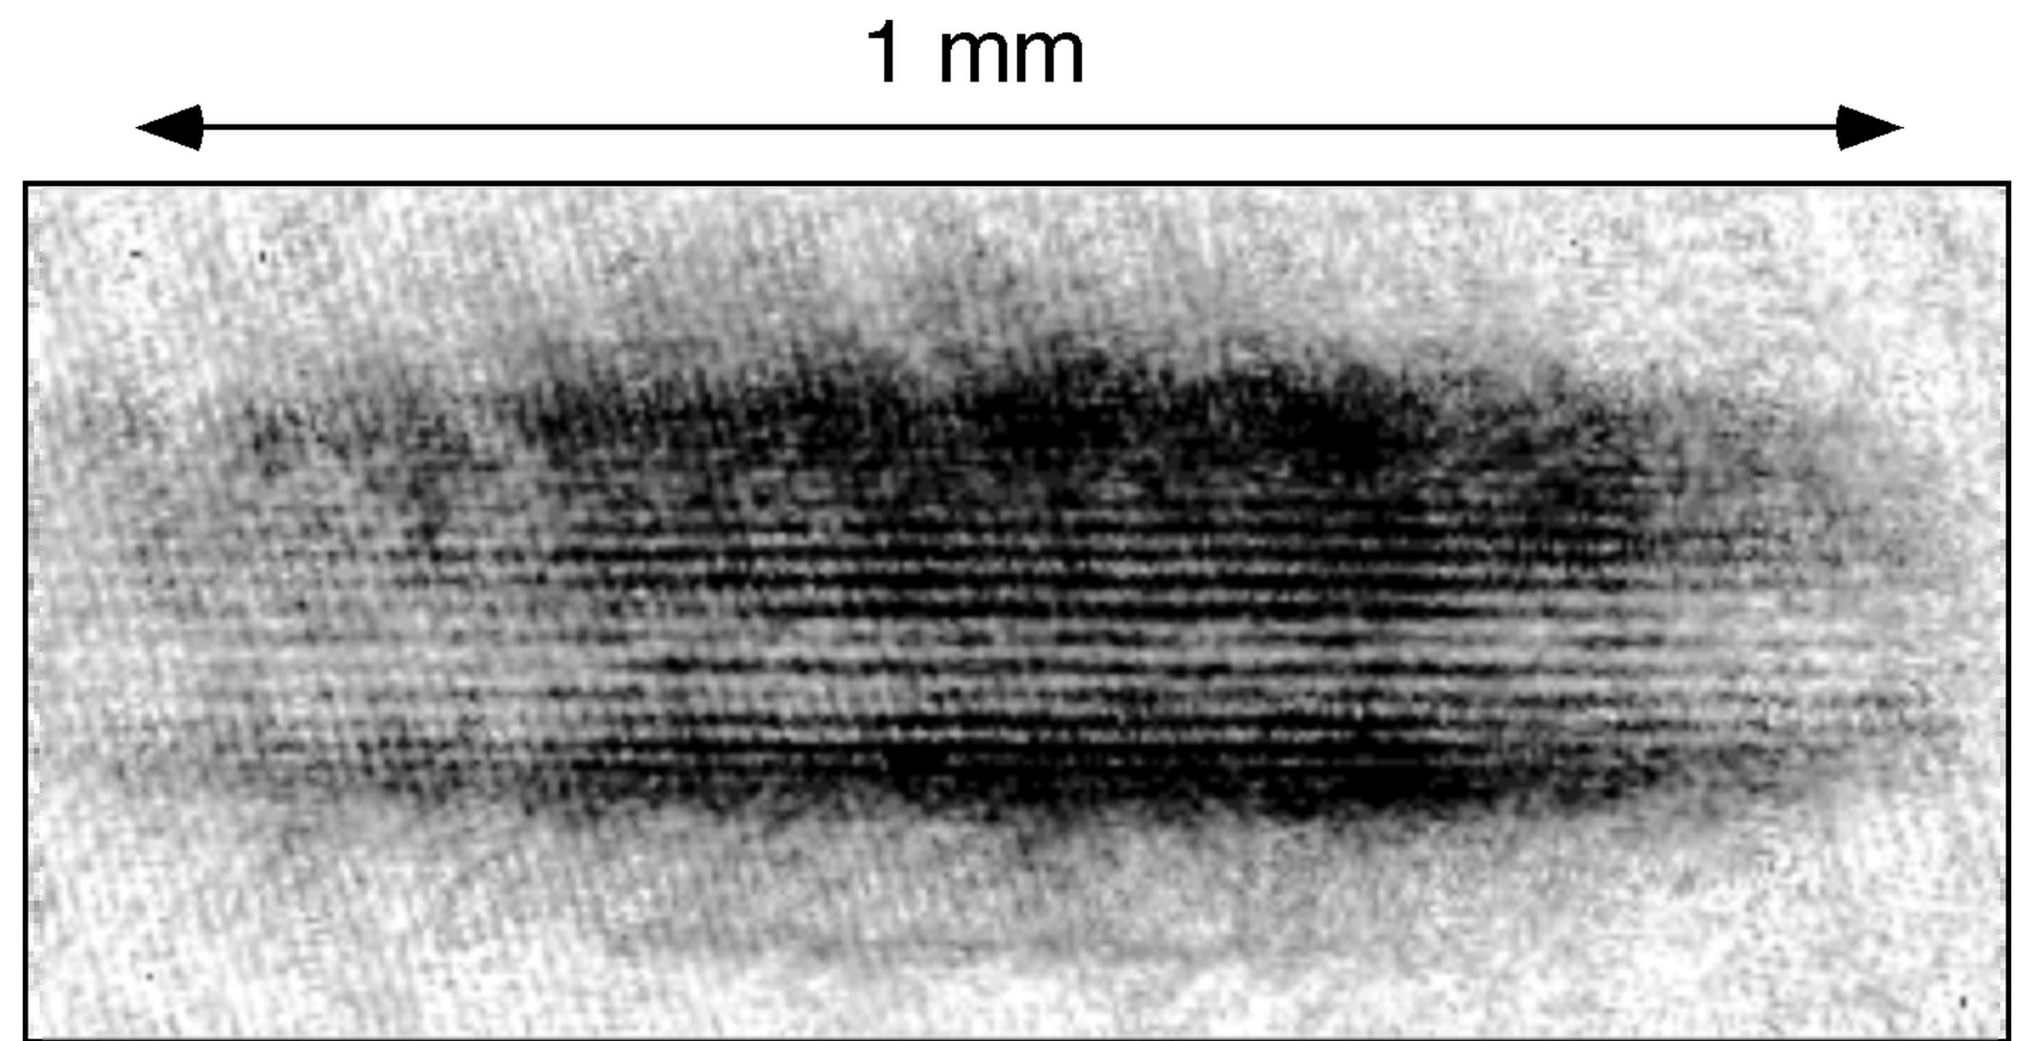
Cold atoms:
25 years of laser cooling
14 years of degenerate quantum gases
All focused on controlling and freezing out motion
Bose-Einstein condensation
Matter wave propagation
Superfluid Fermi gases
Superfluid-to-Mott insulator transition

Slide 9
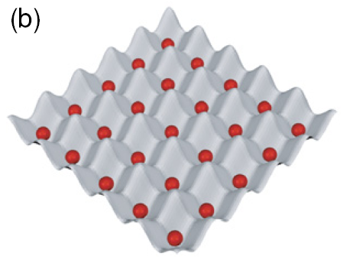
Next challenge
Magnetic ordering - quantum magnetism
(ferromagnetism, antiferromagnetism, spin liquid, …)
Dominant entropy: spin entropy

Slide 10
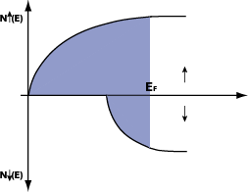
Two paradigms of magnetism
Magnetism of localized electrons
superexchange interactions
localized spin
Magnetism of itinerant electrons
delocalized conduction electrons
Stoner criterion
transition metals and their alloys
Schematics for
free electron gas
*Other “exotic” form of magnetism in BECs:
Spinor BEC: Weak spin-dependent mean field, but with bosonic enhancement
Dipolar BEC

Slide 11
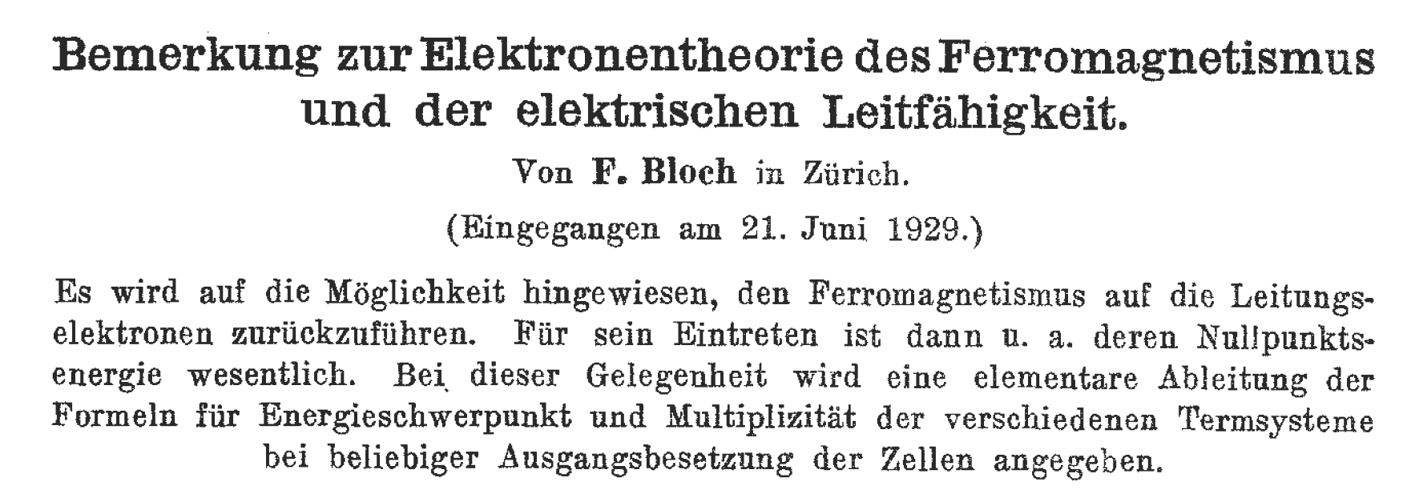

Slide 12
Itinerant Ferromagnetic Phase Transition in Ultracold gases
Increasing k_{F}a
2^{2/3}
EF
EF
Energy
: Spin
: Spin

Slide 13
Two fermions in a well
Non-interacting
Singlet
Triplet
Short range interaction
Triplet
Energy
Singlet
Interaction strength

Slide 14
Two known theorems:
For arbitrary spin-independent interactions, the ground state is always a singlet state
For two particles
In 1D (Lieb-Mattis theorem, 1962)
No solution of proof so far for 2D or 3D.
For three particles in HO: ground state can be ferromagnetic (Drummond, ICAP 2010)

Slide 15
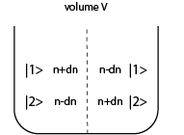
Itinerant Ferromagnetism
T=0 Mean-field Stoner model for
the phase transition
local magnetization
K.E. spin up
K.E. spin down
repulsive mean field interaction

Slide 16
Itinerant Ferromagnetic Phase Transition T=0 Mean-field model
Constant Pressure (minimizing Enthalpy H)
Onset of magnetization
Minimum of kinetic energy
Maximum in
volume

Slide 17
Realize the Stoner model for itinerant ferromagnetism in a trapped two-component Fermi gas
“Solve” the Hamiltonian by performing an experiment ….
Does this Hamiltonian have
a phase transition to a ferromagnetic state?
or: is it possible to have a ferromagnetic gas (without lattice)?
Theory: M.Houbiers et. al. (1997), M.Amoruso et. al.(2001), T.Sogo et. al.(2002), R.A.Duine et. al. (2005), I.Berdnikov et. al.(2008), S.Zhang et. al.(2008), L.LeBlanc et. al. (2009), G.Conduit et al.(2009)

Slide 18
Feshbach Resonance
Energy
Atoms
Molecules
Magnetic field
Atoms form stable molecules
Molecules are unstable
Atoms repel each other a>0
Atoms attract each other a<0
BEC of Molecules:
Condensation of
tightly bound fermion pairs
BCS-limit:
Condensation of
long-range Cooper pairs
Itinerant Ferromagnetism Stoner instability in a free gas

Slide 19
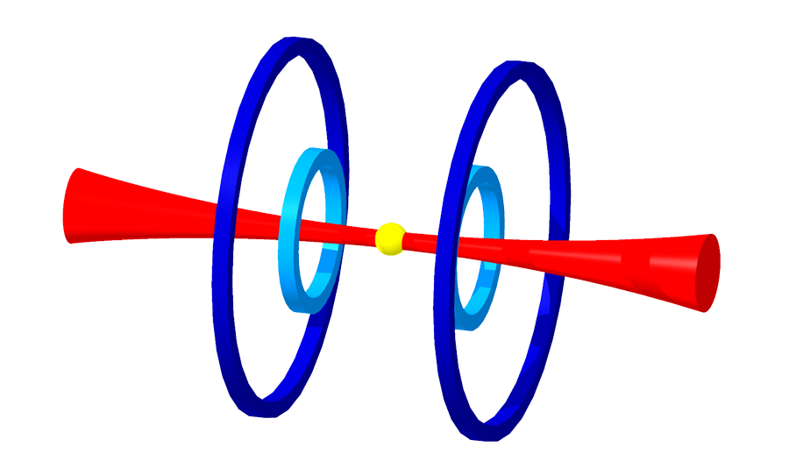
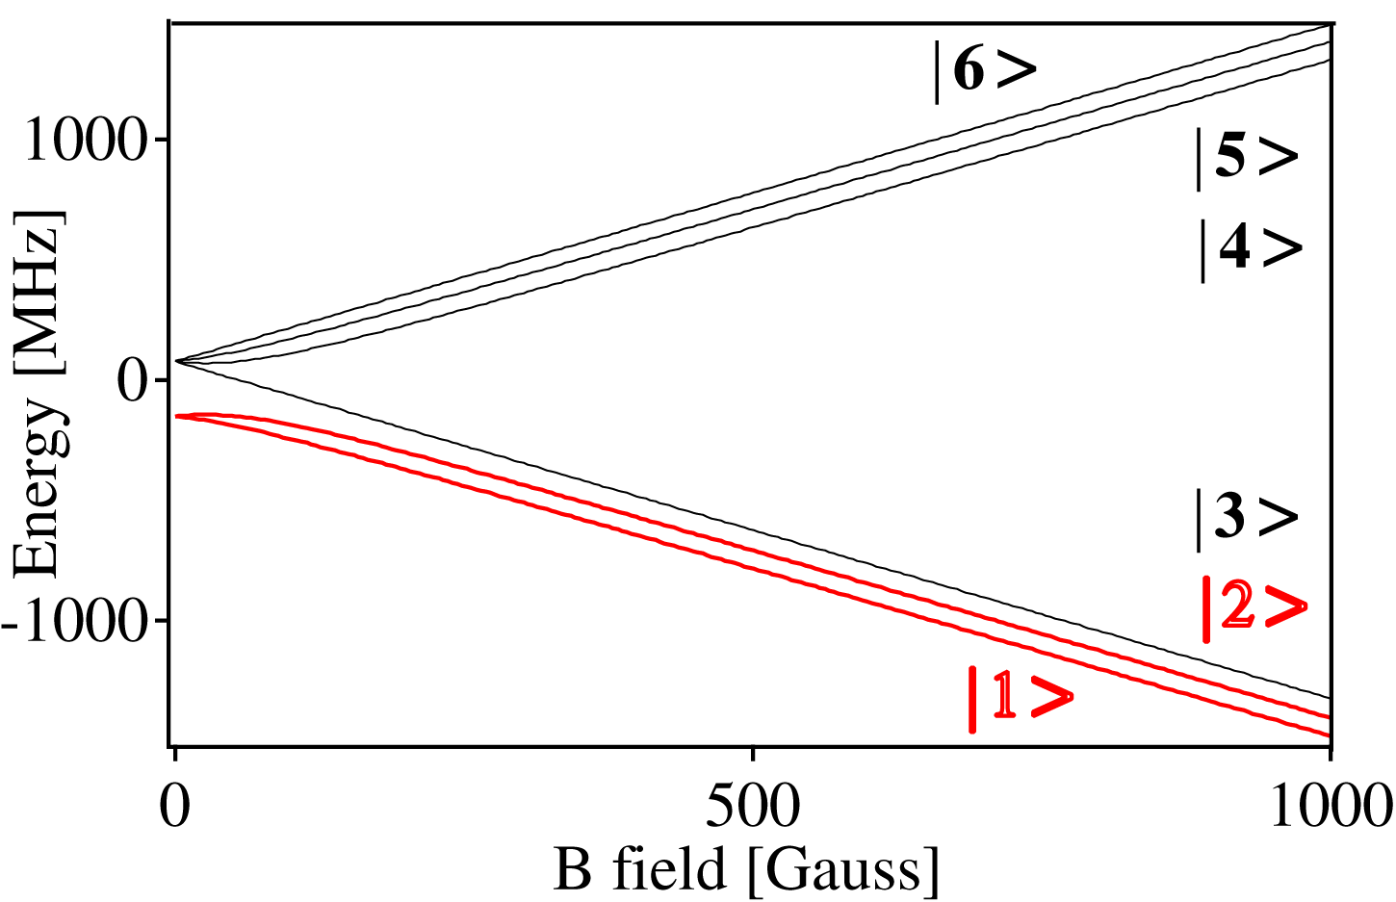
Preparation of an interacting Fermi system in ⁶Li
Typical parameters:
Optical trapping:
10 W @ 1064 nm
ω = 2π × (15,15, 0.2) kHz
E_{trap} = 1 mK
States |1> and |2> correspond to
|↑> and |↓>

Slide 20
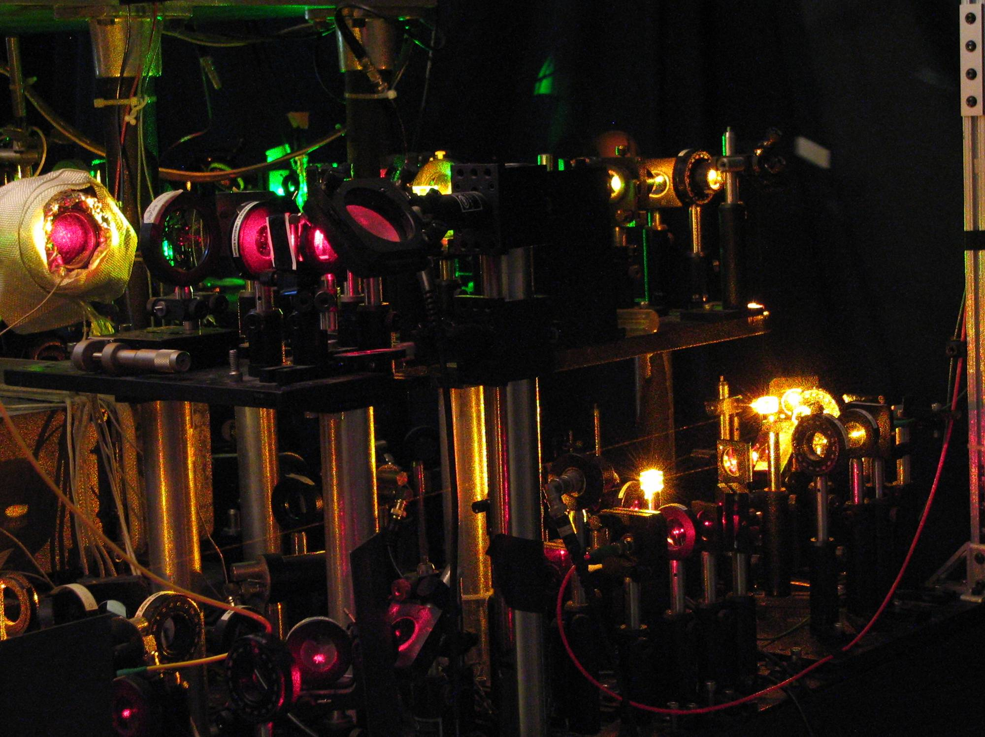

Slide 21
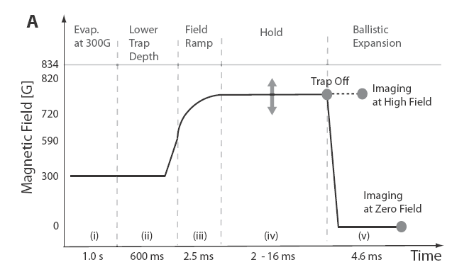
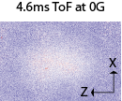
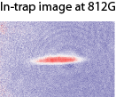
Experiments
Prepared a two-component Fermi gas( ~ 0.65 million per each spin state)
Vary repulsive interactions near Feshbach resonance located at 834 G

Slide 22
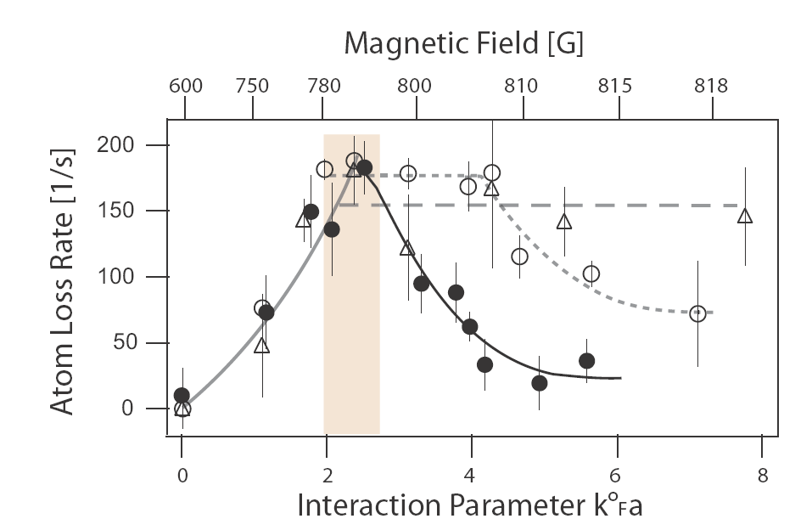
Local Probe for magnetization 
✪ n₁ n₂
Three body recombination rate (molecule formation)
✪ a⁶ n_{total}² (1-²) for small a, T
T/T_{f} = 0.55
T/T_{f} = 0.22
T/T_{f} = 0.12
Highly Suppressed Atom-Atom Collisions

Slide 23
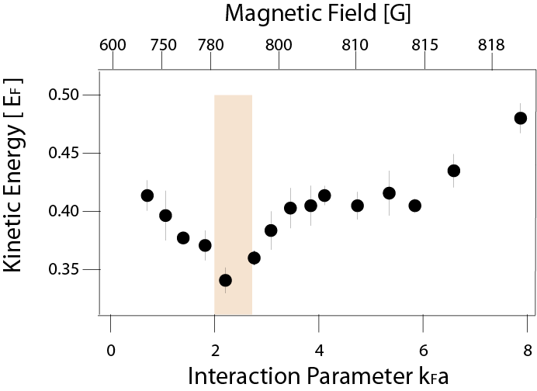
Kinetic Energy of the gas
At T/T_{f} = 0.12
Minimum!

Slide 24
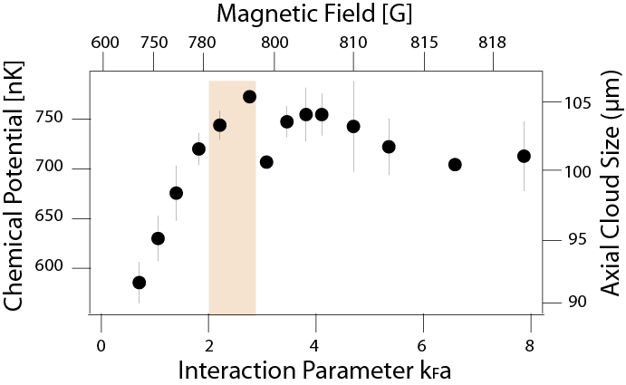
Three observations of non-monotonic behavior when approaching the Feshbach resonance
Suggests that itinerant FM can occur for a free gas with short-range interactions
First study of quantum magnetism in cold fermionic atoms
Quantum simulation of a Hamiltonian for which even the existence of a phase transition is unknown
BUT:
Lifetime only 10 ms
Molecular fraction 25 %
Magnetic domains not resolved
Ferromagnetic fluctuations vs. ferromagnetic ground state
G.B. Jo, Y.R. Lee, J.H. Choi, C.A. Christensen, H. Kim, J. Thywissen, D.E. Pritchard, W.K., Science 325, 1521-1524 (2009).

Slide 25
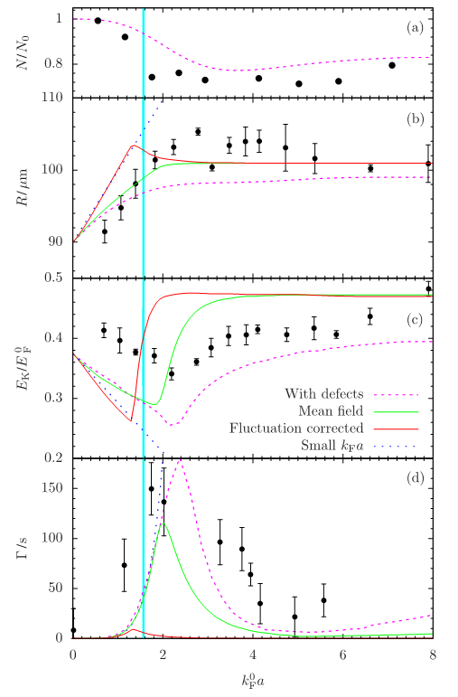
Mean field transition in the presence of the trapping potential
LeBlanc, Thywissen, Burkov & Paramekanti, Phys. Rev. A 80, 013607 (2009)
Conduit & Simons, Phys. Rev. Lett. 103, 200403 (2009)

Slide 26
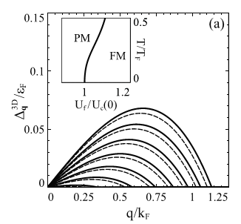
Domain growth after rapid quench across the phase transition
Initial domains are VERY small
Babadi, Pekker, Sensarma, Georges, Demler, arXiv:0908.3483

Slide 27
Correlated versus Ferromagnetic State in Repulsively Interacting Two-Component Fermi Gases
What is the equilibrium state?
Magnetic domains (i.e. ferromagnetic state)
Ferromagnetic fluctuations (correlations), i.e. non-magnetic state
Hui Zhai, Physical Review A, 80, 051605 (2009)
Jason Ho, private communication

Slide 28
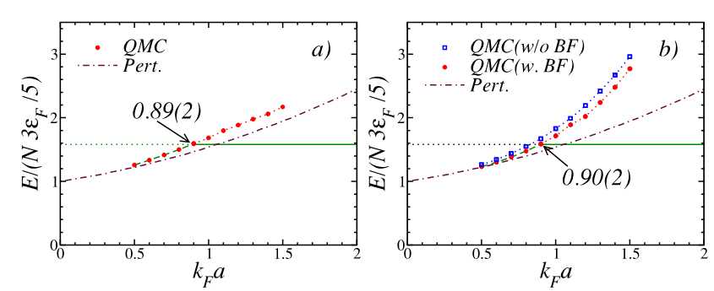
Monte-Carlo simulations of hard core interactions and upper branch of Feshbach resonance
Chang, Randeria & Trivedi, arXiv:1004.2680 Pilati, Bertaina, Giorgini & Troyer arXiv:1004.1169

Slide 29
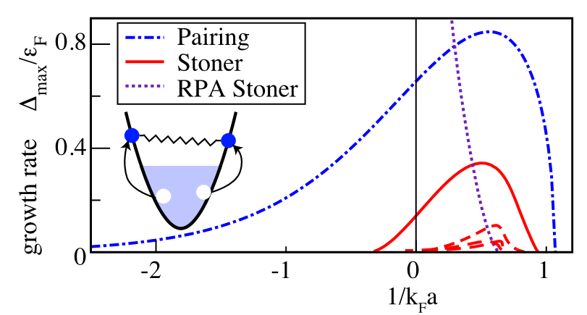
Competition between pairing and ferromagnetic instabilities
Pekker, Babadi, Sensarma, Zinner, Pollet, Zwierlein, Demler, arXiv:1005.2366

Slide 30
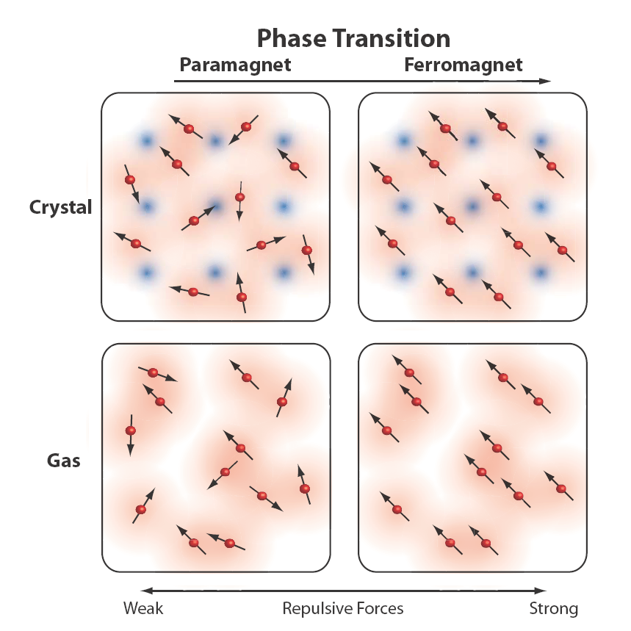

Slide 31
Bosonic or fermionic Hubbard Hamiltonian
is equivalent to spin Hamiltonian (for localized particles)
Duan, Demler, Lukin (2003)

Slide 32
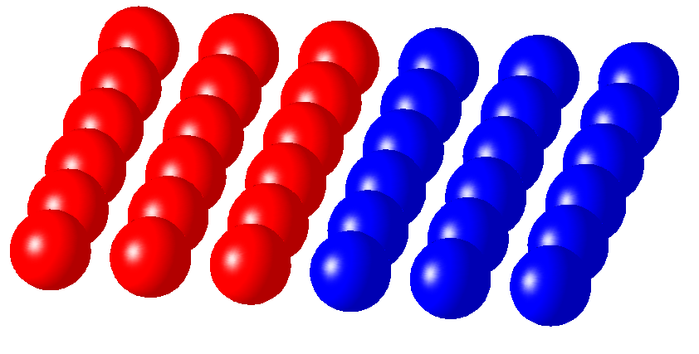
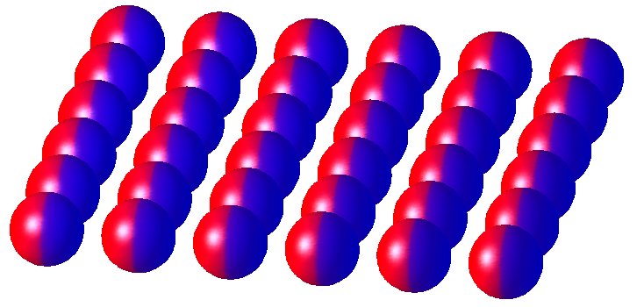
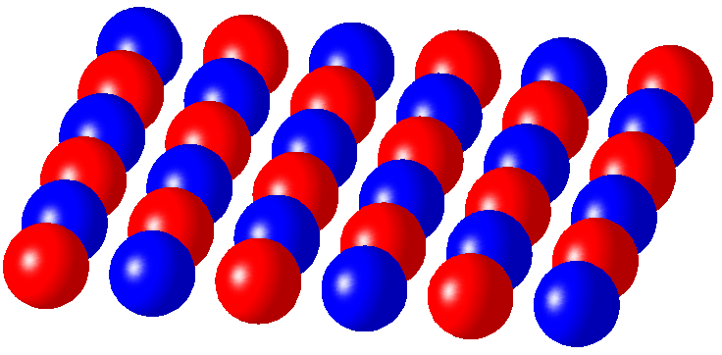
Magnetic Ground States
Z-Ferromagnet:
XY-Ferromagnet:
Antiferromagnet:

Slide 33
Towards quantum magnetism
Characterization of new quantum phases
density fluctuations to determine compressibility, spin susceptibility and temperature (MIT, ETH)
New cooling scheme
spin gradient demagnetization cooling

Slide 34
Challenge:
To reach the low temperatures (entropies) necessary for magnetic ordering
Critical entropy for the Heisenberg antiferromagnet:
S/Nk_{B} = ln2/2

Slide 35
Fermions
AF ordering requires T/T_{F} ≈ 0.02 … 0.07
Bosons
3.6
So far, entropies < log2 have been reached, but not in a lattice (fermions) or with two component bosons

Slide 36
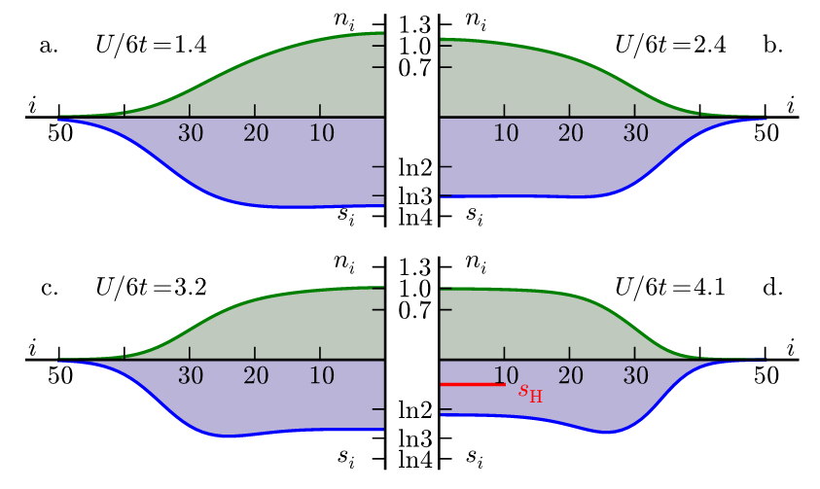
radial profiles of density and entropy

Slide 37
Ultracold atoms to do “room-temperature” physics
Fermions: lowest T/T_{F} achieved
for attractive interactions 0.03
for repulsive interactions 0.1
Electrons in metal:
typical T_{F} is 30,000 K
room temperature is T/T_{F} =0.01
BUT: neutral atoms have adjustable interactions
can be used to have high T_{crit}
e.g. s-wave superfluidity at T/T_{F} = 0.15
compared to ³He (T_{F}=0.5 K): T/T_{F} =0.02 is 10 mK

Slide 38
Rb lattice experiment @ MIT Towards quantum magnetism in a two-component Mott insulator

Slide 39
Goal: Magnetism of localized spins
Requires TOTAL entropy to be less than N k_{B} log2

Slide 40
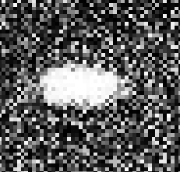
Two component Bosons for Quantum Magnetism
Before we can mix them, we have to control their separation
Two component Mott insulator
equal mix of (2,-2) and (2, 2) states (or (1,-1))
• Variable B-field gradient
• Polarization contrast imaging (or two absorption pictures): 2,+2 (or (1,-1) black, 2,-2 white
2,+2
2,-2
Mixture

Slide 41
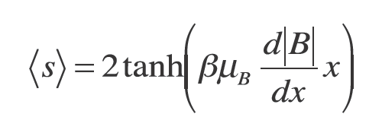
Spin Gradient Thermometry in a 2-component Mott insulator
• Spins separate in a magnetic field gradient (1 G/cm typical)
• At zero temperature: sharp boundary
At non-zero temperatures: finite boundary region

Slide 42
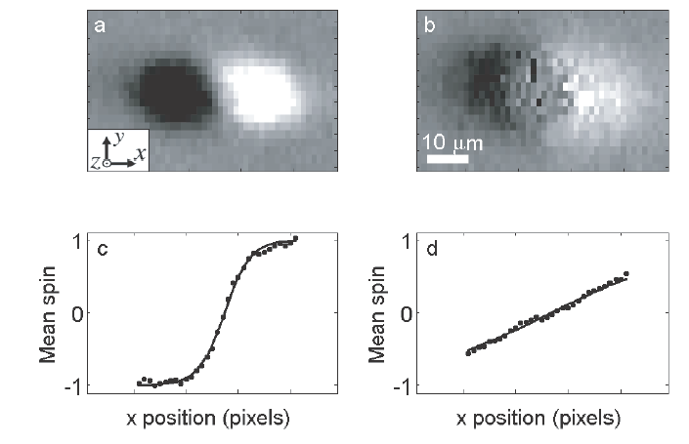
Spin Gradient Thermometry in the Mott Insulator
Cold
Hot
52 nK
296 nK
D.M. Weld, P. Medley, H. Miyake, D. Hucul, D.E. Pritchard, W. K., Phys. Rev. Lett. 103, 245301 (2009).

Slide 43
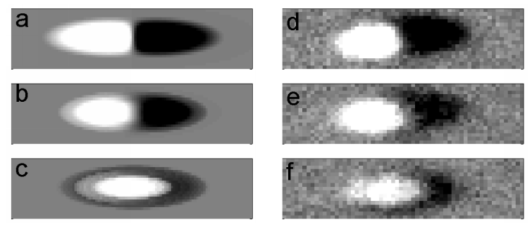
0.7 G/cm
6 nK
0.06 G/cm
2 nK
0.0024 G/cm
0.4 nK
Simulation
Experiment
Simulation includes buoyancy effect due to slightly different scattering lengths of the two states
D.M. Weld, H. Miyake, P. Medley, D.E. Pritchard, W. K.
arXiv:1008.4610

Slide 44
Next: Use field gradient for manipulation
Adiabatic change:
adiabatic cooling of Mott insulator

Slide 45
Adiabatic demagnetization cooling
a standard cryogenic technique
Spin system (electron or nuclear spins)
Other degrees
of freedom
T_{initial}
Other degrees
of freedom
T<T_{initial}
Equil.
Cool
high B field
low B field

Slide 46
Negative temperatures
Spin system (electron or nuclear spins)
positive temperature
negative temperature
fast
high B field
inverted B field

Slide 47
Negative temperatures
More energy than positive temperatures
Possible only for systems with finite maximum energy
higher energy
0
-1/T
-∞
T=0
absolute zero
0
T=±∞
equipopulation
+∞
T=-0
only highest energy state populated

Slide 48
Adiabatic demagnetization cooling
a standard cryogenic technique
Spin system (electron or nuclear spins)
Needs spin flip collisions
(Chromium (Pfau, 2006))
50 pK = 1 Hz = 0.7 μG
Other degrees
of freedom
T_{initial}
Other degrees
of freedom
T<T_{initial}
Equil.
Cool
high B field
low B field

Slide 49
Spin gradient demagnetization cooling
high gradient, T_{initial}
Low gradient, T<<T_{initial}
No coupling with rest of system: width of the layer stays the same
same entropy
Coupling with rest of system:
Entropy flows into layer,
larger width
Principle of adiabatic cooling: Transform spin states into states with lower energy. Entropy of the system will flow to the spin states.

Slide 50
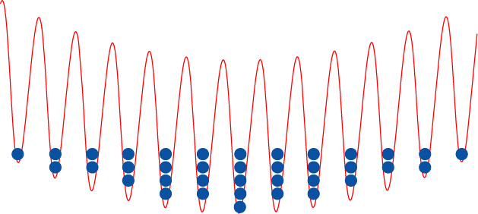
The Superfluid-Mott Insulator transition
Shallow Lattices - Superfluid
Deep Lattices – Mott Insulator

Slide 51
Mott insulator
x
slow spin relaxation
Superfluid
Optical lattice depth
x
Magnetic field gradient
Demag. cooling

Slide 52
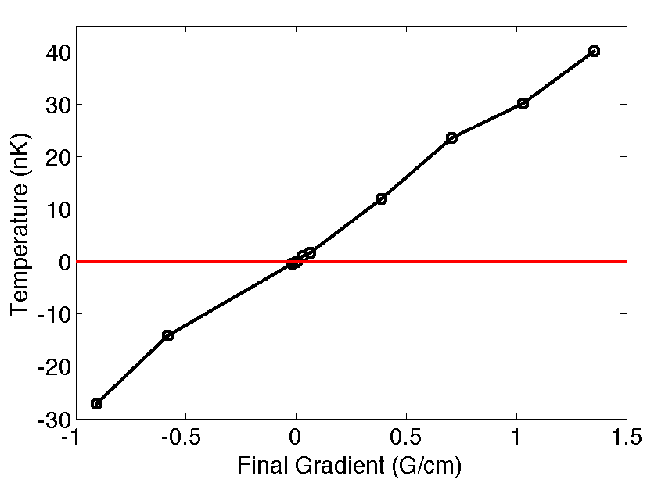
Positive and Negative Spin Temperatures
closer to zero than ±50 picoKelvin
• Takes advantage of long relaxation times in Mott insulator

Slide 53
Negative temperatures
More energy than positive temperatures
Possible only for systems with finite maximum energy
dS=dQ/T
higher energy
0
-1/T
-∞
T=0
absolute zero
0
T=±∞
equipopulation
+∞
T=-0
only highest energy state populated
zero entropy
max. entropy
zero entropy

Slide 54
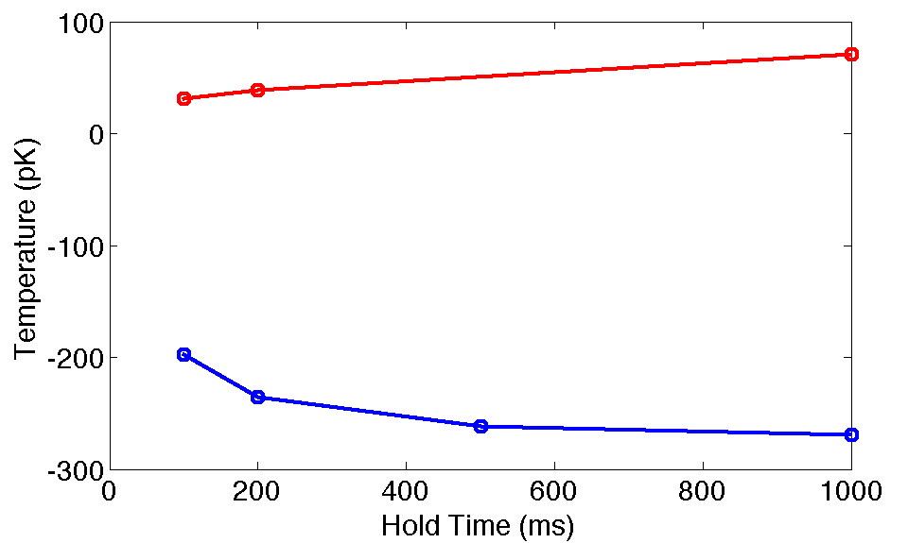
Spin Heating

Slide 55
Note: Spin polarized atoms in magnetic traps have a state purity of typically 1-10⁻⁵
At 100 mG bias field: T_{spin}= - 500 nK
pK temperatures need μG!
Here: mG/cm gradient, 10 μm resolution

Slide 56
Mott insulator
x
Superfluid
slow
Optical lattice depth
fast
spin
relaxation
x
Magnetic field gradient
Demag. cooling

Slide 57
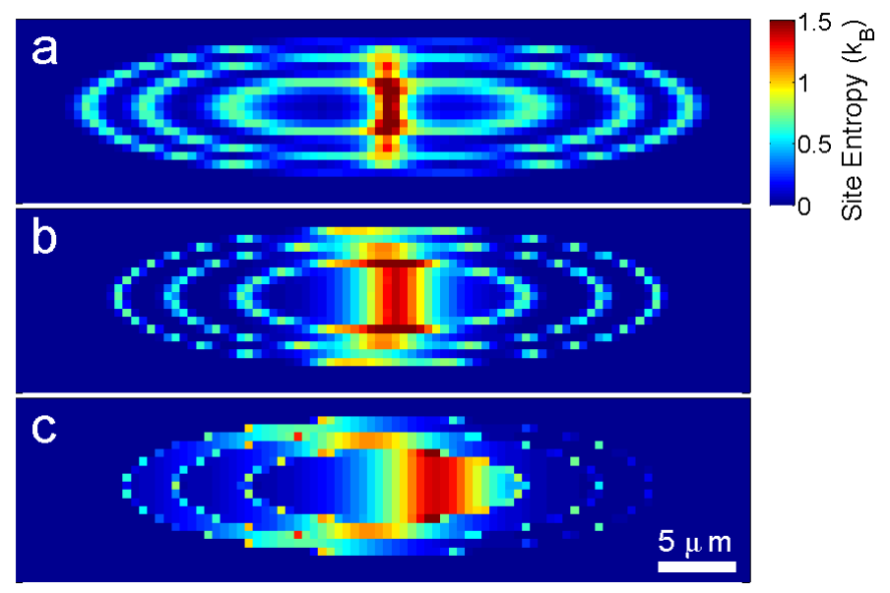
Simulation of entropy density:
Demagnetization from 0.5 to 0.02 G/cm
Temperature reduced from 3 to 0.5 nk

Slide 58
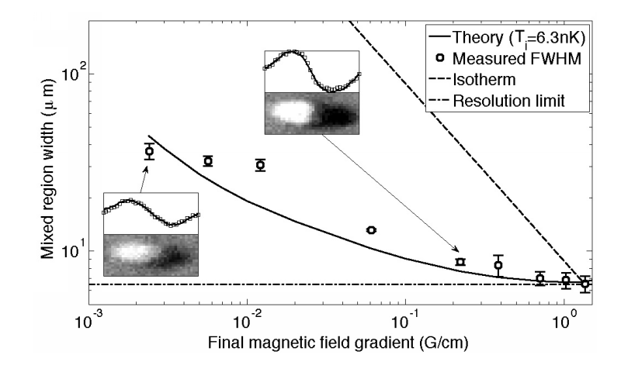
Theory: simple model for entropy based on deep lattice, assuming perfect adiabaticity

Slide 59
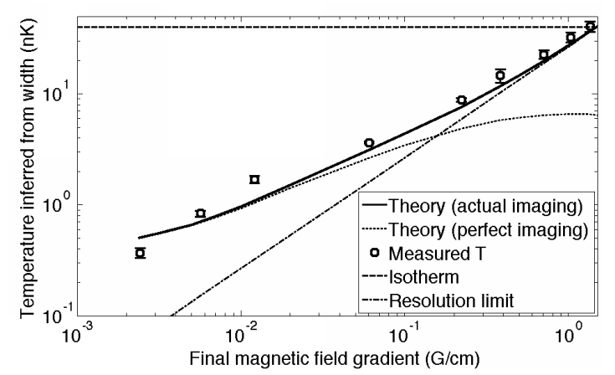
Demagnetization Cooling
350 ± 50 picoKelvin

Slide 60
Lowest temperatures ever recorded
Previous low temperature records
Kinetic temperature in a gas: 450 pK, MIT (2003)
Spin temperature: 100 pK, - 750 pK Helsinki (2000, 1993)

Slide 61
Magnetic Ground States
Z-Ferromagnet:
XY-Ferromagnet:
Antiferromagnet:

Slide 62
Use the tools and precision of atomic physics to realize
new phenomena (Hamiltonians) of many-body physics
Bosons
Weakly interacting Bose gas
Bose-Hubbard model (Mott insulator)
1D Tonks gas
2D KBT transition
Anderson localization of atoms
Fermions
BEC-BCS crossover
Fermions with “infinite” interaction strength
Imbalanced Fermi superfluids
Fermi-Hubbard model
Itinerant ferromagnetism in a gas

Slide 63
BEC II
Ultracold fermions: Lattice density fluct. Christian Sanner
Aviv Keshet
Ed Su
Wujie Huang
Jonathon Gillen
BEC III
Na-Li Ferromagnetism
Caleb Christensen
Ye-ryoung Lee
Jae Choi
Tout Wang
Gregory Lau
D.E. Pritchard
BEC IV
Rb BEC in optical lattices
Patrick Medley
David Weld
Hiro Miyake
D.E. Pritchard
$$
NSF
ONR MURI-AFOSR
DARPA

