Slide 1

Deterministic preparation and control of a few fermion system
Selim Jochim
Physics Institute, Heidelberg University
and Max-Planck-Institute for Nuclear Physics

Slide 2
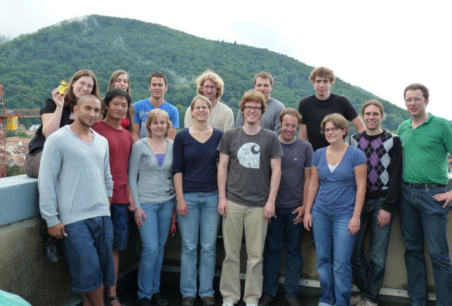
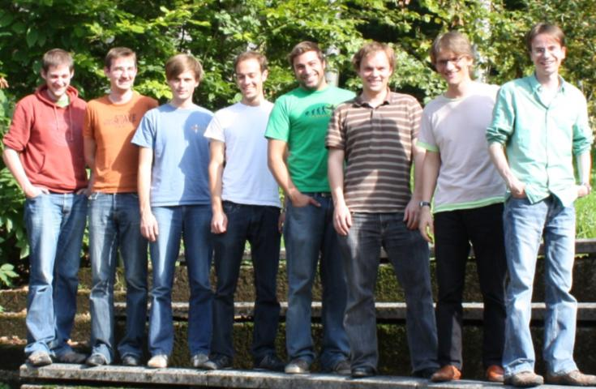
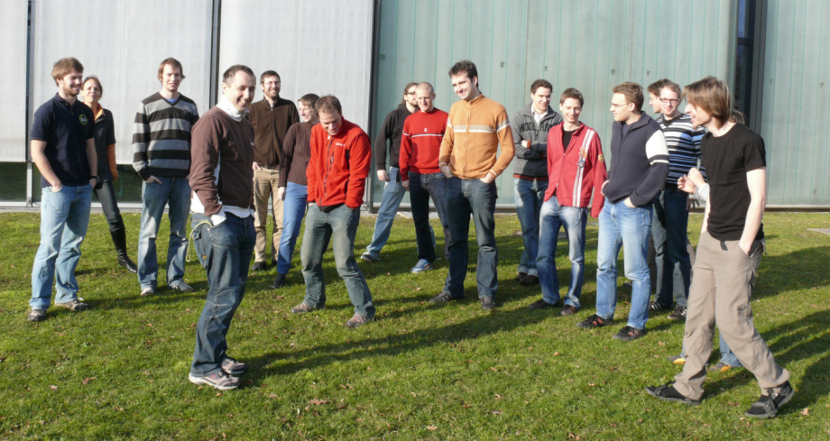

Ultracold atoms experiments @ EMMI
Jochim group
Physikalisches Institut
MPI für Kernphysik
Weidemüller group
Physikalisches Institut
Oberthaler group
Kirchhoff-Institut

Slide 3
The matter we deal with
T=40nK … 1µK
Density n=10⁹ … 10¹⁴cm⁻³
Pressures as low as 10⁻¹⁷mbar
k_{B}T ~ 5peV
Extremely dilute gases,
which can be strongly interacting!
Extreme matter!

Slide 4
Important length scales
interparticle separation
size of the atoms
de Broglie wavelength
size of the atoms
scattering length a , only one length determines interaction strength
→ Universal properties, independent of a particular system!
→ We can tune all the above parameters in our experiments!

Slide 5
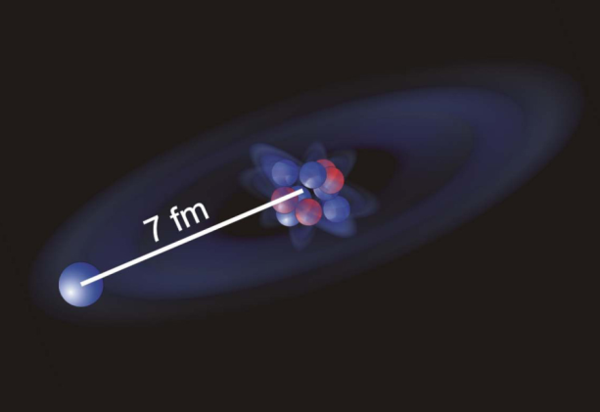
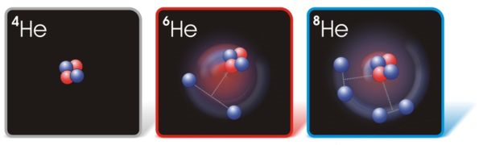
Universality in nuclear systems …
„Halo dimer“
¹¹Be Nörtershäuser et al., PRL102 062503,2009
„Borromean“ states
Argonne Nat. Lab.

Slide 6
What we work on in the lab ….
Three-body physics:
Radio frequency association of Efimov trimers
On the way to complex many-body phases
Finite Fermi systems with tunable interaction
Very recent results!
Crossover from deterministic
to thermodynamic ensembles

Slide 7
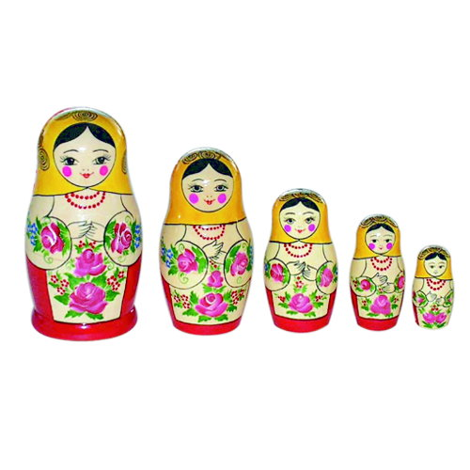
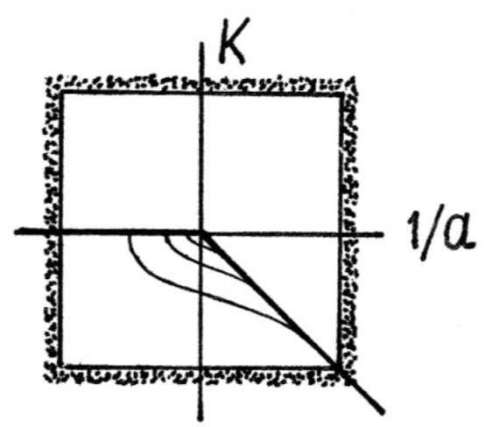


The Efimov effect (V. Efimov, 1970)
An infinite number of 3-body bound states exists when the scattering length diverges: (3 identical bosons)
At infinite scattering length:
E_{n}=22.7²E_{n+1}
Scattering length values where
Efimov trimers become unbound
a_{n+1}=22.7a_{n}
Position of the series fixed by a
three-body parameter, a*
Drawing: V. Efimov

Slide 8
Observing an Efimov Spectrum?
10nm
(1st state)
227nm
(2nd state)
5.2µm
(3rd state)
0.12mm
(4th state)
2.7mm
(5th state)

Slide 9
What is observed in experiments?
three-body recombination
deeply bound molecule

Slide 10

Enhanced recombination
With an (Efimov) trimer at threshold recombination is enhanced:
deeply bound molecule

Slide 11
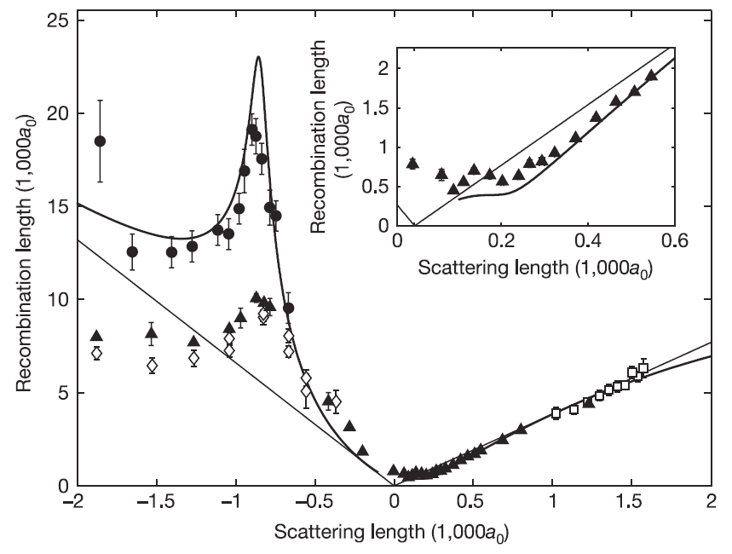
What has been done in experiments?
Observe and analyze collisional stability in
ultracold gases
pioneering experiment with ultracold Cs atoms (Innsbruck):
T. Krämer et al., Nature 440, 315 (2006)

Slide 12
Efimov physics with Fermions?

Slide 13
Efimov physics with fermions
Need three distinguishable fermions with (in general) different scattering lengths:
1
1
a₁₃
a₁₂
a₁₁
a₁₁
1
1
a₁₁
3
2
a₂₃

Slide 14
A three-component mixture of ⁶Li
Ground state of ⁶Li in magnetic field:
Notes:
Up to this point in the talk we have been dealing with only the two lowest hyperfine states and have been using established technology to prepare our samples. How do we now proceed to create the three-component gas? In principle, this is very simple: the three individual states are coupled through two radio frequency transitions, very much like in RF spectroscopy experiments.

Slide 15
… three scattering lengths …
Feshbach resonances
zero crossings
…are tuned with one knob: the magnetic field!

Slide 16
2- and 3-body bound states ….
Binding energies of dimers and trimers:
Three different universal dimers with binding energy
Where are trimer states?

Slide 17
Where are the trimer states?
Theory data from: Braaten et al., PRA 81, 013605 (2010)

Slide 18
Can we also measure binding energies?
Measure binding energies
using RF spectroscopy!
2
1
2
RF field
2
1
3
Attach a third atom to a dimer!
Theory data from: Braaten et al., PRA 81, 013605 (2010)

Slide 19
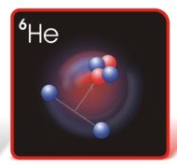
Trimer binding energy
With current precision: theoretical prediction of the binding energy confirmed: Need to include finite range corrections for dimer binding energies
Same results for two different initial systems
1
1
2
3
2
2
T. Lompe et al., arXiv:1006.2241, to be published
T. Lompe et al., PRL 105, 103201 (2010)
See also Nakajima et al. arXiv:1010.1954
Theory curves from Nakajima et al., PRL 105, 023201 (2010)

Slide 20
Many-body physics with three components?
A gas of fermionic “trions”, “baryons”

Slide 21
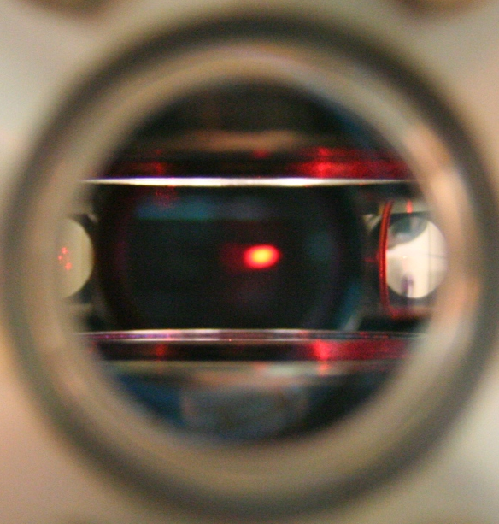
… many different phases are expected
A “color superfluid”?
A. Rapp et al., PRL 98, 160405 (2007)
A. Kantian et al., PRL 103, 240401 (2009)

Slide 22
In between three and many ….
Very recent results:
Create a system of a few fermions with tunable interactions!

Slide 23
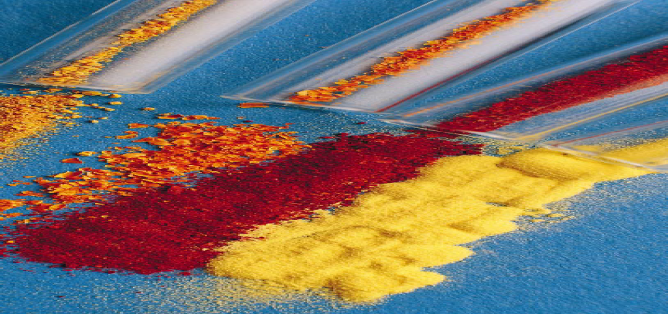
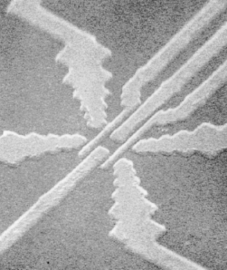
Other finite quantum systems …
Atoms, nuclei …
Quantum dots, clusters …
Extreme repeatability and control over all degrees of freedom, but limited tunability
Wide tunability, but no „identical“ systems

Slide 24
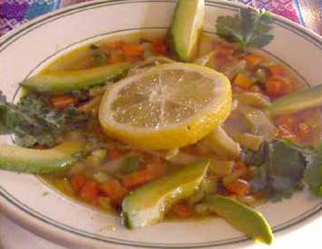

Creating a finite gas of fermions
Control the number of quantum states in the trap!
Conventional trap
like a soup plate!
Shot glass
type trap
Large density of states …
…small density of states

Slide 25
Transfer atoms to microtrap …

Slide 26
Spill most of the atoms:
Lower trap depth
Use a magnetic field gradient to spill:
µ x B
~200 atoms
~2-10 atoms
→ What is the population of the ground state?
“laser culling of atoms”: M. Raizen et al., Phys. Rev. A 80, 030302(R)

Slide 27

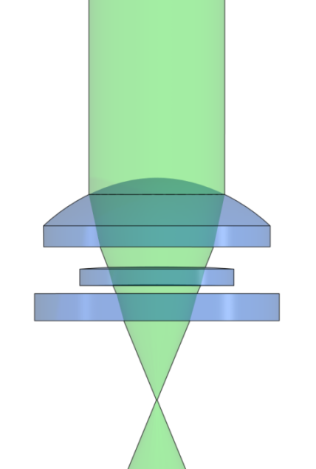


Atoms in a microtrap
Transfer a few 100 atoms into a tightly focused trap (~1.8µm in size)
100µm
100µm
We use the infrared emission of a green laser pointer! (1064nm)

Slide 28
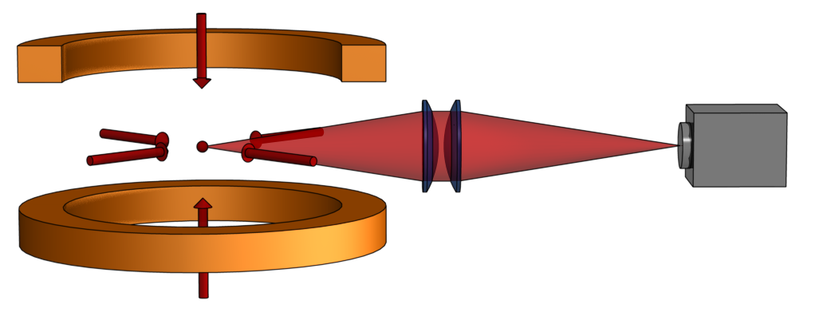
Detection of single atoms
Measure fluorescence signal of single atoms in a compressed
Magneto-optical trap.

Slide 29
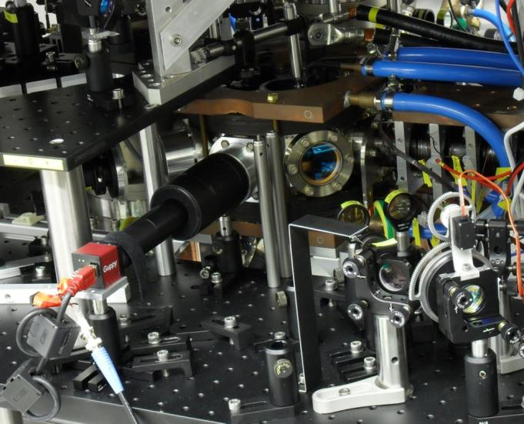
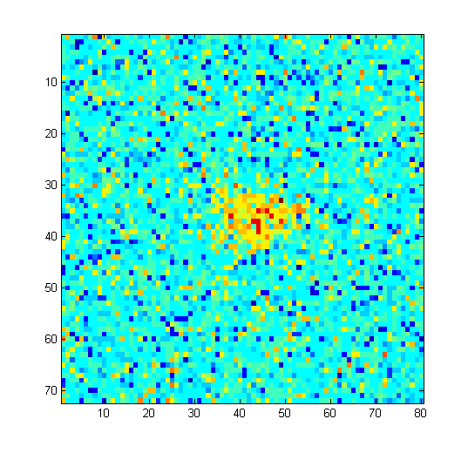
Detection of single atoms
Essential ingredients: Low background and MOT lifetime
1 atom in the MOT
Motorized irises
control beam diameter

Slide 30
Detection fidelity
1-10 atoms can be distinguished: fidelity > 99,7 % (3 σ)
Let‘s prepare ultracold few-fermions systems!

Slide 31
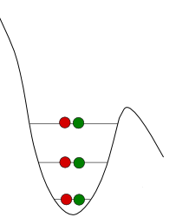
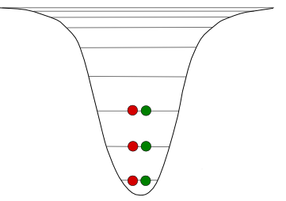
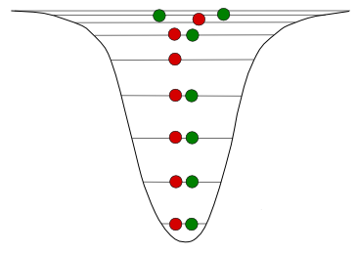
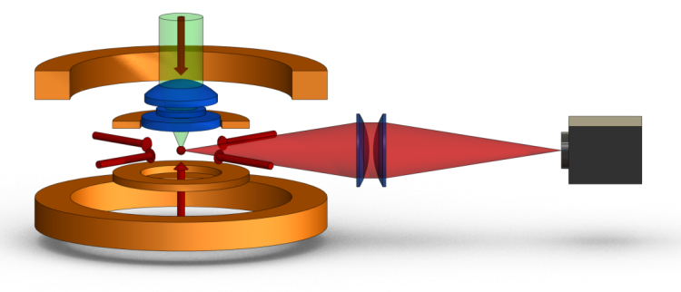
Preparation sequence
Spill atoms in a controlled way
Recapture prepared atoms into Magneto Optical Trap

Slide 32
Spilling the atoms ….
1kHz
~400feV
We can control the atom number with exceptional precision!

Slide 33
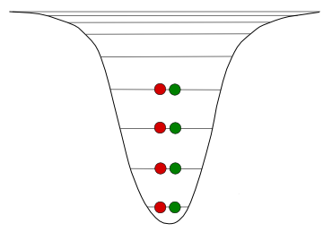
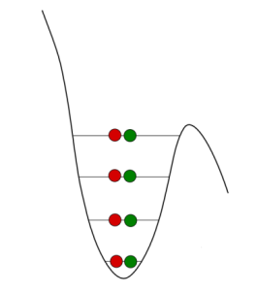
Ground state systems ?
Spill twice!
Lifetime of the system in the ground state: > 60s

Slide 34
First few-body interactions
a>0
a~0
What happens if we switch on some (repulsive) interactions?
We observe only one atom in ν=0!

Slide 35
First few-body interactions
a>0
a~0
What happens if we bring the two atoms in the ground state across the Feshbach resonance
One atom is observed in ν~2

Slide 36
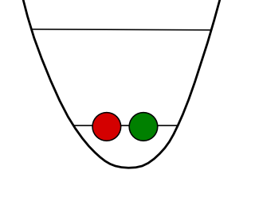
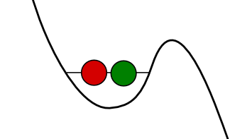
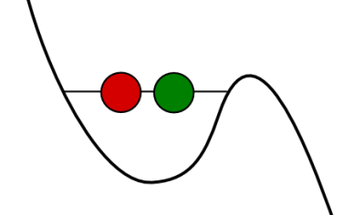
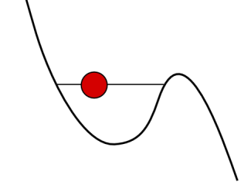
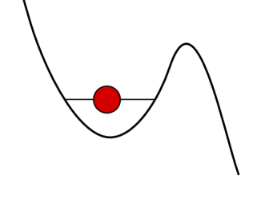
More interactions …
Interaction-induced spilling!

Slide 37
Conclusion
We detect and count single atoms with very high fidelity
We prepare few-fermion systems with unprecedented control
We control the interactions in the few-fermion system
Future:
Investigate interacting few-body systems in the ground state
Study dynamics of few-fermion systems: How many atoms do we need to have a thermal ensemble?

Slide 38
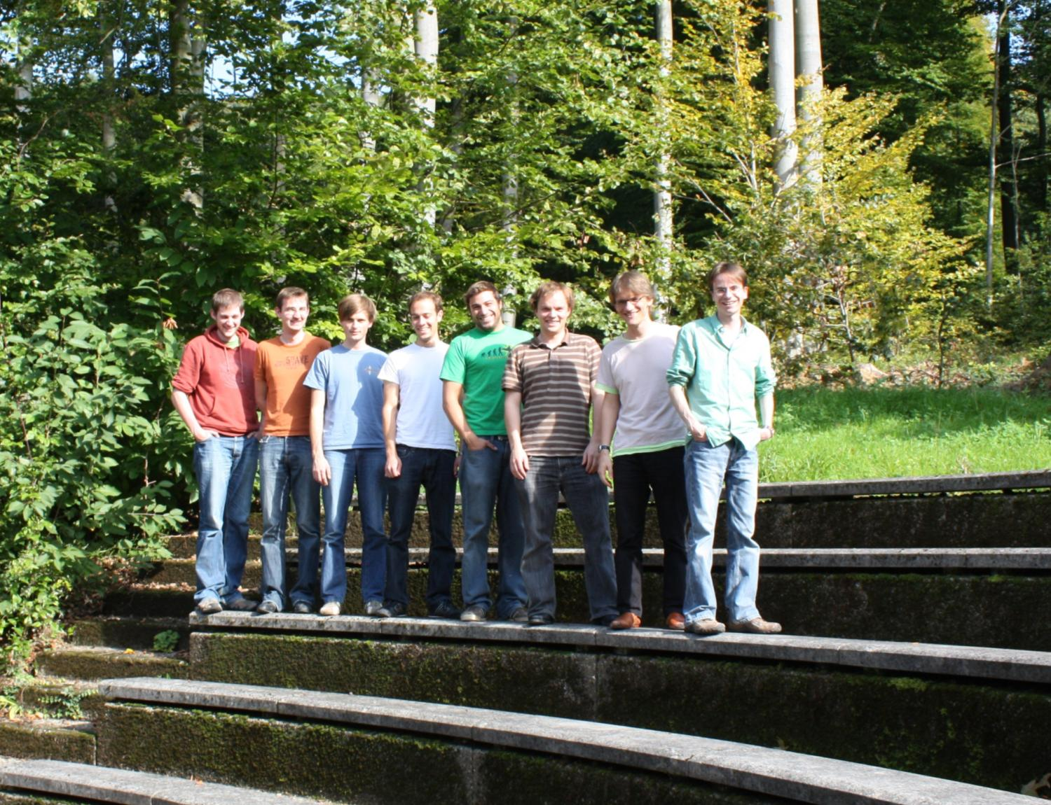


Thank you very much for your attention!
Philipp
Simon
Friedhelm
Serwane
Andre
Wenz
Timo
Ottenstein
Thomas
Lompe
Martin
Ries
Gerhard
Zürn
www.lithium6.de

