Slide 1
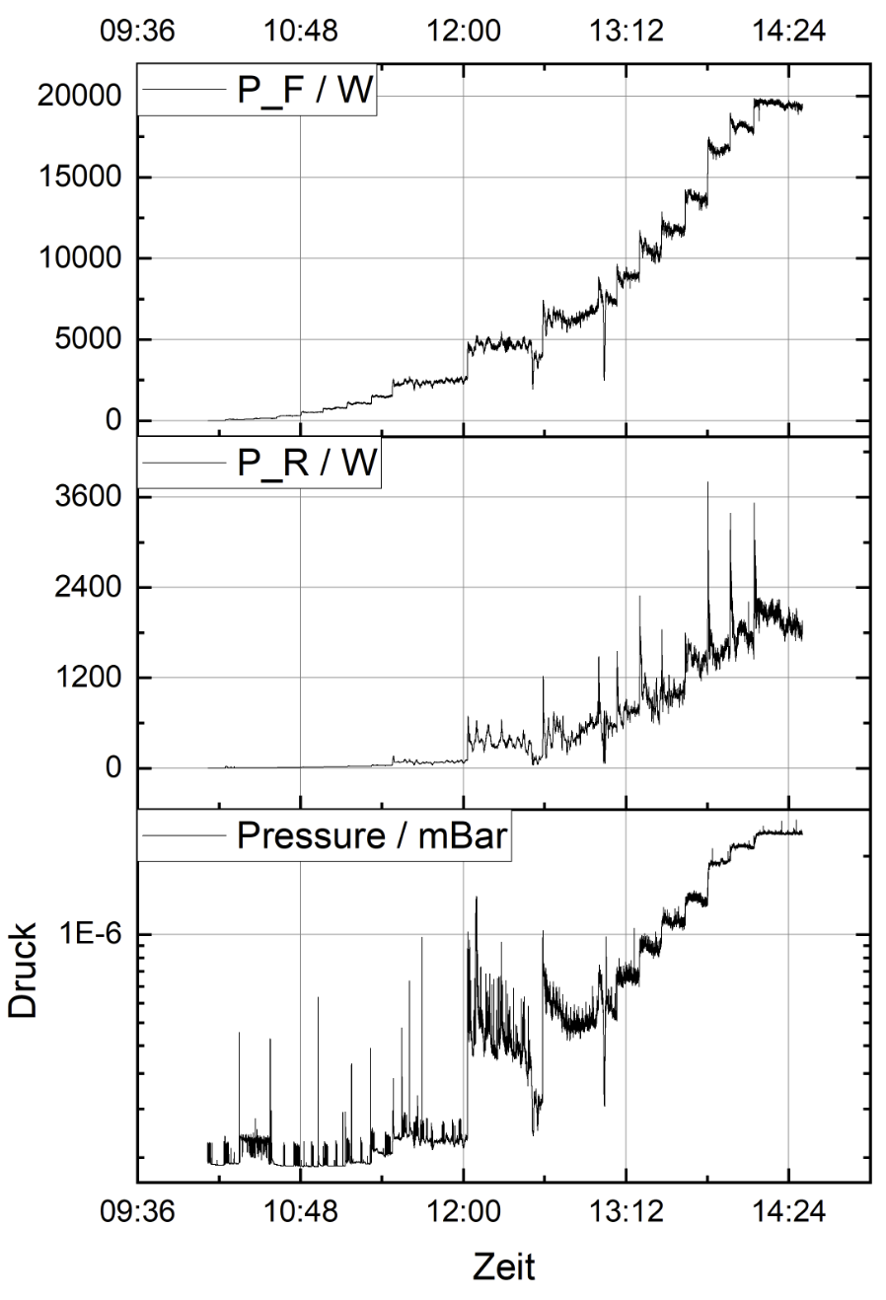
cw-LINAC, 15.09.2020
CH2 @ IAP Frankfurt (start of test promised after eastern!) – IAP-Rf-bunker still not available!
CH0-test @HI-Mainz postponed for September 2020 => CH0 test in progress. Test scheduled for 07.09. - 20.09
Advanced demonstrator and CM2/delivery status:
superconducting solenoids:Q4/2020
cryostat 1 (Q1/2021) , cryostat2 (2021)
superconducting buncher1 (2021), buncher2 (2022)
rf-amplifiers (advanced demonstrator) Q1/2021, rf- amplifiers (CM2) to be ordered
20 rf-windows for high power couplers to be purchased, when budget 2020 and 2021 (prelim.) is available (GFEV already applied last week)
CH3-5 + CH6-8 specification finalized; budgetary offer is available; waiting for budget (GFEV confirmed, preparation of tendering process)
Continuation of Beam line set up@SH4 are ongoing. First part before cryostat is assembled! – Equipment commissioning is the next step…
4rod-RFQ-prototype (cw) Rf-test should be completed by end of this week
max. 80 kW pulse power
max. 20 kW average power (@ 60 kW pulse power, 6ms) => ΔT ≈ 21°C
(3D-laser vibrometer)
Further cw-APF-IH-DTL beam dynamics design and Rf- and mechanical layout for tank 2 started
BSM (FAIR-p-Linac and cw-Linac) commissioning and testing to be postponed (asked for April 2021)
cw-RFQ-prototype-test

