Slide 1
Unilac – 8.9.2020
TK4BB11: brought back to transfer channel. RF power line to be attached.
HLI-IH RF loop: brought to HLI Bunker, to be installed.
Triplet UH3QT3: Cavity pumped after repair, ready for RF test.
HSI-RFQ: ready for RF test. New Idea: glass fibre from RFQ to RF transmitter for quick IL.
Tunnel Septum UT2MUZ Repair: ongoing, complicated but promising.
A3DR8: transported to external galvanics (August 19th).
Gasstripper: leak part disassembled, to be repaired after radiation protection check.
UH4MS5V disassembled, two defined isolation damages found.

Slide 2
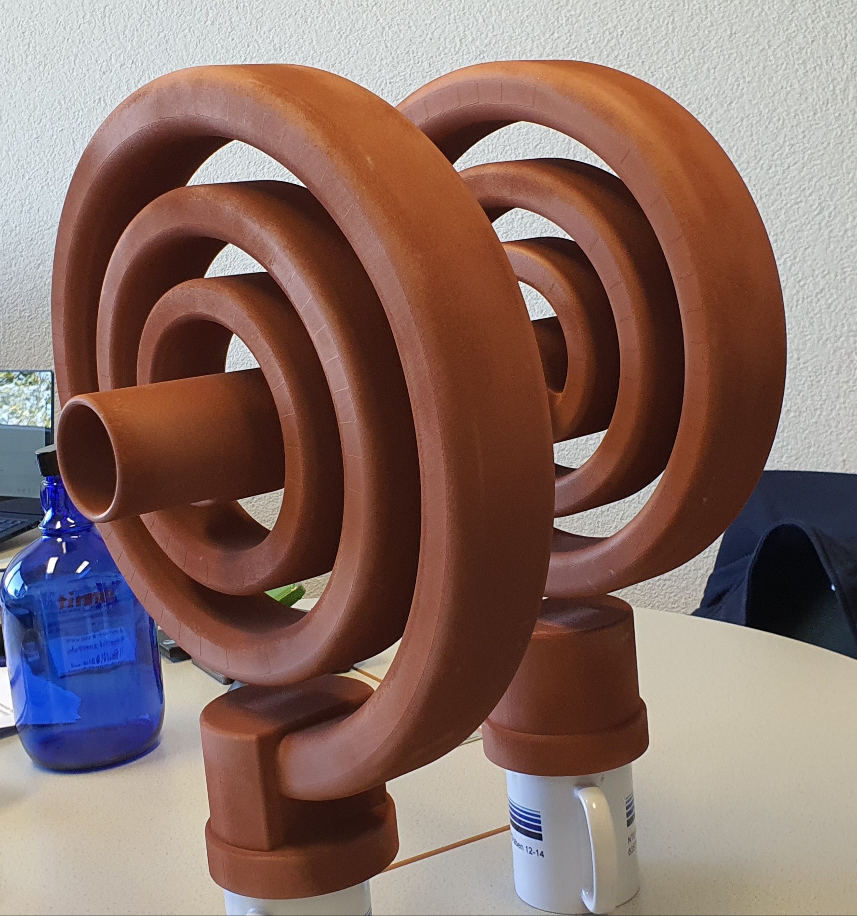
Fabrication new BB3: dummy spirals produced, to be assembled for first RF tests

