Slide 1
HEST – 01.09.2020
Offer for the 3D Laser Scan in HHD is there, ordering procedure has been started
3 additional Faraday cups will be built in for the HEST line between ESR and CRYRING

Slide 2
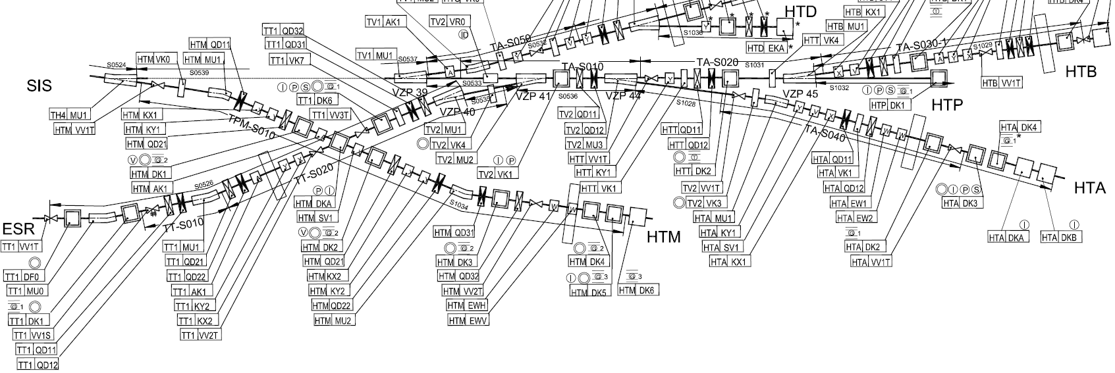
Einbau Orte
HTBDK2
HTYDK1
HTTDK2
Wand
TT1DK6
Wand
Wand
TT1DK1
gewünschte Einbauorte
ist Zustand

