Slide 1
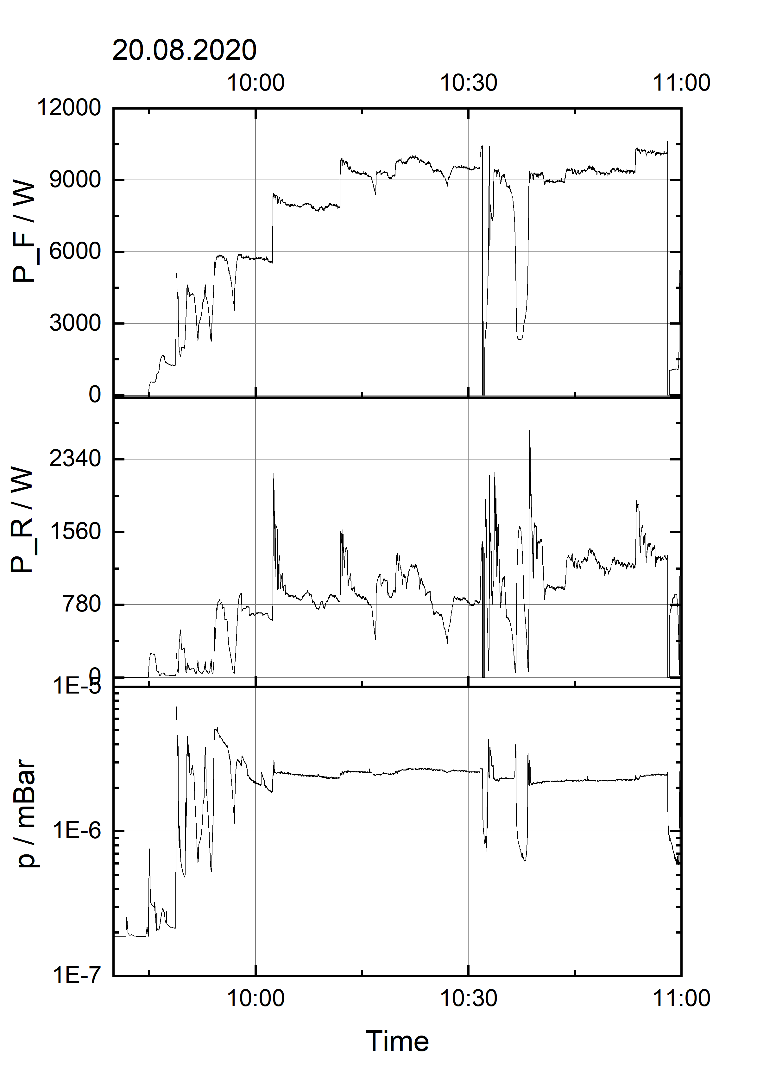
cw-LINAC, 01.09.2020
CH2 @ IAP Frankfurt (start of test promised after eastern!)
IAP still locked down, postponed!
CH0-test @HI-Mainz postponed for September 2020 => CH0 ready for cool down. Test scheduled for 07.09. - 20.09
Advanced demonstrator and CM2/delivery status:
superconducting solenoids:Q4/2020
cryostat 1 (Q1/2021) , cryostat2 (2021)
superconducting buncher1 (2021), buncher2 (2022)
rf-amplifiers (advanced demonstrator) Q1/2021, rf- amplifiers (CM2) to be ordered
20 rf-windows for high power couplers to be purchased
CH3-5 + CH6-8 specification finalized; budgetary offer is available; waiting for budget (GFEV is done waiting for confirmation)
recalibration of temperature sensors for LHe-transfer is done! Commissioning is ongoing – further tests after Sep. 20th.
Beam line set up@SH4 are ongoing. First part before cryostat is assembled! – Equipment commissioning is the next step…
4rod-RFQ-prototype (cw): Preparation for high power Rf-test at test bunker; rf-conditioning is still ongoing (10 kW, 30% duty factor)

