Slide 1
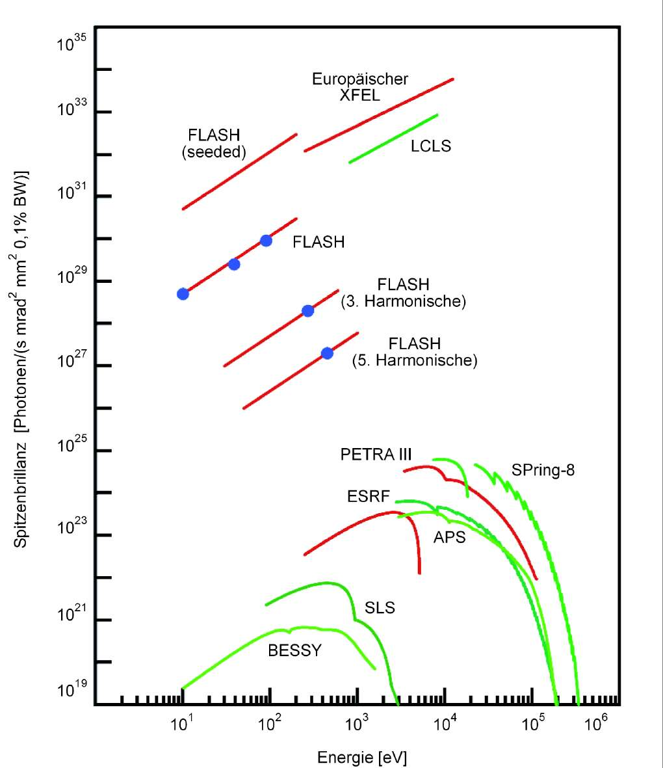

Beam Instrumentation challenges at DESY
by Kay Wittenburg, DESY, Head of Beam Diagnostic & Instrumentation Group MDI
DESY is operating amongst others two of the largest accelerator based light sources of the world, the 2.3 km circumference high brilliant synchrotron light source PETRA III and the 3.4 km long European free electron laser XFEL. PETRA III circles the DESY Campus while the XFEL facility runs from the DESY campus in Hamburg to the town of Schenefeld in Schleswig-Holstein. An upgrade to PETRA IV to a diffraction limited light source is planned for 2025 to 2027. The requirements on beam diagnostic and instrumentation of these machines are touching extremes in many aspects. This talk compares and discusses the active or planned instrumentation which fulfil the needs and ensure stable operations of the accelerators.
GSI, 22.10.2020

Slide 2
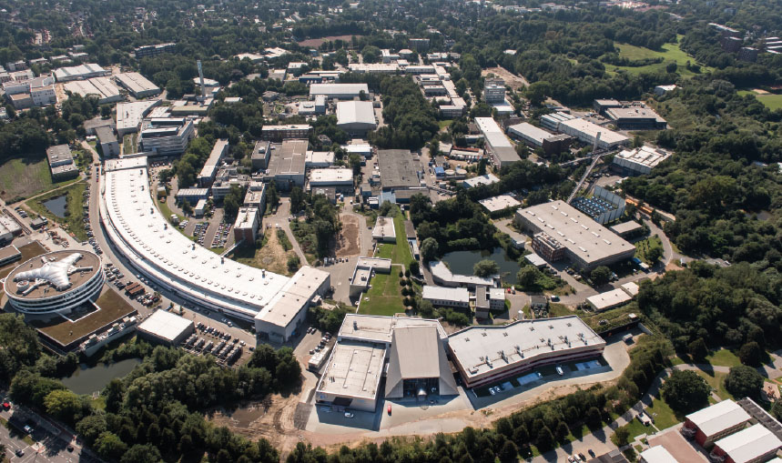
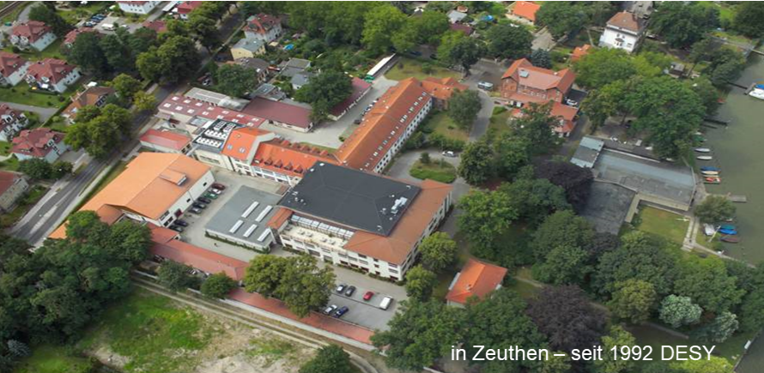
Deutsches Elektronen Synchrotron DESY
National research institute, 1959 founded, Member of the Helmholzgemeinschaft
financed: 90% Bund, 10% Land. Two locations (Hamburg und Zeuthen)
> 2000 Employees in Hamburg and Zeuthen
More than 3000/y scientists from more than 45 Nations using the DESY research institutions and accelerator experiments

Slide 3
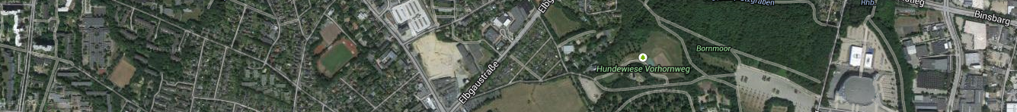


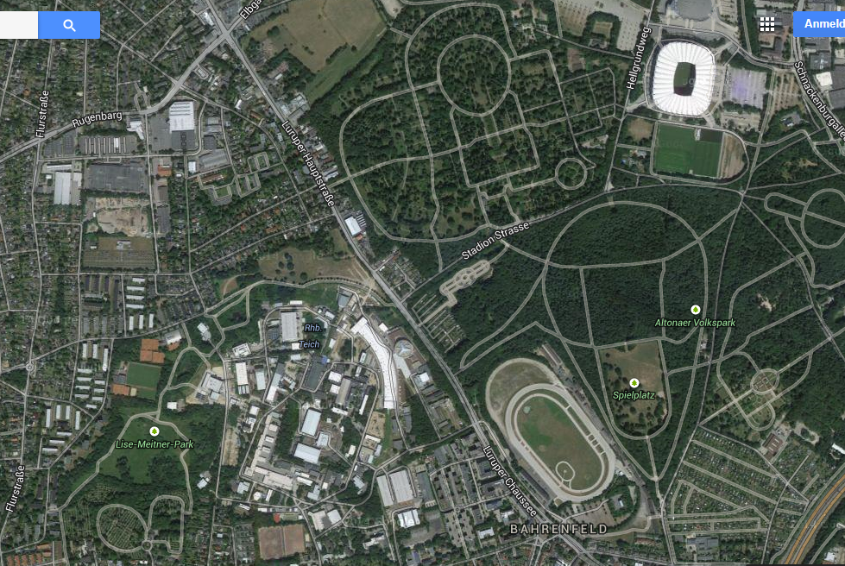

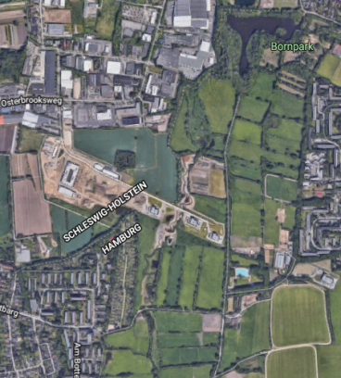
Deutsches Elektronen Synchrotron DESY
XFEL
FLASH
PETRA
DESY
HERA

Slide 4
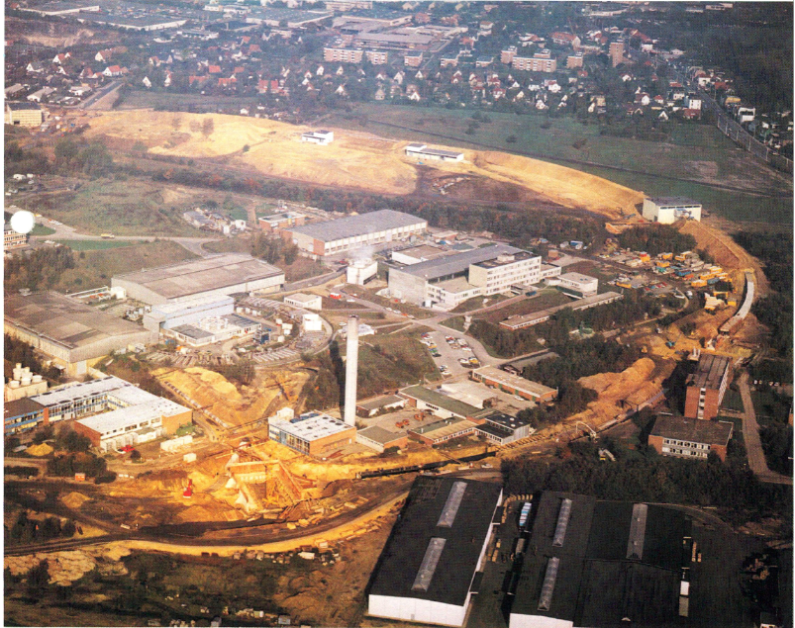
PETRA
(Positron Electron Tandem Ring Accelerator)
PETRA’s history
Build in 1976
Start as e+e- coll. 1978
End of coll. 1986
Preacc. HERA since 1988
Syn. Rad. Fac. since 1995
From 2009 is the worldwide
most brilliant 3rd gen.
storage ring based X-ray
sources for high energy
Photons
Future 2027: PETRA IV.
A 4th gen. light source with
ultra low emittance

Slide 5
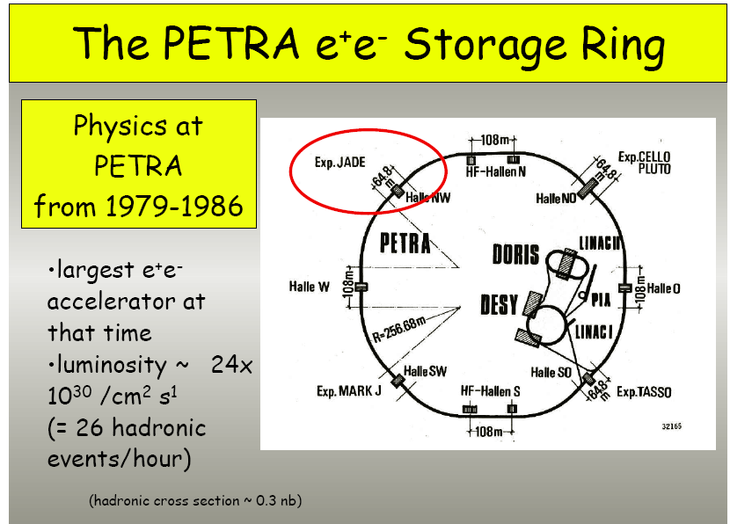
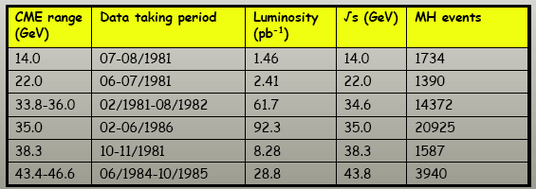
The discovery of the gluon, the carrier particle of the strong nuclear force, in 1979 is counted as one of PETRAs biggest successes.
23.3 GeV / beam!!!

Slide 6
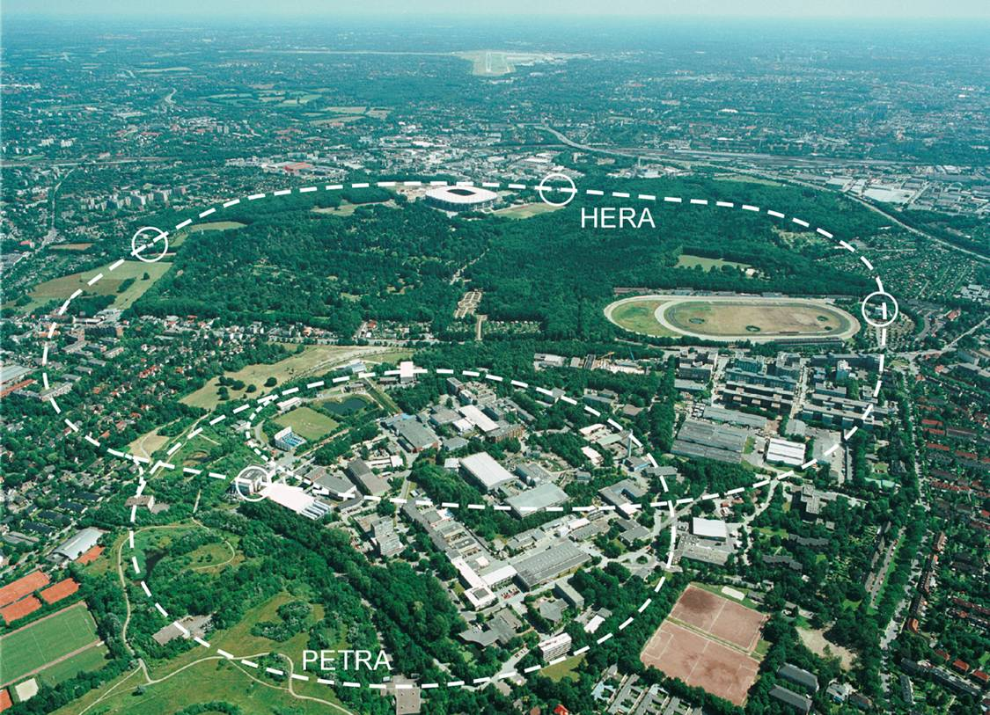

PETRA II
pre-accelerator for HERA (1988-2007)
12 GeV electrons and positrons;
40 GeV protons,
Syn. Rad. Fac. since 1995, equipped with undulators to create synchrotron radiation especially in the X-ray part of the spectrum.

Slide 7
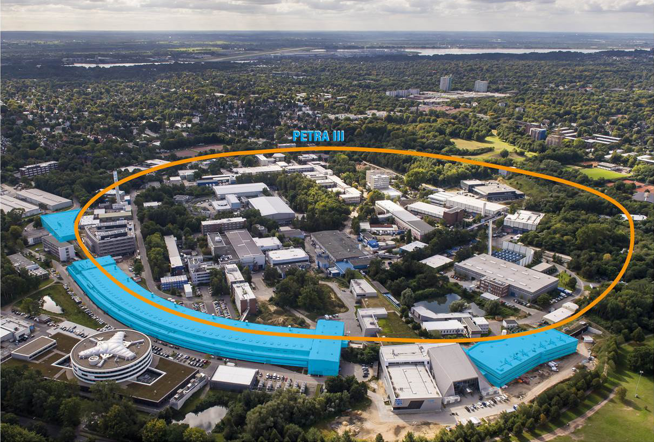
PETRA III: 3rd Generation Synchrotron Light Source
2009
Some Parameters: PETRA III
Circ.: 2304 m
E = 6.08 GeV
I = 100 mA – top-up (769 nC charge)
ε_{hor} ≈ 1.0 nm rad, ε_{vert} ≈ 0.012 nm rad => beam size: 34.6 μm (hor.), 6.6 μm (vert)
960 or variable bunch patterns with min. 8ns bunch distance

Slide 8
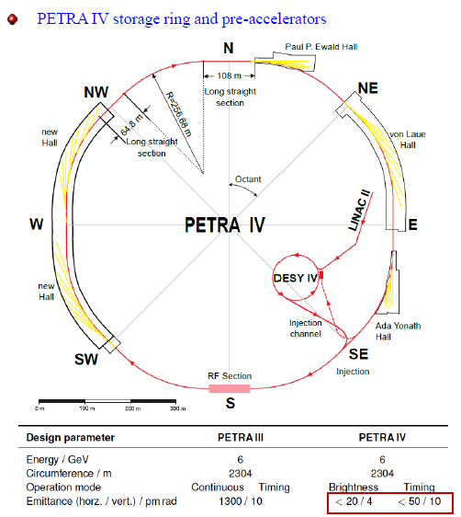
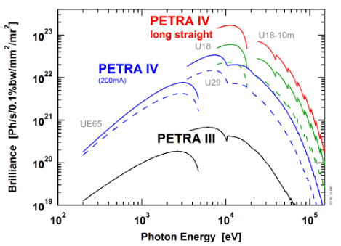
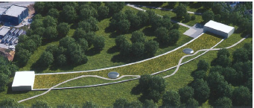
PETRA IV: 4th Generation ultralow emittance Light Source
Start operation: 2027

Slide 9
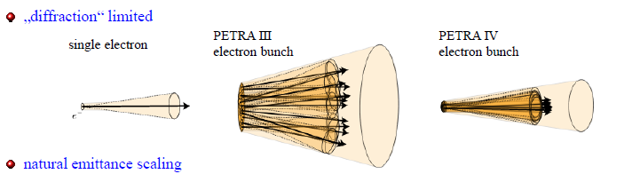
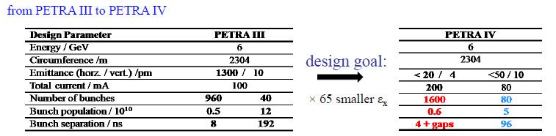
PETRA IV: Diffraction limited Light Source

Slide 10
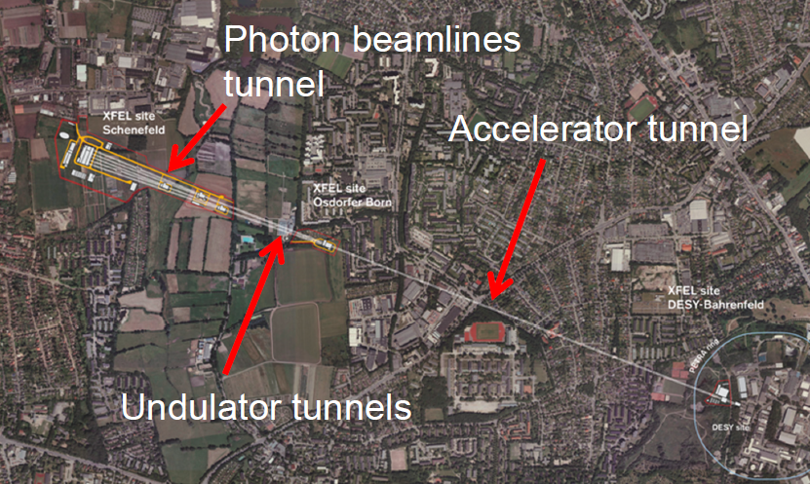
The European XFEL

Slide 11

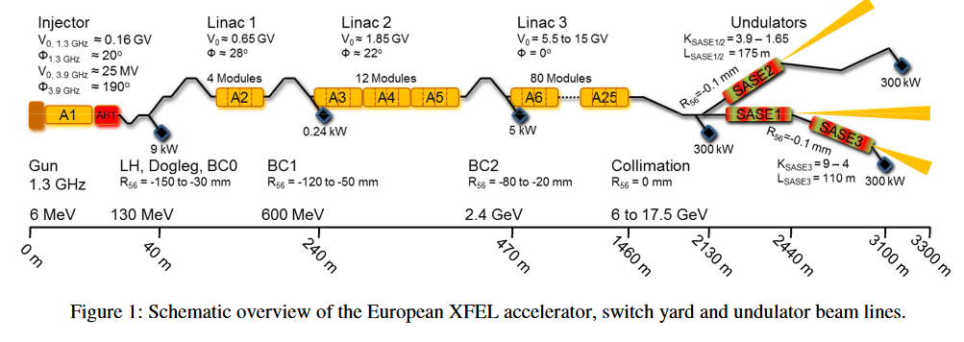
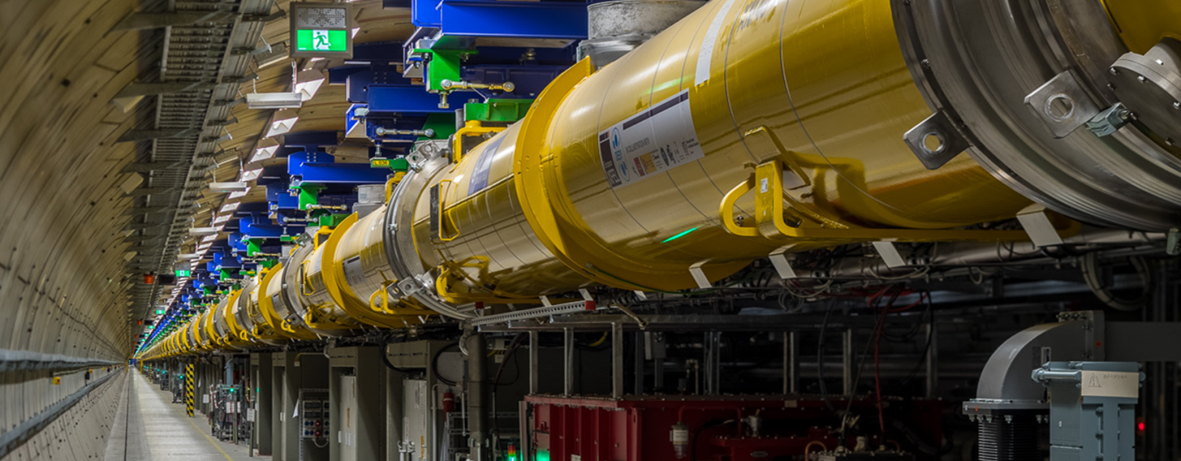
The European XFEL
The European XFEL is a 3.4 km long with a 1.5 km long superconducting linear accelerator
Construction started in early 2009; user operation began in September 2017, it now serves 3 FEL beamlines simultaneously for user experiments.
The European XFEL accelerator can currently energize electrons up to 17.5 gigaelectronvolts (GeV). The electrons are accelerated in pulses with 10 pulses per second. Each pulse can contains up to 2700 electron bunches so that in total up to 27000 X-ray flashes per second can be generated to be used for scientific experiments.
Electron bunch charges can be varied from 20 pC to 1000 pC,
bunch length after compression ranging from 3 fs to 150 fs FWHM.
With three different linac energies (8.5, 14, and 17.5), and the variable gap undulators, photon energies from 0.25 keV to 25 keV can be covered.

Slide 12
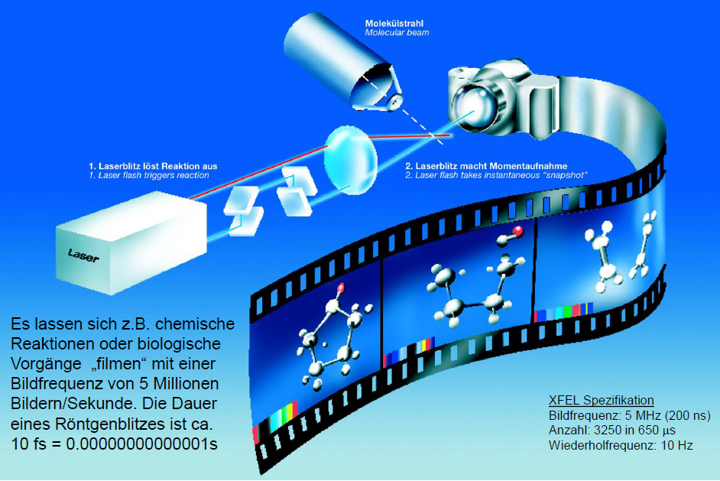
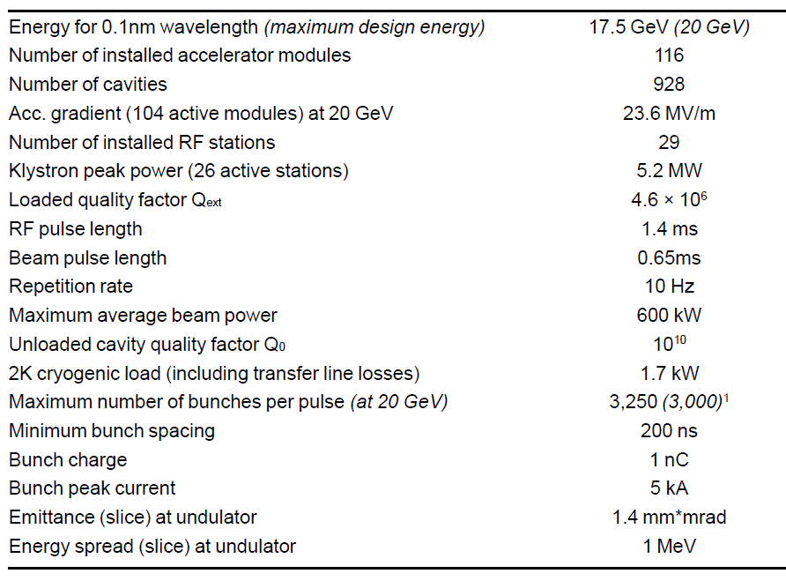
The European XFEL
96 (116)

Slide 13
Comparison (from diagnostic point of view)
Parameter PETRAIII (PETRA IV) XFEL
Energy
Min. Wavelength of Radiation; brilliance
Circumference / length
RF
Revolution / Repetition Time
Bunch Distance (min)
Bunch Number
Horizontal / Vertical Emittance
Beam position stability
Beam Current
Bunch Charge
Beam size at Undulator h / v
Bunch Length (rms)
Long. Feedbacks, arrival time jitter
Beam Energy, Energy spread
Beam Losses
Diagnostic Needs:
6 GeV
≈ 0.01 nm; ≈ 10²⁴
2304 m
499,564 MHz
7.685 μsec
8 ns (4 ns)
40 – 960 (80 – 1920)
1 nrad / 10 prad (<20 /<4 prad)
0.5 μm (Beam, BW ≈200 Hz)
(0.1 μm BW 300 Hz, 20 μm TbT)
100 mA (200 mA)
≤ 1 nC, (<1% stability)
140 / 4.9 μm
44 ps / 13.2 mm
(43ps w. 3rd harm, 4 ps bare)
≈ 10 ps
6 GeV, 0.1%
> few h lifetime
average beam, except: charge, length
0-17.5 GeV
0.05 nm; ≈10³⁴ p/(s mrad² mm² 1%BW)
3200 m
1.3 GHz
10 Hz (Train = 650 μs)
200 ns (5 MHz)
1 – 3250 (32500 Hz)
1.4 μrad (norm) (preservation, by gun)
1 μm (Bunch by bunch)
0.3 mA
≤ 1 nC
12 / 12 μm
< 80 fs / 20 μm
≈ 10 fs
0-17 GeV, 1% (0.1 % resolution)
100 % transmission
Bunch by bunch
Canceled:
Energy spread
Bunch Purity – Halo
Timing System: ns – fs
Photon Diagn.: x-BPM – IPM
Tune + Chromaticity
…

Slide 14
Beam Position Monitors (BPMs) -Tasks
Ring Linac
Orbit (Turn-by-Turn)
Steering during Commissioning
Precise Beam Position in Undulators (< 1 μm)
Feedbacks (slow 10 s,
fast 10 ms, Bunch-by-Bunch)
Sub μm short and long term stability in undulators
Tune
Machine Protection
Orbit (Bunch-by-Bunch)
Steering
Precise Beam Position in Undulators (< 1 μm)
Feedback
(Bunch-by-Bunch)
Sub μm short and long term stability in undulators
Machine Protection

Slide 15
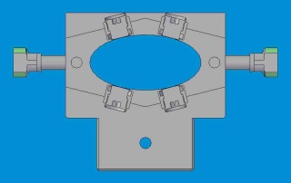
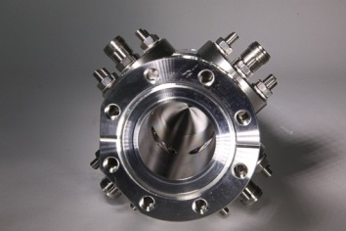
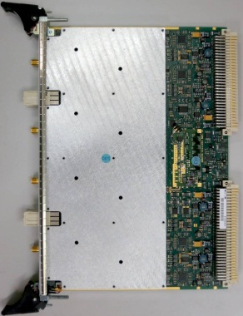
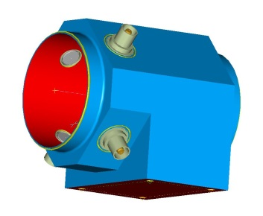
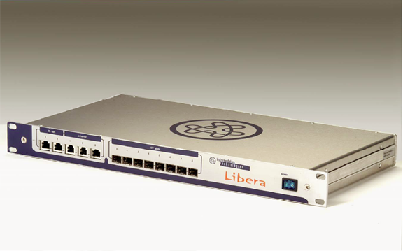
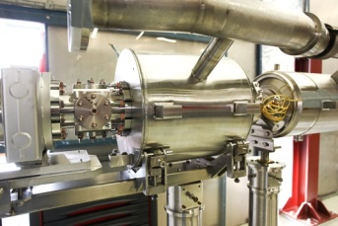
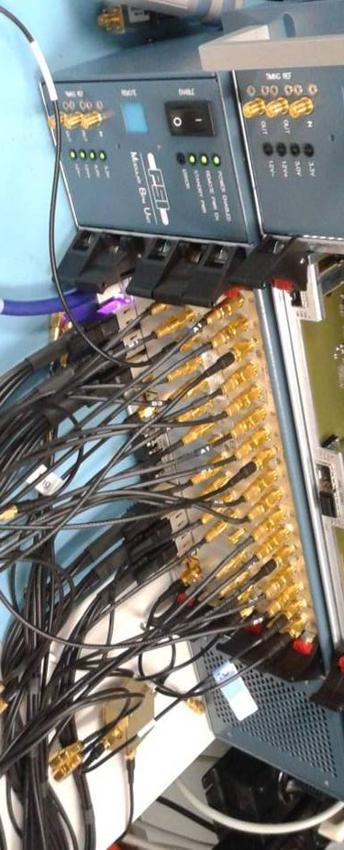
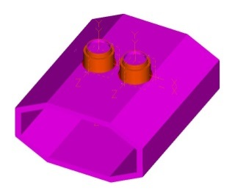
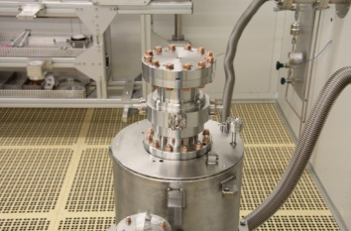
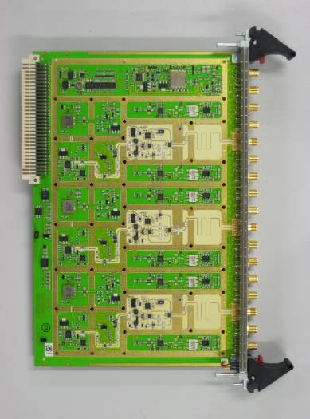
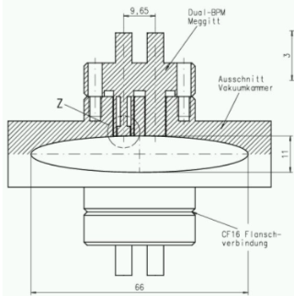
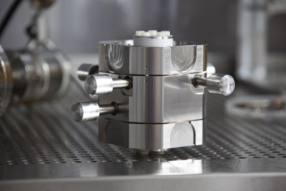
Beam Position Monitors (BPMs)
PETRAIII
208 BPMs - various geometries
XFEL
453 BPMs - various types
few types RF -
Frontends
1 Modular
BPM unit
„MBU“
one type of RF -
Front- / Backend
Max. data rate 130 kHz
(turn-by-turn)
data rate 5 MHz
bunch-by-bunch

Slide 16
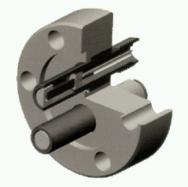
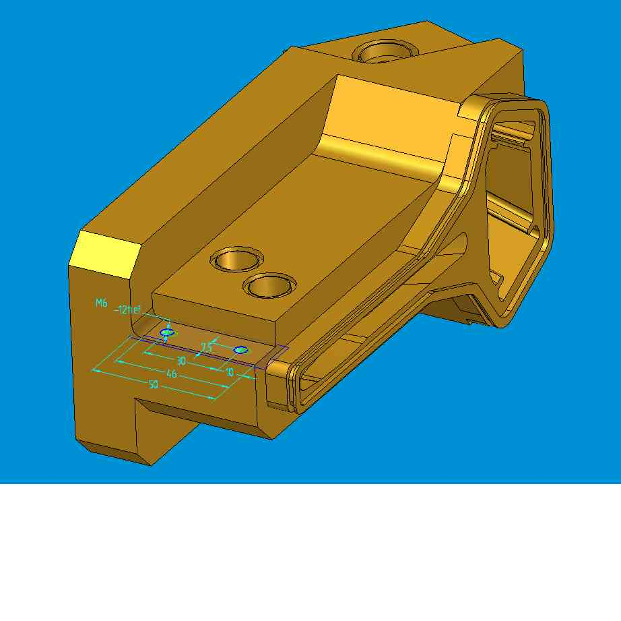
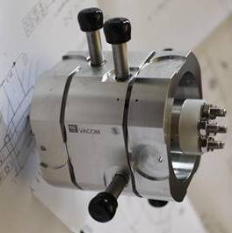
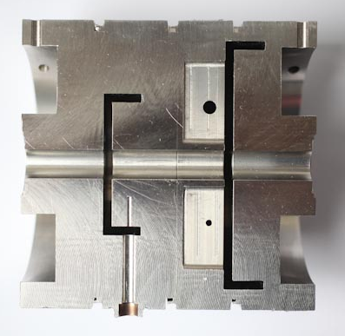
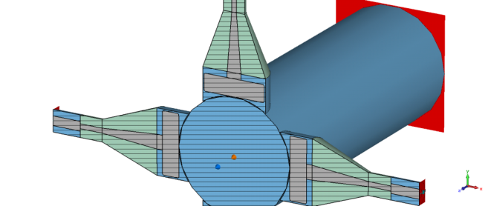
High Precision BPMs
PETRA.: Buttons XFEL: Cavity
Amplitude ~ position
PETRA IV Buttons
(Simulation)
+
+
+
+
+
d
Diff=
+
+
+
+
+
+
+
+
+
+
+
+
+
+
+
+
+
+
+
+
+
+
+
+
+
+
+
+
+
+
+
+
+
+
+
+
+
+
+
+
+
+
+
+
+
+
+
+
+
+
+
+
+
+
+
+
+
+
+
+
+
+
+
+
+
+
+
+
+
+
+
+
courtesy R. Jones-CERN
ns

Slide 17
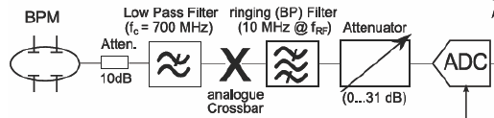
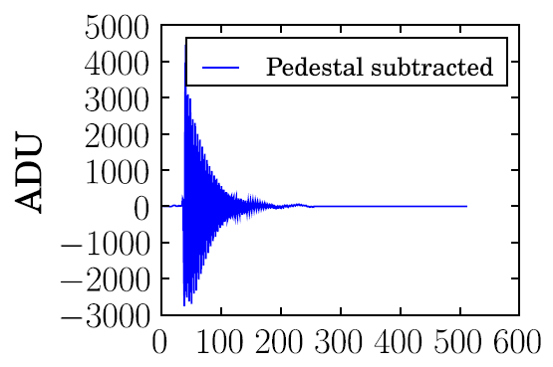
High Precision BPMs
PETRA: Libera XFEL: Cavity
Amplitude ~ position
Low Q
Small bandwidth ringing filter at f_{RF} averages over many bunches (one turn)
Improved resolution
ns
High Q
x10 ns

Slide 18
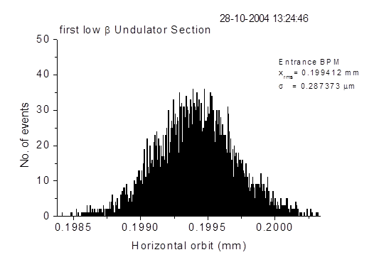
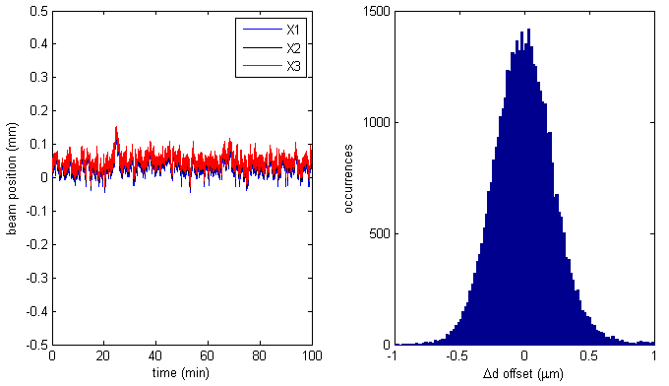
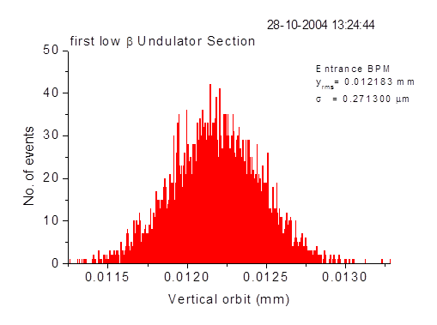
BPM resolution measured
PETRA III (BW 200 Hz, Orbit)
XFEL (Bunch-by-Bunch, 5 MHz)
0.28 μm
Beam Offset (mm) | Beam Charge (pC) | Linear Meas. Range | Measured Resolution (μm-rms)
0.1 | 285 | ±2mm | 0.35
0.5 | 285 | ±2mm | 0.40
1 | 285 | ±2mm | 0.56
0.05 | 183 | ±500μm | 0.18
0.06 | 350 | ±250μm | 0.12
0.2 | 2 | ±6.4m | 12
0.27 μm
K. Balewski, DESY, IWBS 2004
M. Stadler, PSI, E-XFEL BPM & Beam Stability Collaboration Workshop, 2013

Slide 19
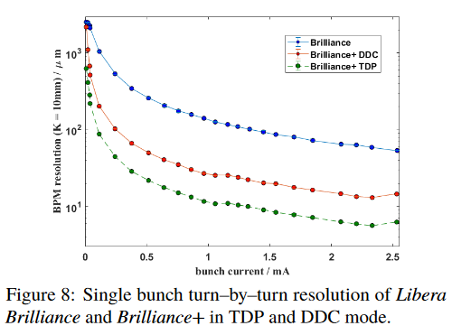
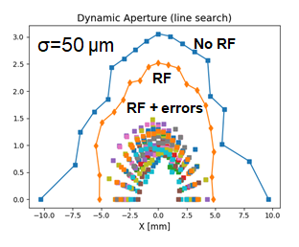
PETRA IV: BPM resolution measured
For PETRA IV a good resolution of the button–type BPMs of about 10-20μm in turn–by–turn, 130 kHz. (and 100 nm in stored beam mode (at 300 Hz bandwidth)) will be required
Ref.: BPM Resolution Studies at PETRA III
G. Kube, et al. IBIC 2019
DDC: digital down conversion TDC: time domain processing
Simulated dynamic aperture in PETRA IV

Slide 20
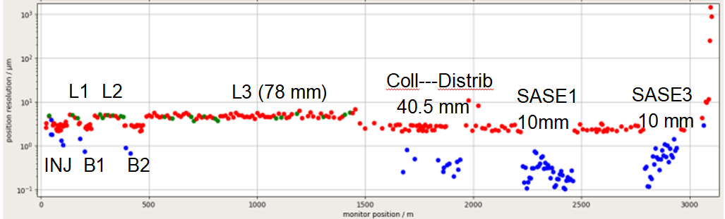
XFEL: BPM resolution measured
Red: Buttons
Green: Re-entrant Cavity BPM
Blue: Cavity BPM
The first 6 cavity BPMs : higher resolutions due to 10 dB attenuation.
The 10 µm resolution for 2 button BPMs at about 2000 m position is due to 100 mm pipe diameter.

Slide 21
Orbit stability and feedback
1) Electronic stabilization
2) Temperature stabilization
3) Mechanical movement (drift) of beam pipe
4) Orbit feedback
Requirements at PETRA IV: 0.1 μm at BW 300 Hz

Slide 22
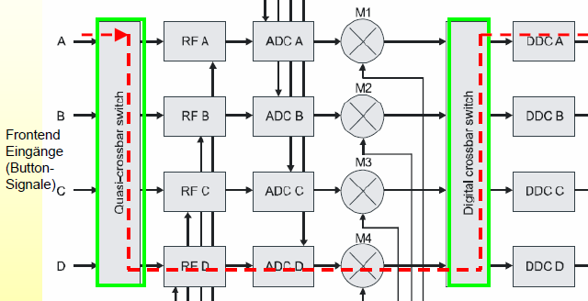
1) Electronic stabilization a) Libera with switching crossbar for dynamic calibration
Timing
Switching crossbar removes different drifts of channels
Long term stabilization
(I-Tech Patent)
Gain and Control

Slide 23
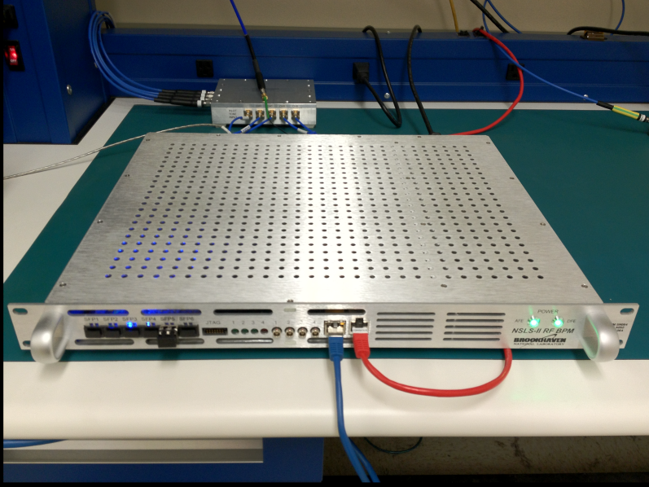
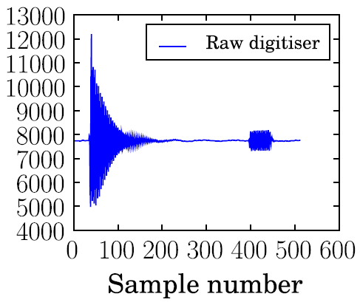
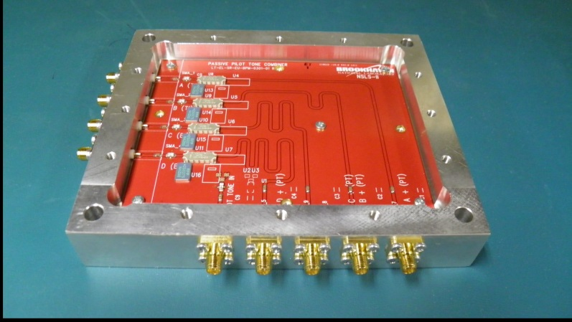
1) Electronic stabilization b) Pilot tone for dynamic calibration
Cavity beam position monitor system for the Accelerator Test Facility 2
Y. I. Kim et al.; Phys. Rev. ST Accel. Beams 15,
An integrated RF synthesizer phase-locked to the ADC clock generates a programmable CW pilot tone for dynamic calibration. The pilot tone is combined with the beam signal within the Pilot Tone Combiner Module.
NSLS-II RF Beam Position Monitor Update
K. Vetter, et al., (BIW12)

Slide 24




PETRA III: 480 Bunches: „Long Term“ Measurement with Pilot Tone (Elettra) + Libera Spark
20191212_fPT3908LongTerm.dat → Start: 12.12. 9:22, Stop: 18.12. 15:34
analysis: 12.12. 16:57 (index 2100) → 18:12. 13:47 (index 41080) (~6.8 days !)
horizontal
vertical
σ = 183.9 nm
σ = 130.0 nm
σ = 23.64 nm
σ = 13.79 nm
Gero Kube, DESY / MDI

Slide 25




Orbit stability and feedback: 2) Temperature stabilization
PETRA III
XFEL
Electronic drift: 0.2 μm/⁰C
± 1° C
Temp.-Management: ± 1° C
Temp.-Measurement: ± 0.1° C

Slide 26









Orbit stability and feedback 3) Meas. of beam pipe movement
PETRAIII FEL
example LCLS
1 sensor/BPM
at undulator,
res. < 20 nm
Two (140 m) long wire, 4 sensors/undulator
Stromerhöhung von 10 -> 50 mA

Slide 27


Orbit stability and feedback: 4a) Fast Orbit FB at PETRA.
0.27 μm
PetraIII
Rate of orbit measurements: ≥4 kHz (218 BPMs)
Data flow on cables (fiber optics)
Digital controller (SVD & PID)
82 coils and power amps
Correctors: air coils
BW ≤ 200 Hz
Slow orbit correction (hours and days) by control system

Slide 28


Orbit stability and feedback: 4b) Intra Bunch Train FB at XFEL
High resolution cavity BPMs
Using first bunches to correct the remaining
Very low latency required
(1 μs) incl.
cables
Correction
by very
fast Stripline
Kickers
IBFB
courtesy PSI

Slide 29

Orbit stability and feedback: 4b) Intra Bunch Train FB at XFEL
IBFB software automatically measures beam response matrix (beam position change as function of IBFB kick) for all IBFB BPMs & kickers (multi-point fit)
•Inverted matrix then used by feedback to calculate kicks from BPM data
Ref. Status of the Transverse Intra Bunch Train Feedback of the European XFEL
W. Koprek, et al. IBIC2017

Slide 30
Beam Current Measurement
Bunch current (AC)
DC current (rings only)

Slide 31


Beam Current Measurement: DC current (rings only)
Range: 1 mA – 200 mA
Resolution: < 3 μA
Bandwidth: DC - 10 kHz

Slide 32






Beam Current Measurement: Fast Current Transformer
PETRAIII (2 pieces)
Range: 10 μA – 10 mA
Resolution: < 1 μA
XFEL (53 pieces)
Range: <10 pc – 3 nC
Resolution: < 1 pC
M. Werner et al. Proceedings of DIPAC2011

Slide 33




Insertion: Damage of a FCT in PETRAIII

Slide 34




Insertion: Damage of a FCT in PETRAIII, Solution for PETRA IV?
Beam settings: I = 85 mA, N = 40 bunches, bunch length 44 ps
New design of gap
Inner air cooling
Max temp 90 deg. at 13 ps
Temp. resistive materials
Bunch length with 3rd harm. cavity at 43 ps.

Slide 35

Petra IV: Heating of BPMs (and all other diagnostics)

Slide 36




Beam Current Measurement
PETRAIII
DC: Circulating current, lifetime
resolution < 0.1%
AC: Bunch current for defined filling and top-up (1% Stability)
XFEL
Bunch current for
  Bunch pattern,
  Transport efficiency,
  LLRF (beam loading) and
  Machine Protection

Slide 37

XFEL: Charge pattern and transmission

Slide 38




XFEL: Charge pattern and transmission

Slide 39

XFEL: MPS + BLMs
Most BLMs in undulator area,
Total 472 BLMs
All BLMs connected to the Machine Protection System (MPS)
Stops beam production at the photoinjector gun
Latency: up to 28us → ~130 bunches @ 4.5 MHz run through
Slow protection prevents continously losses of consecutive bunchtrains with loss
BLM Alarm Masking of dedicated Losses, e.g, wire scans, Screen inserted, TDS

Slide 40



BLMs + MPS
PETRA III: Ups, no BLMs???
=> Conclusion after 11 years of operation:
Might be important at undulators to prevent their radiation damage (de-magnetisation). Unclear if (topping up-) injection losses or continuous (Touschek-) losses are damaging the undulators. This requires a system with huge dynamic range, bunch-by-bunch capabilities and insensitivity to synchrotron radiation…
Lifetime, injection and orbit interlocks (+ many other technical interlocks) are sufficient to protect the machine (so far…)
BLM system still under R&D for PETRA IV
An online Dosimetry system (from XFEL) is planned to measure the dose at the undulators.
XFEL: PMT- Scintillator System, fast and sensitive
Single Bunch
10 bunches
Integral

Slide 41

Beam Size
PETRAIII
Beam size at Undulator h / v: 140 / 4.9 μm
Resolution requirement: ≈10 μm (beam)
at higher β-function in ring
Problems:
(Visible) Synchrotron Radiation is diffraction limited (≈ 200 μm)
Solutions:
  Visible: Interferometer
X-ray (diffraction ≈ 10 μm): x-Ray Pinhole
XFEL
Beam size at Undulator h / v: 12 / 12 μm
Resolution requirement: ≈10 μm (bunch/beam)
at higher β-function in Linac
Problems:
No Synchrotron Radiation (Linac)
Fast
Non destructive
Coherent optic. radiation
(SR, OTR, ODR)
(micro bunching
with ≥ visible wavelength)
Solutions:
Scint. Screens (destructive,
few bunches only)
Wire Scanners (fast: bunch train,
slow: many shots)

Slide 42






Beam Size
PETRA III
Dedicated Diagnostics Beamlines
XFEL:
Many (≈ 50) Stations along Linac
Scintillation Screen
X-ray imaging
signal on CCD
pinhole, mirror, zone plate, CRL
Wire Scanner
Interferometer
signal on CCD
double slit
Visible
courtesy G. Kube (DESY)

Slide 43











Beam Size: PETRA III
X-ray SR
Interferometer (visible light)
X-ray camera
commercial system HAMAMATSU
Compound refractive lense Pinhole
coded aperture
courtesy T. Mitsuhashi (KEK)

Slide 44










Beam Size: XFEL
Scint. Screen (67 pieces)
Wire Scanner (v_{max} = 1m/s) (12 pieces)
LYSO:Ce
vert. wire scanner
Slow
scan
Fast scan
hor. wire scanner
FLASH
screen mover
light
“Get a sharp image of an entire plane, if focus, image, and object plane cut in a single line.“

Slide 45

XFEL specials
“OTR” is historical name for Screens

Slide 46


XFEL specials: 1) Charging screens
GND
The screen charging effect affects the beam orbit
and the SASE level as a consequence
Build new screens with conducting layer
-> solved

Slide 47


XFEL specials: 2) Quenching screens
Observation:
“smoke rings”
at high density
Beams
(no COTR!)

Slide 48


XFEL specials: 2) Quenching screens
New screen material GGAG (gallium gadolinium aluminium garnet) solved the problem! Now very good agreement with wire scanners down to σ = 10 μm.

Slide 49
Bunch length; devices
PETRA III: req. resolution ≈ 2 ps
Optical Streak Camera
Fast Photodiodes
Incoherent spectral analysis
At low α Optics:
  Electro-Optical Sampling
  Coherent SR,
  …
…
XFEL: req. resolution < 20 fs
Transverse Deflecting Structure TDS (Intra Beam Streak Camera)
Electro- Optical Sampling
Coherent Radiation
Optical Replica
…

Slide 50





PETRA III: Bunch length, Streak Camera
Optical Streak Camera
generation of visible light (Cherenkov radiation, OTR, synchrotron radiation) in instantaneous process → assumption that light distribution represents bunch distribution
photo cathode converts light pulses into number of electrons proportional to incident intensity distribution
photo-electrons are accelerated along streak tube and transversely swept by deflecting plates
→ convert incident time distribution in spatial distribution on Micro Channel Plate (MCP)
Synchroscan Camera with 2 orthogonal deflection plates (2. for slow sweep to display many bunches)
amplification of photo-electrons by MCP and back-conversion to visible light on phosphor screen
→ read out with scientific-grade CCD detector
courtesy G. Kube (DESY)

Slide 51


PETRA III: Streak Camera, measurements
Streak Camera
XFEL:
TDS
Multibunch
Instability
σ_{z} = 36 ps
8 ns
courtesy M. Ferianis, Elettra; H.CH. Schröder, DESY

Slide 52

XFEL: Bunch Length, TDS
TDS as intra-beam streak camera
transverse density distribution
electron beam
CCD camera
vertical
screen
horizontal
courtesy C. Behrens (DESY)

Slide 53

XFEL: Bunch Length, TDS
TDS as intra-beam streak camera
transverse density distribution
electron beam
CCD camera
vertical
screen
vertical
horizontal
longitudinal
courtesy C. Behrens (DESY)

Slide 54

XFEL: Bunch Length, TDS
TDS as intra-beam streak camera
transverse density distribution
electron beam
CCD camera
vertical
screen
vertical
horizontal
longitudinal
courtesy C. Behrens (DESY)

Slide 55


XFEL: Bunch Length, TDS
TDS as intra-beam streak camera
transverse density distribution
electron beam
CCD camera
vertical
screen
vertical
horizontal
longitudinal
courtesy C. Behrens (DESY)

Slide 56



Bunch length, measurements
Streak Camera
TDS
PETRAIII
Elettra
longitudinal
σ_{z} = 36 ps
courtesy M. Ferianis, Elettra; H.CH. Schröder, DESY
courtesy C. Behrens; B. Steffen(DESY)

Slide 57

XFEL: More TDS
For the European XFEL a deflector with an active length of 1.5 m was developed. A shortened version of 0.5 m is used in the injector at 150 MeV, a single TDS is foreseen for the first bunch compressor at 700 MeV and a combination of two structures is installed in the second bunch compressor at 2.4 GeV. The latter two are connected in series to effectively form a 3 m structure.
M. Hüning, LINAC2018

Slide 58

Longitudinal (timing) stability and fast feedbacks
PETRA III:
Bunch-by-Bunch feedback (rings)
XFEL:
Bunch arrival time (also energy feedback)
Bunch length by compression
FEW-FEMTOSECOND FACILITY-WIDE SYNCHRONIZATION OF THE EUROPEAN XFEL. (Ref.: S. Schulz, FEL2019)

Slide 59








Longitudinal (timing) stability and fast feedbacks
PETRA III:
Due to wakefields and impedance, most high intensity rings need multibunch feedbacks to stabilize the beam.
XFEL:
A precise arrival timing is essential (e.g. to synchronize pump probe experiments).
Same bunch length (by compression) along the train is required
Rapid change at head of bunch train from beam loading.
Longitudinal
Transversal
F. Loehl et al., EPAC08,
beam
Power Amplifier,
9 kHz - 250 MHz
4 * 250 W
courtesy
J. Klute (DESY)
The required minimum bandwidth (62.5MHz ) is determined by the shortest distance between bunches (8 ns at PetraIII)
The input for the amplitude control is a BAM (time) and for the phase control a BCM (compression).

Slide 60





Longitudinal Beam Stability XFEL: Bunch Compression
PETRA III:
Due to wakefields and impedance, most high intensity rings need multibunch feedbacks to stabilize the beam.
Bunch Compression / Phase control
Longitudinal
Transversal
beam
Signal Processor
Board 130 MS/s
Use of coherent radiation:
Example here:
Coherent diffraction radiation
Power Amplifier,
9 kHz - 250 MHz
4 * 250 W
Latency of 30 μs due to SC RF
courtesy
J. Klute (DESY)
The required minimum bandwidth (62.5MHz ) is determined by the shortest distance between bunches (8 ns at PetraIII)
Ch. Behrens, FLS-2010

Slide 61




Longitudinal Beam Stability XFEL: Beam arrival
BAM delivers arrival time of each bunch in bunch train with < 10 fs resolution
Time over?
Signal Processor
Board 130 MS/s
Ref: M. K. Czwalinna, IBIC 2019

Slide 62



Beam Energy and Energy spread
PETRA III:
Energy:
Use of Dipole Calibration ≈ 1‰ but energy is 1% off at PETRAIII?
Photon Based Measurements
Resonant Depolarization
(ΔE/E ≈ 10⁻⁵)
Energy Spread:
Beam width enhancement at high dispersion ~ Energy spread
Bunch Length ~ Energy spread
44 ps => Δp/p=1.3 •10⁻³
XFEL:
Energy
Spectrometers (Bunch Compressors, Doglegs, Dump Lines) (Beam Position in BC); resolution < 10⁻⁴
BAM (different orbit length in BC)
relative resolution ≈ 10⁻⁵ (LLRF E-feedback)
Energy Spread:
Beam width enhancement at dispersion ~ Energy spread
(Bunch Compressors, Doglegs, Dump Lines)
+ TDS = slice energy spread (within one bunch)

Slide 63



Ring: Energy Measurement by Resonant Depolarization
Idea:
Polarization of electron beams in storage rings is a diagnostic tool we get for free. A beam of electrons with spins of random orientations develops polarization under the Sokolov-Ternov effect.
The average over all particles of the number of spin oscillations per revolution is defined as the spin tune (depends on Energy):
Depolarize beam by exciting beam on ν, eg. by using vertical betatron tune striplines kickers.
Measurement
Touschek cross-section depends on electron beam polarization -> use loss monitor rate as a measure for polarization level.
At the SPEAR3 electron storage ring. The beam energy has been measured as 2.997251 (7) GeV, representing a relative
uncertainty of 3×10⁻⁶.
2. Resonant Depolarization
Resonant Spin Depolarisation Measurements at the SPEAR3 Electron Storage Ring; K.P. Wootton,IPAC12

Slide 64





XFEL: Beam Energy by BPM (Spectrometer)
BPM Array
Ref.: B. Lorbeer et al., IPAC2018

Slide 65


XFEL: Beam Energy by Beam Arrival Time
By recording the bunch arrival time difference Δt = t2−t1 between the BAMs down- and upstream of the BC, variations in the flight time through the BC can be measured.
An absolute energy determination requires a calibration of the BC dipoles (≥ 1 ‰)
BEAM ENERGY MEASUREMENTS IN THE FLASH INJECTOR USING
SYNCHROTRON RADIATION AND BUNCH ARRIVAL MONITORS
Ch. Gerth et al., FEL2011

Slide 66



The End
Thanks for listening
XFEL Undulators
91 undulators in 3 beam lines
(2x175m and 105 m)
PETRAIII Undulators
24 Undulators (2m and 5m) in 24 beam lines

Slide 67



Energy Spread at XFEL
Energy Spread with SR Monitor Slice energy spread with TDS
Beam Position ~ Energy, Width ~ Spread
Ch. Gerth, DIPAC07

Slide 68


Bunch length; what defines bunch length in the machine?
PETRAIII
Long. synchrotron oscillation defines bunch length to ≈ 40 ps
XFEL
Bunch compressor chicane defines bunch length to ≥ 80 fs
η ~ ΔE/E, ξ ~ z ~ t
.
http://photon-science.desy.de
Φ²/Ω_{S} ~ ΔE/E, Φ ~ z ~ t
When the bunch arrives, the particles in the head of the bunch have a lower energy than those in the back. To realize the energy slope, the RF phase in the first accelerator module is adjusted in such a way that the particles are accelerated on the right slope of the RF wave.
Area within the separatrix is called “RF bucket”.
CERN Accelerator School

Slide 69


Bunch Purity Measurements
Measurement of the sometimes special fill pattern of synchrotron light sources (rings) is important for the time-resolved experiments. The adjacent buckets must not have any stored particles or, in reality, as few as possible. A method with very good time resolution (<< 1ns for a 500 MHz RF-System) and high dynamic range (more than six orders of magnitude) is necessary.
Mechanism of loosing electrons
1) Quantum lifetime. An electron is lost from a bucket by emitting a photon having a momentum larger than bucket heigth η_{RF} and can be captured by the backward buckets.
2) Lifetime determined by the vacuum pressure. Electrons lose energy by collisions with residual gas molecules in the vacuum chamber.
3) Touschek effect. Electrons in a bunch execute betatron oscillation with transverse momenta. When two electrons are scattered elastically (Moller scattering), the transverse momenta can be transferred to longitudinal ones.
4) Injection errors (energy, timing,). At top-up a source of impurity growth on the both time sides of the main rf buckets.
A typical measurement is: Time-Correlated Single Photon Counting (TCSPC)
Measurement of the longitudinal bunch structure in the Photon Factory positron storage ring with a photon counting method, Obina T. et al., NIM A Vol.354, Nr. 2
Electron Bunch Pattern Monitoring via Single Photon Counting at SPEAR3, B. Xu, et al., IBIC2017, Grand Rapids, MI, USA

Slide 70

TCSPC
Time-correlated single photon counting method
PETRA II setup:
“The parasitic bunch measurement is achieved by an
avalanche-photo diode (APD) detecting scattered X-rays from a 1 mm thick graphite foil. It is located in the PETRA beamline 31.3 m downstream of a dipole used as x-ray source. The detector
signals are amplified close to the diode by a fast amplifier. “
The detector must be carefully shielded against stray light.
ESRF Setup
http://www.esrf.eu/Accelerators/Groups/Diagnostics/BunchPurityMeasurements
PARASITIC BUNCH MEASUREMENT IN e+/e– STORAGE RINGS, H. Franz et al., DIPAC 2003 – Mainz, Germany

Slide 71



TCSPC
The arrival time of single photons emitted by the electron bunches passing through a particular dipole in the storage ring is measured. The photon arrival time is measured relative to a clock pulse which is synchronized to the bunch revolution frequency via the storage ring RF system.
The amplified signal is analyzed using a time-to-digital-converter (TDC) and a multichannel-analyzer (MCA). To reduce the influence of the so-called “walk” and to reduce the background due to electronic noise the amplified detector signal is filtered by a constant-fraction-discriminator (CFD).
CFD

Slide 72
TCSPC
The TDC-board offers 4096 channels with minimum width below 40 ps and can work at count rates up to 3 MHz (300 ns recovery time).
To measure a histogram not affected by recovery-time and pile-up effects, the detector count rate should be limited to below 1.5% of the sync rate.
Bunch distance = 10 MHz, count rate = 10 kHz, expected dynamic range: 10⁷
=> time to resolve 1/10⁷ = 100 sec, with better statistic => 1000 s ≈ 16 min!!!!

Slide 73


TCSPC
PETRA; 500 MHz RF,
detuned injection energy
w/o with clearing by tune excitation

Slide 74
Electrostatic Beam Position Monitor
V
-
+
-
+
-
-
+
-
+
-
+
-
-
+
-
+
-
+
-
+
-
-
+
-
+
-
+
-
+
-
+
-
-
+
-
+
+
-
-
-
-
+
-
+
-
-
-
-
+
+
-
+
-
-
+
-
+
-
-
-
-
-
-
-
-
-
+
-
+
+
-
+
+
-
+
-
-
+
-
+
-
+
-
+
-
+
+
+
+
-
+
-
-
+
-
+
+
+
+
+
+
+
+
+
+
+
+
+
+
+
+
+
+
+
+
+
+
+
+
+
+
+
+
+
+
+
+
+
+
+
+
+
+
+
+
+
+
+
+
+
+
+
+
+
+
+
+
+
+
+
+
+
+
+
+
+
+
+
+
+
+
+
+
+
+
+
+
+
+
+
+
+
+
+
+
-
+
+
-
+
+
-
-
-
-
+
-
-
+
-
-
+
+
+
-
-
+
-
+
+
-
-
-
+
-
+
-
-
-
-
-
-
+
-
+
+
+
+
-
+
-
-
+
courtesy R. Jones-CERN

Slide 75




High Precision Cavity BPM
Reference cavity
Reference cavity
beam
Position cavity
beam
Position cavity
half-cut
Monopole Mode
Dipole Mode
Simulations by D. Lipka, DESY

Slide 76

BPM + MOMO

