Slide 1
SIS 18 VHF Cavity Status
JSt

Slide 2
RF Tests have started
Expected:
Resonanzfrequenz f0 82,4 MHz
Shuntimpedanz RSK 4,6 MOhm
Unbelastete Güte Q0 29.500
Measured before new contacting
Resonanzfrequenz f0 82,4MHz
Shuntimpedanz RSK 78kOhm
Unbelastete Güte Q0 500
Measured with new contacting
Resonanzfrequenz f0 82,4MHz
Shuntimpedanz RSK 94kOhm
Unbelastete Güte Q0 600

Slide 3
Interpretaion, migration
Possible cause:
The dielectric loss faktor of the gap ceramics limits the shunt impedance to 735 kOhm.
Simulations show, that this cannot be the only effect
Conclusion: Expected metallic contermination in islands on the gap ceramics -> Cleaning!

Slide 4
tentative ! measures
The RRF team is mostly on leavve or in Corvid quarantaine, so the expert meeting had to be rescheduled
With the present cleande gap 22-25 kV gap voltage should be possible. Enough for proof of principle (see: „Status of simulation studies on bunched beam slow extraction with very high frequency rf cavity by beginning of April 2020”, S. Sorge, P. Forck and R. Singh)
Later change gap material to lower dielectric loss factor (saphhire)

Slide 5
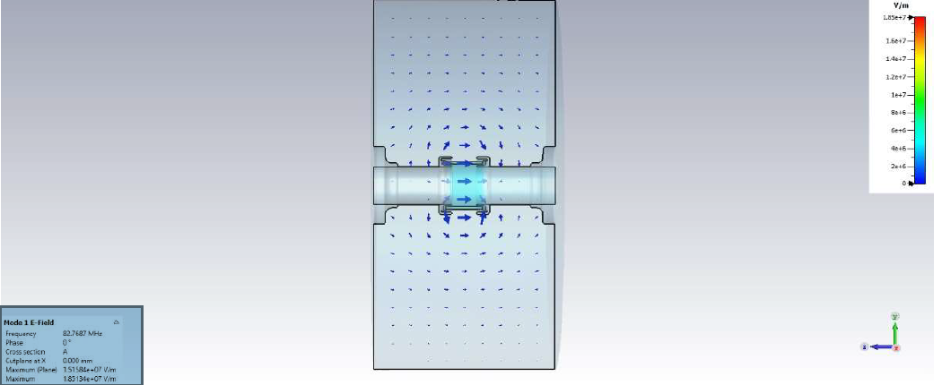
Elektric field at 82,8 MHz

