Slide 1
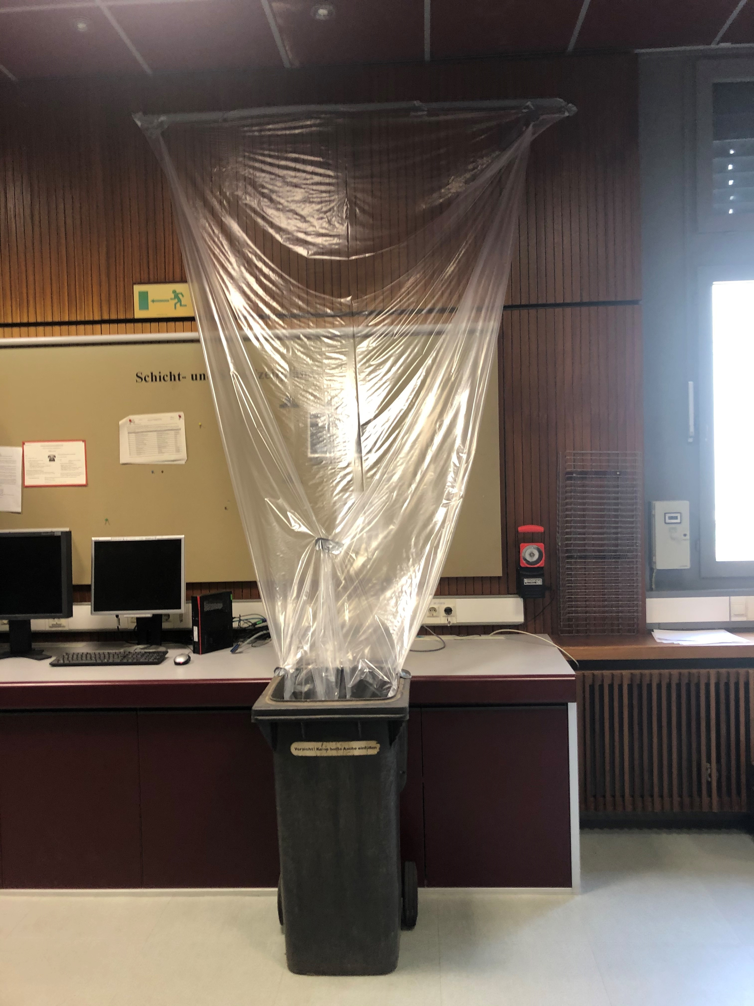
Operations – 25.08.2020
Shutdown
essentially ongoing as planned
Risks:
substantial delay of FSB Tunnel 101 → subsidence of ground → delayed survey and alignment of SIS18 → start of beam time 2021 in Feb. is at risk
more information after meeting (invitation of T. Miertsch this Thursday)
Water ingress over HKR ceiling
Mr. Reckziegel responded and takes care on the issue, a leakage in HKR-roof was identified
a preliminary “drainage” has been installed in HKR
Beryllium-contamination in “Leichtbauhalle”.
encapsulation of critical area finished → no impact on shutdown work expected anymore
irritating and corrosive liquid found during sealing work, caused a closure of the Kicker-Room for work → delays in sealing and shutdown work
A. Schumann provided a schedule for cleaning of the transformers and the switching cabinet in front of the kicker room until 31.08. to not to interfere with H=2-Cavity tests
New Main Control Room in FCC
first decisions taken on internal design together with architect
FSN: full digitization of on-call process
Meeting with PA, BR, Datenschutz and FSN team successfully finished
3 processes for digitization identified
Next step: layout of FSN user-interfaces for PA, BR and Department heads
2021/22 general schedule
Not all operators are back from vacation, but first discussions with shift crew indicate, that we might need to prolong the intermediate shutdown (eastern) for SIS18 by ca. 10 days. The option June/July with reduced operation mode is feasible from the manpower point of view. (assuming support from VAC and IKP)
Discussion needed, whether re-scheduling of delayed FSB-tunnel would affect FAIR commissioning schedule / in this case a prioritization against beam-time is recommended
dedicated Block for FAIR-development and machine studies is missing in the present schedule
Next steps:
After GPAC: layout a new combined proposal for both years 2021 and 2022 including the new information and feedback
Meeting with Machine Coordinators and Heads of technical departments on details (commissioning time and order, technical availabilities, intermediate shutdown, beam studies, availability of on-call, ...)

