Slide 1




Results on MIMOSIS-0
M. Deveaux, GSI

Slide 2

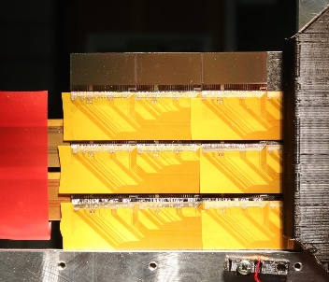

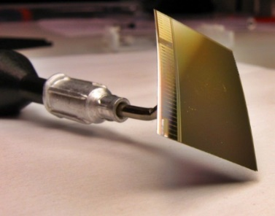
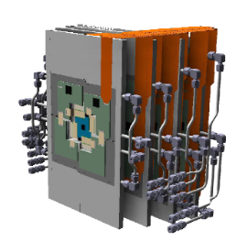


MAPS activities at CBM
IPHC Strasbourg
IKF University Frankfurt
Sensor design
Sensor test
Sensor integration
The CBM-MVD
Know-how transfer
New task sharing
CBM host laboratory
Silicon strip R&D
Sensor test
Sensor integration

Slide 3
Competences @ FAIR/GSI
PCB and DAQ – Design
MAPS – tests:
Experience in operating MAPS.
Experience in rad. tolerance tests.
Together with
MAPS – simulation:
Experience in building digitizer models.
Access to heavy ion beams:
Few AMeV to ~1 AGeV.
Proton to ²³⁸U.
Sizeable clean rooms/ workshops.
Experience with micro – integration.

Slide 4
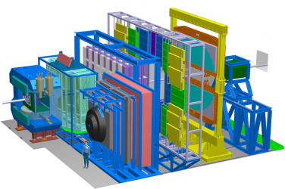
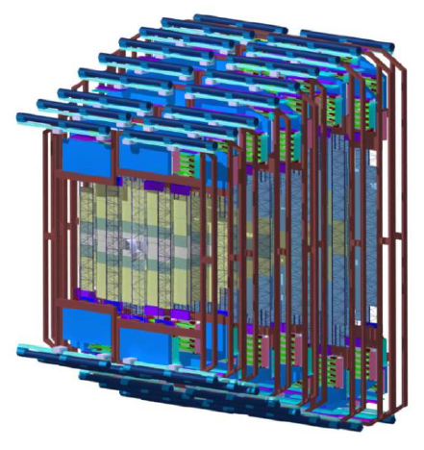
Where do we want to go?
Micro Vertex Detector
Ultra thin: 0.3 – 0.5% X₀
5 µm spatial resolution.
10⁵ Au+Au collisions.
MAPS based.
The CBM – Experiment
Silicon Tracking System (upgrade)
Ver. 1 – Silicon Strip Detectors.
Reduce material budget.
Improve resolution.
Improve rate capability.
Better momentum resolution
Easier tracking
?
Ideas for additional projects are
welcome.

Slide 5
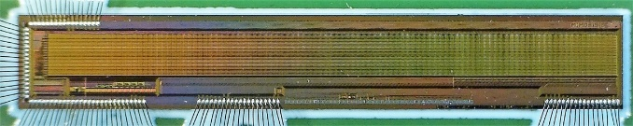
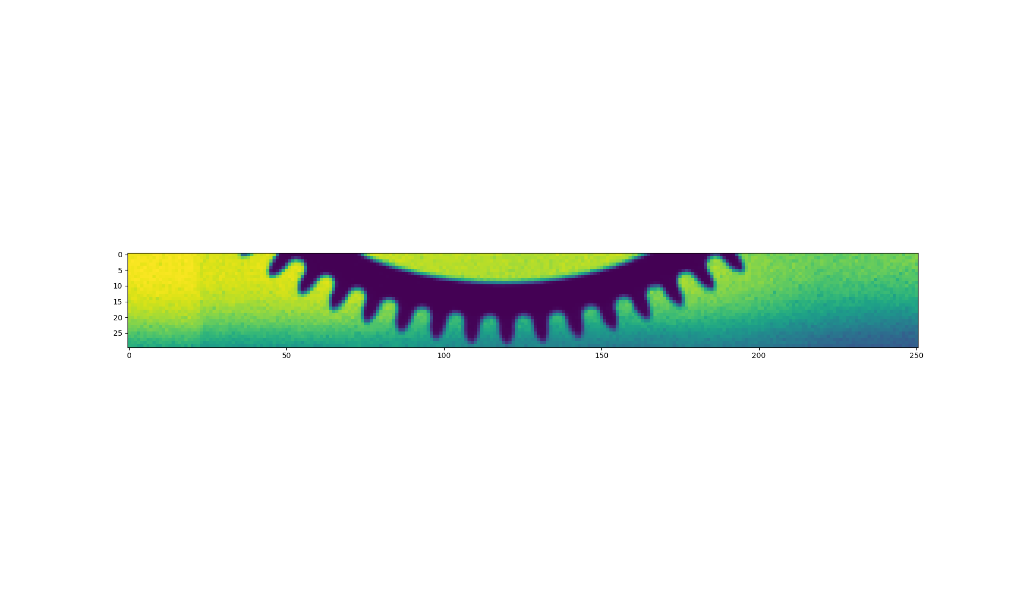
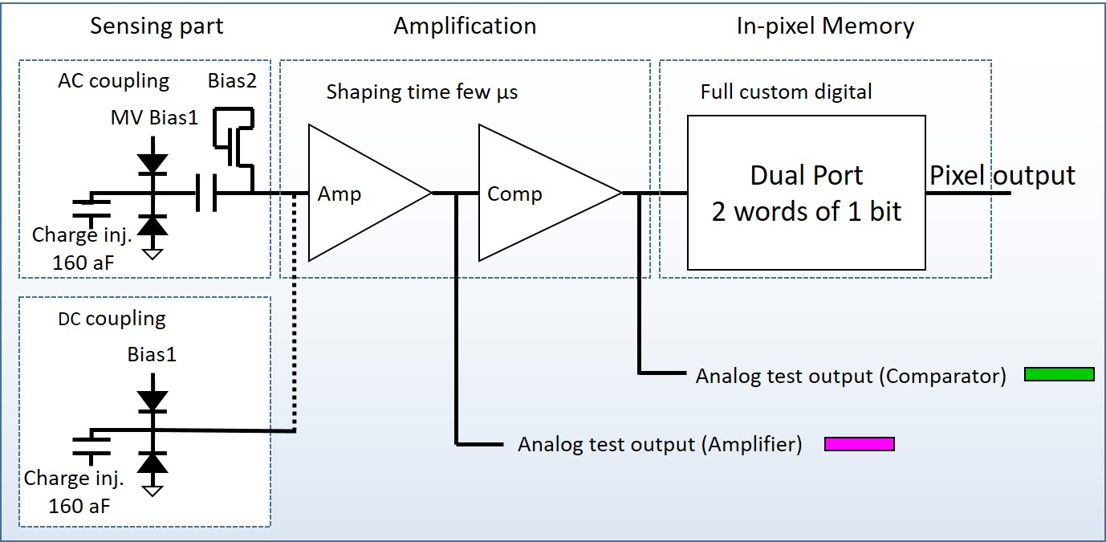
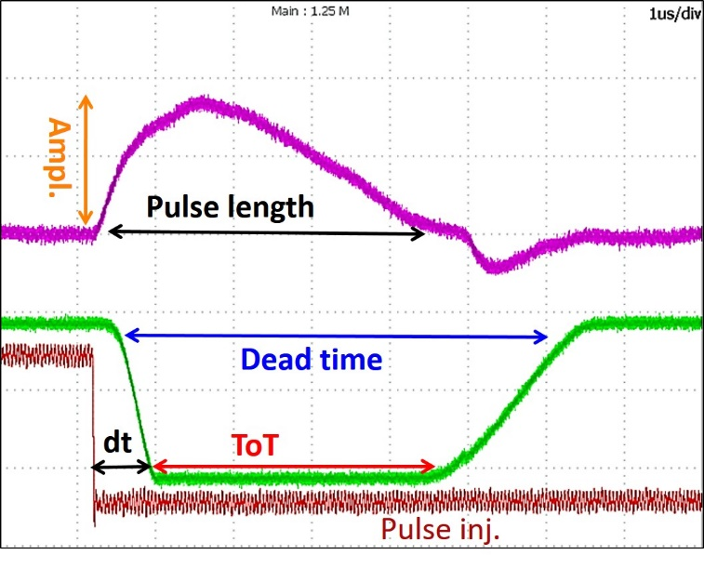
Results from MIMOSIS-0
1 mm
MIMOSIS-0
32 columns of 504 pixel.
Priority encoder.
Up to 40V depletion voltage.
No data buffers yet.
X-ray picture taken with MIMOSIS-0
Oscilloscope screen shot
1µs
MIMOSIS-0 pixel
Test setup:
Compare amplifier response time with pulse injection time.
Record delay and jitter as function of pulse amplitude.

Slide 6
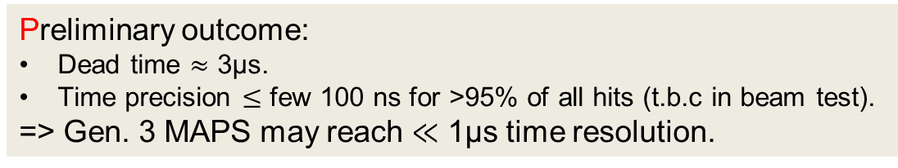
Results from MIMOSIS-0 / CREMAPS-0
<5%
>95% of all hits
Preliminary outcome:
Dead time $≈$ 3µs.
Time precision $≤$ few 100 ns for >95% of all hits (t.b.c in beam test).
=> Gen. 3 MAPS may reach $≪$ 1µs time resolution.

Slide 7
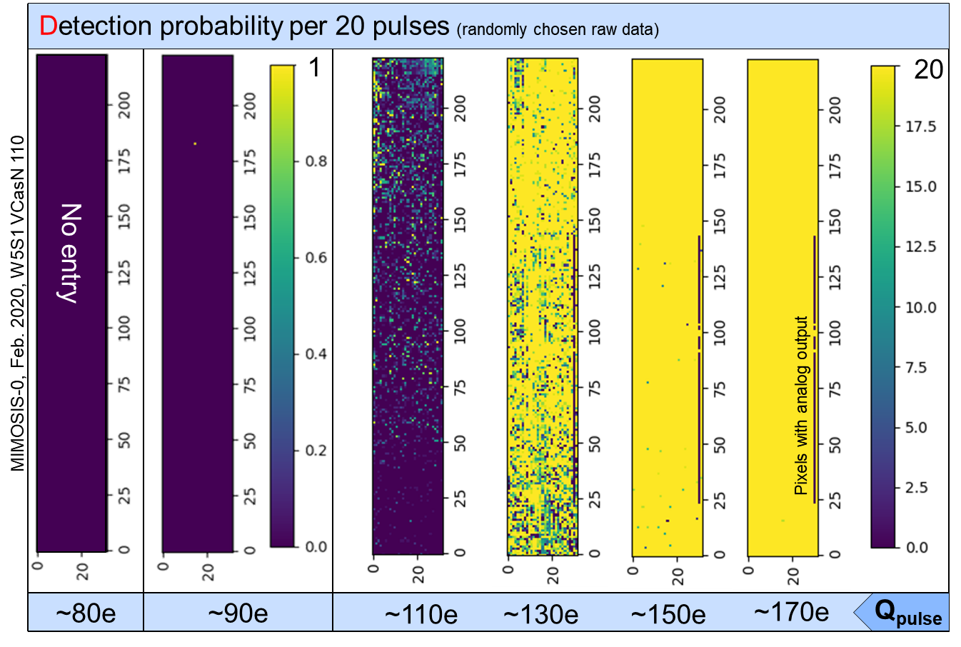
Pixel response
Inject pulses with increasing amplitude at given threshold.
Estimate pixel noise.
Scan for bad pixels

Slide 8

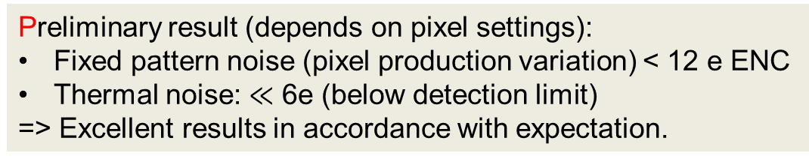

Pixel response
$$Q_{thr}=116 e ENC$$
$$σ=11.6 e ENC$$
Analog pixels: underflow
Preliminary result (depends on pixel settings):
Fixed pattern noise (pixel production variation) < 12 e ENC
Thermal noise: $≪$ 6e (below detection limit)
=> Excellent results in accordance with expectation.

Slide 9
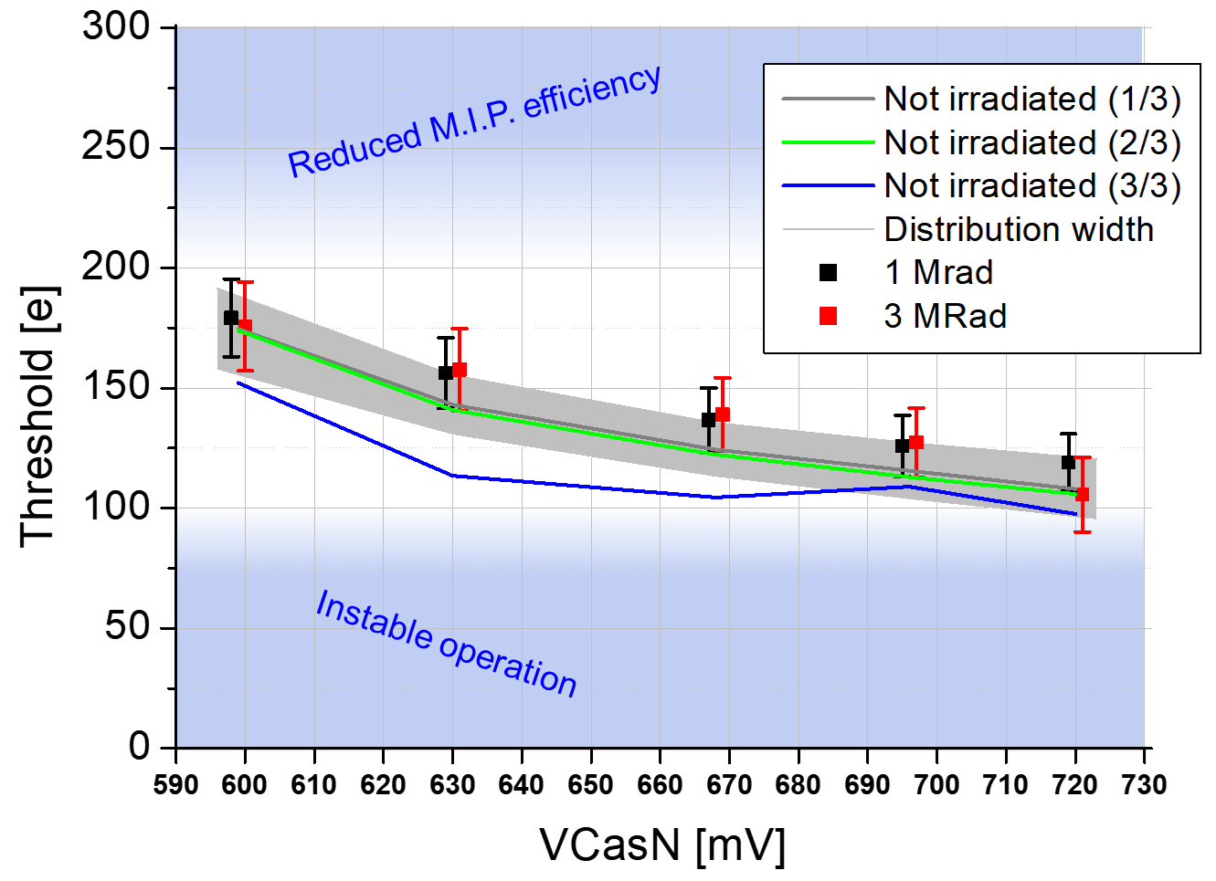
Response to total ionizing doses
Sensors irradiated with ionizing doses.
Test threshold shift and noise.
+ 1 year room temp. annealing
Preliminary result:
Noise mostly unchanged.
Threshold shift remains in acceptable range
=> Excellent but needs confirmation for non-annealed chips

Slide 10
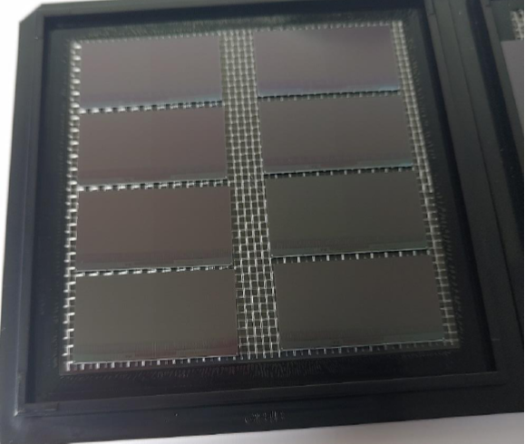
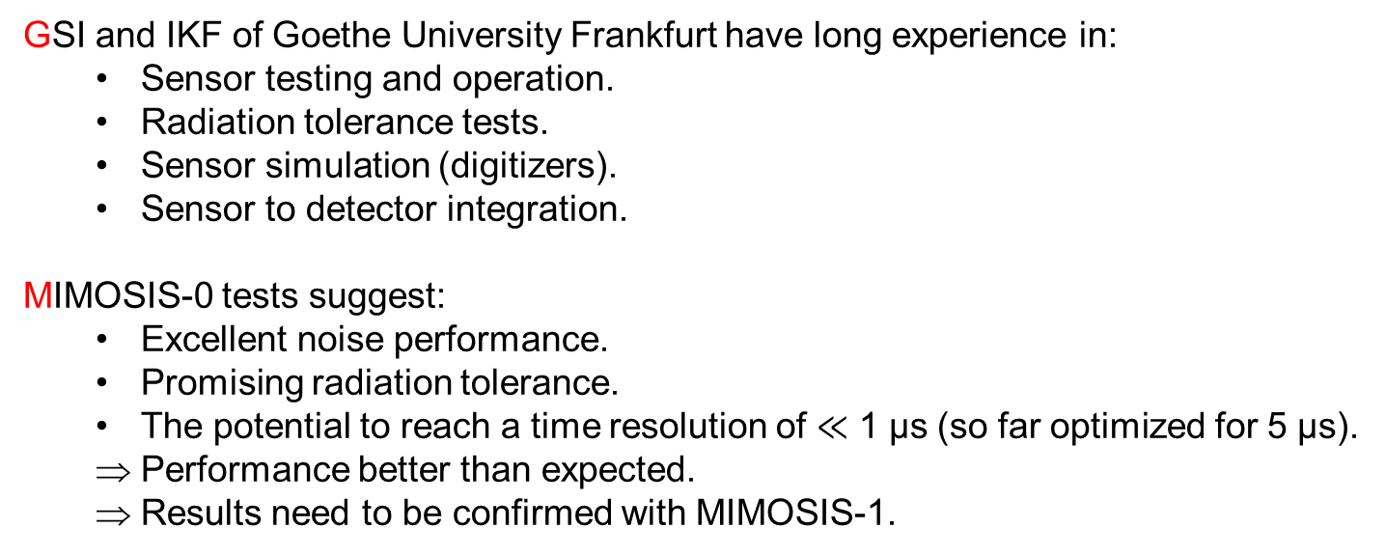
Summary and outlook: Test MIMOSIS-1
GSI and IKF of Goethe University Frankfurt have long experience in:
  Sensor testing and operation.
  Radiation tolerance tests.
  Sensor simulation (digitizers).
  Sensor to detector integration.
MIMOSIS-0 tests suggest:
  Excellent noise performance.
  Promising radiation tolerance.
  The potential to reach a time resolution of $≪$ 1 µs (so far optimized for 5 µs).
  Performance better than expected.
  Results need to be confirmed with MIMOSIS-1.
Next steps (together with IPHC and Uni-Frankfurt):
Basic functionality tests (time response, noise etc.).
Radiation tolerance tests.
Immunity to heavy ion impacts with GSI beams
=> HI impacts: Particularly dangerous for micro-chips.
MIMOSIS-1

