Slide 1




MAPS and charged particle tracking – the fundamentals
M. Deveaux - GSI

Slide 2
Outline
The goal of this talk:
Explain what MAPS are good for and where we stand…
… in 20 minutes to young scientists of the neutron community.
NOT goal of this talk:
Show things as complicated as they really are.
Outline:
The challenge of charged particle tracking.
What are MAPS?
MAPS performance and ongoing research.

Slide 3
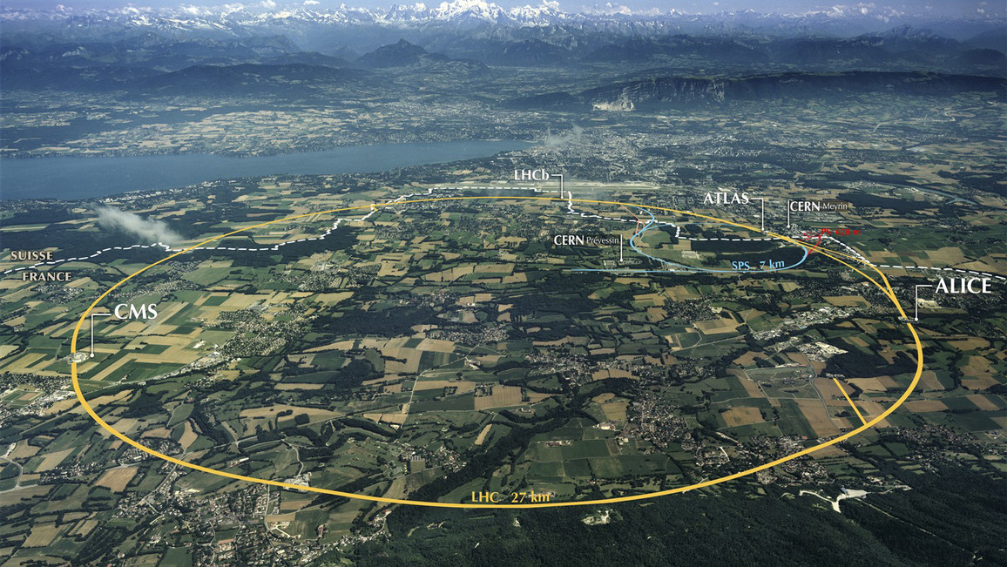
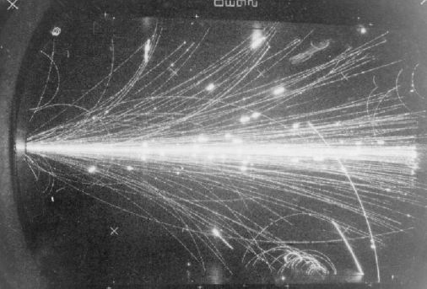

The challenge of charged particle tracking
How to find a new particle?
Accelerate some particles.
Generate particles of interest from collision energy.
Measure/identify this particle.
What do I need to know to identify a particle
Particle mass + charge will do.
x
x
x
$$\vec{B}$$
The aim of charged particle tracking:
Make trajectories of particles visible.
Measure charge and momentum by Lorentz-Force.

Slide 4
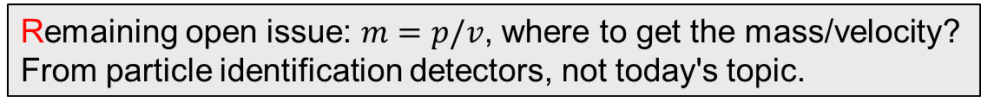

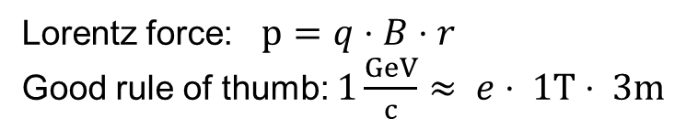

The challenge of charged particle tracking
x
x
x
$$\vec{B}$$
$$\vec{r}$$
Charge positive
(bending direction)
Lorentz force: $p=q⋅B⋅r$
Good rule of thumb: $1\frac{GeV}{c}≈ e⋅ 1T⋅ 3m$
Remaining open issue: $m=p/v$, where to get the mass/velocity?
From particle identification detectors, not today's topic.

Slide 5
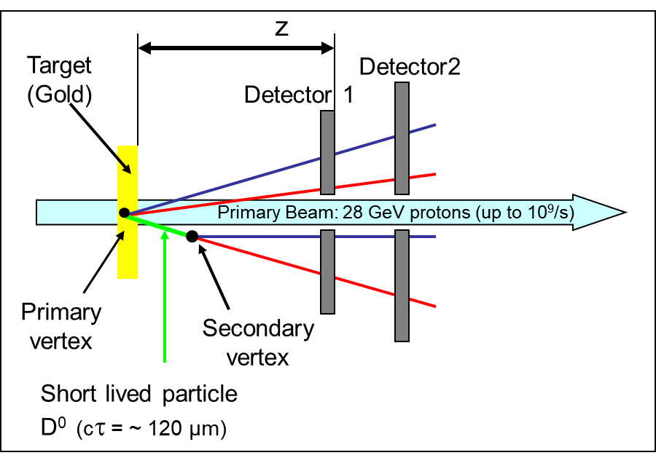
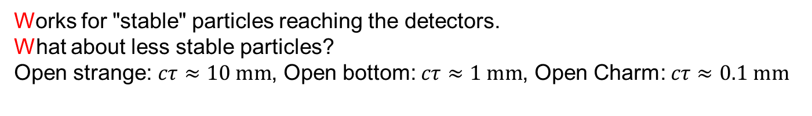
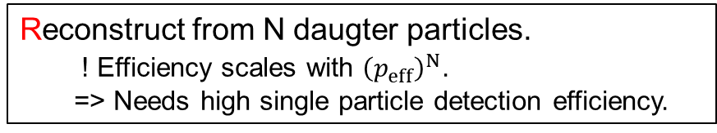
Where to get the mass/velocity?
Works for "stable" particles reaching the detectors.
What about less stable particles?
Open strange: $cτ≈10 mm$, Open bottom: $cτ≈1 mm$, Open Charm: $cτ≈0.1 mm$
Prove existence of short lived particle by separating primary and secondary vertex.
Compute its properties by:
Adding 4-vectors of daugters (invariant mass).
"Add" quark content of daugters.
Sounds too easy, where is the challenge?
Reconstruct from N daugter particles.
! Efficiency scales with ${\left(p_{eff}\right)}^{N}$.
=> Needs high single particle detection efficiency.

Slide 6
Where is the challenge?
Limited detector resolution spoils vertex resolution.
  Needs <5µm.

Slide 7
Where is the challenge?
Limited detector resolution spoils vertex resolution.
  Needs <5µm.
Multiple coulomb scattering manipulated particle trajectory.
  Needs x< 0.3% X_{0.}
Radiation
length

Slide 8
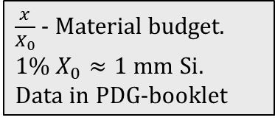
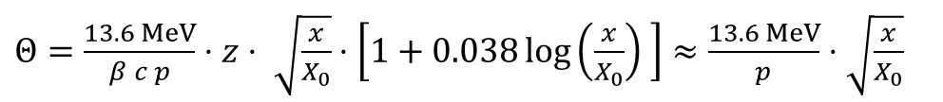
Where is the challenge?
Limited detector resolution spoils vertex resolution.
  Needs <5µm.
Multiple coulomb scattering manipulated particle trajectory.
  Needs x< 0.3% X_{0.}
300µm Si
Radiation
length
$\frac{x}{X_{0}}$ - Material budget. $1\% X_{0}≈1 mm Si.$
Data in PDG-booklet
Scattering angle
Relativistic particles with z=1
$Θ=\frac{13.6 MeV}{β c p}⋅z⋅ \sqrt{\frac{x}{X_{0}}}⋅\left[1+0.038\log\left(\frac{x}{X_{0}}\right) \right]≈\frac{13.6 MeV}{p}⋅\sqrt{\frac{x}{X_{0}}}$
No challenge…
We just have to build mass-less detectors with infinitely good spatial resolution and perfect efficiency…

Slide 9
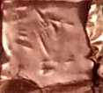
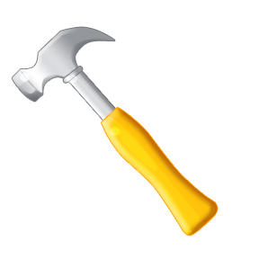
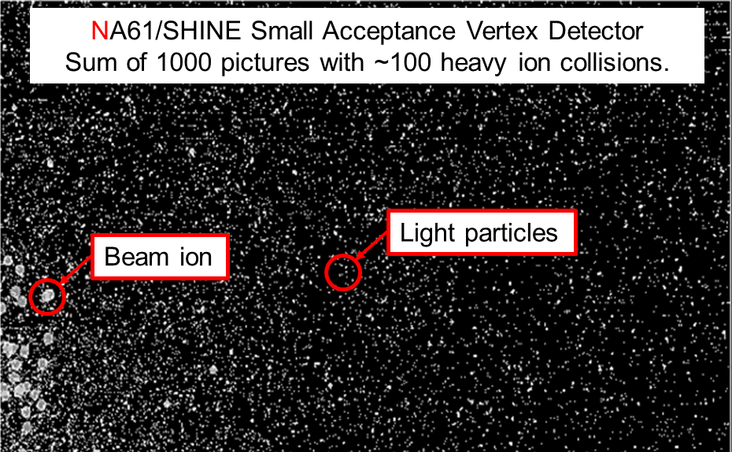
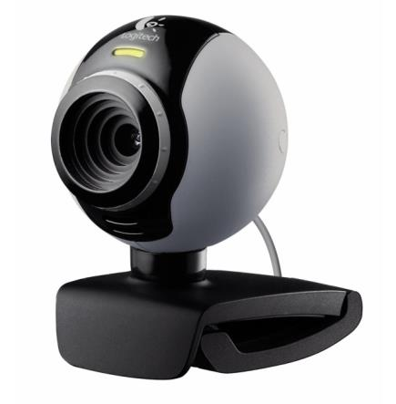

Toward the perfect detector
We need: 5 µm resolution, <300 µm thickness, 100% efficiency…
What do I need to get this ideal detector?
First of all a hammer…
…metal tape…
… a webcam…
…and a bit of radiation.

Slide 10
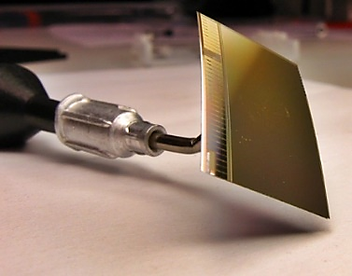

What are MAPS / CPS?
CMOS Monolithic Active Pixel Sensors
Pixel size : ~ 30 x 30 µm².
~ 500k pixels / sensor.
Resolution: < 5µm.
Thickness: 50 µm.
99.9% particle detection efficiency.
Easy for webcams
Yes, it is really a bended silicon crystal!
MAPS outperform other silicon detectors by factors in resolution and thickness.
Well, they need a little tuning…
if you want results during your life-time.
But you don't build experiments with webcams?

Slide 11

Ongoing research on MAPS: Speed
CREMAPS(?)
Gen. 3 – On pixel
discriminator
MIMOSIS-0
ALPIDE
MIMOSA-26
FSBB
Gen. 2 – On chip
discriminator
MIMOSTAR-3
Gen. 1 – Off chip
discriminator
MIMOSA-5
Video (DVD)

Slide 12
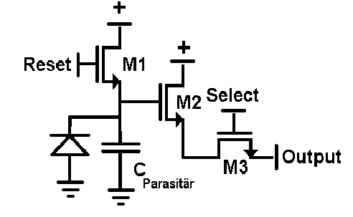
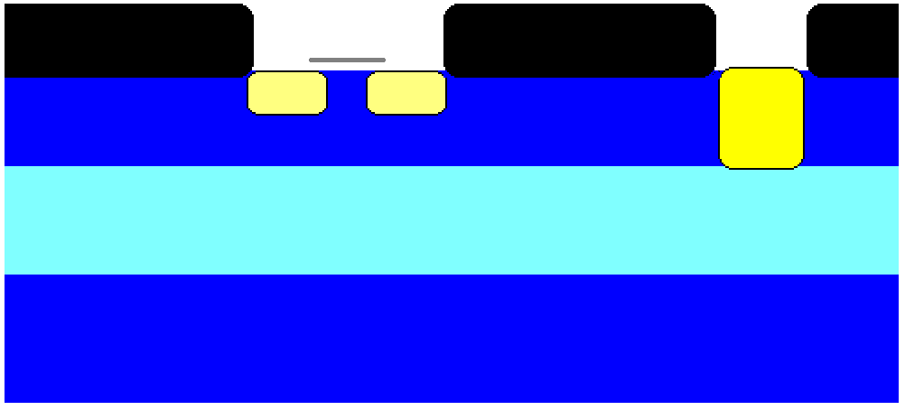
Operation principle of MAPS
+3.3V
Reset
+3.3V
Output
SiO₂
SiO₂
SiO₂
N++
N++
N+
P+
P-
P+

Slide 13
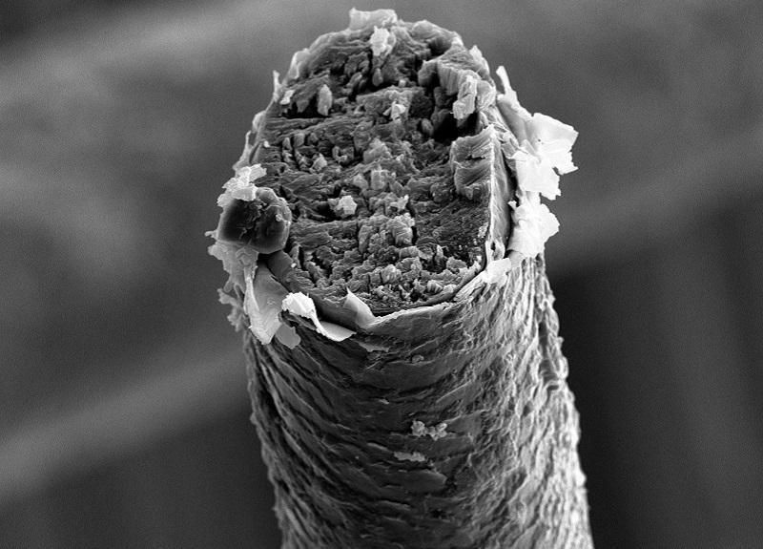
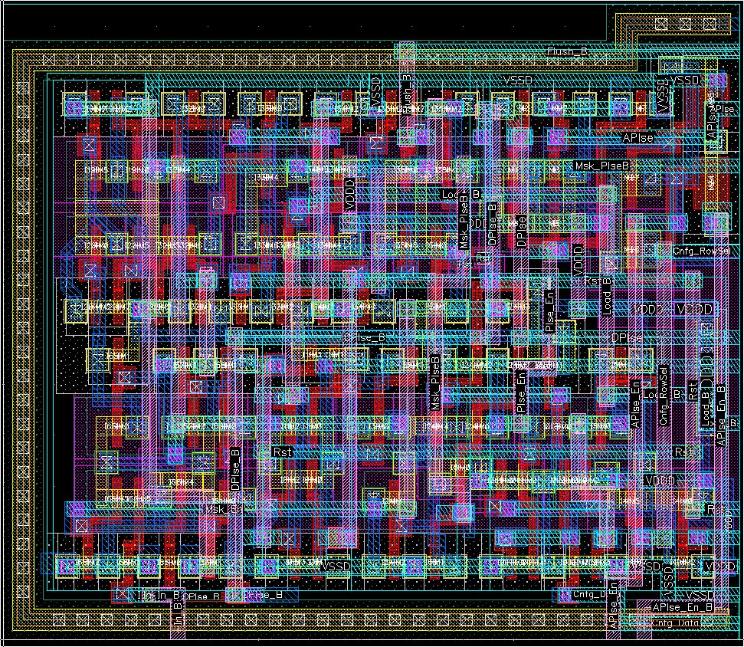
Block diagram of Gen. 3 MAPS (CREMAPS)
~30µm
Pixel:
Sensor (also depleted).
Amplifier – shaper.
Discriminator.
Sample-and-hold.
~30µm
Priority encoder:
Reads data.
Order guaranteed.
Ignores empty pixels.
Human hair (to scale)
14.5µm
Buffer:
Compresses data.
Averages data stream.
Data buffer
Mimosis Pixel Logic Layout (106 Transistors)
On-chip

Slide 14

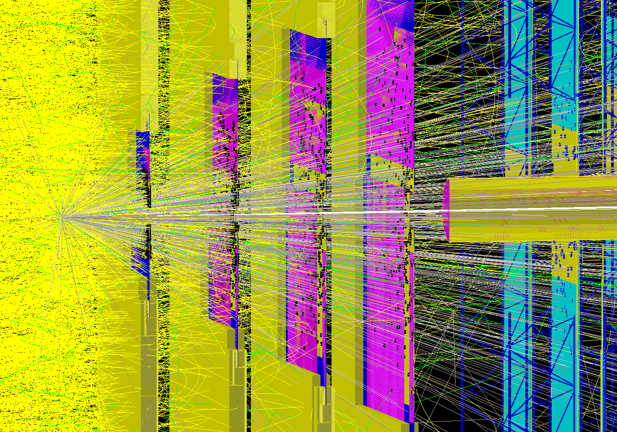


Block diagram of Gen. 3 MAPS (CREMAPS)
Pixel:
Sensor (also depleted).
Amplifyer – shaper.
Discriminator.
Sample-and-hold.
Priority encoder:
Reads data.
Order guaranteed.
Ignores empty pixels.
Buffer:
Compresses data.
Averages data stream.
01001010010
01001010110
01001011000
Data buffer
On-chip
Off-chip

Slide 15
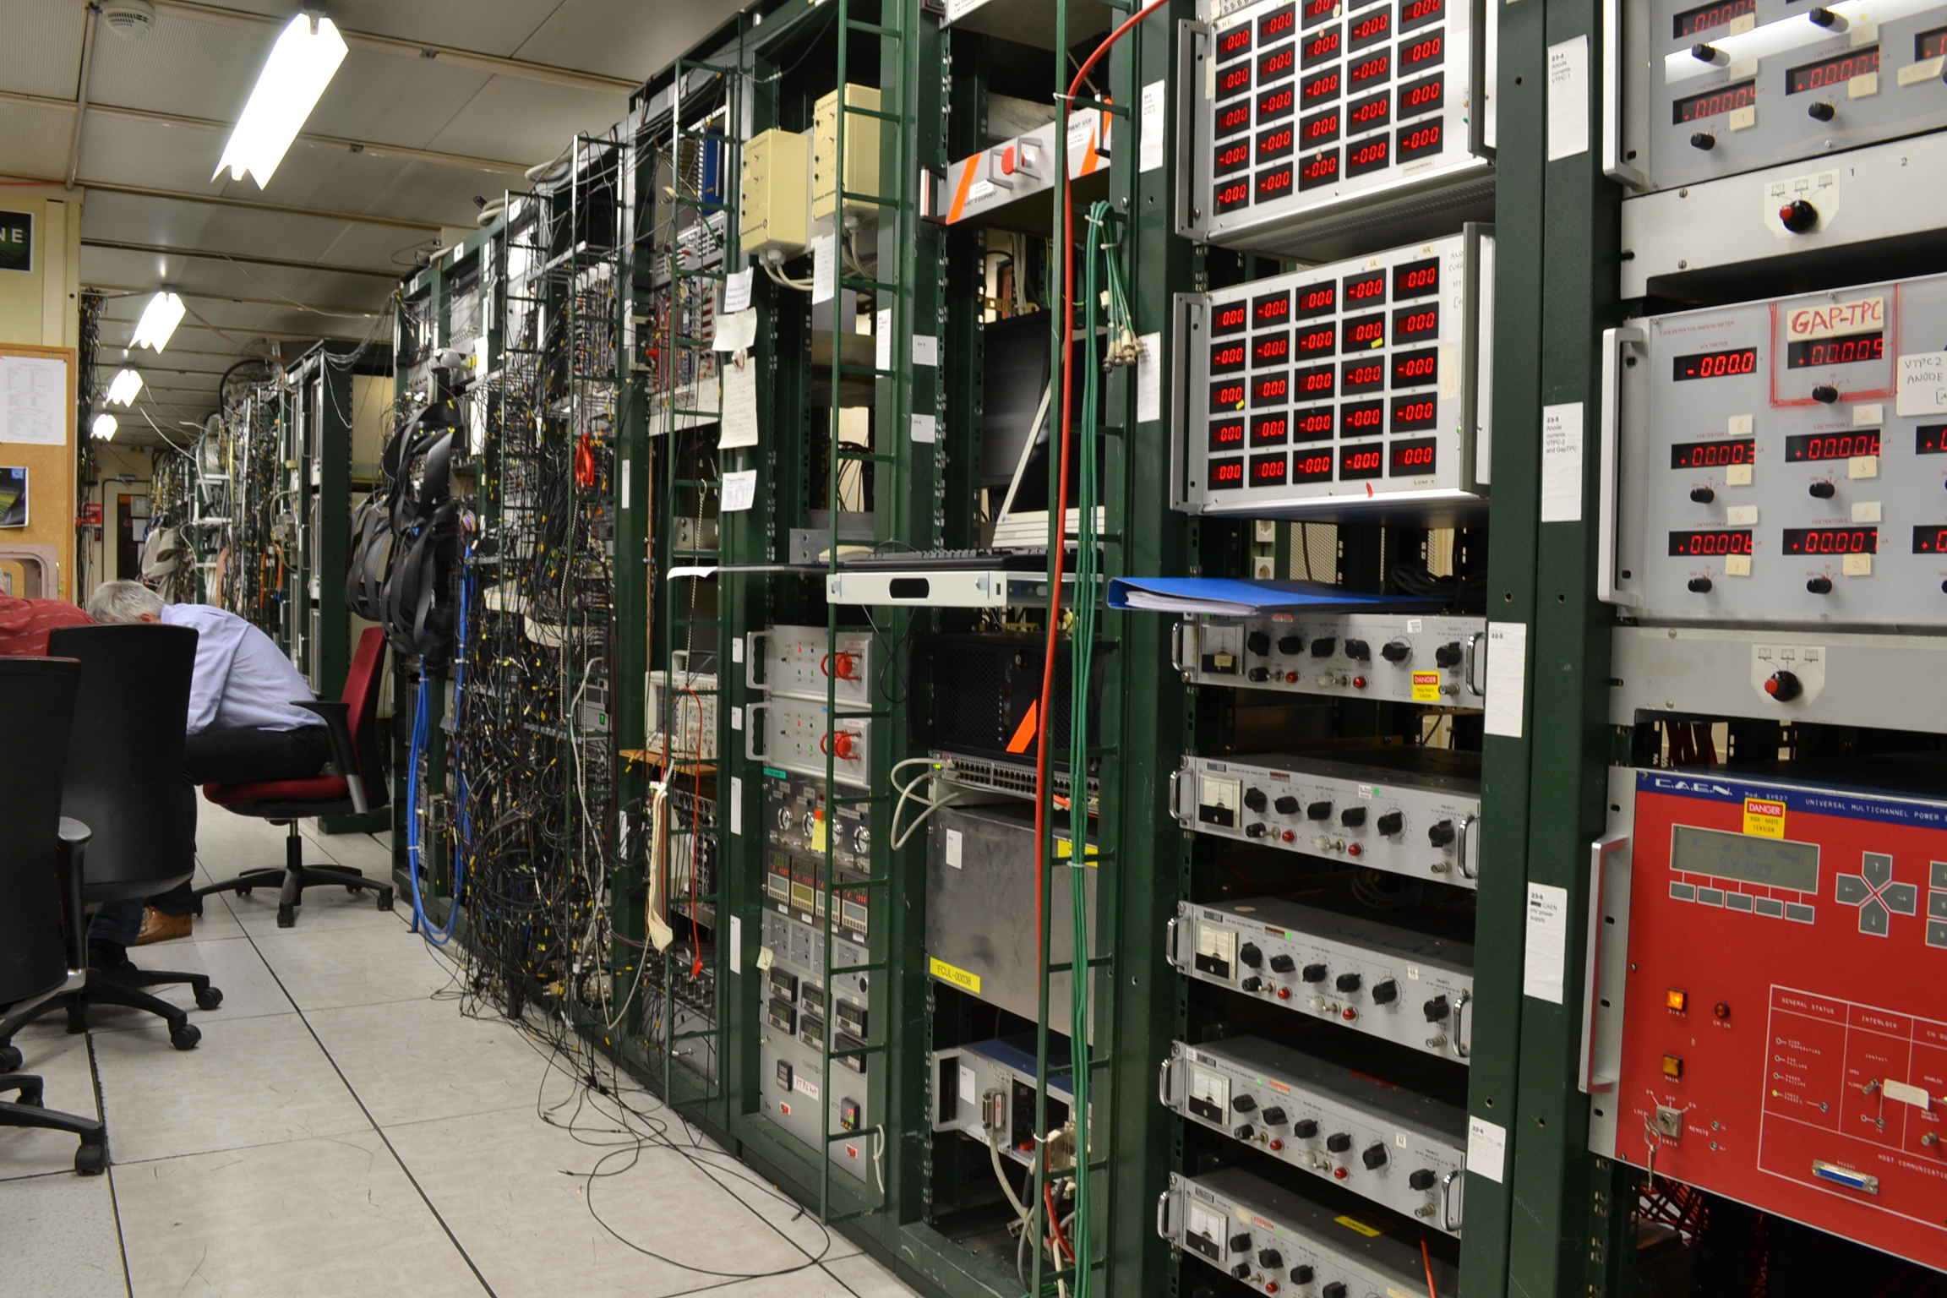

How to control 500 000 channels
Side band contains:
Data buffers.
Voltage regulators, trim DACs.
Slow control interface.
Temperature sensors.
…
$$≈$$
0.3 x 2 cm²
CMOS technology integrates:
Sensors.
Analog FEE.
Digital data processing.

Slide 16
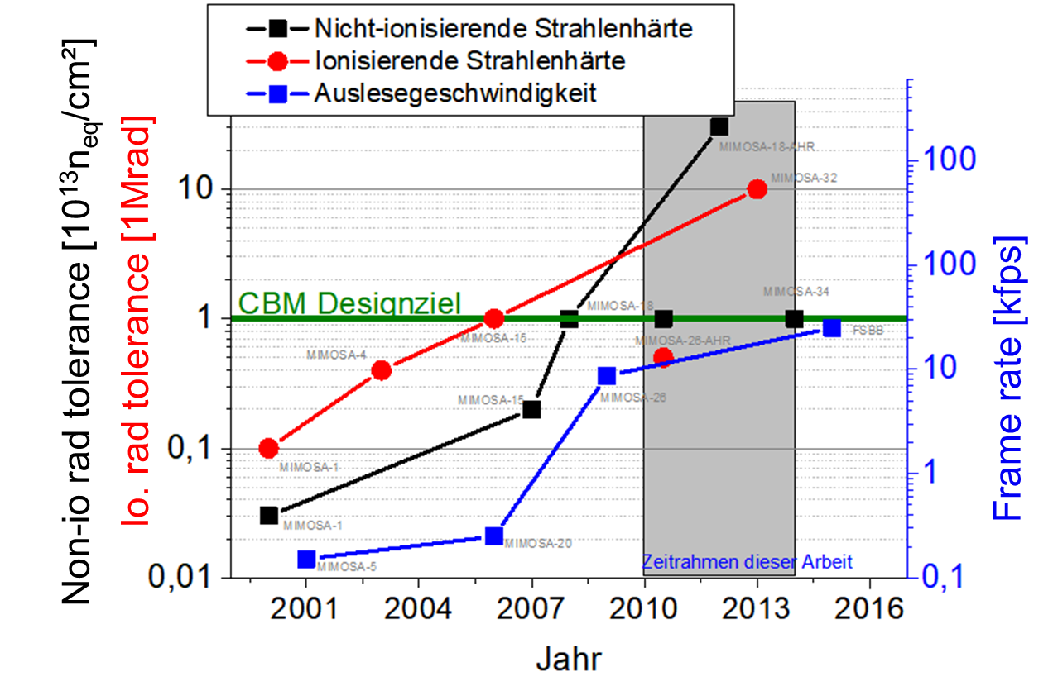
Ongoing research on MAPS: Rad. tolerance
Rad. tolerance (non-ionizing)
Rad. tolerance (ionizing)
Frame rate
Radiation tolerance is an important issue – but no time today.
Further reading: M. Deveaux, JINST 2019 JINST 14 R11001

Slide 17
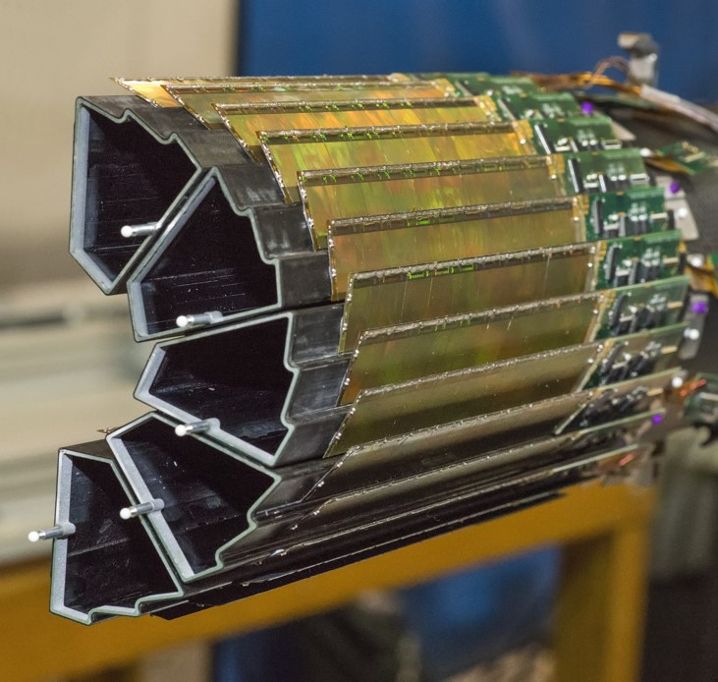

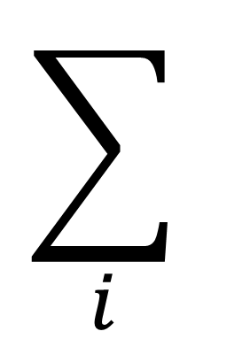
Sensor integration
$$\sum_{i}{ }$$
$$≪$$
OK, the sensors are thin.
But one cannot hold them with air, right?
Right. One needs:
Holding structures.
Cooling for O(0.1 – 1 kW).
Cables for data O(100 Gbps/s) and bias.
Preferably without material…
… as the sensors are the lightest part.
Building ultra-light detectors is an art of its own.

Slide 18
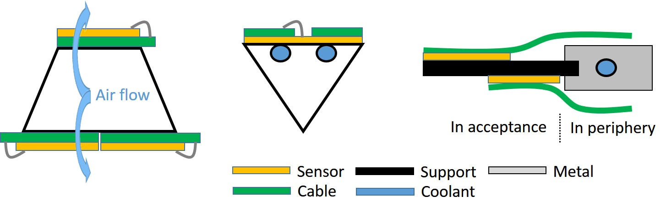
Sensor integration
$$\sum_{i}{ }$$
$$≪$$
OK, the sensors are thin.
But one cannot hold them with air, right?
STAR-PXL
ALICE-ITS2
CBM - MVD

Slide 19
Summary
Charged particle tracking aims to measure particle charge and momentum.
Tracking detectors => momentum measurement.
Vertex detectors => Identify short lived particles.
Tracking and vertexing detectors must provide:
Good resolution, thin material => Good measurement precision.
High efficiency, rate capability and rad. tolerance => Good measurement statistics.
CMOS Monolithic Active Pixel Sensors provide:
<5 µm spatial resolution.
~ 50 µm thickness.
< 10 µs time resolution.
Advanced radiation tolerance.
MAPS detector integration has to:
Minimize material budget of cooling, support and bias.

Slide 20

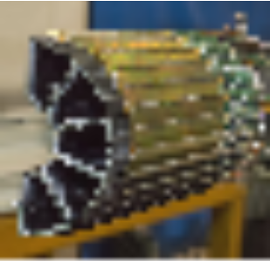
Resolution
Hybrid pixels (LHC / CMS)
MAPS (ALPIDE/MIMOSIS-1)
Thank you for your attention.

