Slide 1
CREMLIN-Plus WP7-DETEC Kick-Off
Sept. 4, 2020
Virtual Meeting in Covid-19 Times
Christian J. Schmidt

Slide 2
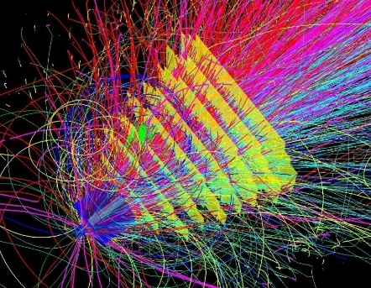
WP7- DETEC: horizontal activity on development of detector technologies
Develop beyond state of the art detector technologies
Aim to foster - cooperation, ideas and technologies-interchange - education of young scientists in the field of particle detectors and related technologies
Joining two fields that typically have only few links:
CMOS pixel sensors for nuclear- and high energy physics tracking applications
Detector technologies for thermal neutrons
Christian J. Schmidt, CREMLIN-Plus Kick-Off, DESY, Feb. 19 – 20, 2020

Slide 3
WP7 - DETEC – Charge of today´s kick-off meeting
Mutual encounter of distinct communities
Get organized and arrange collaboration
Organizational issues and reporting, deliverables and milestones
Agenda: 5 sessions, 10:00 to latest 17:30
Scientific questions and goals – get acquainted with the two research fields
Introduction of activities and institutes part I
Lunchbreak
Introduction of activities and institutes part II
Working program and discussions
Work session on neutron detectors: Deliverable D7.1 (due M3)

Slide 4
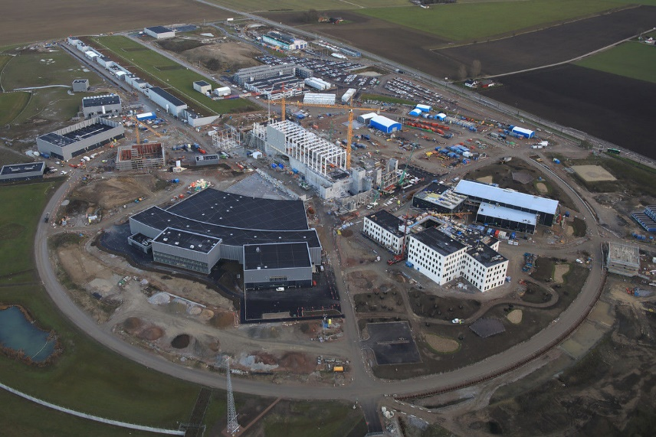
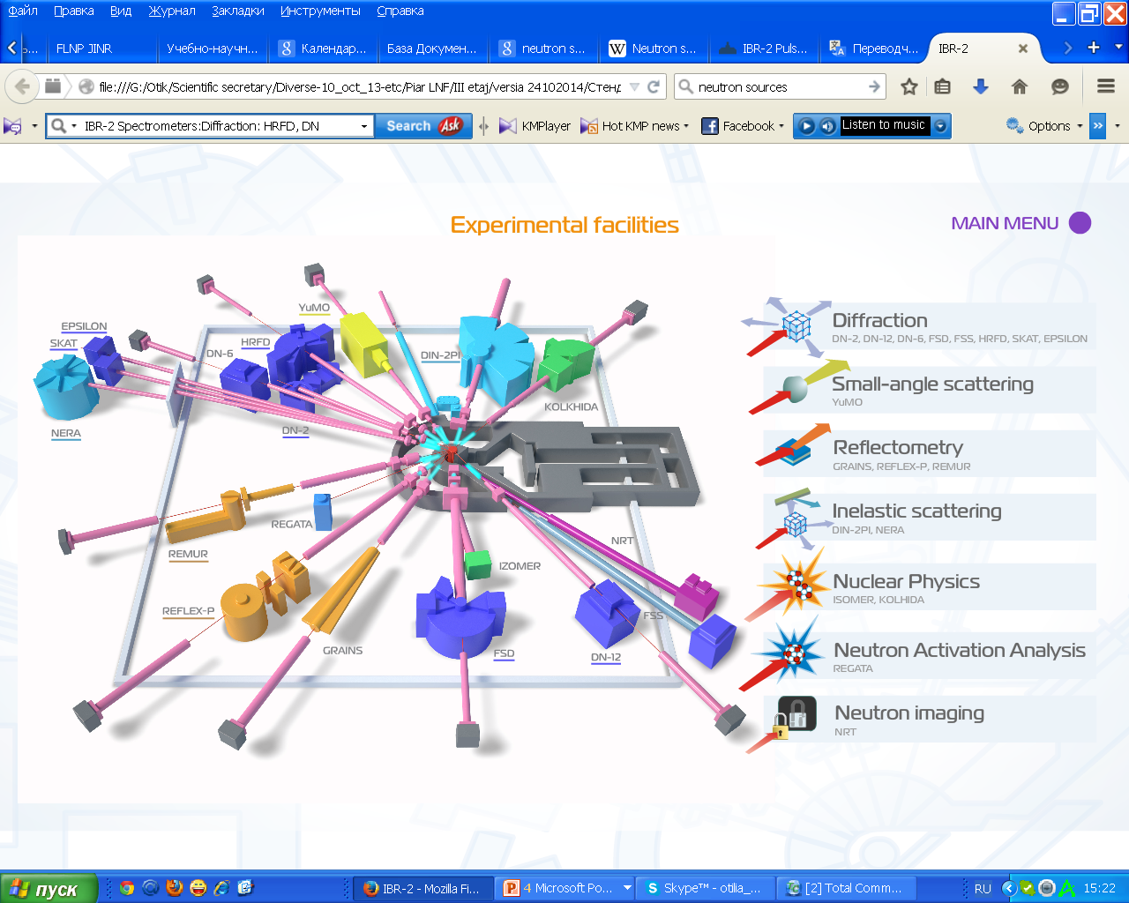
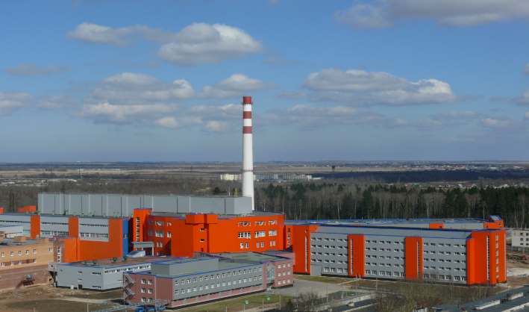
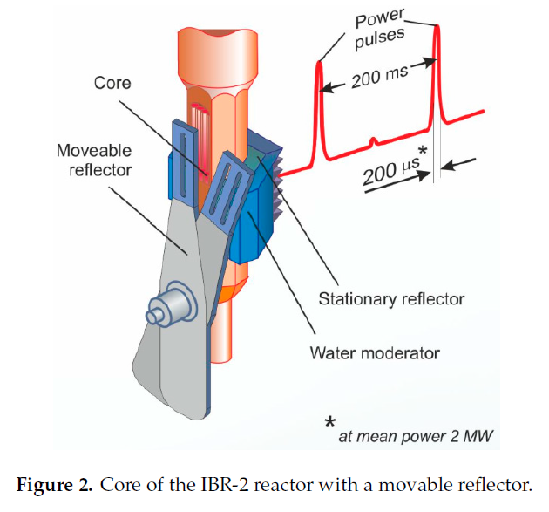
WP7 – DETEC Conjoined Neutron Detector Competence
Activity on Neutron Detector Developments
Instrument Facilities at JINR IBR-2 reactor, supported by facility detector development lab
ESS Detector Group
100 MW Research Reactor PIK, Gatchina, Russia
KI-PNPI aims to set-up and commission
20 instruments with detectors until 2024 at PIK
Notes:
14 spectrometers of different types, a neutron imaging facility, two facilities for neutron nuclear physics investigation and a neutron activation facility
4

Slide 5
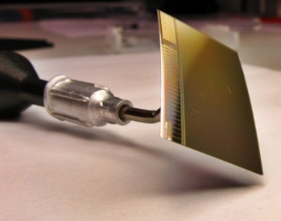
WP7 – DETEC MAPS Monolithic Active Pixel Detectors
Ongoing decade-old grand, research activity pushed forward by the tracking detector community in High-Energy-, Nucl. and Heavy-Ion Physics → HL-LHC, FAIR, NICA etc.
DETEC aims to
very actively corroborate the field
broaden knowledge base to expert personnel facing the integration challenge
disseminate technology to other science fields and eventually to societal benefit
CMOS pixel sensor

Slide 6
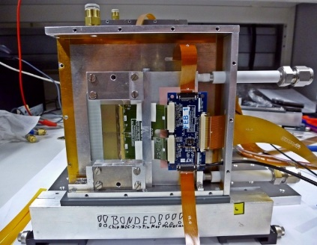
WP7 – DETEC Monolithic Active Pixel Tracking Detector
MAPS integration,
power management
Silicon integration, r/o electronics
MAPS sensor design
technological stake holders
Kiew Institute for Nuclear Research
KINR
silicon detector characterization
and evaluation
Precision e-test-beam facility
characterization of telescope
beneficiary of resulting prototype

Slide 7
broaden knowledge base – widen horizon foster young scientists to get involved make use of WP8, WP9 and WP10 funding
Summer school on detector technologies and electronics as
„joint workshop on modern neutron and tracking detector challenges“
allow for most effective one week to three months secondment of scientists in collaborating partner institution
follow-up on integrating project: employ MAPS for neutron detection
→ master or PhD thesis

