Slide 1
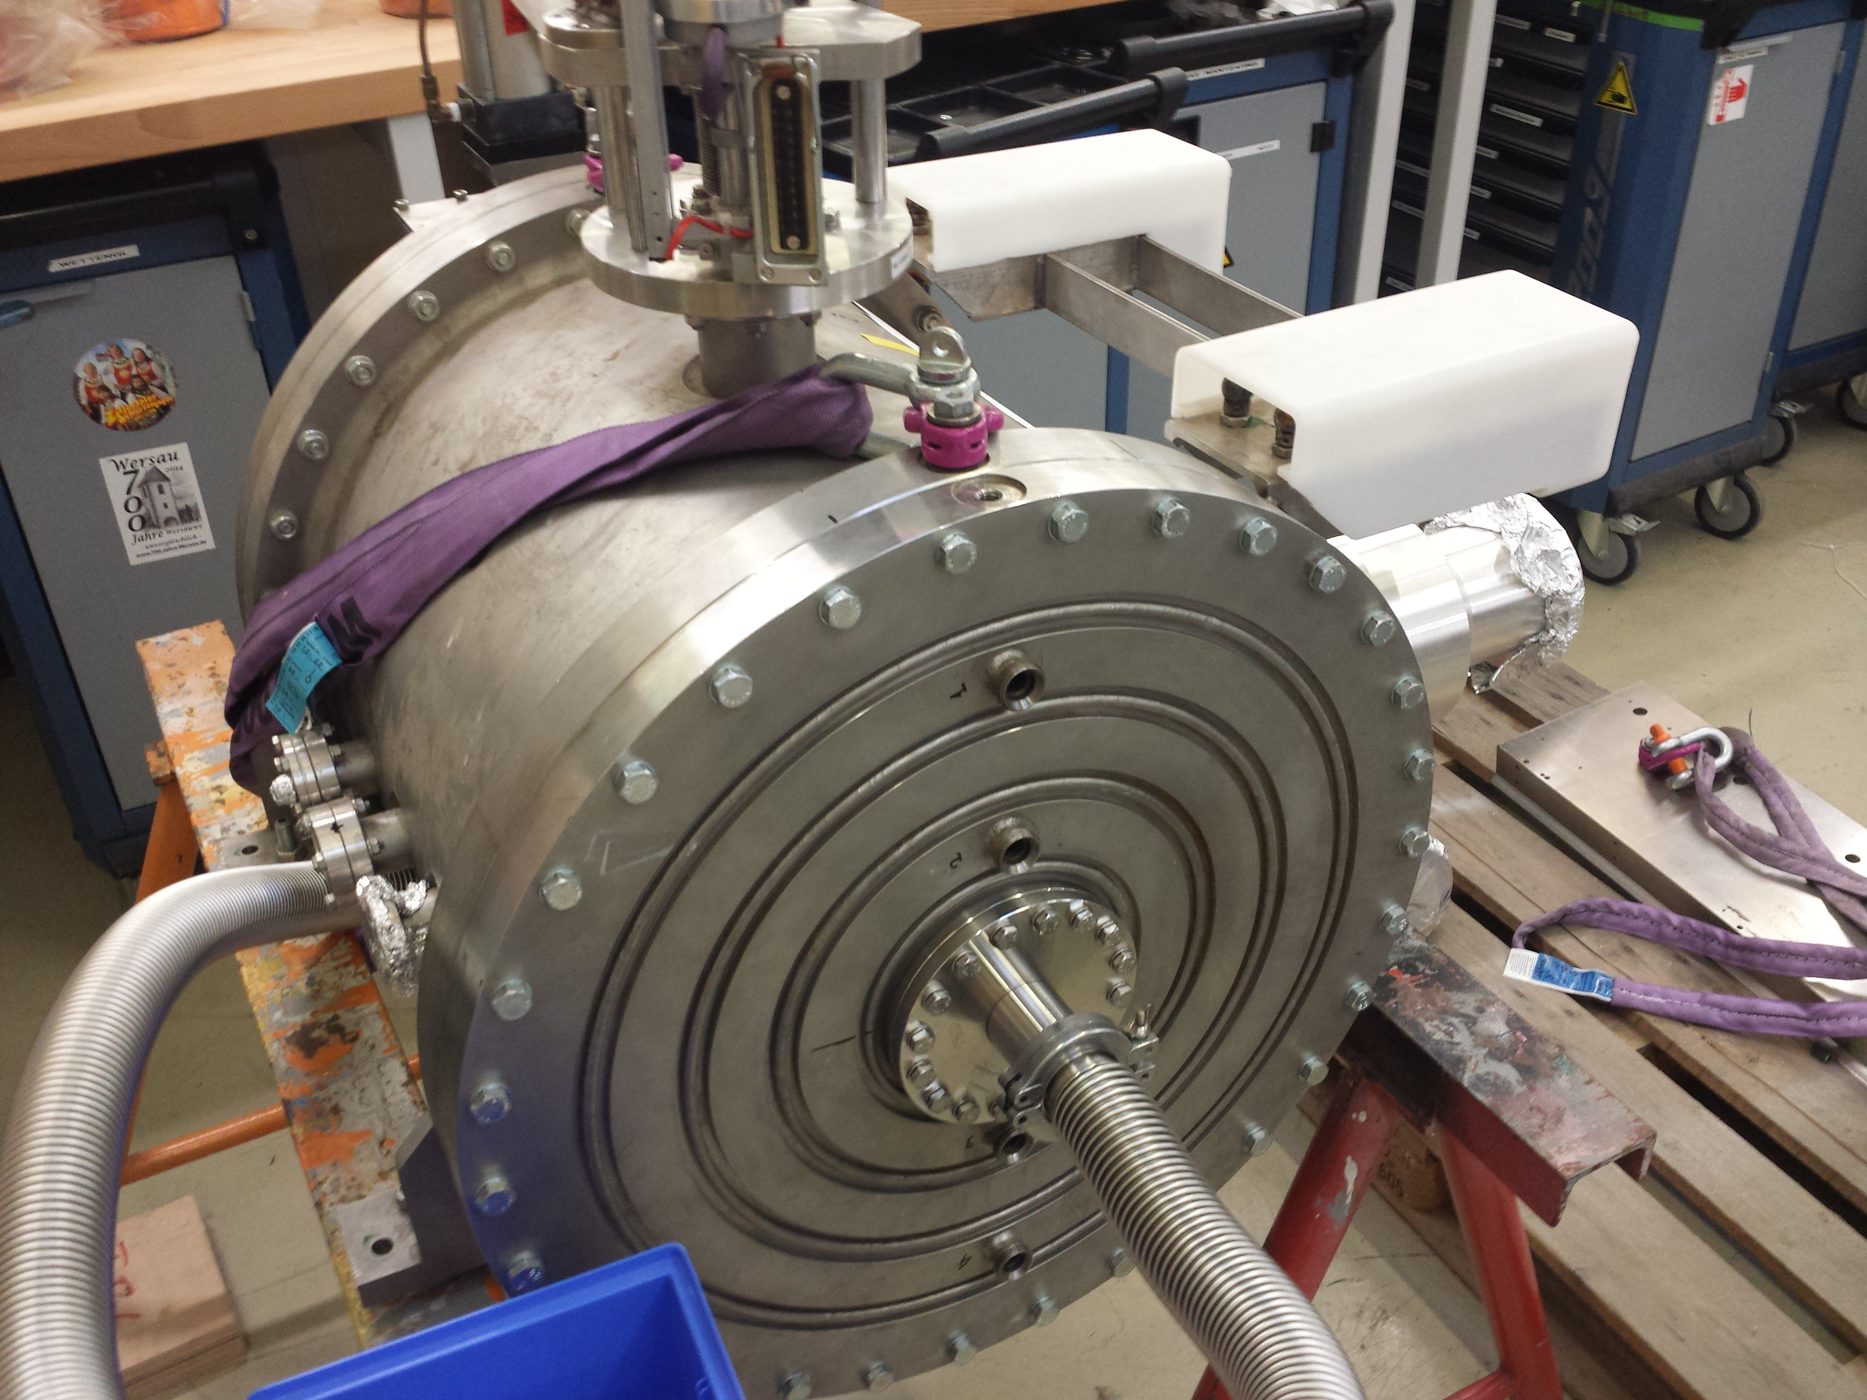
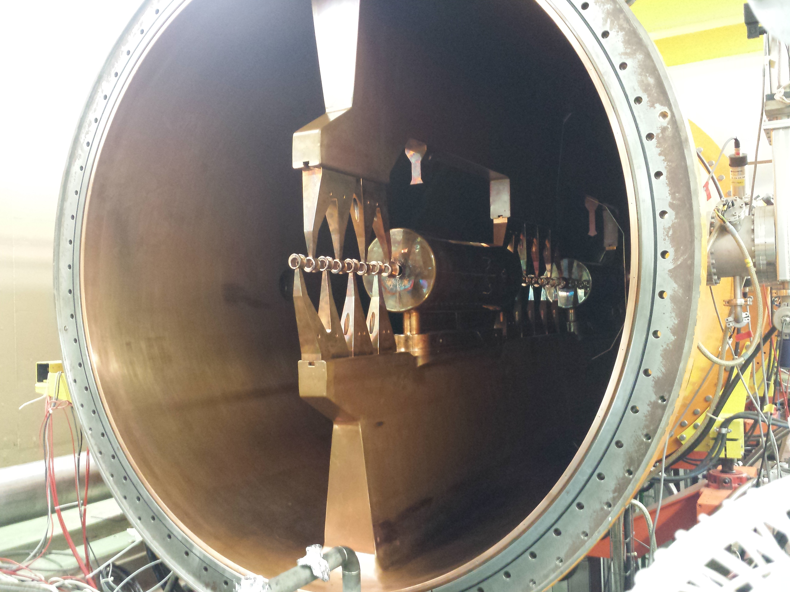
Unilac – 18.8.2020
TK4BB11: plunger leak brazed, RF loop tuned, almost ready. But now RF probe leak, to be repaired in T-Lab.
HLI-IH RF loop: MEWE work ongoing (after leakage of the first re-built loop).
Triplet UH3QT3 water loss repaired (brazed), triplet re-assembled to girder, vacuum tested, okay, ground fault check okay, endplate now to be closed.

Slide 2
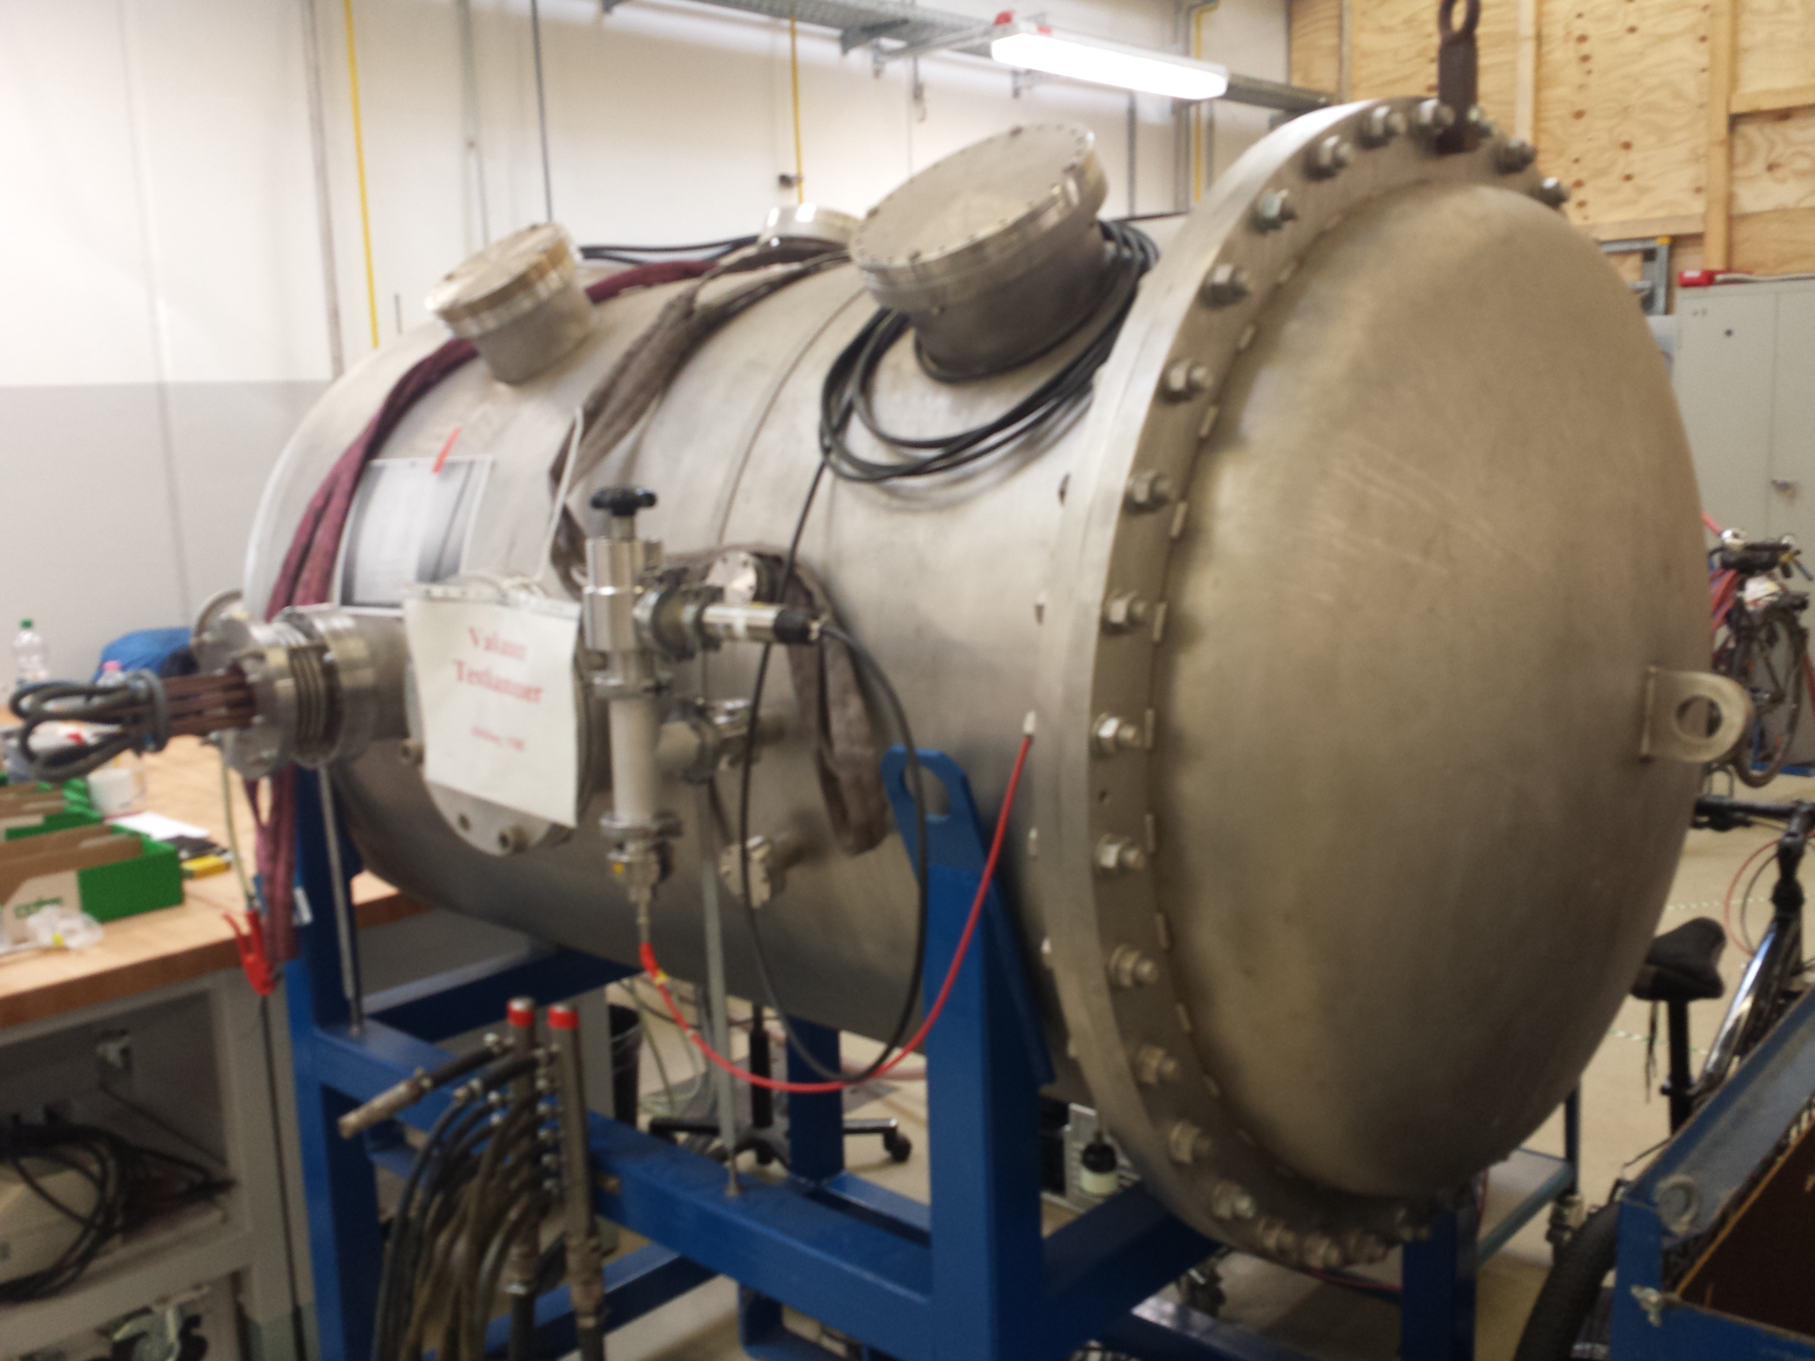
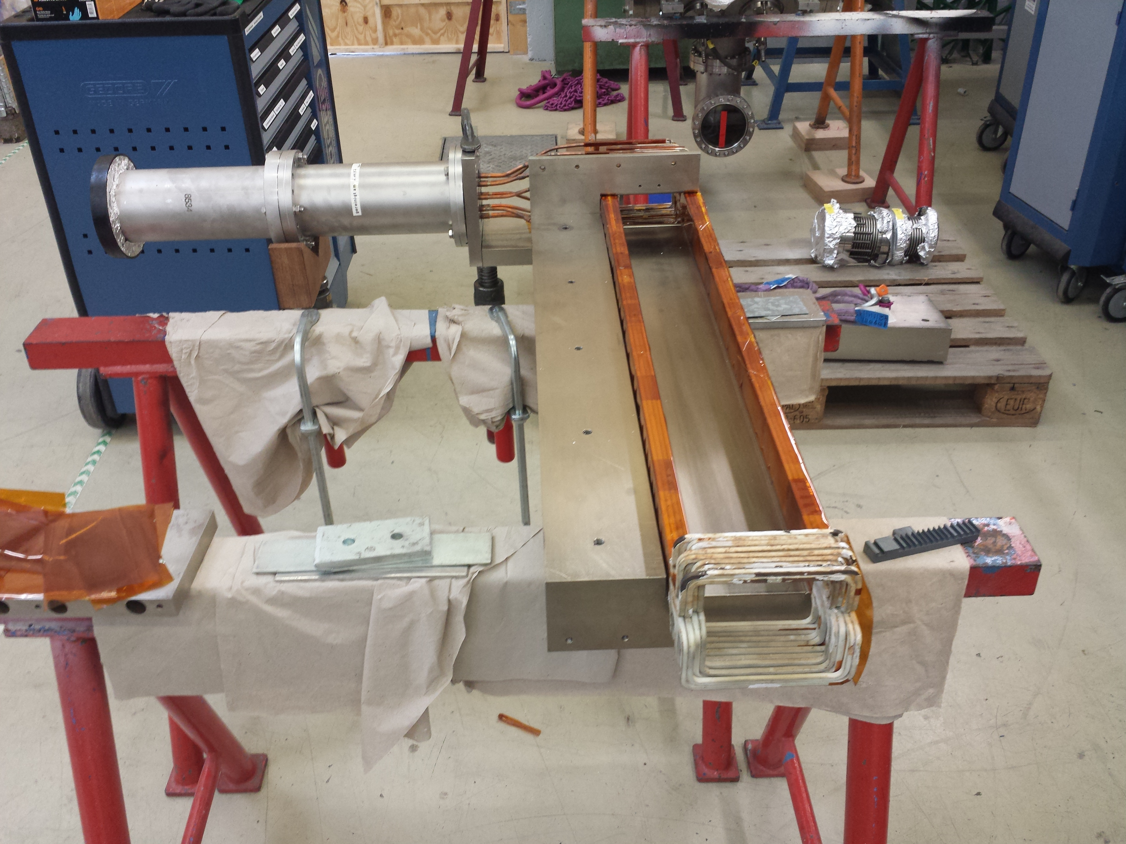
HSI-RFQ: visual inspection through flange when vented again for superlens assembly.
Tunnel Septum Repair: spare part repaired, vacuum test ongoing. Broken Z-coil repair ongoing (“rakes” (combes) from PEEK will be produced when milling machine repaired).
A3DR8: manufacturing finished, packed in box, ready for transportation to external galvanics.

