Slide 1
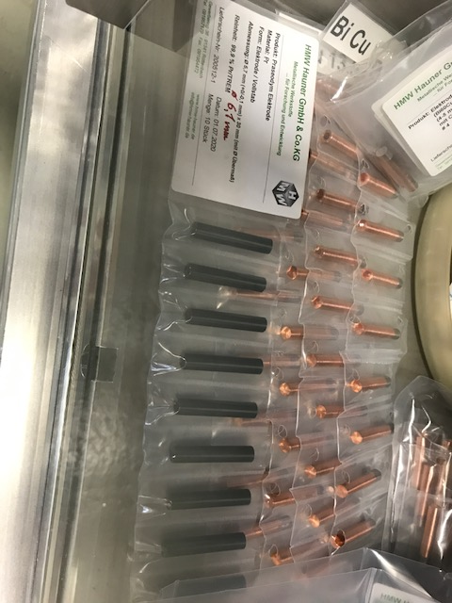
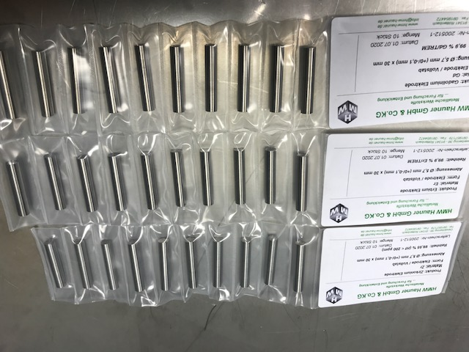
Ion Source Status
Aug 18, 2020
Preparation of 7-Li tests from PIG: Li-Al and Li-Cu are the favorites to increase the melting temperature from 180°C to around 350-400°C; company Hauner is preparing the electrodes
Preparation of high current tests from VARIS for Dy, Pr, Gd, Er, Zr; electrodes are in house
Fire protection measures for HKR will not affect the ion source tests; agreement with Mr. Reckziegel is found
Shut down work is going on

