Slide 1
HEST – 18.08.2020
Visit in HEST took place to prepare electrical safety inspection. 4 weeks will be needed for NE3, NE5 and NE8.
Visit with BEA representatives in HEST took place to identify old unused equipment for disposal or storage. Next step: Visit with T. Radon to discuss activation measurements.
Cleaning of HEST has been scheduled for beginning of November.

Slide 2
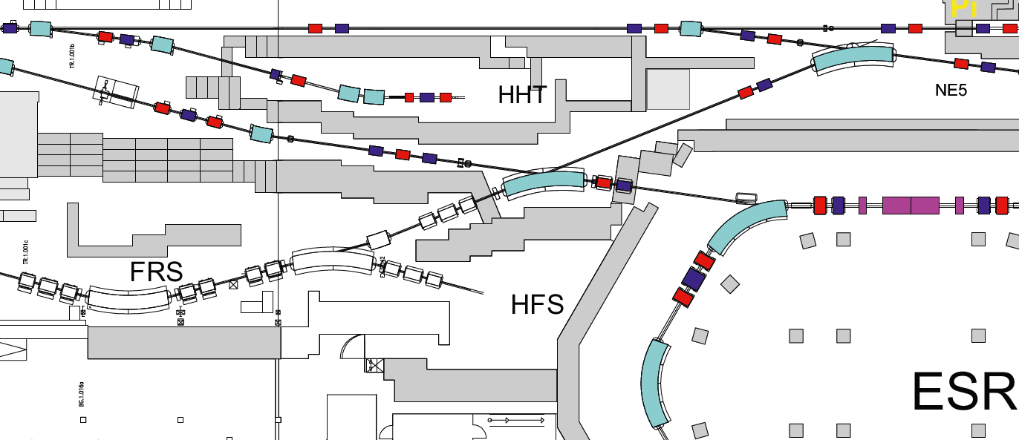
HEST – 18.08.2020
Request from FRS team received to change cabling of some quadrupoles in FRS/HEST so that
GTS7QD11/12 and GTE5QD11/12 will be powered with the same pair of power converters.
GTS7QD11/12 will be on, when beam is sent via FRS to target hall.
GTE5QD11/12 will be off, when beam is sent via FRS to target hall, even if ESR is served at the same time.
To be investigated if optics of SIS18_TE_ESR line could be found, which does not require GTE5QD11/12.
To be verified with beam study.
In Benno‘s drawing GTE5QD21/22 is missing. Why? Was it added later? Is this a hint that one doublet is not sufficient?
GTS7QD11/12
GTE5QD11/12
GTE5QD21/22

