Slide 1
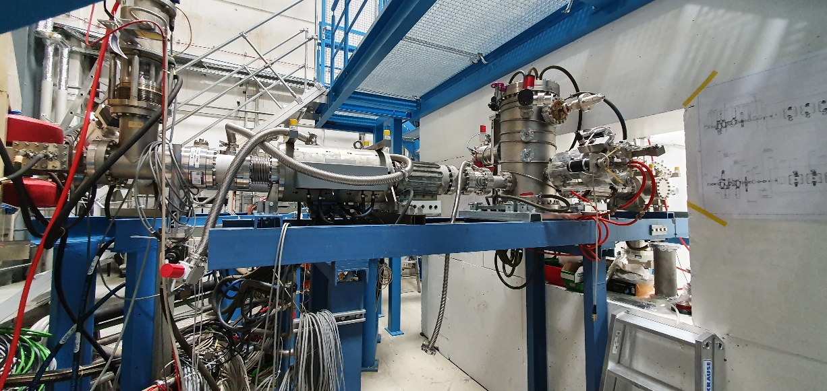
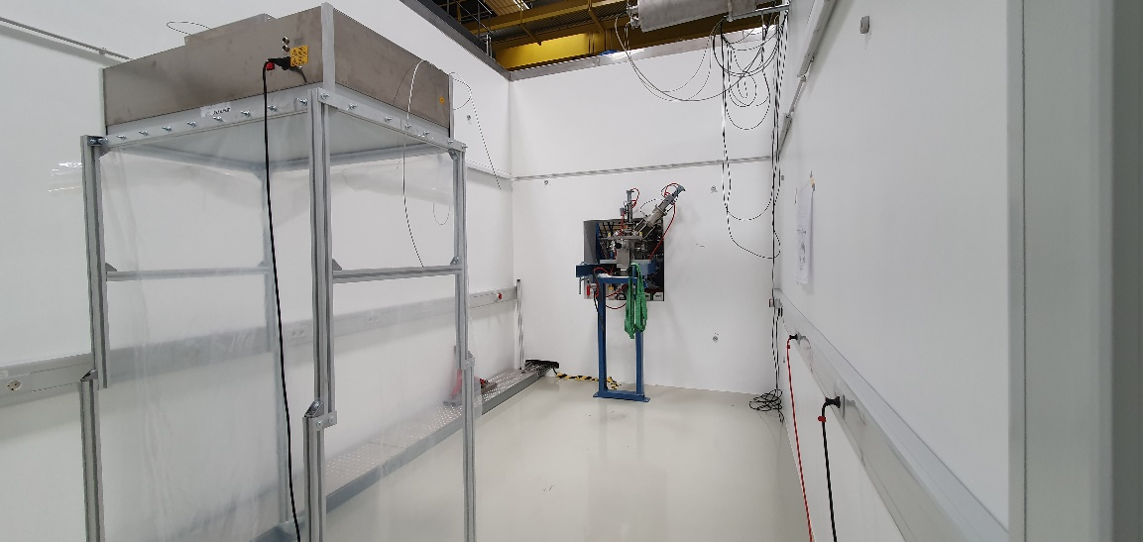
cw-LINAC 18.08.2020
CH2 @ IAP Frankfurt (start of test promised after eastern!) IAP still locked down, postponed!
CH0-test @HI-Mainz postponed for September 2020 => test in preparation. Test scheduled to 01.09. - 20.09
CH0&CH1: HPR for CH1 ordered, offer for CH0 now available
CH3-5 specification finalized; budgetary offer is available; waiting for budget (GFEV is done)
recalibration of temperature sensors for LHe-transfer is done! Commissioning is ongoing
Cleaning of SH1 (HLI-hall) is done!
Beam line set up@SH4 are ongoing. First part before cryostat is assembled!
RFQ-prototype: Preparation for high power Rf-test at test bunker; rf-conditioning is ongoing

