Slide 1
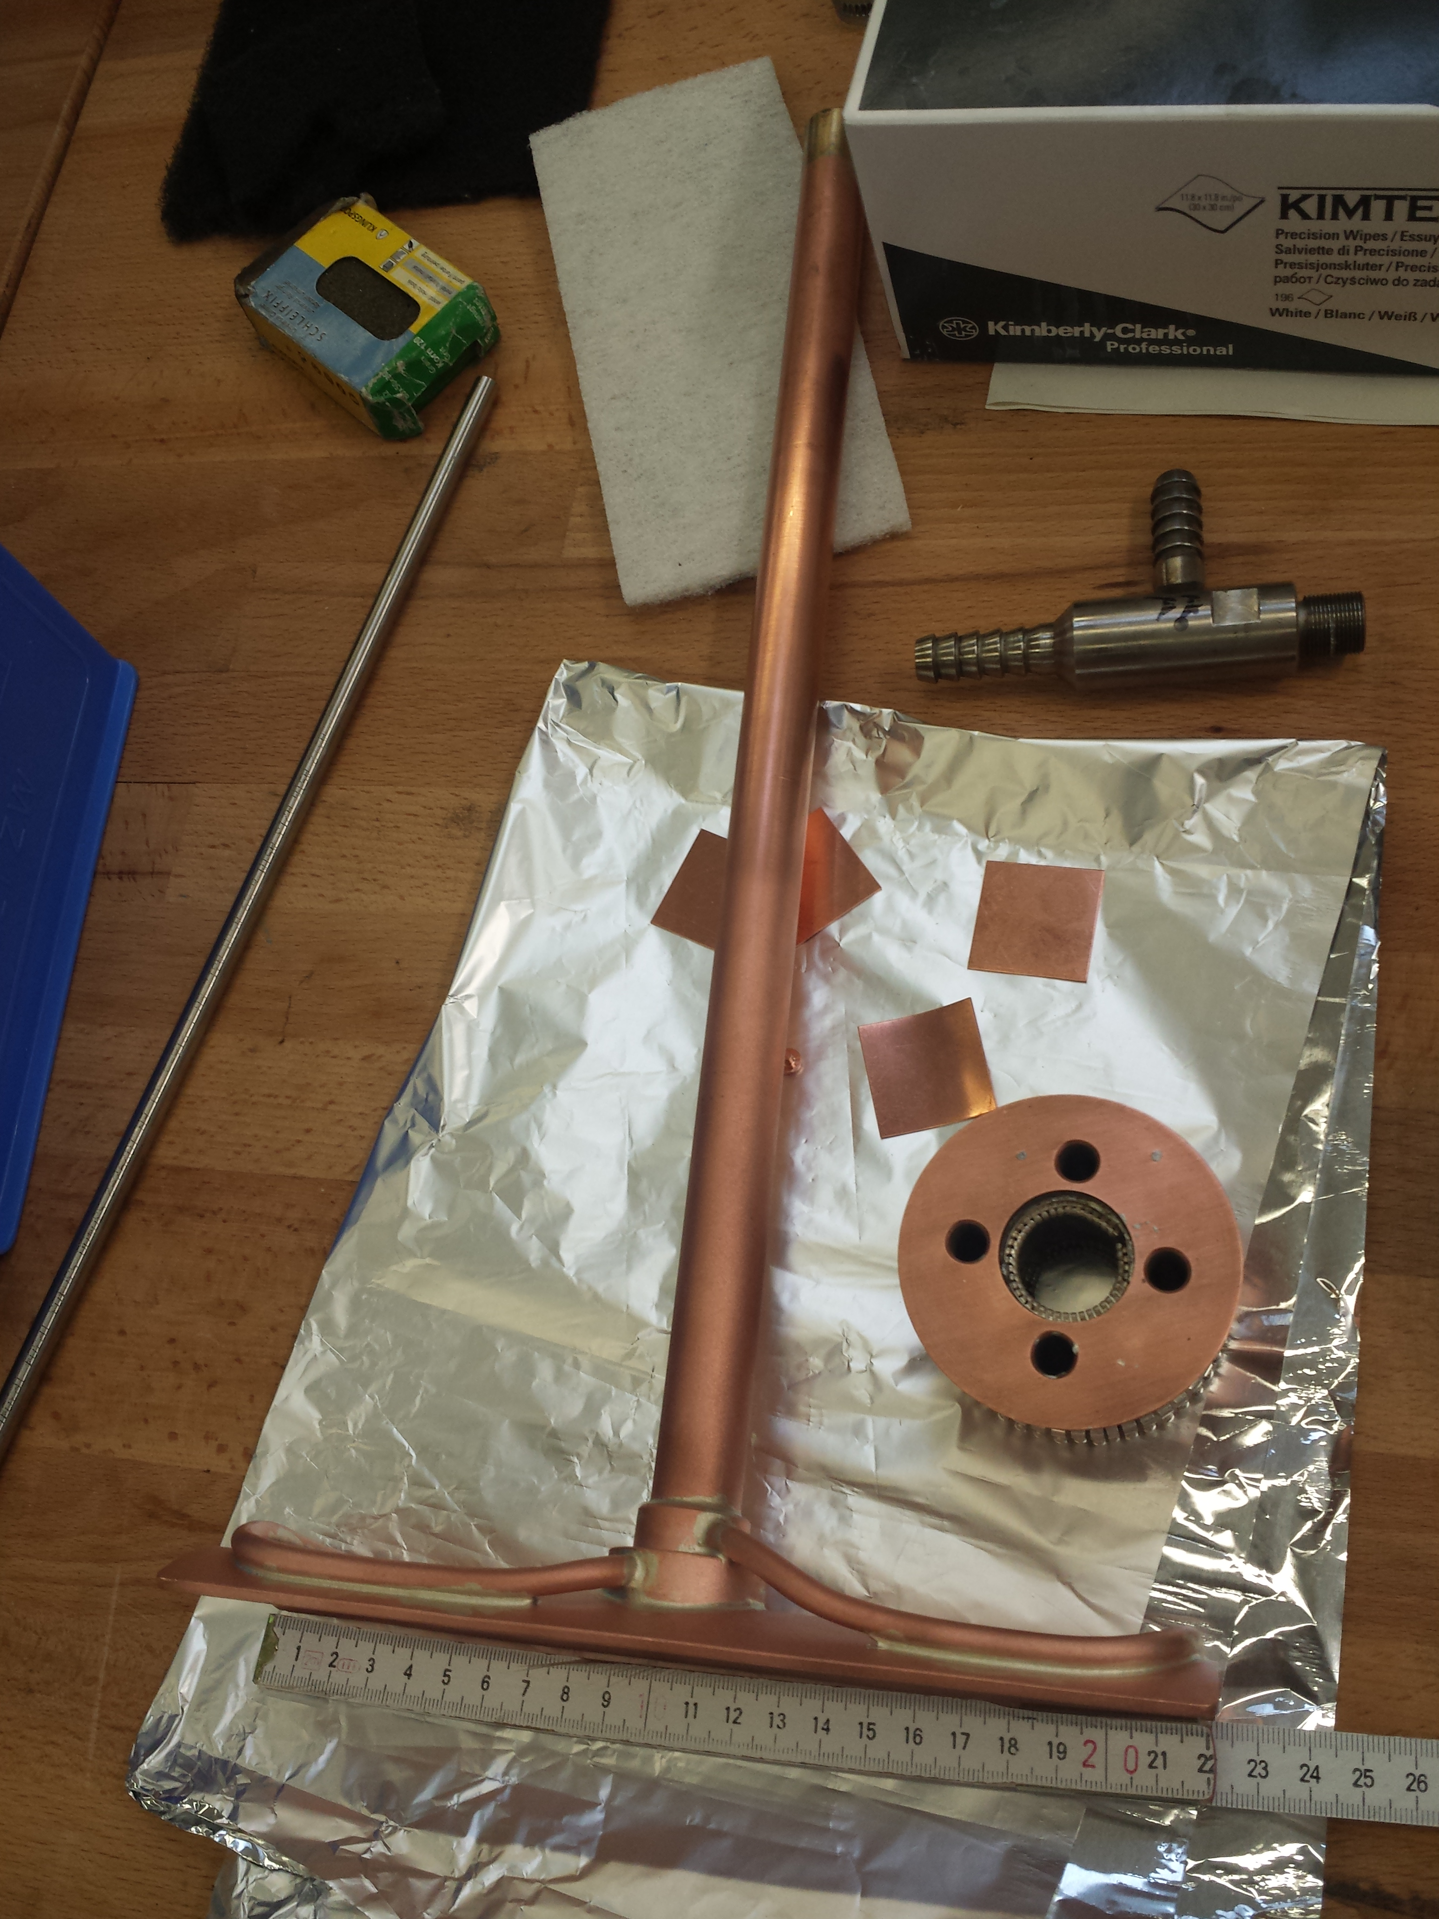
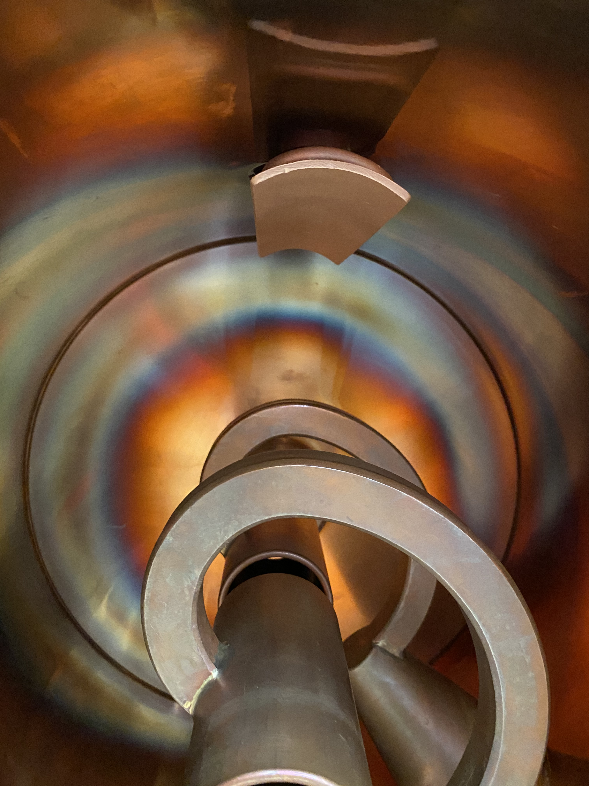
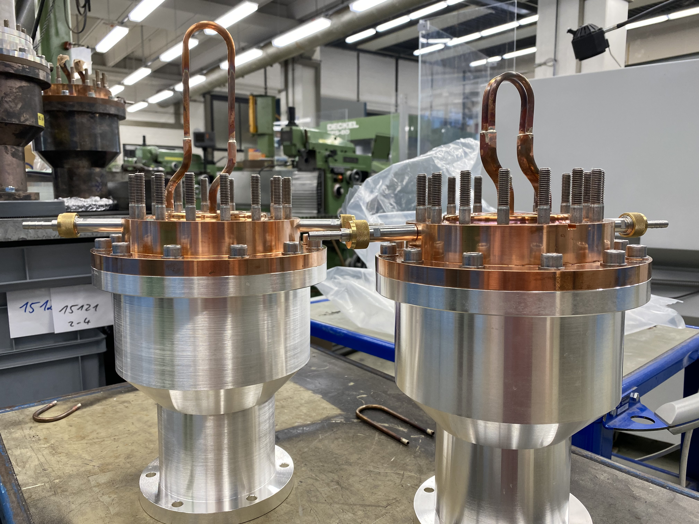
BB11 and HLI-IH coupler
MM- Unilac Report – 07.08.2020
TK4BB11: plunger is repaired, mounted and leak tested. RF coupling loop is brazed, polished and leakage tested. Mounting and alignment is planned for next week.
Coupler for HLI-IH is leak inside the basic body.
Vacuum pumps for the Gas-Stripper section has been exchanged. (in total 13 new pumps). 4 of them are losing oil. Meeting between VAC and company is organized for next Monday.

Slide 2
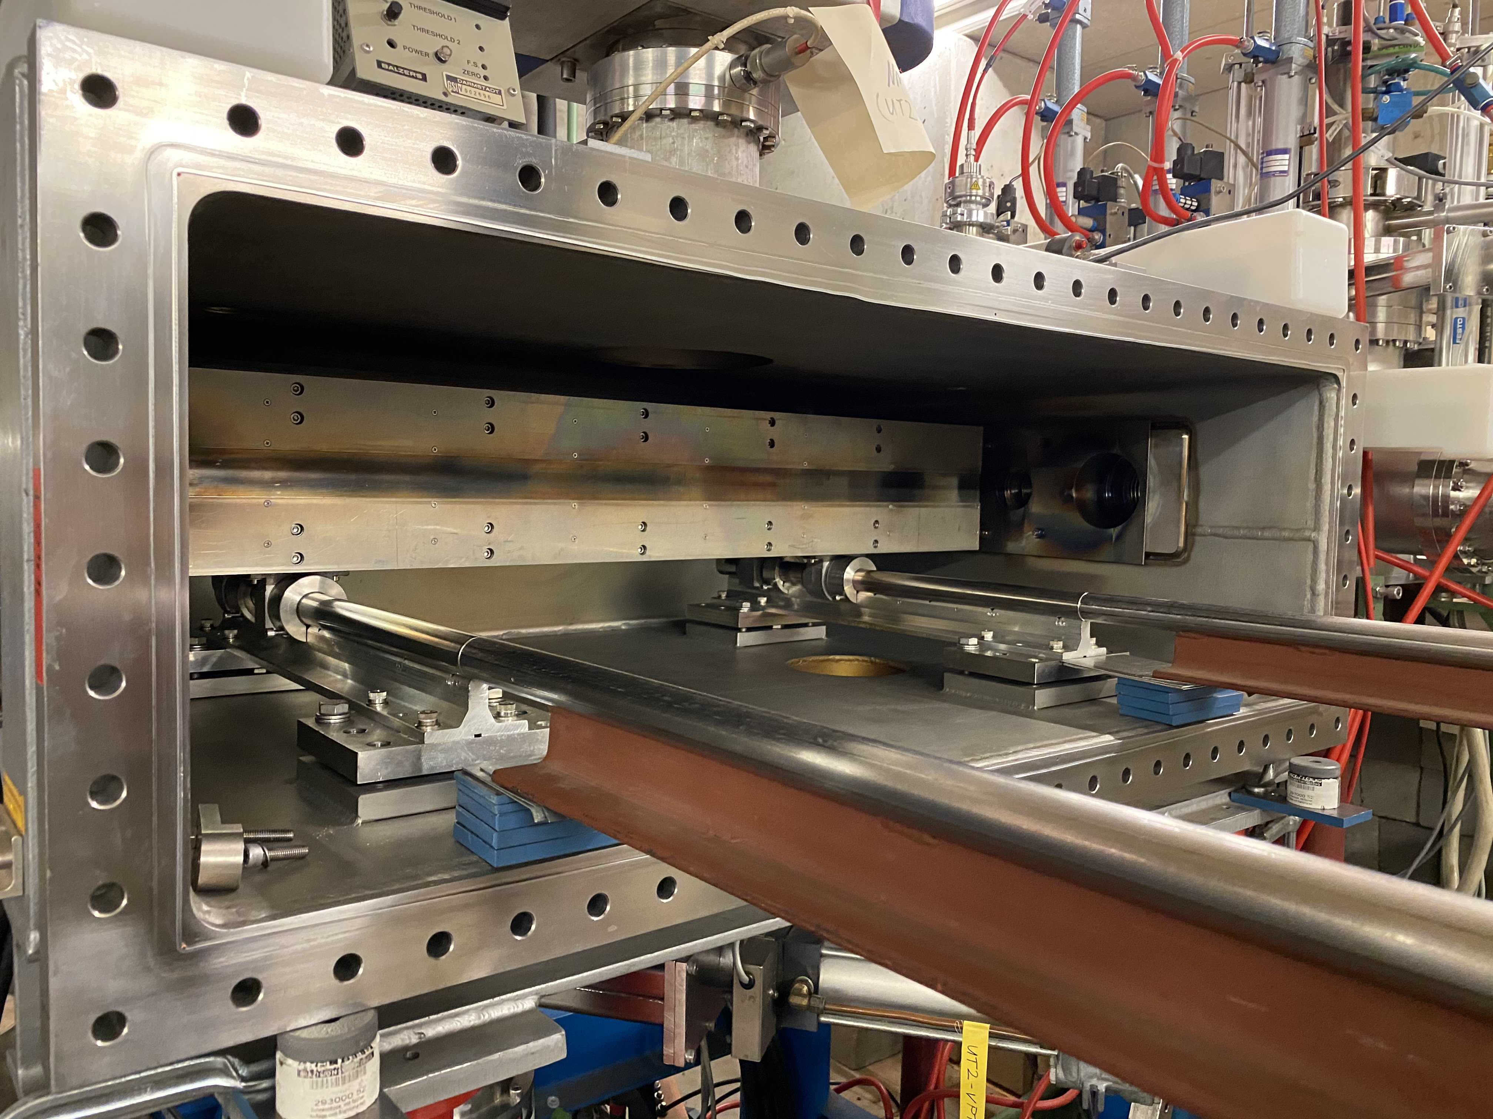
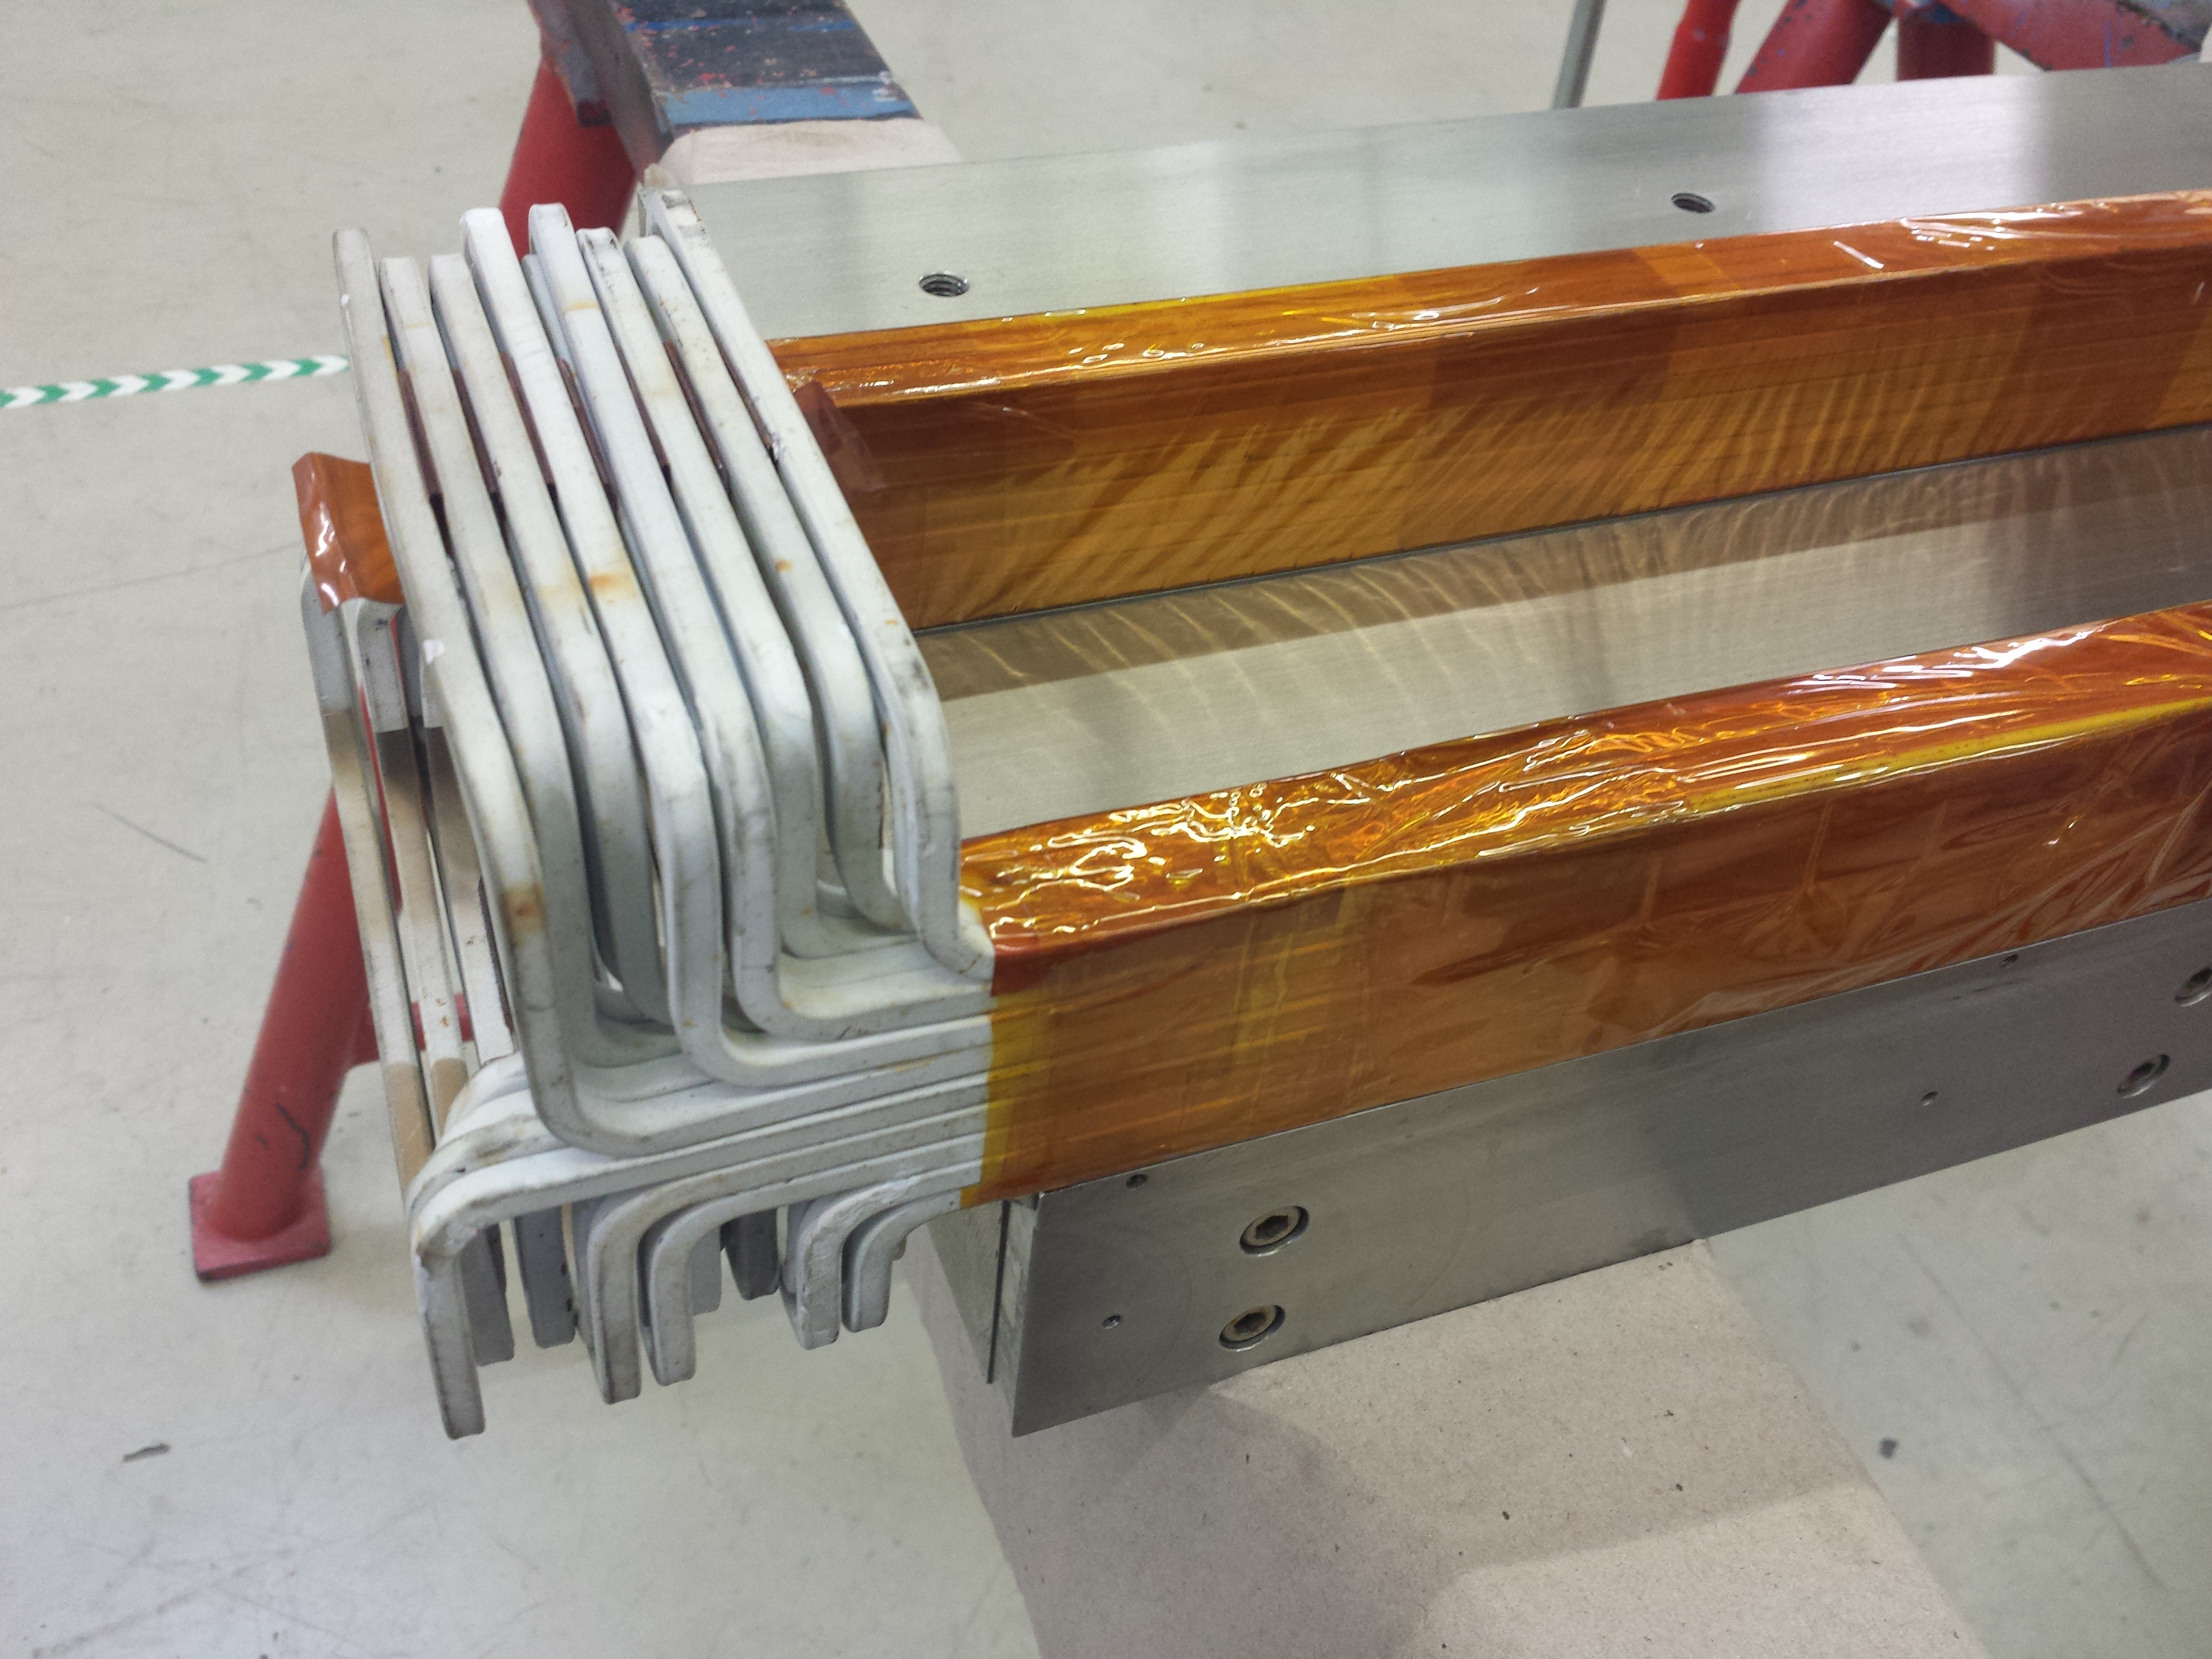
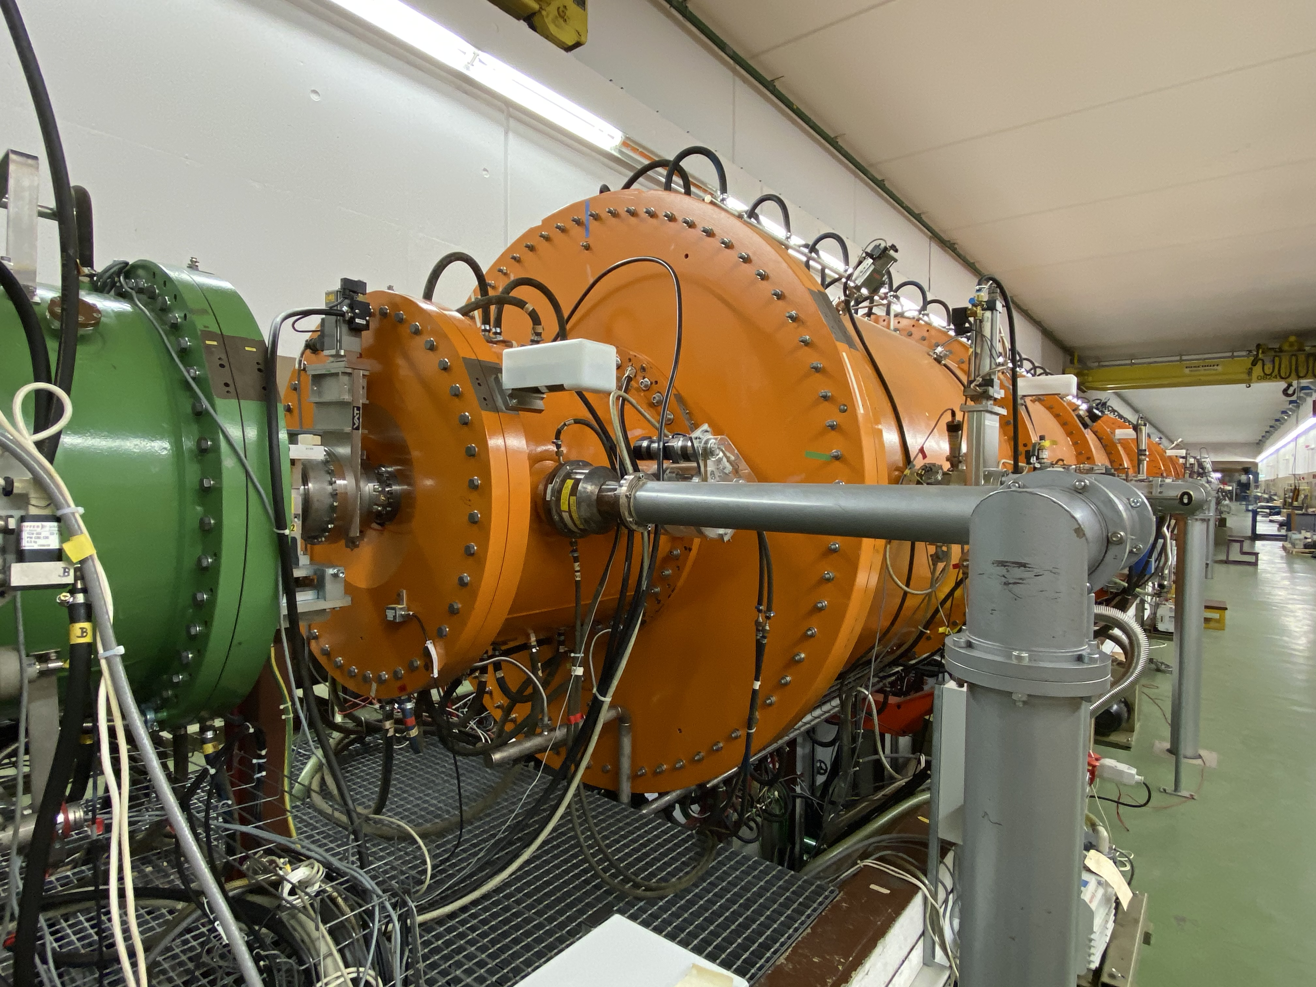
Unilac tunnel septum / HSI-IH
MM- Unilac Report – 07.08.2020
tunnel septum repair: ground short located, repaired. high voltage test was not successful, new test are in preparation. (new rake and inside vacuum)
HSI-IH: Water leakage at internal triplet UH3QT3 was found after Unilac tunnel opening. Next RF Test is skipped, the works started yesterday.

Slide 3
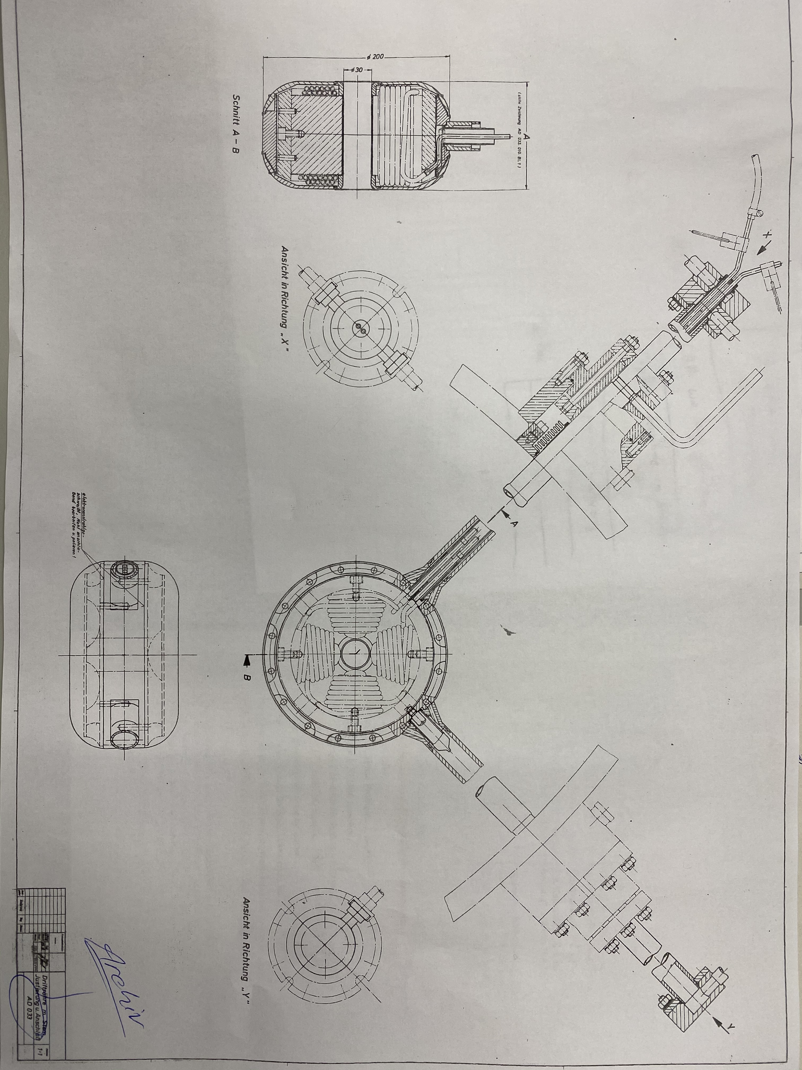
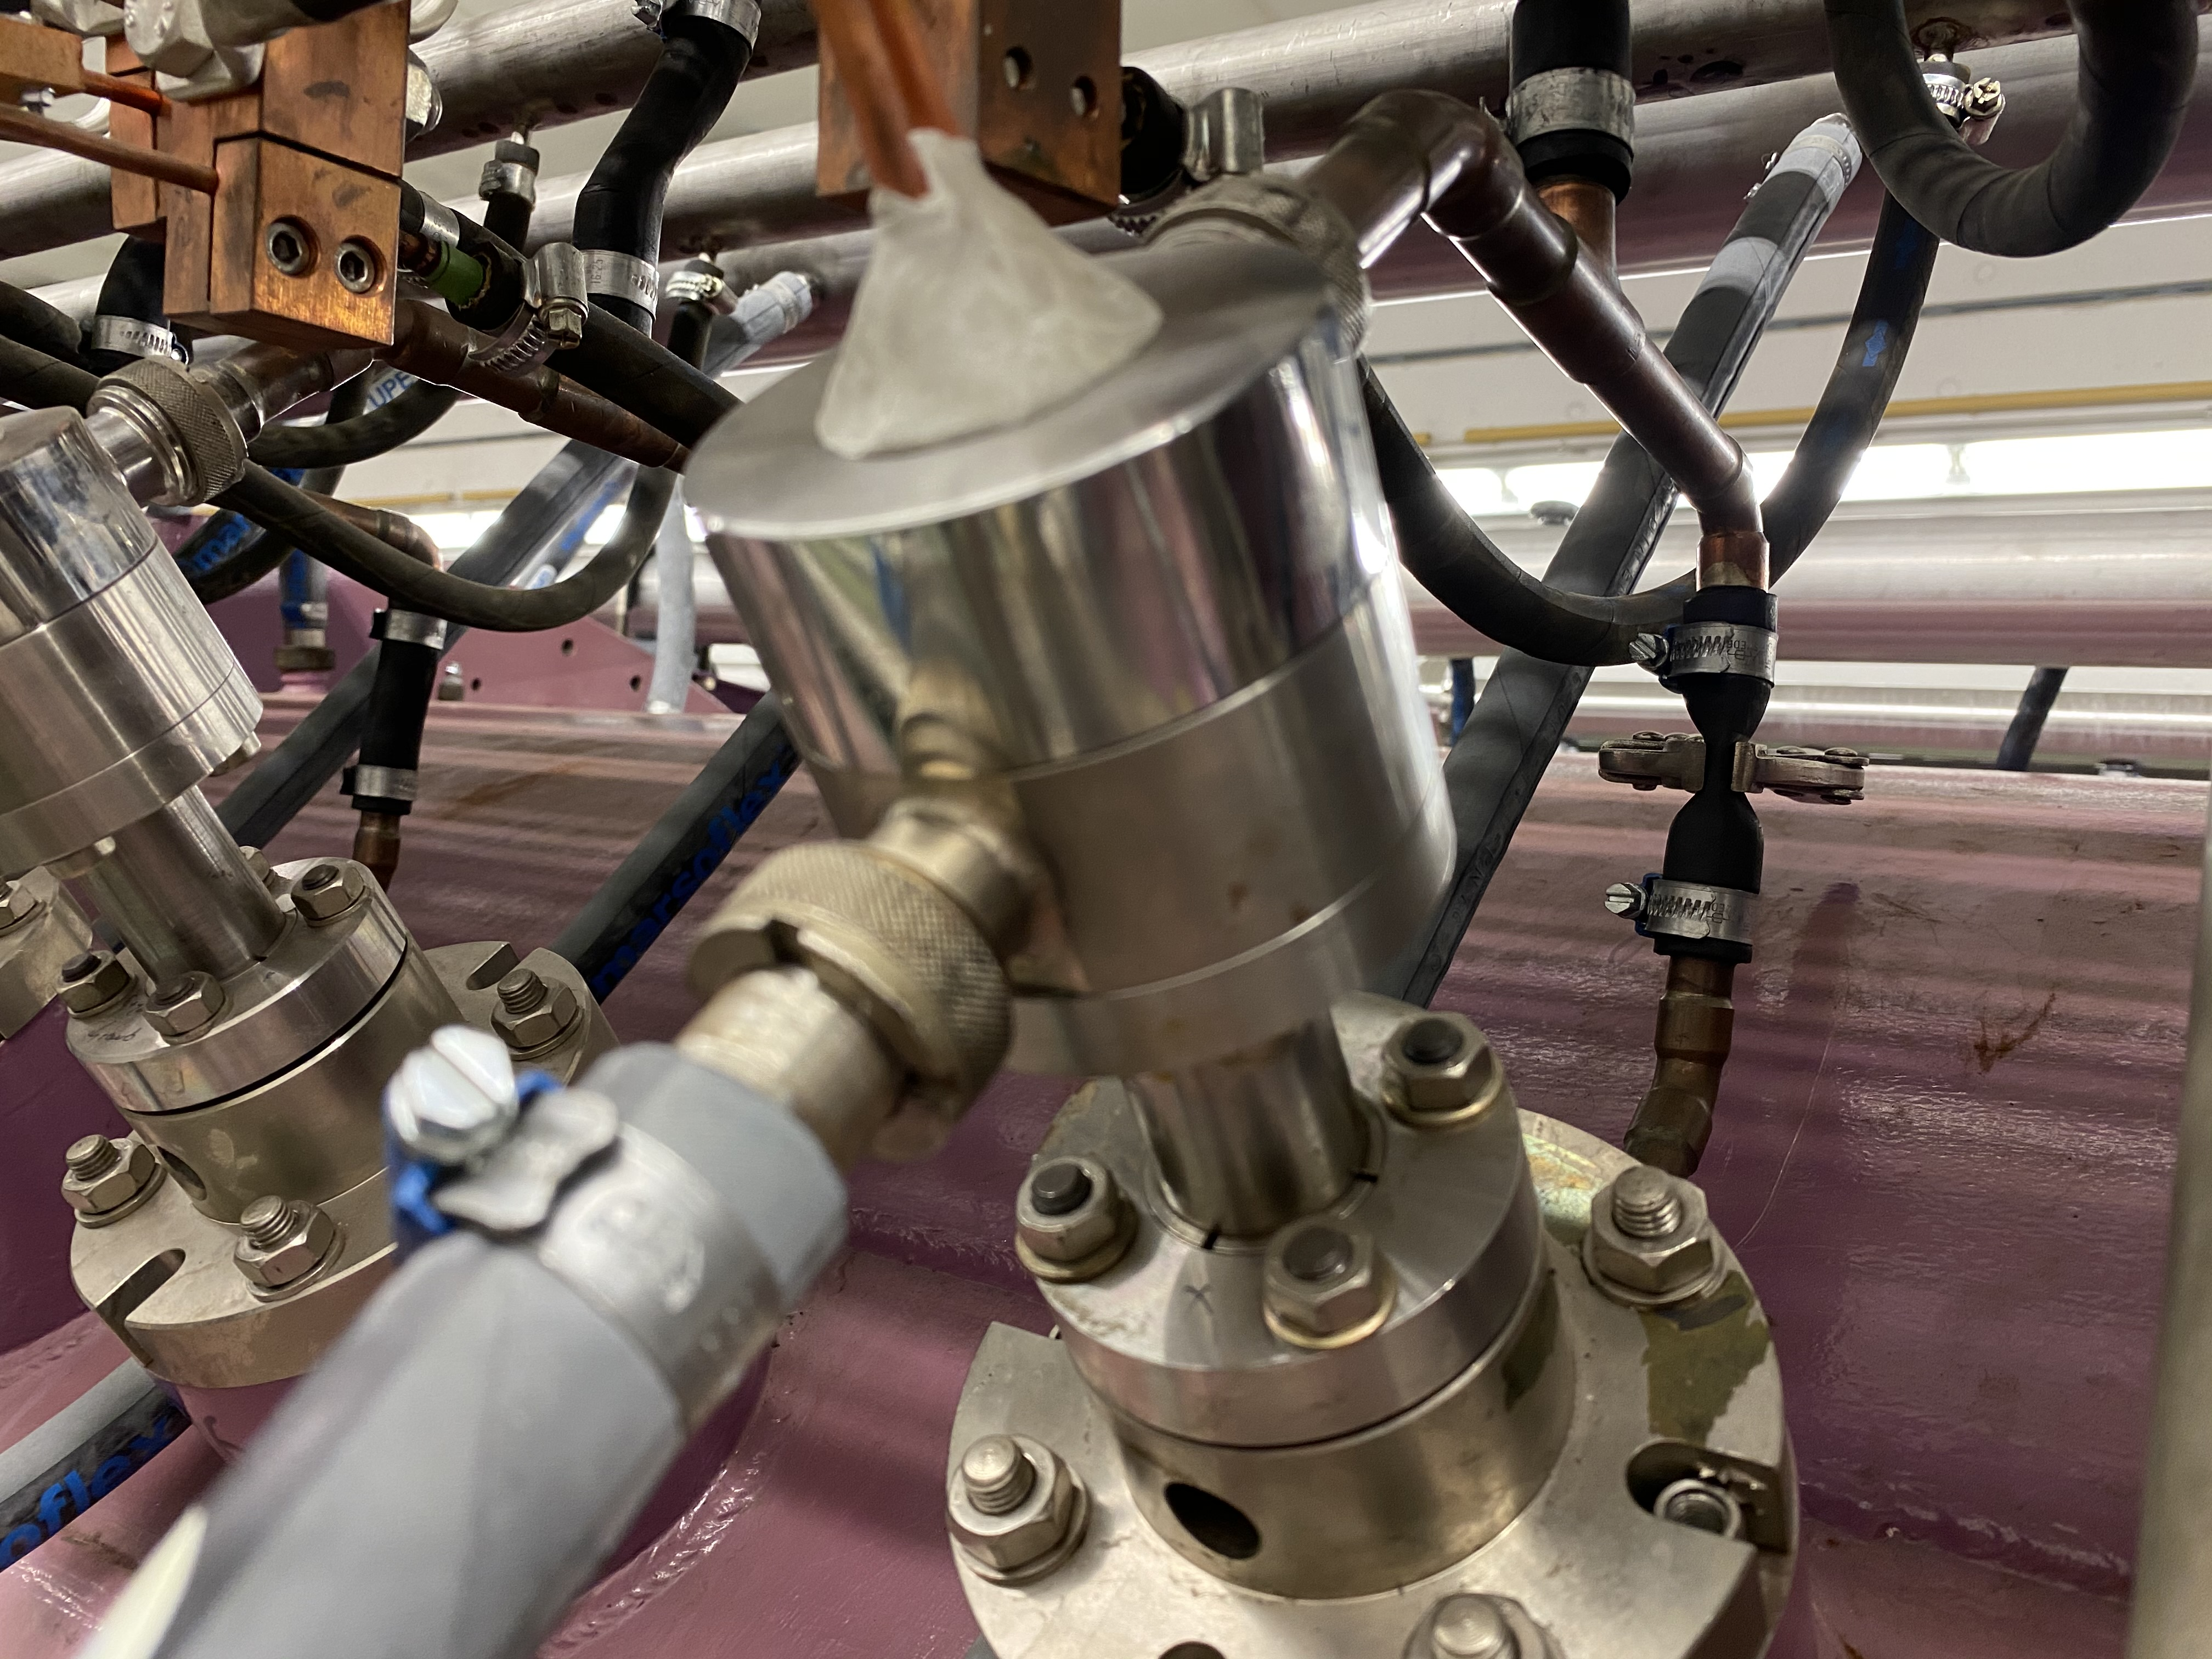
A3 drifttube
MM- Unilac Report – 07.08.2020
A3DR8: Drifttube is welded. Magnetically axis measurement was done. Next steps is the mechanical post-processing. Middle of August copper plating at external company.
A2DR75: leakage to the pre-vacuum disappeared, O-ring´s will be exchanged.
Pre-vacuum pump of A1 / A2 losing and burns a lot of oil and must be serviced.
One of the two cranes inside Unilac tunnel is broken. An company will be called for the repair.

