Slide 1
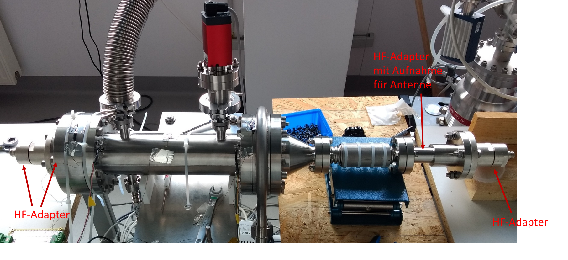
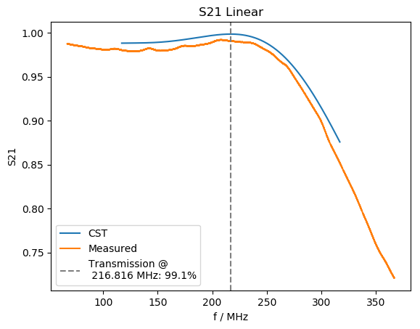
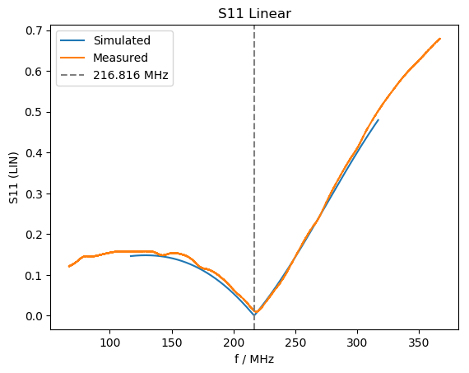
cw-LINAC 07.08.2020
CH2 @ IAP Frankfurt (start of test promised after eastern!) IAP still locked down, postponed!
CH0-test @HI-Mainz postponed for September 2020 => test in preparation, 1.08.20: Start of “eingeschränkter Regelbetrieb”
CH0&CH1: HPR for CH1 ordered, offer for CH0 now available
CH3-5 specification finalized; budgetary offer is available; waiting for budget
recalibration of temperature sensors for LHe-transfer is done! Commissioning is ongoing
High power coupler tests completed. Vacuum bellow requires coper plating (external company)
Cleaning of SH1 (HLI-hall) is done!
Beam line set up@SH4 are ongoing.
RFQ-prototype: Preparation for high power Rf-test at test bunker; start of tests scheduled for next week

