Slide 1
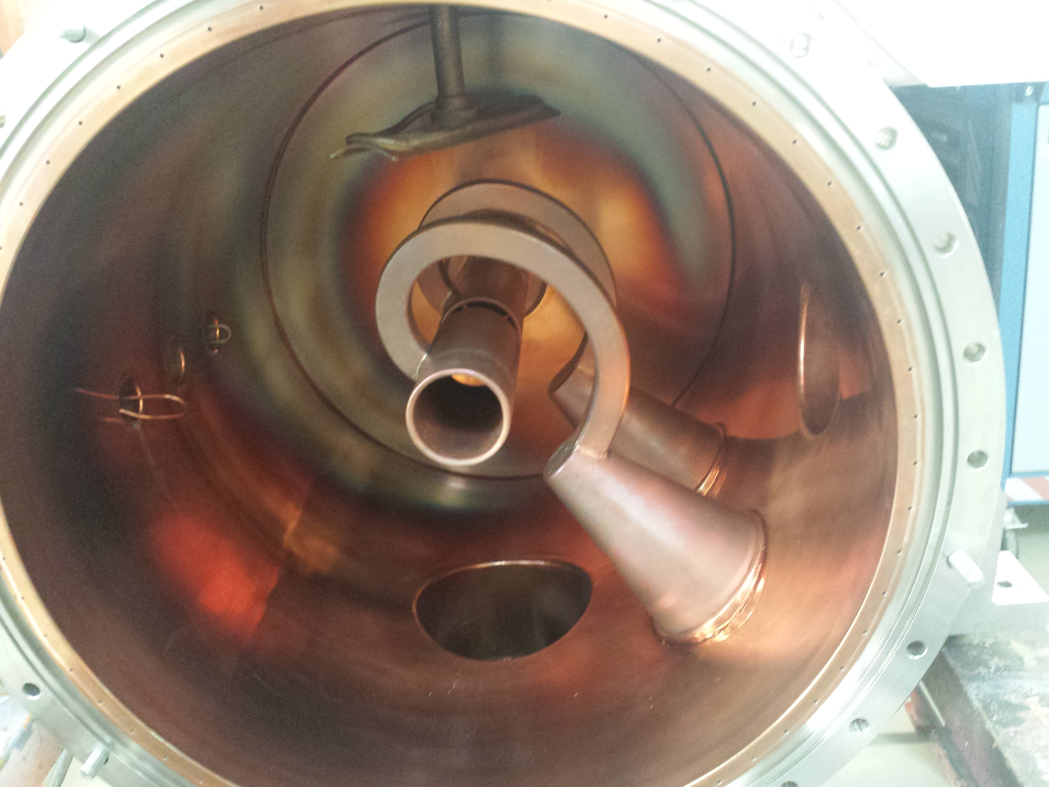
Unilac – 14.7.2020
A3DR8: Endplates re-machined, isolation improved, brazing+welding ongoing, Copper coating externally (hopefully August-September)
HLI RF loop: MEWE work ongoing.
TK4BB11 (repair in Grossmontage): plunger leak brazed, RF loop MEWE work ongoing.
HSI-RFQ: one cooling circuit rinsed, one fixed plunger changed, tests ongoin.
tunnel septum repair: ground short located, repair work ongoing.

Slide 2
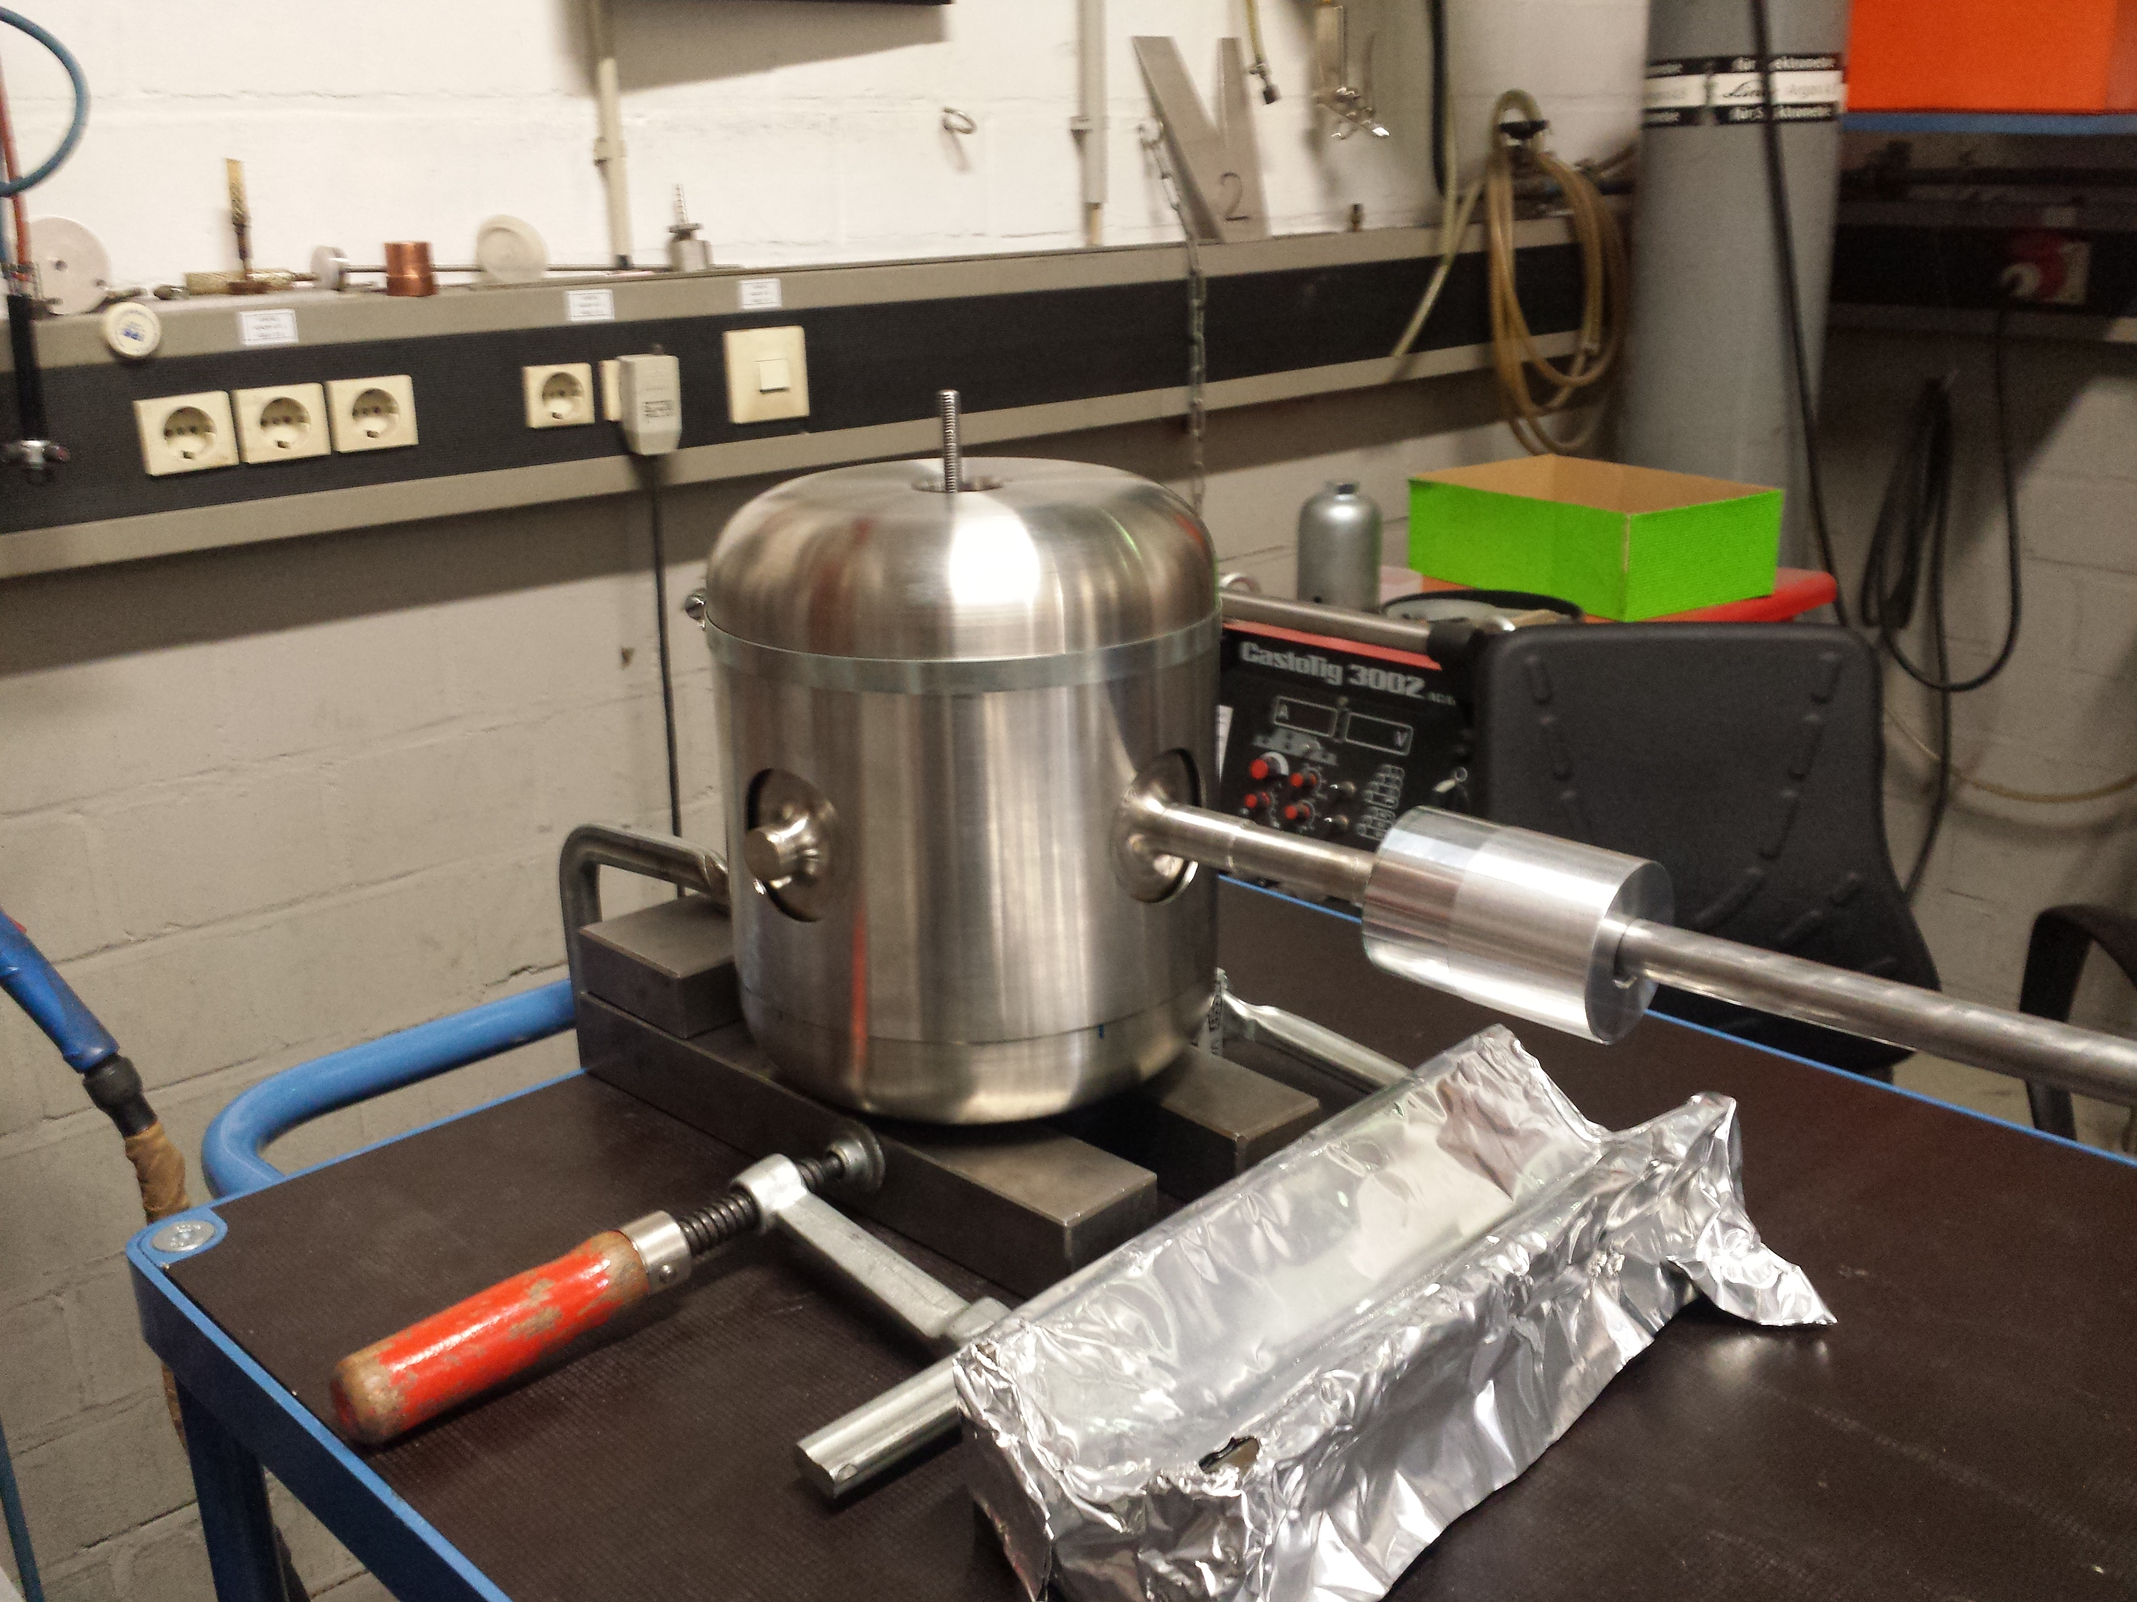

Slide 3
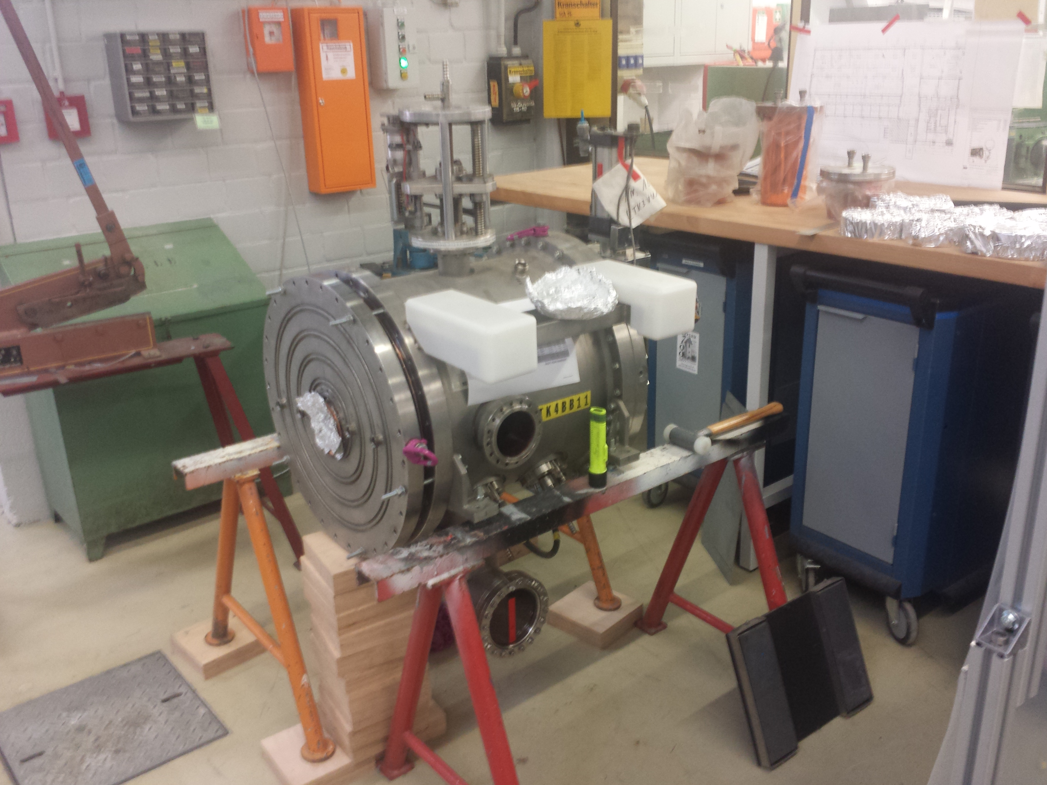
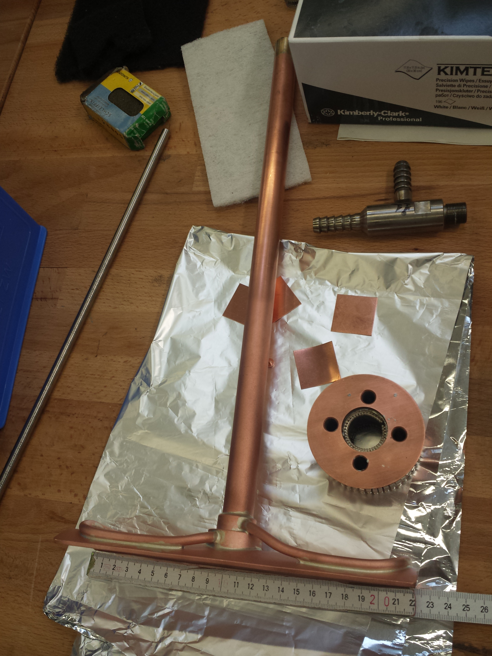
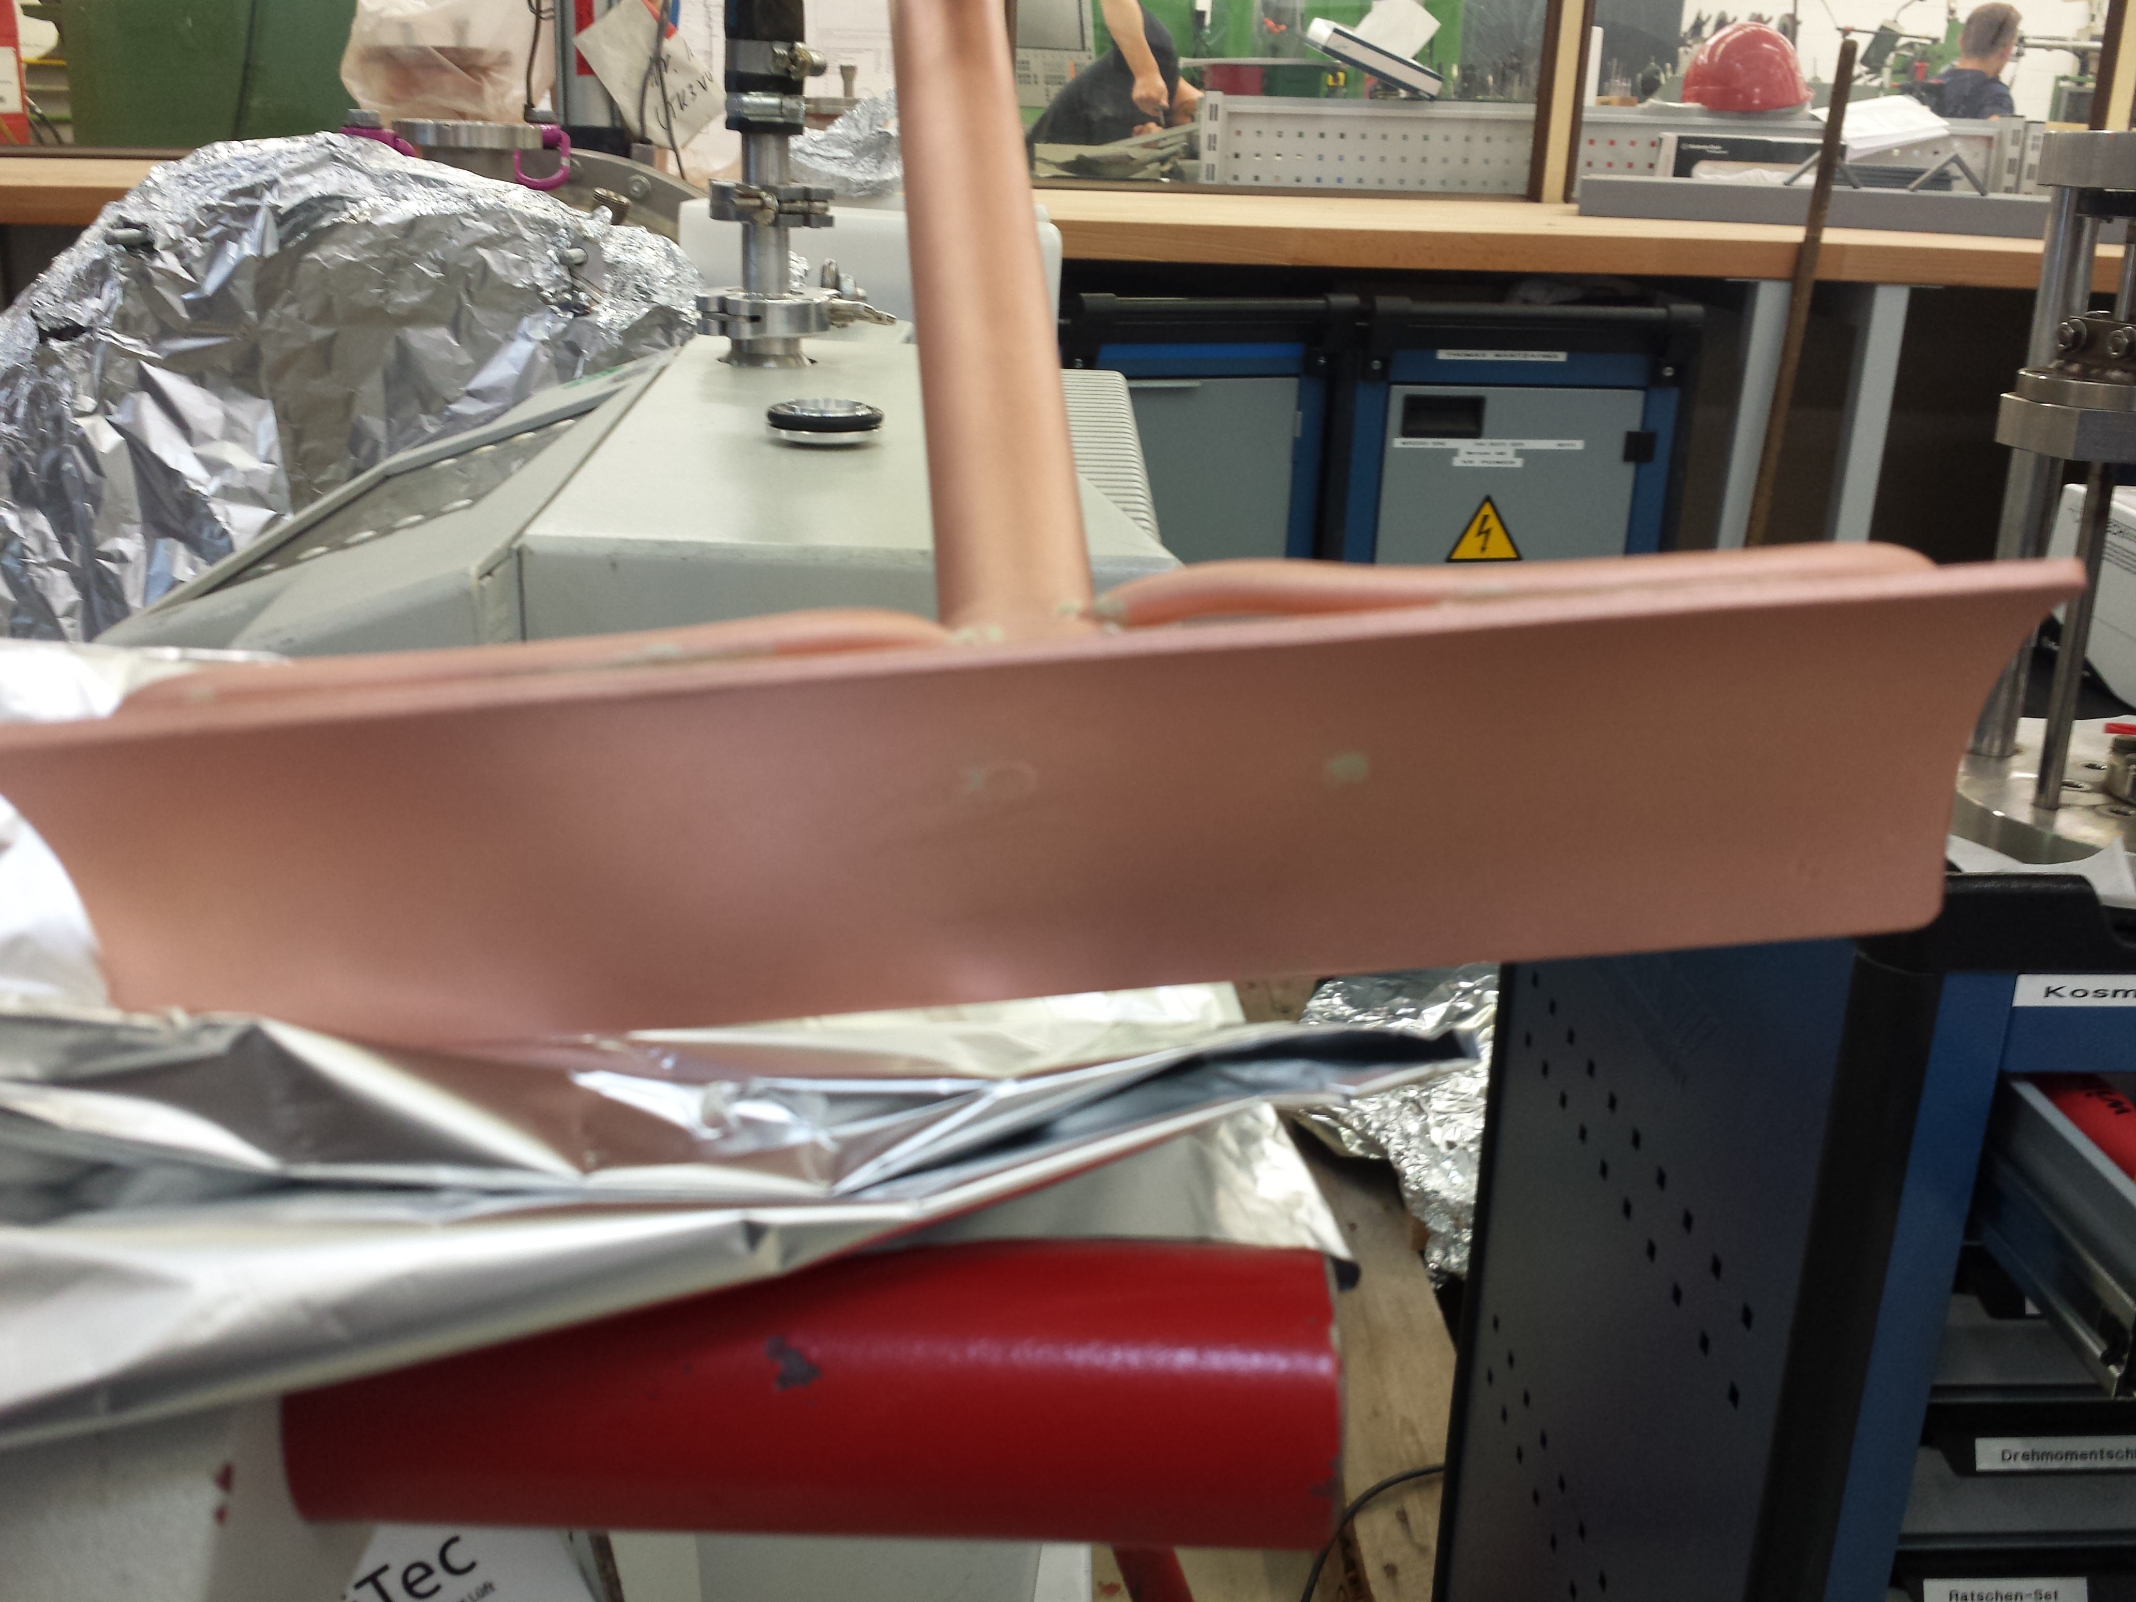
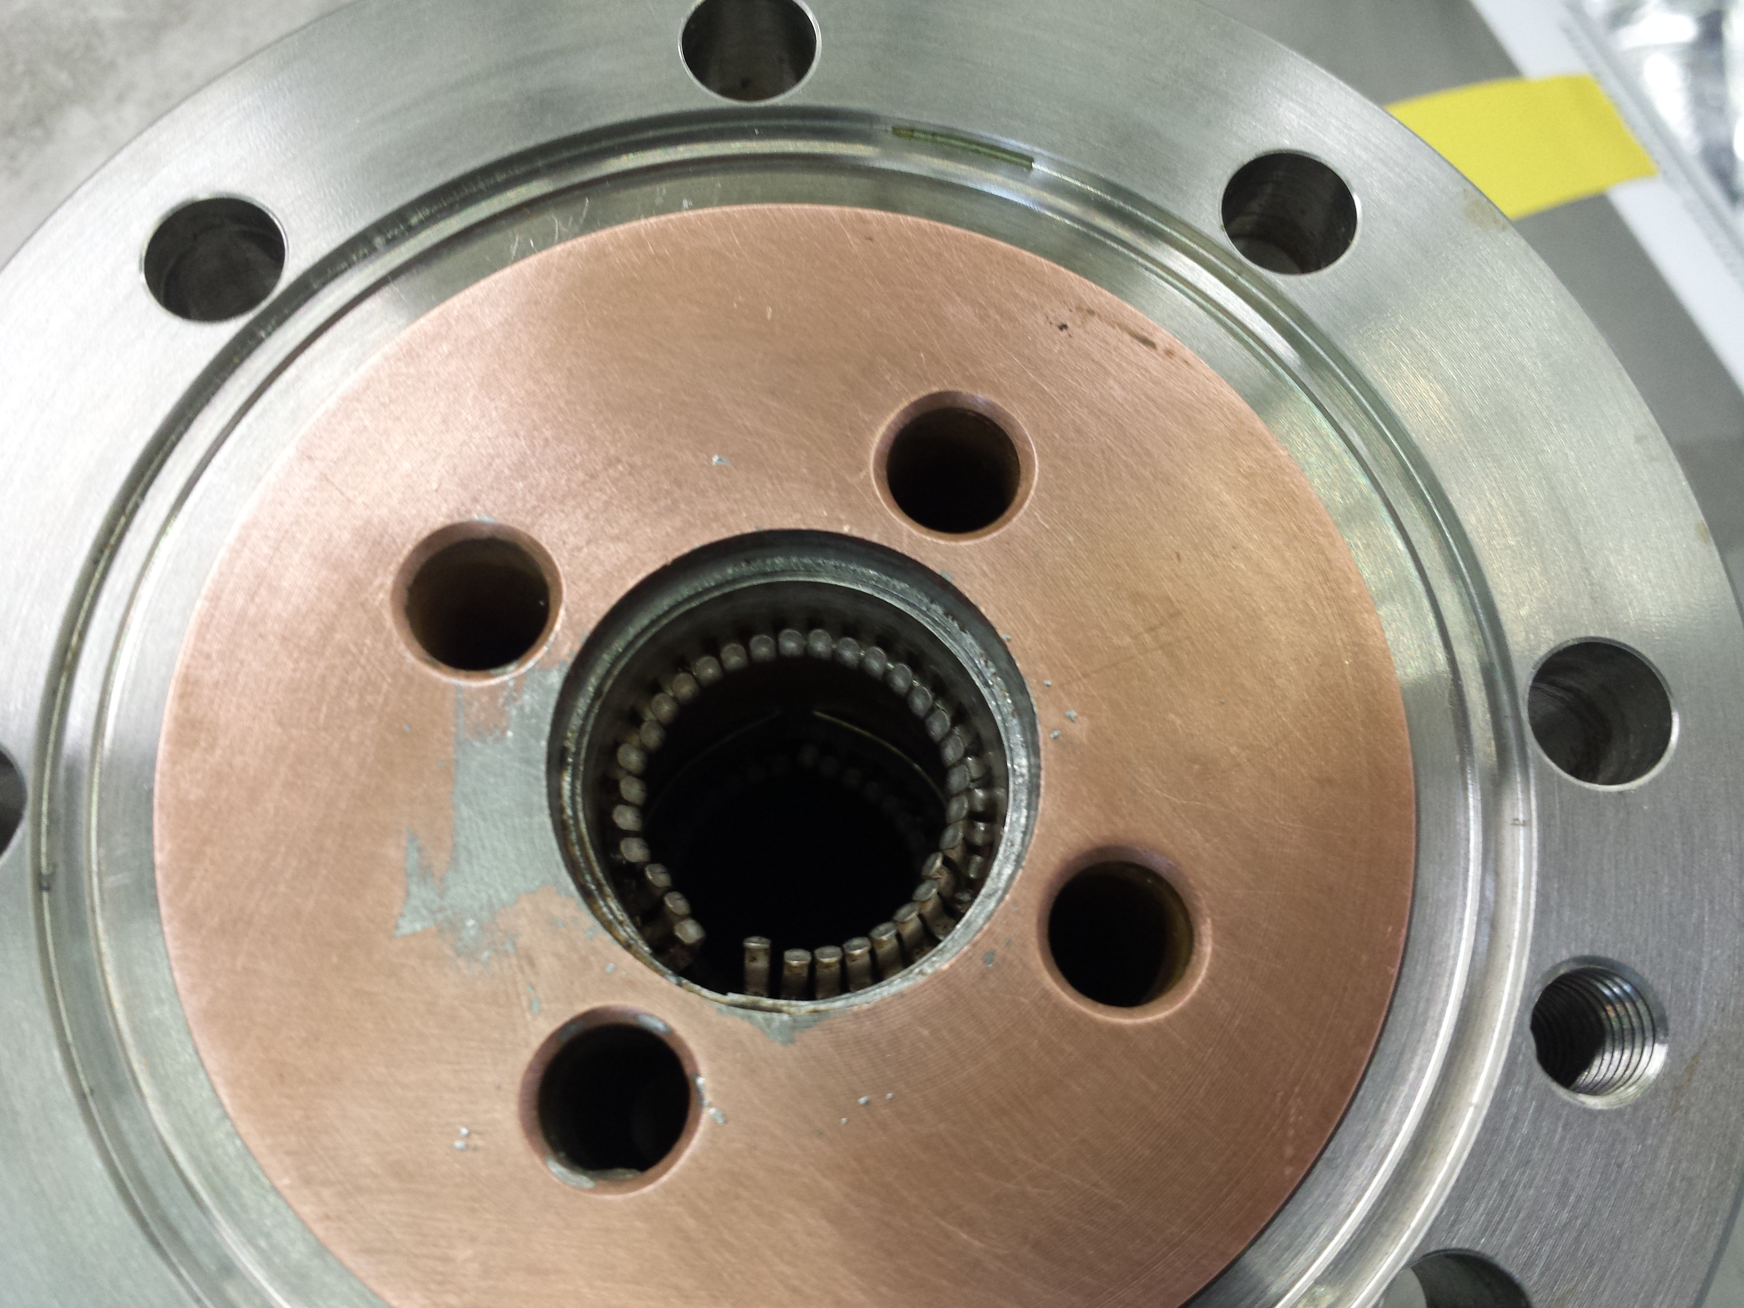

Slide 4
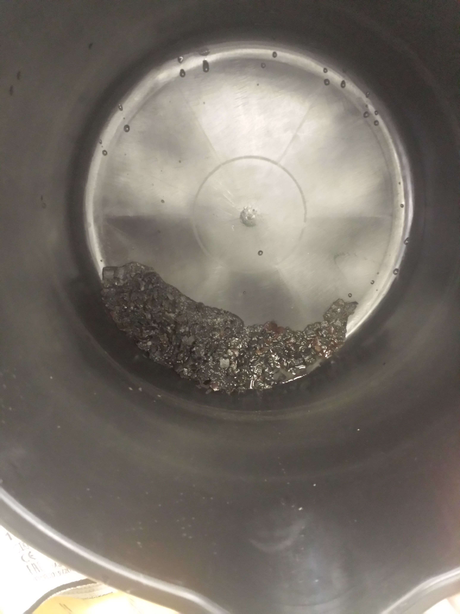
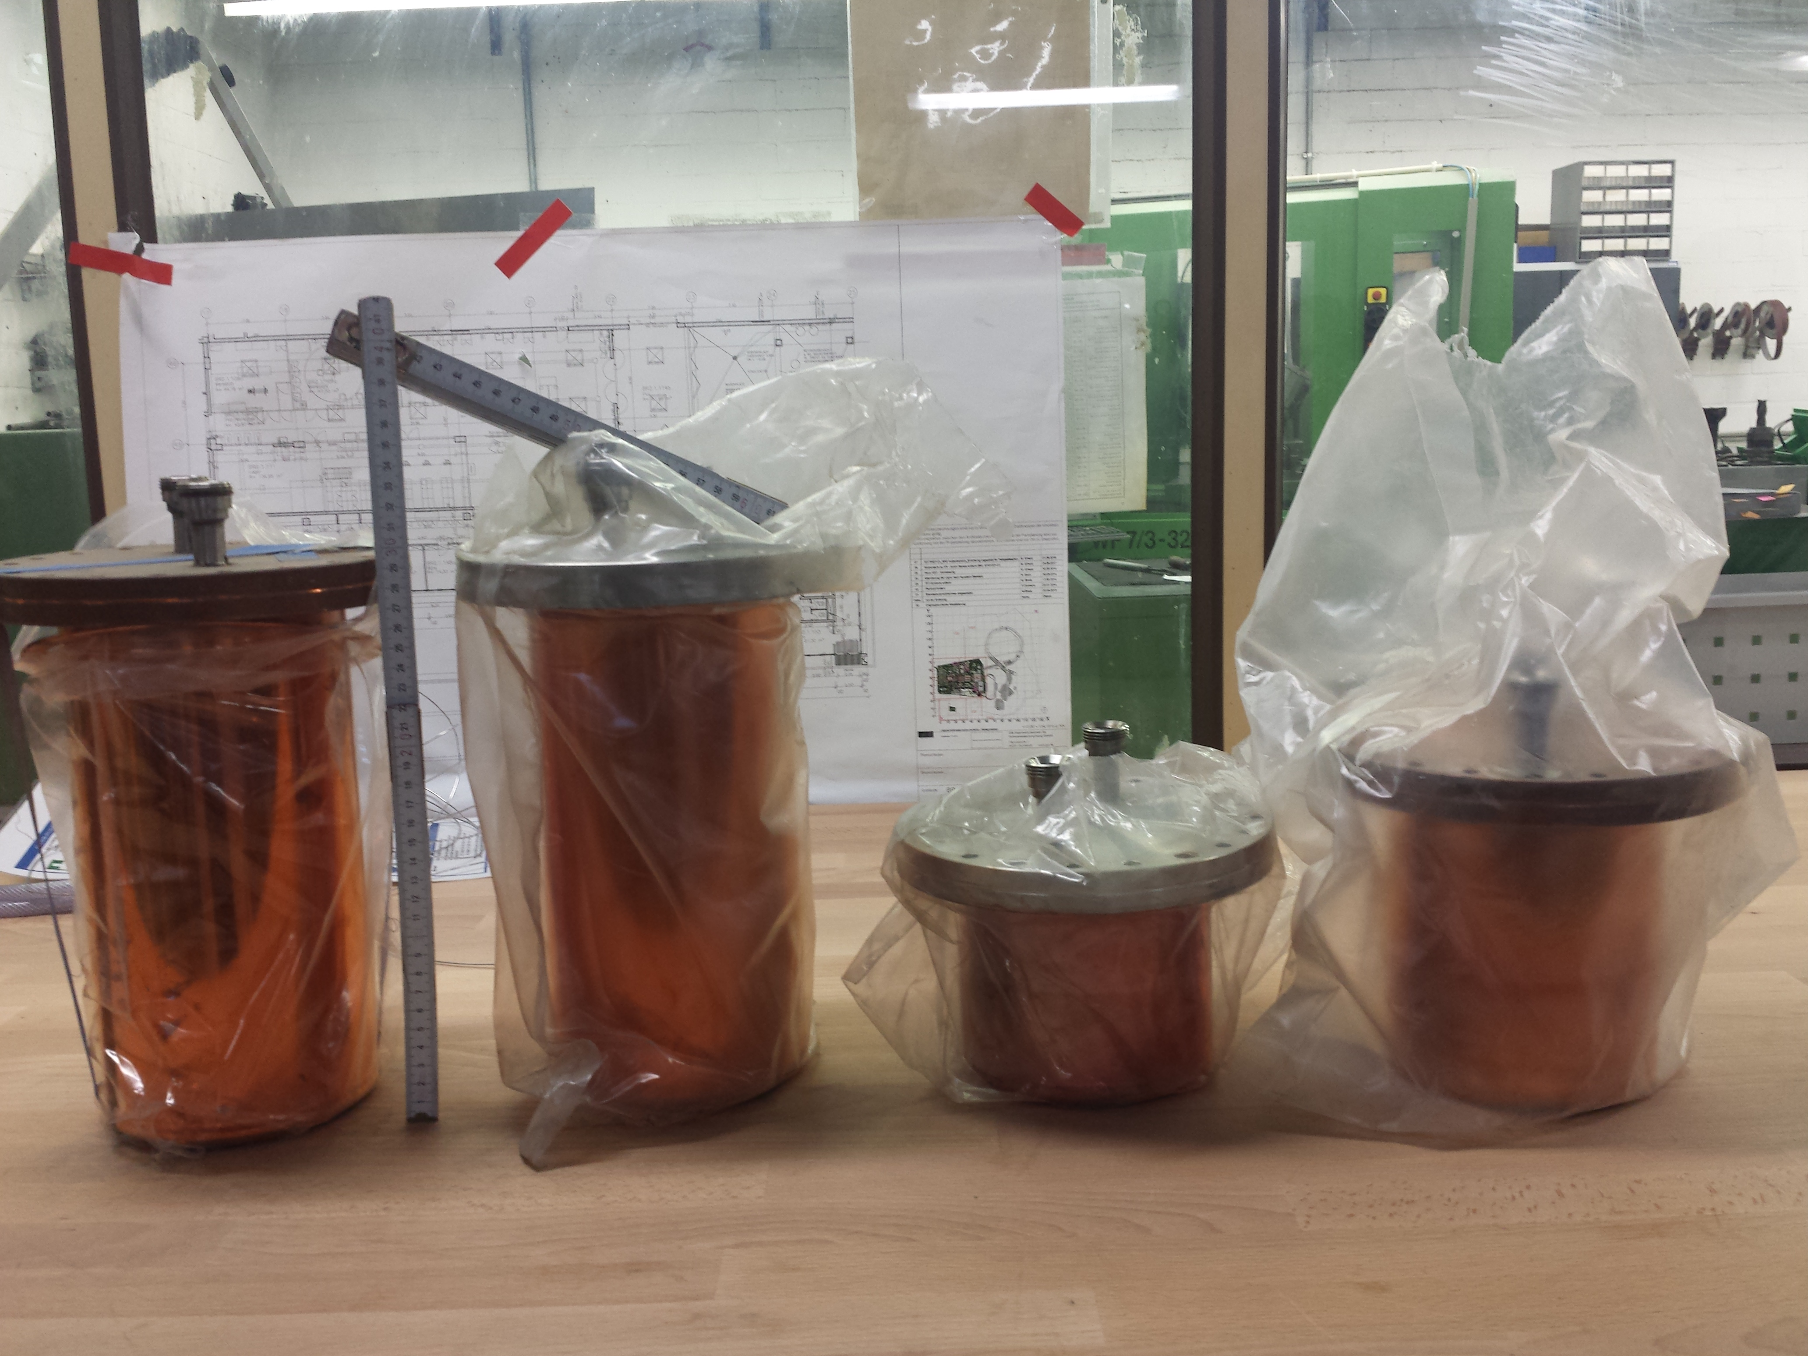
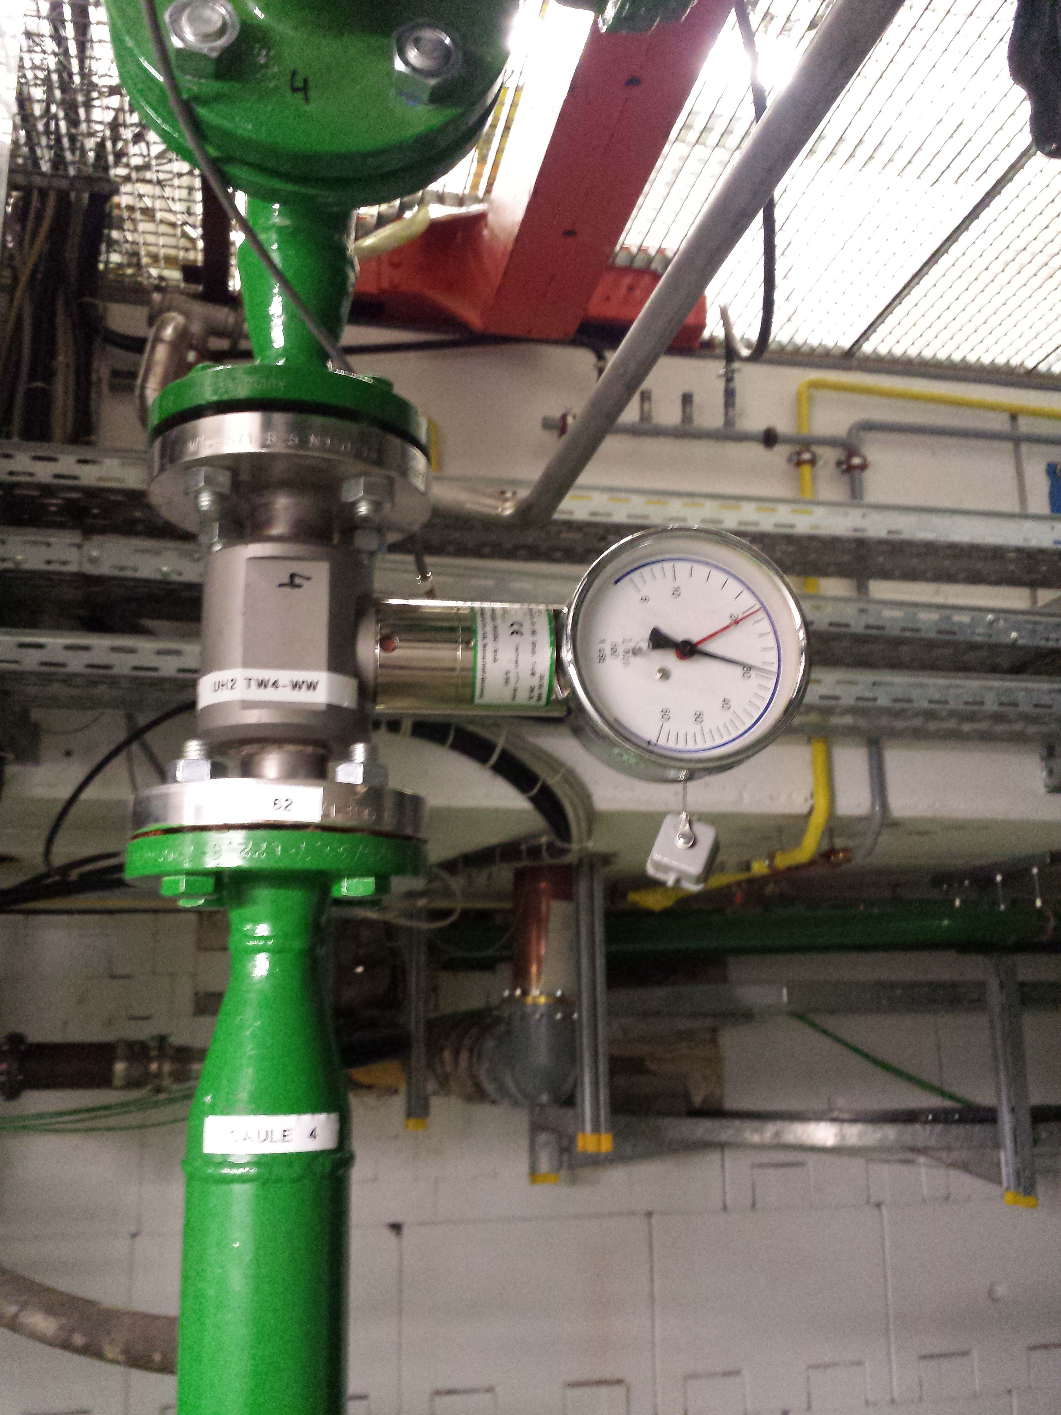
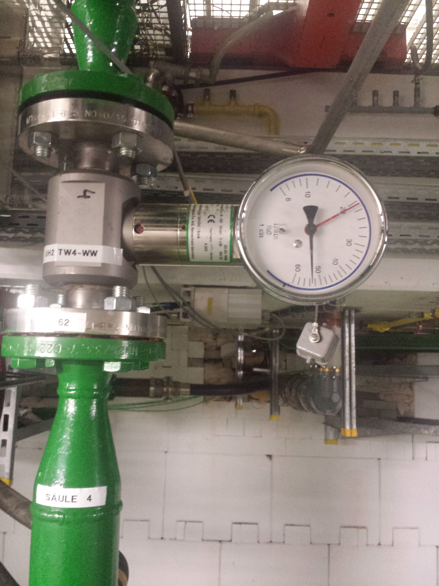

Slide 5
