Slide 1
The NIIKAM-SEL-A spheroelastomer is a completely closed-porous lightweight elastic material for filling sandwich structures subject to vibrational stresses and climatic factors, for example, for filling the propeller blades and wings of aircraft.
It is possible to manufacture blocks of a spheroelastomer or structural elements of a special shape with a density of 0.055 to 0.12 g / cm3.
Compared with rigid foams (such as Rohacell) they do not crumble during vibration and have an order of magnitude lower moisture and water absorption.

Slide 2
Material | Rohacell |  |  | НИИКАМ-СЭЛ-А
Type | 51WF | 71WF | 110WF | 52 | 65 | 78 | 110
Compressive strength, МРа | 0,8 | 1,7 | 3,6 | > 100
Density, g/см³ | 0,052 | 0,075 | 0,11 | 0,052 | 0,065 | 0,078 | 0,11
Compression stress, kPa at strain 25% | Destroyed already by deformation of 2-4% |  |  | 151 | 173 | 183 | 210
40 % | - |  |  | 204 | 223 | 239 | 280
50 % | - |  |  | 252 | 272 | 293 | 340
70 % | - |  |  | 426 | 452 | 493 | 530

Slide 3
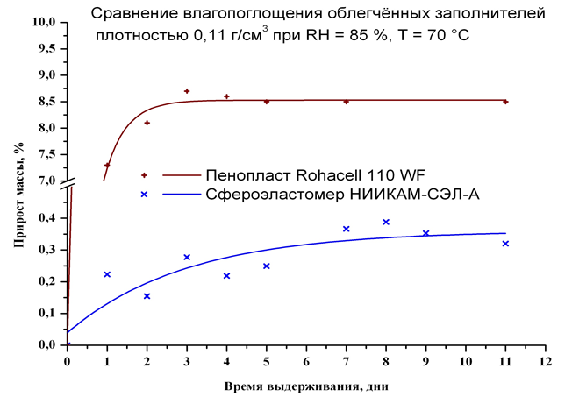
Moisture absorption
mass gain, %
Time, days

