Slide 1
Overview on BM@N-STS Mechanics
JINR, SINP MSU

Slide 2
Outline
Main frame
¼ of station
Carbon C-frame and Al C-frame with cooling
FEB, FEB box, FEB connectivity
Cable routing
Plans

Slide 3
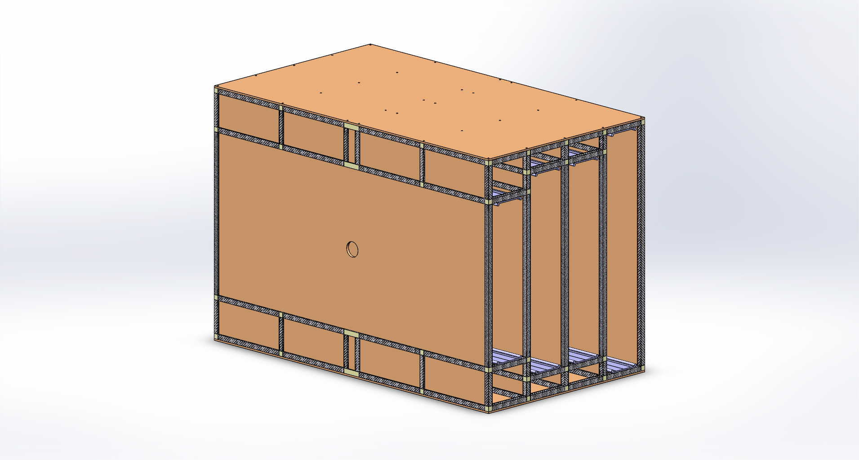
Main frame

Slide 4
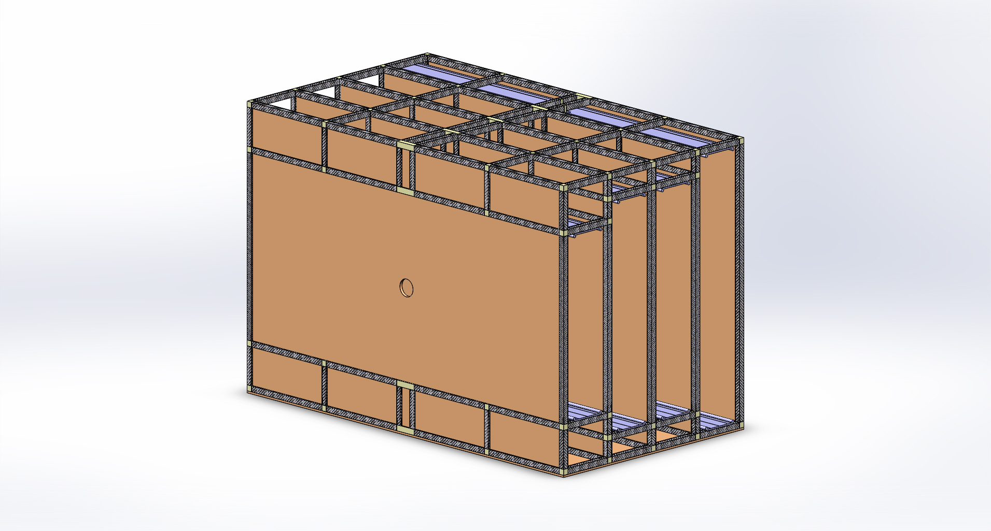
Main frame

Slide 5
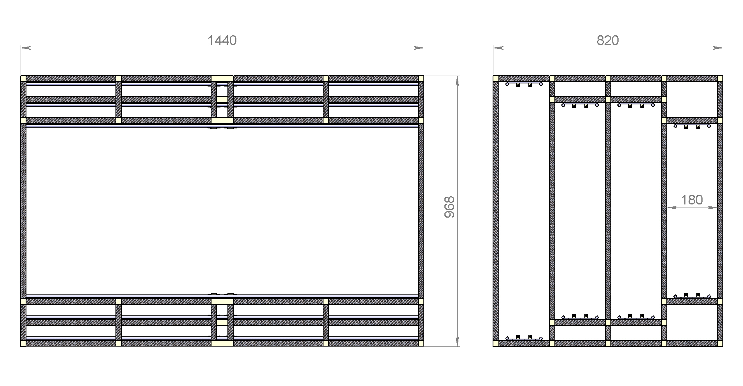
Main frame

Slide 6
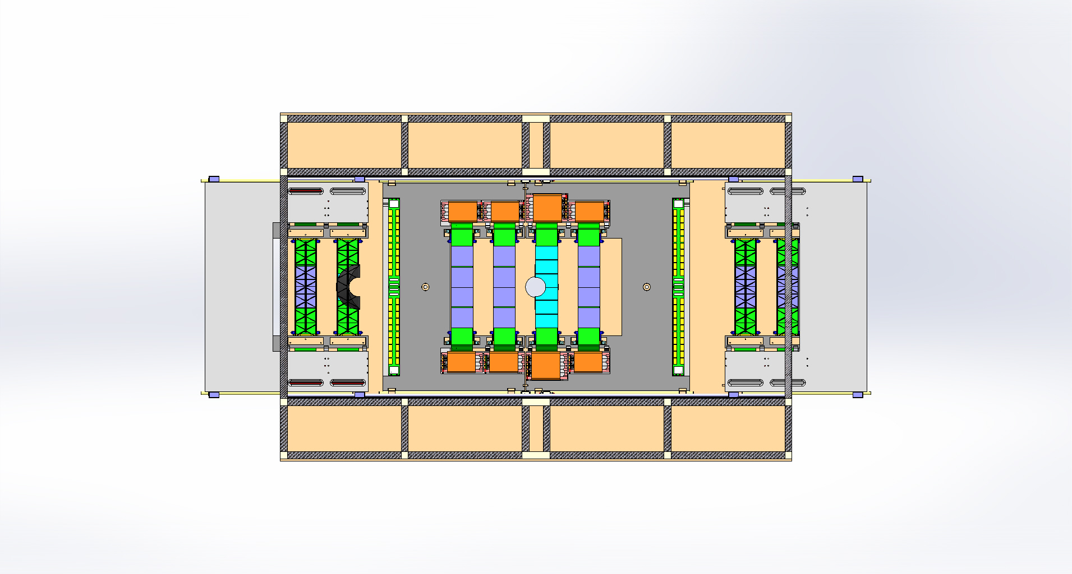
Station in Main frame

Slide 7
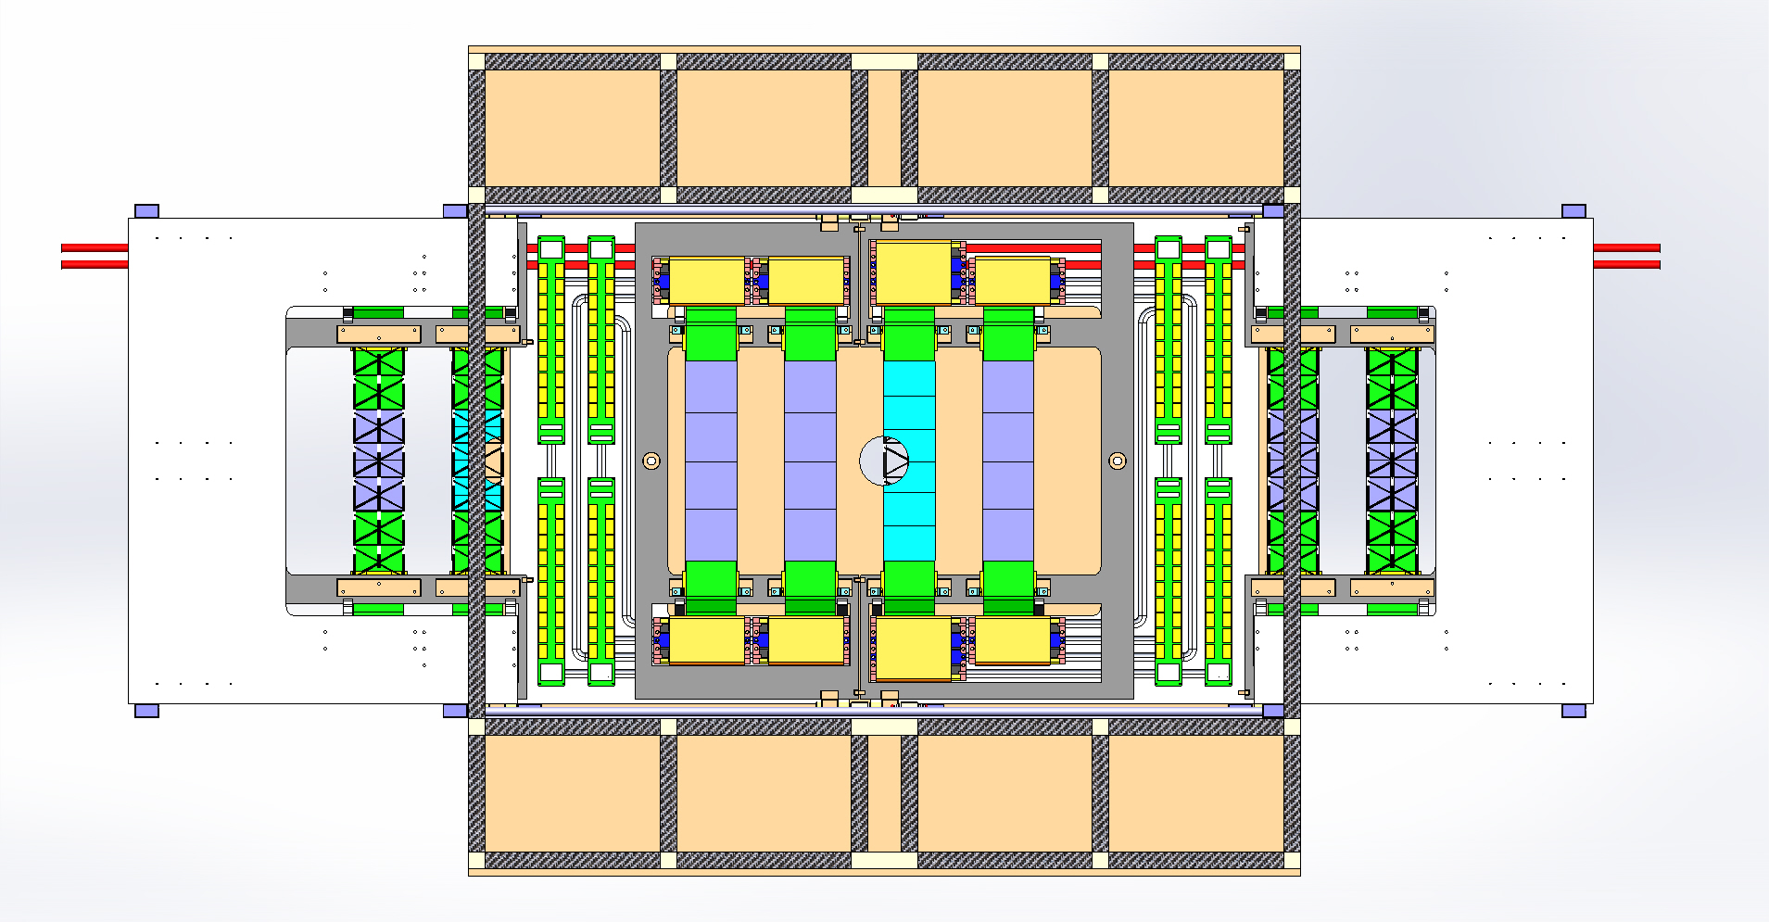
Station in Main frame

Slide 8
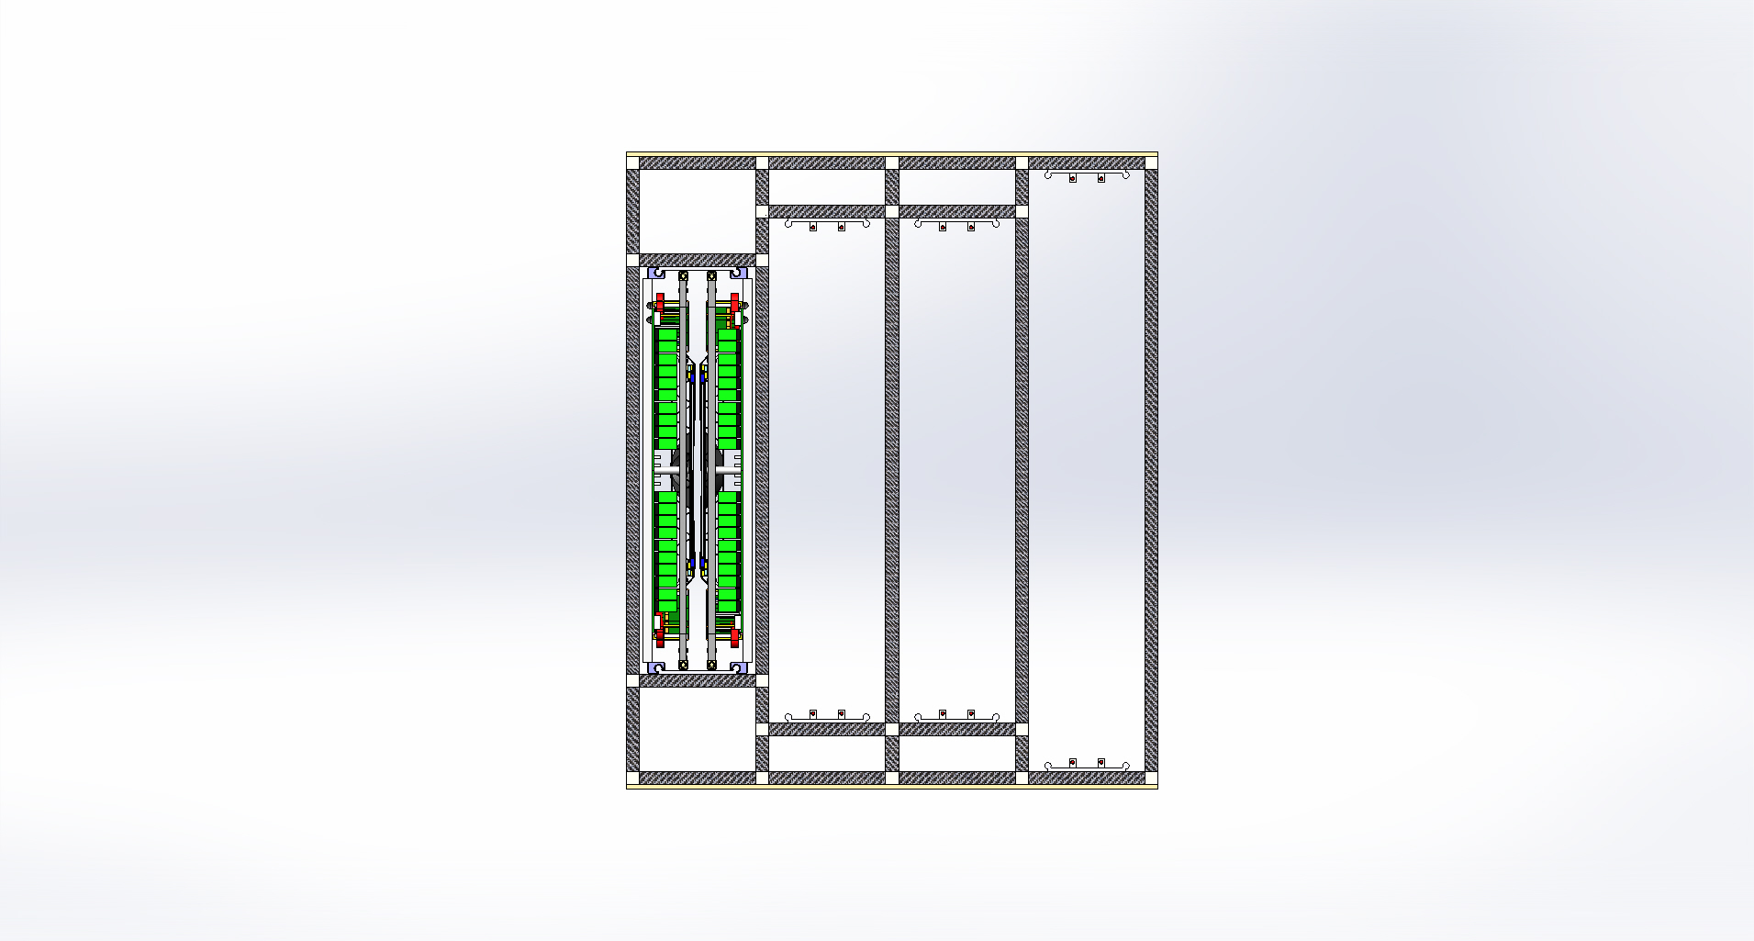
1-st station Main frame (side view)

Slide 9
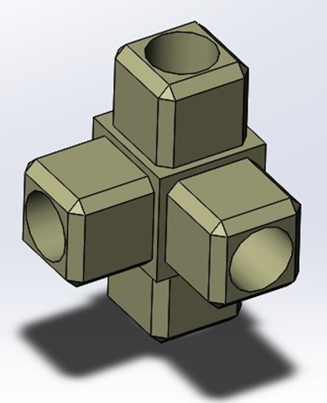
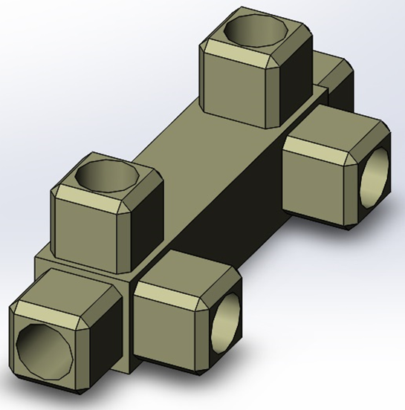
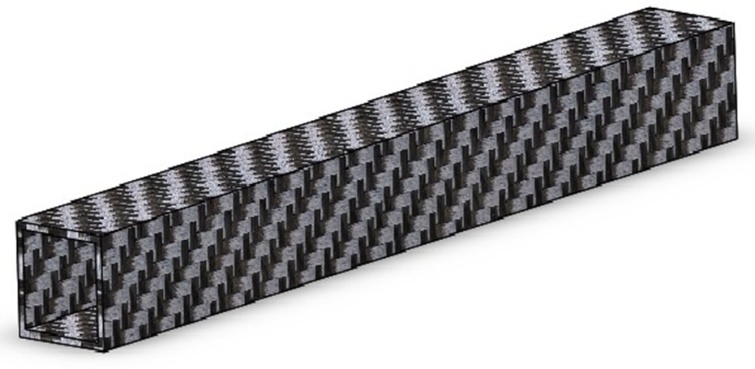
Main frame details

Slide 10
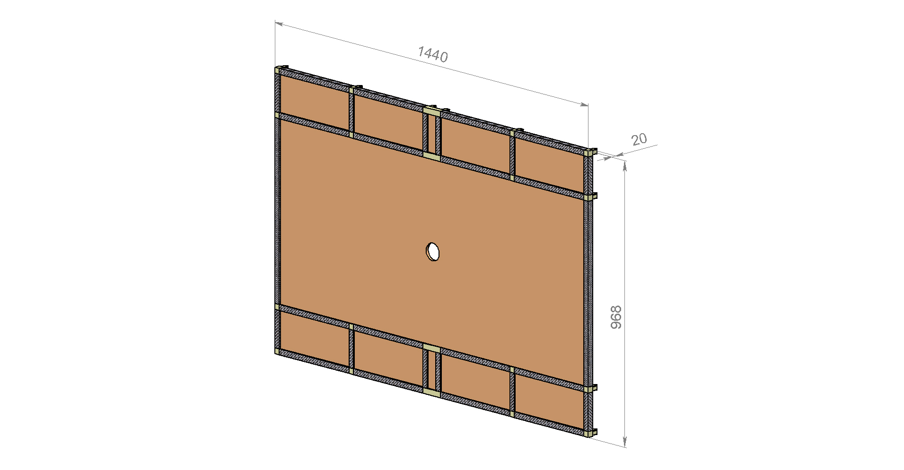
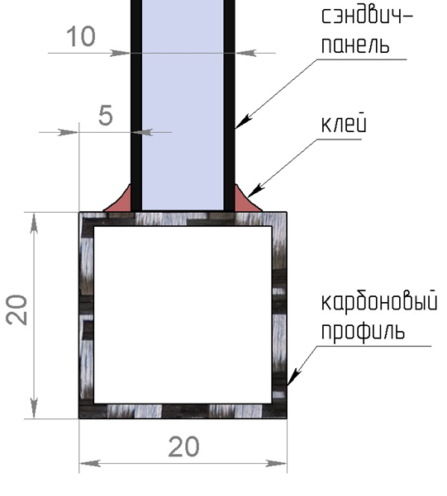
Main frame details

Slide 11
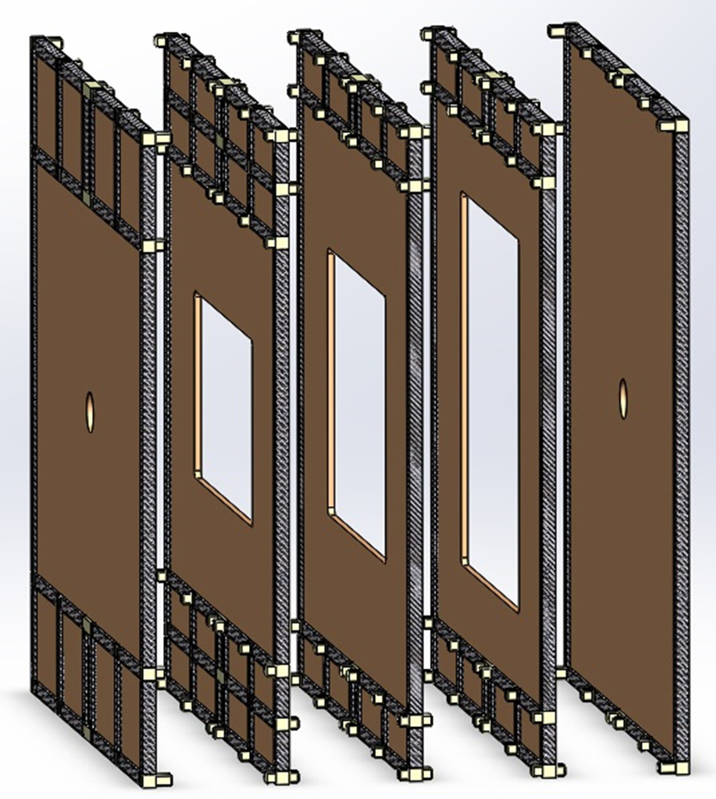
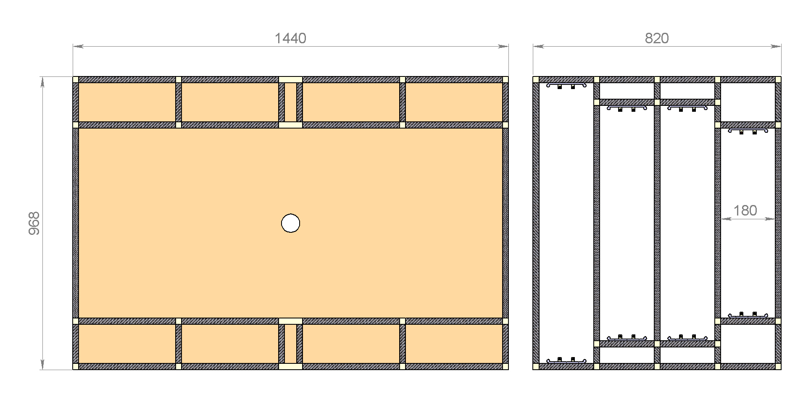
Main frame

Slide 12
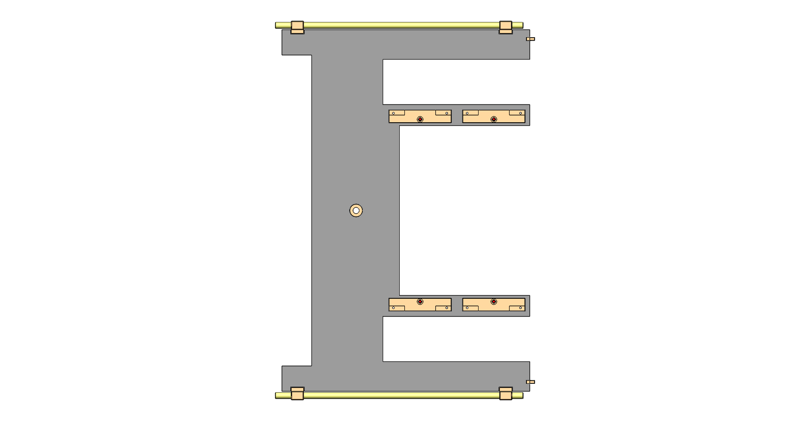
Carbon (sandwich panel) C-frame 1-st station

Slide 13
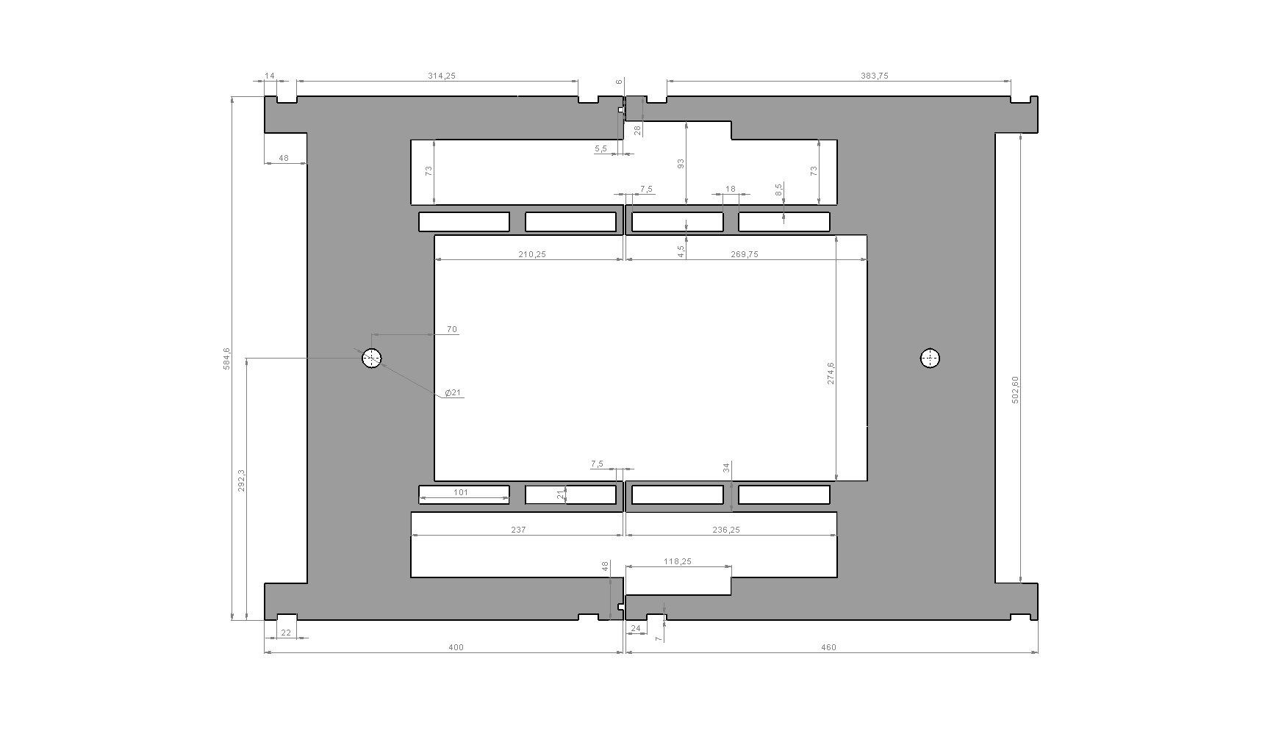
Carbon (sandwich panel) C-frame 4-th station

Slide 14
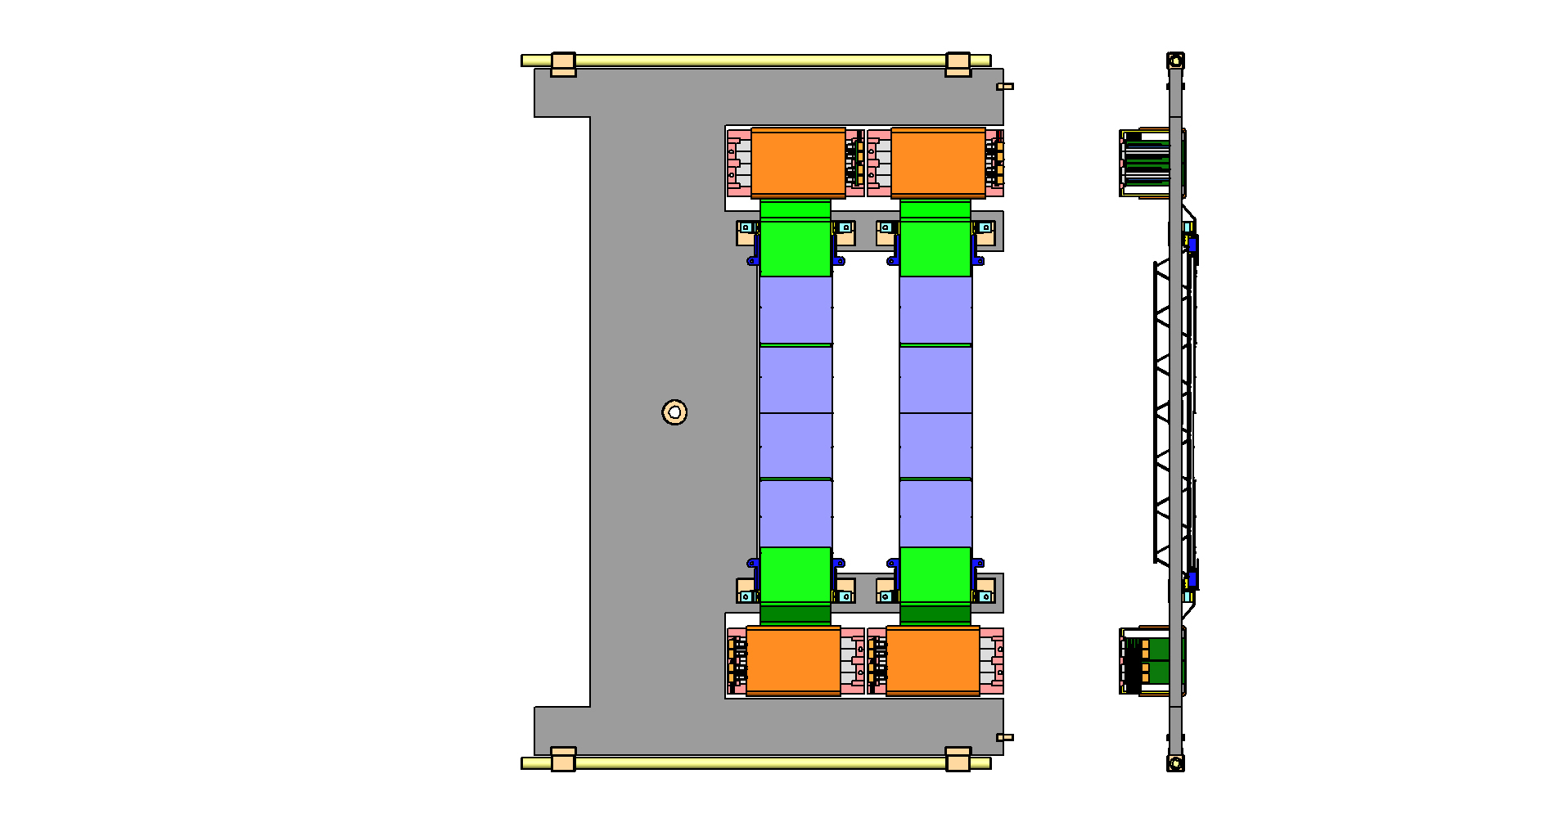
Carbon C-frame, Al C-frame invisible

Slide 15
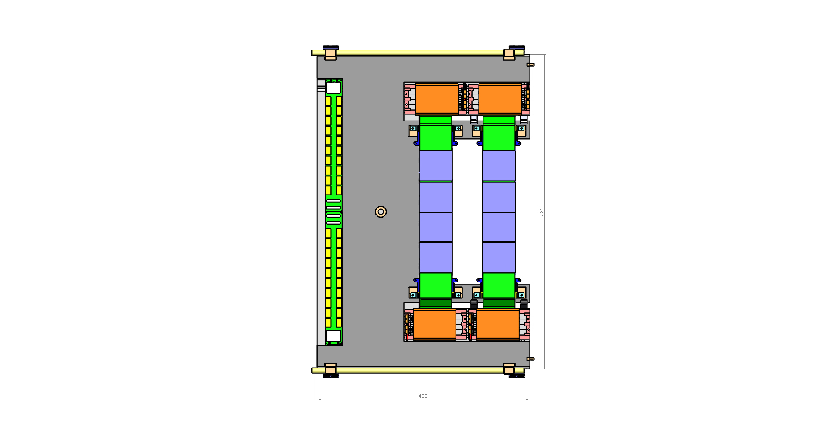
¼ of the 1-st station

Slide 16
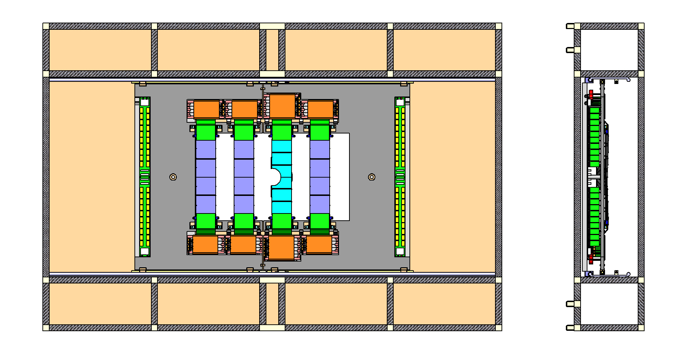
½ of the 1-st station in Main frame

Slide 17
Al c-frame and carbon c-frame

Slide 18
Al c-frame and carbon c-frame

Slide 19
Al c-frame and carbon c-frame

Slide 20
¼ of the 1-st station

Slide 21
The 1-st station in Main frame

Slide 22
Central Ladder for the 1-st station

Slide 23
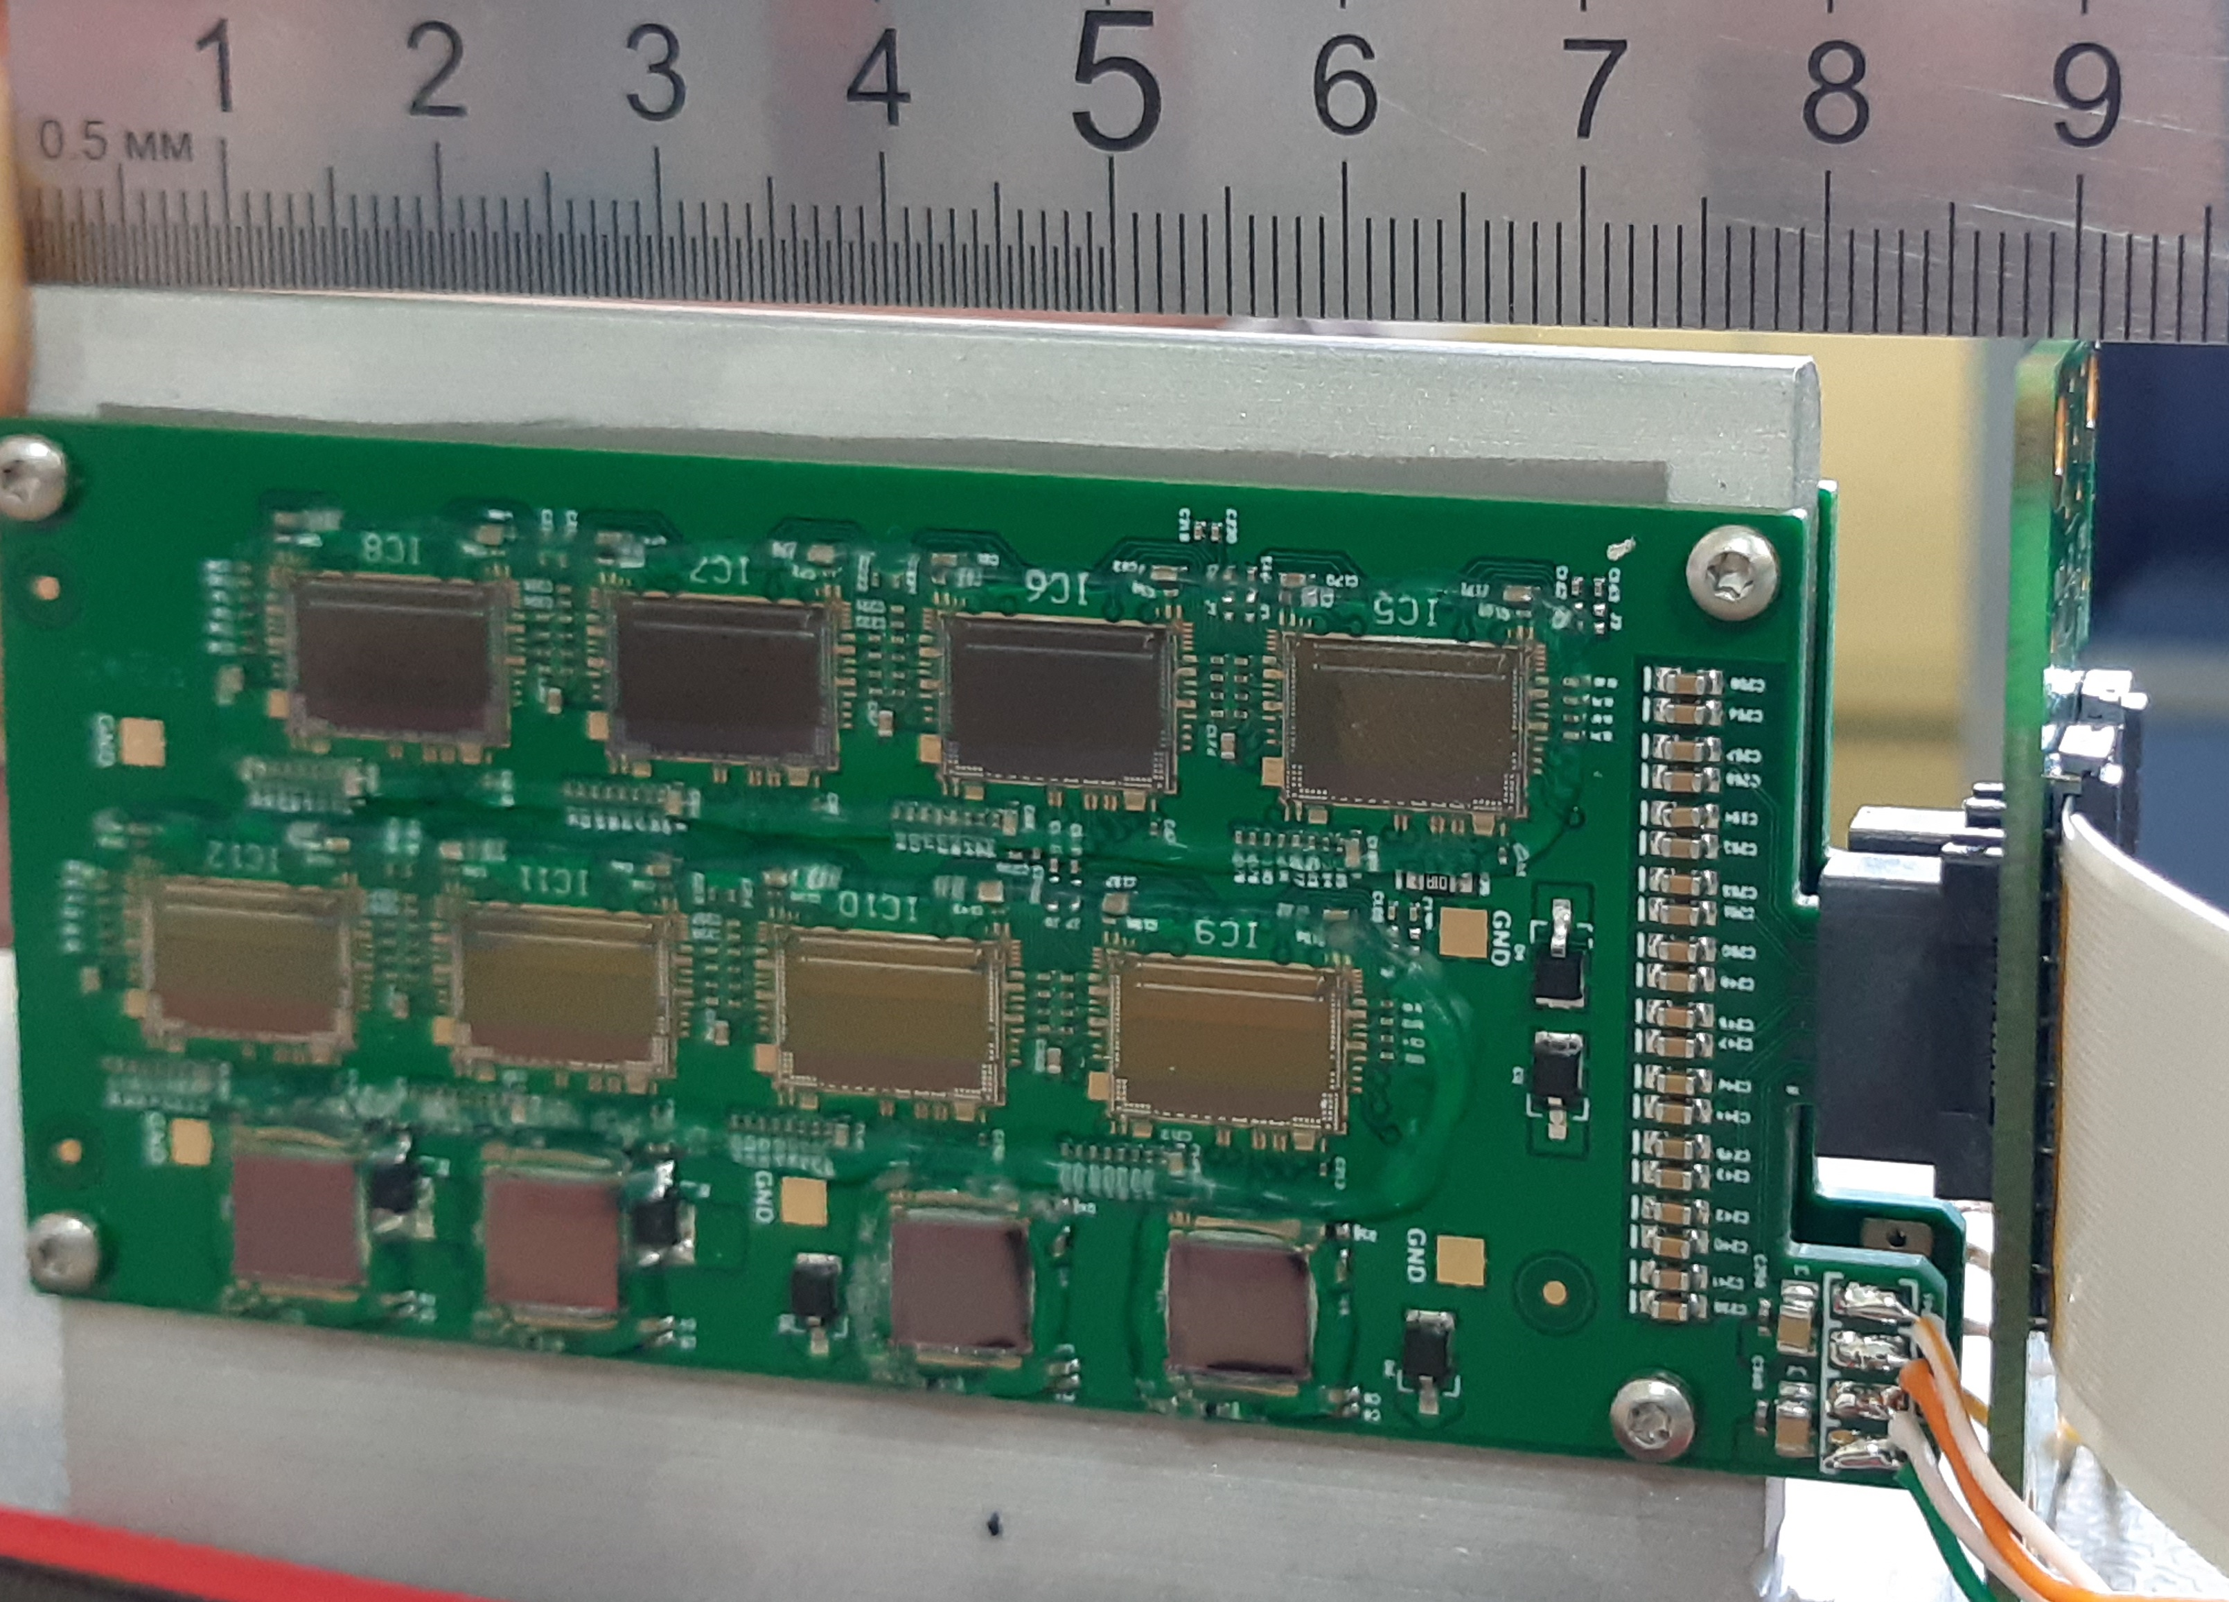
BM@N Front-end Boards
Features:
  Size: 87*40 mm²;
  Thickness with components: 3 mm;
  Edge-type connector with two pin groups: [ HV, LV ] & [ DATA ]
Advantages:
  Increased space for the cabling between FEB-boxes;
  90 bending of cables is not needed ;
  Easy connectivity with a FEB-panel;
  Low thickness of the board allows to increase thickness of the cooling fin for one FEB up to 3 mm.
Comparison of two FEB geometries
Prototypes of FEB with FEB-panel

Slide 24
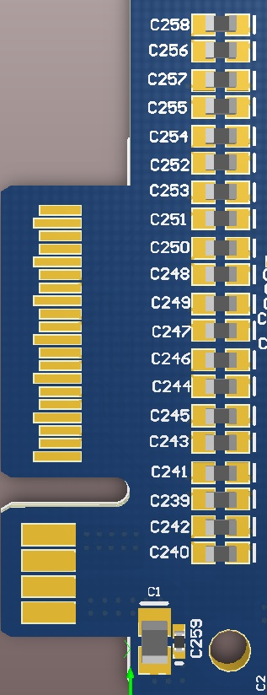
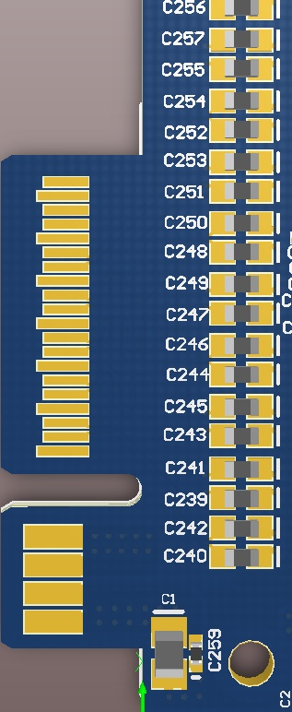
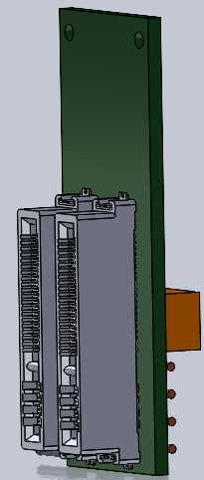
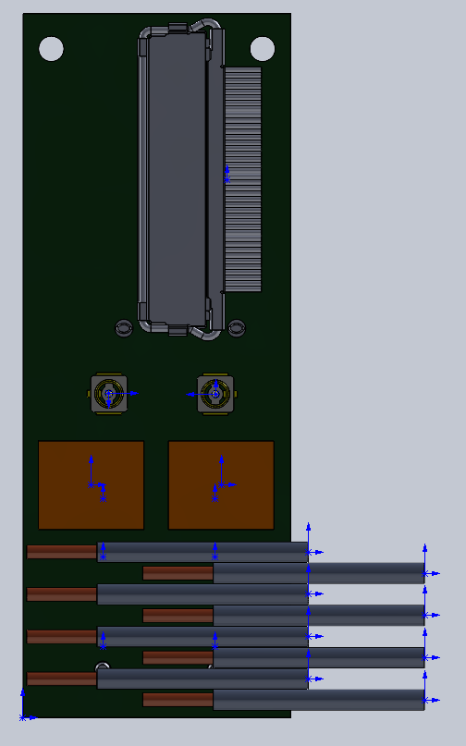
FEB connectivity
Data connector
AWG40 microcoax cables
IPEX Cabline connector
DATA PINS
DATA PINS
HV connectors
Sig. ret. Caps
POWER PINS
POWER PINS
20 AWG
power cables
2× FEBs
FEB panel

Slide 25
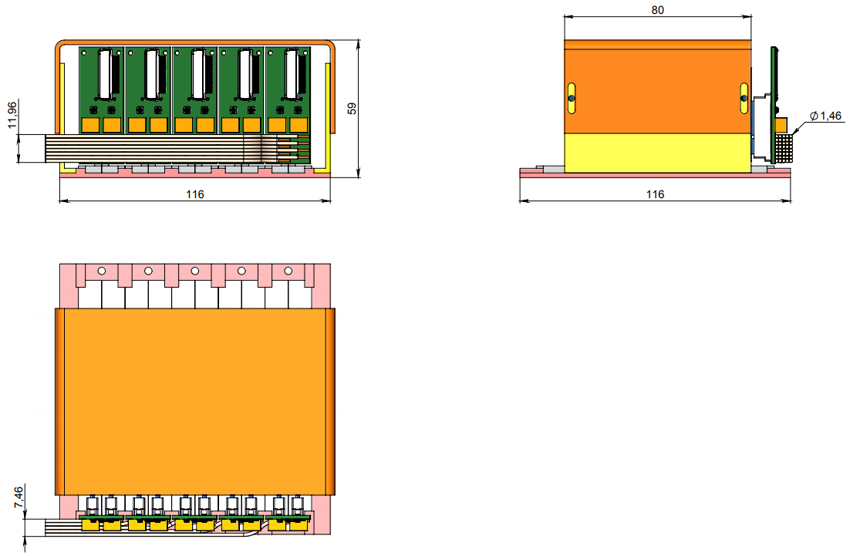
FEB box

Slide 26
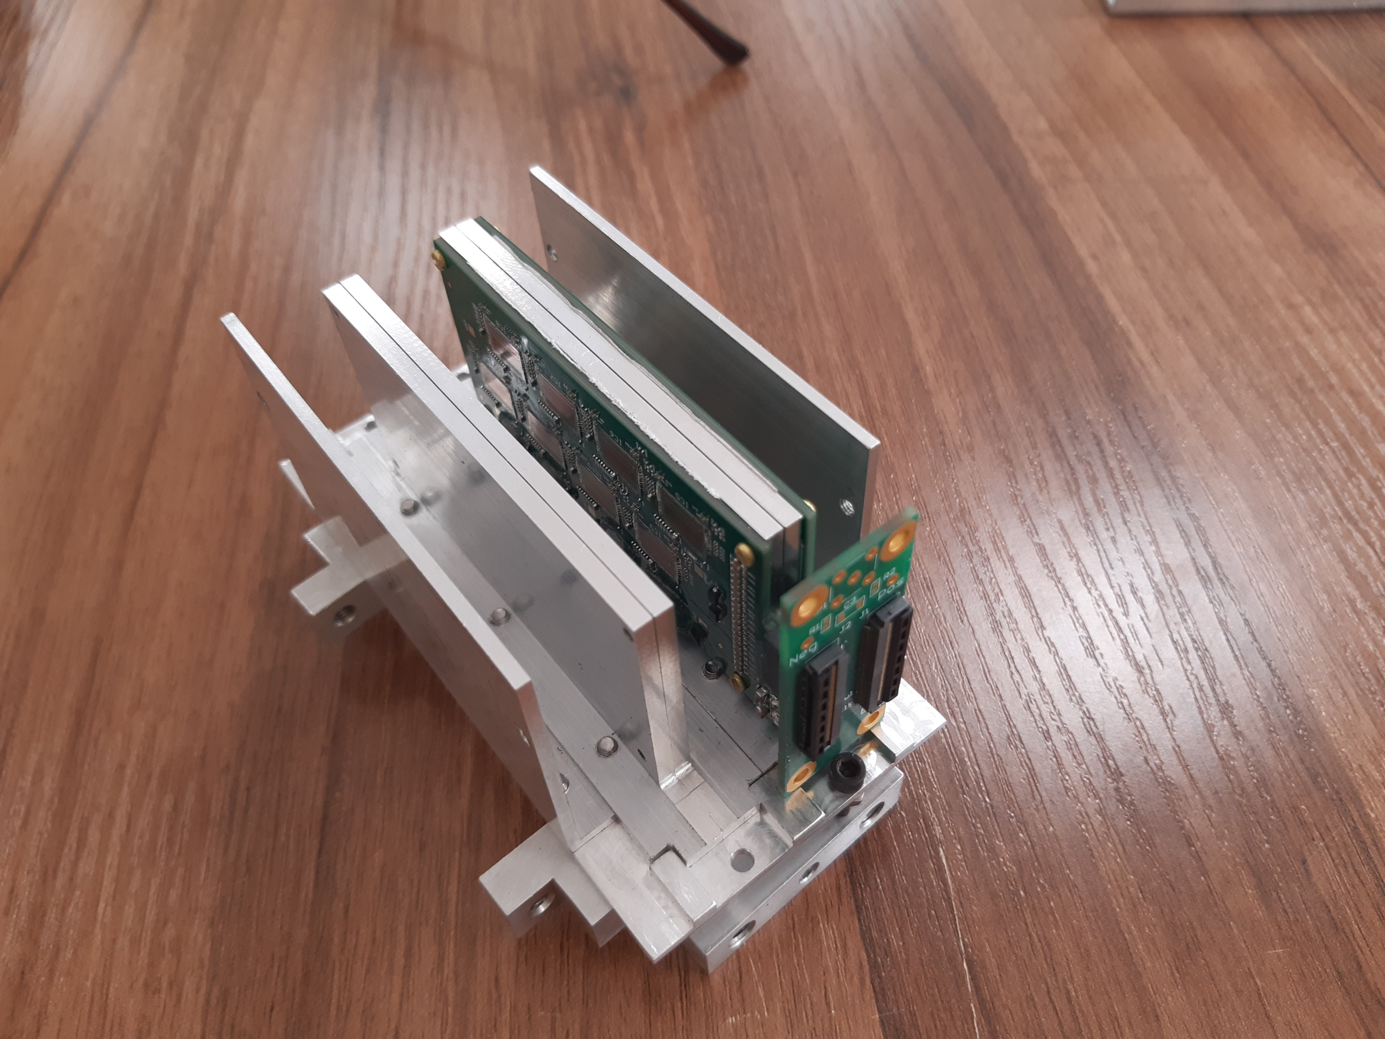
FEB box prototype

Slide 27
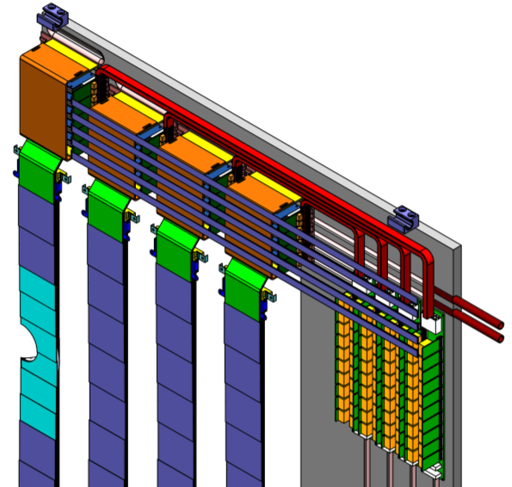
Cable routing
Power cables to POB
DATA cables to patch panel

Slide 28
Plans for the construction of the STS mechanics
Production of a prototype C-frames without cooling system for the 4-th station.
The goal is to test the possibility of positioning, evaluate accuracy.
Production of a prototype C-frame without cooling system for 1-st station
The goal is to develop the assembly of ladders and its installation
on the C-frame
Purchase of sandwich panels. EU? NIIKAM (Pereslavl-Zalessky)?.
Production of a prototypes of radiators.
Prototype tooling for manufacturing a main frame.

Slide 29
Thank you !

