Slide 1
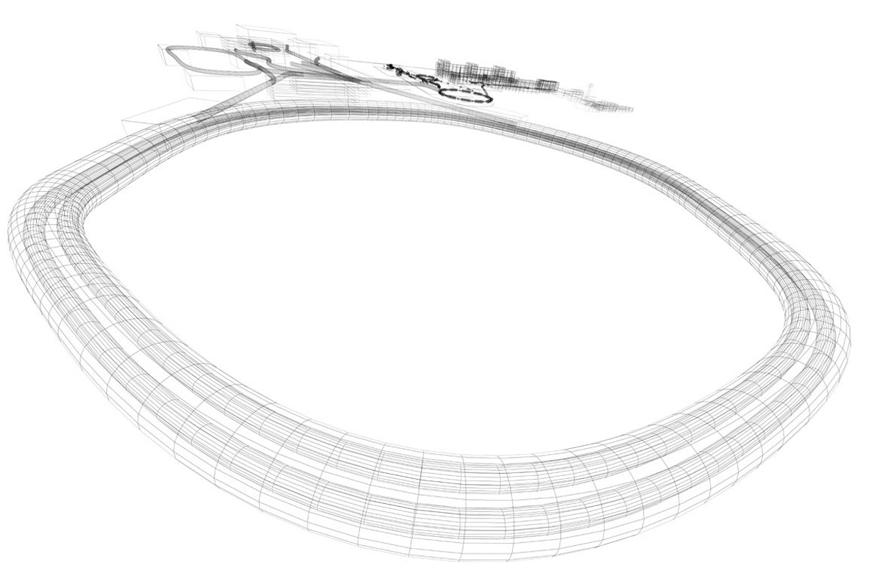
DL Engineering
Overview on CBM-STS Mechanics
GSI Darmstadt
30.06.2020
O. Vasylyev

Slide 2

Agenda
STS design
Detailed system and components overview
  Mainframe and components
  C – frame and components
  Ladder bearings

Slide 3
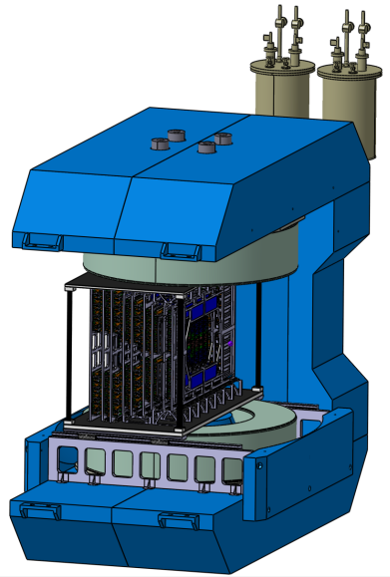
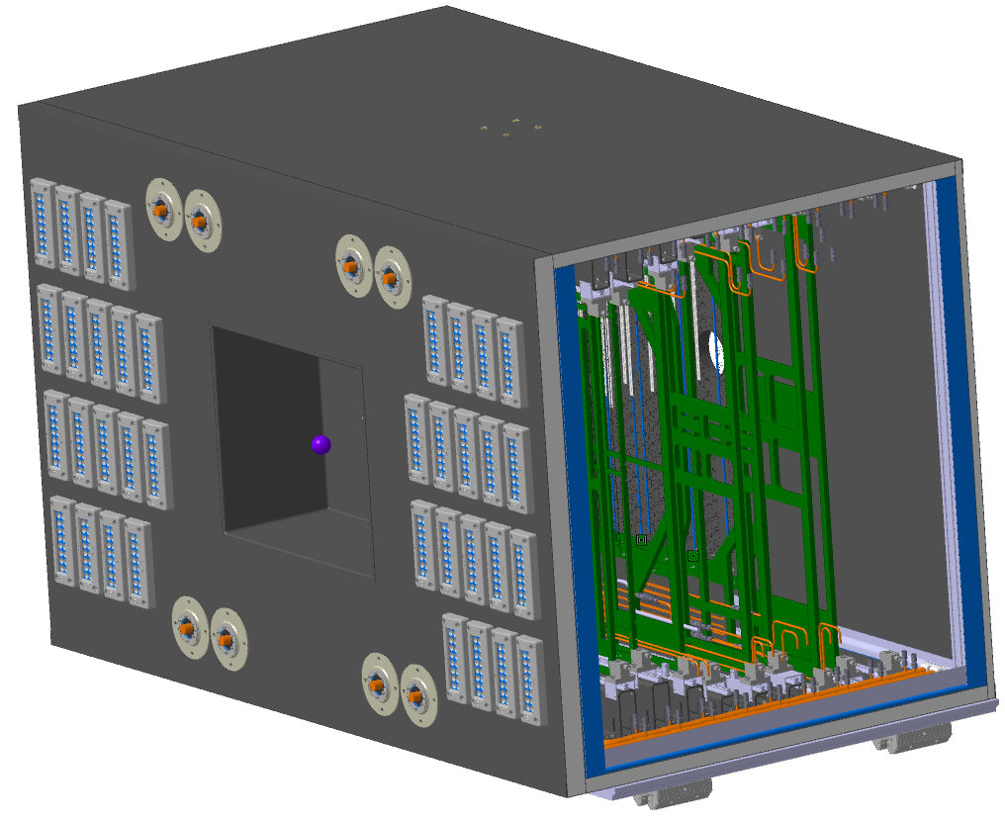
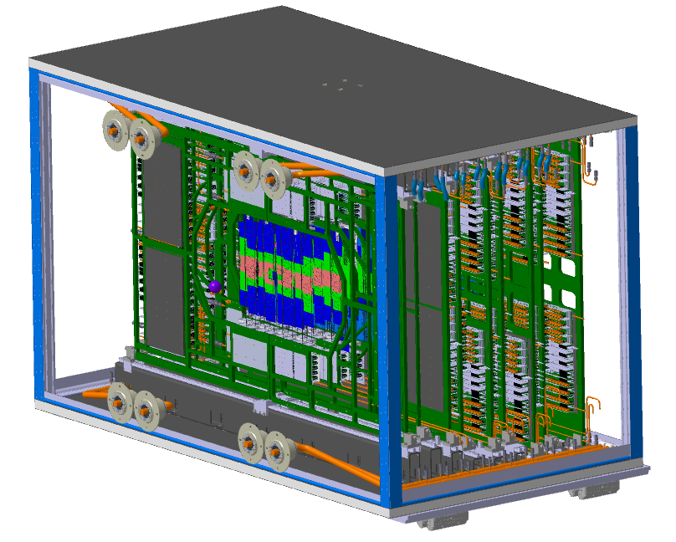
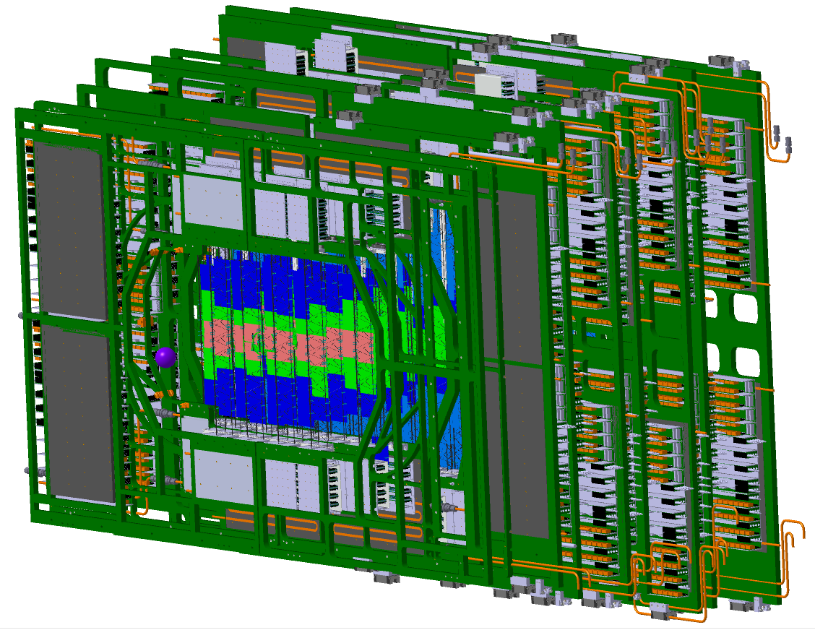
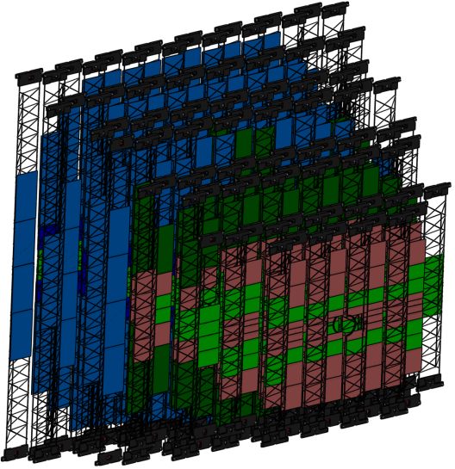
1. STS Model overview
STS inside the magnet
STS inside the thermal enclosure
Self carrying STS Mainframe
STS Units
STS Carbon ladders
General facts:
8 Stations
9 Units
106 Carbon ladders
896 Sensor modules

Slide 4
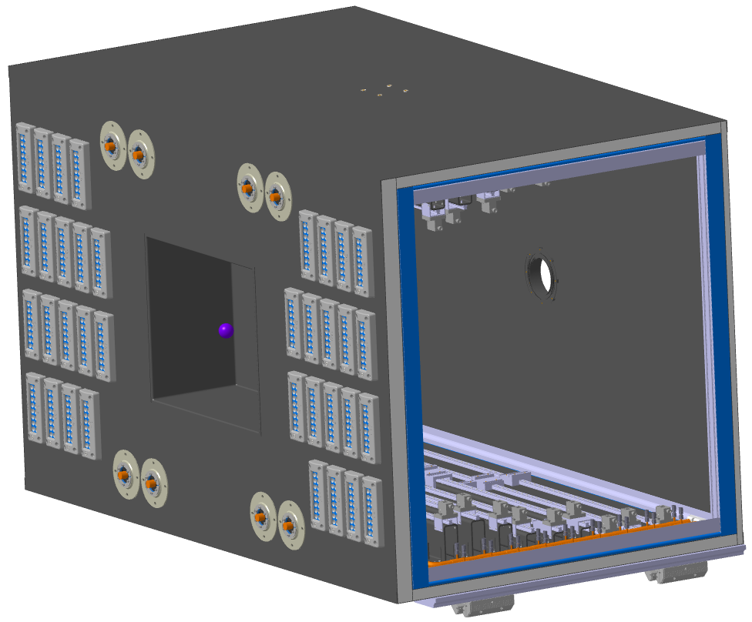
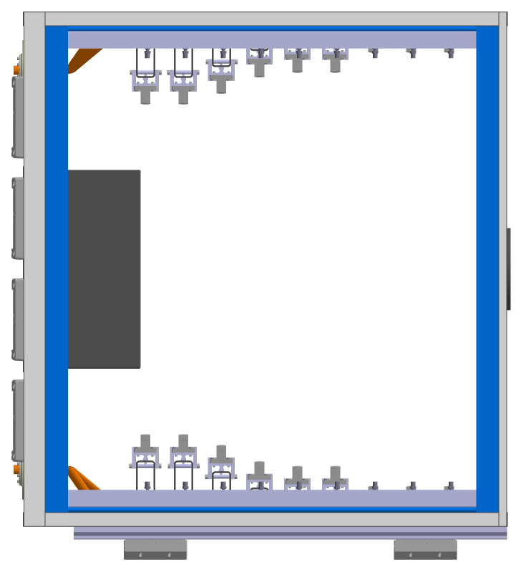
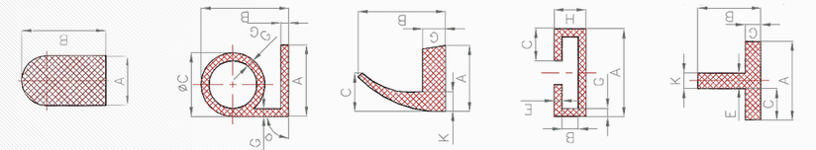
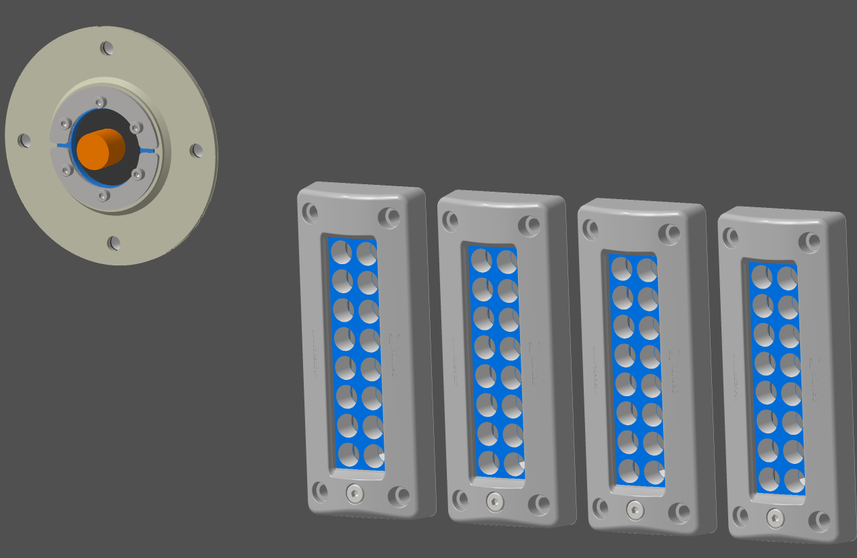
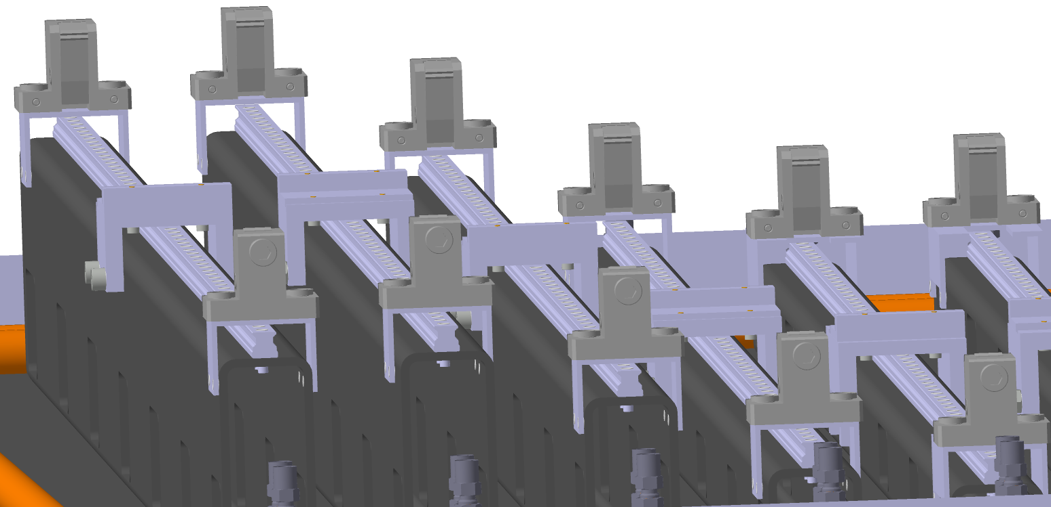
2. Mainframe overview
Outer Enclosure
Conceptual Insulation
Insulation:
Between Al Frame and thermal enclosure sandwich
No hard requirements
Easy assembly
Different shapes, and materials available
Power cable feedthroughs
C-Frame rail supports
Mainframe structure:
Combination of standard and custom Al profiles
Easy assembly
Large knowledge base
Different precision levels
Extensive industrial support
Industrial feedthroughs „Roxtec“
Flexible configuration possible
individual feedthrough access
Amagnetic, high precision rails
C-Frame fixtures
Industrially available
30.06.2020

Slide 5
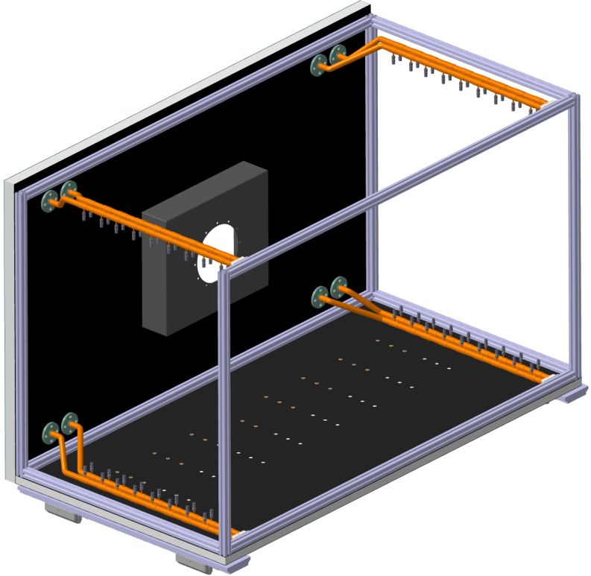
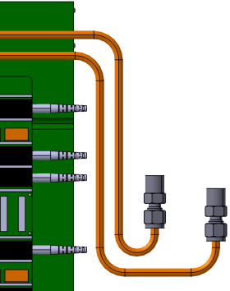
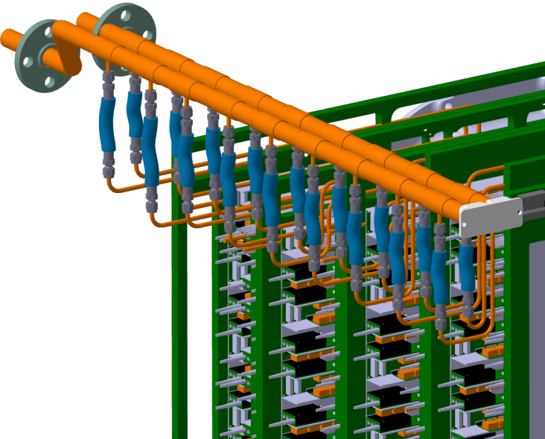

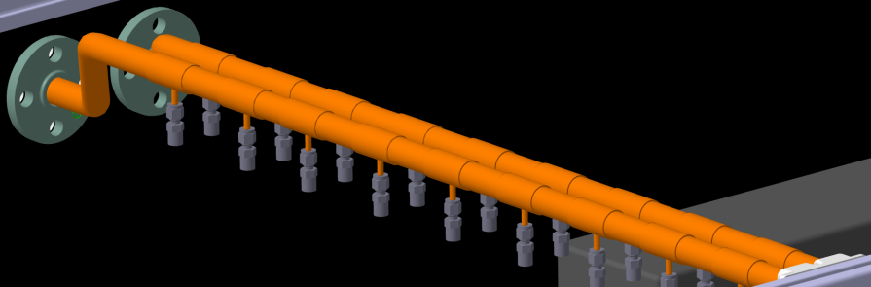
2. Mainframe overview
Cooling manifolds
Idea: K. Agarwal
Connection to the cooling blocks
Damping:
Swagelok flexible tube
Custom shaped
C-Frame piping required!
Concept Facts:
Two manifolds per quarter STS
Flange and manifold is one assembly unit
Space-saving on the front wall
Flexible connection to the C-Frame -> vibration damping
Individual C – Frame access (mostly)
Feasibility test required
Front flange
Out manifold
In manifold
Rear holder
Disassembly:
Unscrew the flange, holder and cooling lines -> pull towards the rear wall
30.06.2020

Slide 6
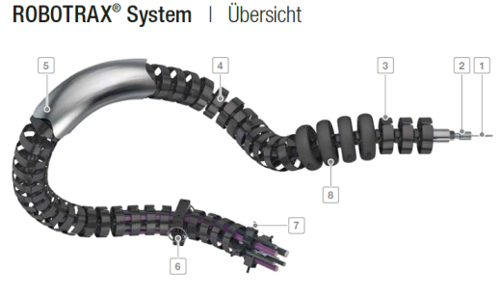
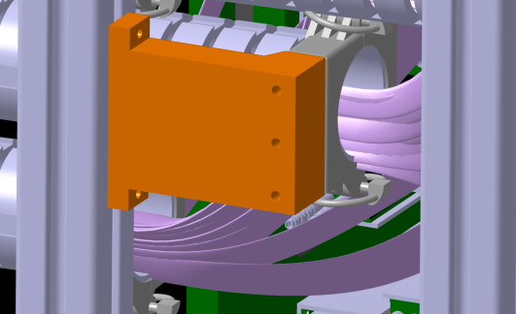
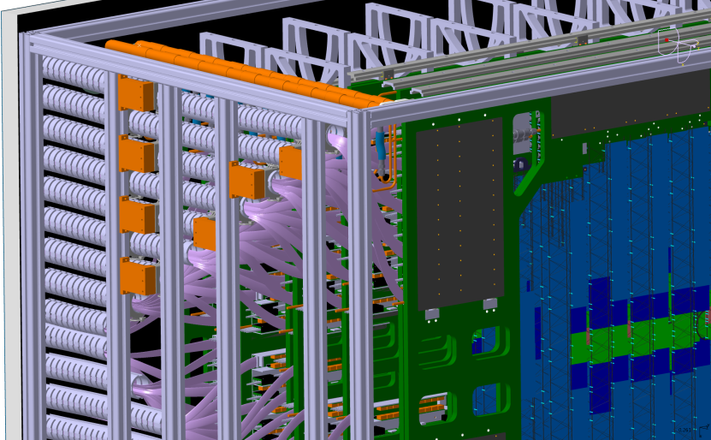
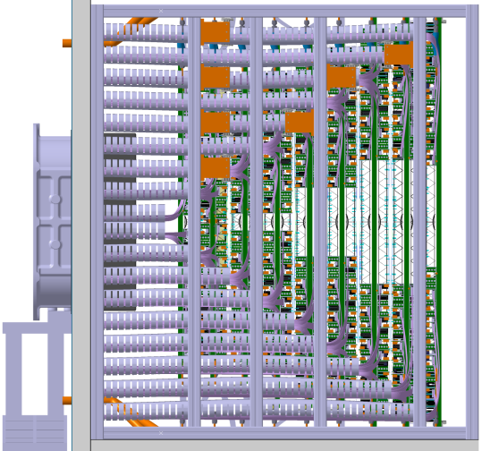
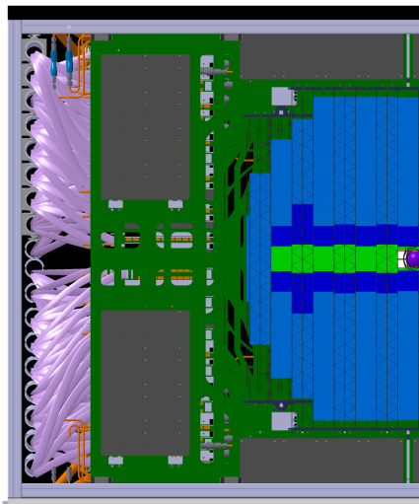
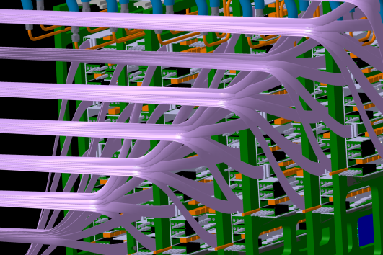
2. Mainframe overview
Robotrax
cable trays
Custom
holders
Power cable
bundles
Custom holders
Robotrax cable tray
3D cable movement possible
Mostly used on robotic arms
Highly customizable system
Idea requires testing
Integration issues:
Only side routing possible
Space on the front panel
Robotrax dimensioning
Fibers integration
Individual C – Frame access
Side view
Rear view
Cable bundles
=>
To be tested in the STS mechanical demonstrator
Bundle area approximation
Only power bundles now
Required space estimation
30.06.2020

Slide 7
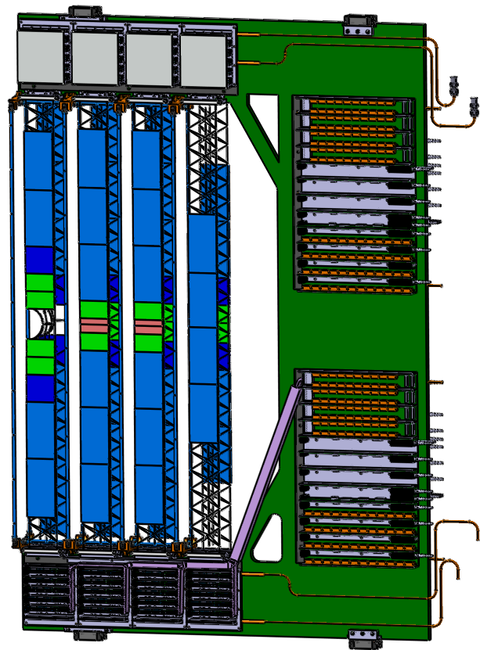
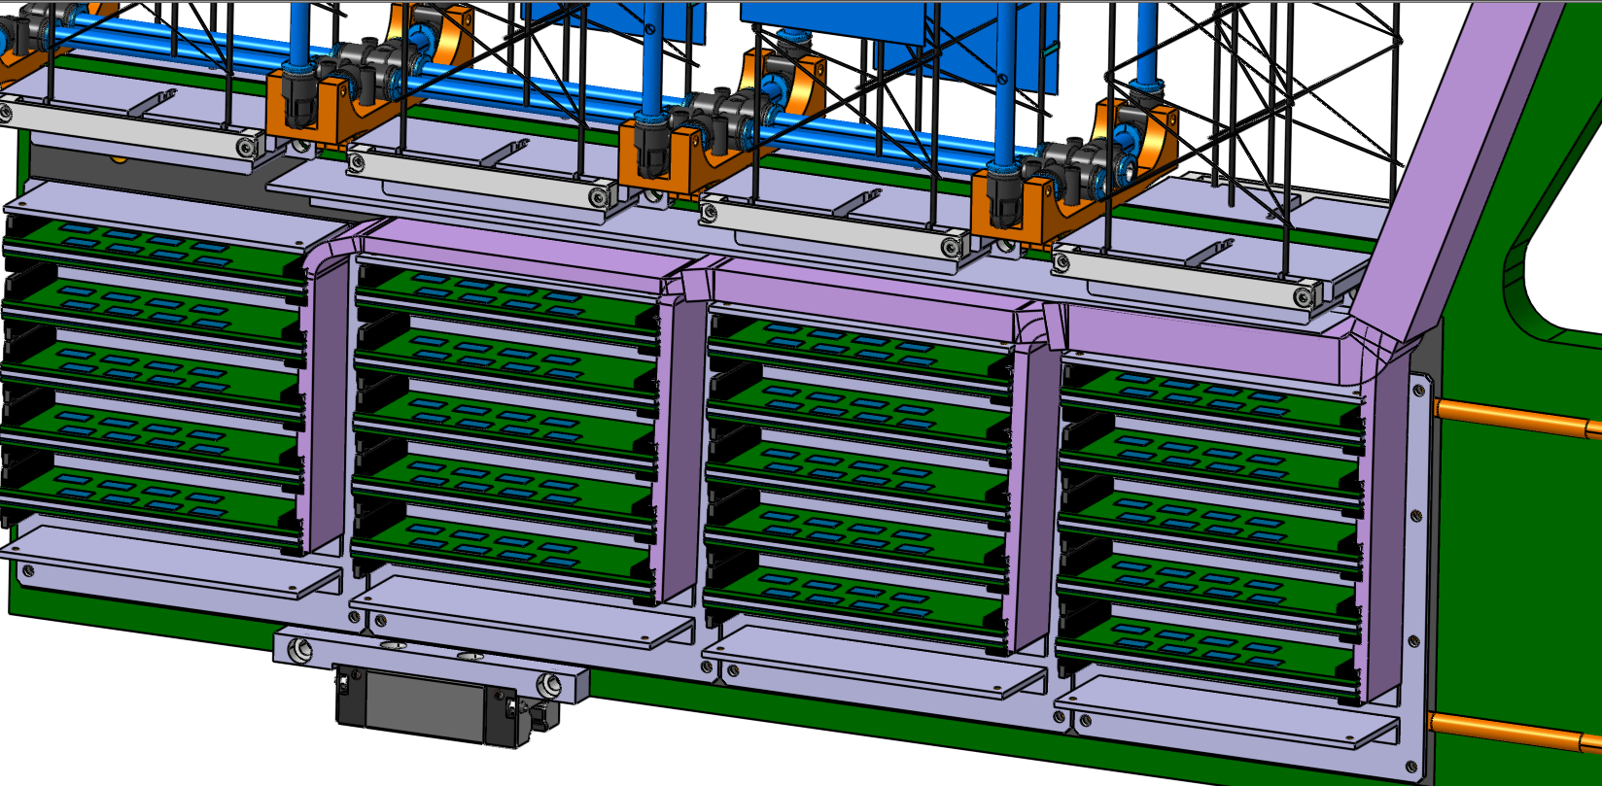
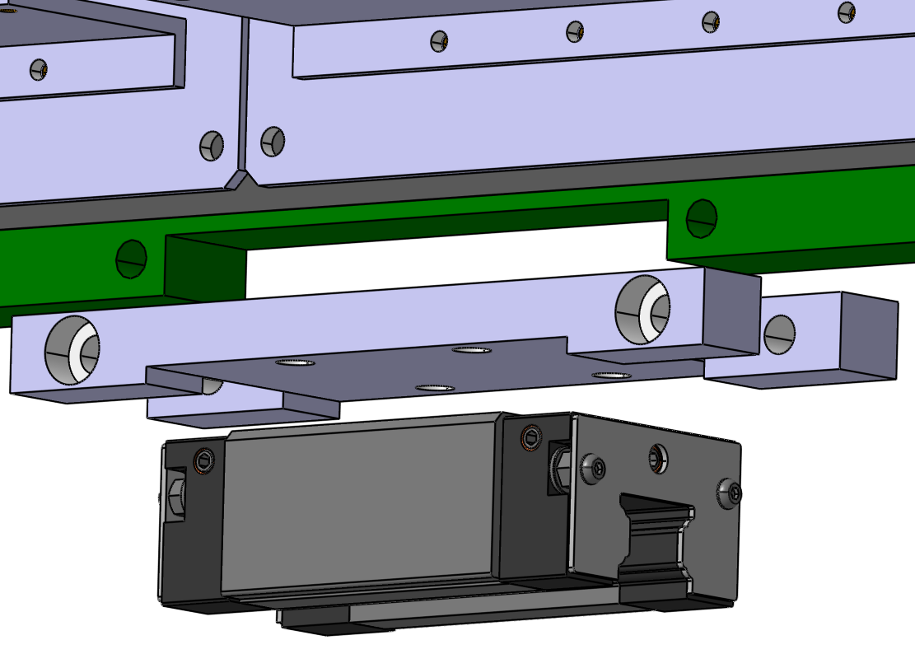
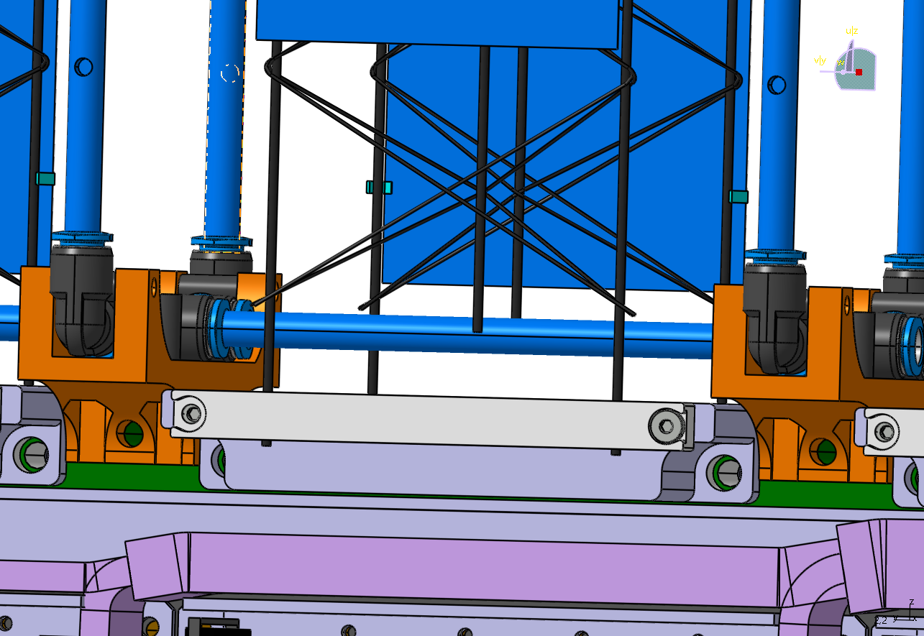
2. C-Frame overview
Overview Unit 07R:
~24mm
Power cable bundle
~27mm
Reserved for
read-out cables
~30mm
Perforated tube
Cooling system
adapter
Represents a „worst case Unit“
Extremely limited space for:
  Rail system
  Cable routing
  Sensor cooling
C-Frame wagon mount
Fixed ladder bearing
Power cable cover
Most critical components realistically designed
30.06.2020

Slide 8
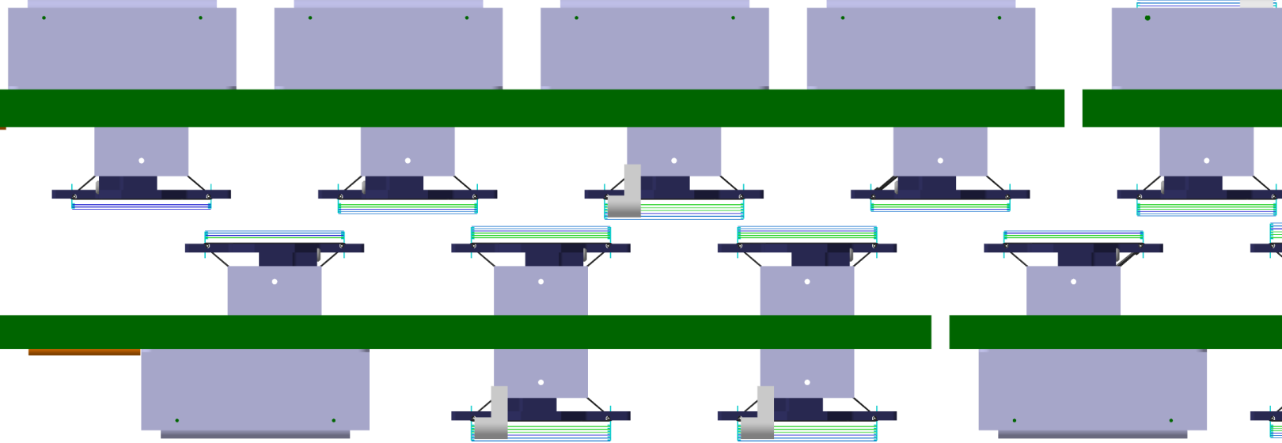
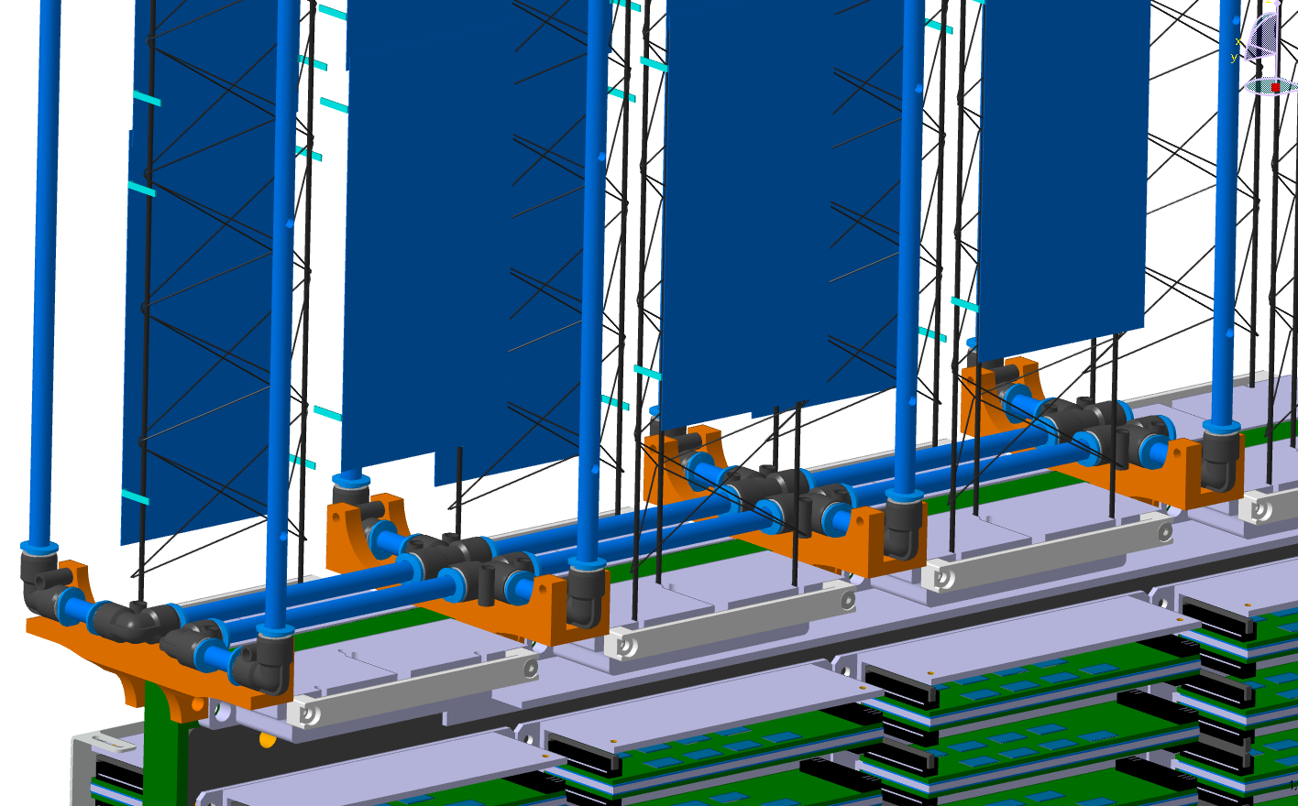
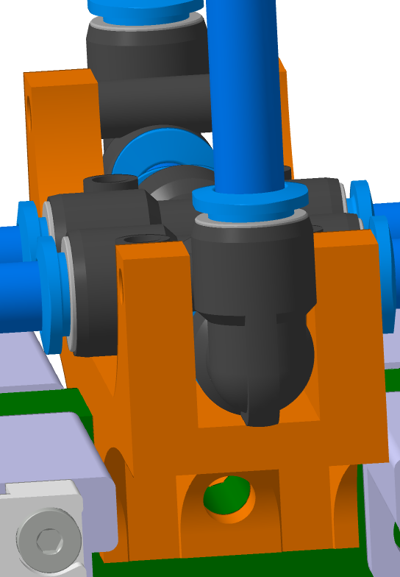
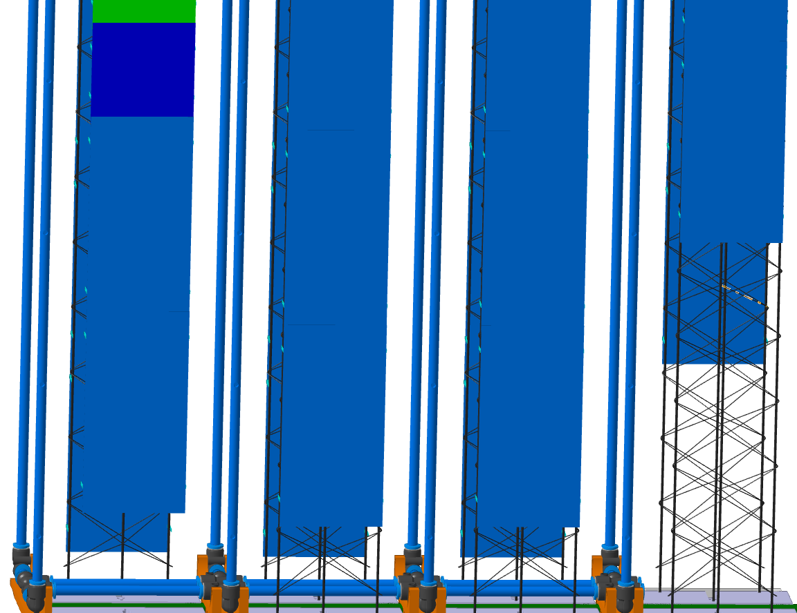
3. Conceptual integration: sensor cooling
Sensor cooling concept:
C - Frames
Ladders with hidden FEB Boxes
Concept Facts:
Nozzles are an example
Space is available
Easy to use tubes e.g. FESTO
Routing is flexible
Concept test
Vibrations?
Visible sensor surface
cooling
element
cooling
element
cooling
element
cooling
element
cooling
element
cooling
element
cooling
element
cooling
element
cooling
element
Visible sensor surface
Top view
FESTO Fittings
3D Printed holders
Perforated tubes
30.06.2020

Slide 9
3. Ladder bearings
Design and slides by F. Nickels (DTL)
easy assembly
moderate manufacturing
few parts
ideally no adjustment
increased stiffness
high precision due to simple shapes and common mechanical fits!
30.06.2020

Slide 10
DL Engineering
Thank you

