Slide 1
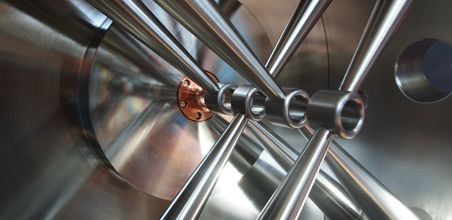
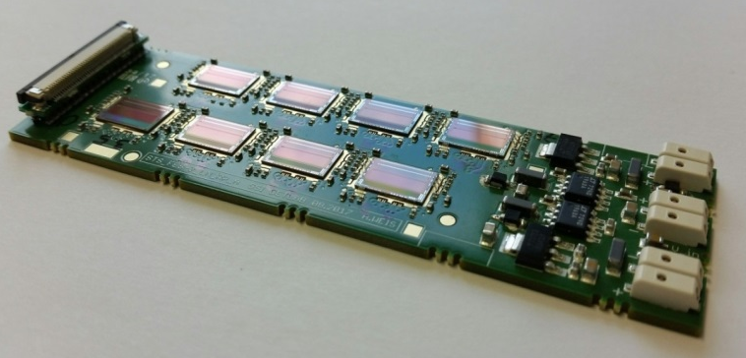
German-Russian Roadmap
Peter Senger
June 30, 2020
1. Large Research Infrastructures
JINR-GSI Cooperation Agreement
Coordination and technical follow-up 0.4 M€
1. Stochastic Cooling for the NICA Collider (FZJ): 2.3 M€
2. Beam diagnostics and LLRF electronics for linear accelerators 1.8 M€
3. Silicon tracking system for the NICA BM@N experiment 9.8 M€
4. Readout electronics and data acquisition for the BM@N experiment 4.5 M€
5. R&D for superconducting high-intensity ion-injector Linacs@JINR (GSI): 1.2 M€
5. Joint LINear ACcelerator developments 2.9 M€
TOTAL: 20.0 M€
21.7 M€

Slide 2
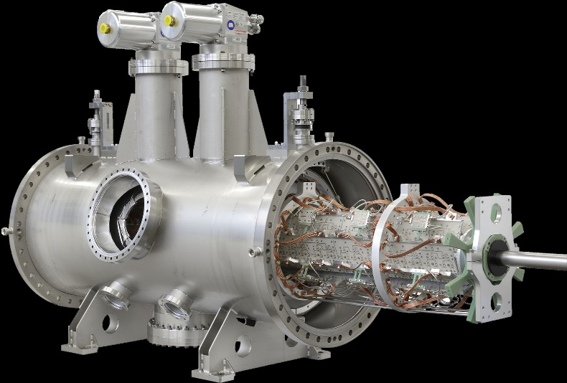
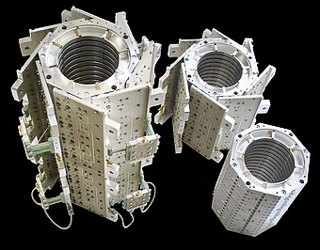
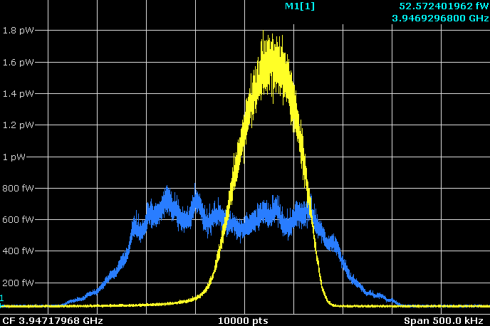
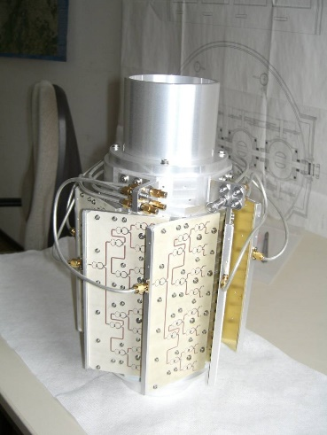
Stochastic cooling structures for HESR and NICA (FZ Jülich)
Tests at COSY with original
PANDA Cluster-Target:
1*10¹⁵ atoms/cm², 2*10⁹ protons
New slot-ring couplers for HESR
Tests at Nuclotron with single
Groups of 16 rings
Each Pickup and Kicker consists
of 4 groups each with 16 rings
Structures for Nuclotron
March 2013:
Pickup: 16 rings
Kicker: 16 rings
Filter cooling with optical
Notch-Filter
Ions: D+
Intensity: 2E9
Cooling time: 480s
Initial dp/p: 0.55x10-3
Final dp/p: 0.25x10-3

Slide 3
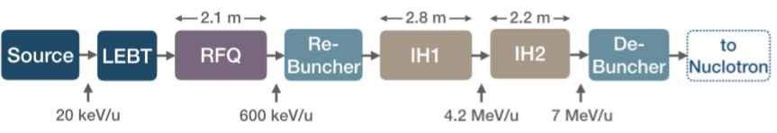
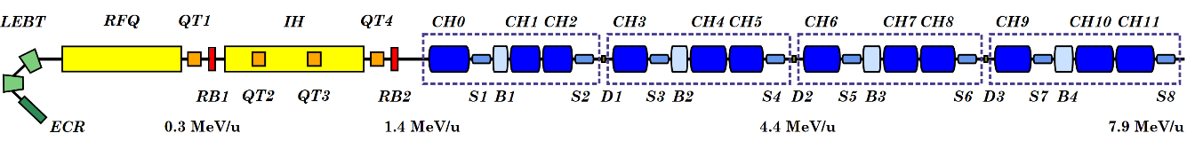
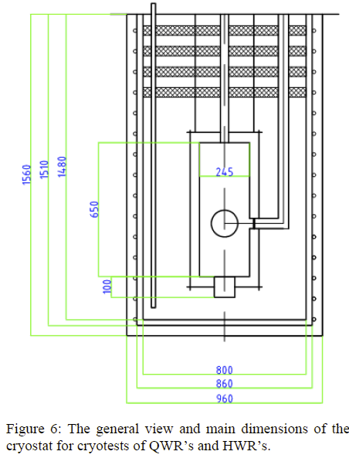
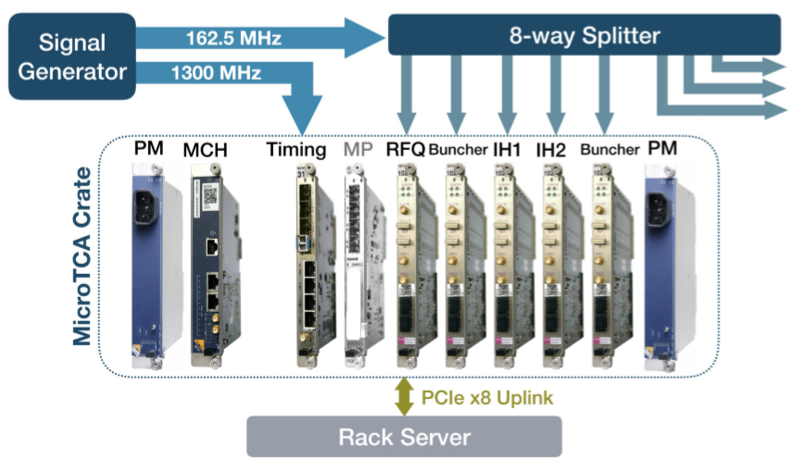
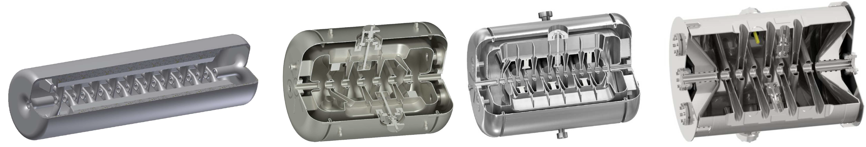
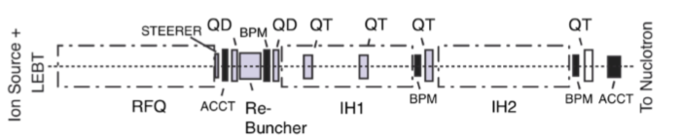
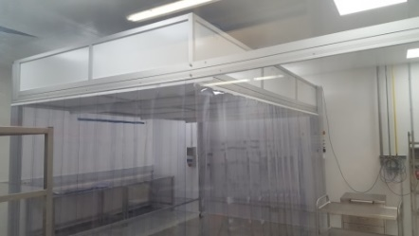
Joint LINear ACcelerator developments (GSI)
LIGHT ION LINEAR ACCELERATOR UP TO 7 AMEV FOR NICA
HEAVY ION LINEAR ACCELERATOR UP TO 7 AMEV FOR GSI
Low Level Rf-System
(Rf-master oscillator, controller channels, CPU-processing)
Universal Test-Cryostat
Superconducting RF-Cavity R&D
Crossbar H-Mode Multi Cell Cavities
15 cells 8 cells
Accelerating Cryo Module
(sc-CH-cavities, sc-buncher, sc-solenods
Common Infrastructure
(clean rooms, HPR, SRF-labs)
Beam Diagnostics R&D (Beam Position Monitors, ACCTs, …)

Slide 4
Working packages and cost estimates of the GSI in-kind contributions
to the NICA/BM@N/MPD experiments (“STS”)
Working package “STS” |  | Manpower for 3 years |  | Invest k€ | Sum k€
 |  | FTE | k€
1 | Reconstruction software, physics performance studies | 3 | 630 | 0 | 630
2 | Design and production of central sensors for BM@N at CIS | 0 | 0 | 250 | 250
3 | Development and production of micro-cables from LTU | 0 | 0 | 820 | 820
4 | Production of FEBs for the BM@N-STS | 0 | 0 | 400 | 400
5 | Module assembly for BM@N and QA facilities | 3 | 630 | 250 | 880
6 | 4 US Bonding Machine M17S (F&K Delvotec) | 0 | 0 | 640 | 640
7 | STS experiment integration (commissioning, metrology, temporary DAQ, auxiliary infrastructure) | 1 | 210 | 510 | 720
8 | Licencies for Siemens SCADA WinCP, etc. | 0 | 0 | 200 | 200
9 | Development of Construction Managing Information System (CMIS) by KIBERNETIKA, + 1 year maintenance | 0 | 0 | 100 | 100
10 | Servers equipment for installation of KIBERNETKA CMIS at JINR computer center | 0 | 0 | 25 | 25
11 | License for ORACLE for two processors+1 year maintenance | 0 | 0 | 45 | 45
12 | Mechanical system integration | 1 | 210 | 200 | 410
13 | Power generation and distribution systems for STS and TPC (incl. LDO 2800 pcs.) | 1 | 210 | 660 | 870
14 | LV & HV power supply system (Wiener, Germany) | 0 | 0 | 300 | 300
15 | FEAST DC/DC converters from CERN (1500 pcs) | 0 | 0 | 90 | 90
16 | Climatic equipment for VB LHEP clean rooms | 0 | 0 | 150 | 150
17 | High-voltage supplies for the MPD TPC | 0 | 0 | 570 | 570
18 | Sensor gas cooling | 1 | 210 | 450 | 660
19 | Cables, connectivity, optical fibers | 0 | 0 | 770 | 770
20 | Hardware-oriented data analysis (calibration, corrections, efficiencies), detector monitoring and controls hardware | 2 | 420 | 250 | 670
21 | Beam pipe for MPD | 0 | 0 | 600 | 600
 | Sum | 12 | 2520 | 7280 | 9800

Slide 5
Working packages and cost estimates of the GSI in-kind contributions
to the NICA/BM@N/MPD experiments (“Electronics”)
Working package „Electronics“ |  | Manpower for 3 years |  | Invest k€ | Sum k€
 |  | FTE | k€
1 | Hardware for the BM@N STS DAQ (GBTxEMU-Boards) | 1,5 | 315 | 460 | 775
2 | General Readout Interface GERI | 2 | 420 | 415 | 835
3 | Timing and Fast Control Network TFCS | 2 | 420 | 150 | 570
4 | Leak-less cooling plant for the MPD from CERN | 0 | 0 | 350 | 350
5 | Contract on development and production of the cooling plant for BM@N STS | 0 | 0 | 150 | 150
6 | Development of firmware for data driven-to-triggered systems | 0.5 | 105 | 20 | 125
7 | Development of auxiliary test systems for QA control of assembly of modules | 0.5 | 105 | 100 | 205
8 | Development of firmware for the BM@N STS DAQ | 1 | 210 | 20 | 230
9 | Production and tests of STS-XYTER 2.2 for BM@N STS (5000 pcs) | 0 | 0 | 550 | 550
10 | Production of readout boards in China | 0 | 0 | 300 | 300
11 | FPC for MPD from Swiss PCB (800 pcs) | 0 | 0 | 200 | 200
12 | Coordination | 1 | 210 | - | 210
 | Sum | 8.5 | 1785 | 2715 | 4500

Slide 6
Status
JINR and GSI finally agreed on a joint linac project, BMBF agrees to cover cost increase. Common start of all projects now possible.
2nd iteration of the application for STS and electronics submitted to Project Office (PT) on Monday, June 22. No response yet.
3rd party office of GSI already started to fill out the required forms

