Slide 1
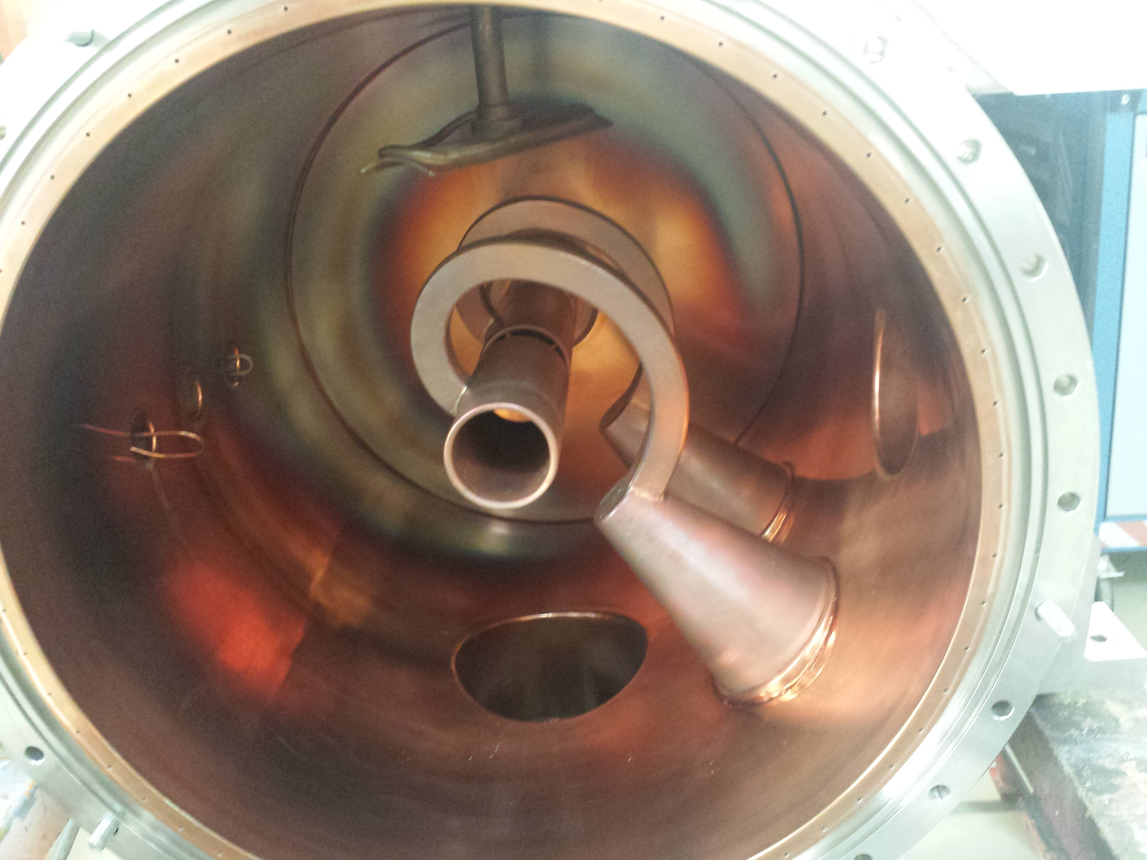
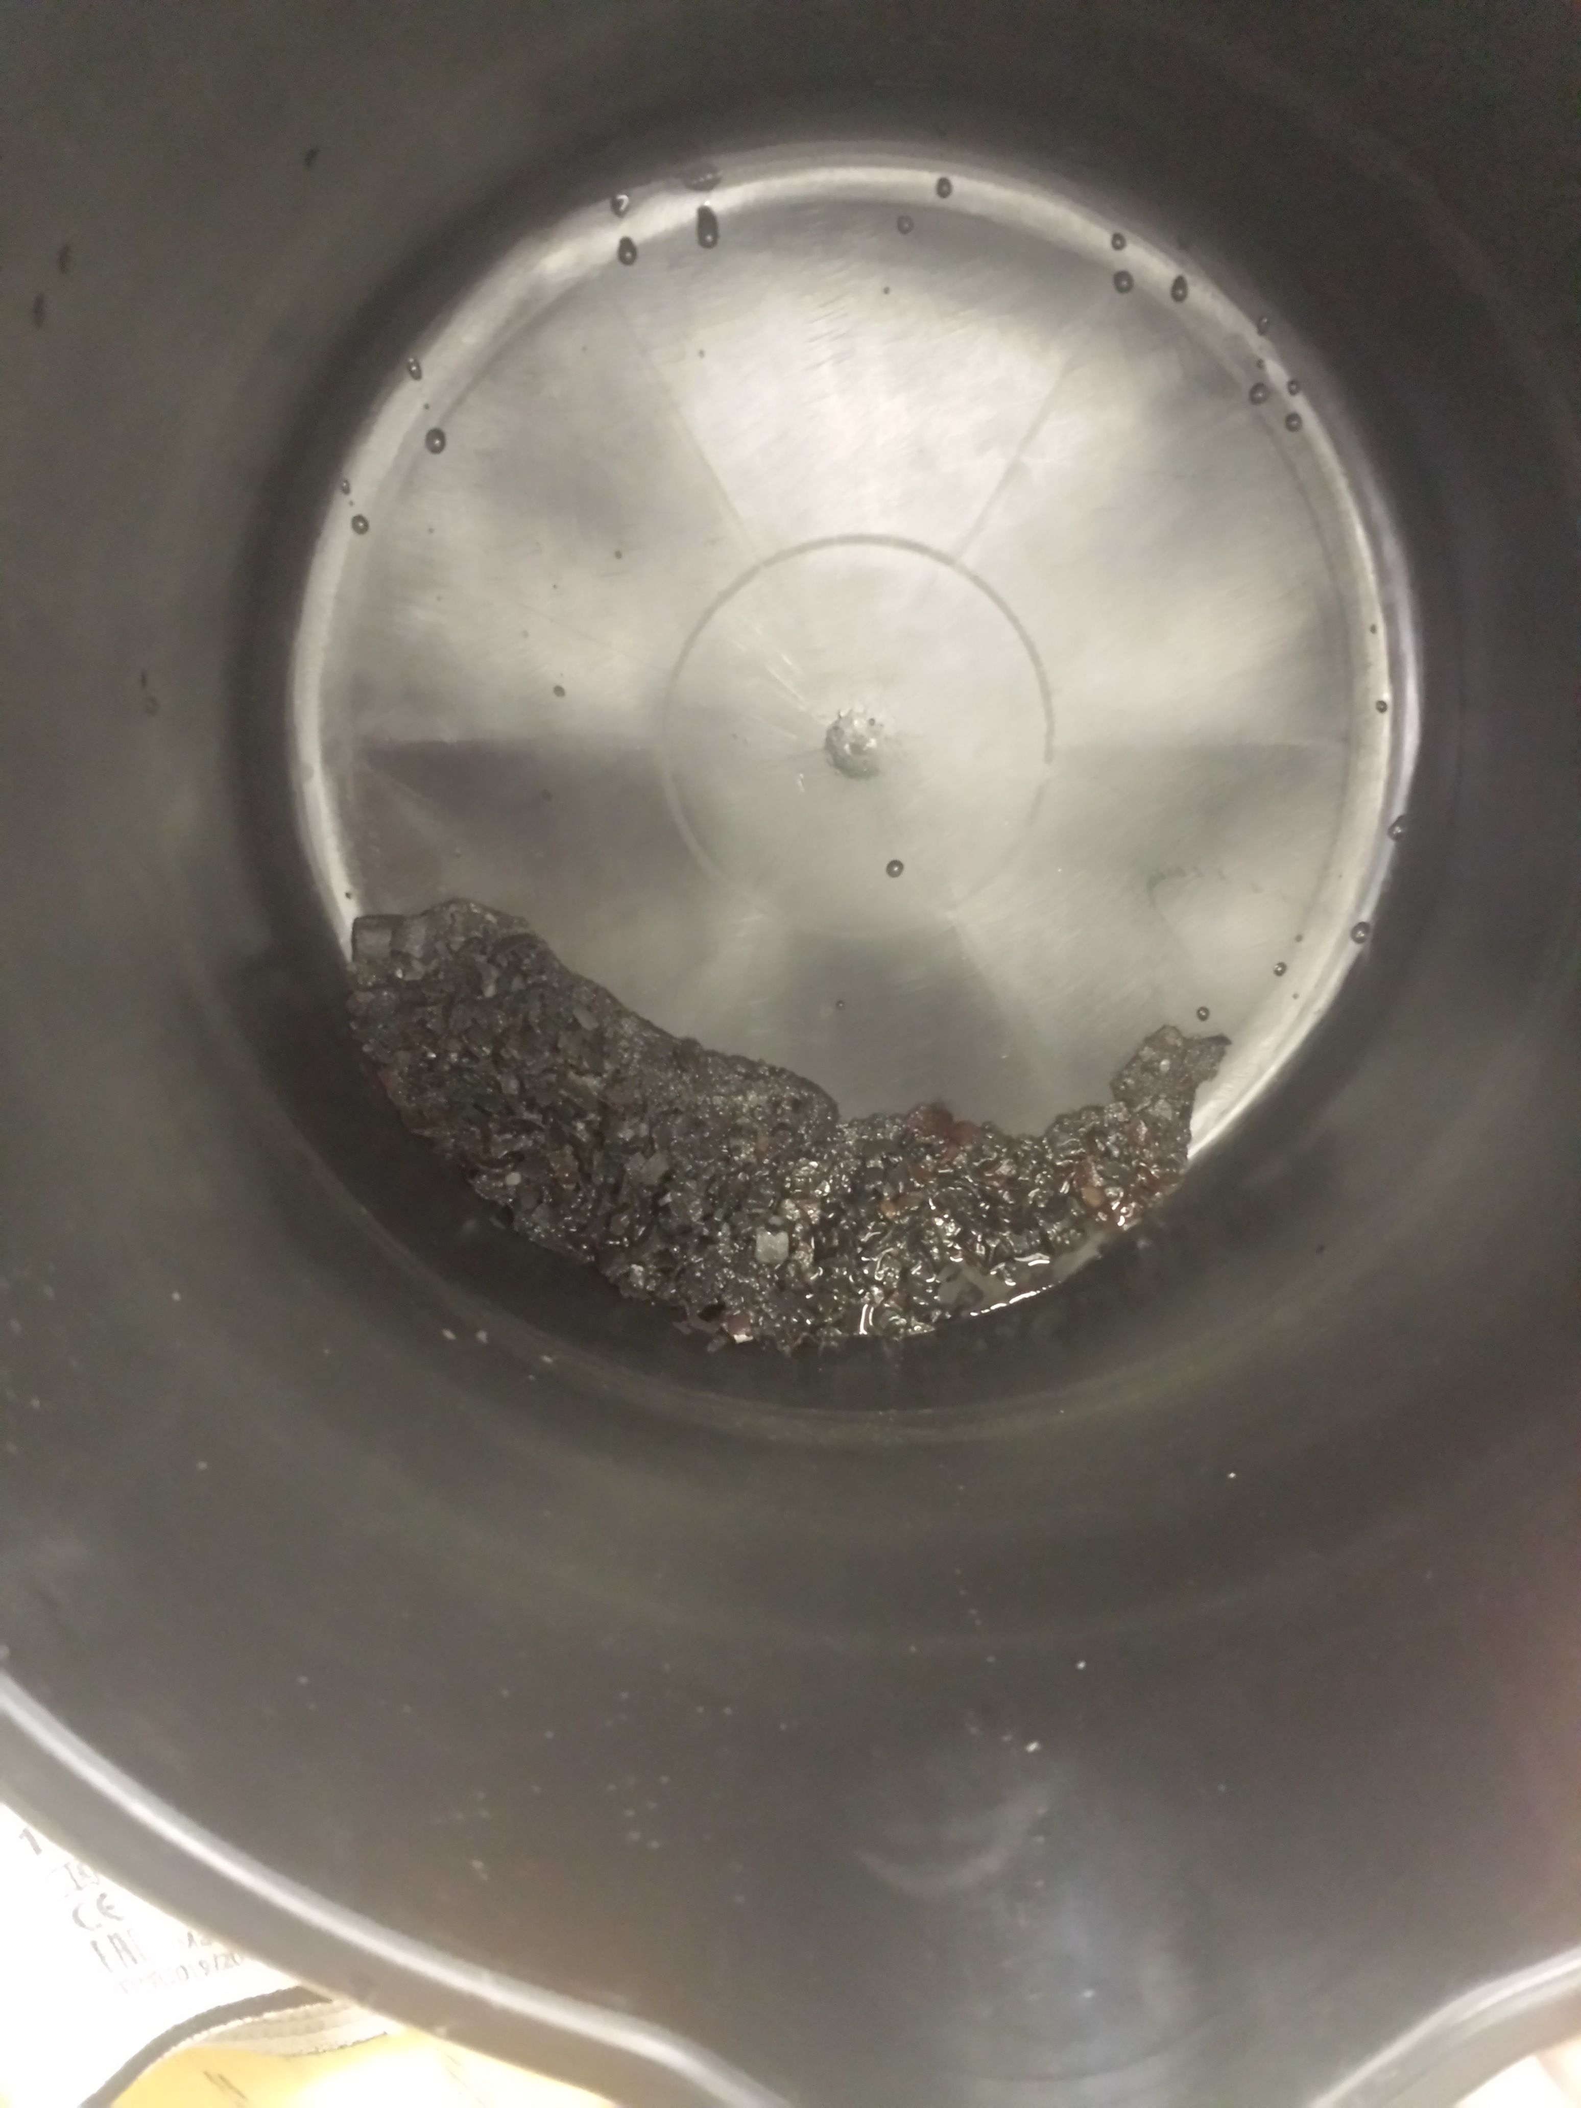
Unilac – 30.6.2020
Shutdown works.
Spare parts (A3DR8: Endplates re-machined, isolation improved, brazing+welding ongoing)
HLI RF loop: MEWE starts now.
TK4BB11: Ceiling TK opened, BB11 taken out, plunger leak located, RF loop brought to MEWE.
HSI-RFQ: cooling circuit rinsed, more water flow, tests starting now.
tunnel septum repair: ground short checked again, repair work started.

