Slide 1
Projektvorschlag Bunch Profile Measurement using Transition Radiation
Ansprechpartner
THM: A. Penirschke GSI/FAIR: R. Singh (M. Schwickert)

Slide 2
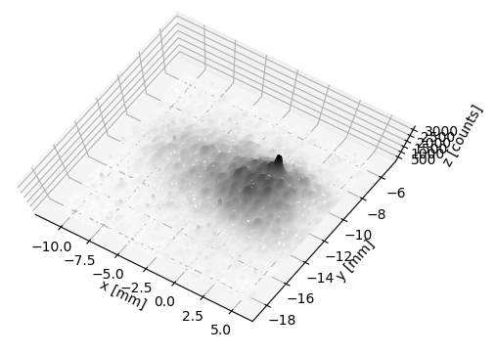
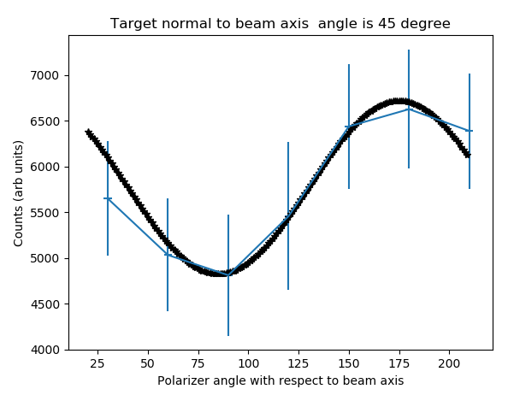
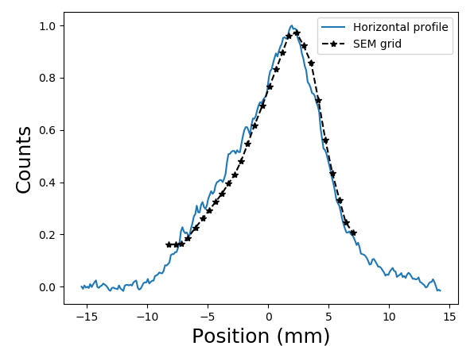
Optical transition radiation for transverse profile measurements (R. Singh, T. Reichert, B. Walasek-Hoehne)
2D image (Ar18+, ~100 uA for 100us pulse)
Comparison with SEM grid
Polarized photons
Polarized
Un-polarized
Measurements in range of 4 uA -1 mA currents, 6-11.4 MeV/u
→ Polarized transition radiation photons account for 35% of total measured photons
Un-polarized source (unrecognized) with upto 20 times more photons for shallow target angles
Both polarized and unpolarized photons are linear with incident beam current and profiles match well with the SEM grid
Metal „sieve“ based OTR monitor can be used for SEM grid (profile-gitter) like operation
$\frac{N_{ph,pol}}{N_{ions}}\sim {10}^{−6}∗{β^{2}Z}^{2}$
$$N_{ph,un−pol} \sim { 20 N}_{ph,pol}$$

Slide 3
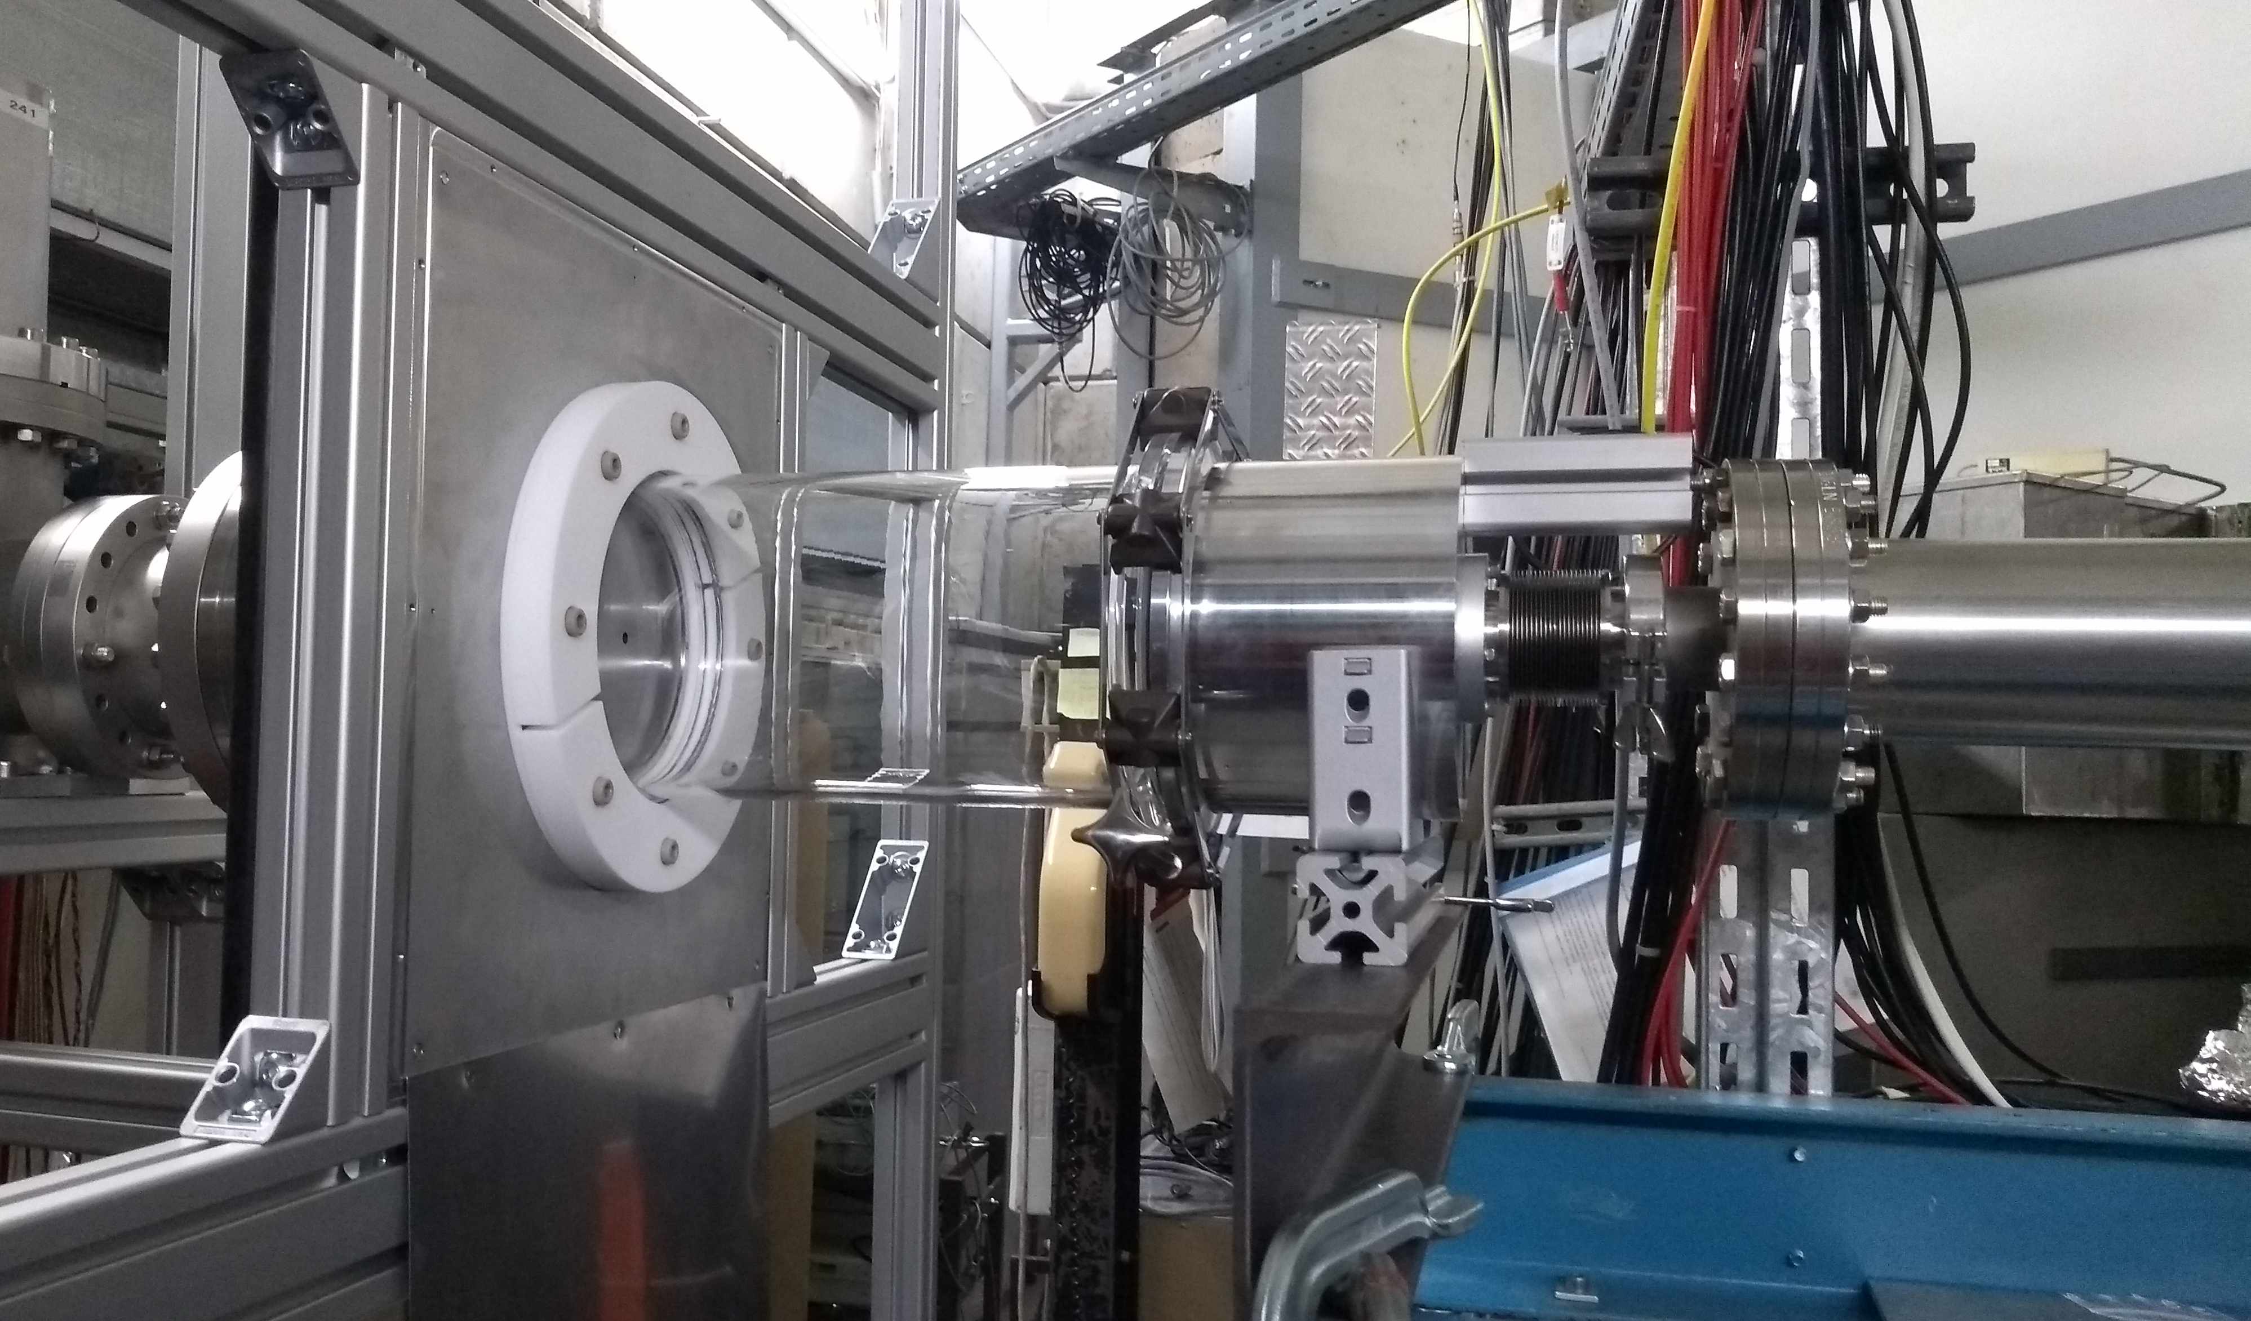
GHz transition radiation for longitudinal profile measurements (R. Singh, T. Reichert, B. Walasek-Hoehne)
Antenna
GTR
Beam
Target
with hole
Current state-of-the-art longitudinal profile measurement for non-relativistic beams are time-averaged
→ only one measurement over several macropulses
Our novel technique utlizes coherent GHz transition radiation along with broadband linear phase antennas for bunch-by-bunch longitudinal profile measurements
→ Possibility of non-destructive measurements
First demonstration with Bi²⁶⁺ beam with 600 uA current
Energy and bunch length variation along the macropulse is visible
The results are consistent with pick-up measurements

