Slide 1
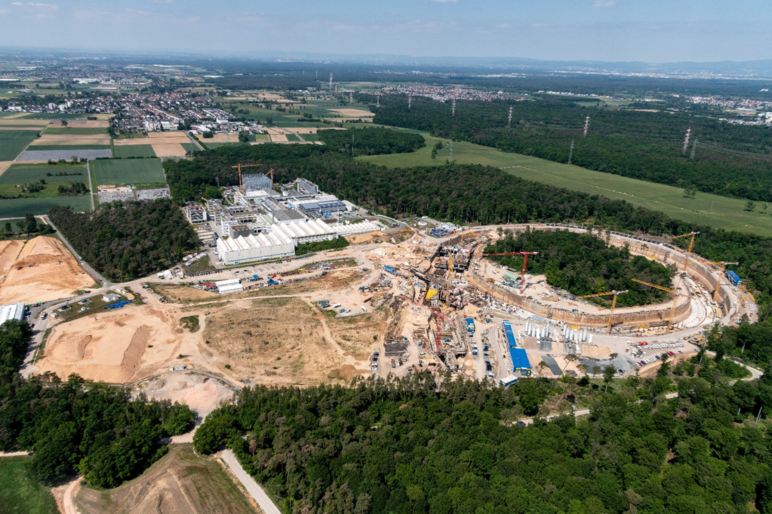


WP2 kick-off meeting
Overview CREMLIN+
history
scope
science communities/projects
WPs
consortium / management bodies
WP2 [NICA - FAIR]
(NICA (BM@N-MPD) – FAIR(CBM))
tasks
particpants
recruitments of personnel
milestones and deliverables
workplan and future meetings
Jürgen Eschke, FAIR GmbH, 01.07.2020

Slide 2

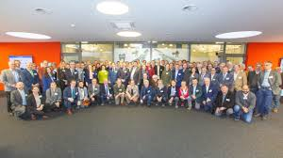
History of EU projects dedicated to European Russian cooperation for Large-scale Research Infrastructures

Slide 3
Scope: Science cooperation between European Research Infrastructures and
the following

Slide 5
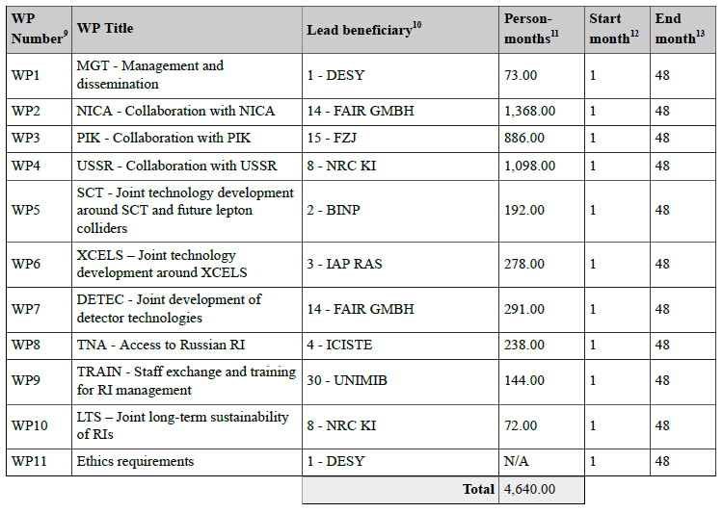
Workpackages

Slide 6
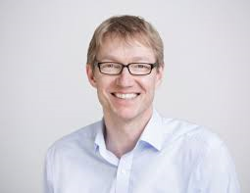


Coordinator:
Martin Sandhop, DESY
(chair: Jürgen Eschke)
3.7.

Slide 7


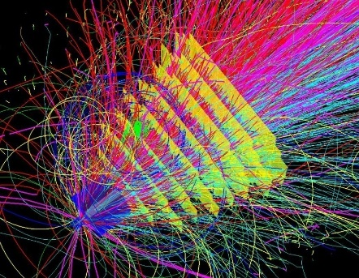
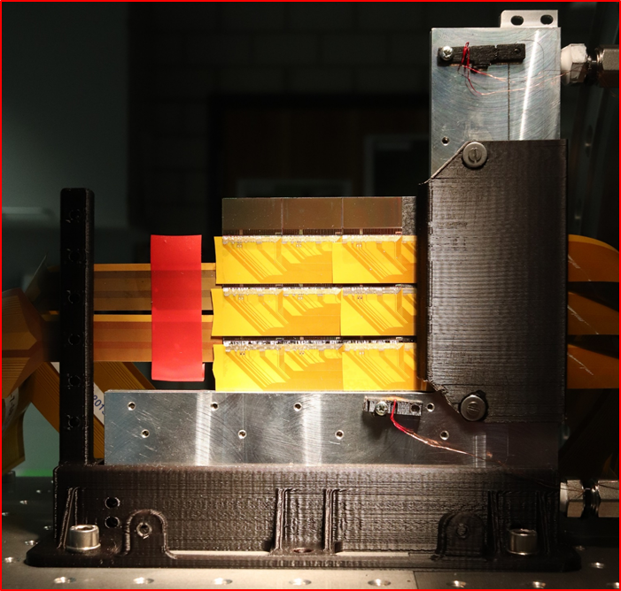
EU project CREMLINplus
Science Cooperation between European Research Infrastructures and the
Russian megascience projects (NICA, PIK, USSR, SCT and EXCELS)
Proposal approved: 4-year-project – starting 1.2.2020, Total Budget: 25 M€
Consortium: 35 participants from 12 countries - 25 European laboratories 10 Russian laboratories
10 working packages (WPs), GSI/FAIR and JINR involvement in WP2 and WP7
WP2: Collaboration with NICA - Development of instrumentation for NICA and FAIR/CBM (WP leader: J. Eschke)
Engineering and construction of fast detectors,
Development of high rate data acquisition chain and software packages for simulation and data analysis, PSD, beam pipe design
Budget 4.61 M€
Participants: JINR (9 FTE), FAIR (8.3 FTE), U Tübingen (1 FTE), WUT Warsaw (2 FTE), Wigner Budapest (2 FTE), MEPhI (4 FTE),
INR Moscow (1 FTE), NPI Prague (2 FTE)
WP7: Joint development of detector technologies
Develop a beyond state of the art CMOS pixel sensors (MAPS) for high-rate Silicon trackers for several particle physics and heavy-ion research communities in Europe and Russia for the potential upgrade of many experimental setups (WP leader: C. Schmidt)
Development of neutron detectors, detector school at BINP
Budget 1.8 M€ (~1.0 M€ for MAPS (CBM Institutes only)
Participants: JINR (0,75 FTE), FAIR (0,8 FTE), DESY (0,52 FTE), U Frankfurt ( 0,75 FTE), IPHC Strasbourg (1 FTE), KINR Kiev (0,75 FTE), ESS (0,75 FTE), PNPI (0,38 FTE), JINR (0,38 FTE), BINP

Slide 8
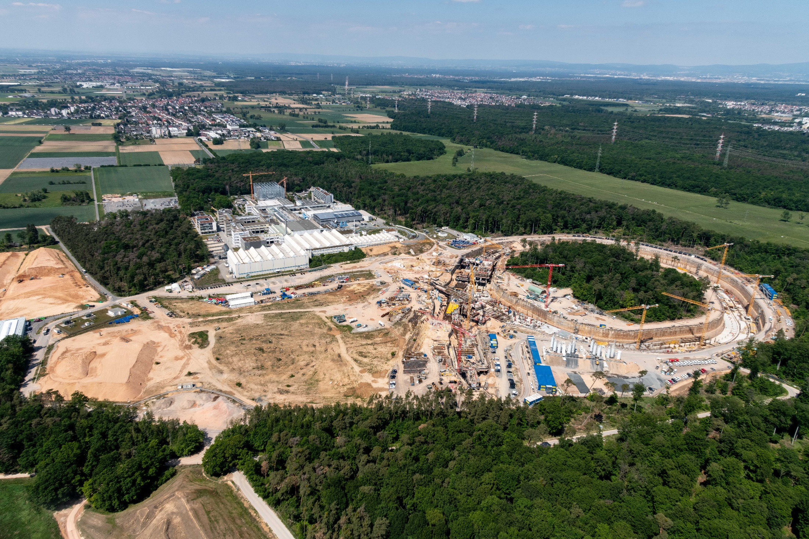
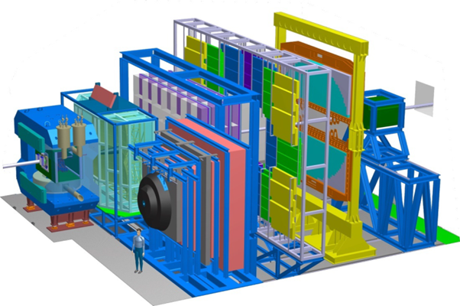
CREMLINplus EU project
WP2 – NICA Ion collider facility
and joint developments for NICA and FAIR
NICA construction site
CBM Cave
Compressed Baryonic Matter
experiment (CBM)
FAIR construction site
8

Slide 9

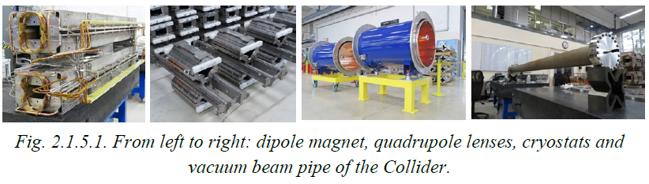
NICA construction site 2019
Booster dipole magnet
inside the cryostat
RF3 resonator
9

Slide 10
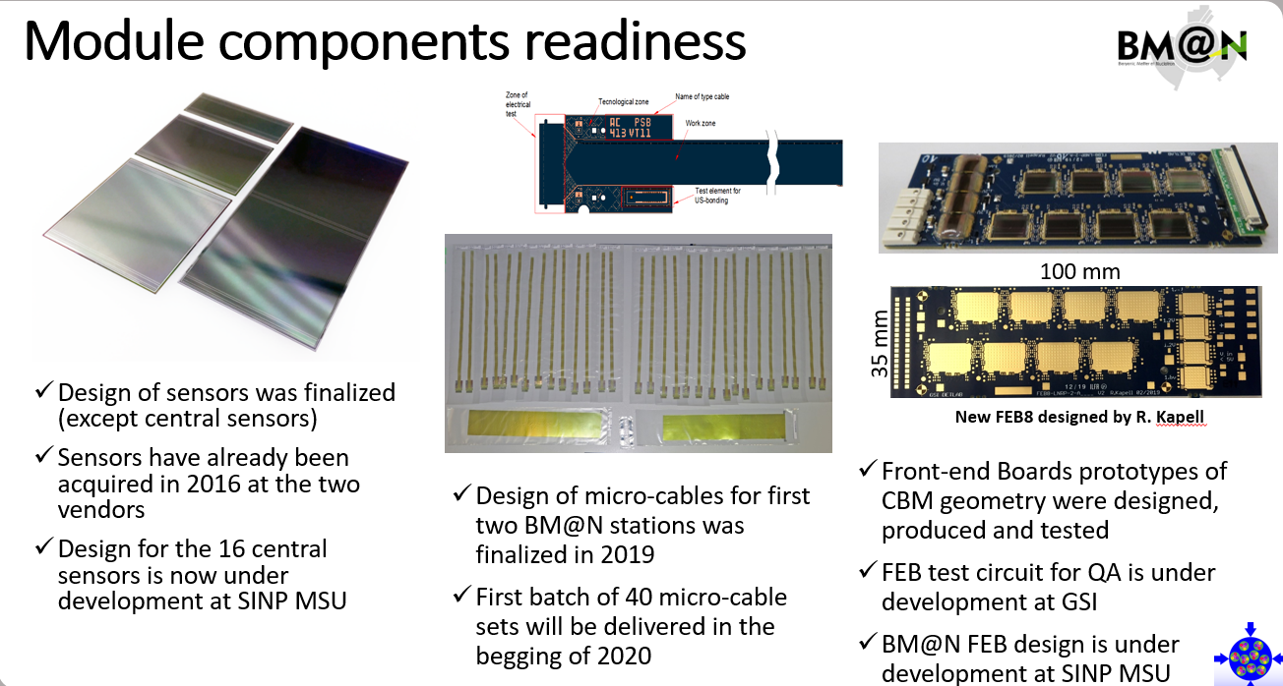
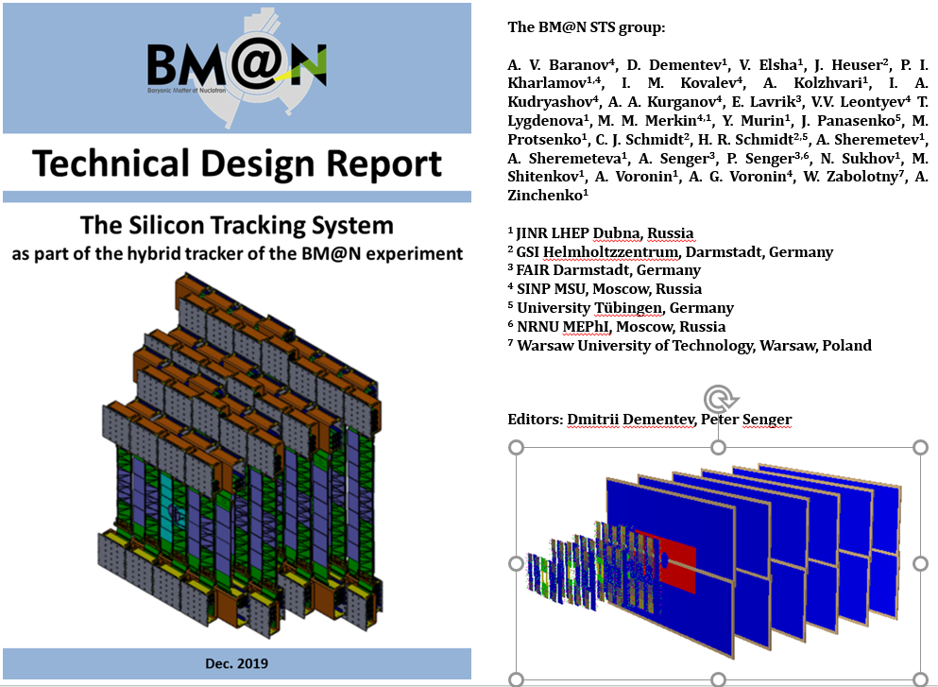

BM@N experiment
Multi Purpose Detector (MPD)
The complete assembly of the MPD solenoid has been finished in September 2019
10

Slide 11
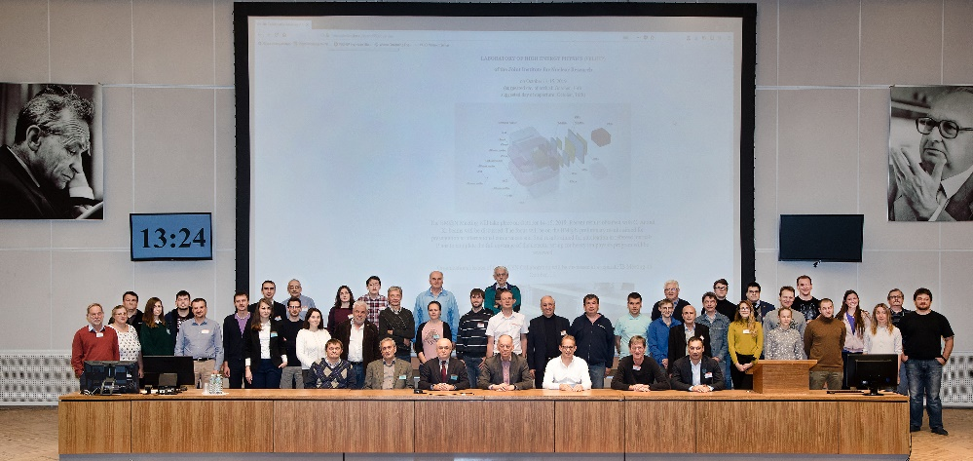
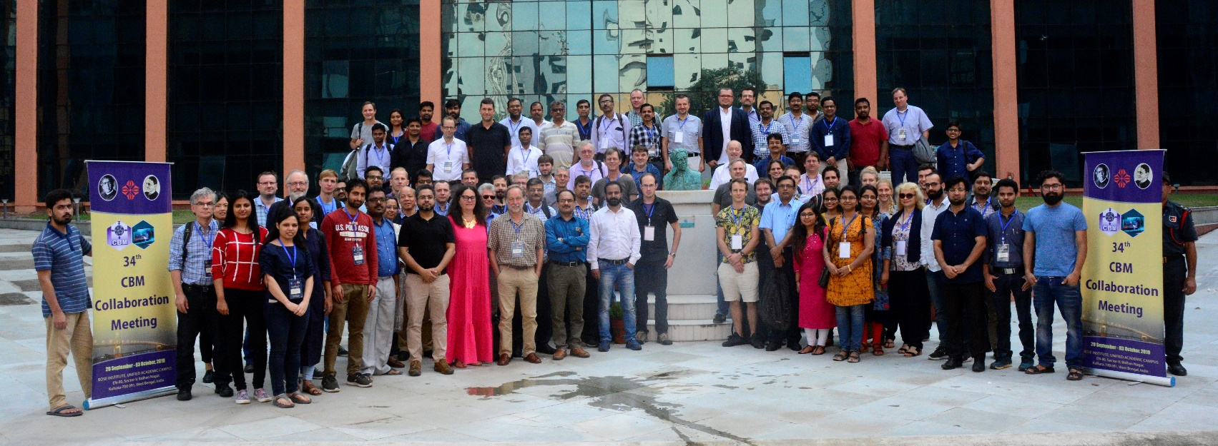
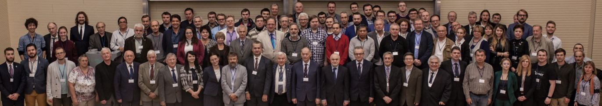
Synergies between NICA experiments (BM@N, MPD)
and CBM experiment at FAIR
4th Collaboration Meeting (Dubna, October 2019)
of the BM@N Experiment at the NICA Facility
Synergies in:
Detector development
Front End Electronics, DAQ and Computing
Physics Performance Studies and Data Analysis
34th CBM Collaboration Meeting, Kolkata, October 2019
NICA Days and 4th MPD collaboration meeting, Warsaw, October 2019
J. Eschke, CREMLINplus kick off, 19 February 2020, DESY, Hamburg
11

Slide 12
CREMLINplus WP2:NICA-FAIR/CBM WP Leader: Jürgen Eschke (FAIR), Deputy WP Leader: Yuri Murin(JINR) | FAIR 7,5 FTE over 48 months (360 PM) | JINR 9 FTE over 48months (432 PM) | EKUT Tübingen 1 FTE (48 PM) | WUT Warsaw 2 FTE (96 PM) | Mephi Moscow 4 FTE (192 PM | Wigner Budapest 2 FTE (96 PM) | NPI Rez 2 FTE (96 PM) | INR Moscow 1 FTE (48 PM
Task 2.1: Integration, installation, and test of Silicon trackers for NICA and CBM (FAIR, JINR, EKUT) (Taskleader: Johann Heuser, GSI) | 2 | 4 | 1
Task 2.2: Developments for the data acquisition chain, for data preprocessing and computing (WUT, FAIR, JINR) (Taskleader: Wojtek Zabolotny, WUT) | 2 | 2 |  | 2
Task 2.3: Development of common software packages for simulation and data analysis, participation in physics performance studies(MEPhI, FAIR, JINR, Wigner RCP) (Taskleader: Arkadiy Taranenko,MEPHI, deputy taskleader Ilya Selyuzhenkov, GSI) | 2 | 2 |  |  | 4 | 2
Task 2.4: Development and construction of beam monitors, target chamber and beam pipe for NICA and CBM (FAIR, JINR) (Taskleader: Peter Senger, FAIR) | 1 | 1
Task 2.5: Development and construction of Zero Degree Calorimeters for NICA and CBM (INR RAS, NPI CAS) (Taskleader: Fedor Guber, INR) |  |  |  |  |  |  | 2 | 1
Coordination of joint activities | 0.5

Slide 13
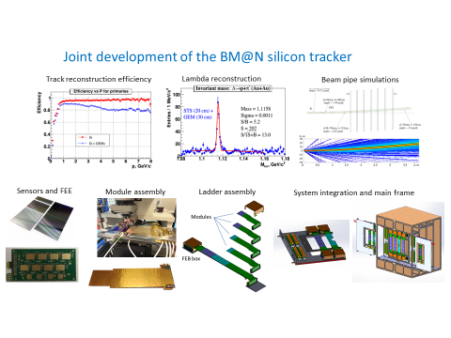
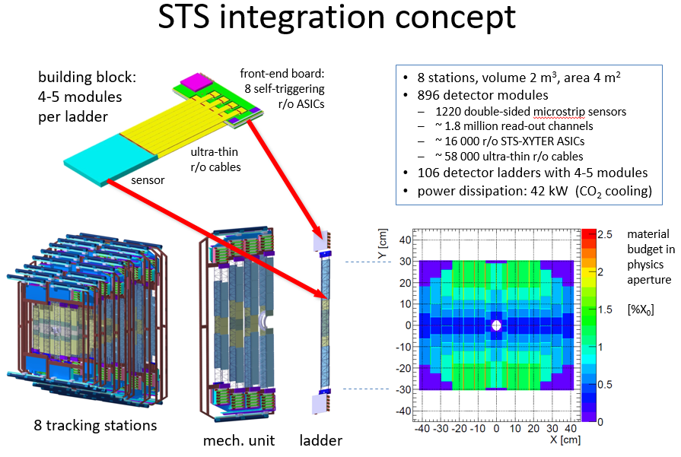
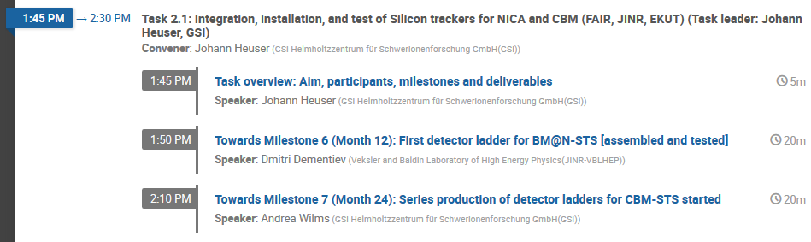
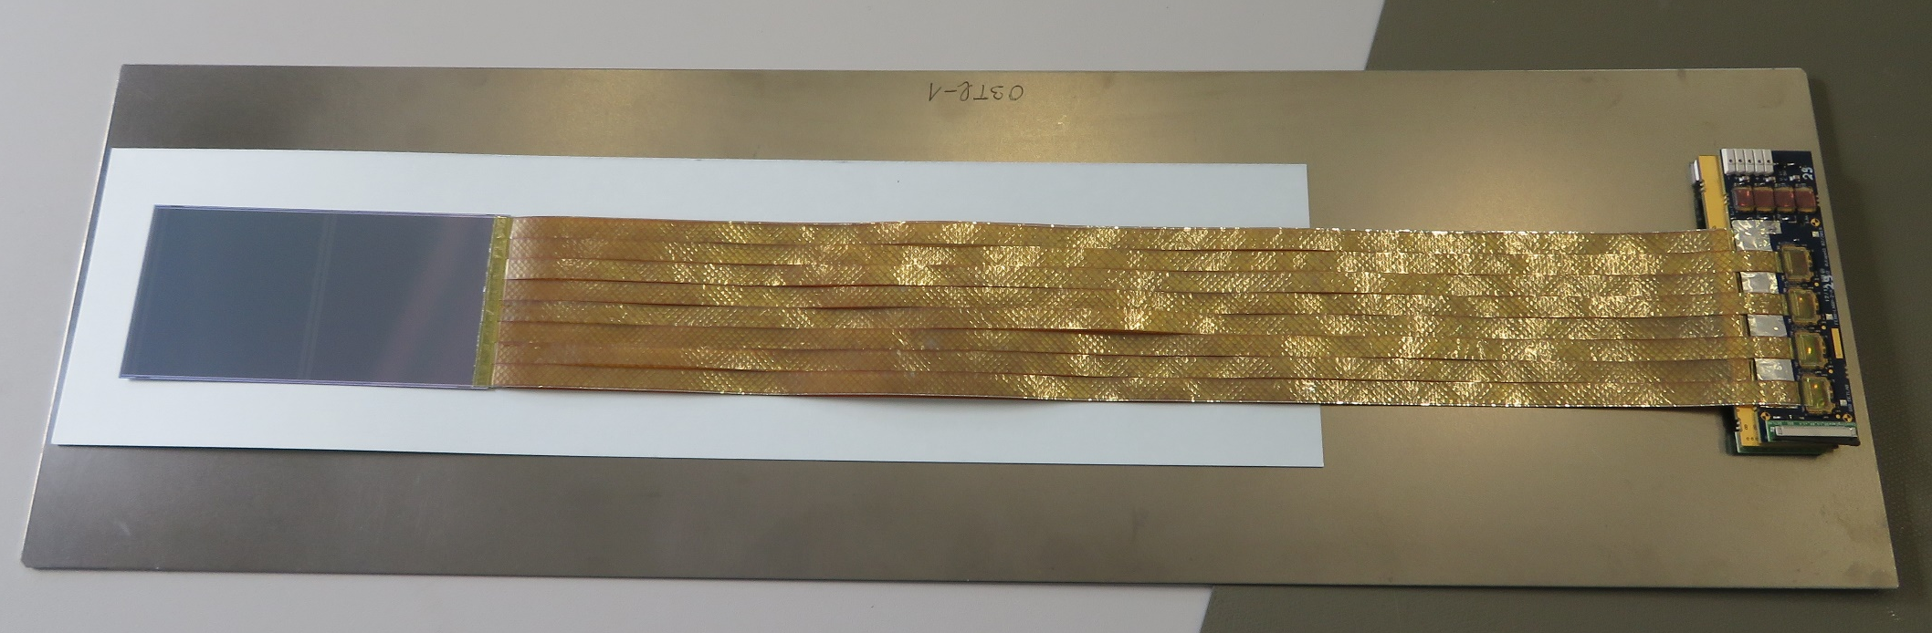
CREMLINplus WP2- NICA - FAIR
Task 2.1: Integration, installation, and test of Silicon trackers for NICA and CBM
(FAIR, JINR, EKUT)
Module Assembly
13

Slide 14
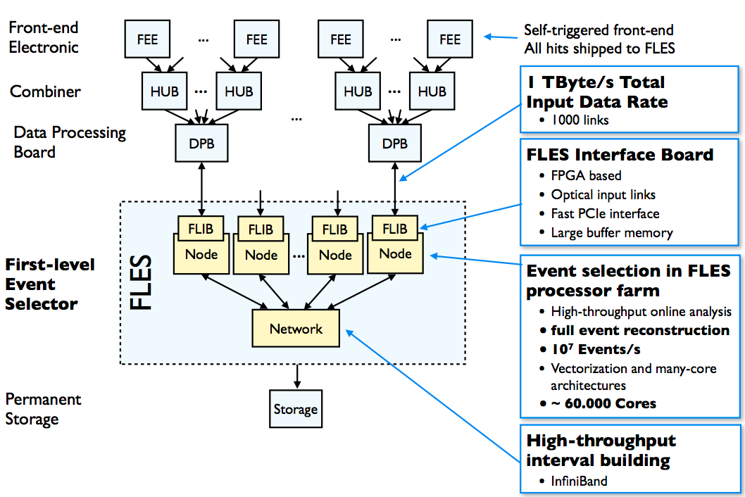
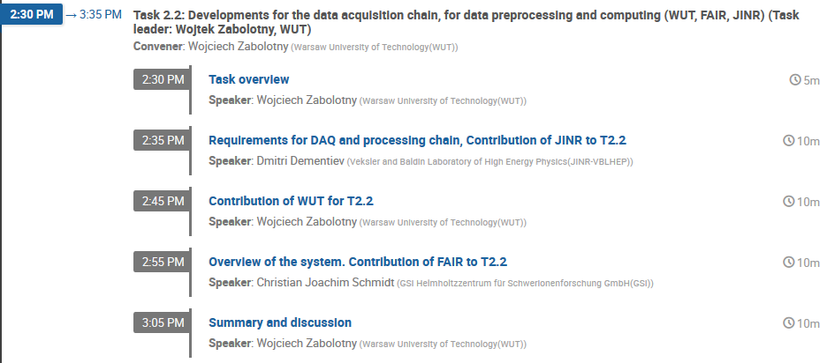
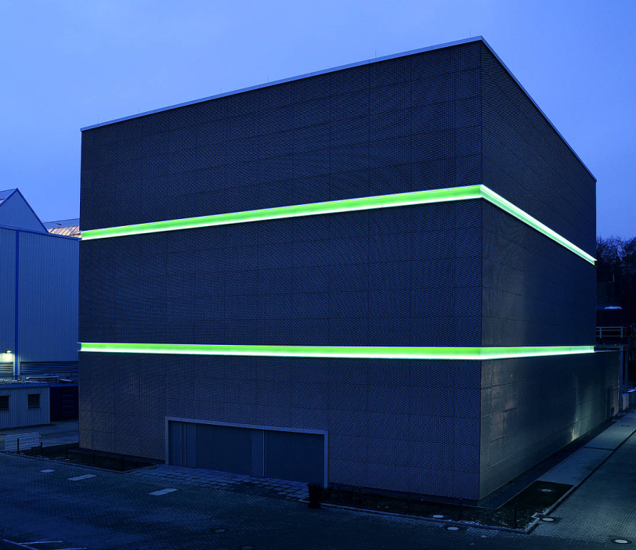
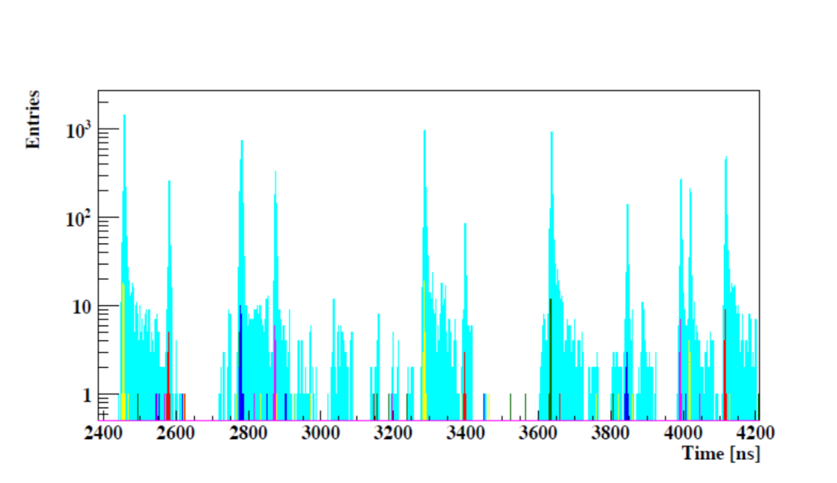
DAQ and online event selection
CREMLINplus WP2- NICA - FAIR
Task 2.2: Developments for the data acquisition chain, for data preprocessing and computing (WUT, FAIR, JINR)
1 TByte/s Total
Input Data rate
Novel readout system:
no hardware trigger on events
detector hits with time stamps
full online 4-D track and event reconstruction.
full event reconstr.
10⁷ events/s
GSI Green IT Cube
First-level Event Selector
Hit and track time distribution for Au+Au 10A GeV collisions at 10 MHz (UrQMD)
high rack storage, 100,000 cores
only 5% of total energy consumption needed for cooling
14

Slide 15
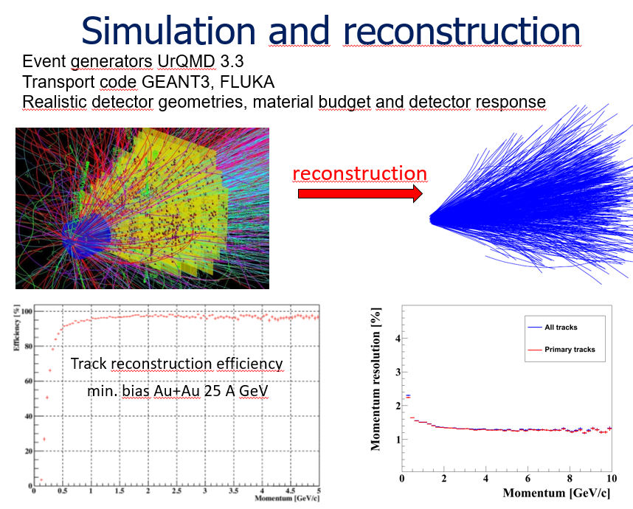
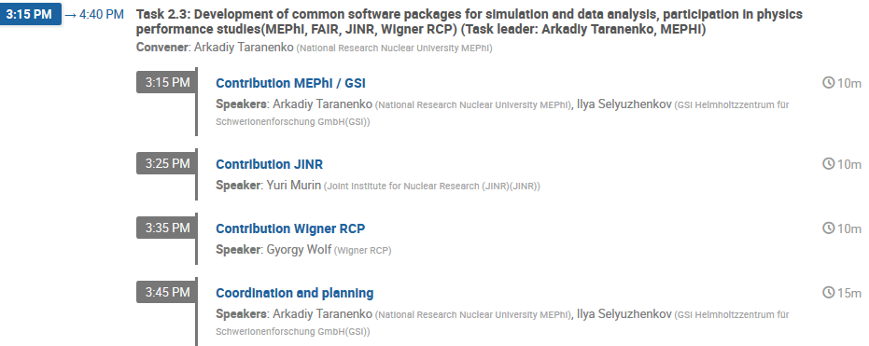
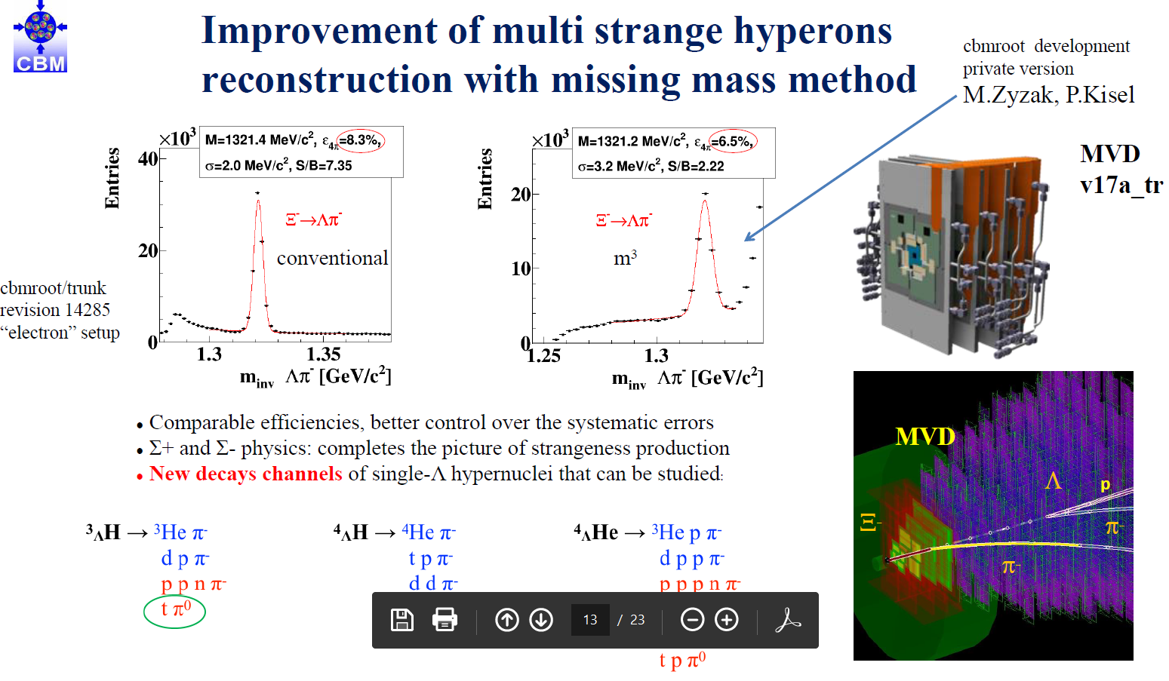
CREMLINplus WP2- NICA - FAIR
Task 2.3: Development of common software packages for simulation and data analysis, participation in physics performance studies (MEPhI, FAIR, JINR, Wigner RCP,)
15

Slide 16
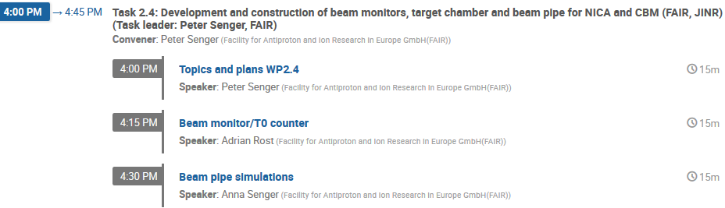
CREMLINplus WP2- NICA - FAIR
Task 2.4: Development and construction of beam monitors, target chamber and beam pipe for NICA and CBM (FAIR, JINR)
16

Slide 17
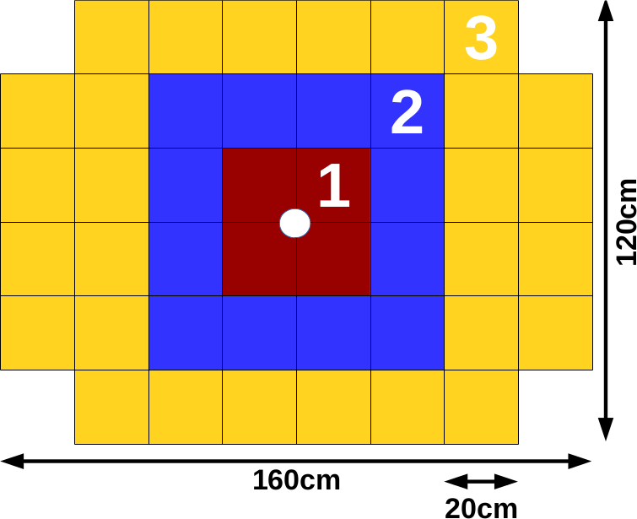
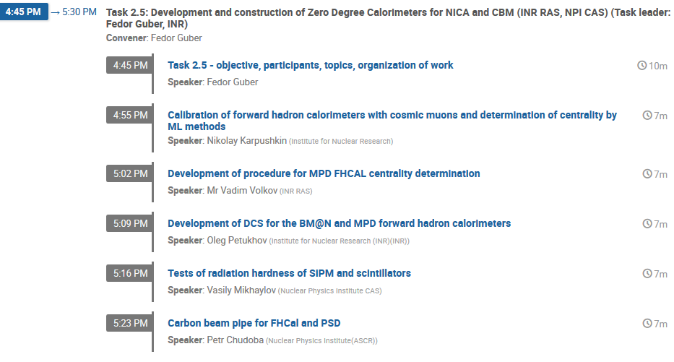
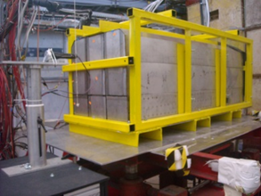
CREMLINplus WP2- NICA - FAIR
Task 2.5: Development and construction of Zero Degree Calorimeters for NICA and CBM (INR RAS, NPI CAS)
PSD – Projectile Spectator Detector.
This forward hadron calorimeter will be used at the CBM
to measure centrality of interaction and reaction plane orientation.
Supermodule
BM@N Zero Degree Calorimeter
СВМ PSD supermodule tests at CERN T9/T10
17

Slide 18
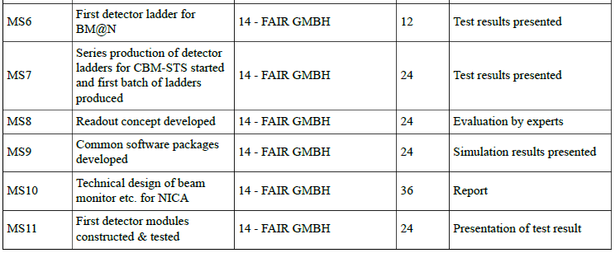
CREMLINplus WP2- NICA - FAIR
Milestones
month
18

Slide 19
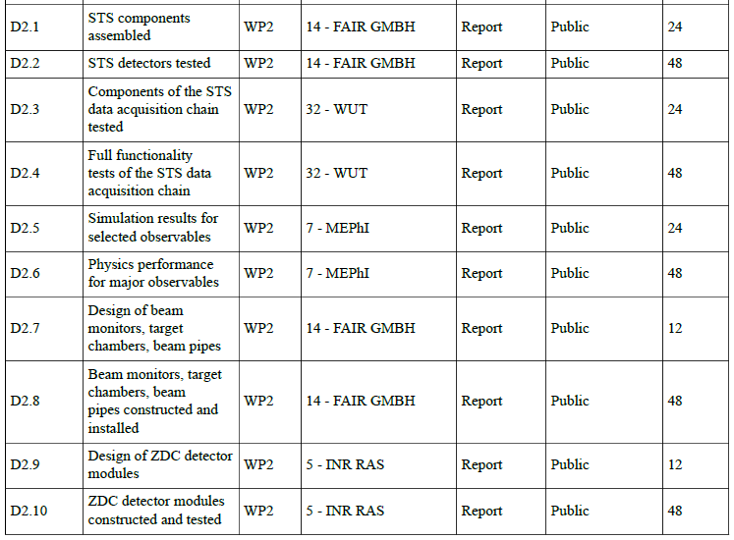
CREMLINplus WP2- NICA - FAIR
Deliverables
month

Slide 20
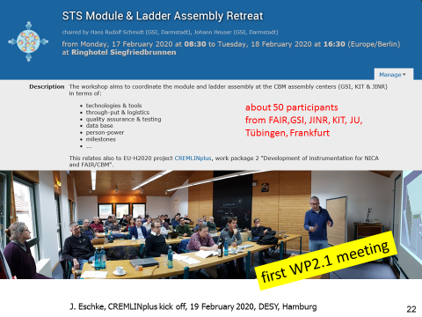
CREMLINplus WP2- NICA - FAIR
Aim of the WP2 kick off meeting
status organization of work within each task between the participating institutes and persons
status recruitment of additional personnel in each institution
  --> involving additional person in the work in each task
strategy for reaching the milestones and deliverable
mitigating actions taken to deal with potential delay caused by the corona pandemic
organization of task meetings (example first WP2.1 meeting)

Slide 21
CREMLINplus WP2- NICA - FAIR
status recruitment at FAIR GmbH
Name | EU Auftrag FAIR GmbH in PROZ
Müller, Walter F. J., Dr. (30%) | 471009 EU-H2020:871072-CREMLINplus-WP2.1
Senger, Anna, Dr. | 471009 EU-H2020:871072-CREMLINplus-WP2.1
Senger, Peter, Prof. Dr. | 471010 EU-H2020:871072-CREMLINplus-WP2.2
Loizeau, Alain-Pierre | 471010 EU-H2020:871072-CREMLINplus-WP2.2
Dominik Smith | 471011 EU-H2020:871072-CREMLINplus-WP2.3
Eoin Clerkin | 471011 EU-H2020:871072-CREMLINplus-WP2.3
Schünemann, Kerstin | 471009 EU-H2020:871072-CREMLINplus-WP2.1
Kuhl, Peter | 471009 EU-H2020:871072-CREMLINplus-WP2.1
Rost, Adrian | 471012 EU-H2020:871072-CREMLINplus-WP2.4
Klochkov, Viktor | 471009 EU-H2020:871072-CREMLINplus-WP2.1

Slide 22
WP2: Collaboration with NICA - Development of instrumentation for NICA and FAIR/CBM
Engineering and construction of fast detectors,
Development of high rate data acquisition chain and software packages for simulation and data analysis, PSD, beam pipe design
WP7: Joint development of detector technologies
Develop a beyond state of the art CMOS pixel sensors (MAPS) for high-rate Silicon trackers for several particle physics and heavy-ion research communities in Europe and Russia for the potential upgrade of many experimental setups
Development of
neutron detectors,
detector school at BINP
WP9 TRAIN - Staff exchange
and training for RI management
Organisation annual summer schools attracting young scientists …
additional fellowships for students from all of Europe and Russia.
detector school at BINP

Slide 23
CBM cave November 2019
Thank you for your attention
47

