Slide 1


Development of
Detector Control System (DCS)
for BM@N and MPD Forward Hadron Calorimeters
Oleg Petukhov, INR RAS
CREMLIN+ kick-off meeting 01.07.2020

Slide 2
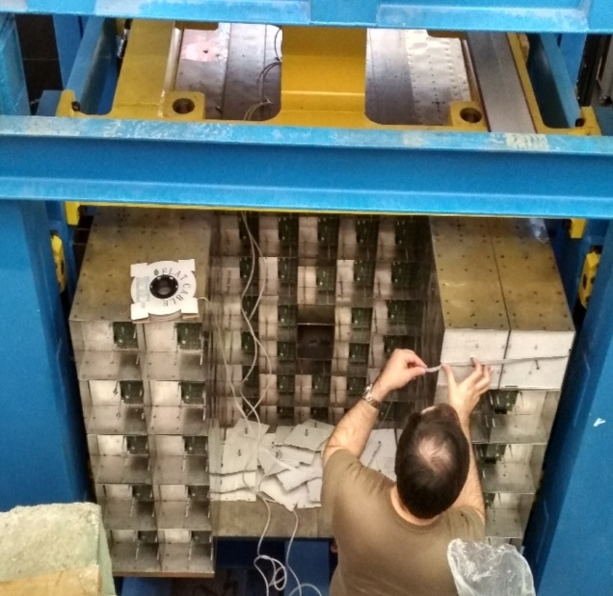
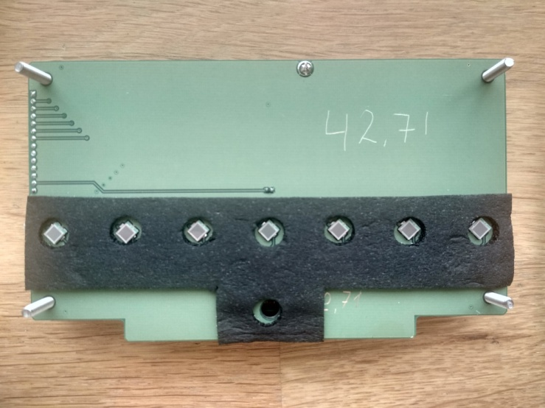
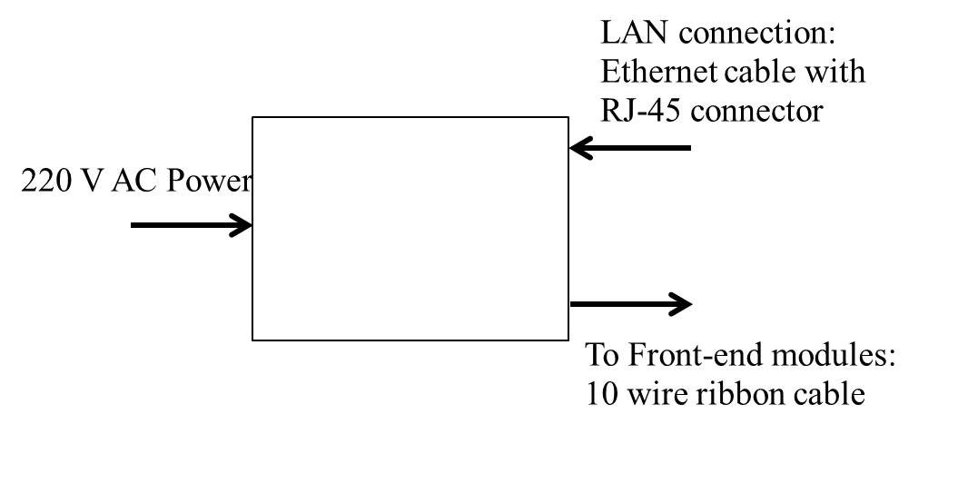
BM@N FHCal
Status
Hardware
FHCal assembly
FHCal fully assembled
Calorimeter modules
FEE, ADC boards, cabling
Key features
Control of HV at photodetectors (MPPC);
Temperature control of photodetectors;
Correction of temperature drift of MPPC;
Monitoring of MPPC gain with stabilized (LED) light source.
FEE
System Module
2

Slide 3
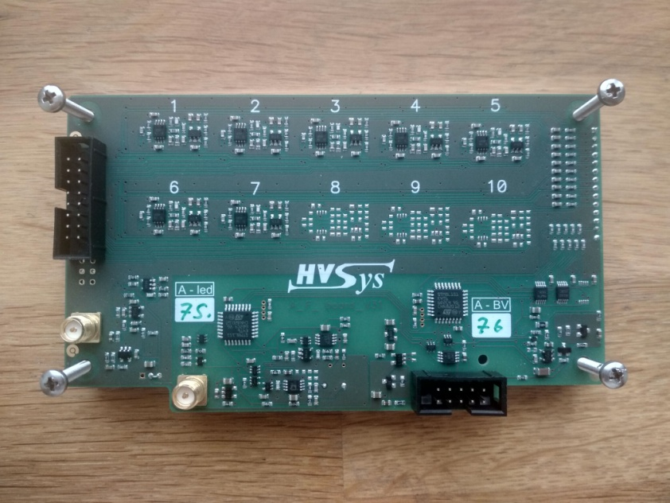
Hardware
FHcal FEE including:
  HV controller
    Status
    Set / meas voltage (7-10 channels)
    Set / meas pedestal voltage
    Ramp time, ramp status
    Voltage calibration min / max
    Temperature
  LED controller
    Status
    Frequency
    Amplitude
    Autoregulation on/off, ADC setpoint, number of measurements

Slide 4
DCS System Requirements
Works over LAN/serial connection to HVsys devices
  System module for FEE
  LED pulse generator
  Power supplies
Non-blocking interaction with multiple devices (we need 2 for MPD)
HV, LED, temperature correction, alerts
+ diagnostic mode (read/write all FEE registers)
Acts as a proxy for experiment-wide DCS (Tango)
Backward compatible with “legacy” Slow Control configuration files
NICA
Slow Control
New DCS
(proxy)
System Module
FEE
FEE
FEE
System Module
FEE
Database
FEE
FEE

Slide 5
Plans
Summer 2020: DCS Software development
End 2020: BM@N Cosmics calibration (need fully functioning DCS)
2021: FHCal DCS for MPD experiment

Slide 6

Thank you!

