Slide 1


Task 2.2 – WUT contribution
Developments for the data acquisition chain, for data preprocessing and computing
Wojciech M. Zabolotny
Warsaw University of Technology (WUT)

Slide 2
What WUT will contribute
Allocated resources: 2xFTE
  Hiring process completed on 15.05.2015 – 2 persons employed for ¾ FTE (Marek Guminski – with 5 years experience in cooperation with GSI, Piotr Miedzik – with previous experience in working at GSI)
  Additional support from staff not hired for the project (ca. 3 * ¼ FTE)
Main involvement:
  FPGA FW development + low level supporting software development
  Testing of the HW with developped FW+SW
  Consulting regarding the readout architecture
Additional involvement
  Consulting regarding the HW design
  Consulting regarding the SW implementation

Slide 3
Background
Our team is involved in preparation of solutions for CBM for a long time
  First contacts in 2008
  In 2010 first cores developed with CBM in mind (e.g. heap sorting in FPGA – published in 2011)
  Since 2012 we are the members of collaboration
  Since 2014 the serious development of FW (initially also HW) for CBM started.

Slide 4
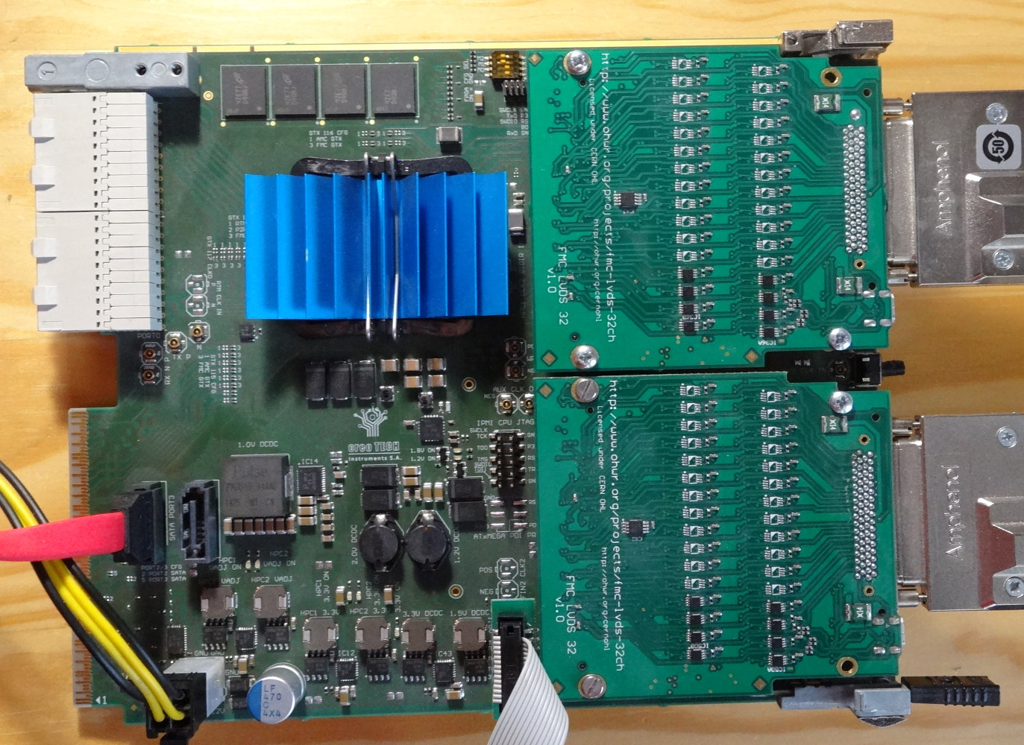
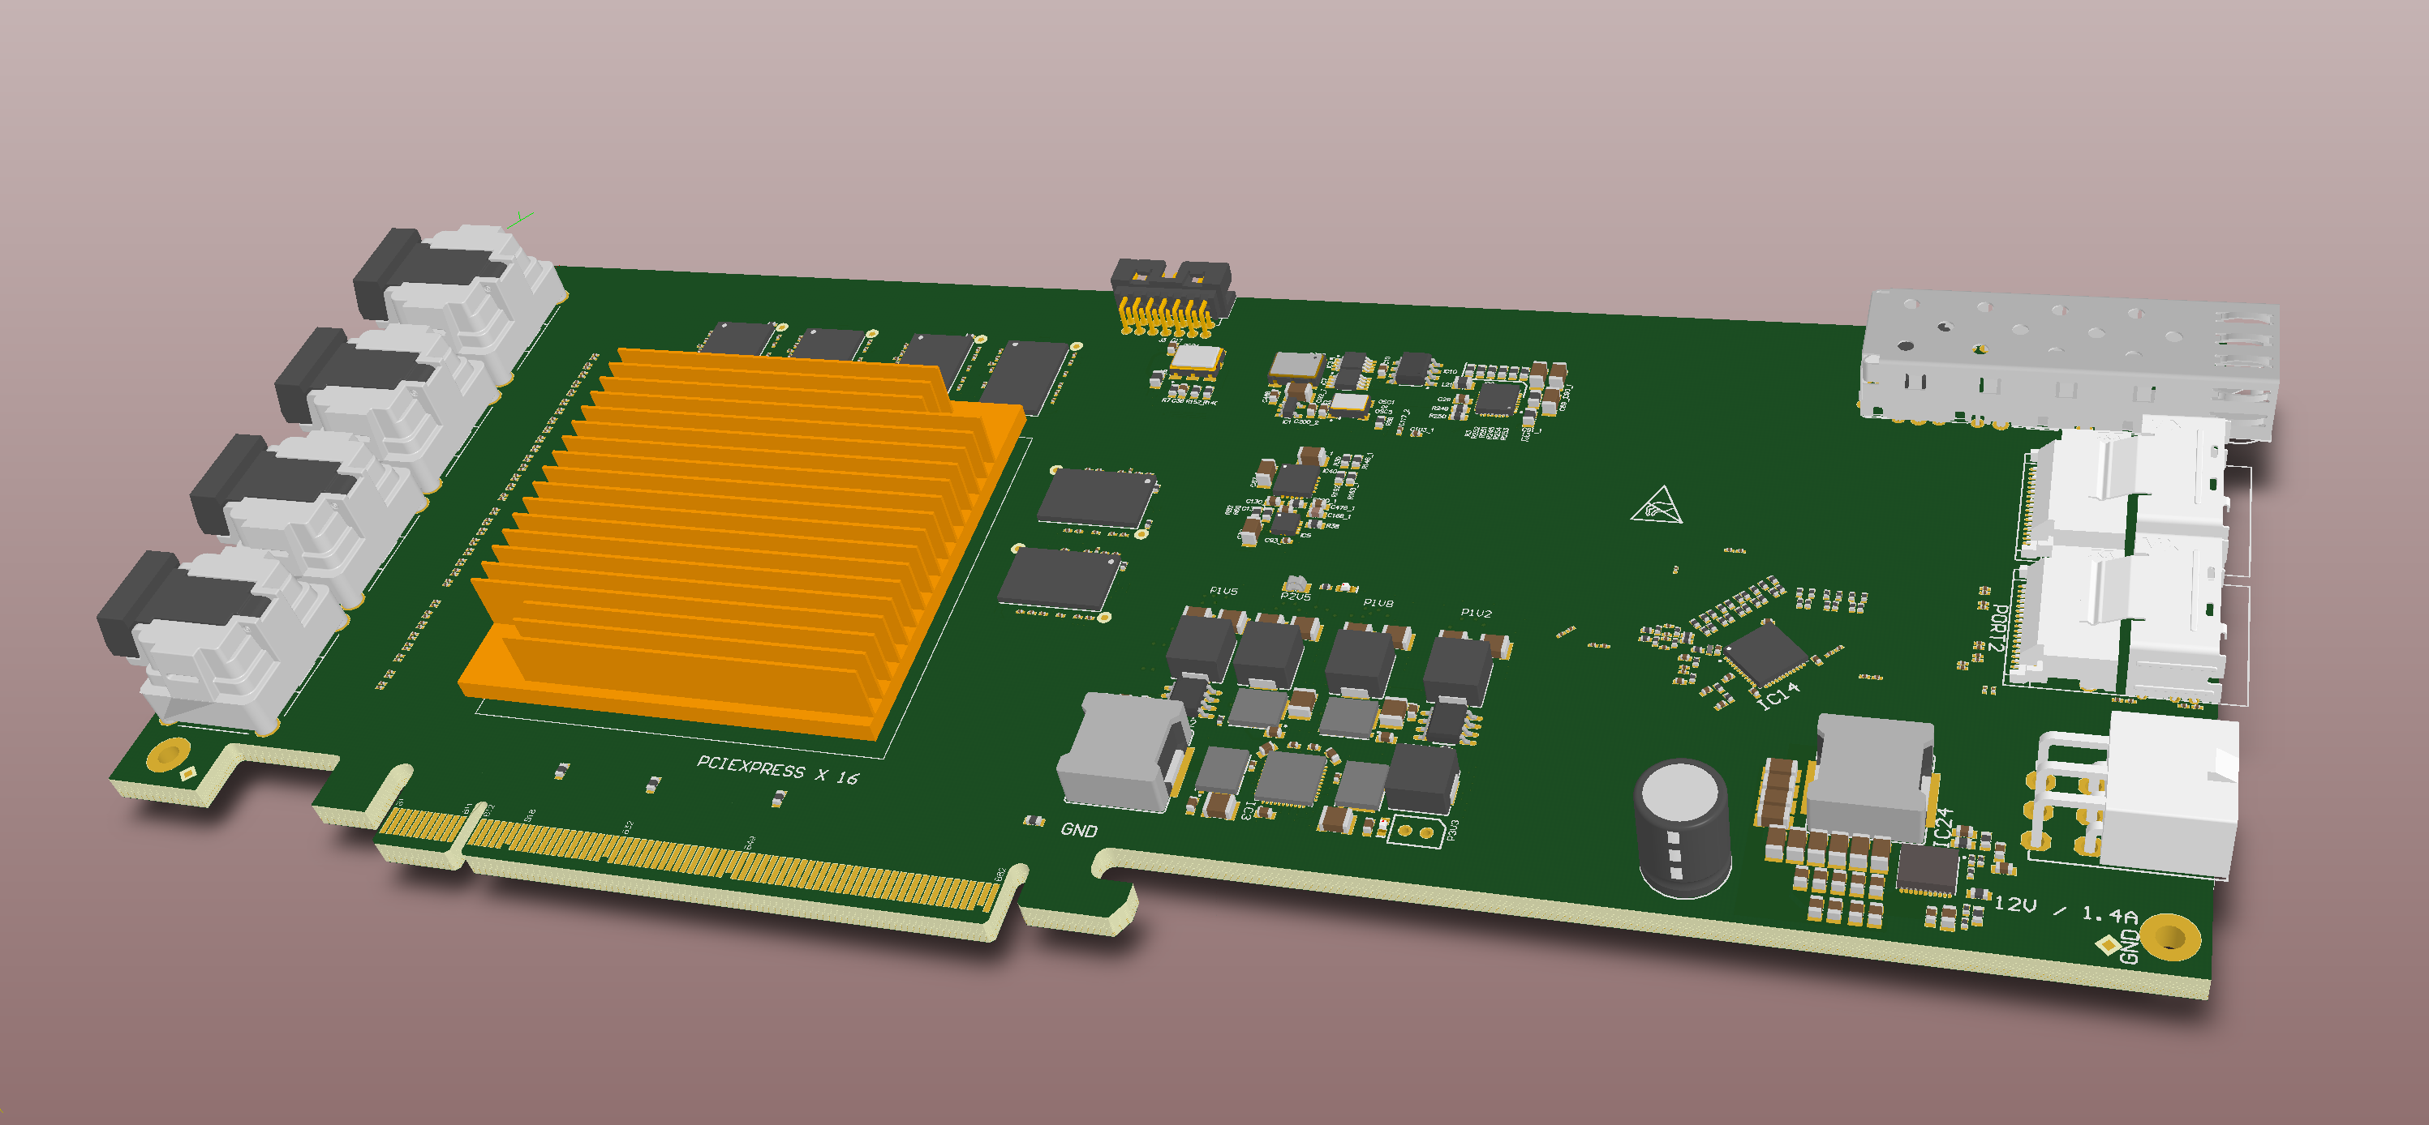
HW development
The AFCK board used for DPB prototyping was developed at WUT and manufactured by Creotech
Also the proposal of an enhanced version to be used as CRI was created in 2017, but was dropped in favor of using an already existing and tested solution

Slide 5
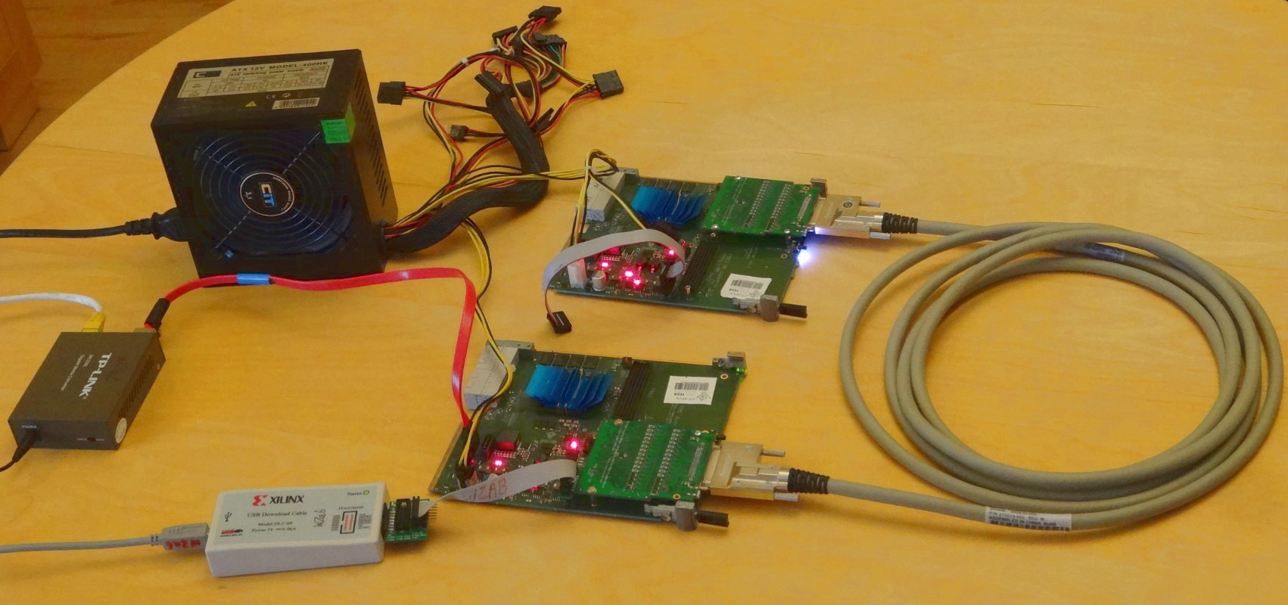
FW development
We have participated in development of the STS-XYTER (SMX) communication protocol
Various FW blocks were developed in that process
  The SMX model in FPGA
  The SMX controller
  The SMX protocol tester
  Low level control and communication software
Those solutions will be reused for BM@N , either directly or as parts of other designs

Slide 6
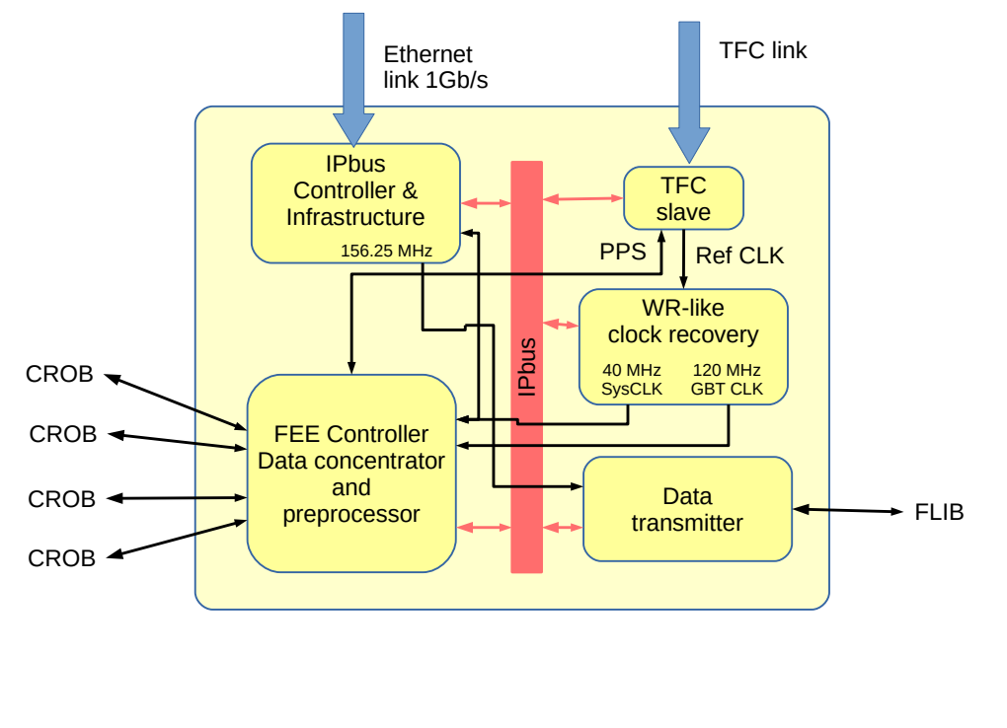
FW development – cont.
The DPB FW used as development basis and in STS/MUCH setups was mostly developed at WUT
The FW has been refactored with portability in mind
The port to CRI platform will be done for CBM
Similar port to the GERI platform will be needed for BM@N
That allows us to utilize the synergy effects

Slide 7
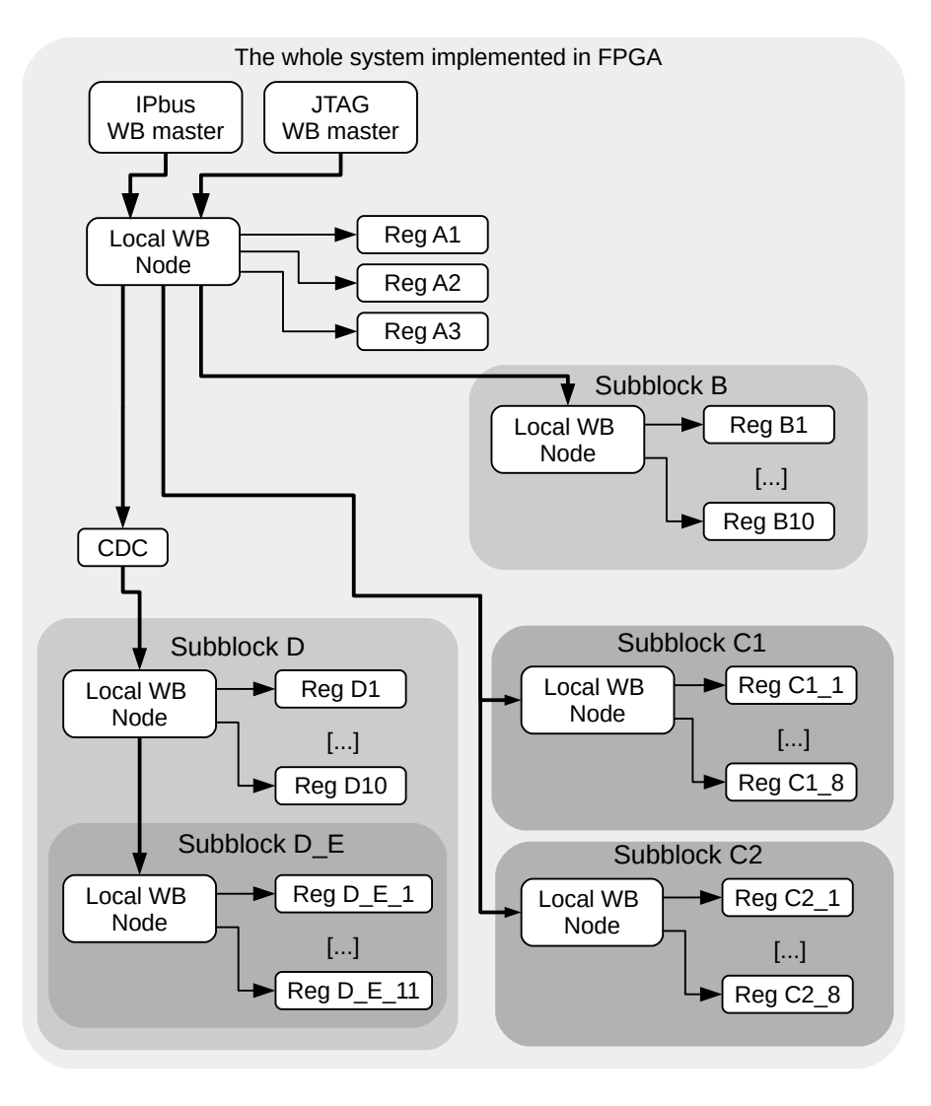
Dedicated solutions for complex FPGA FW
To support complex hierarchical designs in FPGA we have created AGWB – the local control bus management system
It has been tested, when developing the GBTxEMU firmware
It will be used for CRI port
It will be used for GERI port (full synergy)

Slide 8
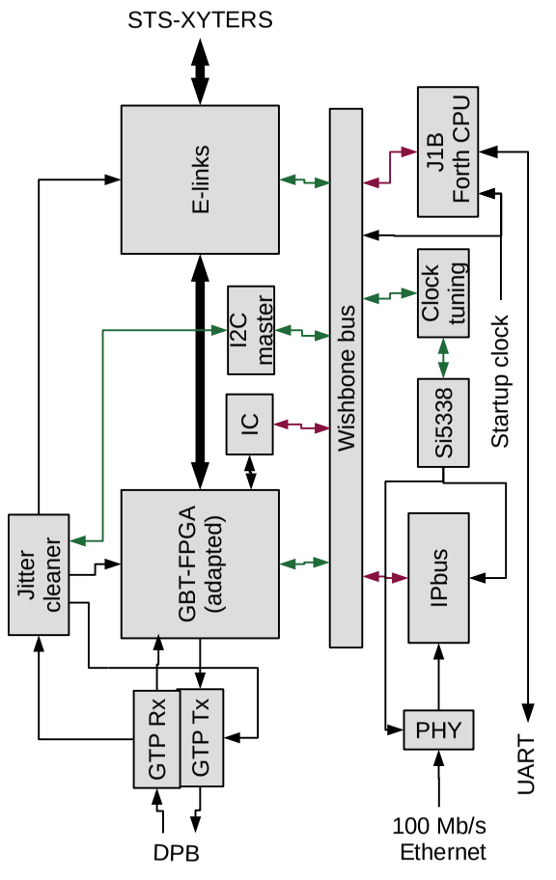
GBTxEMU firmware
The firmware for GBTxEMU was developed mainly in 2019
It provides functional emulation of the restricted GBTx ASIC
It will be used in prototype version of BM@N readout chain
It will be also used for preparation of the SMX testers (synergy)

Slide 9
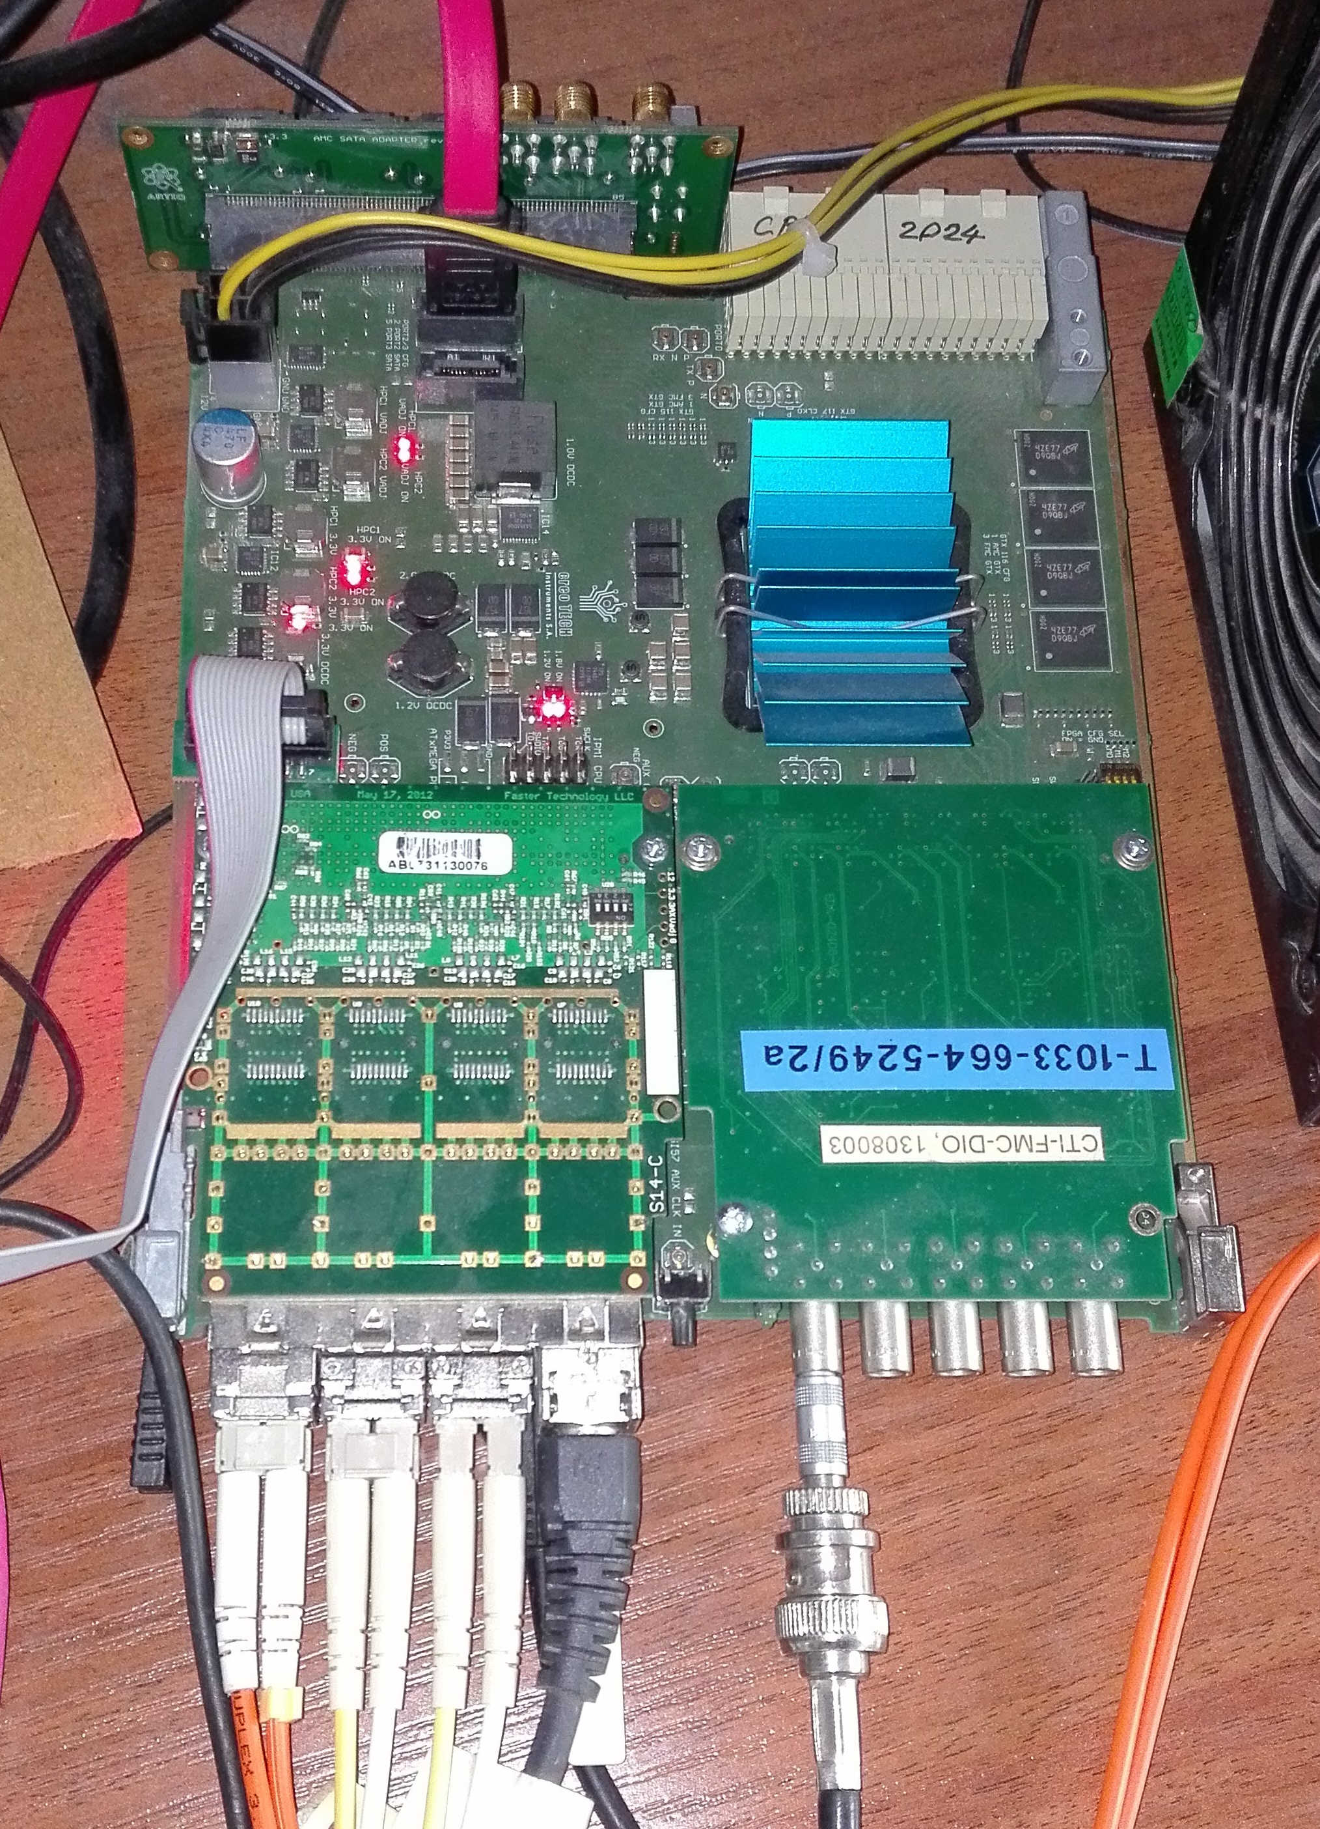
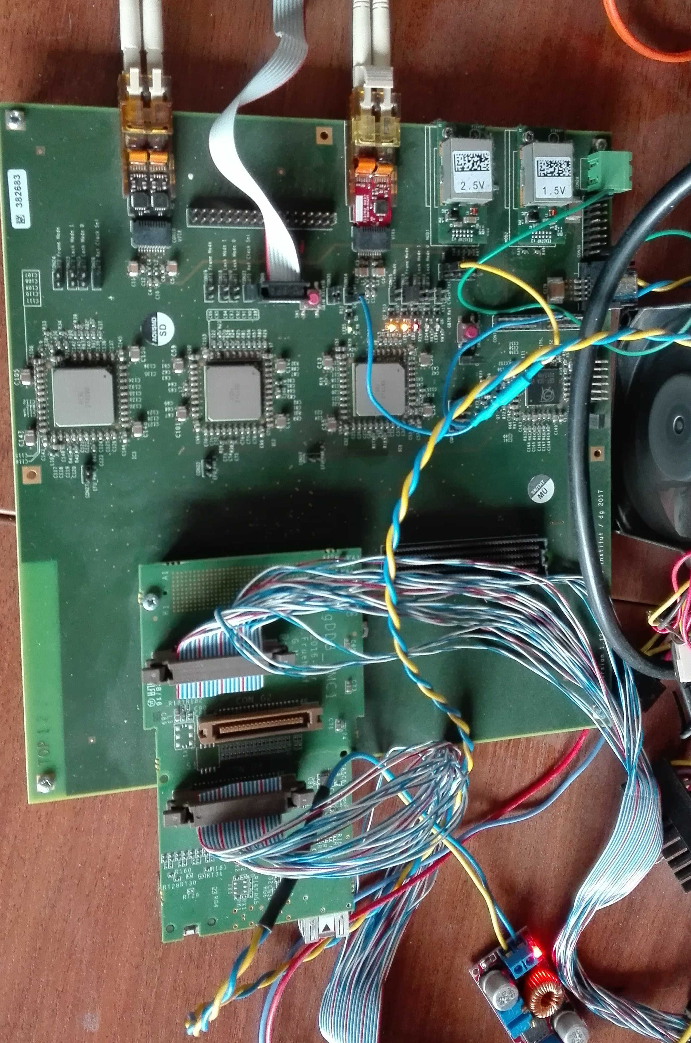
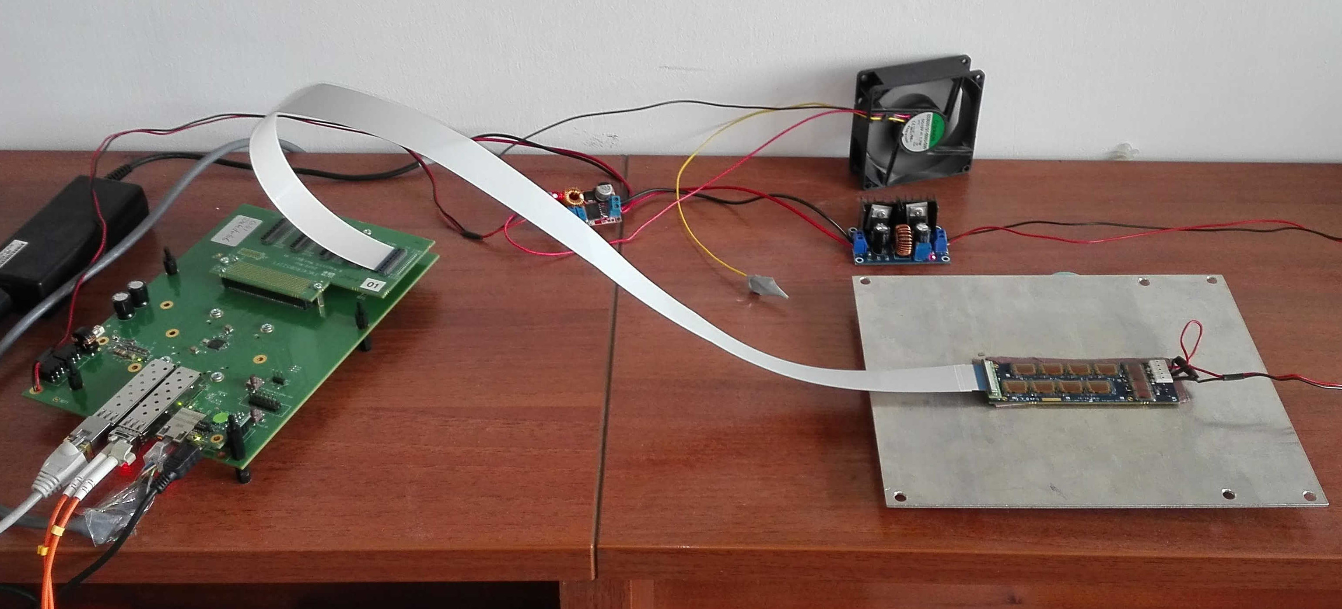
Test setups at WUT
Currently we have limited test setups prepared for GBT-based and GBTxEMU based readout development
We also have dedicated machines with UltraScale and UltraScale+ FPGA boards
However a possibility of remote debugging is essential

Slide 10
Remote testing and debugging
Our group has rich extensive experience in remote testing and debugging of FPGA-based systems
  We have successfully used this approach in CMS experiment in CERN (since 2006, using our own tools)
  We have used that approach in JET (Culham) using standard tools provided by Xilinx
  We were using that approach to test solutions used in CBM and to support mCBM
  It is essential, when the same experts should be used to support systems both in FAIR and in JINR (synergy)

Slide 11
Future activity
Evaluation of consequences of transition from IPbus control to PCIe control
  Potentially it may reduce the complexity of the firmware
  Full synergy with CBM
Porting of GBT-FPGA to GERI platform
  Previous experience with adaptation of GBT-FPGA
  BM@N specific
Porting of other components of DPB firmware to GERI (partial synergy)
Development of new components specific for BM@N – e.g. adaptation for triggered acquisition (depending on final structure of the reaudout)
Preparation of low level control software for new design (full synergy)

Slide 12
Influence of the COVID-19 crisis
The hiring procedure at WUT was significantly delayed (by ca. 3 months) due to lockdown – our specialists are hired since 15.05.2020
Fortunately most part of the FW development/testing can be done remotely
We have faced certain lockdown-related problems with preparing the test setups. E.g., the setup for PCIe development that required physical access to the machine was located at home and was available only for a single developer.Posibility to modify/fix other test setups was also limited.

Slide 13
Thank you for your attention

