Slide 1
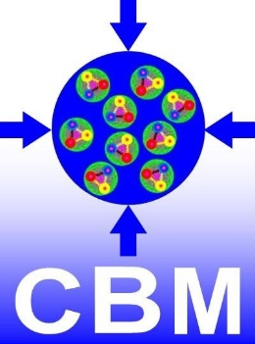
Towards a DAQ and Control System for the BM@N Silicon Tracker Overview
Christian J. Schmidt
WP2 Kick-Off, 01.07.2020

Slide 2
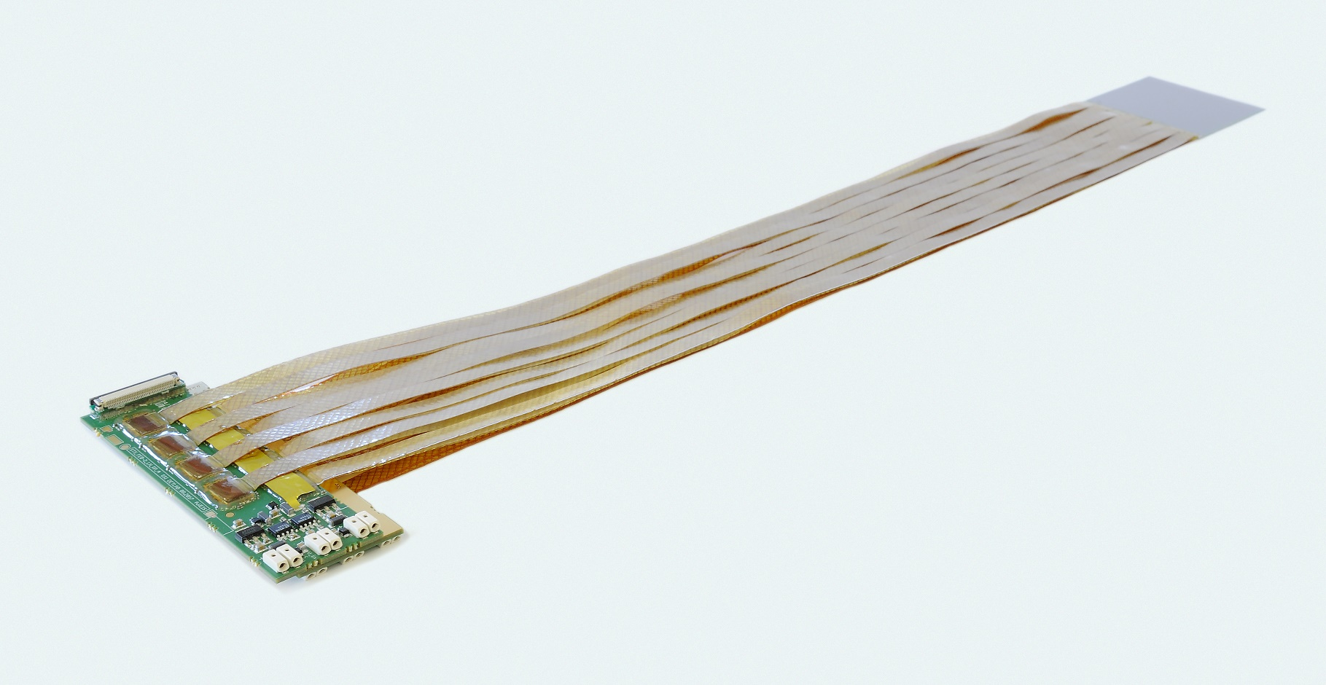
Double Sided Silicon Micro Strip Sensor Module Operated in Free Streaming Readout Mode at BM@N and CBM
1024 strips per side
read out through analog micro cables
One FEB-8 with 8 STS-XYTER chips reads one sensor side of 1024 strips
Two FEB-8 per Sensor
876 Modules for CBM-STS
300 Modules for BM@N
Christian J. Schmidt, WP2 Kick-Off, July 1st, 2020

Slide 3
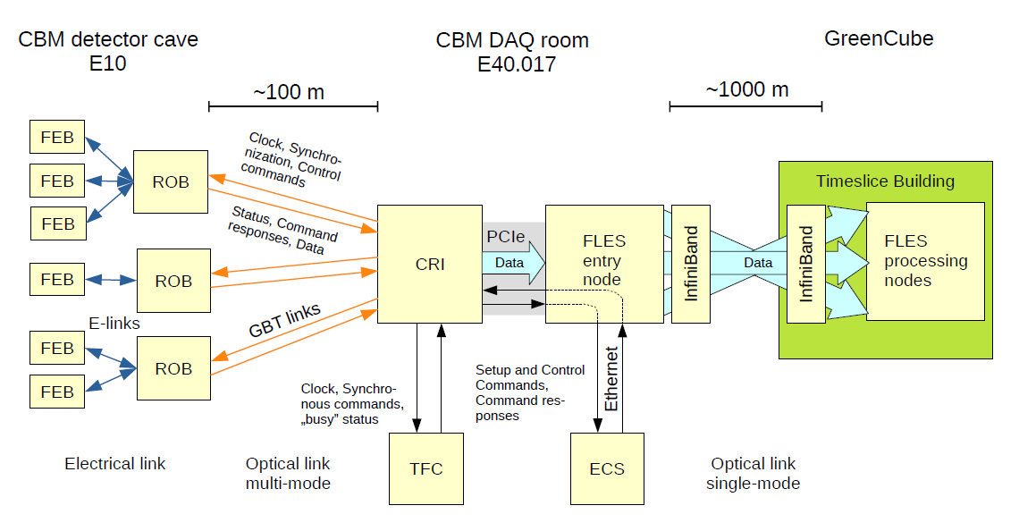
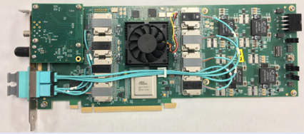
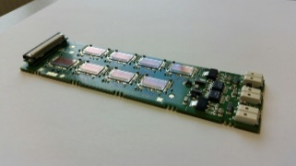
The CBM readout and control architecture
1
2
Green IT Cube
3
CRI / BNL-712 / FELIX board

Slide 4
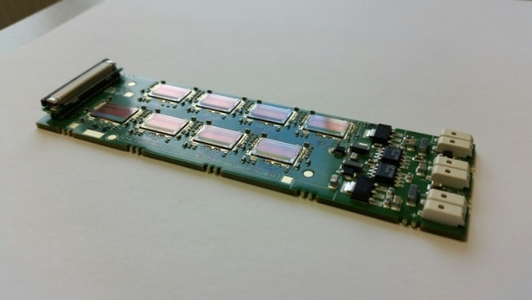
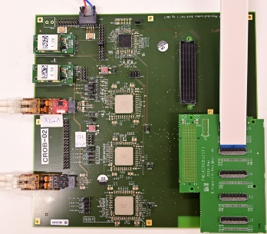
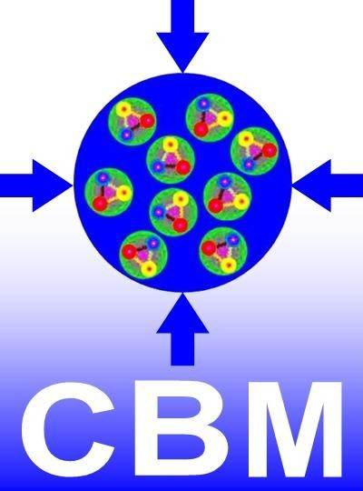
… at CBM currently being set-up
Computing System
ROB
3 GBTx on one ROB
give 42 e-links
Feb-8 FEE
elinks
CERN GBTx
serializer and data combiner chip
14 x 320 Mbit/s
to 4.48 Gbit/s optical
Feb-8 FEE
Gbit opt.
CRI-Board
FPGA based
PCIe Interface to computer system
Feb-8 FEE
Feb-8 FEE
Feb-8 FEE
Feb-8 FEE
9.41 Mhit/s/elink
CRI / BNL-712 / FELIX board
completely synchronous full system operation,
generating free streaming data
time-stamp-clocks on all chips need to be synchronous
TFC
Timing and Fast Control
Christian J. Schmidt, WP2 Kick-Off, July 1st, 2020

Slide 5
emulate GBTx functionality on an FPGA,
rescale hardware to rate necessities at BM@N
employ all of CBM firm- and software for BM@N
scale rate capability to adequately match BM@N data rates
→ operate with one e-link per STS-XYTER chip (out of 5) 1/5
→ operate at 80 Mbit/s, down from 320 Mbit/s ¼
total reduction in rate capability compared to CBM maximum rate: 1/20 corresponding to 2.5 Mhits/s per ASIC = 25 kHits/readout channel
Christian J. Schmidt, WP2 Kick-Off, July 1st, 2020

Slide 6
Proposal for DAQ of the BM@N Silicon Tracker
Data into
compute farm
TFC (Timing and fast control)
up to
16 clients
ECS exp. control syst.
through
compute node
GERI and FMC
max 16
Trenz
TE0712-02-100-2C
6 x (8 e-links_up +
1 e-link_down + 1clk) = 60 LVDS pairs
BW = 48 x 80 Mbit/s = 3.75 Gbps
BWmax_out = 56 x 80 Mbit/s
= 4.375 Gbps
determined by optical uplinks
GBTxEMU-3Sens
64 LVDS pairs + 14 pairs at 3.3V
max 7
80 Mbps e-links
absolute max:
6 x 7 x 16 = 672 FEB
= 336 Sensors
FEB-8
FEB-8
max 6
FEB-8

Slide 7
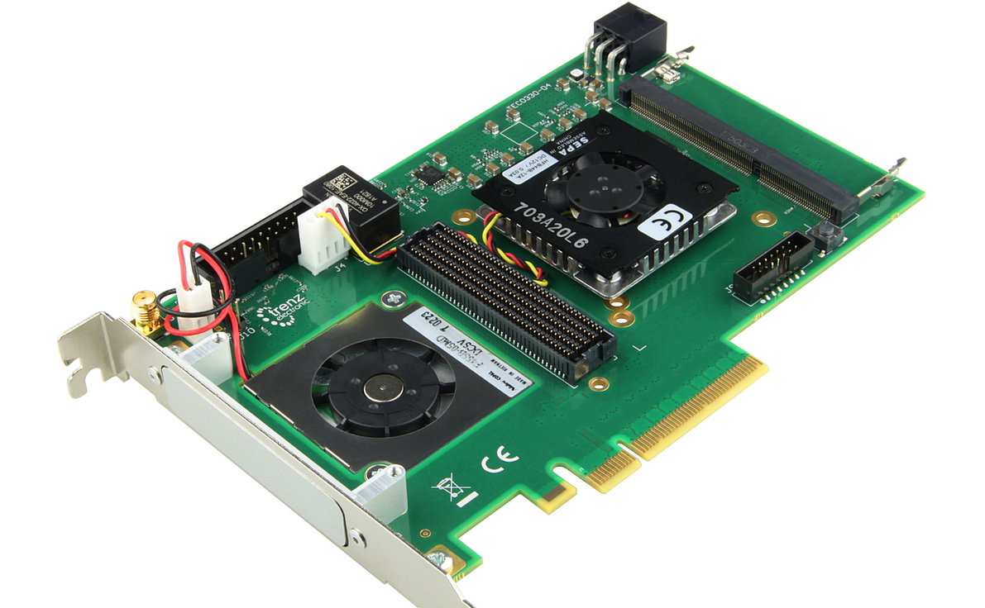
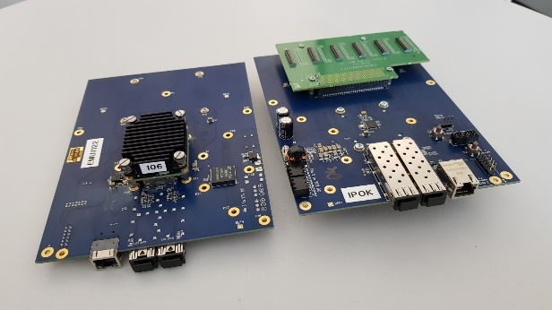
Nomenclature
TFC: Timing and Fast Control FPGA Board as for CBM
GERI GbtxEmuReadoutInterface: Interfaceboard based on Trenz TEC0330-04 (Virtex-7 PCIe FMC Carrier, 8 Lane PCIe GEN2) via PCIe to computer. Similar function to CRI-Board for CBM
GBTxEMU-3Sens
connectivity for 3 full sensors (48 e-links), one 4.4Gbps uplink, each e-link at 80Mbps
Christian J. Schmidt, WP2 Kick-Off, July 1st, 2020

Slide 8
Optimized System 336 Sensors
1 TFC with 1:16 synch fanout
16 GERI in-nodes (each good for 7 GBTxEMU-3Sens-1)
112 GBTxEMU-3Sens (each good for six sensor sides, 3 sensors)
Total bandwidth: 112 x 6 x 8 x 80 Mbit/s = 420 Gbit/s corresponding to 13.6 Ghits/s
Christian J. Schmidt, WP2 Kick-Off, July 1st, 2020

Slide 9
Visa-Card sized XYLINX Serial-7 FPGA Board heart of GBTxEMU board
Trenz TE0712-02-200-2C
connectivity for 6 FEB-8
Fully functional and tested, long term availability (15 years guaranteed by TRENZ)
Prototype GBTxEMU-3Sens Board, available

Slide 10
towards radiation hardness
evaluate and optimize system with EMU-solution using Artix FPGAs
In parallel start a Russian rad-hard ASIC design implementing this functionality “GBJINR” (e.g. at MEPHI)
Plug-in compatibility: can replace TRENZ Boards upon availability.
Christian J. Schmidt, WP2 Kick-Off, July 1st, 2020

Slide 11
Pilot System for 42 Sensors
minimum sized system with full complexity, delivered to JINR
1 TFC with 2 output synch channels
2 GERI in-nodes (each good for 7 GBTxEMU-3Sens-1)
14 GBTxEMU-3Sens-1 (each good for six sensor sides)
Total bandwidth: 14 x 7 x 8 x 80 Mbit/s = 61,25 Gbit/s,
corresponding to 1,7 Ghit/s
Good for readout of 42 sensors
AMC FMC Carrier Kintex (AFCK)
here HTG 700
TE0712
Christian J. Schmidt, WP2 Kick-Off, July 1st, 2020

Slide 12
Firmware Workpackages
Firmware
GBTxEMU-3Sens
practically done
WUT Warsaw, W. Zabolotny
Firmware
GERI
WUT Warsaw, W. Zabolotny
and University Frankfurt ?!
Firmware
TFC-System
KIT Karlsruhe, Vladimir Sidorenko
followed on Lukas Meder (PhD)
ongoing contract with KIT
in 2020
additionally software development needed
this should be JINR hosted!
Christian J. Schmidt, WP2 Kick-Off, July 1st, 2020

Slide 13
Firmware
GBTxEMU-3Sens
WUT Warsaw, W. Zabolotny
receive synchronous system Clk
realize bit/frame alignment with ASICs, set-ups
(much simpler than with GBT as operation at 40/80MHz)
distribute ASIC fast ctrl. commands to respective downlinks (from TFC to ASIC)
Channel uplink data onto 4.8 Gbit/s optical links
Firmware design along GBT functionality, striped down as much as possible
(lower clk-speeds, no error correction, no automatic delay calibration etc. )
Christian J. Schmidt, WP2 Kick-Off, July 1st, 2020

Slide 14
Firmware
GERI
WUT Warsaw, W. Zabolotny
and University Frankfurt ?!
Realize CBM-STS-CRI functionality
Port to receive and distribute control commands from PCIe to ASICs
Port to receive global master clock and synchronization from TFC
Throttling control, react to overload signals from ASICs
MicroTimeSlices should be created in compute farm as in CBM, not the GERI any more
Conceptual tasks practically identical to CBM-CRI, with matured CRI system can branch-off GERI-Firmware
Christian J. Schmidt, WP2 Kick-Off, July 1st, 2020

Slide 15
Firmware
TFC-System
KIT Karlsruhe, Vladimir Sidorenko
followed on Lukas Meder (PhD)
KIT contracted to realize TFC in 2020
Synchronous clock and synch. distribution to FEE-ASICs
Fast Control Interface, control interface for GBTxEMU3Sense and GERI configuration
Organized resynchronization of e-links and GBTxEMU3Sense links
Throttling master control
May and should be identical to CBM-TFC System
need less connectivity, simple 1:16 fan-out (TFC-Master), no cascaded fan-out (TFC-Slaves)
Adaptation/configuration to special hardware, otherwise CBM
Christian J. Schmidt, WP2 Kick-Off, July 1st, 2020

Slide 16
DAQ and Controls Software
Controls and configuration software operating though Compute Node
No clear assignments yet, but urgently needed
CBM (GSI) has no additional resources for softwaredevelopment!
Need integration into BM@N DAQ!
Adaptation/configuration to special hardware, otherwise preferably CBM inherited
Christian J. Schmidt, WP2 Kick-Off, July 1st, 2020

Slide 17
Free Streaming ← → Triggered DAQ
The CBM-STS-derived DAQ is self-triggered - concept generating free streaming data
Most the other detector systems at BM@N will rely upon triggered concepts
System-Level integration of both DAQ-concepts needs to be addressed!
→ this is element of German-Russian Roadmap
Christian J. Schmidt, WP2 Kick-Off, July 1st, 2020

