Slide 1
Requirements for DAQ and processing chain, Contribution of JINR to T2.2
Dmitrii Dementev for JINR STS group
CREMLINplus WP2 kick-off meeting
Jul 1, 2020

Slide 2
Readout chain of BM@N STS
BM@N trigger
Computing System
GBTxEMU
48 e-links
3 x Sensors
Feb-8 FEE
elinks
Gbit opt.
Feb-8 FEE
2.35 MHit/s/elink
FPGA based emulator of CERN GBTx
serializer and data combiner chip
48 x 80 Mbit/s
to 3.84 Gbit/s optical
GERI-Board
FPGA based
PCIe Interface to computer system
Feb-8 FEE
Feb-8 FEE
BM@N
Data center
Feb-8 FEE
FEB-8 FEE
Data,
Synch,
commands
Data,
Synch,
commands
Firmware GBTxEMU, GERI:
WUT Warshow, W. Zabolotny
Firmware TFC:
KIT Karlsruhe, Vladimir Sidorenko
Synch,
commands
Hardware developments: GSI Detector Lab, JINR, MSU
TFC
Timing and Fast Control

Slide 3
General requirements
BM@N STS data acquisition chain is based on the readout concept of CBM and is adopted to BM@N requirements.
BM@N experiment:
4.5 AGeV Au beam;
Maximum IR: 5 MHz;
Trigger rate: 50 kHz;
Requirements to the Front-end electronics:
Maximum strip occupancy is ~5⋅10⁻⁴ per event- >0.32 Mhit/s – per one STSXYTER ASIC;
Bandwidth of each STSXYTER ASIC could be decreased down to 2.5 Mhits/s according to 50 Mhits/s in CBM;
Total number of channels ~ 600k;
Signal integrity of the data transmitted via 10 m copper cables between on-detector electronics and GBTxEmu boards
Requirements to the processing chain:
Emulation of GBTx functionality on FPGA;
Trigger-based readout with a trigger latency of 5 us;
Synchronization of STS timing system with the one used in BM@N within 1 ns accuracy;
Data packaging into MPDRawData format.

Slide 4
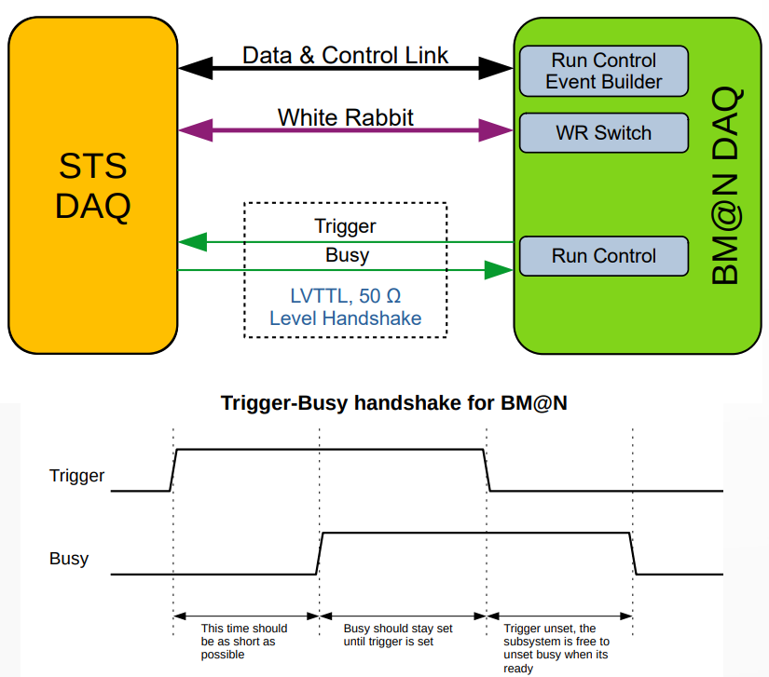
Integration of STS readout into BM@N DAQ
STS integration requirements:
Data & Control link from BM@N Run Control and Event Builder software
White Rabbit Link
Two 50 Ω coaxial connectors for trigger distribution and busy collection;
Data packed in MPDRawData format
Time synch between BM@N DAQ and STS DAQ within ~1 ns
STS needs 40 MHz reference clock;
BM@N WRS could provide 10 MHz (or 125 MHz) clock + PPS
Slide by A. Baskakov from 5th BM@N CM

Slide 5
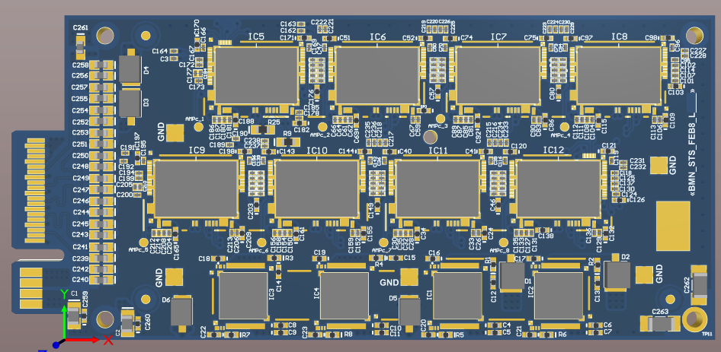
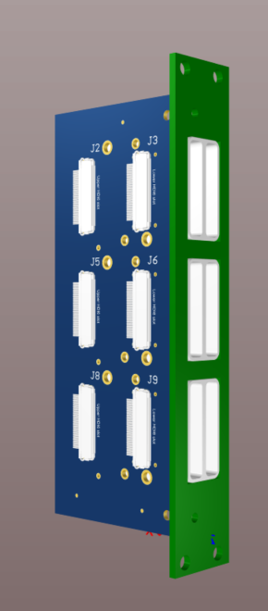
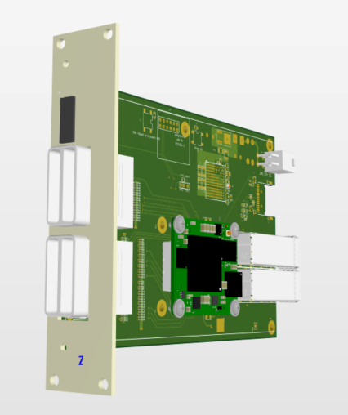
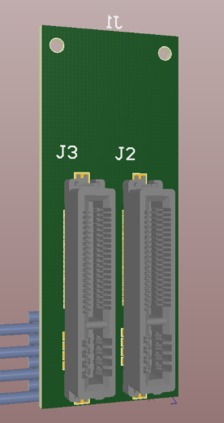
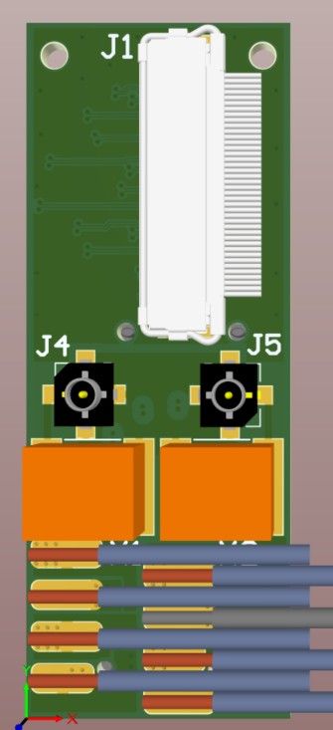
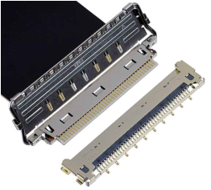
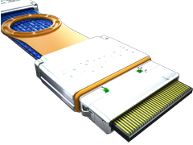
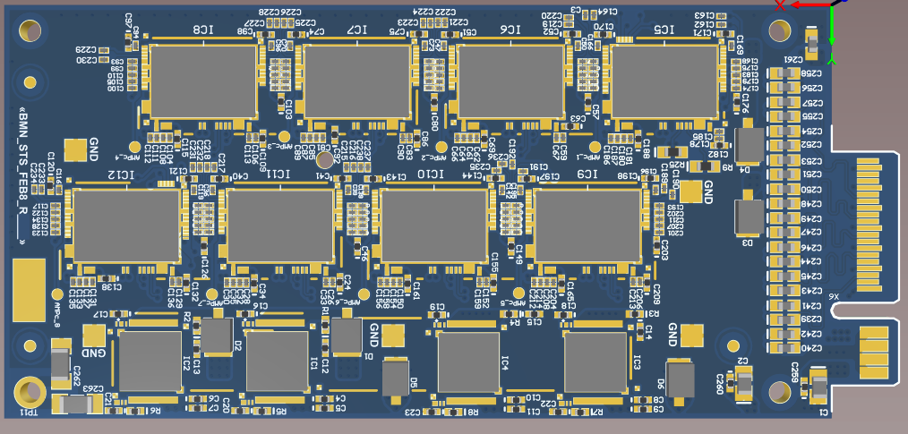
Contribution of JINR to T2.2
BM@N FEBs
FEB-panel
Twinax cable
~10 m long
Microcoax cable
~0.7 m long
FEB box
Patch panel
STS box
GBTxEmu in crate
Tasks:
PCB design developments (FEBs, FEB-panel?):
Front-end boards;
FEB-panels and patch panels;
New design of GBTxEmu board;
Development of FEB connectivity scheme;
Optimization of the noise performance;
S/W Developments:
Configuration routines;
Data analysis.
Integration aspects: BM@N DAQ group
Taskforce:
JINR: D.Dementev, M. Shitenkow, N.Sukhov, V. Leontyev
SINP MSU: A. G.Voronin, I. Kudryashov,
Maraphon Ltd.
CREMLINPlus open positions:
S/W engineer;
H/W engineer;

Slide 6
BM@N FEB developments
Features:
Size: 87*40 mm²;
Thickness with components: 3 mm;
Edge-type connector with two pin groups:
[ HV, LV ] & [ DATA ]
1 Uplink per one ASIC
Advantages:
Increased space for the cabling between FEB-boxes;
90 bending of cables is not needed ;
Easy connectivity with a FEB-panel;
Low thickness of the board allows to increase thickness of the cooling fin for one FEB up to 3 mm.
Current status:
First prototypes are developed and tested;
New design is now ready;
New FEB boards will be available in Aug
Comparison of two FEB geometries
1x Downlink – 40 Mb/s
1x Clock - 40 MHz
8x Uplinks – 80 Mb/s
~ 10 m electrical
connection to GBTxEMU

Slide 7
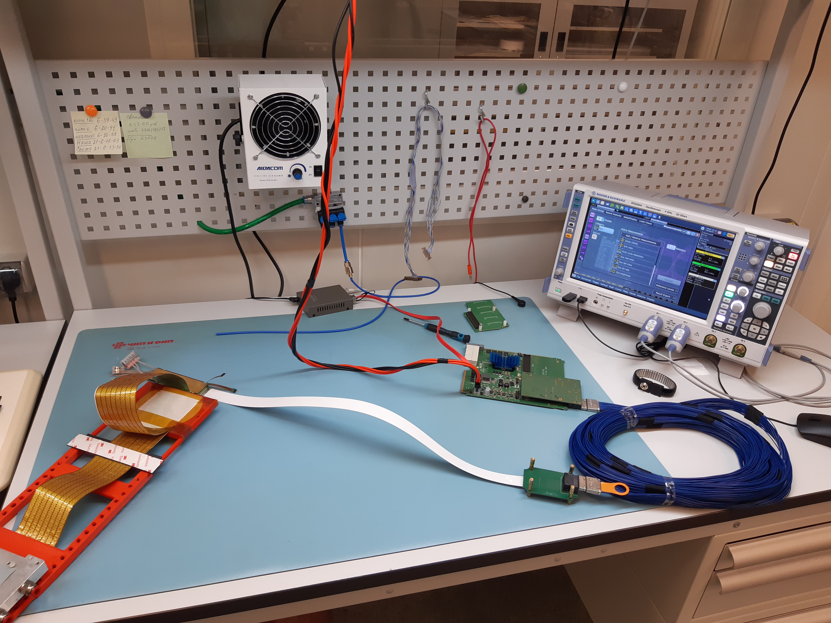
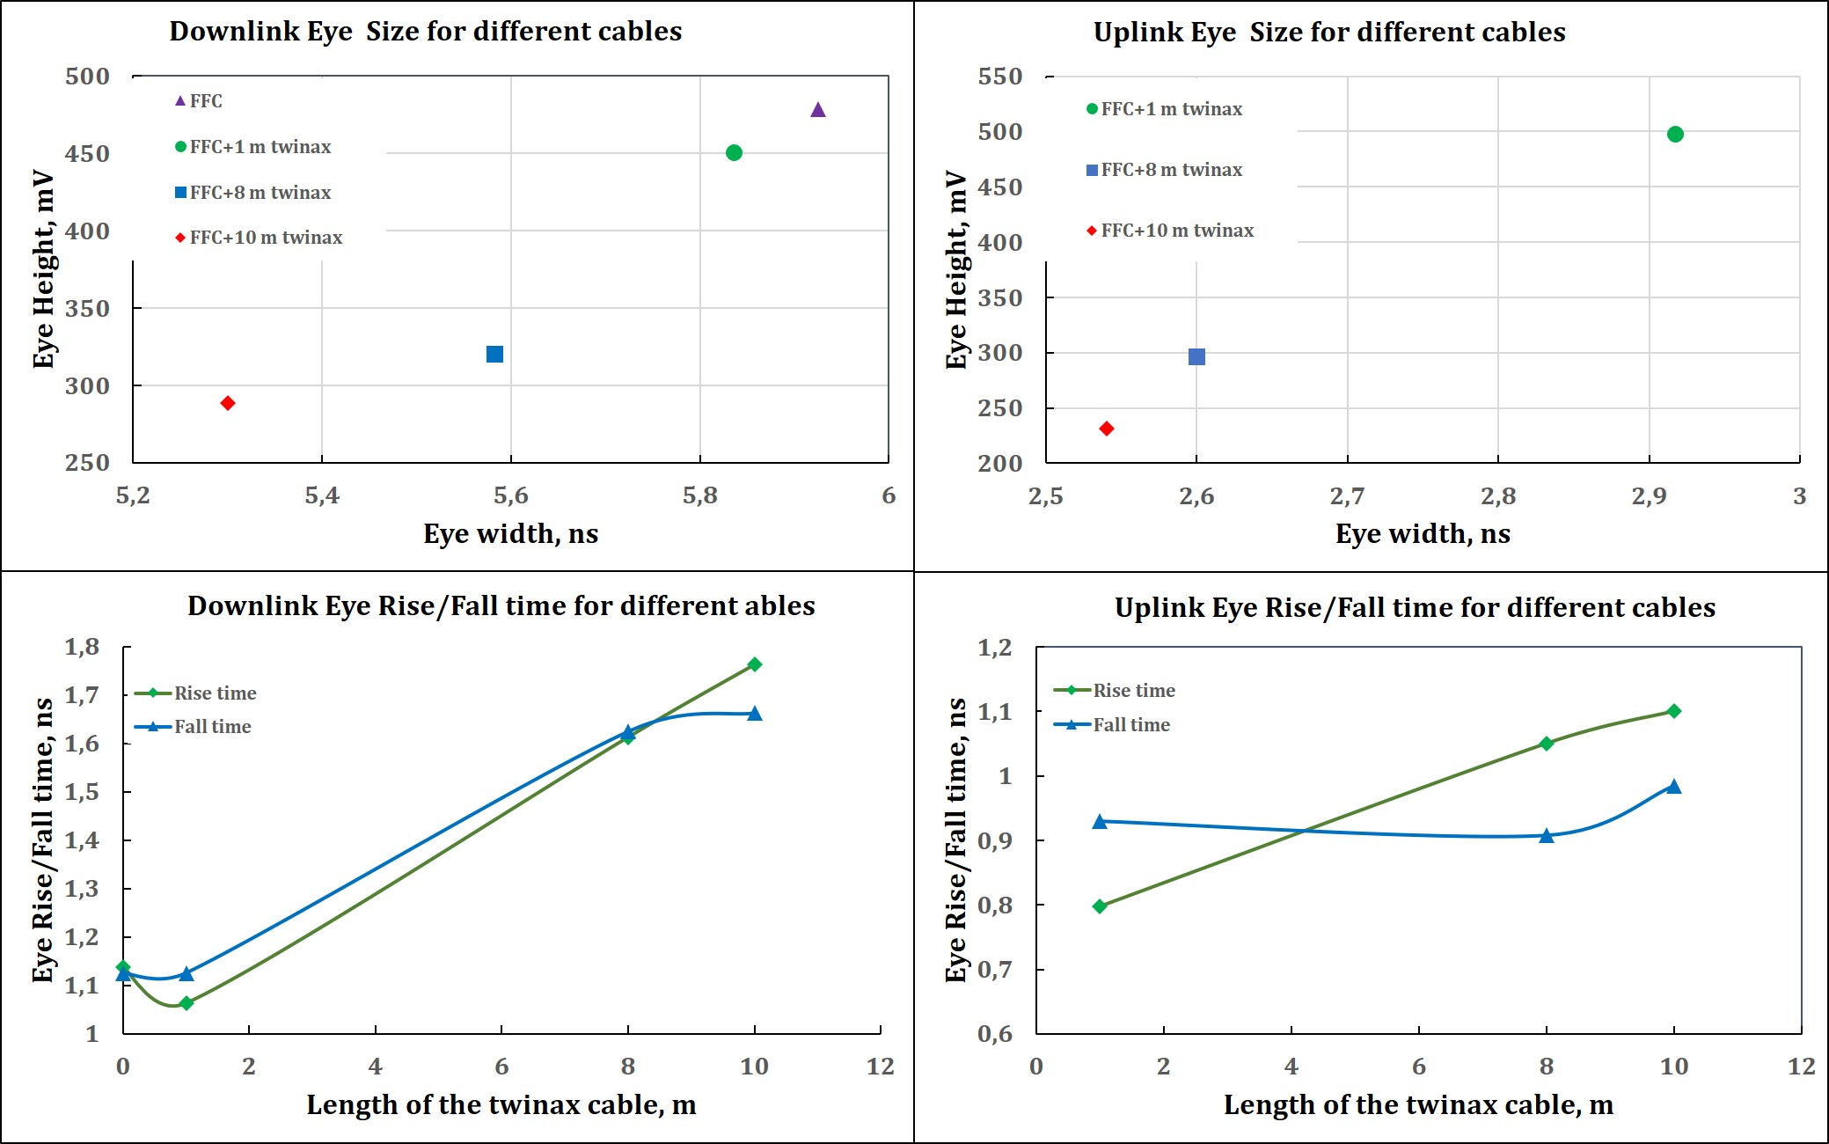
FEB connectivity
Eye diagram of the Dwn-link signal at 160 MHz Clck
Eye diagram of the Dwn-link signal at 80 MHz Clck

Slide 8
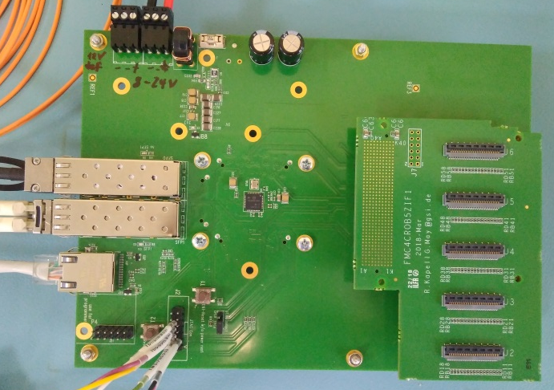
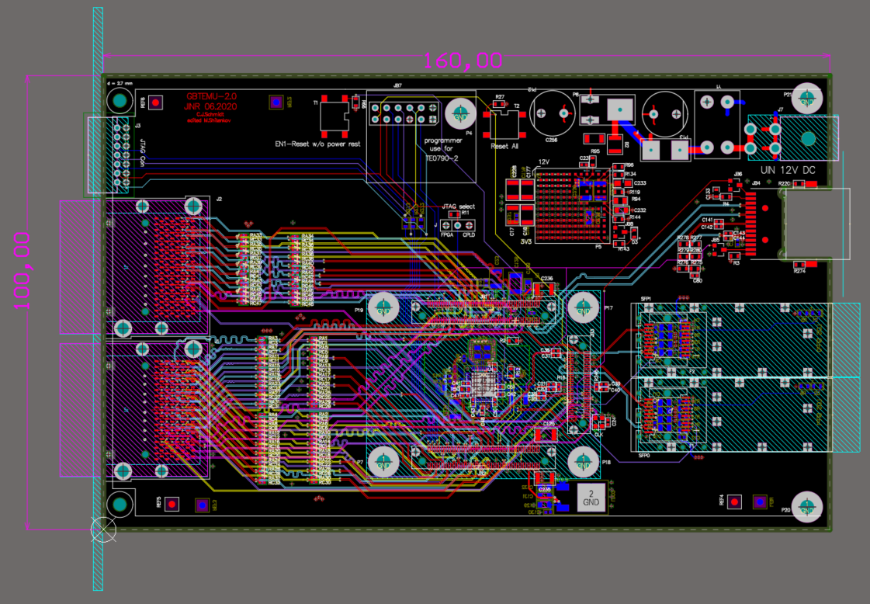
GBTxEmu board
Features:
12 layers PCB design;
3U crate format;
HDI6 connectors instead
of mezzanine card;
Minimal number of s/w modifications are needed according to the prev. h/w platform
Status:
Preliminary PCB Design is ready;
First boards on the table – Dec 2020
GBTxEmu board being developed at JINR
GBTxEmu board developed at GSI

Slide 9
Timelines
2022 – pilot v. of STS based on two stations with 42 modules
2023 – readout chain for 292 modules
Delays of the project caused by pandemic control measures in Russia – ½ year
Tests and optimization of the FEB-GBTx connectivity: Q4/20;
BM@N FEB8 – start of serial production: Q1/21;
GBTxEmu for the pilot v.: Q2/21
Thank you for your attention!

