Slide 1

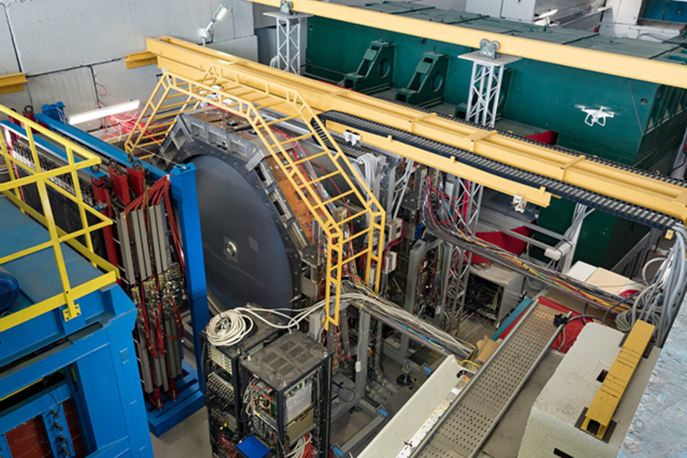
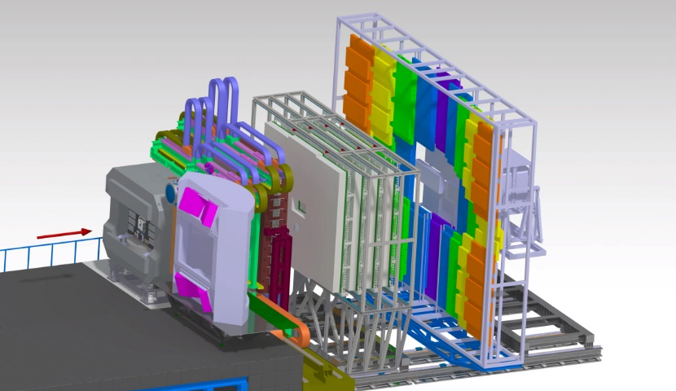

WP 2.4:
Development and construction of beam monitors, target chamber and beam pipe for NICA and CBM (FAIR, JINR)
BM@N
P. Senger
CBM

Slide 2
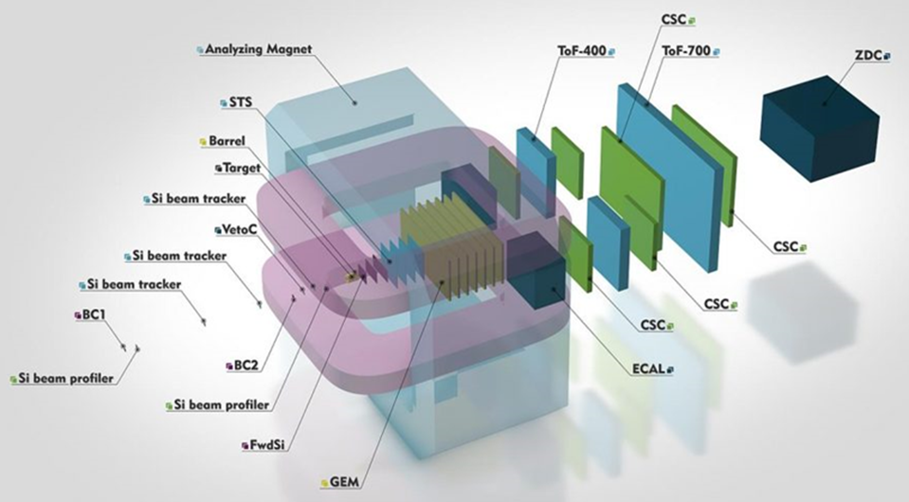
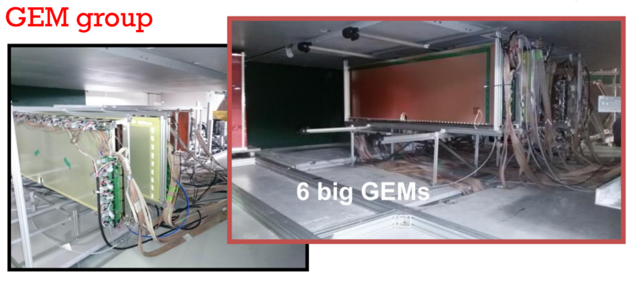
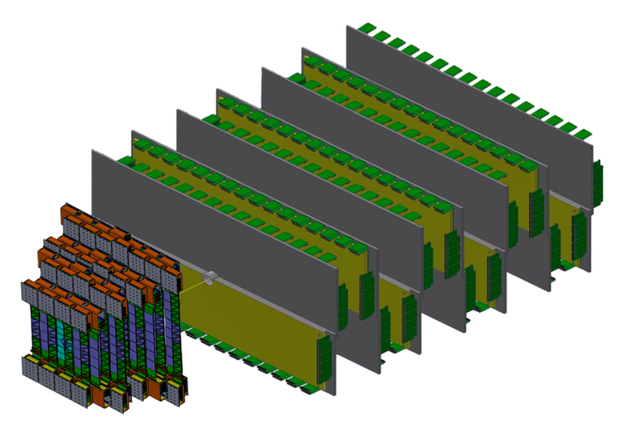
BM@N upgrade for Au+Au collisions up to 4.5A GeV
The hybrid tracking system:
4 stations double-sided micro-strip silicon sensors
7 stations Gas-Electron-Multiplier (GEM) chambers

Slide 4
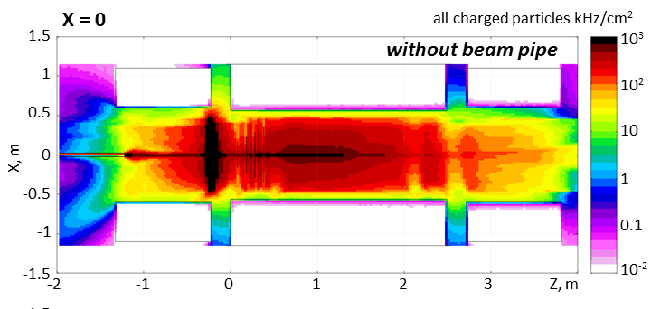
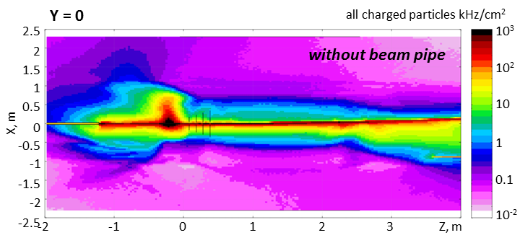
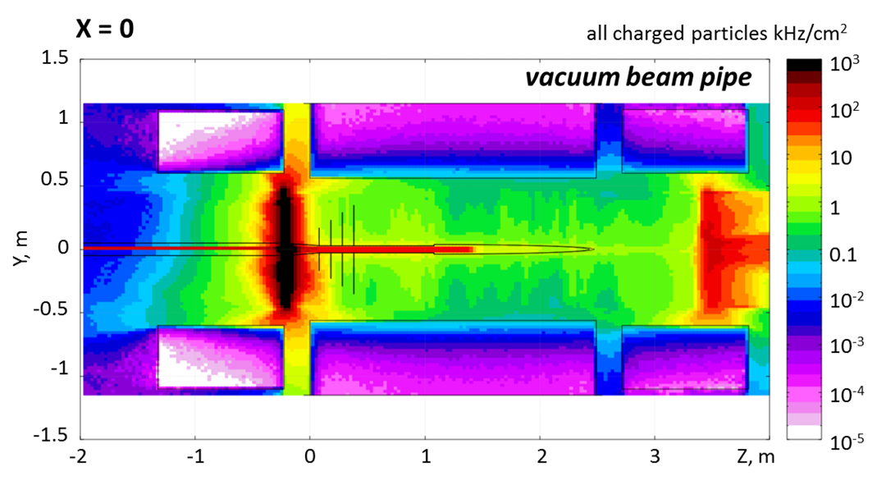
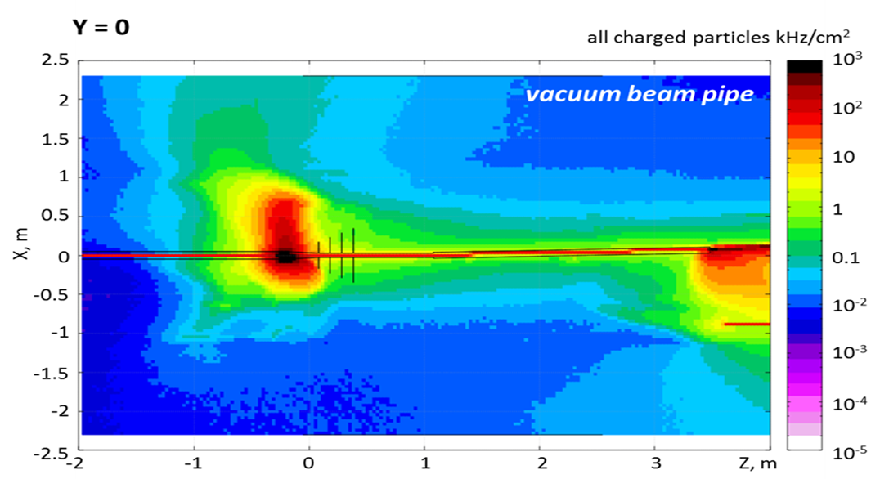
FLUKA simulations: upgraded BM@N needs beam pipe
Au beam: 5 A GeV, 10⁶/s, Au target: 1% interact. rate (A. Senger)
Vertical distribution charged particles
Horizontal distribution charged particles

Slide 5
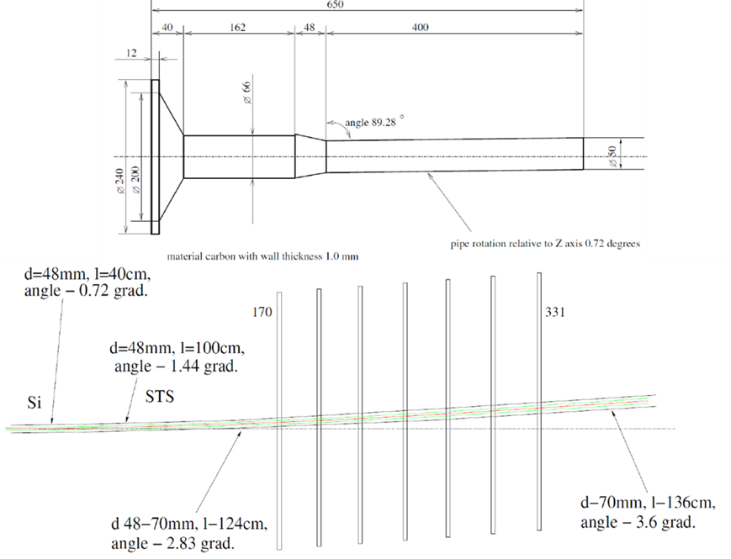
Target chamber and beam pipe for BM@N
Design: V. Spaskov

Slide 6
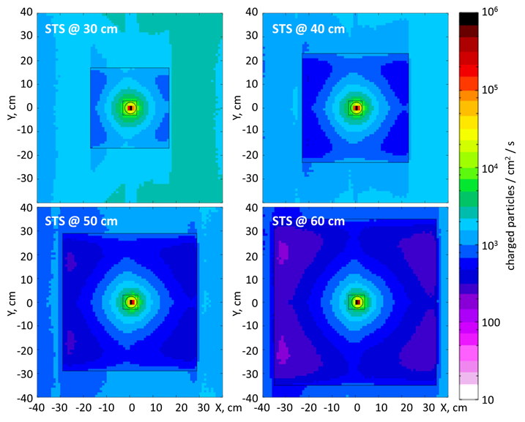
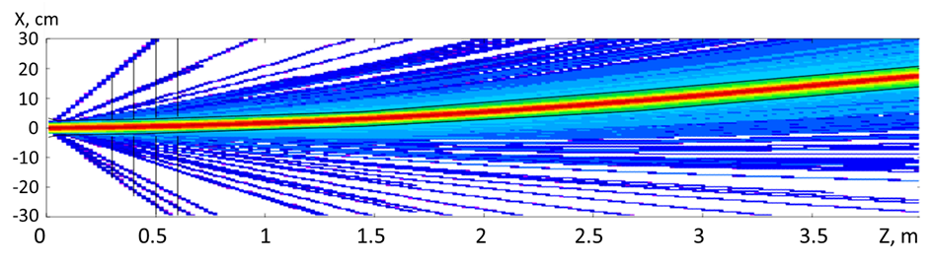
Target chamber and beam pipe for BM@N
Design: V. Spaskov
Nuclotron energies: 2 – 4.5 A GeV
Beam pipe with fixed curvature optimized for Au-beam 4.5A GeV and B = 0.9 T
A. Senger
Au 4.5A GeV
σ = 3.5 mm
div. 1mrad.
max. rate 5 kHz/cm² (innermost sensors)
strip size 50 μm ⋅ 6 cm = 3⋅10⁻² cm²
read-out time 1 μs
→ occupancy 1.5⋅10⁻⁴

Slide 7
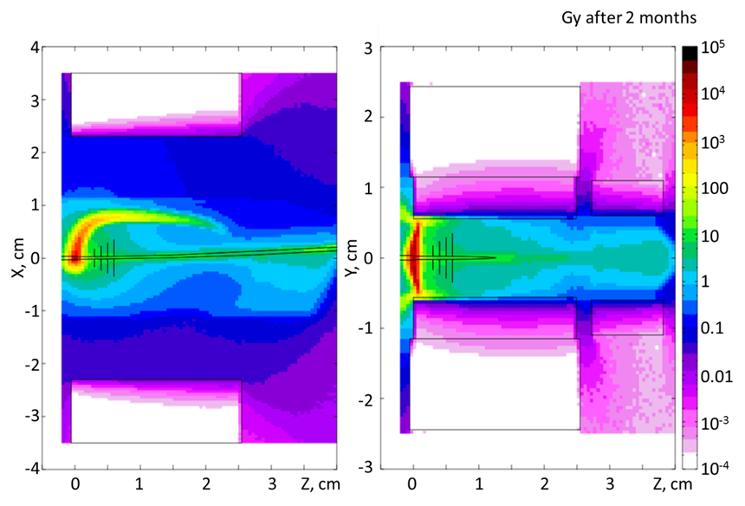
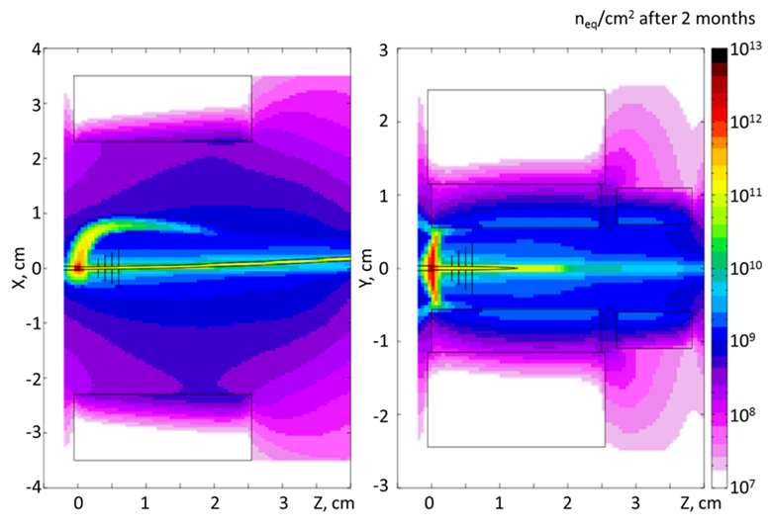
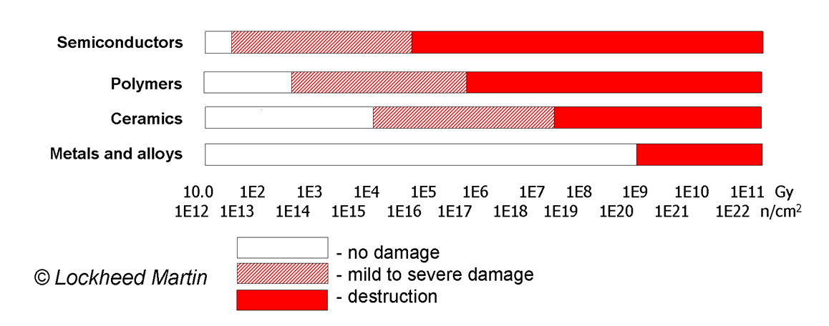
Radiation doses
2 months of running with an Au beam of 4.5A GeV with an intensity of 2⋅10⁶ ions/s
Ionizing dose Gy
NIEL n_{eq}/cm²
STS life time dose:
5 years, 4 months/y
→ 100 Gy
(mild damage)
STS life time dose:
5 years, 4 months/y
→ 10¹¹ n_{eq}/cm²
(well below type inv.)

Slide 8
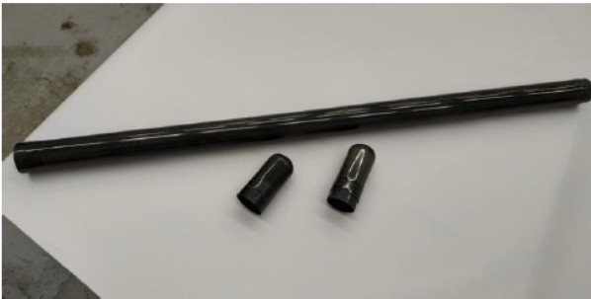
Optimized design of the BM@N carbon beam pipe
Beam: Au 4.5A GeV, Magnet: I =1800 A, B ~0.9 T
V. Spaskov
Flangeless
design
S. Piyadin

Slide 9
Sergey Sedykh
5th BM@N
Collab. Meet.
April 20, 2020

Slide 10
Sergey Sedykh, 5th BM@N Collab. Meet. April 20, 2020

Slide 11
Sergey Sedykh
5th BM@N
Collab. Meet.
April 20, 2020

Slide 12
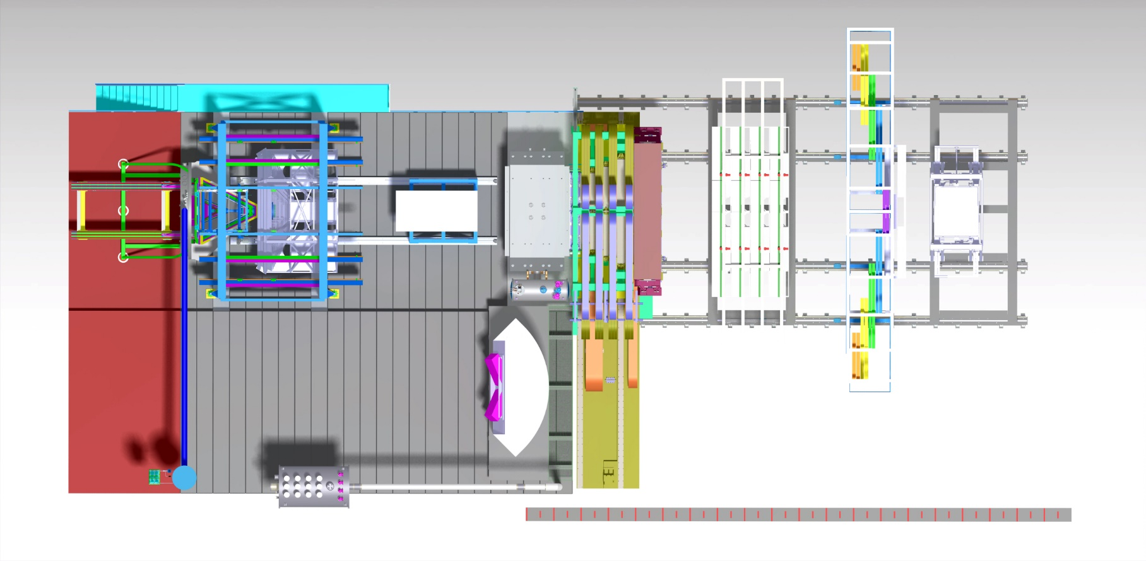
Beam pipe for CBM
0
5
10
15
20 m

Slide 13
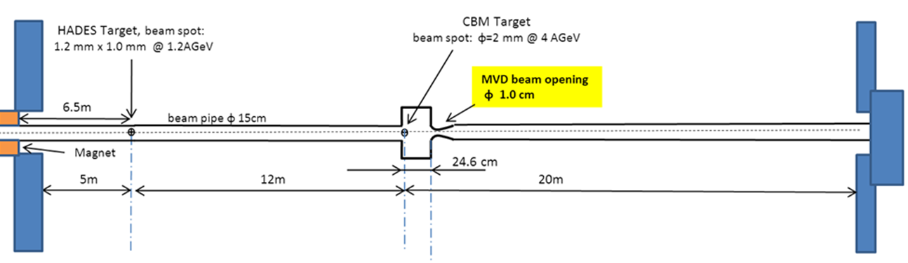
Beam pipe for CBM
T0 counter/
beam monitor

Slide 14
Fixed beam pipe bending angle versus flexible bending angle:
→ consequences for physics performance

Slide 15
From Technical Note 180001 on beam pipe (A. Senger)
in front of RICH/MuCh
behind RICH/MuCh

Slide 16
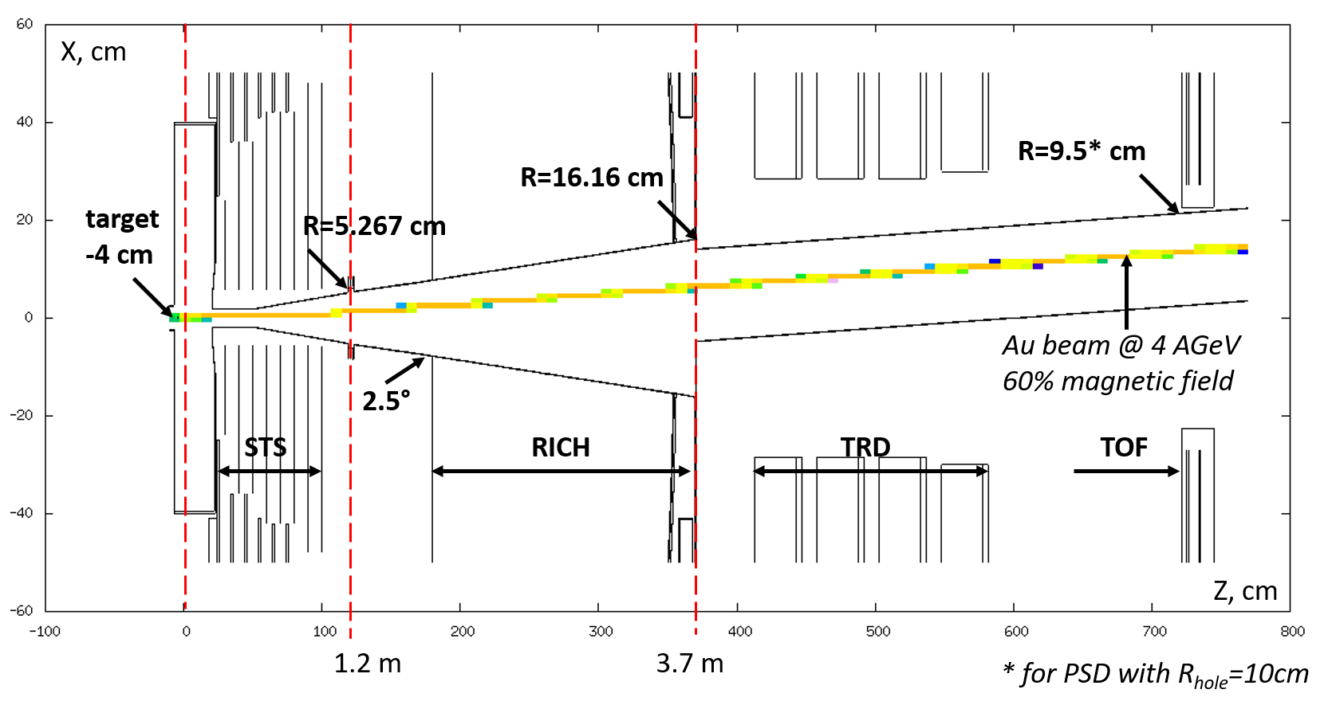
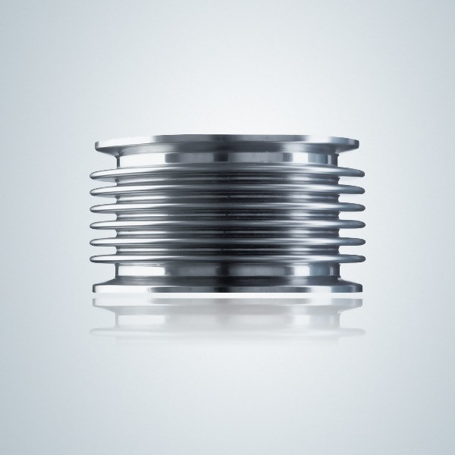
Experimental layout RICH configuration

Slide 17
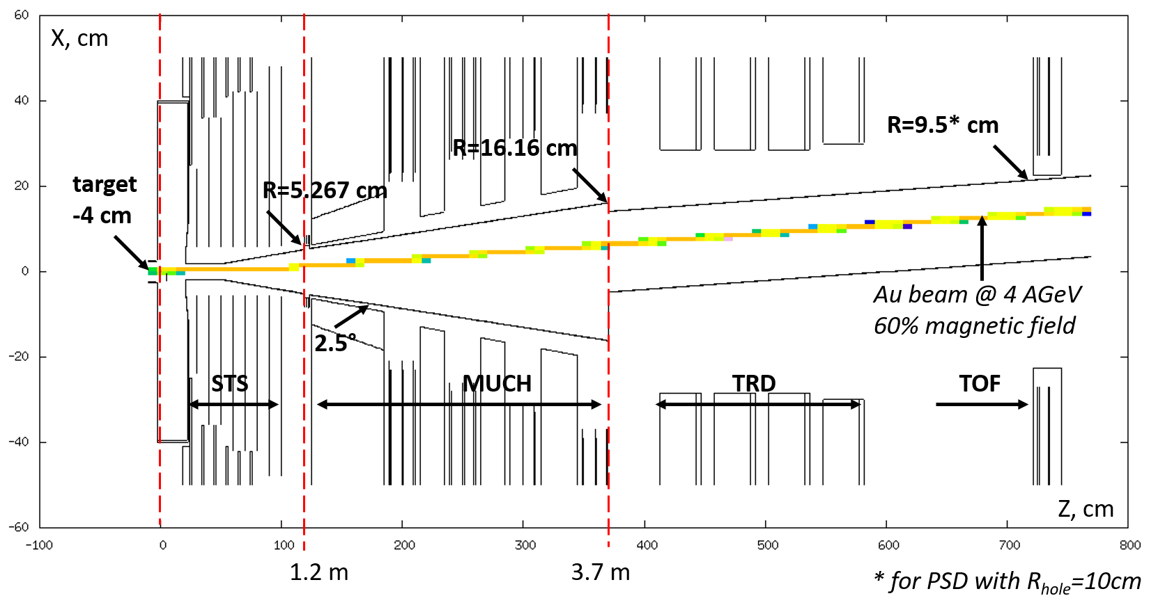
Experimental layout MuCh configuration

Slide 18
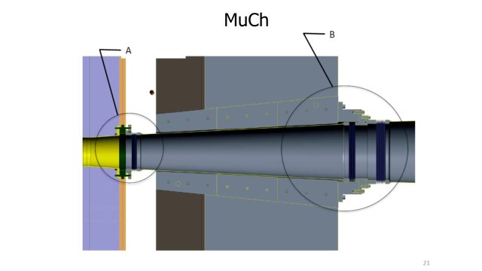
Beam pipe segments
STS
STS group
PNPI will start from scratch to design beam pipe for RICH/MuCh
RICH/MuCH
Segments pivotable by ± 2°:
bellow + beam pipe between RICH/MuCh through TRD and TOF to PSD
beam pipe through PSD
beam pipe from PSD to beam dump
help from CTU Prague engineers

Slide 19
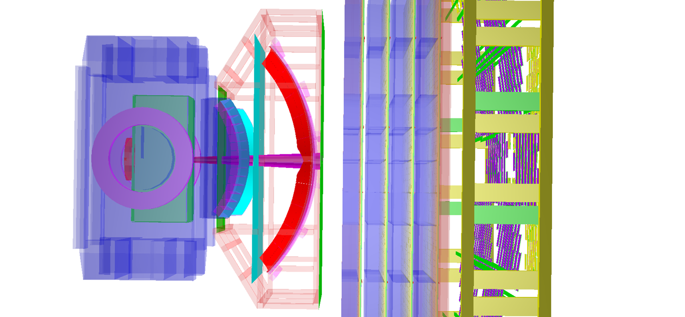
Bellow + reduction of cross section
Experimental layout RICH configuration
0
3.7 m

Slide 20
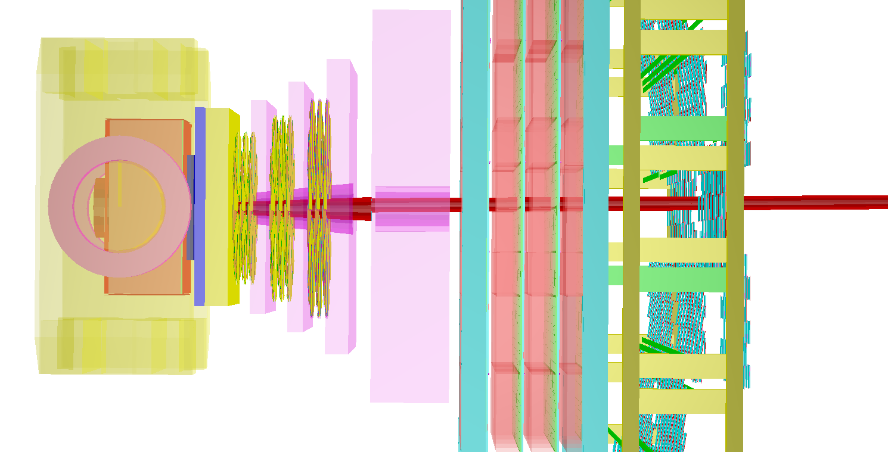
Bellow +
reduction of cross section
Experimental layout MuCh configuration
0
3.7 m

Slide 21
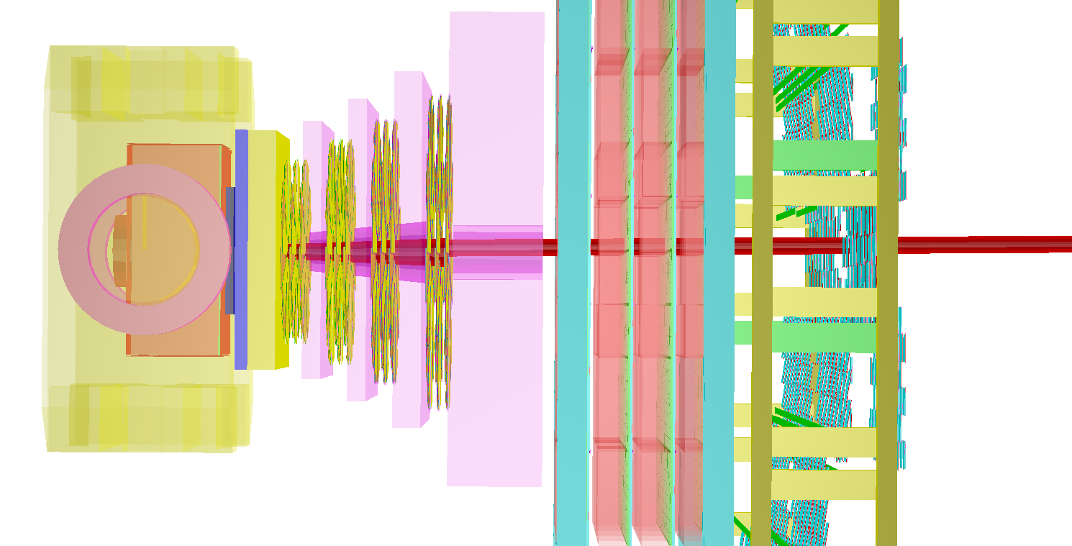
?
Experimental layout MuCh configuration
0
3.7 m

Slide 22
To do:
Design and construction of high-rate CBM T0 Counter/beam monitor (→ Adrian Rost)
Design and construction of CBM target chamber (→ ?)
STS beam pipe
Simulations based on existing design:
Radiation background (Anna Senger) + physics performance
New mechanical design (company + STS contact person and GSI engineer)
RICH and MuCh beam pipes
Mechanical design by PNPI. Coupling to STS pipe requires GSI engineer
Radiation and performance simulations
TRD/TOF/PSD/dump beam pipe
Mechanical design incl. bellow, rotation (< 2°), support and pumping, help from Czech TU
Coupling to RICH/MuCh beam pipe requires cooperation with GSI engineer and PNPI
Design of support/supply structures requires help from cave coordinator and CBM chief engineer
Radiation and performance simulations
➢ Required: beam-pipe coordinator/project/task force leader and GSI/CBM project engineer

Slide 23
Deliverables and milestones
Deliverable/Milestone | Title | Verification | Date
D2.7 | Design of beam monitors, target chambers, beam pipes | Report | 12/2020
MS10 | Technical design of beam monitors, target chambers, beam pipes | Report | 12/2022
D2.8 | Beam monitors, target chambers, beam pipes constructed and installed | Report | 12/2023

