Slide 1


Towards Milestone 7 (Month 24):
Series production of detector ladders for CBM-STS started
Andrea Wilms, GSI

Slide 2
Overview:
  Assembly Tools
  (Data-) Logistics
  Assembly Workflow
  Documentation and QA related topics
  Ressources

Slide 3
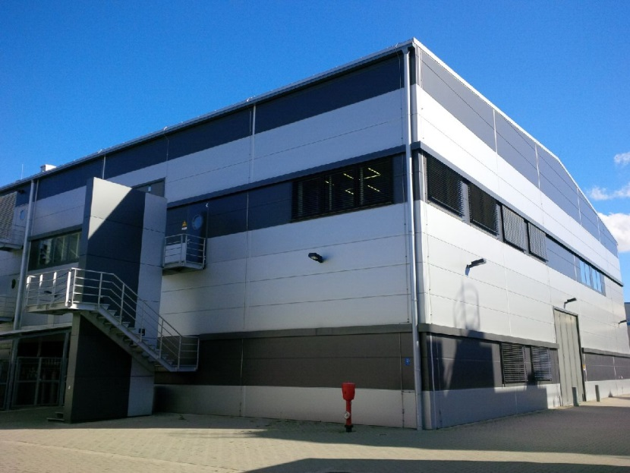
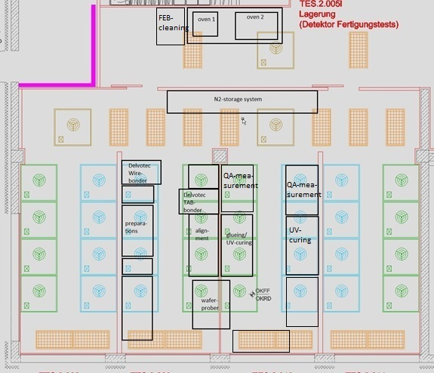
Module & Ladder Assembly--Where?
Solid State Section of cleanroom: 150 m²
GSI Detector Laboratory
QA mea-
surement
600 m² clean rooms (2nd floor)
600 m² gray rooms + workshops (1st floor)

Slide 4
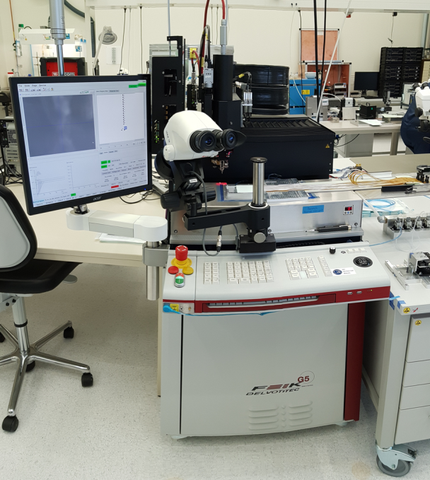
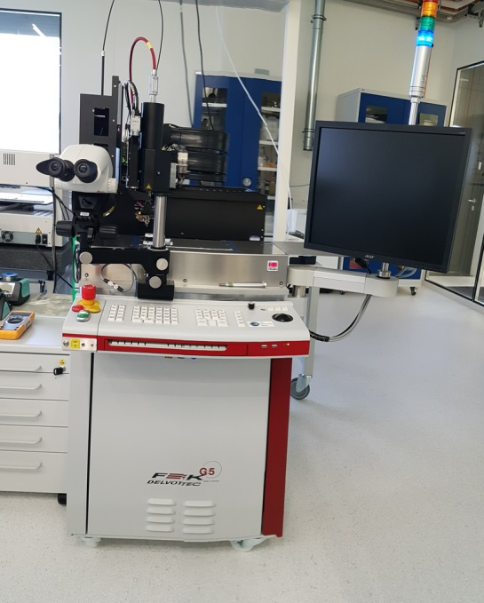
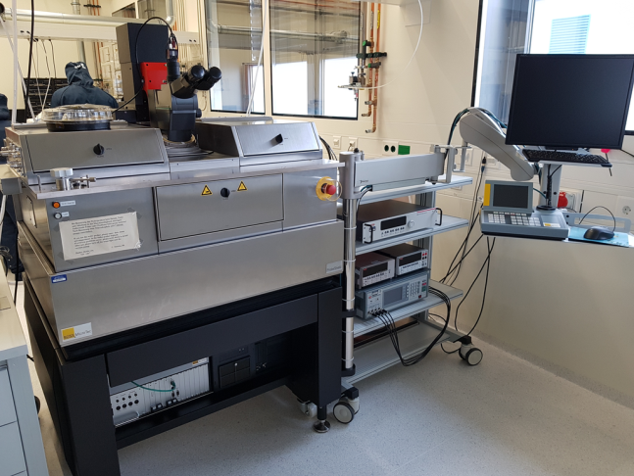
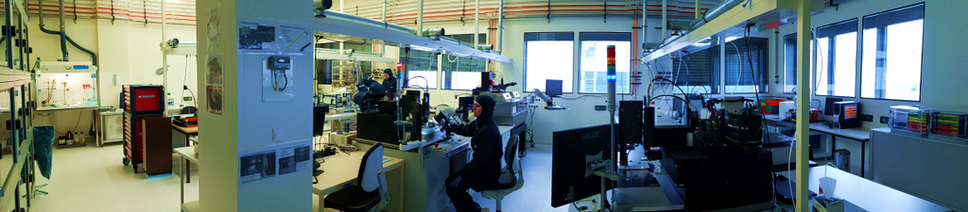
Module assembly:
The step beforehand Ladder Assembly
Wafer prober (Sensor QA)
Delvotec G5 bonder (tab)
Delvotec G5 bonder (wire)

Slide 5
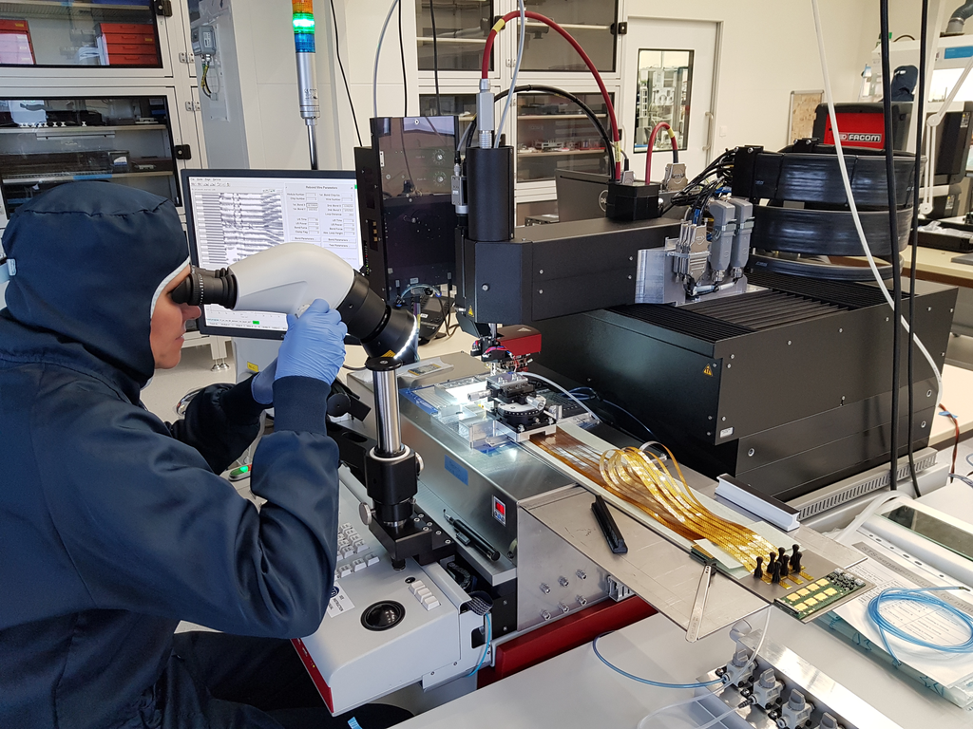
Module & Ladder Assembly--Who?
Current status:
Module assembly team:
1 shift crew – 3 people
Ladder assembly team:
2 people
for prototyping/procedure finalization
Use CREMLINplus impact (personnel) to set up and increase production teams ☺

Slide 6
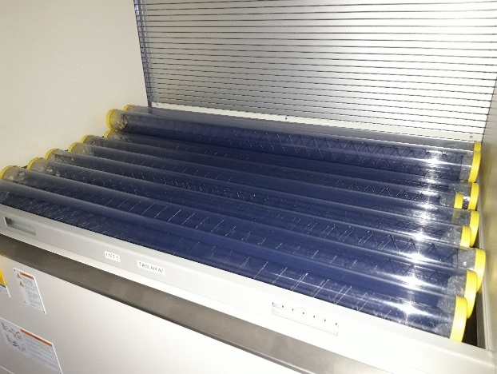
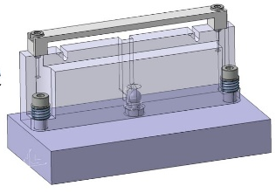
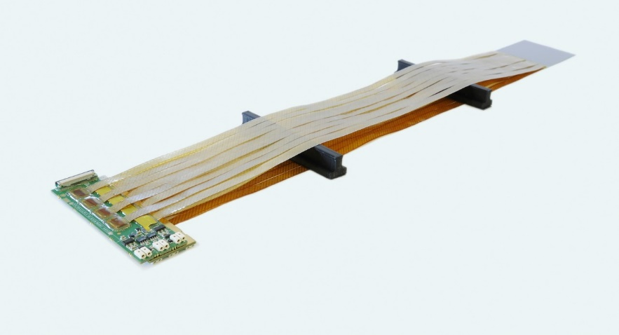
„Ladder-Ingredients“
QA passed modules
QA passed CF-structure
L-Legs & Bearings, FEB Box
Assembled ladder

Slide 7
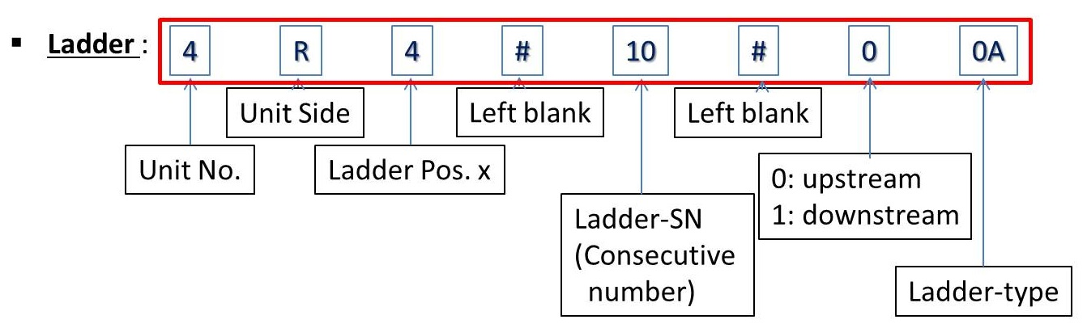
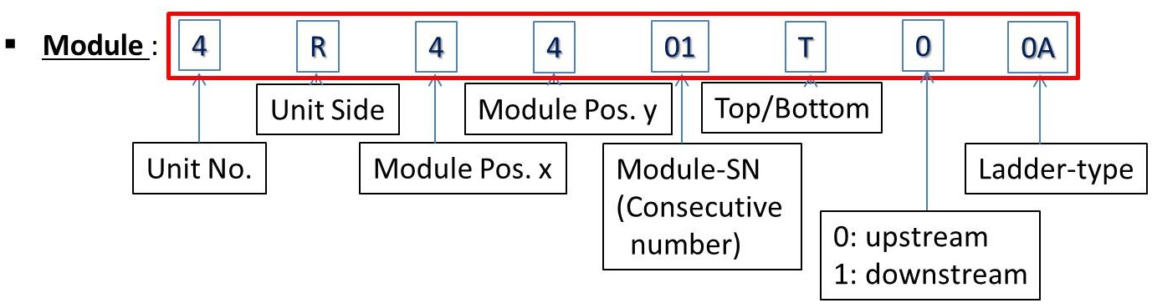
Assembly on demand
Info encoded in Ladder-ID:
Info encoded in Module-ID:

Slide 8
Assembly on demand
Nomenclature provides list of needed modules
+ serial number of CF-structure
+ necessary tool list
→ Bill Of Materials (BOM) for designated Ladder to be provided to Ladder Assembly Team
Consumables for Ladder-Assembly:
  Different types of L-legs
  Glues
  Bearings
  FEB Boxes

Slide 9
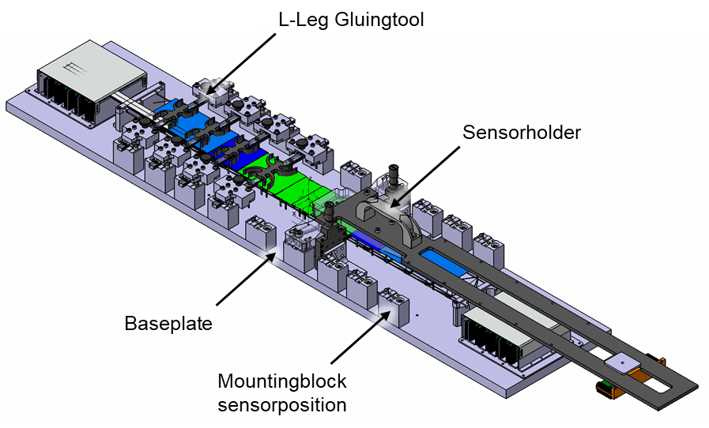
Assembly Tools @ GSI
Ladder Assembly Jigs – Status @ GSI
Modular design of Jigs:
Some different base plates
Set of mounting blocks of the sensorpositions,
Gluingtools (L-Legs)
Set of Sensorholders
→ large number of different ladders
can be assembled with a small number
of parts for the Jigs
One ‘Set of Assembly Jigs’ consist of:
approximately fifteen base plates (1 plate
for some similar ladders)
thirty mounting blocks (useable for ALL ladders)
sixteen sensor holders
twenty L-Leg gluing tools

Slide 10
Assembly Workflow
Gluing the Ladder on the bearings
Gluing L-Legs on the Ladder
Gluing Sensors successively on the L-Legs
Mainly three steps procedure:
Curing time I
Curing time II
Curing time
III

Slide 11
Assembly Workflow: First part
1. Cutting and cleaning the CF-ladder
2. Assembling and cleaning the Jig
3. Gluing ladder on bearing blocks
Once per ladder
4. Support long ladders to prevent deflection
5. Preparing the gluing positions of ladder and L-legs
6. Assembling the L-Leg gluingtool incl. L-Legs
7. Gluing the L-Legs on the ladder
Once per ladder
8. Disassembling the L-leg gluingtools
Ready for sensor gluing
Curing time I
Curing time II

Slide 12
Assembly Workflow: Second part
9. Assembling of vertical positioner
10. Checking sensor orientation
11. Cleaning of sensor holder
12. Positioning of sensor onto the sensor-holder
- Check of position with microscope - applying negative pressure
13. Fixing cables on sensorholder
14. Applying glue on L-Legs
15. Turning around sensorholder and position it on the Jig – support the FEBs
Depends on amount of modules
16. Removng the sensorholder
17. Disassembling Vertical Positioner
Once per assembled ladder
Curing time III
Assembled ladder

Slide 13
Manpower & Time
assumption
Based on an average amount of modules for assembly of one ladder of 8.23 modules:
Assembly steps | Iteration factor | Working Time [min] | Time [days] (curing included) | Persons
1-3 | 1 | 70 | 1 | 1
4-7 | 1 | 110 | 1 | 1
8 | 1 | 20
9-15 | 5.12 | 493.8 | 5.12 | up to 3
16-17 | 1 | 160 | 7.12 | 1
→ 1.42 weeks per ladder
Note: Assembly steps 16-17 in parallel to Assembly steps 1-3 of the next ladder to be assembled
Simultaneous activities on different ladders (at different assembly stages) as often as possible ☺

Slide 14
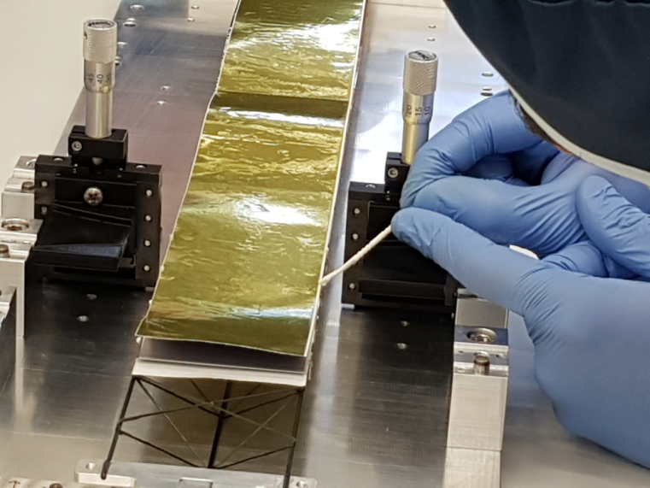
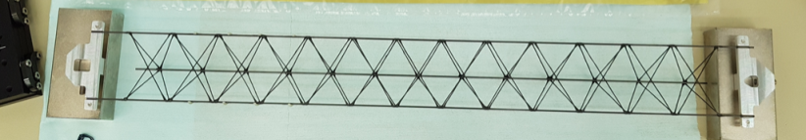
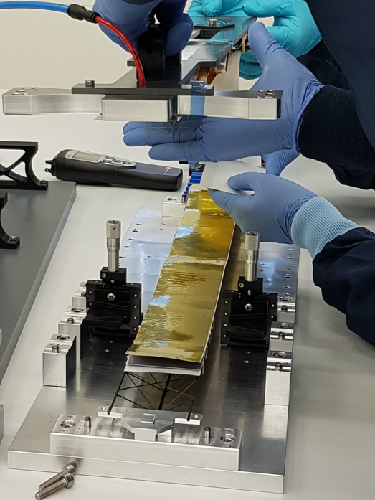
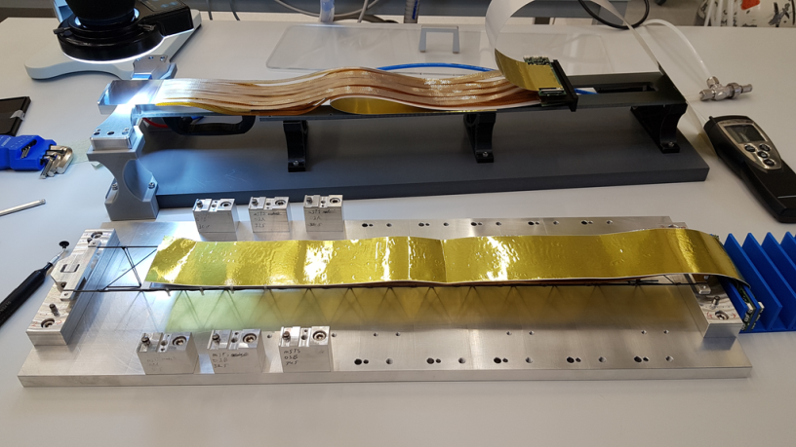
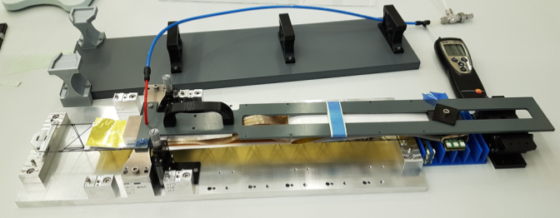
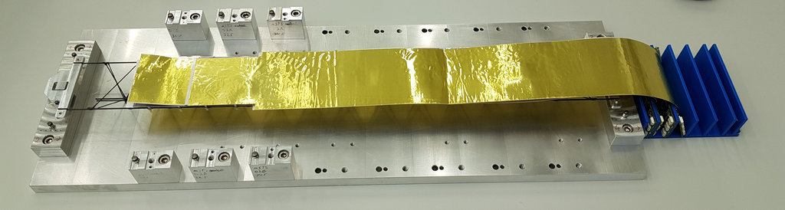
Ladder Assembly in pictures
e.g. Ladder #0 for mSTS
Transfer of module #1 to ladder
Application of glue onto L-legs
module #0 installed on Ladder
module #1 on transfer tool
module #1 transferred, fixed during curing of glue

Slide 15
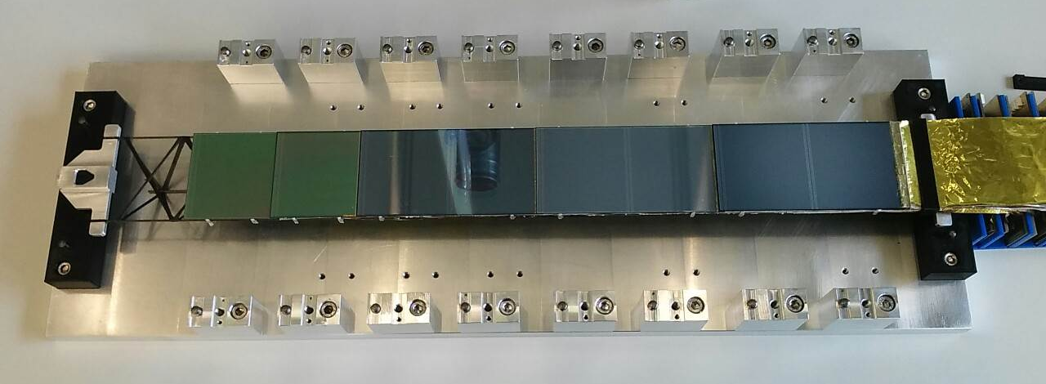
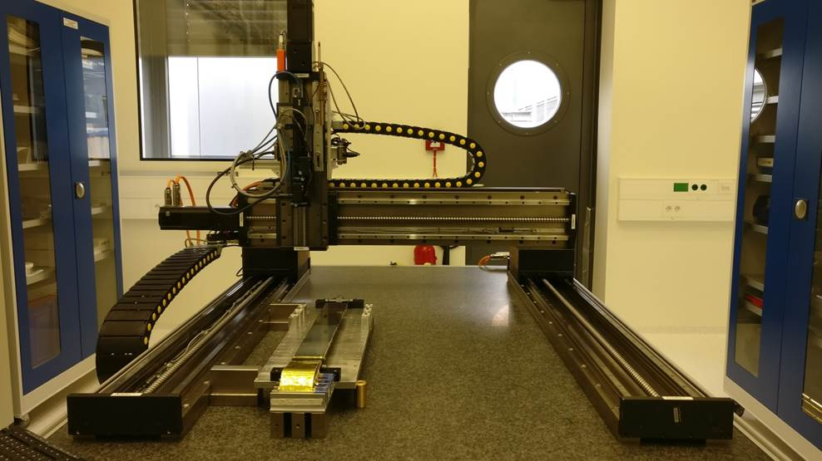
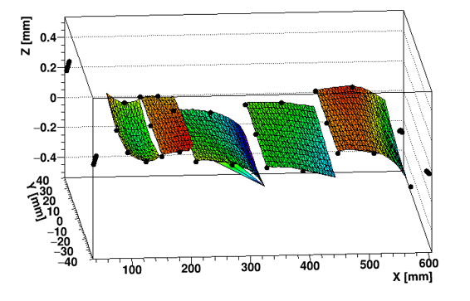
Assembled Ladder in pictures
Metrology measurment of sensor
positions on ladder

Slide 16
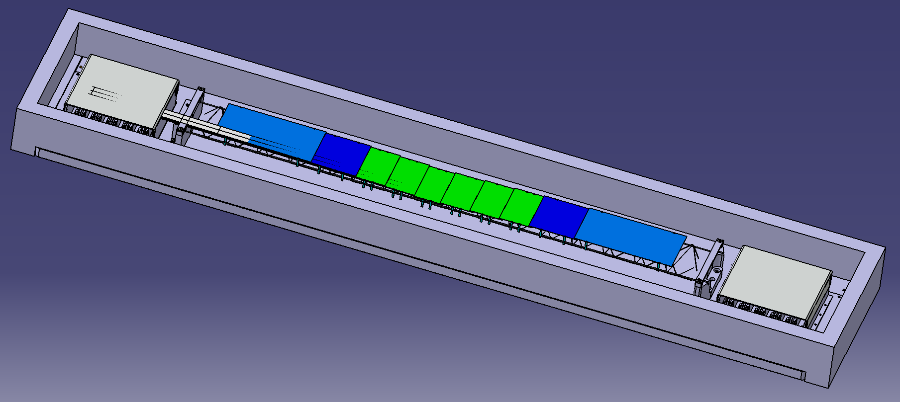
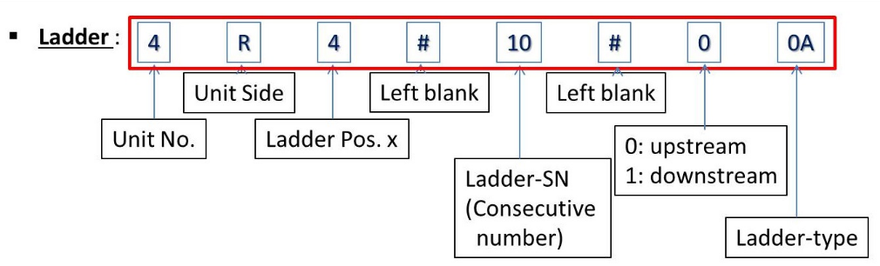
Assembled Ladder: Storage
Storage Box of an assembled ladder (design to be finalized)
Assembled ladder & baseplate are stored within
FEB Boxes and Bearings are fixed within
ESD protective

Slide 17
Test Records and Documentation
Ladder Assembly as part of the overall STS data logistics workflow:
Documentation of workflow status and possible ‘events’ during assembly and/or testing:
electronic logbook elog
QA data to be stored at Central storage place, before Component database (DB) upload initialized
(also logistics aspects are stored herein)
Test records/Bill of Materials (BOMs), based on ‘Assembly on demand’ are provided to the
Assembly Team via Redmine
elog example:
Ladder assembly workflow as interactive workflow sheet/checklist
Check of correct nomenclatures (BOM consistency) included
To do:
Individual checklist steps have to be adopted due to optimized workflow (work in progress}
Nomenclature checks have to be adopted due to necessary additional labeling of CF structures
Consistency checks & User Alert/Warnings, etc. have to be implemented
(successfully tested for Module Assembly Workflow sheet already )

Slide 18
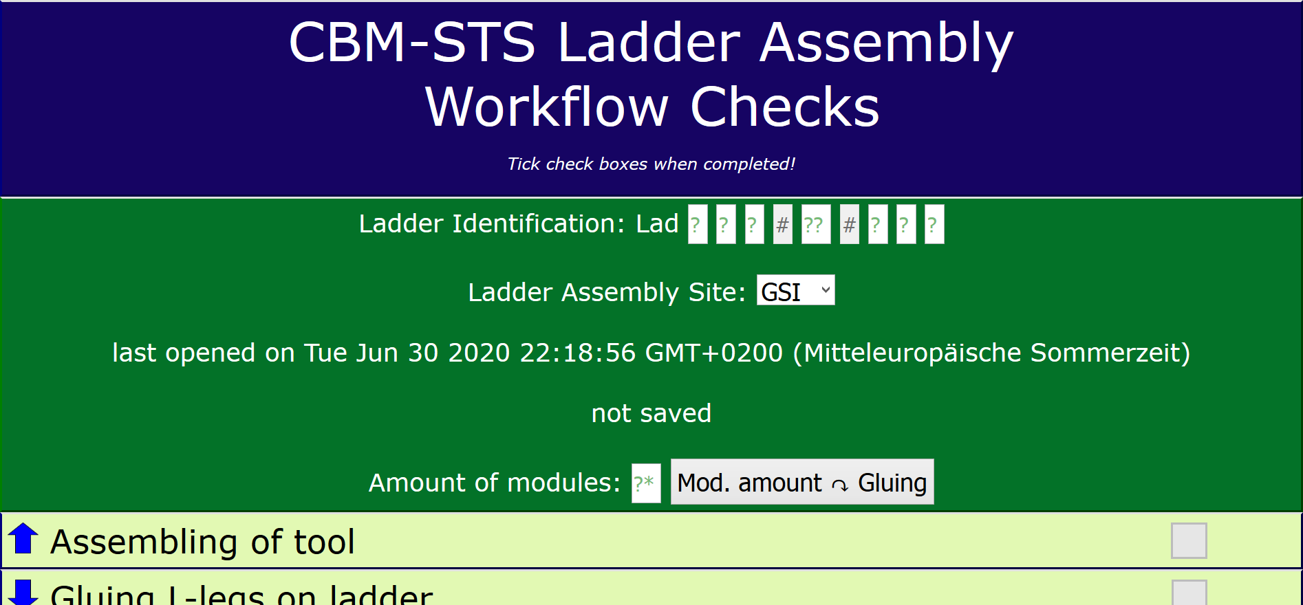
Interactive workflow sheet as part of
Ladder Assembly elog

Slide 19
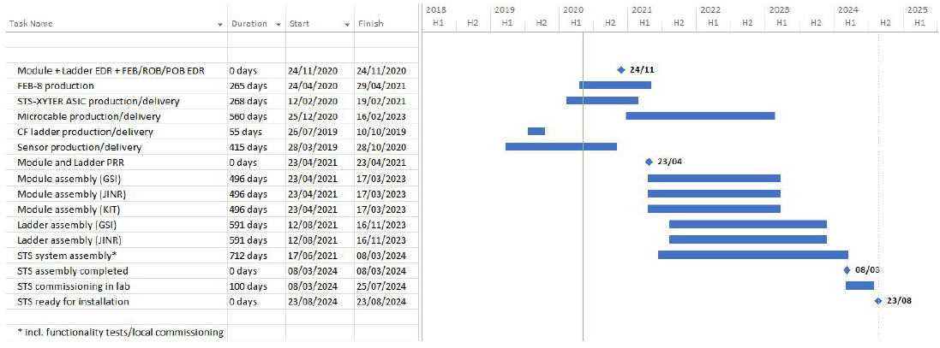
Timelines
today
start series production
CBM Project Timeline:
2020
2021
2022
2023
M7 Ladder Series Production
Module and Ladder Production Readiness Review: 04/2021
Module and Ladder Series Production: 04/2021 – 11/2023
STS system assembly and commissioning in laboratory: 06/2021 – 08/2024

Slide 20
We are well set up and actively working towards matching the milestone M7

