Slide 1
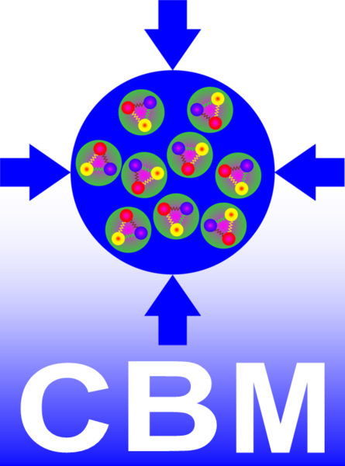
Towards Milestone 6 (Month 12): First detector ladder for BM@N-STS [assembled and tested]
Dmitrii Dementev for JINR STS group
CREMLINplus WP2 kick-off meeting
Jul 1, 2020

Slide 2
BM@N STS Ladder
Si sensor
Micro-cables
FEB-box with front-end electronics
Bearings
4 BM@N STS Stations;
34 ladders;
292 modules;
Carbon-fiber frame

Slide 3
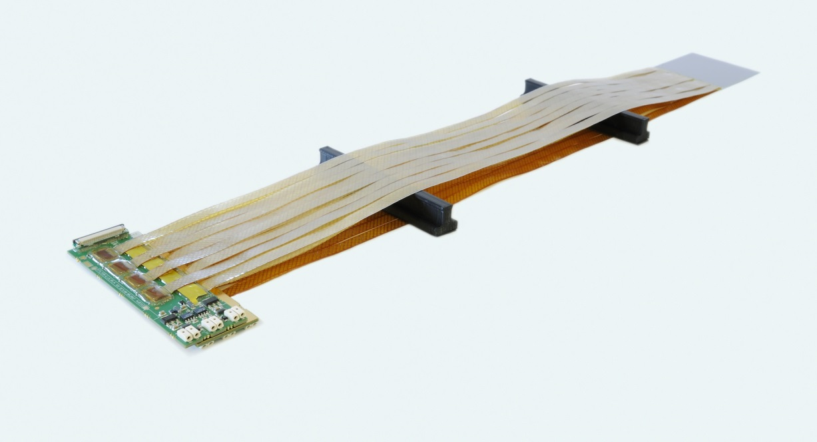
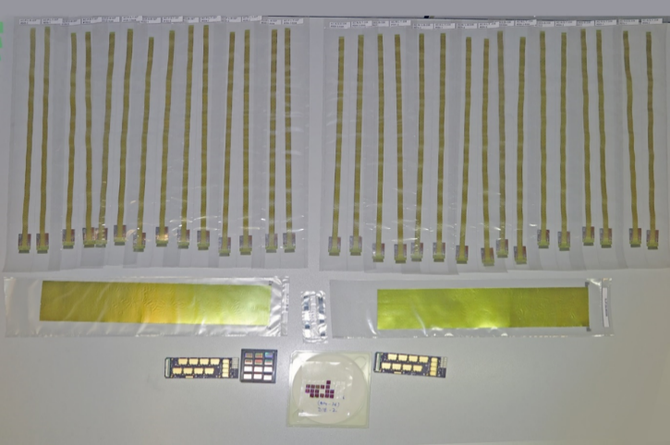
STS Module
Micro-cables
Si-sensor
Front-end boards
Assembled module (GSI)
Module components
Assembled module covered with shieldings (JINR)

Slide 4
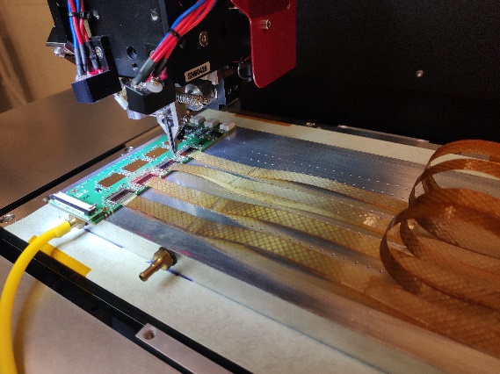
Module assembly at JINR
Current status:
Set of jigs was developed and produced;
Assembly workflow developed and tested on the mockups and first operational modules;
QA tests during and after assembly were developed and implemented in Elog;
Still a big step should be done to start serial production.
Module assembly team:
A.Sheremetev, N. Sukhov, T. Andreeva, T. Semchukova
Delays caused by pandemic control measures in RF:
2.5 month pause in the assembly cite;
Assembly of a new module started this week
Module assembly

Slide 5
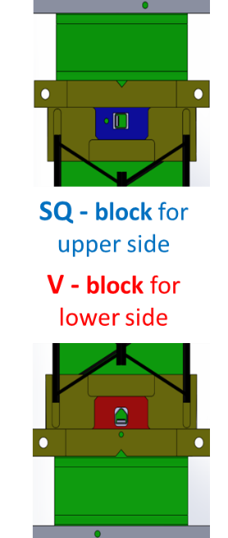
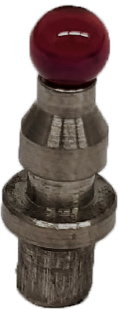
CF frame and bearings
CF-truss with bearings
All CF trusses are already produced at CERN and delivered to JINR;
Jigs for gluing of ruby-ball bearings were developed and produced for all ladder lengths;
Stuff involved:
A.Voronin, I.Gorelikov*, S. Igolkin as a consultant
*CREMLINPlus position
Bearings for the precise positioning
of the ladder on ruby-balls pins

Slide 6
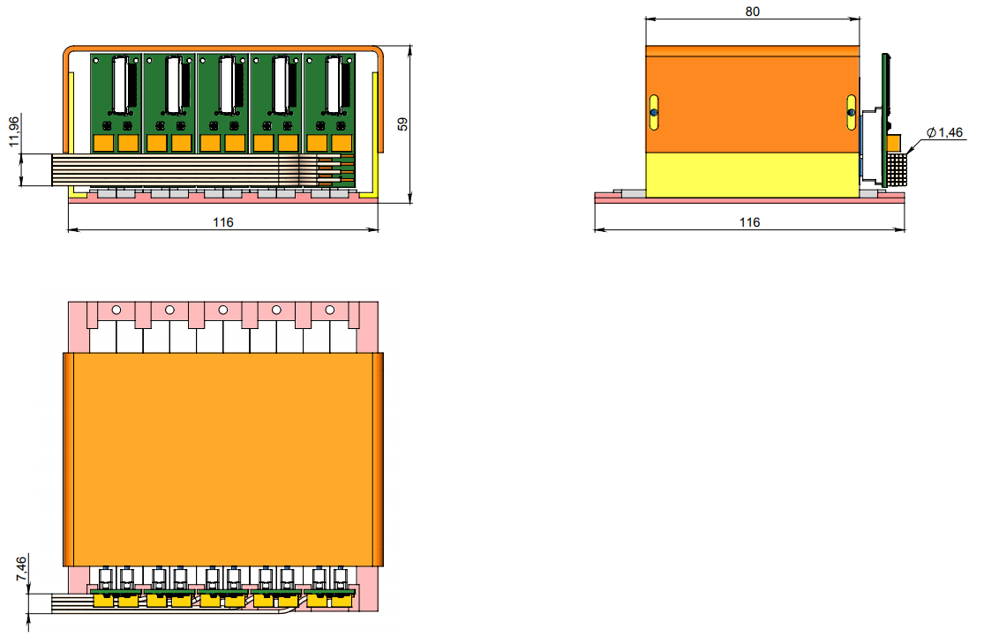
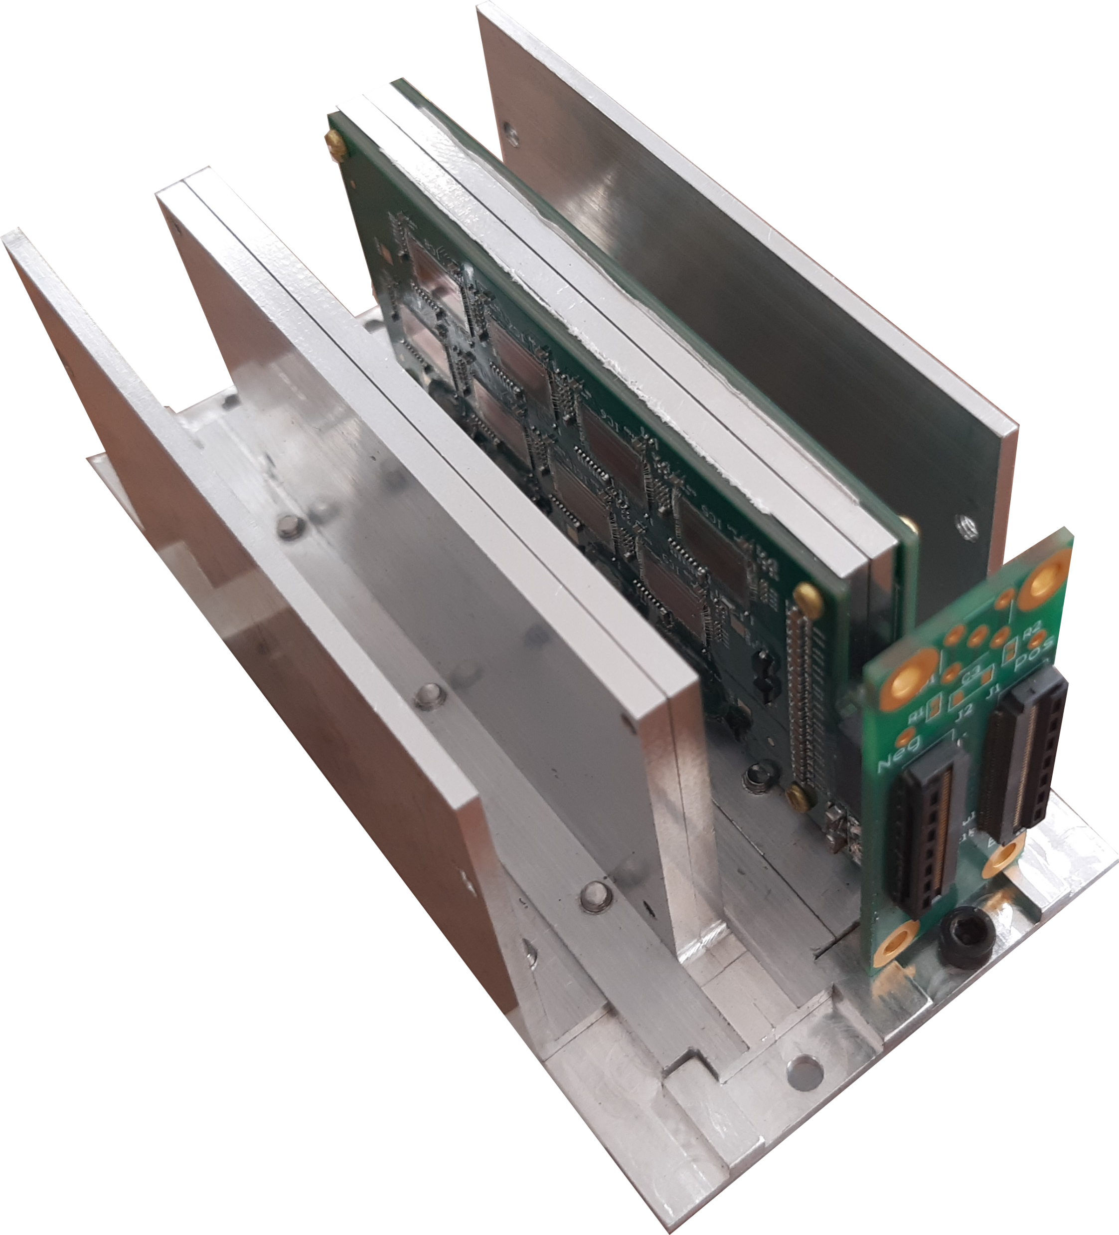
FEB-box
Workforce:
A.Baranov (SINP MSU) - design development;
T.Lydenova* – thermal tests.
*CREMLINPlus position

Slide 7
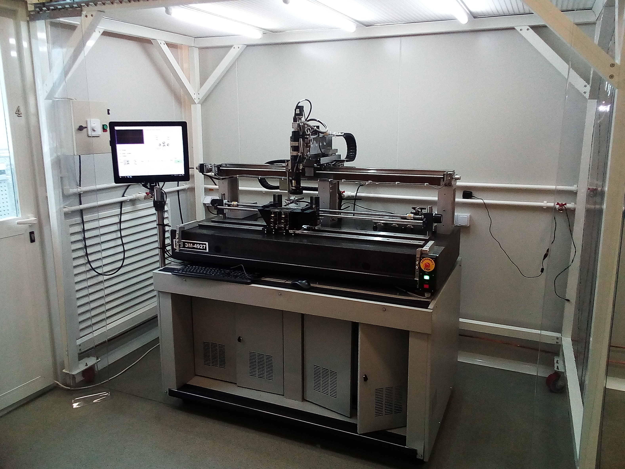
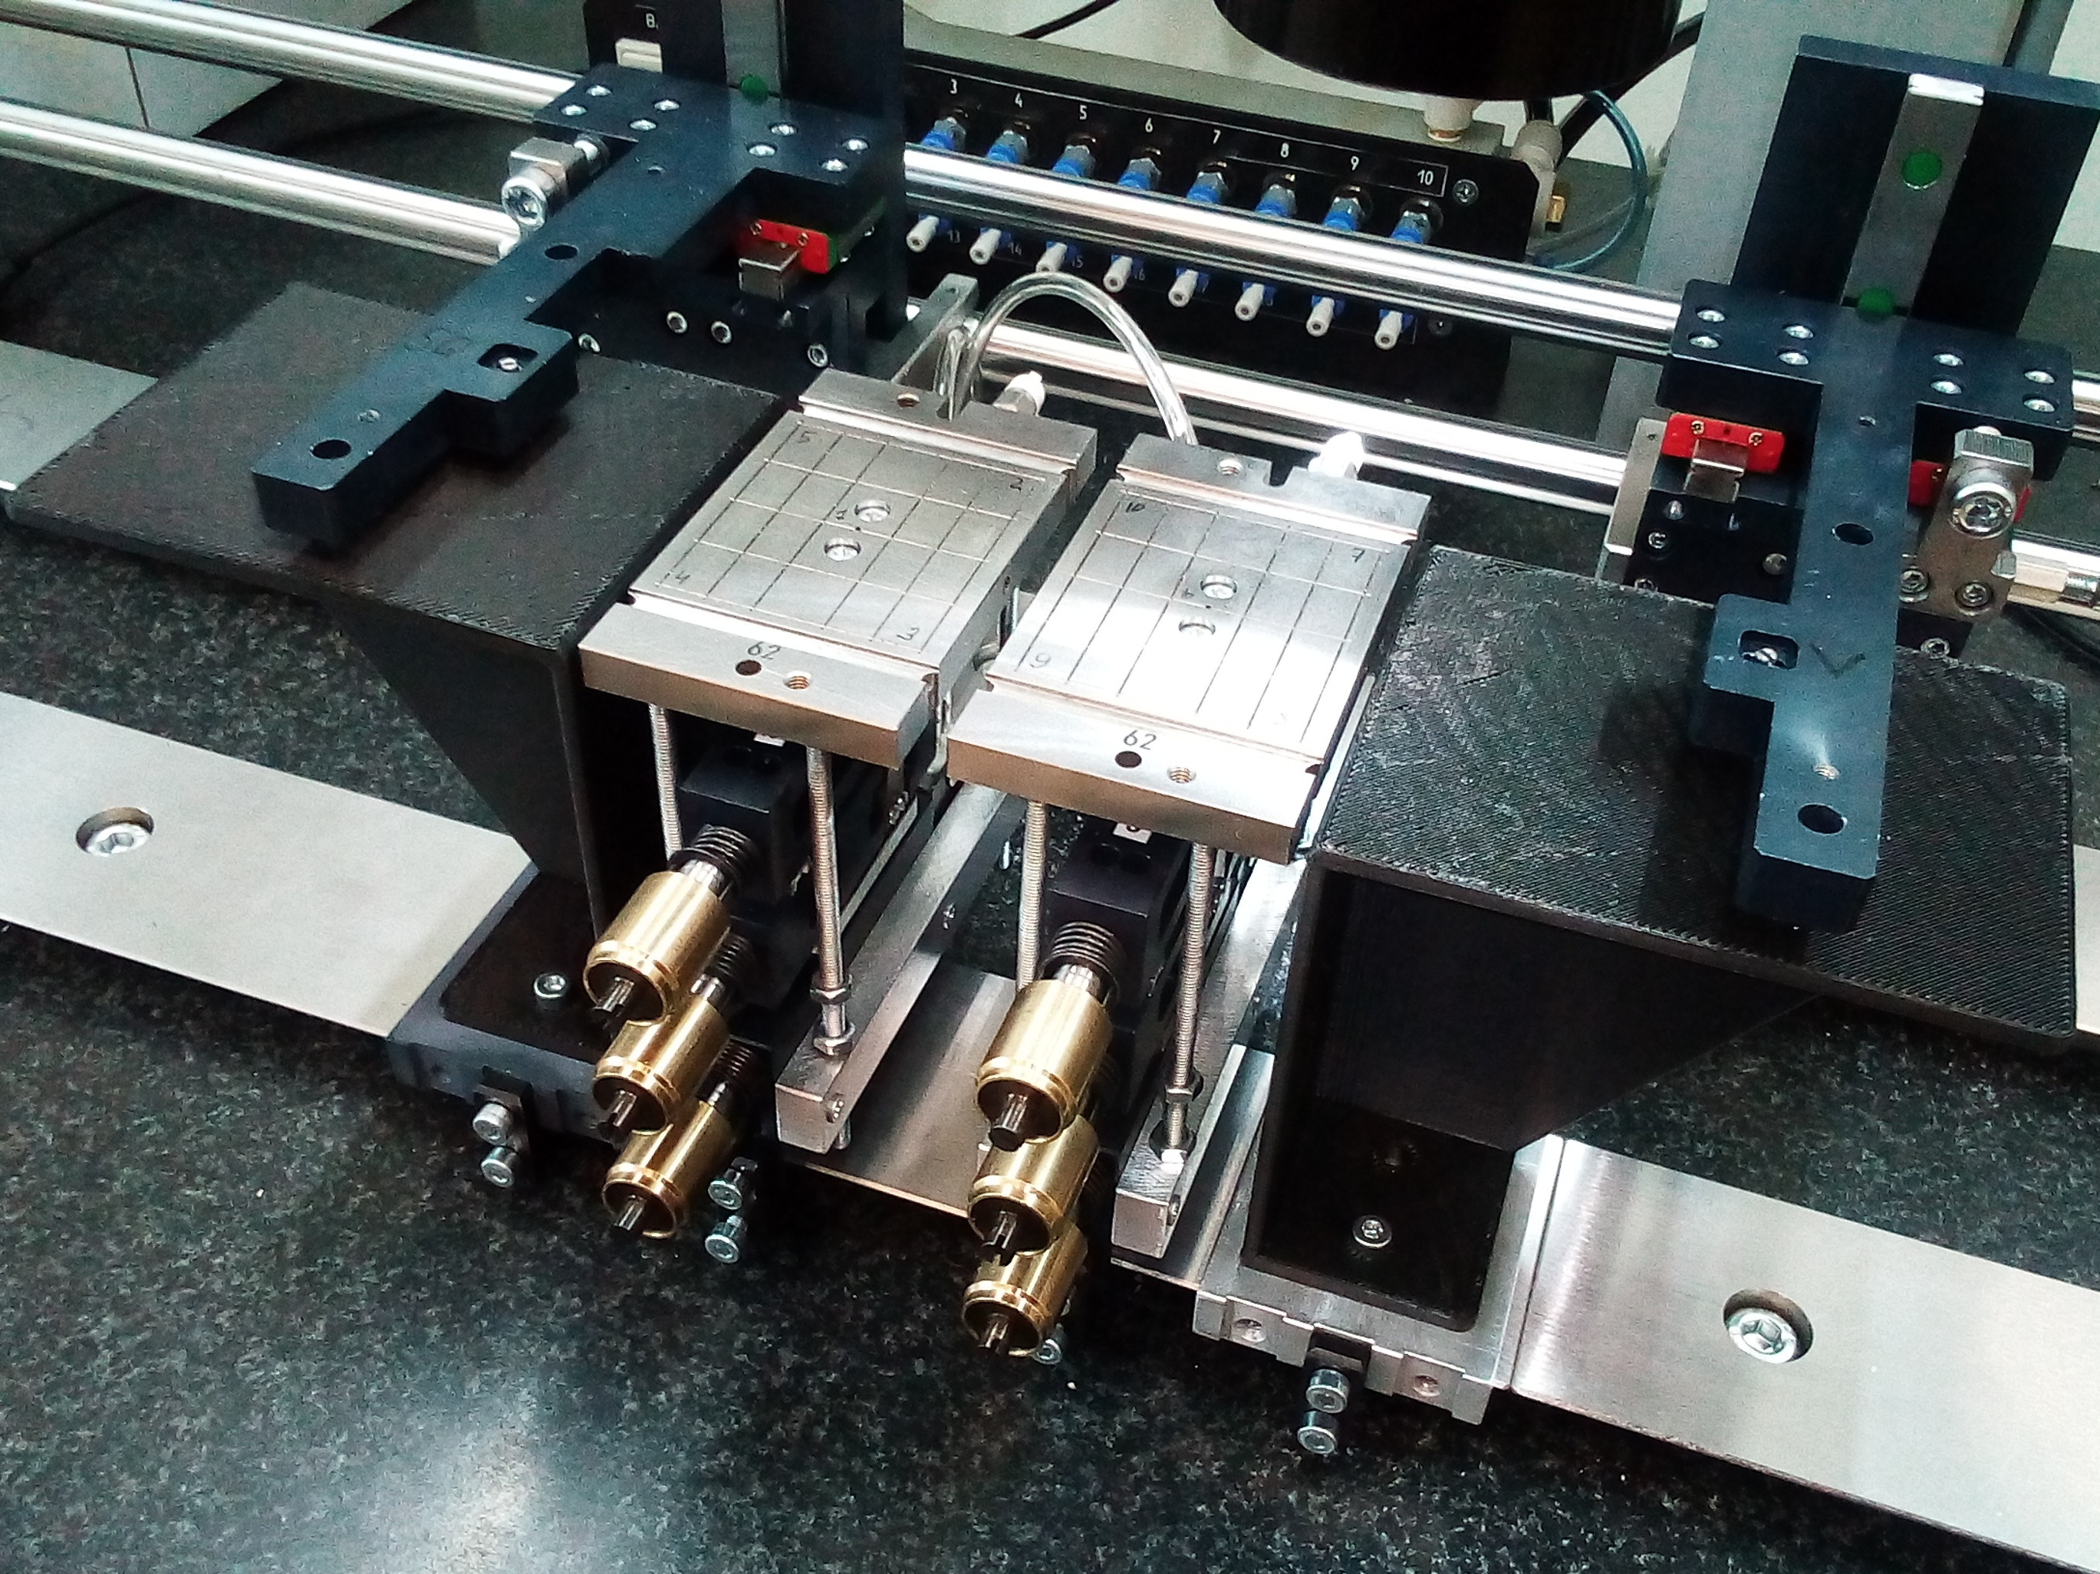
JINR Ladder Assembly Device
LAD consists of:
optical system, which is used for the monitoring of the sensor position in a horizontal plane and has an accuracy of 2μm.
different sets of sensor positioning tables with micro-screws
lift unit for the vertical displacement of the ladder sensor supporting CF truss.
Device is installed on the heavy diabase table to avoid vibrations of the LAD during operation.
LAD should provide the following accuracy of the sensor positioning:
X coordinate: ±15 μm on 1200 mm along the truss;
Y, Z coordinates: ± 50 μm across the truss;
Ladder assembly team:
V. Elsha, A.Baranov

Slide 8
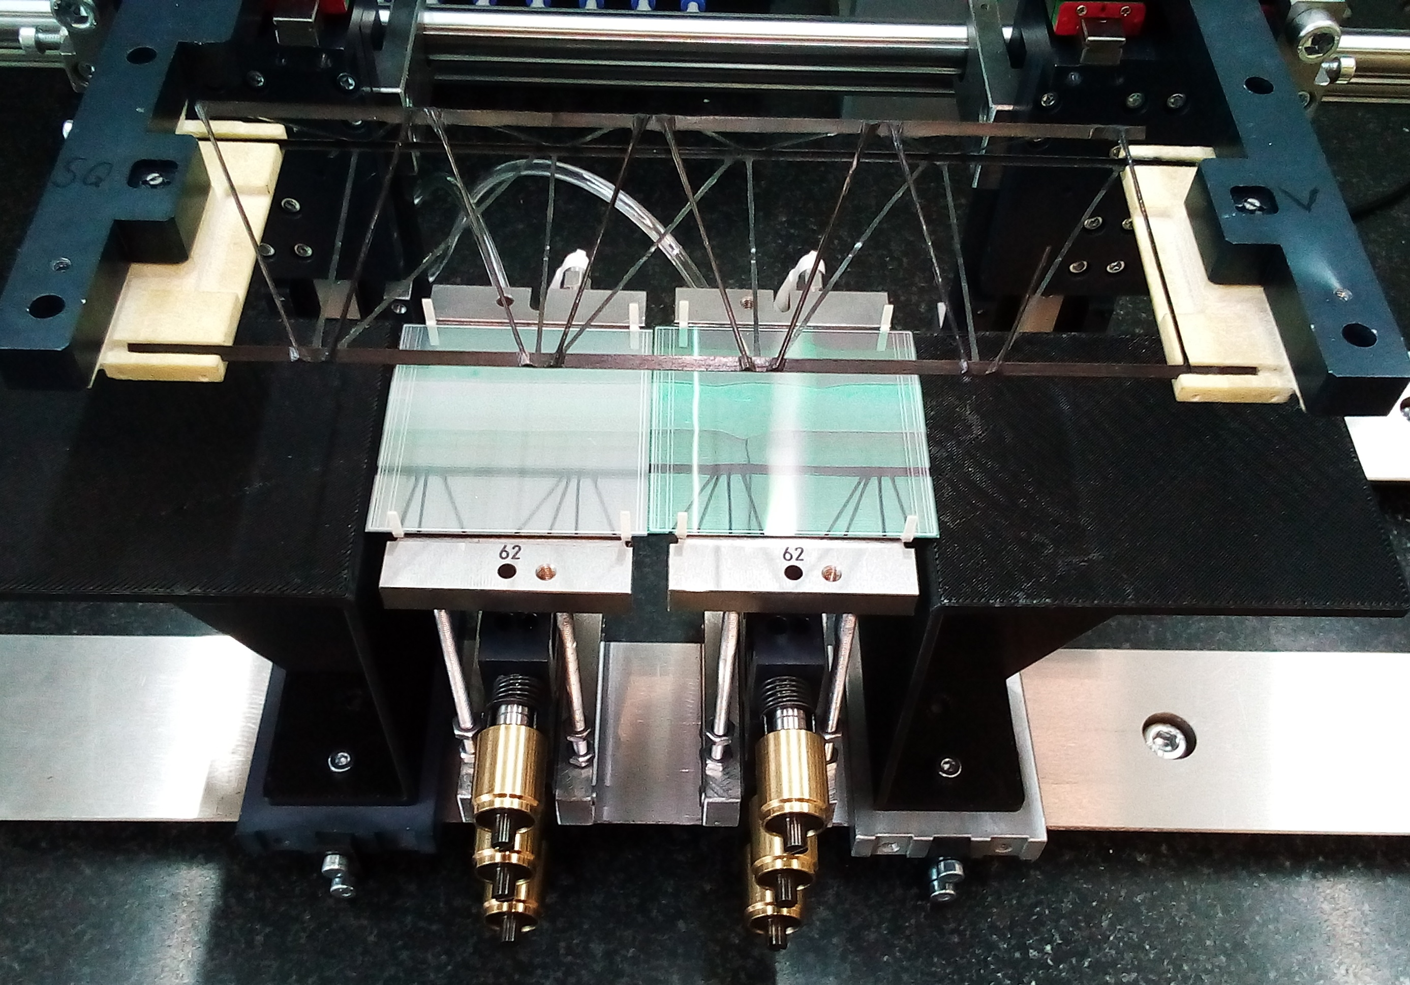
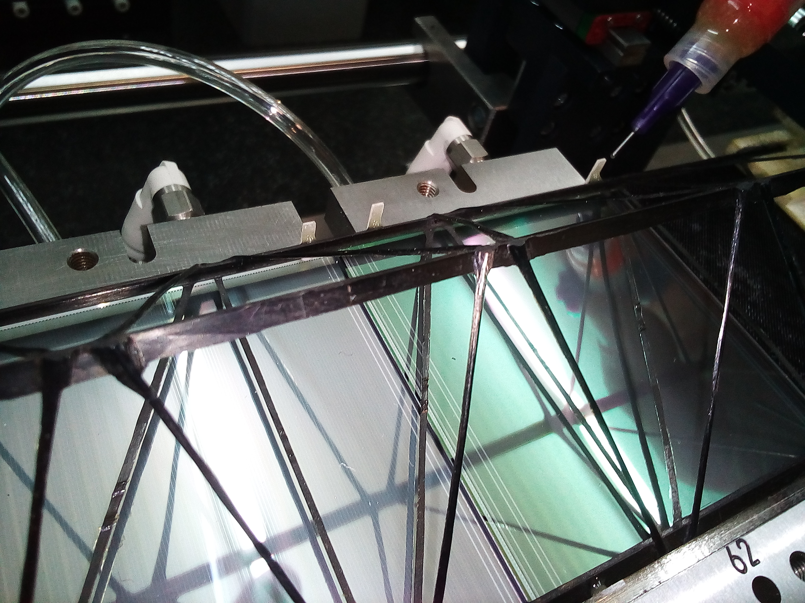
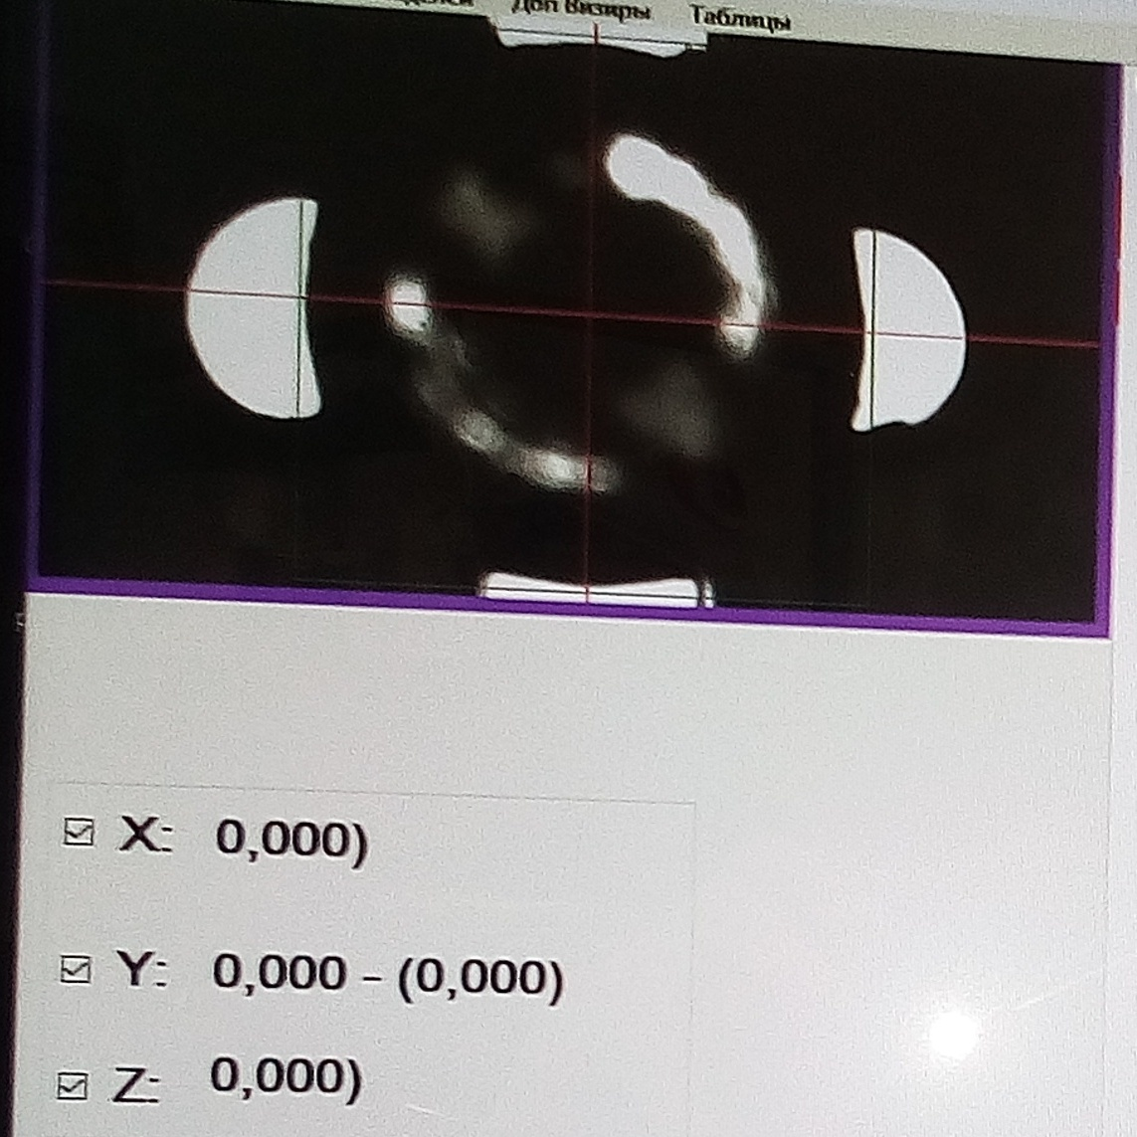
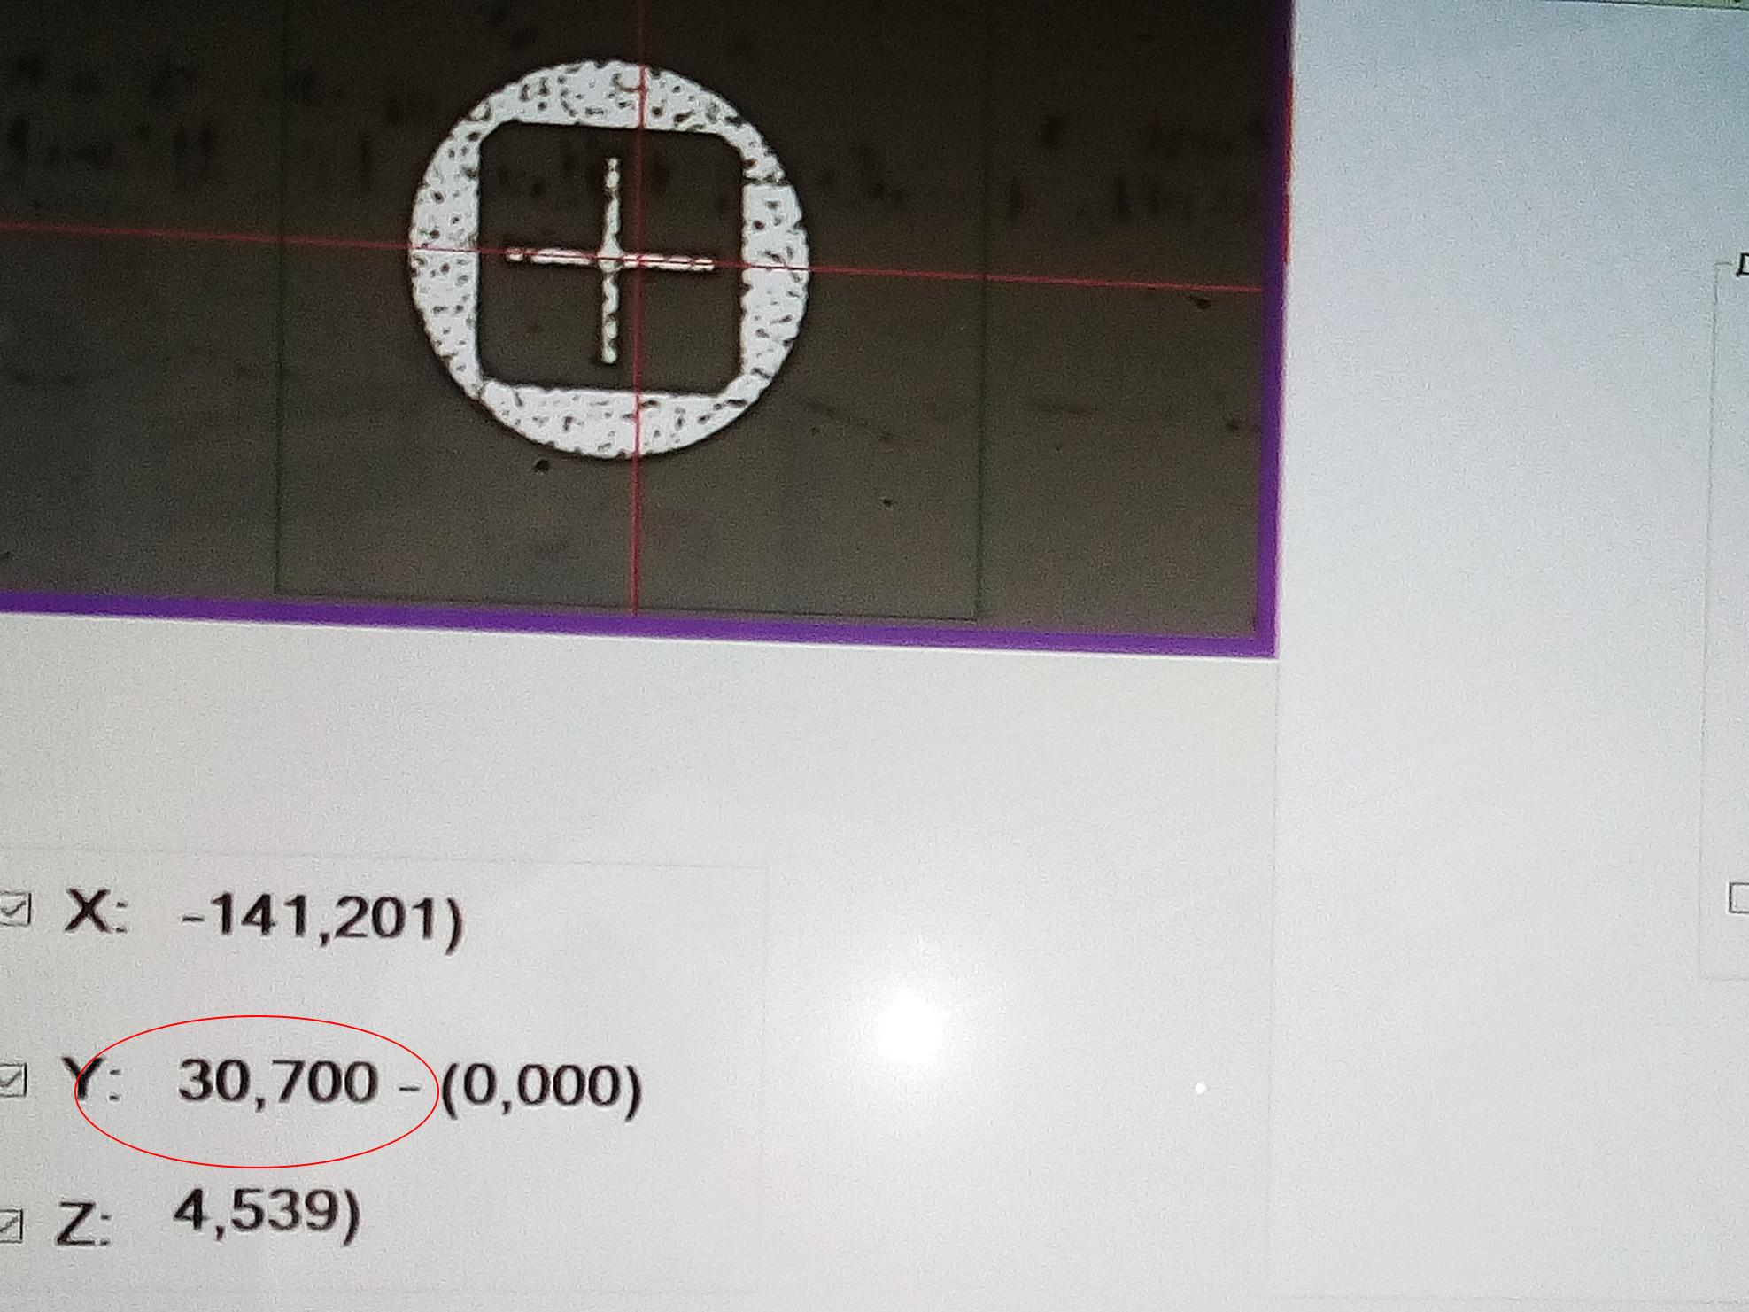
First assembled mockup of the ladder
Lifting down the CF frame on pre-aligned sensors
Gluing of sensors to CF truss

Slide 9
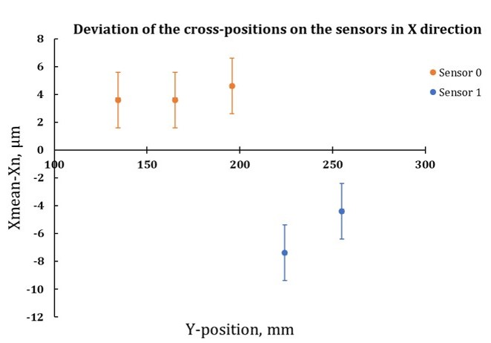
First assembled mockup of the ladder
Fiducial marks on sensors
Mockup of the ladder
Measured deviations of X coordinates of the fiducial
marks on the sensors from the mean value.

Slide 10
Open tasks
Task | Taskforce
Upgrade of jigs for LAD: | V. Elsha, Planar Ltd
Software developments for LAD: | M. Korolev (SINP MSU), Planar Ltd
Cable-clamp development: | V. Elsha
Development of the ladder-carrying jig: | V. Elsha
Development of the ladder test box | V. Baranov, M. Merkin (SINP MSU)
Delays caused by pandemic control measures in RF:
2.5 month pause in the assembly cite;
Assembly of the mockup of 1st BM@N STS station ladder mockup started this week
Mockup of the ladder-carrying tool

Slide 11
Metrology of assembled ladders
Features:
Measuring area (XYZ): 905 x 2005 x 605 mm
Equipped with a contact and optical sensor;
Accuracy ~ 1.8 um;
Current status:
Delivered to JINR;
Installation is postponed till 2021 due to absence of available space
Personnel:
One vacant CREMLINPlus position for the metrology
Mitutoyo Crysta-Apex S9206

Slide 12
CMIS
People involved:
C.C. Sanchez, E. Tsapulina*
* CREMLINPlus position
The Construction Management Information System (CMIS) adopted by the STS department for the NICA projects at JINR, is an Oracle-based all-around project management database system, that allows the organization and follow-up of every aspect of the project.
It will be hosted at LIT JINR and is the same one that is being used by the ALICE collaboration at CERN for the production of the ITS2 and MFT detectors.

Slide 13
Towards first detector ladder
Milestones:
Mockup of the ladder of 1st BM@N STS station – Aug 2020
4 Modules + spare operational and tested for the assembly of 1 STS ladder – Oct 2020
Operational ladder for the 1st BM@N STS station assembled and tested – Dec 2020
People involved:
Module assembly: 2 engineers + 2 technicians;
Ladder assembly: 1 engineer;
Jigs and S/W developments for LAD: 2 engineers from SINP MSU + Planar Ltd.
Tests of assembled ladder: 2 PhD students;
CMIS developments: 1 Postdoc + 1 Engineer.
Personnel hired for CREMLINPlus Task 2.1:
Ekaterina Tsapulina – engineer
Tuyana Lygdenova - engineer
Ilya Gorelikov – technician
Margarita Perez - technician

Slide 14
Thank you for your attention!

