Slide 1
CREMLINplus Task 2.1: Integration, installation, and test of Silicon Trackers for NICA and CBM − Aim, participants, milestones and deliverables −
Johann M. Heuser, GSI Helmholtz Center
Kick-off Meeting, 1 July 2020

Slide 2
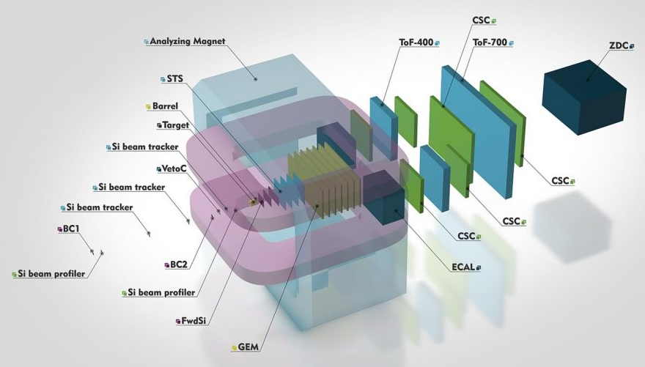
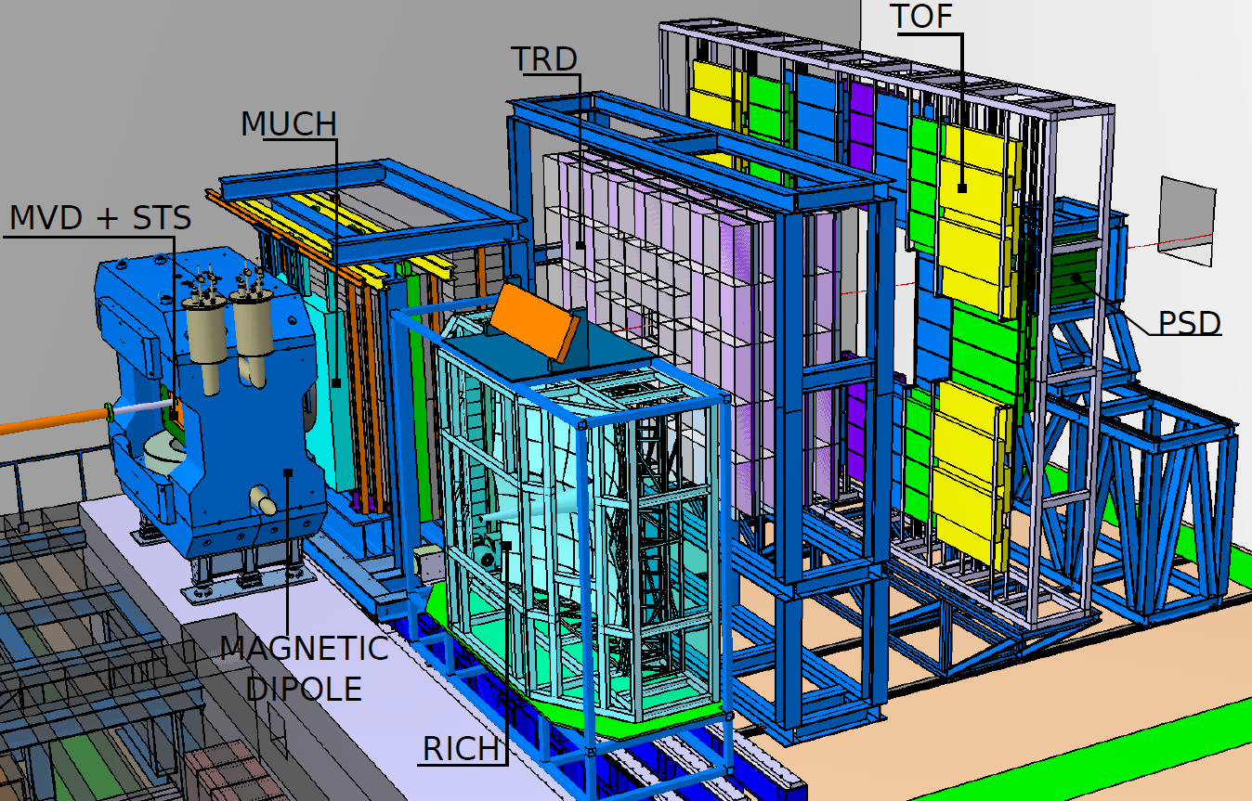
Silicon Tracking System (STS) detectors in the experiments BM@N/NICA/Nuclotron and CBM/FAIR
BM@N + CBM: stationary-target heavy-ion physics experiments to study nuclear matter at highest densities
closely linked/complementary in terms of physics … and also technology: e.g. STS detectors
STS
STS
BM@N-Collaboration
CBM-Collaboration

Slide 3
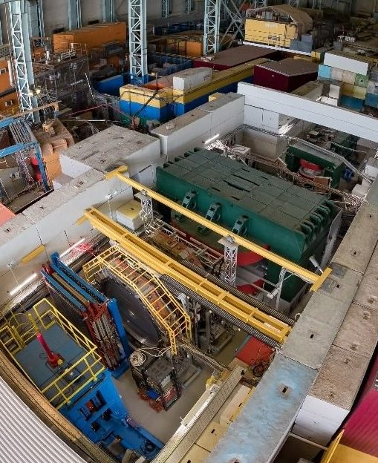
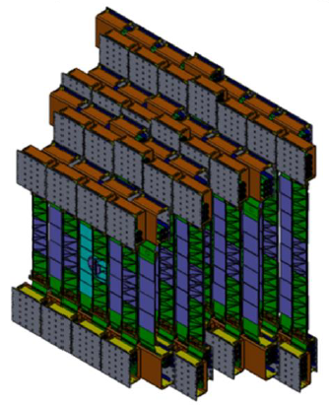
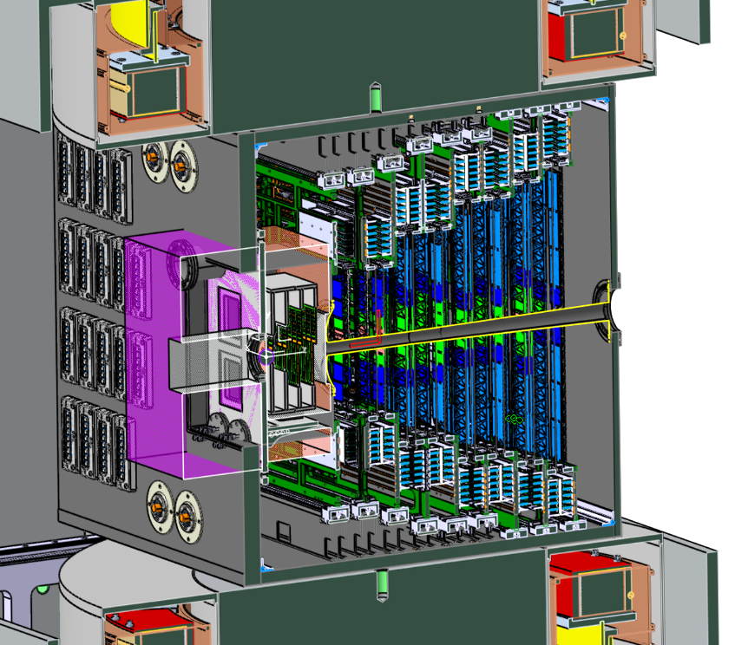
Silicon Tracking System (STS) detectors in the experiments BM@N/NICA/Nuclotron and CBM/FAIR
CBM STS
BM@N STS
BM@N
in operation
CBM + FAIR
under construction

Slide 4
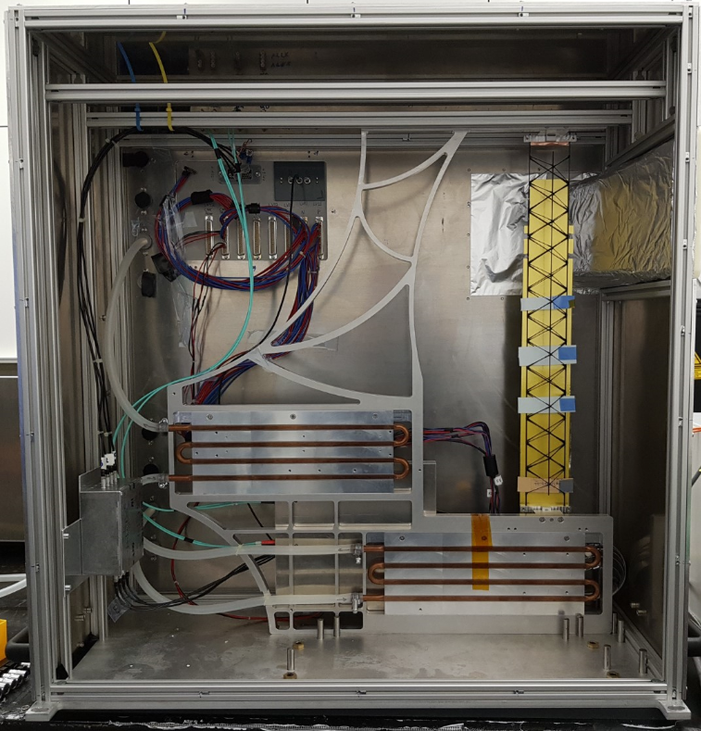
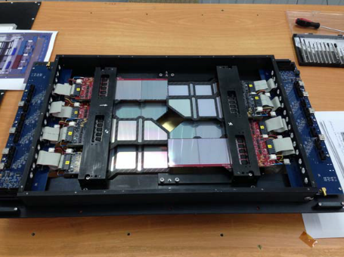
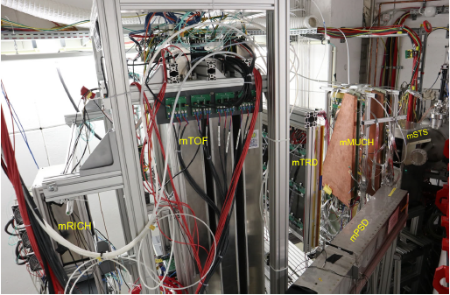
Silicon Tracking System (STS) detectors in the experiments BM@N/NICA/Nuclotron and CBM/FAIR
mSTS test detector operating in mCBM
initial Central Strip Tracker
BM@N
in operation
CBM + FAIR
under construction
mCBM demonstrator experiment at SIS18

Slide 5
Aim of this EU project task:
micro cables
advance at JINR and FAIR to starting series assembly of STS detector ladders.
specific ladder variants for BM@N and CBM
(1) module assembly
Si sensor
read-out electronics
(2) carbon fiber frames
for BM@N: 292 modules / 34 ladders
for CBM: 979 modules / 106 ladders
up to 10 modules per ladder
(3) ladder assembly
(photomontage from two prototype CBM half-ladders)

Slide 6
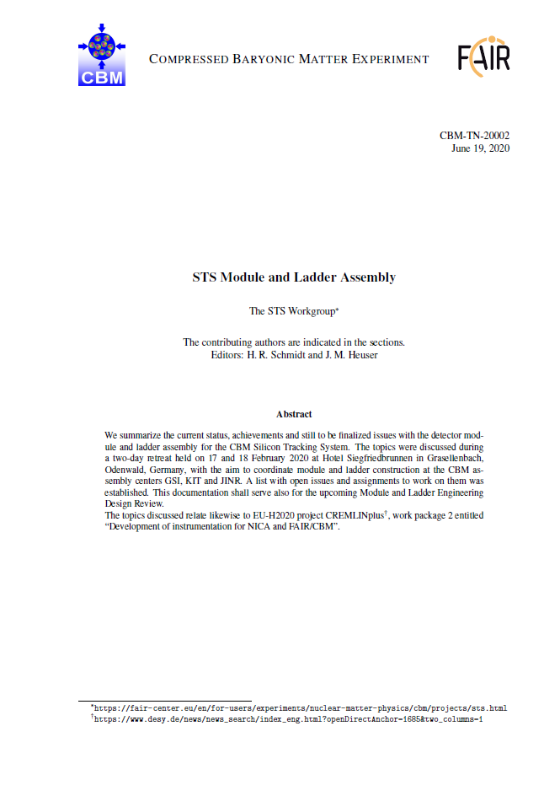
Teams in WP2.1:
FAIR / GSI
Univ. Tübingen (EKUT)
JINR
members in both* the CBM and BM@N Collaborations
* FAIR / GSI membership in BM@N to be confirmed participation through German-Russian Roadmap “Scientific and Technological Cooperation for the Next decade”
CBM Workshop, 17 and 18 February 2020
Teams are part of long-established CBM-STS work group
“STS Module and Ladder Assembly”
addressing exactly the tasks of WP2.1
Outcome: Technical Note CBM-TN-20002,
100 pages on status, R&D issues, logistics: input to upcoming Engineering Design Review

Slide 7
Hiring in WP2.1:
participant | hiring
FAIR / GSI | intended: 2 persons FTE status: 1 technician hired (50%) 1 engineer hired (50%) 1 postoc: job interviews held, ready to hire (100%)
JINR | intended: 4 persons FTE status: 2 engineers hired 2 technicians hired
Tübingen University (EKUT) | intended: 1 person FTE (100%) status: 1 postdoc, ready to hire (100%)

Slide 8
Milestones and deliverables
Task 2.1: Integration, installation, and test of Silicon trackers for NICA and CBM
Duration: Month 1 – Month 48 (4 years)
Milestones
Milestone number | Milestone title | WP number | Lead beneficiary | Due date/ month | Means of verification
MS6 | First detector ladder for BM@N | WP2 | 14 - FAIR GMBH | 12 | Test results presented
MS4 | Annual Meeting | All | DESY | 24 | Minutes
MS7 | Series production of detector ladders for CBM-STS started and first batch of ladders produced | WP2 | 14 - FAIR GMBH | 24 | Test results presented
MS5 | Annual Meeting | All | DESY | 36 | Minutes
MS6 (Month 12)
MS7 (Month 24)

Slide 9
Milestones and deliverables
Task 2.1: Integration, installation, and test of Silicon trackers for NICA and CBM
Duration: Month 1 – Month 48 (4 years)
Deliverables
Deliverable number | Deliverable title | WP number | Lead beneficiary | Type | Dessimination level | Due date / month
D1.2 | Kick-off workshops for WP2-WP7 | WP1 | 1 - DESY | Report | Public | 7
D2.1 | STS components assembled | WP2 | 14 - FAIR GMBH | Report | Public | 24
D2.2 | STS detectors tested | WP2 | 14 - FAIR GMBH | Report | Public | 48
D2.1 (Month 24)
D2.2 (Month 48)

Slide 10
STS session agenda:
Towards Milestone 6 (Month 12): First detector ladder for BM@N-STS [assembled and tested] (Dmitrii Dementiev, JINR-VBLHEP)
Towards Milestone 7 (Month 24): Series production of detector ladders for CBM-STS started (Andrea Wilms, GSI)

