Slide 1
PANDA COLLABORATION MEETING
Forward Spectrometer Dipole Magnet
STATUS AND PLANS
24 June 2020

Slide 2
Specification for Dipole magnet
Field integral along beam axis (z-direction) 2.0 T·m
Field integral in midplane (y=0) along x= 75 cm > 1.70 T·m
Total length ≤ 2.52 m
Gap opening (H x W) (0.8-1.01 m) x 3.1 m
Dimensions according to model https://edms.cern.ch/document/1064100/1
Lamination of yoke ~ 10 cm
Mass of yoke with field clamp and support structure 210 tons < m < 220 tons
Steel quality of yoke St-10
Coil Resistive, water cooled
Conductor current 2.0…2.2 kA
Coil inclination ± 3°… 4°
Total weight of both coils ≤ 20 tons
Total dissipated power ≤ 400 kW
Water temperature rise ≤ 25 K
Allowable pressure drop 10 bars

Slide 3
Issues to be solved
Magnetic field integral is not less than 2 T x m
Yoke separation to avoid eddy currents
Tolerance and deformation/sag as acceptable values (0.2 mm or so)
Alignment of dipole for vertical and horizontal planes as +/- 5 mm
Power consumption is less than 400 kW
Possibility of assembling at the PANDA site
Seismic stability

Slide 4
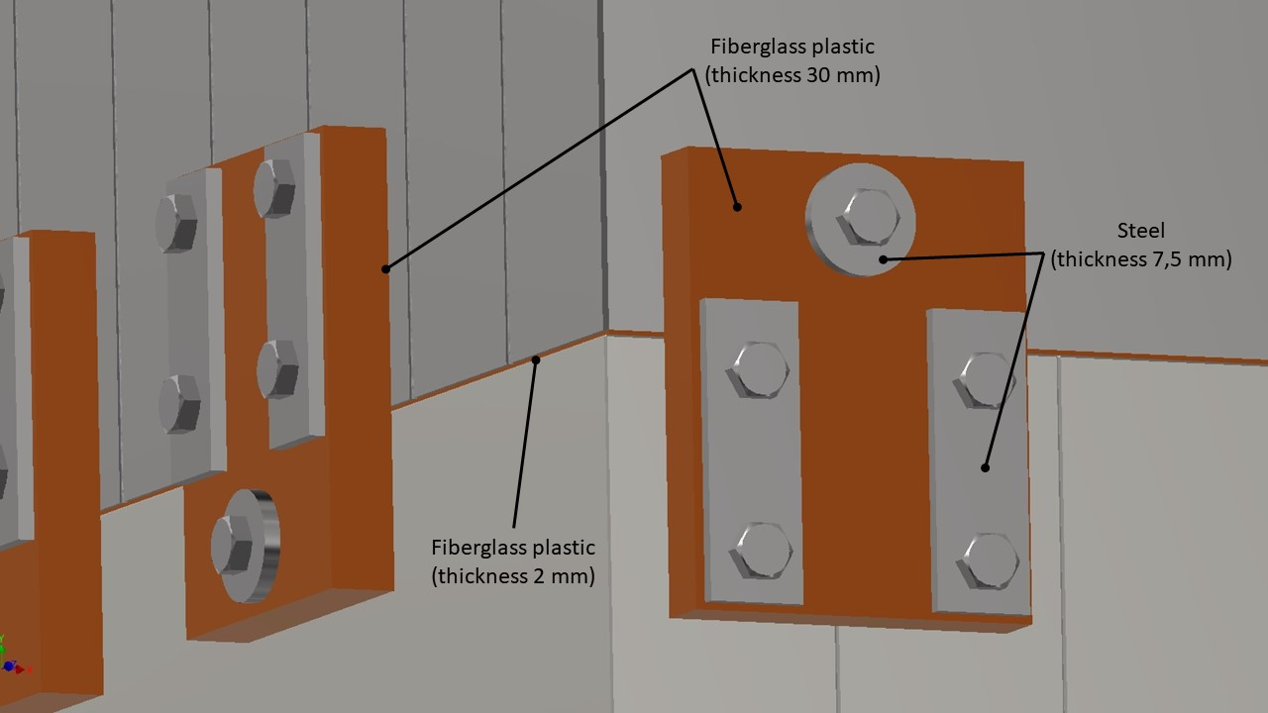
Design of Dipole Magnet - Yoke
Connecting parts must be
insulated!

Slide 5
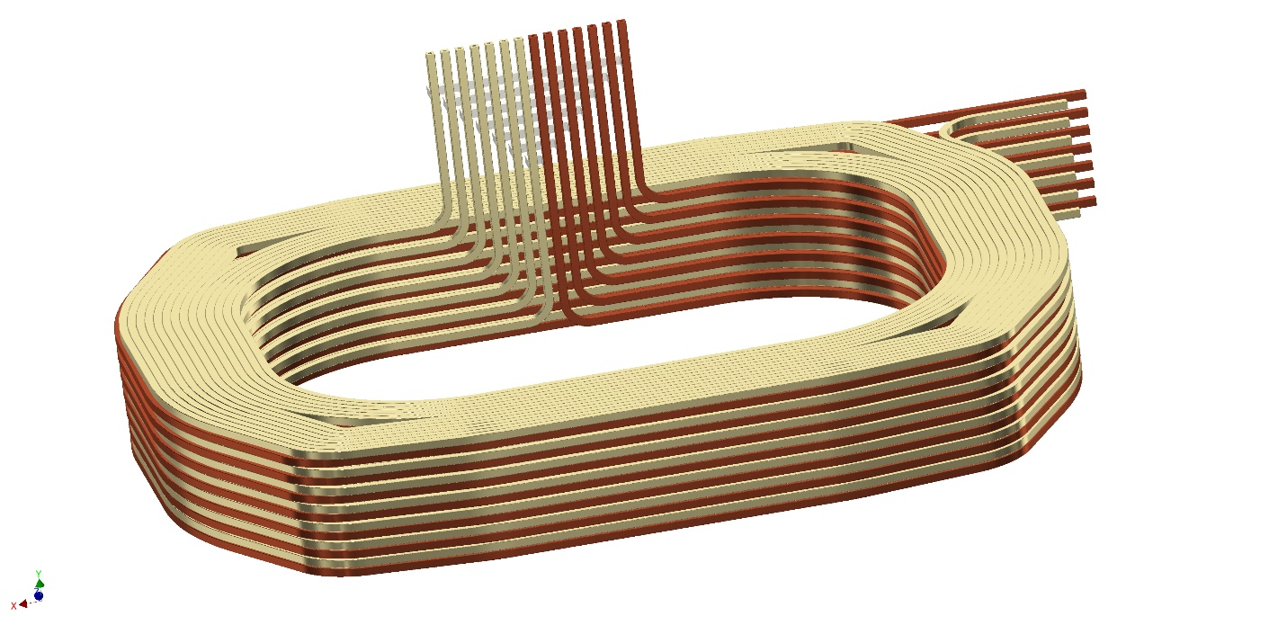
Design of Dipole Magnet - Coil
Coil section is double pancake
with individual cooling of each winding
Total coil is made as 7 sections/14 windings
Copper conductor is 26 x 26, dia. 10 mm.
Thus temperature rise is 10 deg. for 10 bars

Slide 6
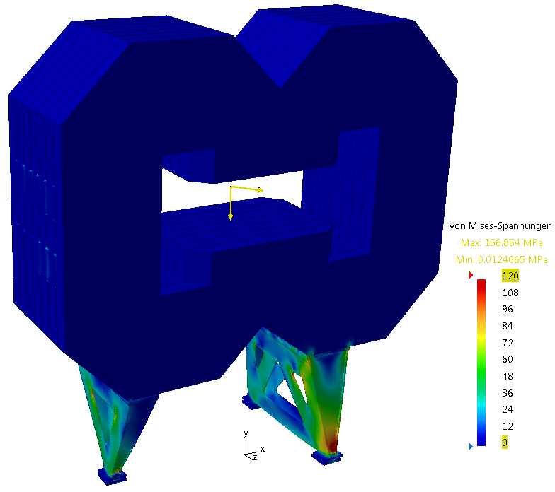
Design of support structure and stability
total weight (240 tons) applied in centre-of-gravity, horizontal load 8% of weight
highest support load in the direction of the horizontal force (see yellow force vector in the centre of gravity)

Slide 7
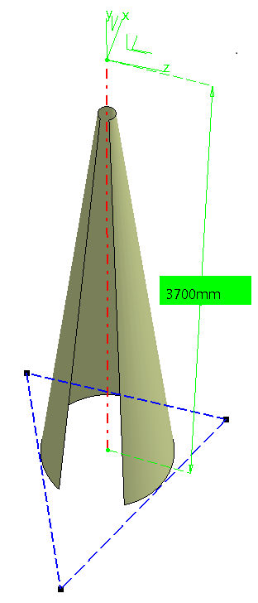
Design of support structure and stability
centre-of-gravity
foot
foot
Radius at floor level 444mm
foot

Slide 8
Deformation and stability – alignment

Slide 9
Deformation and stability
Deformation of support structure is defined by leg deformation.
Thus proper design of legs and their positions should be found following
the correct location of center of gravity.

Slide 10
Stress analysis
Installation | Displacement
 | BINP simulation | GSI simulation
No girders | 1.6 mm | 5.5 mm
II girders | 1.6 mm | 1.9 mm
V girders | 1.2 mm | 1.7 mm
Stress simulations for initial version of support structure (with no girders) shown the maximum stress as 330 MPa and related displacement as 2-5 mm. Thus vertical girders had been installed to enhance the support structure.

Slide 11
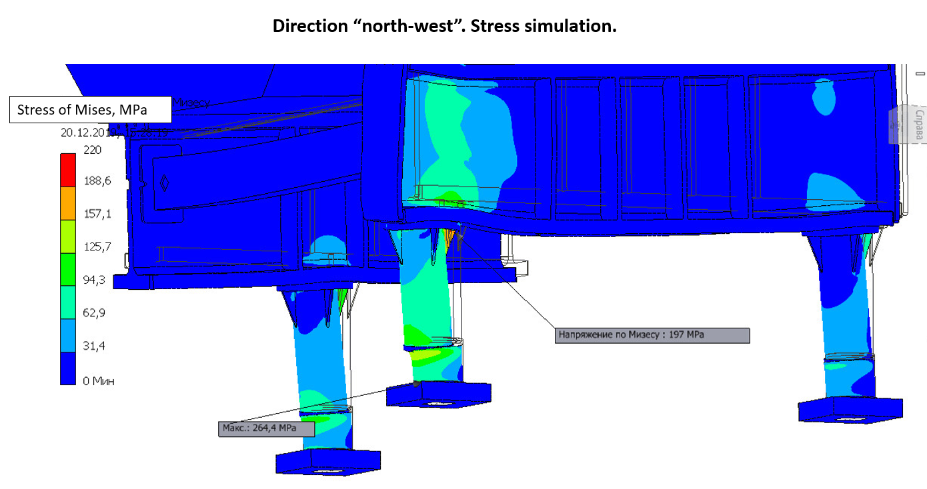
Stress analysis-2
To further reduce the stress and displacement:
The leg wall thickness was increased from 20 to 30 mm.
The triangle girder was installed under the flange of leg
Contact between surfaces was inputed with double condensed mesh
The design of ground plate for connection of jack head and leg was improved.
Finally no area with stress above
the yield strength of 255 MPa for St10.

Slide 12
Magnetic field simulations
Field distribution along dipole magnet.
Field integral is 2.1 T x m.

Slide 13
Magnetic field simulations for lines directed from IP
I have this modification.
Transverse integral field distribution for coming apart lines directed at IP
for current fraction I=0,937

Slide 14
Magnetic field simulations – eddy currents
Magnetic field rise vs. current
Then 106.7 mm thickness plate was selected
Magnetic field rise vs. current for 10 6.7 mm
The time delay is less than 0.6 sec.

Slide 15
Status
Stress analysis completed (except detail output for legs)
Magnetic field simulations completed, except repelling forces
Design of yoke (plates, blocks, halves, assembly ) completed
Design of support structure completed
Design of coils completed
Yoke machining technology developed
3D model for total magnet completed
2D drawings derived and under checking/approval of technology
Intermediate report accepted as conditional acceptance

Slide 16
Remaining issues. Repelling force for edge blocks.
From 2D code Mermaid for edge block the repelling force is 25-35 tons (by integration method over surrounding block surface).
To check the above, the force estimation by magnetic energy difference method was done (by MASTAC 3D code), i.e. Fz=- dE/dZ
Before edge block shifting (dZ =1 cm) E1= 2378000 J,
after shifting E2= 2380200 J.
Thus Fz=22 tons as attracted.
Checking for double mesh:
before shifting E1= 2382450 J,
after shifting E2= 2384400 J.
Thus Fz=22 tons as attracted too.

Slide 17
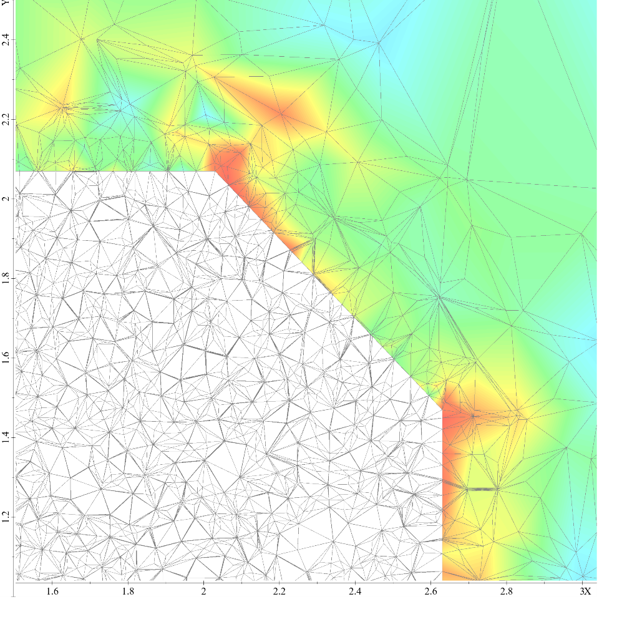
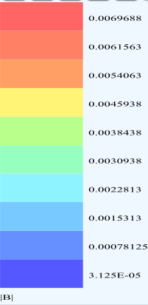
Remaining issues. Stray fields.
40 G
Original mesh
Condensed mesh
(number of nodes × 8)
Одинарная сетка Удвоенная сетка

Slide 18
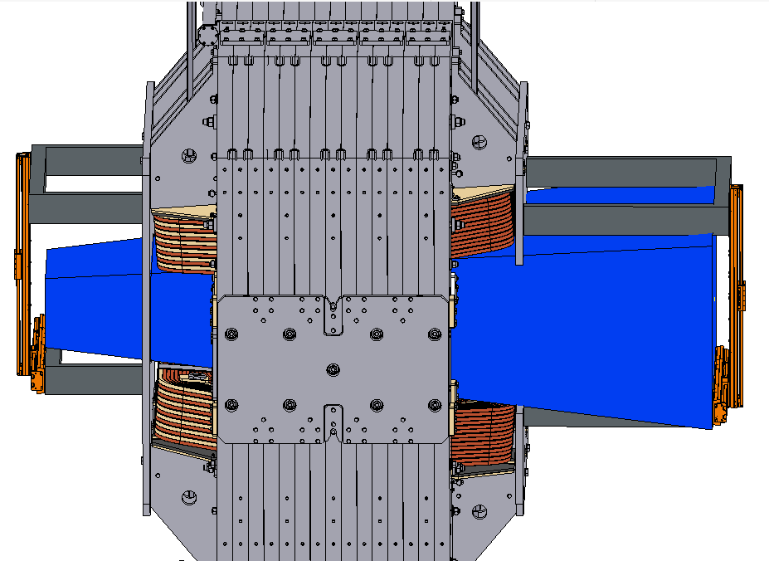
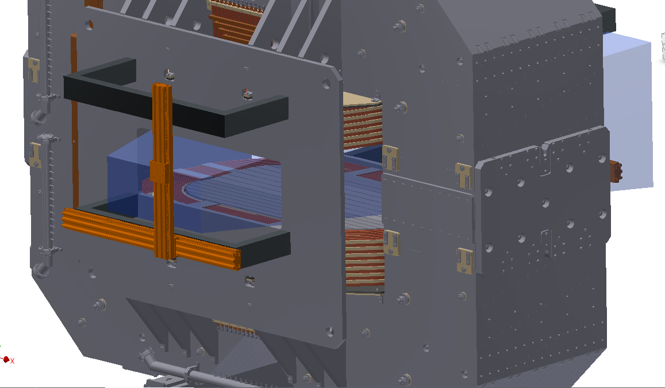
Magnetic measurement system for dipole.
Boundary conditions:
- using one 3D Hall sensor
- covering all area inside magnet gap
- accuracy 1 Gauss
- measuring positions as X, Y, Z.
common control unit with Solenoid
field mapping system

Slide 19
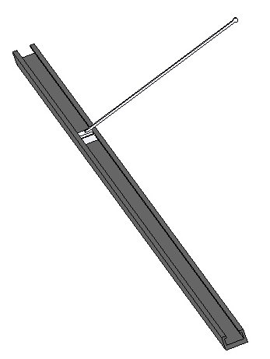
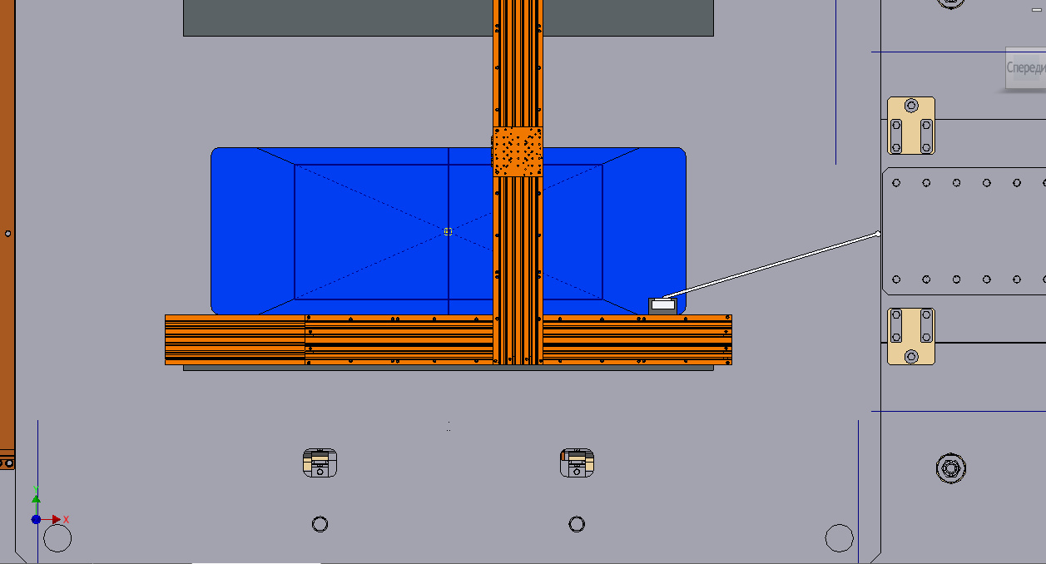
Magnetic measurement system for dipole-2.
Location of 3D Hall Sensor and Laser Reflector
XY moving system can only move inside the area marked by blue (restriction imposed by a hole in the upstream field clamp)
Carbon fiber plastic
Guidelline and carriage
Using this shape of the carriage, it is possible to measure the field near the pole surface inside the magnet gap while the guide is placed in the area of possible movement. The elongation height of the carriage was chosen so that measurements could be started below the median plane.

Slide 20
Magnetic measurement system for dipole-3.
Guide line of carbon fiber plastic (weight 16 kg for 6 m)
Sag of guide line is 1.5 mm (inclination angle is 0.06 deg.) => at points with large Bz the error to By is about 4-5 G.
=> Carriage with 3 mirrors and 3D Hall sensor (weight 2 kg) for measuring field, coordinates and angles.
Selecting the reliable and cheap moving system
(NEWPORT is good, but expansive).
Design is in process.

Slide 21
Plans
- Conditional acceptance items to be complited
2D drawings: checking to be completed and sent to GS
3D model checking to be completed for collisions.
Specification for dipole construction to be developed.

