Slide 1
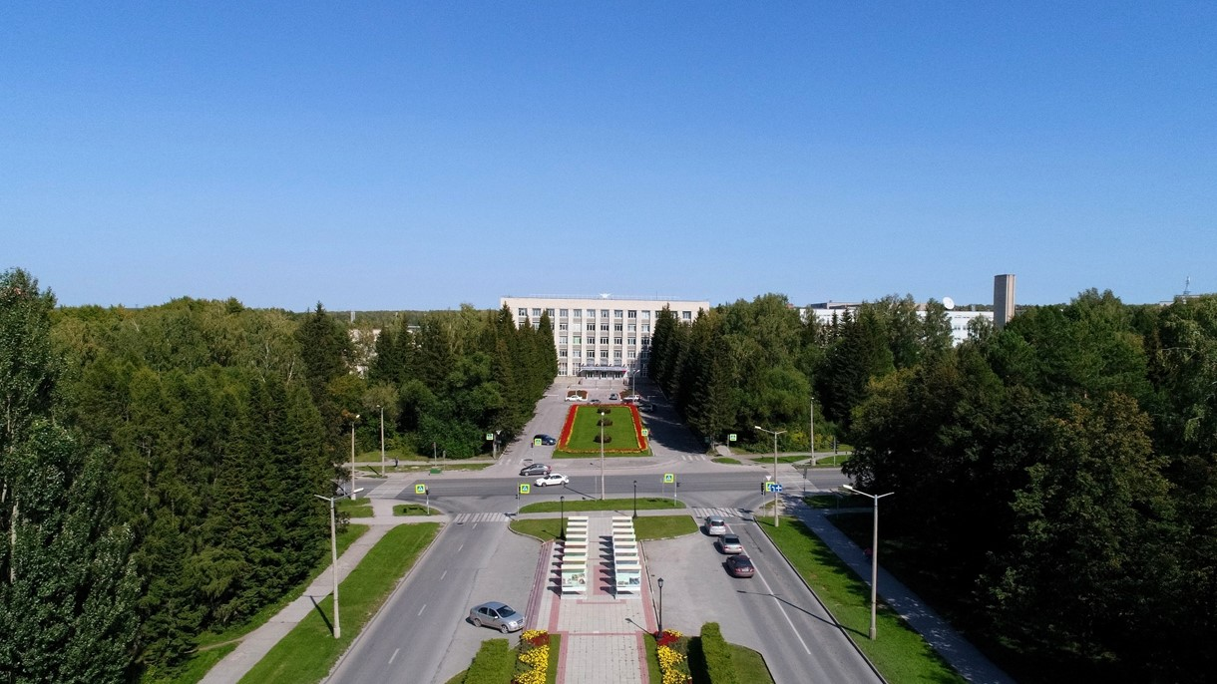
PANDA meeting
Status production PANDA solenoid
E.Pyata, BINP, Novosibirsk

Slide 2
The main milestones of production of the PANDA solenoid magnet
The scope of delivery includes:
Magnetic and engineering design of the magnet including tools and support;
Production and delivery of the magnet (consisting of yoke, cold mass and cryostat, alignment components, proximity cryogenics, support frame and platform beams) and all tools;
Power converter and quench protection and instrumentation.
Item | Date
Start contract | 03/2017
Control assembling of the Yoke of solenoid at the BINP site | 09/2020
Magnetic tests of the PANDA solenoid including safety system and electrical components at BINP (additional contract) | 12/2021 - 05/2022
Assembling and tests at the FAIR site
Assembling of the magnet at Darmstadt | 06/2022
Acceptant tests at FAIR | 08/2022
Installation of the PANDA solenoid magnet at worked position and final acceptance tests | 01-05/2023

Slide 3
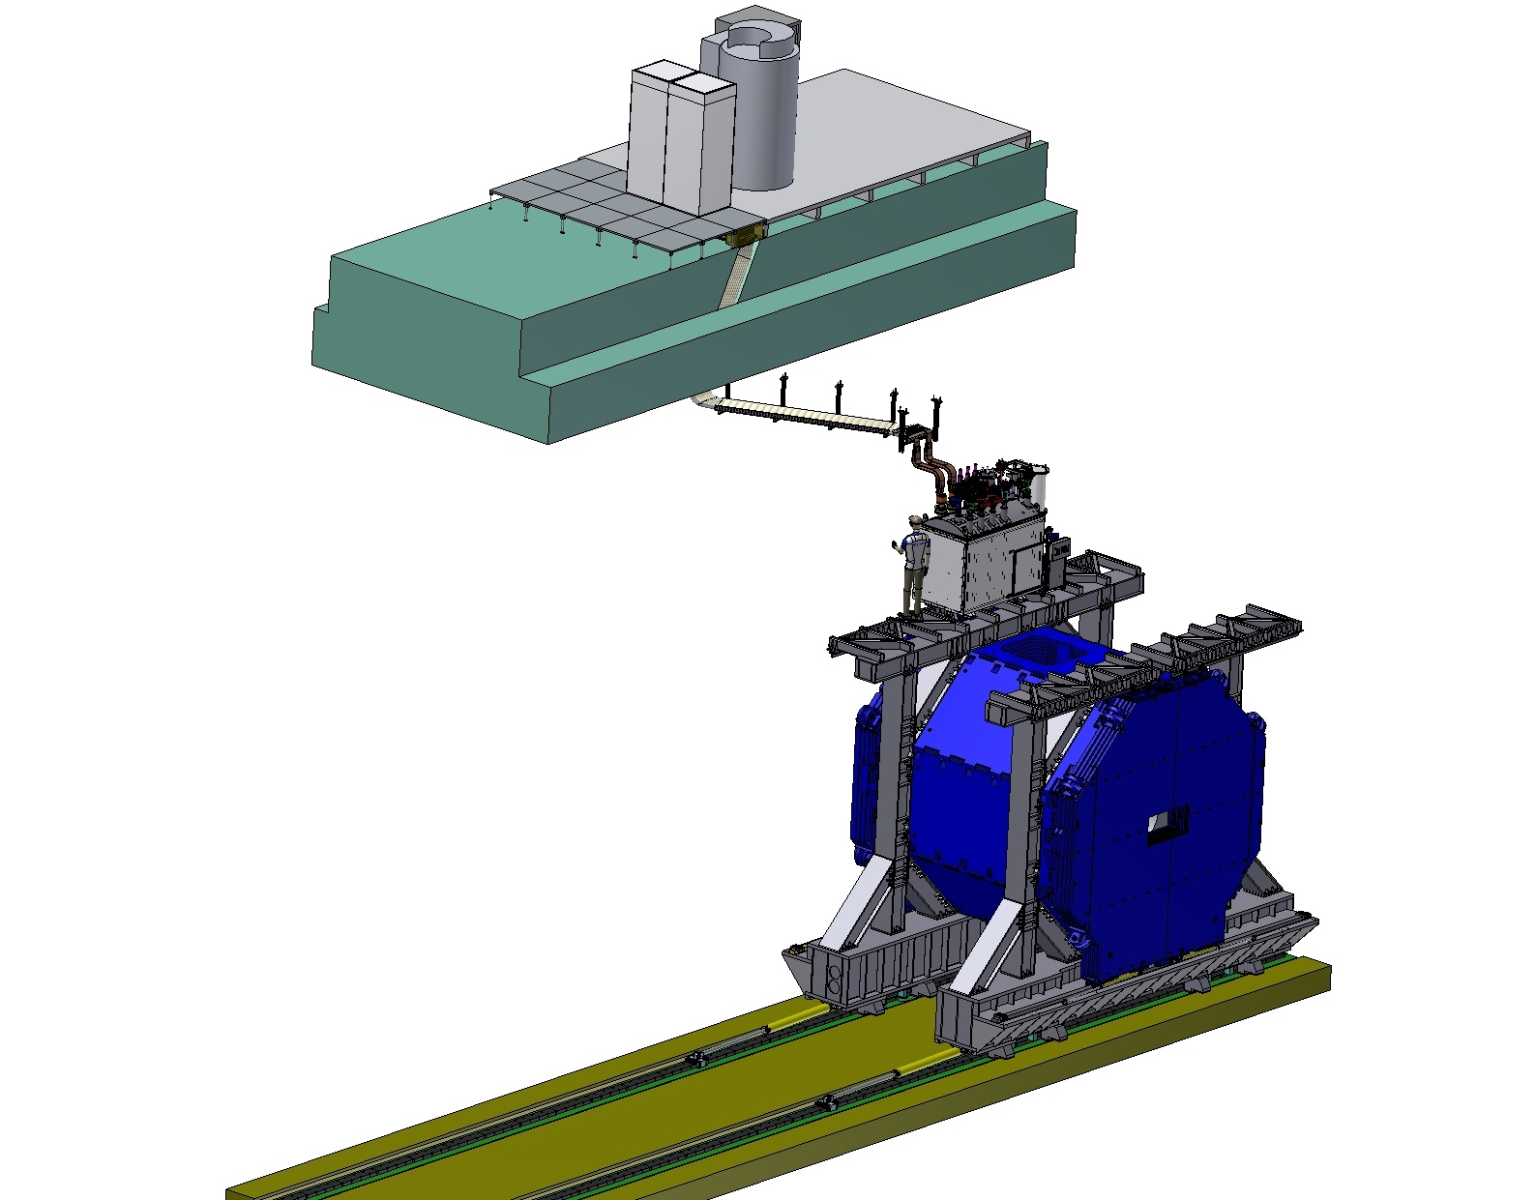
PANDA solenoid magnet, BINP responsibility
Power supply and energy extraction system
Control Dewar box
Cable channel
Solenoid and yoke
Frame of Yoke

Slide 4
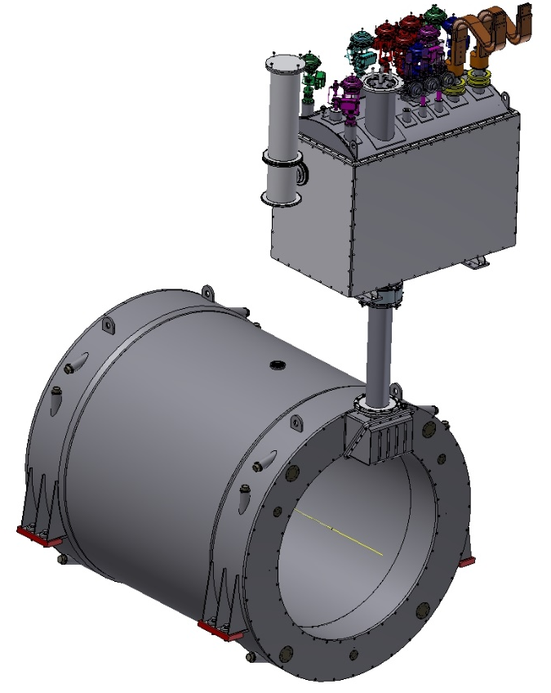
3D model of the Magnet and Control Dewar.
Control Dewar box
Cryostat and Coil

Slide 5
Development of the PANDA solenoid magnet
Name of item | Status of work
Yoke and frame | Final machining 5 July 2020 Start control assembling July 2020
Cryostat of solenoid & Cold mass | Design is ready, technological development, purchasing raw materials Call for tender July 2020
Conductor purchasing | Development work, Call for tender July 2020
Control Dewar box | Preliminary design September 2020
PANDA solenoid power cabling | Design is ready, production
Power supply and energy extraction system | Detail design is ready, purchasing power convertors & components Production
Magnet safety system | in process

Slide 6
Status of the PANDA cryostat and cold mass production

Slide 7
The main milestones of the Cryostat production
Name of milestone |  | Date 2017/10
FDR of the Cryostat |  | 08/02/2019
FDR of the Cold Mass |  | 17/04/2019
Status production
Cryostat stands for assembling solenoid and magnet Cold Mass | Call for tender July 2020
 | Purchasing raw material 09/2020
 | Manufacturing Technical documentation 11/2021
 | Contract: delivery to BINP 09/2021

Slide 8
Status of the PANDA yoke production

Slide 9
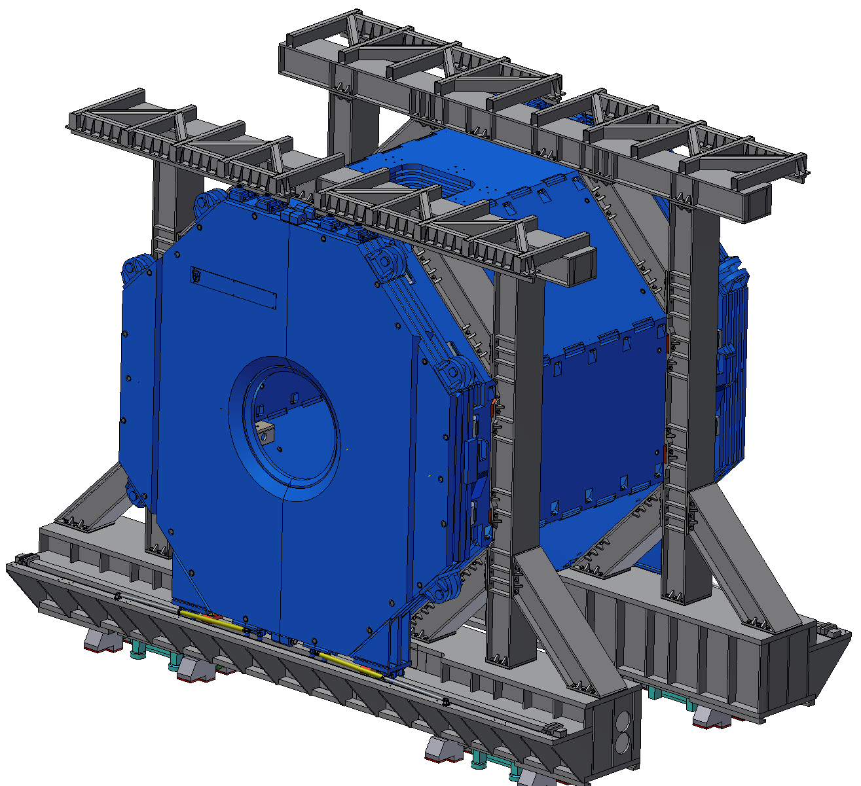
3D model of the Yoke and Frame.
Frame
Yoke
Control assembling 12/2019

Slide 10
The main milestones of the yoke production
Name of milestone |  | Date 2017/10 | Comments
Production of the all barrel octants |  | 04/2020 | Ready
Production of the frame and beams |  | 04/2020 | Ready
Production of the doors | Upstream | 05/2020 | Ready
 | Downstream | 06/2020 | June 2020
Control assembling at SET |  | 07– 09/2020
Finalization of the parts |  | 08 - 10/2020
Assembling of the Yoke at BINP |  | ?

Slide 11
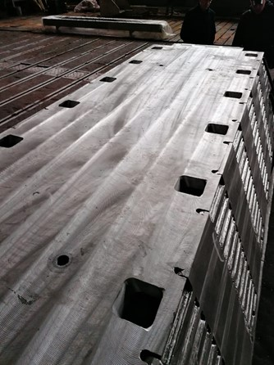
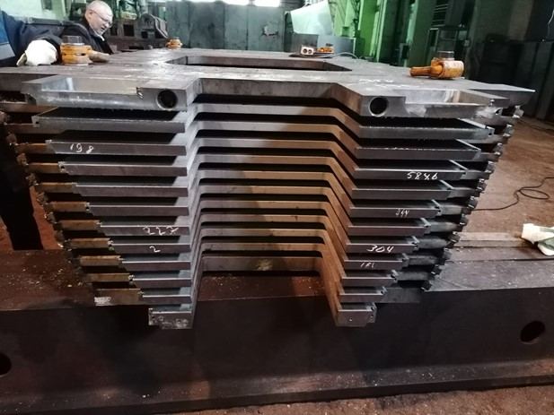
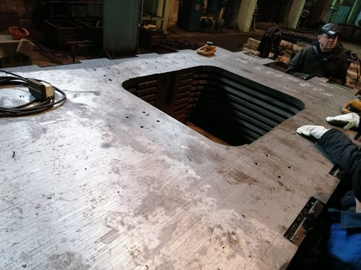
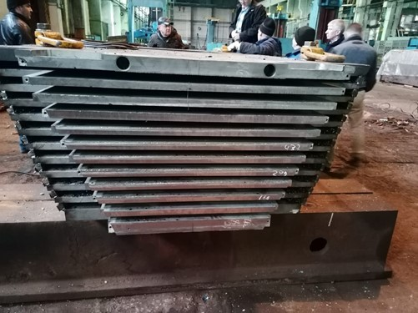
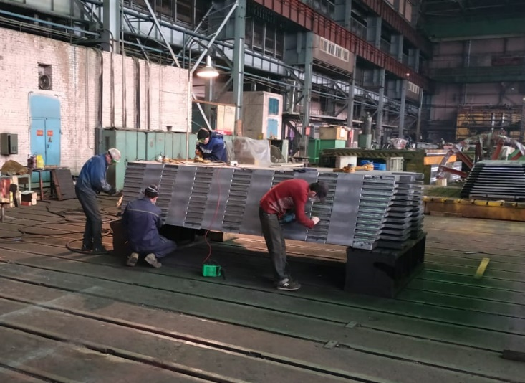
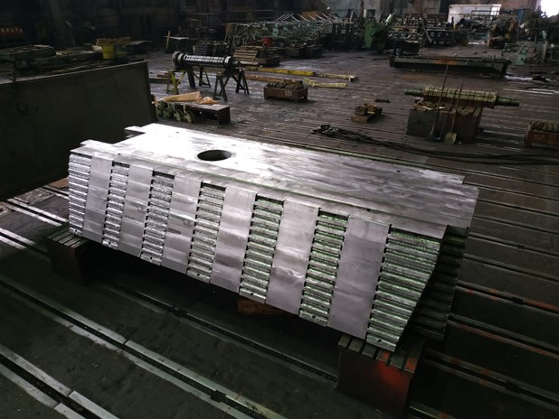
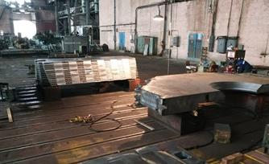
Production of the parts of the Yoke
Modules W5 and W7 after final machining
Acceptance tests of the W5 and W7 modules in plant site

Slide 12
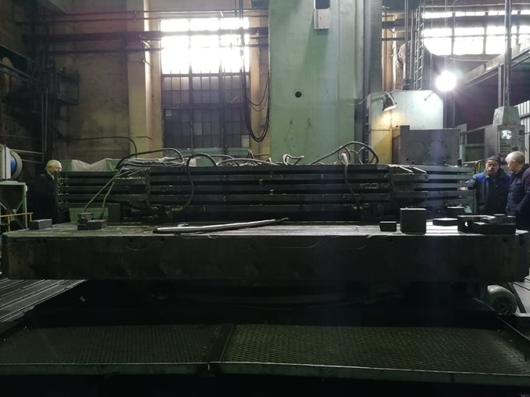
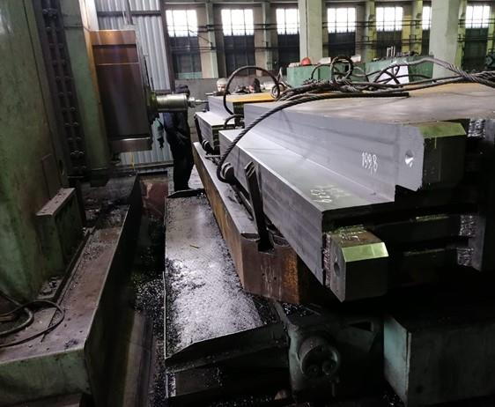
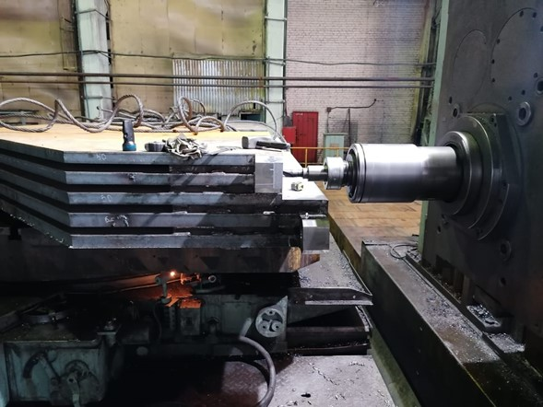
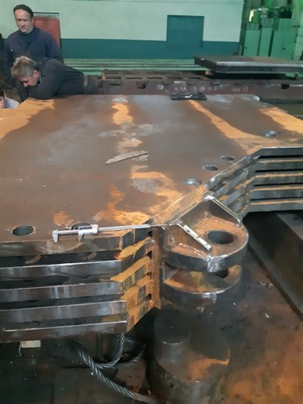
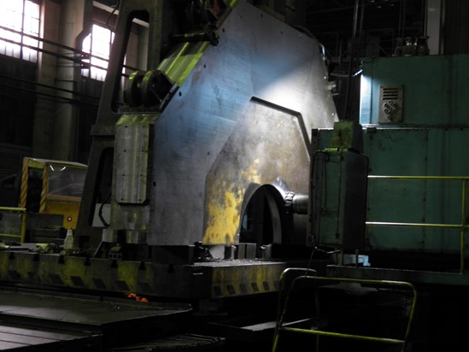
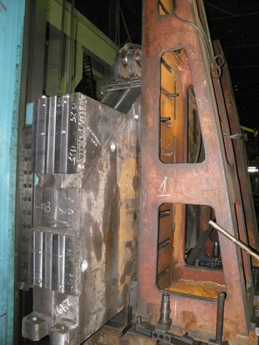
Production of the parts of the Yoke

Slide 13
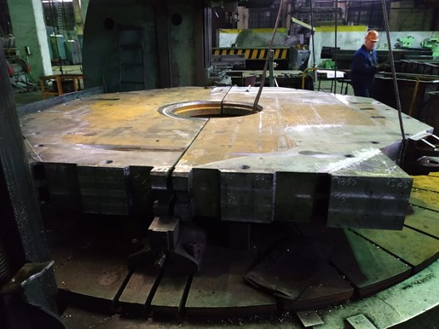
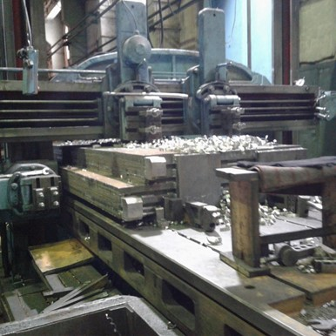
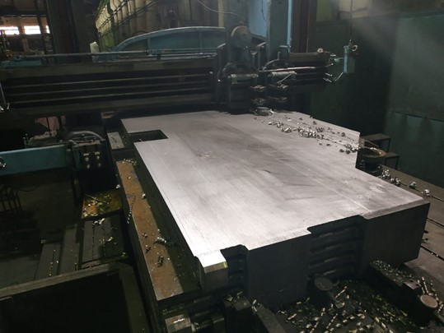
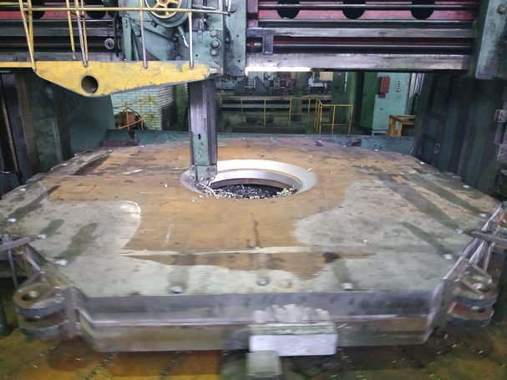
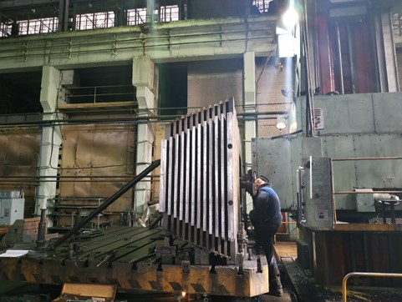
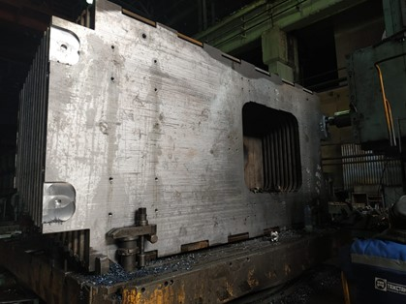
Production of the parts of the Yoke

Slide 14
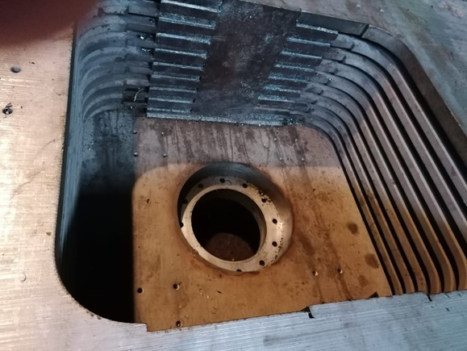
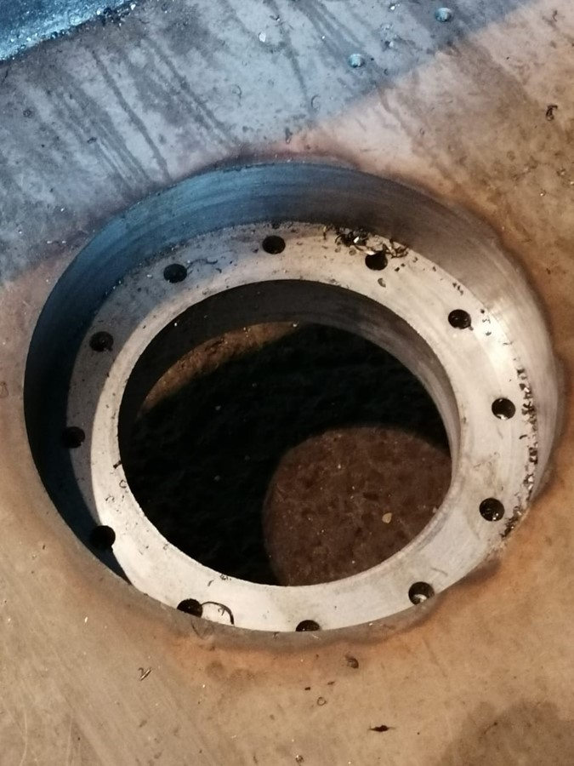
Production of the parts of the Yoke
No. | Parameter | Measured beams W5 | Reference
1 | Dimension, 4070₋₁ mm | 4069,5/4069,5
2 | Dimension, 805 mm | 801-803
3 | Dimension, 1900 ₋₅ mm | 1898/1899
4 | Dimension, 1234 ₋₁ mm | 1236/ 1234 | Not acceptable
6 | Dimension, 806 mm
7 | Angle 22°30ʹ_{-9ʹ} | 22°31ʹ | Not acceptable
8 | Angle 22°30ʹ_{-9ʹ} | 22°34ʹ | Not acceptable
9 |  | OK | By laser trecker
10 |  | OK | By laser trecker
12
13 |  | OK | By laser trecker
14 | Dimension, 1585 ^{±0.5} mm | 1582 | Not acceptable Tests 20200429
 |  | 1584.45 | By laser trecker Tests 20200610
15 | Dimension, 1730 mm | OK
16 | Dimension, 1730 mm | OK
17 | Dimension, 1645 mm | OK
18 | Dimension, 1645 mm | OK
20 | Dimension, 1130 mm | OK
21 | Dimension, 1130 mm | OK
22 | Dimension, 565 mm | OK
23 | Dimension, 565 mm | OK
24 | Dimension, 1000 mm | 1003/1004
25 | Dimension, 1200 mm | 1188,4/1187,4 | Not acceptable Tests 20200429
 |  | 1200.6 | Tests 20200603
26 | Dimension, 1020 mm | 1015 | Not acceptable Tests 20200429
 |  | 1021 | Tests 20200603
27 | Dimension, 1020 mm | 1004 | Not acceptable Tests 20200429
 |  | 1020.5 | Tests 20200603
28 | Dimension, Ø 350⁺¹ mm | 350,76
29 | Dimension, Ø 500 mm | 501
30 | Dimension, 90 mm | 89
31 | Dimension, 190 mm | 194 | Not acceptable
 |  | 190.4 | Tests 20200603
32 | Dimension, 30 mm, go | OK
33 | Welding, visual control | OK
34 | Dimension, 145 mm | OK
35 | Dimension, 145 mm | OK
36 | Dimension, 145 mm | OK
37 | Dimension, 145 mm | OK
38 | Dimension, 1360 mm | OK
39 | Dimension, 680 mm | 681
 | Dimension, 680 mm | 681
 | Dimension, Ø 440 mm | 440
No objection | Objection | Left with defects
 | 22°31ʹ (7) | Yes
 | 22°34ʹ(8) | Yes
 | 1236/ 1234 (4) | Yes
 | 1582 (14)
 | 1188,4/1187,4 (25)
 | 1004/1060 (26)
 | 1004/1030 (27)
 | 194 (31)
Table 8. Main dimensions. Drawings FPD SSM 02010300AS_E.
*General tolerance for linear dimensions if not set the value of a tolerance for dimension: H14, h14, ±IT14/2 (DIN ISO 2768-m)
Test results: Repair: Results of repair:
3D measurements
Test results: Repair: Results of repair:
Conclusion: Upper module is produced according to the specification and drawings FPD SSM 02010300AS_E and is allowed to assembly the yoke.
No objection | Objection | Left with defects | Comments
1584.45 (14) |  |  | Measurement 2020/06/09
1200(25) |  |  | Measurement 2020/06/06
1021(26) |  |  | Measurement 2020/06/06
1020.5 (27) |  |  | Measurement 2020/06/06
190.4 (31) |  |  | Measurement 2020/06/06
No objection | Objection | Left with defects
x

Slide 15
Status of the PANDA conductor development/ procurement

Slide 16
Main risks. Conductor.
Status of the PANDA conductor development/ procurement
VNIINM Bochvar
VNIIKP
Saransk cable optic (SarKO)
Purchasing superconductive conductor - lack of a manufacturers
Rutherford cable co-extrusion/ conklad in a pure Al
Production1000m Cu Rutherford cable for tests in SARKO - 03-04/ 2020 (in BINP)
Tests in SARKO, 1000m Cu Rutherford cable - 09-12/ 2020
Preparation contracts for PANDA NbTi strands production, VNIINM - 03/ 2020
Production strands VNIINM for central coil - 02/2021
Production strands VNIINM for up/downstream coils - 09/2021
PANDA Rutherford cables production, VNIIKP - 03-10/ 2021
Production PANDA conductor with SARKO - 03 - 11/ 2021

Slide 17
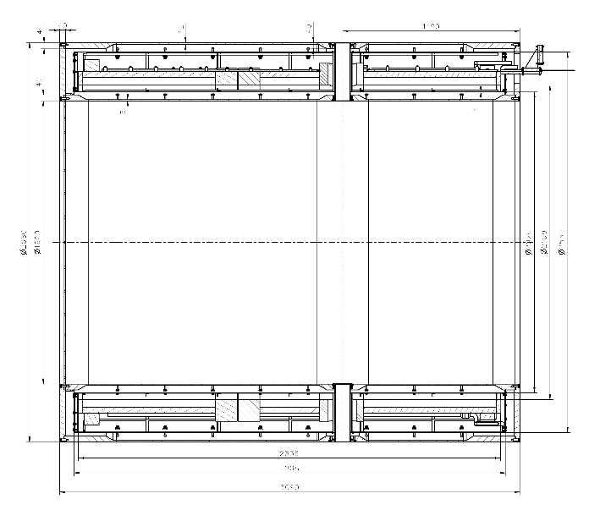
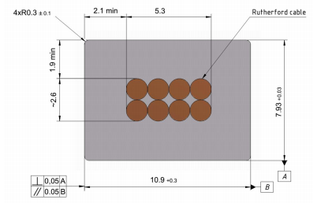
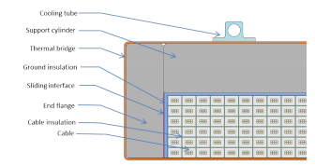
Main risks
Purchasing super conductive conductor - lack of a manufacturers
Rutherford cable, 8 strands, extruded in Al matrix
Thickness (after cold work) at 300 K | mm | 7.93 | ± 0.03
Width (after cold work) at 300 K | mm | 10.95 | ± 0.03
Critical current (at 4.2 K, 5 T) | A | > 14690
Critical current (at 4.5 K, 3 T) | A | > 16750
Overall Al/Cu/sc ratio |  | 10.5/1.0/1.0
Aluminum RRR (at 4.2 K, 0 T) |  | > 1000
Al 0.2% yield strength at 300 K | MPa | > 30
Longitudinal section of the cryostat with cold mass.
Conductor mechanical and electrical parameters.
Cold mass cross-section.
Cross-section of the conductor.

Slide 18
Status of the PANDA conductor development/ procurement
Development works with a prototype Rutherford cable (Cu or NbTi) to co-extrusion/ conklad in a pure Al 995 and Aluminum A95
No. | Process | Plan | Comments
1 | Conklad with a prototype NbTi PANDA cable and A995/998 wire 9,5 mm. | 02/2020 | ? Depend from production A995
2 | Tests of the prototype NbTi PANDA cable and A995/998 matrix after Conklad | 02-03/2020 | After step 1
3 | Co-extrusion/ Conklad in SARKO with Cu Rutherford cable 1000m and A95 wire 9,5 mm. | 07-08/2020 | Discussing details of contract with SARKO
4 | Co-extrusion/ Conklad in SARKO with Cu Rutherford cable 1000m and A995/998 wire 9,5 mm. | ? | After step 1
5 | Cold work to result the overall geometrical conductor dimensions | 09-10/ 2020 | After steps 3 and 4; purchasing dies

Slide 19
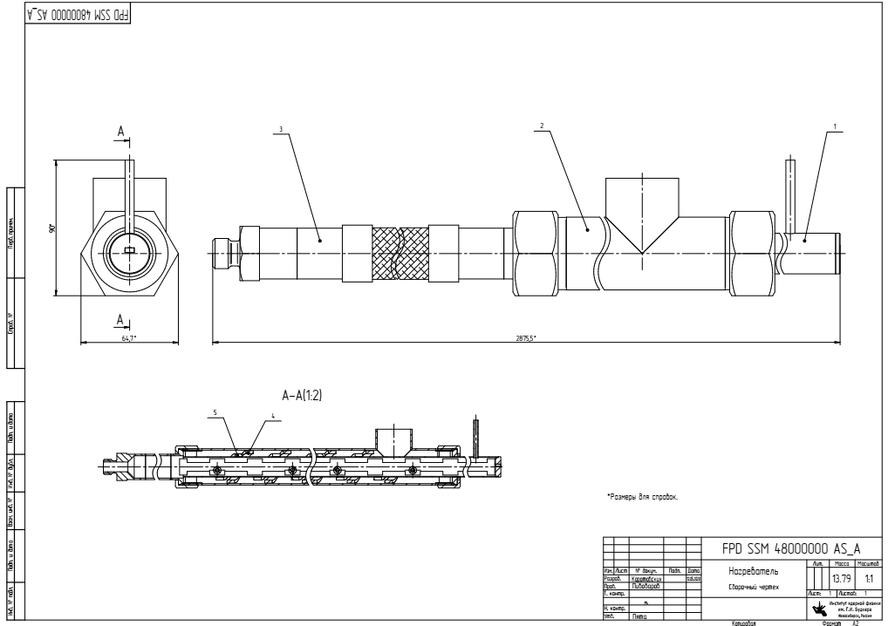
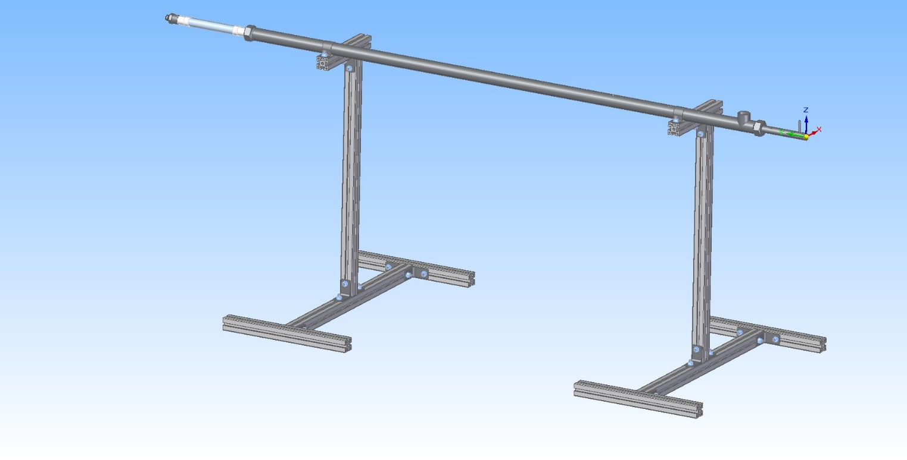
Status of the PANDA conductor development/ procurement
Development works with a prototype Rutherford cable (Cu or NbTi) to co-extrusion/ conklad in a pure Al 995 and Aluminum A95
Oven for preheating a Rutherford cable.
Temperature - 200 ÷ 450°C;
Shielding gas – N₂

Slide 20
Status of the PANDA coils production

Slide 21
The main milestones of the coils production
Status production
Cryostat and stands for assembling solenoid and magnet | Design is ready, technological development, Call for tender
Cold Mass | Design is ready, technological development, Call for tender
First Prototype of the Coil | 11/2019
Second Prototype of the Coil | 03/2020
Third Prototype of the Coil | 08/2020
Tooling for winding Coil (and Prototype) | 11/2019
Tooling for impregnation of Coil (and Prototype)/modified | 11.2019/03.2020
Prepress prototype coil into cold mass | 08/2020
Tooling for winding and impregnation of PANDA Coil | Design is ready, technological development, Call for tender

Slide 22
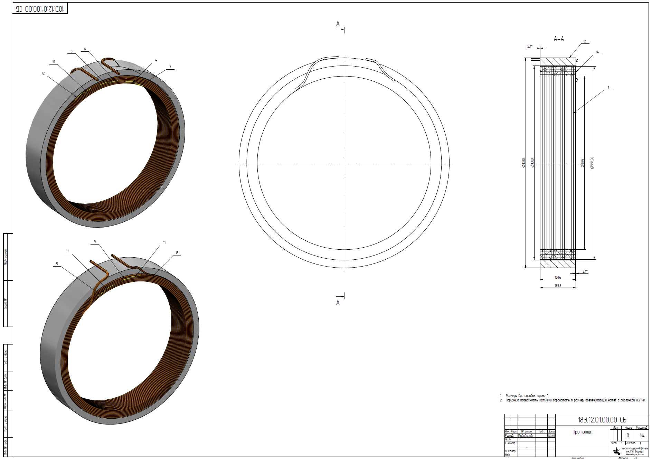
The Prototype of the Coil (3pcs.)
OD = 1m,
h=180 mm
Conductor:Al
10,85 мм x 7.93 мм,
6 layers
16 turns
Design is ready, 2 prototype produced
.

Slide 23
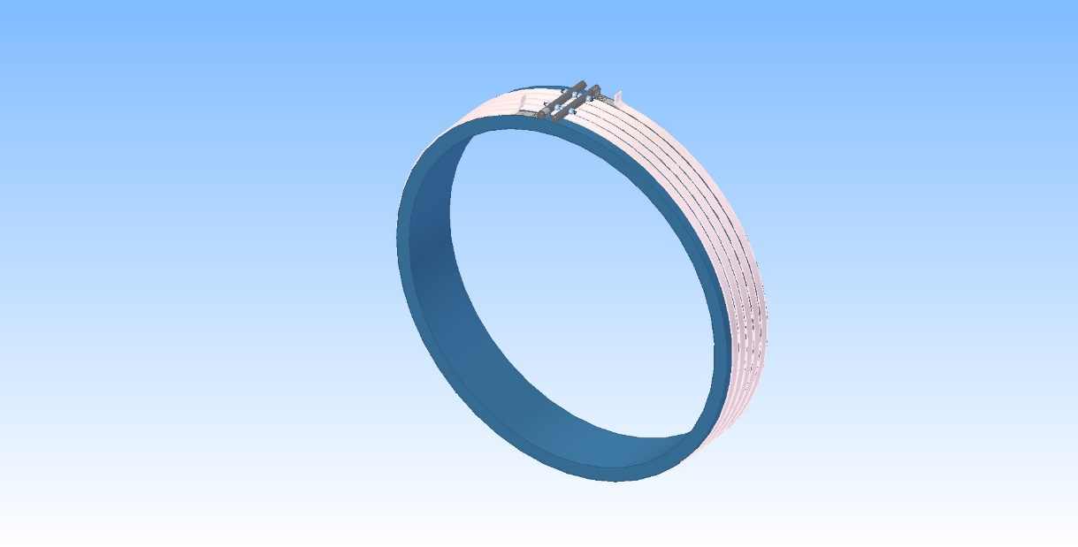
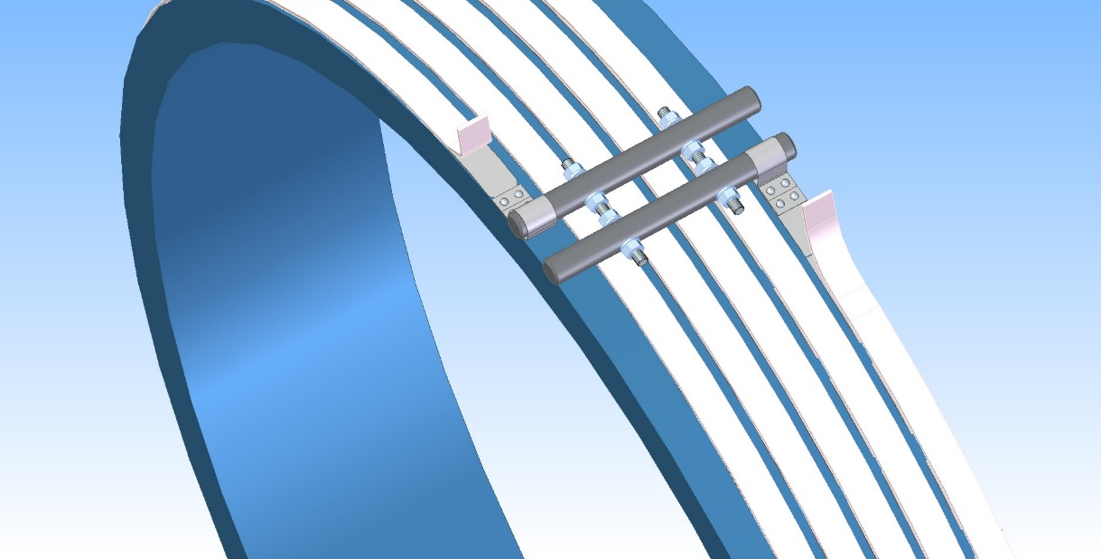
The Prototype of the Coil (3pcs.)
Preparation prestress procedure of coil
to an aluminum shell
For prototype heater:
Length - 17m;
Power - 3,5 kW;
Cross section - 24 x 3 mm;
Quantity - 1 pc.
For PANDA coil
Length - 36m;
Power - 3,0 kW;
Cross section - 24 x 3 mm;
Quantity - 8-9 pc.
Design is ready, preparation heat system
.

Slide 24
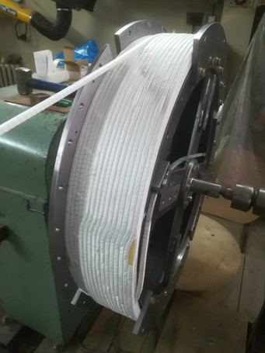
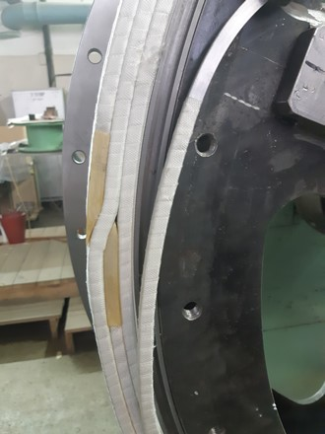
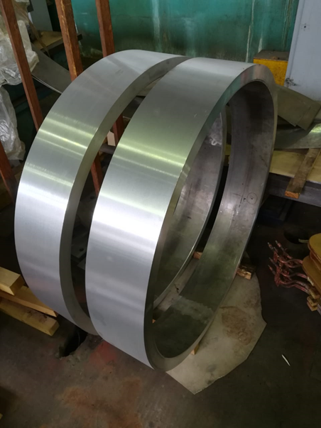
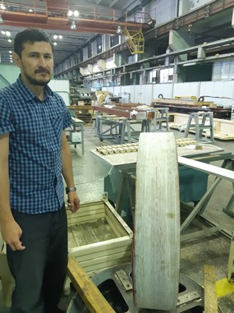
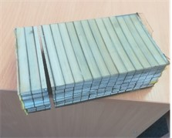
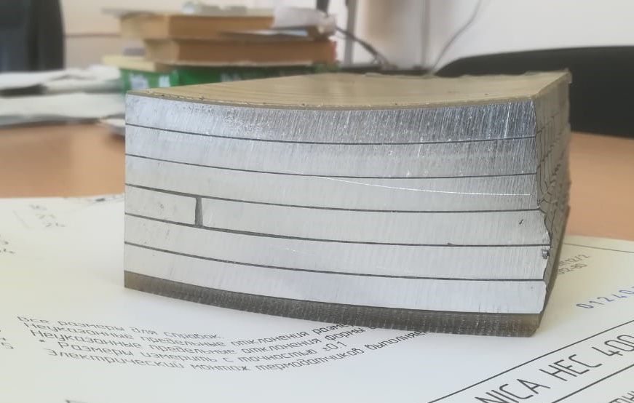
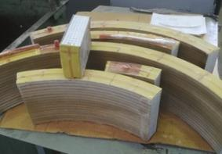
Production of the coil prototype

Slide 25
Status of the PANDA coil development/ production
Development works with a prototype Rutherford conductor.
Material is Aluminum A95
Second prototype
Electrical tests;
Procedure heating Al shell with control uniformity distribution of temperature, temperature rate, shell expansion measurement;
Assembling coil and Al shell with prestress;
Mechanical test coil assembling;
Destroy tests;
Checking quality of an epoxy penetration, mechanical tests;
Analysis of the manufacturing quality of the second prototype;
Preparation production of the third prototype

Slide 26
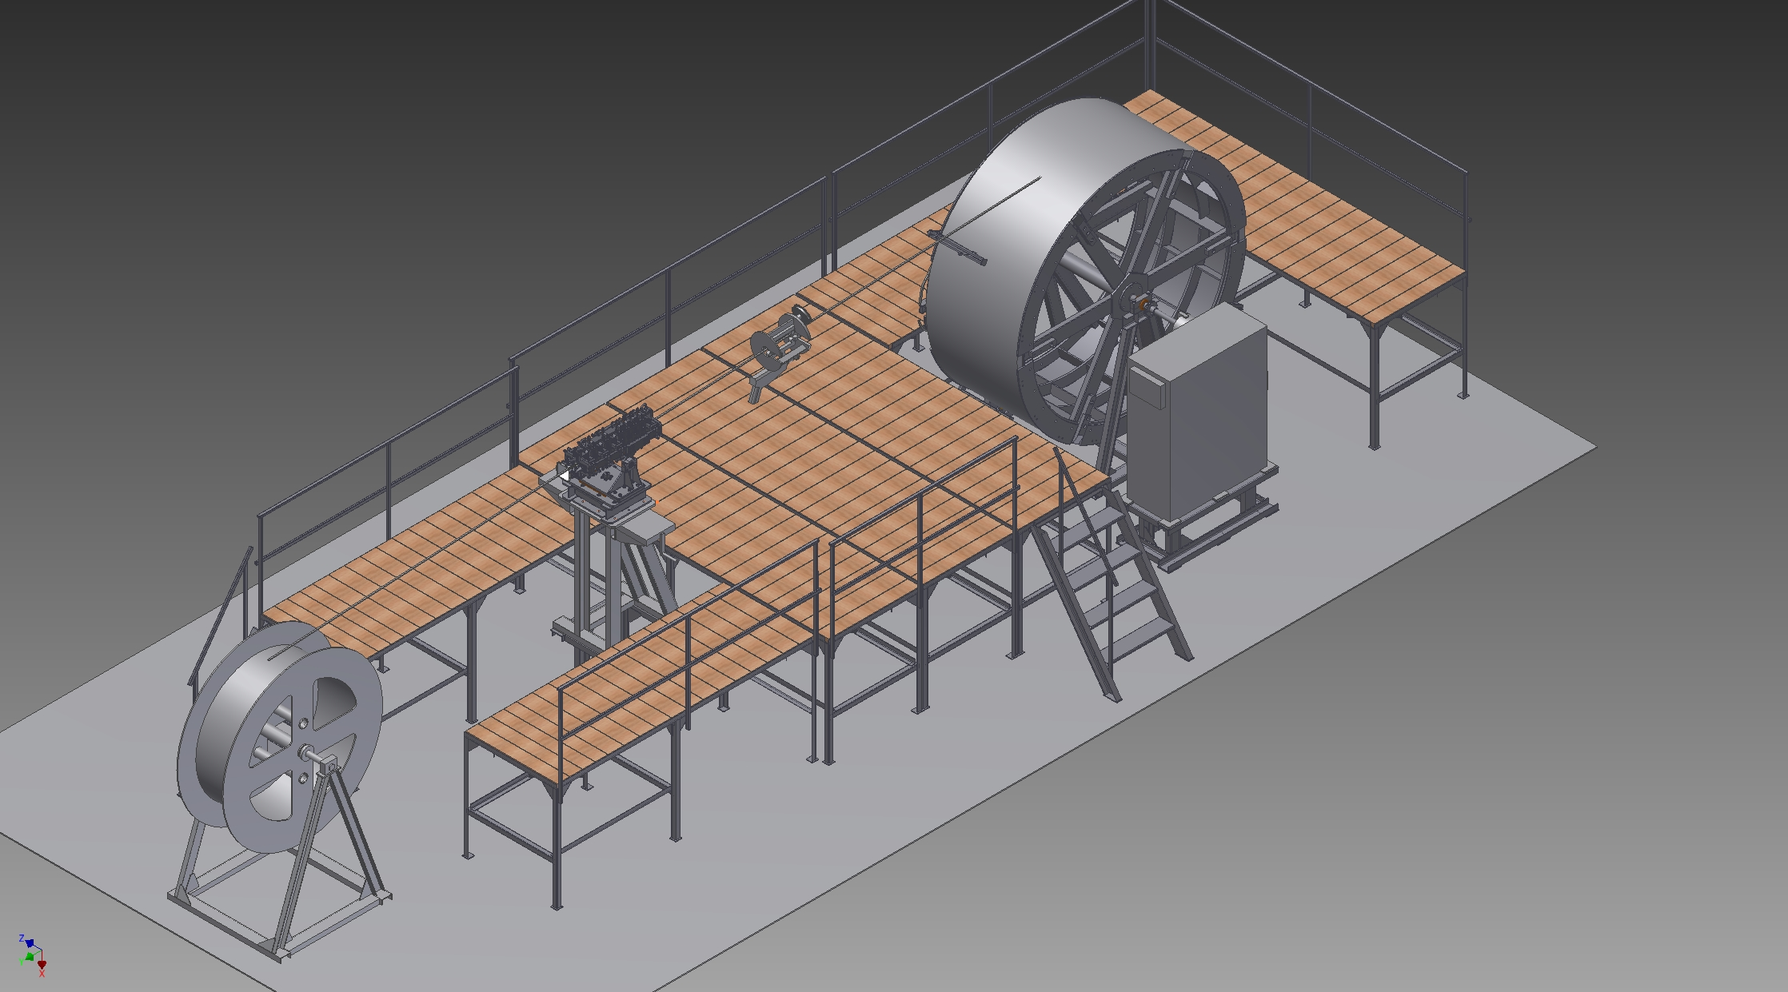
Drawing of the Devices for winding coil (scheme).
Design is ready, production until 2020

Slide 27
Status of the PANDA cryostat and cold mass production

Slide 28
Status of the PANDA cryostat, cold mass and stands production
Item | Plan | Status
Design |  | Ready
Specification for production |  | Ready
Call for tender |  | In process
Procurement raw materials | 08-09/ 2020 | In process
Ti bars for suspend system | 10/ 2019 | In BINP
Procurement interconnector Al/Stainless steel | 12/ 2020 | Negotiation with producers
Procurement Al pipes of cold mass | 2021 | In plan
Al pipes for thermoshields |  | In BINP

Slide 29
LHe and GHe sealing

Slide 30
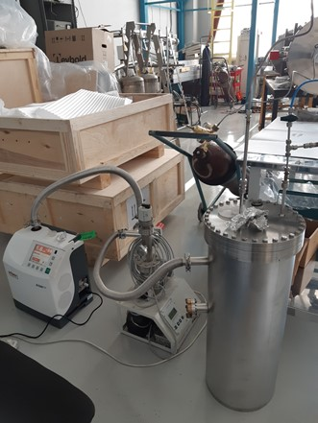
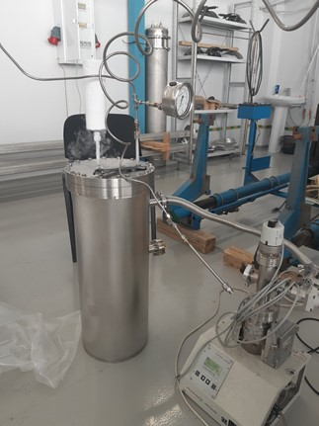
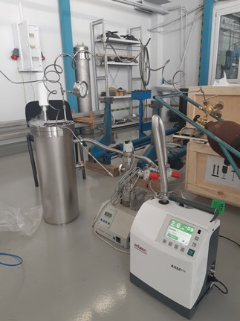
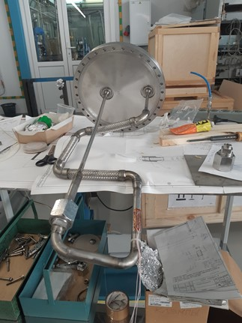
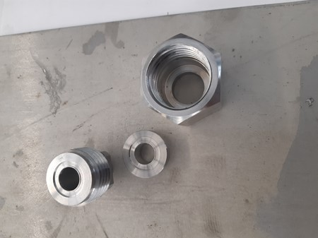
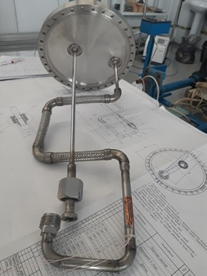
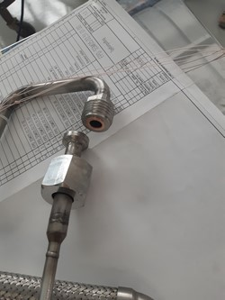
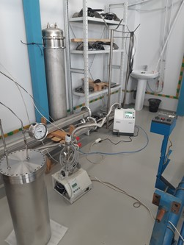
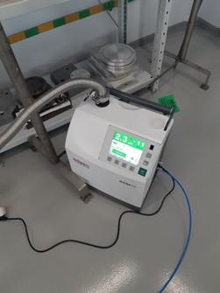

Slide 31
Vacuum tests of the MO (Matsumot - Ohtsuka) type flange
Connection cryogenic process pipes in place assembly / disassembly transfer line between He liquefier and Control Dewar to move PANDA detector from beam position to assembling area.
Connection MO flange 1 | Date | Quantity cycle 78K – 300K without leakage | Test Leak rate, mbar x l/s | Pressure tests, bar | Time tests 78K, min | Leakage, mbar x l/s
Gasket 1 | 20/04 2020 - | 1 - 17 | ≤5 x 10E-10 | 25 | 30-40 | no
 | 25/05/2020 | 18 | 1,6 x 10E-11 | 10 | 1 | 8 x 10E-9
Gasket 2 | 27/05 – 15/06/2020 | 20 | ≤5 x 10E-11 | 25 | 30-40 | no
Gasket 3 | 15/06/2020 – present time | 15 | ≤5 x 10E-11 | 25 | 30-40 | no
Connection MO flange 2..3

Slide 32






Flexible bus bar between cable way and current leads

Slide 33
Power supply and energy extraction system

Slide 34
Power Supply (Current Source – TDK-Lambda, Genesys+, 10V, 1500A)
New power supply

Slide 35



Dump resistor sections assembling

Slide 36
Preparation tests in BINP

Slide 37

PANDA magnet, bld. 13. Area for cryogenic and coils tests and measurements of a magnetic field

Slide 38

Thank you for your attention

