Slide 1
FE-EMC Installation
MEC Session, PANDA Collaboration Meeting 20/2
J. Lühning, GSI
Area downstream of the TS before installing the FE-EMC
Rail system for FE-EMC
Start position of FE-EMC
End position of FE-EMC
Use of support for moving-in other components
Downstream support of big installation beam
Issues to be solved

Slide 2
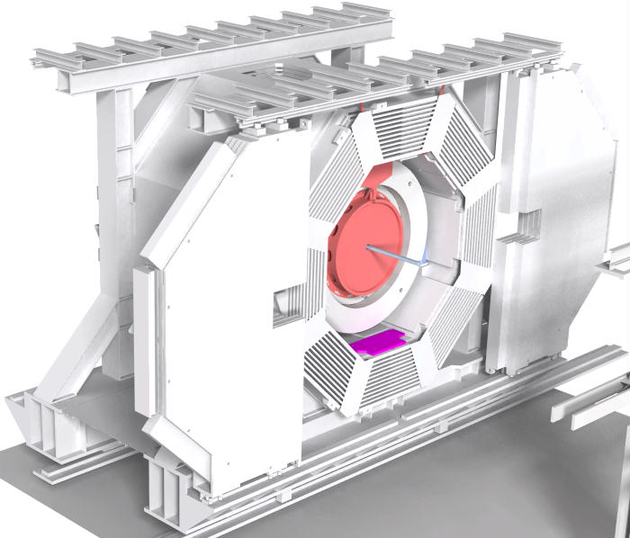
Area downstream of the TS before installing the FE-EMC
beam-tube
GEM
mounting plate for FE-EMC
components of Forward Spectrometer
View on downstream side of the Target Spectrometer in the maintenance area. The GEM-tracker is already installed, the beam-pipe shown ends 2.9 meters downstream of the Interaction Point.
On the right, there are shown some components of the Forward Spectrometer (just to illustrate that the space for installing the FE-EMC is limited).

Slide 3
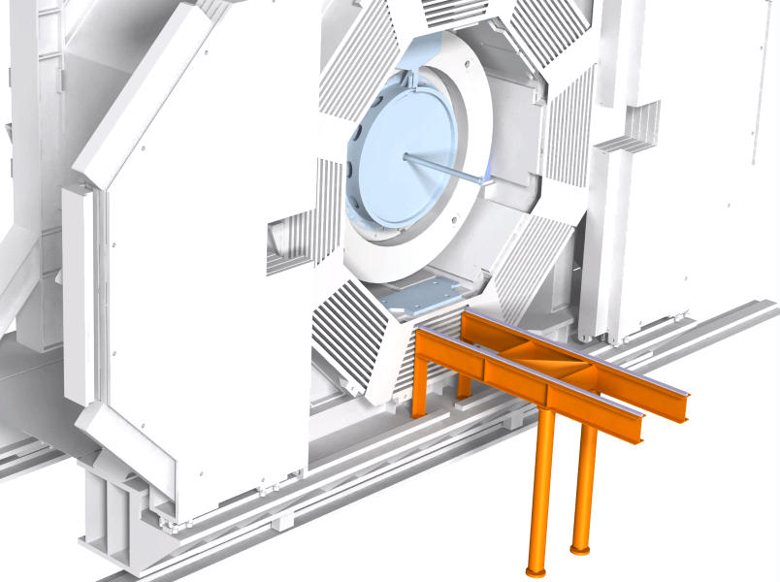
Rail system for FE-EMC
rail for low-friction roller skid
beam IPE_270, length 2.8m
short support, resting on big TS-beam
columns, height 1.8m
Rails, beams, and supports for FE-EMC movement are installed

Slide 4
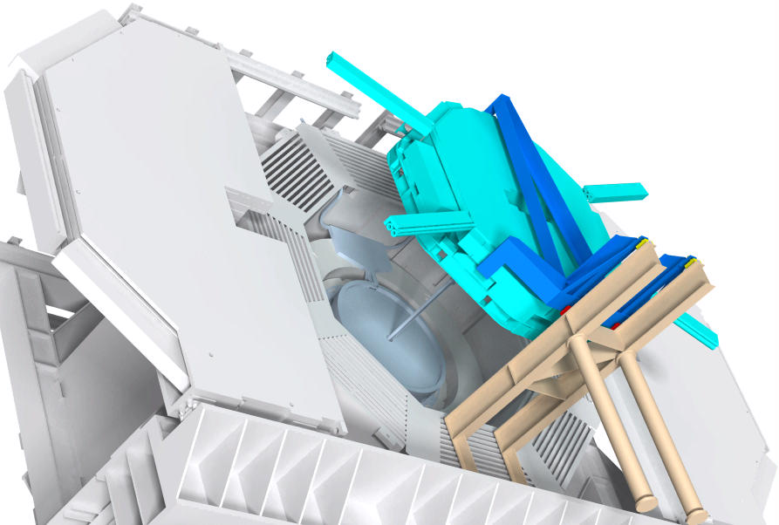
Start position of FE-EMC
The 2 roller skids marked red are nearer to the main load. They are expected to carry 55kN, each.
Each of the 2 skids marked yellow will carry about 15kN in reverse direction (tension!)
Trolley (marked blue), loaded with FE-EMC (turquoise) and Disc-DIRC (closely attached to the FE-EMC, not visible here) .

Slide 5
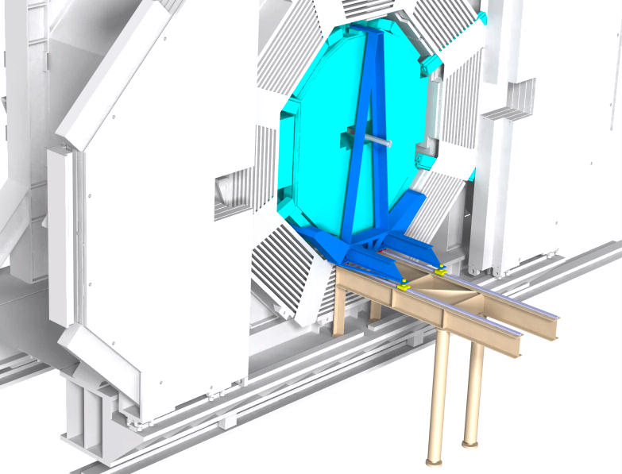
End position of FE-EMC

Slide 6
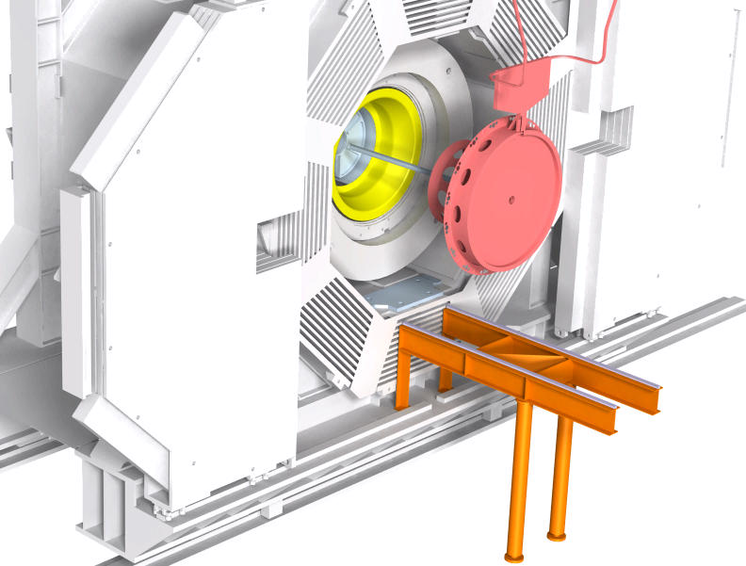
Use of support for moving-in other components
The set-up with supports and rails can be used for moving-in other components, for instance the GEM-tracker or the support cone (marked yellow) which supports the STT and other central components.

Slide 7
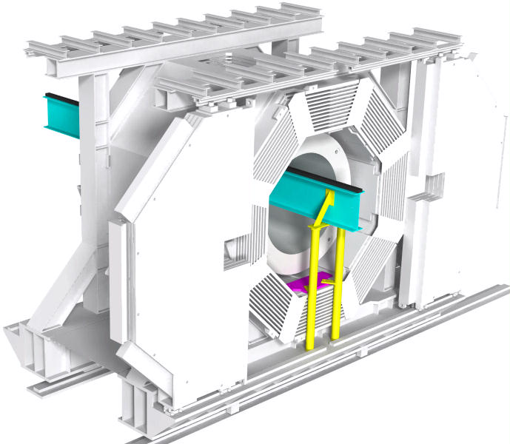
Downstream support of big installation beam
A big installation beam (length 900 cm, height 70 cm, marked turquoise here) will be used to move the cryostat and the barrel-EMC into the solenoid yoke from the upstream side. No voluminous scaffold will be needed to support this beam on the downstream side. Supports (yellow) resting on the rail cornices for the downstream door wings seem to be sufficient. Maximum load at this end of the big beam 15 tons.

Slide 8
Issues to be solved
There are still a lot of issues to be solved, the main ones:
Definition of geometric interfaces between detector and trolley
Transfer of detector from its transport frame to trolley
Load transmission from detector to trolley
Placing the trolley with its load onto the rails
Accessibility of positioning screws

